Slide 1
Chapter 11 Smoke and Heat Hazards

Slide 2
Objectives
List the hazards to people and property from a fire.
Explain the following types of harm from a fire: acute effects, postexposure effects, and chronic effects.
List the most important toxic gases in smoke.

Slide 3
Objectives
Explain the differences between narcotic gases and irritant gases.
Explain the concept of fractional effective dose.
Explain the underlying principle of Haber’s rule.
Explain the concept of limiting hazard and its role in fire protection.

Slide 4
Introduction
MGM Grand Hotel 1980 fire
75 fatalities from smoke inhalation
Products of incomplete combustion create toxic hazard in the fire-generated atmosphere.

Slide 5
Exposure Effects
Multiple levels of harm
Highest: Possible death of occupant
Lower exposure: Incapacitating effects, hinders escape
Sub-incapacitating effects: Impaired mobility, reduced clarity of thinking, detrimental behavior

Slide 6
Exposure Effects
Acute toxic effect(s)
Postexposure effect(s)
Chronic toxic effect(s)

Slide 7
Smoke Components
60% of fire fatalities had more than half of hemoglobin in blood converted to carboxyhemoglobin.
Presence of CO reduces body’s capacity for transporting oxygen.
Burning materials that contain nitrogen can produce hydrogen cyanide.
Cause of death in fire victims

Slide 8
Smoke Components
No standard procedures for quantifying presence of other inhaled toxic gases in the deceased
Lists of potentially harmful gases
Animal smoke exposure studies

Slide 9
General Precepts Fundamental to Fire Toxicology
Three classes of toxic gases:
Asphyxiant gases
Sensory irritant gases
Others (no commonality of chemical structure)

Slide 10
General Precepts Fundamental to Fire Toxicology
Product
Commercially available item
Composed of one or more materials
Not chemically homogeneous
Burning behavior of products is measured with large-scale tests while fire properties of materials are determined in bench-scale tests.

Slide 11
General Precepts Fundamental to Fire Toxicology
The effects of the gases can be combined within the first two groups.
Asphyxiants’ effects are dose-related.
Fractional effective dose (FED)
Haber’s rule

Slide 12
General Precepts Fundamental to Fire Toxicology
Sensory effects of irritant gases are concentration related.
Fraction effective concentration
Average person experiences effect at FEC = 1.

Slide 13
General Precepts Fundamental to Fire Toxicology
Fires generate hundreds of gases.
Death of rats exposed to fire smoke was estimated to be due to only a few gases.
N-gas model
Lethal smoke exposure is approximately 2–3 times the incapacitating exposure.

Slide 14
Equations for Incapacitation Due to Exposure to Gases
Narcotic gases
Equation 11-1: FED = ∑ {[CO]/35000} ∆t + ∑ {[HCN]^{2.36}/(1.2·10⁶)} ∆t

Slide 15
Equations for Incapacitation Due to Inhalation of Gases
Equation 11-2: v_{CO2} = e^{[CO2]/5}
[CO₂] is the average volume percent of CO₂ during the time increment.

Slide 16
Equations for Incapacitation Due to Inhalation of Gases
Irritant gases
Equation 11-3: FEC = ∑ [Z]/F_{Z}
Approximate F_{Z} values for irritant gases:
HCl or HBr: 1000 (µL/L)
HF: 500 (µL/L)
NO₂ or formaldehyde: 250 (µL/L)
SO₂: 150 (µL/L)
Acrolein: 30 (µL/L)

Slide 17
Carbon Monoxide
Narcotic toxicant common to nearly all fire smoke
Major contributor to lethality

Slide 18
Carbon Monoxide
Equation 11-1 is based on exposure time leading to incapacitation of the average person.
Other equations factor in personal variables.

Slide 19
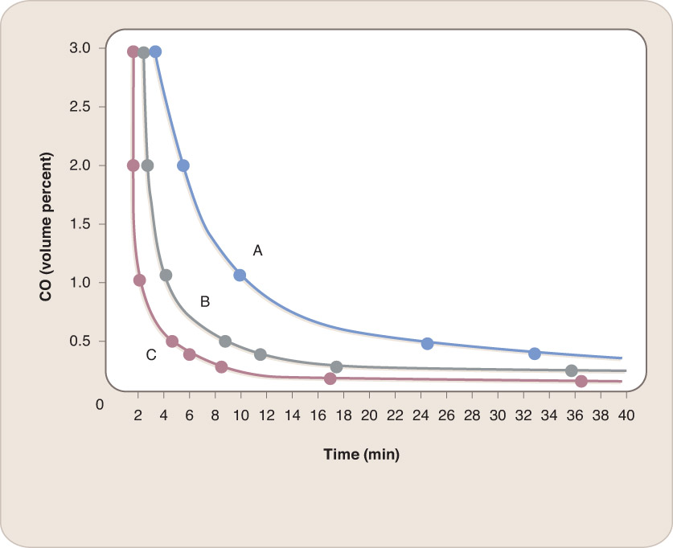
Carbon Monoxide
CO following Haber’s rule over most volume and time ranges
Curve A: Person at rest, 40 percent COHb, breathing rate of 8.5 L/min
Curve B: Light work (e.g., walking at 6.4 km/h, 4 mph), 30 percent COHb, breathing rate of 50 L/min
Curve C: Heavy work (e.g., slow running at 8.5 km/h, 5.3 mph, or walking up a 17 percent incline at 5.6 km/h, 3.5 mph)
Reproduced from: Purser, D. A. (2008). Assessment of Hazards to Occupants from Smoke, Toxic Gases, and Heat. In: The SFPE Handbook of Fire Protection
Engineering, 4th ed., DiNenno, P. J., et al., eds. Quincy, MA: National Fire Protection Association.

Slide 20
Carbon Dioxide
Generated in all fires involving organic materials
Estimated volume fraction of CO₂ in fire effluent
Not toxic in concentrations up to 5% by volume
Concentrations close to 10%
In residential fires, heat and temperature are generally at untenable levels before CO₂ concentration reaches 5%.

Slide 21
Hydrogen Cyanide (HCN)
Lethal toxicity of HCN is approximately 20× that of CO.
Volume fractions in smoke are lower than CO volume fractions.
Like CO, HCN affects the amount of oxygen made available to the body’s cells and the brain.

Slide 22
Hydrogen Cyanide (HCN)
HCN does not interfere with the hemoglobin transport of oxygen.
After entering the bloodstream through the lungs, HCN combines with cellular enzymes and inactivates them.

Slide 23
Hydrogen Cyanide (HCN)
Average person incapacitated from 10-min exposure to 130 µL/L of HCN in air
Minor hyperventilation after exposure to HCN concentrations below 80 µL/L for up to an hour

Slide 24
Hydrogen Chloride (HCl) and Hydrogen Bromide (HBr)
Equal toxic potencies of HCl and HBr
Very low volume fractions of HCl result in eye, nose, throat irritant reaction
Higher volume fraction
High doses

Slide 25
Hydrogen Chloride (HCl) and Hydrogen Bromide (HBr)
HCl adsorbed on small soot particles can be inhaled and reach the lungs.
Volume fraction of HCl for immediate incapacitation is 1000 µL/L.

Slide 26
Nitrogen Oxides
Oxidation of nitrogen in burning leads to nitrogen dioxide (NO₂) and nitric oxide (NO).
Toxic potency of NO₂ is 5× that of NO.
Estimated incapacitating volume fraction of NO₂ is 250 µL/L.

Slide 27
Organic Irritants
Among small, partially oxidized organic molecules that act as strong irritants, acrolein most concerning
Exposure to low volume fractions (as low as 10 µl/L) could be lethal to people.

Slide 28
Other Toxic Species
Other toxic gases found in smoke:
Ammonia (NH₃)
Sulfur dioxide (SO₂)
Hydrogen sulfide (H₂S)
Hydrogen fluoride (HF)
Isocyanates
Phosphorus compounds

Slide 29
Oxygen Deficiency
Effects of oxygen deficiency appear at concentrations toward 14% by volume.
Environments at less than 10% oxygen become lethal.
Temperatures untenable when oxygen concentrations reach lethal levels.

Slide 30
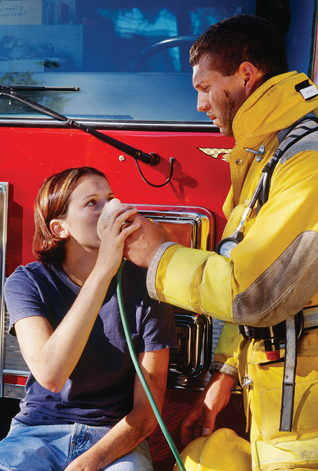
Oxygen Deficiency
Effects of CO and HCN are enhanced if oxygen levels fall below 21%.
© Patti McConville/Alamy Images.

Slide 31
Test Methods
Physical fire model
Stand-alone indicators of material acceptability
Test results vary.

Slide 32
Test Methods
Fire hazard or risk assessment includes:
Mass and burning properties of the combustibles
Room/building properties
Nature of the building
Locations of the occupants
Types of potential fires
Outcomes to be avoided

Slide 33
Test Methods
Principles for describing and evaluating toxic potency:
Apparatus replicating one or more fire stages
Test specimen representative of product being evaluated
Test animals exposed to smoke
Analysis of combustion or pyrolysis products
Measurement of mass loss of test specimen.
Determination of accuracy of toxic species yields
Determination and documentation of within-laboratory repeatability and inter-laboratory reproducibility of test results

Slide 34
Values
Since a single fire typically involves multiple products, it would be a useful simplification if nearly all combustibles could be represented by a single LC₅₀ or IC₅₀ value.
Products whose smoke is extremely toxic could be treated as exceptions.

Slide 35
Values
Table 11-3: Mean LC₅₀ and IC₅₀ Values (g/m³)
Animal data
Mean EC₅₀ values not sensitive to mode of combustion
Incapacitation dose
Specimen EC₅₀ values
Average LC₅₀ values are comparable to value for a post-flashover atmosphere with only CO and CO₂ as harmful gases.

Slide 36
Values
ISO 13571
LCt₅₀ value 900 g/m³ × min
LCt₅₀ value 450 g/m³ × min
Values only for healthy adults
Longer-term effects of fire smoke
Polychlorinated biphenyls

Slide 37
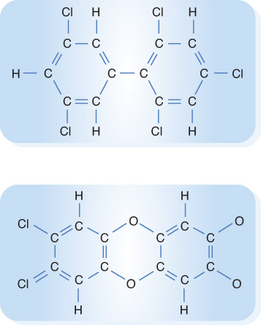
Values
Polychlorinated biphenyls

Slide 38
Chemical Effects of Smoke
Can damage structure
Example: HCl corrodes steel reinforcing rods.
Can leave odors in textiles
Extinguishing agents can generate corrosion byproducts.

Slide 39
Electronic Equipment
Smoke damage
HCl will attack most metals.
Conductive soot particles render equipment inoperable.
Smoke contamination removal

Slide 40
Thermal Damage
Enough heat can cause structural collapse.
World Trade Center Building 7
Structural damage occurs in wooden structures as well.

Slide 41
Limiting Hazard Concept
Most important shortcoming
Limiting hazard
Calculations or computational model

Slide 42
Summary
Smoke inhalation is a factor in most fire deaths in the United States, especially those that result from post-flashover fires.

Slide 43
Summary
A single exposure to fire smoke can have both acute effects and post-exposure effects. Fire fighters can experience chronic effects from multiple exposures to smoke.

Slide 44
Summary
Most of the acute toxic gases fall into two classes.
Asphyxiant (narcotic) gases, mainly CO and HCN, deprive the body of oxygen. The effects are dose related—that is, a function of the volume fraction of the gas and the duration of exposure. Oxygen depletion and carbon dioxide increase the effect.

Slide 45
Summary
Two classes of toxic gases (cont’d):
Irritant gases can have acute, instantaneous effects on the senses and upper respiratory tract as well as long-term effects on the lungs. Prominent irritant gases include the halogen acids, nitrogen oxides, formaldehyde, and acrolein.

Slide 46
Summary
The fractional effective dose concept enables combining the effects of the individual toxic gases and estimating the intensity and length of exposure to smoke that would result in incapacitation or death.

Slide 47
Summary
To a first approximation, one can use an average toxic potency value in engineering calculations. However, the toxic potencies of smoke from a large number of materials are significantly worse than the average value.

Slide 48
Summary
Smoke can cause nonthermal damage to electronic circuitry contacts and building structural components.

Slide 49
Summary
The heat from a fire can cause skin burns and can weaken a structure to the point of collapse.

Slide 50
Summary
Using the full range of knowledge to identify the limiting hazard(s) in the event of a fire can help developers and owners of structures implement the most effective fire protection technology.

