Slide 1
Joining Together: The Team Approach

Slide 2
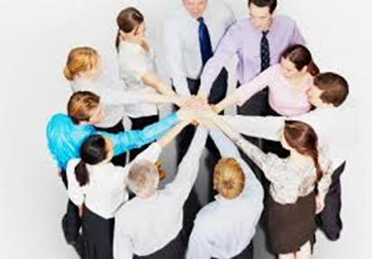
Healthcare is a Team Approach

Slide 3
Who is on the Interdisciplinary team?
•Administrator
•Nurse
•Physician
•Occupational Therapist (help with feeding)
•Speech Pathologist (diet for dysphagia)
•Social worker/discharge planner
•RD/CDM/DTR
Pharmacist
Physical Therapist

Slide 4
What makes a group a team?
Group=people interacting that influence each other
Team=People with skills that complement each other who are committed to a common purpose and goals
What is the difference?
1-producing specific results and all are responsible
2-have an awareness that they need each other

Slide 5
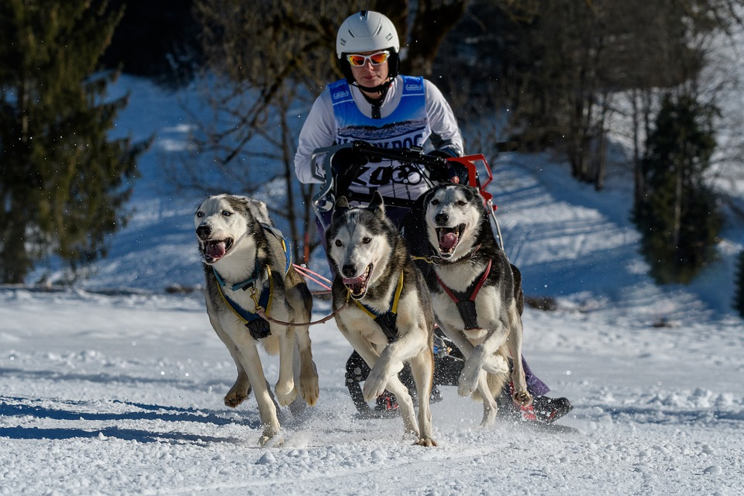
How can a group become a team?
6 stages to become a team
Orientation
Conflict
Cohesion
Delusion
Disillusion
Acceptance

Slide 6
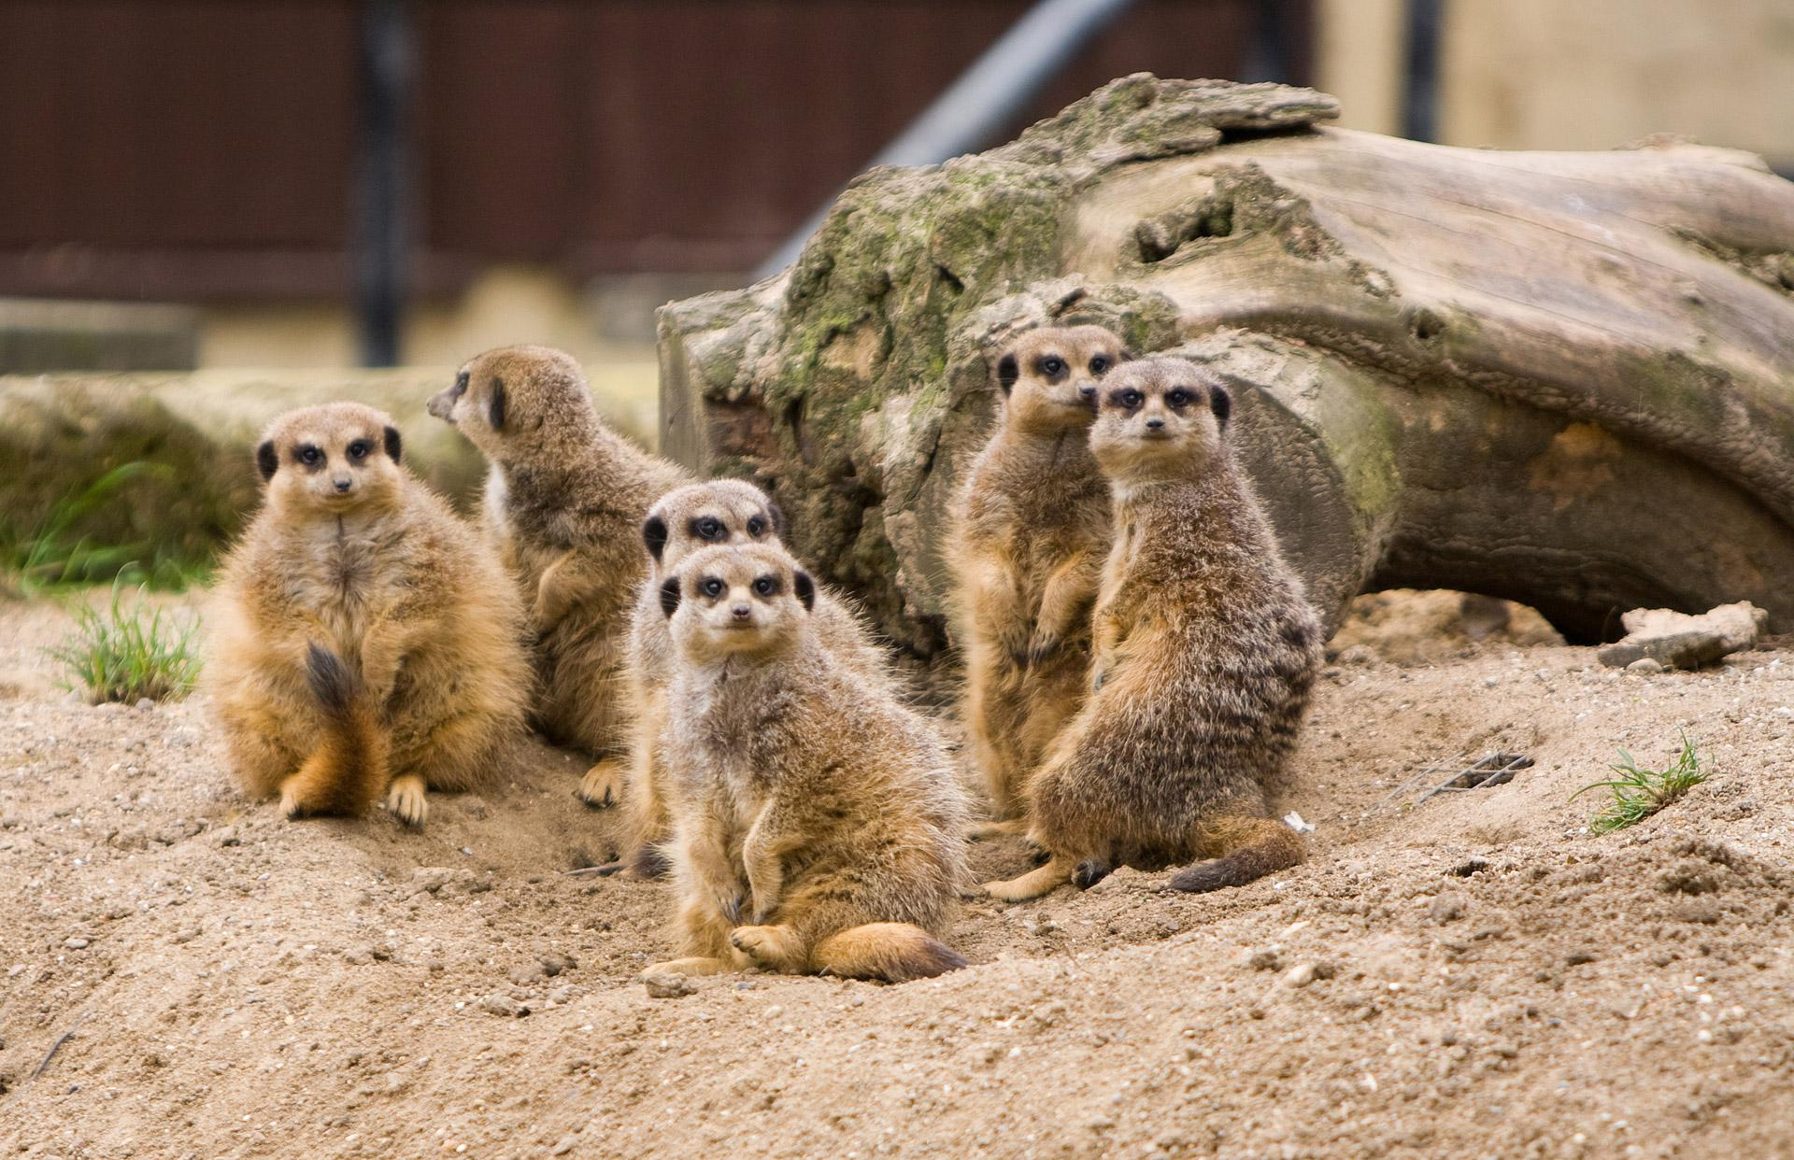
Characteristics of a mature team
Members are aware of each other’s strengths and weaknesses
Differences are accepted
Strong interpersonal relationships
Decision made through discussion
Conflicts are about the team issues not emotional issues
Members are aware of their role in team processes

Slide 7
What about trust?
May be the key to effective teamwork..how do you build trust?
Open honest communication (take the quiz on your communication skills for extra credit) https://www.mindtools.com/pages/article/newCS_99.htm
Support
Respect
Fairness
Predictability
Competence

