Slide 1
Chapter 10 Combustion Products

Slide 2
Objectives
Describe the two main types of smoke aerosols and explain why they are important in fires.
Explain how soot forms.
Describe the two principal methods for quantifying the aerosol content of smoke produced in an experimental fire.

Slide 3
Objectives
Describe the smoke-point height method for estimating the relative sooting tendency of a gaseous fuel.
List some relationships between fuel chemistry and sooting tendency.
Estimate the mass of burned fuel that can lead to loss of visibility due to smoke obscuration.

Slide 4
Objectives
List the principal combustion products formed in fires.
Explain the principles of operation for ionization smoke alarms and photoelectric smoke alarms, and identify the differences in what they detect.

Slide 5
Introduction—Definitions
Smoke
Fire effluent
Yield
Type and quantity of smoke are determined by burning materials/products and the burning conditions.

Slide 6
Smoke Aerosols—General Nature
Importance of smoke aerosols in fire:
Radiative heat transfer rate from the soot in flames is a principal determinant of the gasification of fuel and the combustion rate of an item.
Radiative heat transfer from flames and hot upper layer in fire room causes item-to-item flame spread.
Determine visual obscuration from fires.
Principal fire signature detected by residential smoke alarms.

Slide 7
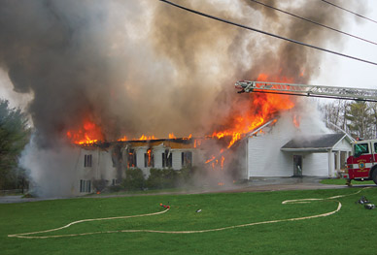
Smoke Aerosols—General Nature
Smoke aerosol types:
Soot
Aerosol mist
© Kratka Photography/ShutterStock, Inc.

Slide 8
Soot Formation
Soot constituents:
Carbon (main)
Hydrogen (secondary)
Possibly mineral matter and other atoms

Slide 9
Soot Formation
Soot formation process:
Diffusion and fuel-rich premixed flames
Forms on fuel side of fuel–air mixtures
High temps cause thermal fragmentation of fuel molecules.
Fragments collide and merge to form larger molecules.
Spherical
Diameters 0.01–1 µm

Slide 10
Soot Formation
Particles are dilute and tend to stay small. More particles are formed in larger, more turbulent fires, and they grow larger.
Coagulation
Reproduced from: National Institute of Standards and Technology.

Slide 11
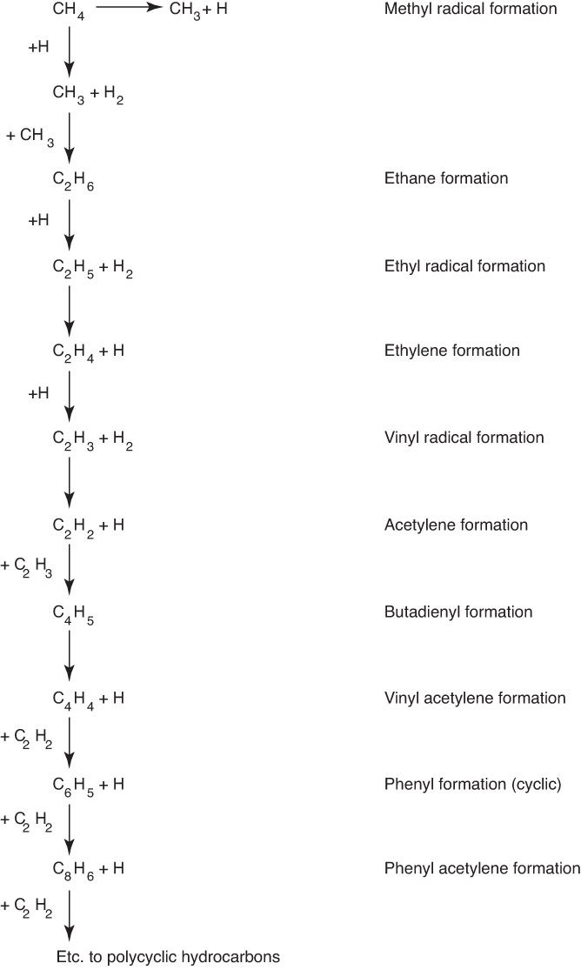
Soot Formation

Slide 12
Soot Formation
Chemical reaction process of soot formation
Stable acetylene molecules form on fuel side of a diffusion flame.
Acetylene molecules add to hydrocarbon radicals.
Hydrogen atoms extract H from hydrocarbon to form H₂.

Slide 13
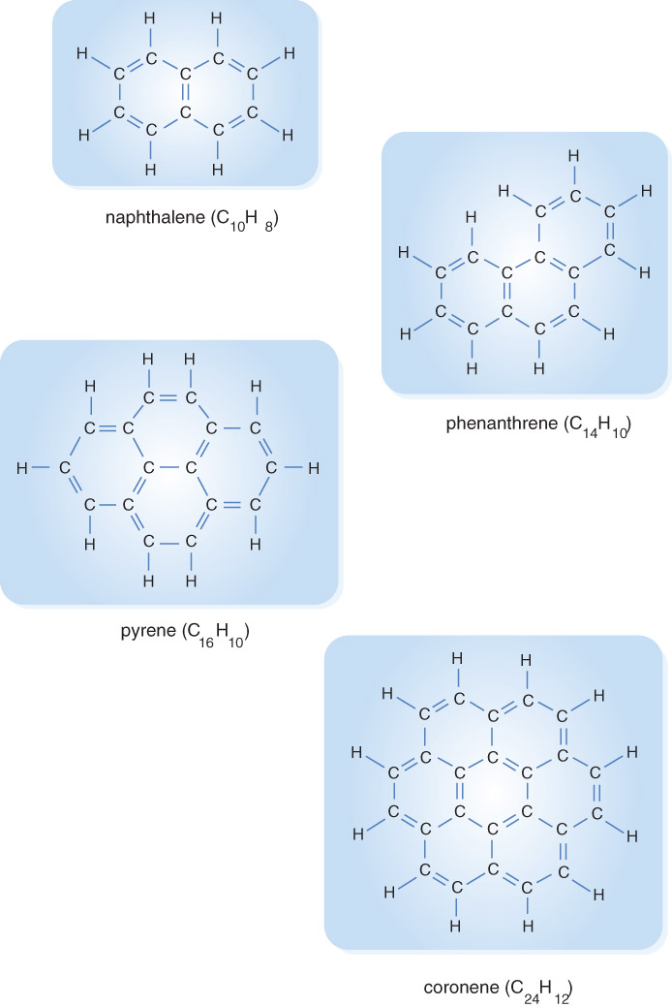
Soot Formation
Large enough molecules form closed rings that lead to formation of PCAHs that become soot particles.

Slide 14
Soot Formation
Fuels with H/C ratios higher than saturated hydrocarbons produce sootier flames.

Slide 15
Soot Formation
Turbulent burning polymeric materials can produce soot via alternative formation pathway.
Diffusion flames emit soot.

Slide 16
Smoke Point Height
Measurement of relative tendency of a gaseous fuel to generate soot is via the smoke-point height.
Shorter the smoke-point height, greater tendency of the fuel to soot.
Saturated hydrocarbon fuels

Slide 17
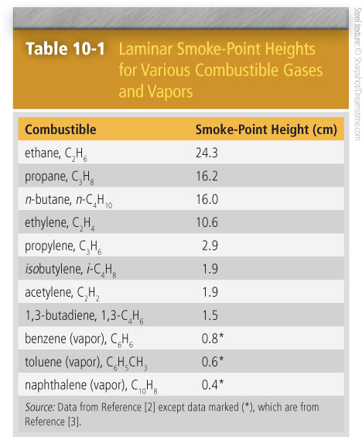
Smoke Point Height

Slide 18
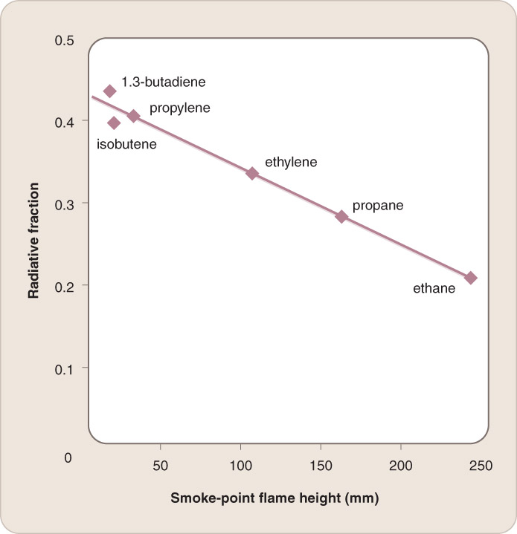
Smoke Point Height
Smoke-point heights for laminar flames are closely correlated with the radiative fraction for turbulent flames for the same combustibles.
Reproduced from: Markstein, G.H., “Relationship Between Smoke Point and Radiant Emission from Buoyant Turbulent and Laminar
Diffusion Flames,” Proceedings of the Combustion Institute 20, 1055–1061 (1985). Copyright Elsevier.

Slide 19
Aerosol Mist Formation
Smoke cools from > 2200 °F (1500 K) to 80 °F (300 K) after leaving flame vicinity.
Condensation of molecule vapors forms liquid droplets.
Aerosol mist has H/C ratio higher than soot particles.

Slide 20
Measurement of Aerosol Yields
Quantifying aerosol content of smoke:
Collect and weigh the aerosol (gravimetry) and calculate the ratio to the mass loss of the combustible.
Measure attenuation of a beam of light passing through the smoke and normalize the result.

Slide 21
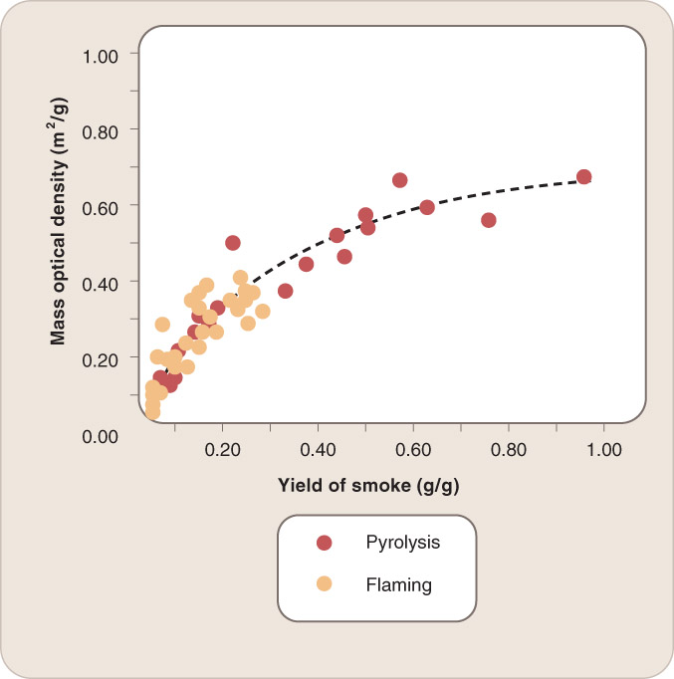
Measurement of Aerosol Yields

Slide 22
Measurement of Aerosol Yields
Gravimetric approach
Equation 10-1:
M_{T,soot} = M_{coll,soot} [ V°_{total} / V°_{probe} ]
Equation 10-2:
Y_{soot} = M_{T,soot} / M_{lost}

Slide 23
Measurement of Aerosol Yields
Weight, pictures, and dimension of soot can be obtained.
Soot spheres can form aggregates.
Optical method for measuring smoke is based on the scattering of light.
It can provide information about visibility through smoke.
Beam of light is directed across a gap with a photometer at the other end of the space.

Slide 24
Measurement of Aerosol Yields
Intensity of the light beam at the photometer is I_{o}.
Light reaching the detector has a lower intensity, I.
Bouguer’s Law (Beer-Lambert Law)
Equation 10-3: I/I_{o} = 10^{–Dx}
Equation 10-4: D = D_{m} × m_{ν}

Slide 25
Measurement of Aerosol Yields
For smoke from flaming fires, D_{m} = 3.8 m²/g ± 13%.
Equation 10-5: (D_{m}x)^{–1} log₁₀ (I_{o}/I) = m_{ν}
Smoke aerosol can also be measured by collecting light that scatters away from the forward direction.

Slide 26
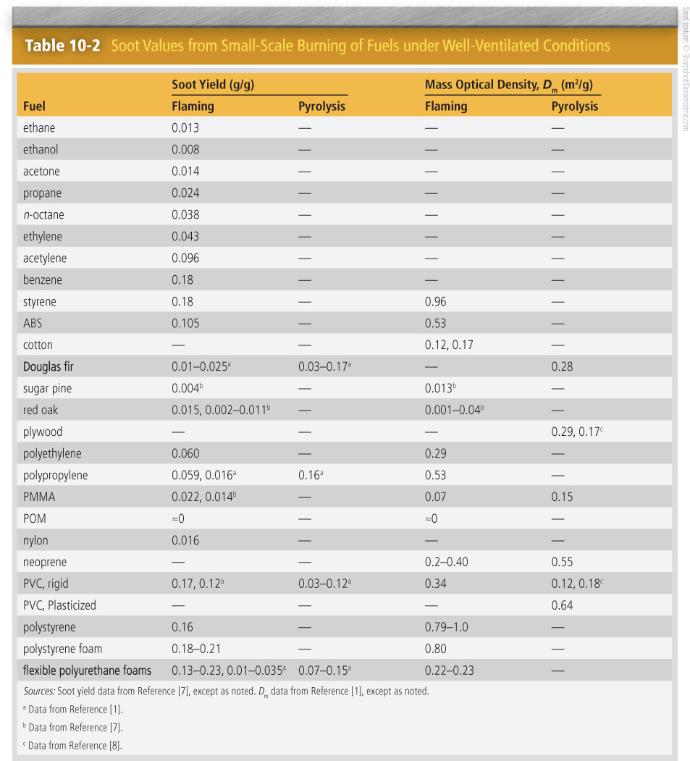
Quantity of Smoke Particles Produced

Slide 27
Quantity of Smoke Particles Produced
Burning fuels principles:
Flaming fuels containing oxygen generate less smoke than oxygen-free fuels.
Aromatic materials can produce high smoke yields.
Molecules containing halogen atoms tend to burn with high smoke production.

Slide 28
Quantity of Smoke Particles Produced
Smoke yield rises significantly as fire proceeds from well-ventilated to underventilated conditions.
Fire retardants affect combustibility and smoke yields.

Slide 29
Quantity of Smoke Particles Produced
Difficulty of relating smoke yield data from small-scale tests to yields from room-scale tests of finished products:
Flaming combustion and pyrolysis often occur at the same time.
Finished products often have multiple materials; different parts burn at different times.
Difficult to simulate restricted ventilation and partial recirculation of combustion products to the flame
Comparison of data from different laboratories

Slide 30
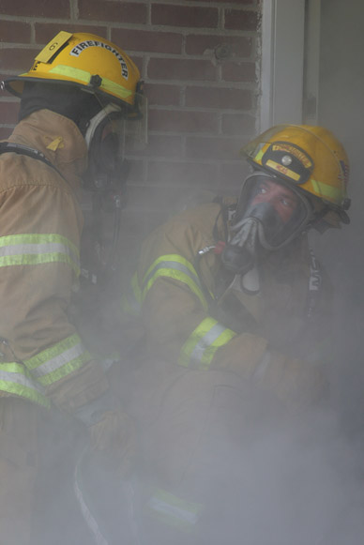
Visibility Through Smoke
Visible light has wavelengths ranging from 0.4 µm (blue light) to 0.8 µm (red light).
Large mass fraction of fire smoke aerosols have diameters between 0.1 and 1 µm.
Scattering effect causes objects to appear blurry.
Courtesy of Cpl. K. A. Thompson/U.S. Marines.

Slide 31
Visibility Through Smoke
Visibility through smoke can be expressed with reference to the distance over which an exit sign can be seen.
Equation 10-7: l = 1.3/D_{m} (m/v)
Equation 10-8: l = 3.5/D_{m} (m/v)
Minimum detectable contrast = 0.02

Slide 32
Visibility Through Smoke
Average D_{m} value = 0.2 m²/g plus distance between observer and light-reflecting exit sign = 10 m; then mass density of smoke aerosol = 0.65 g/m³.
Formulas remain approximations:
Variability of human vision
Varying background illumination level
Presence of eye irritants

Slide 33
Visibility Through Smoke
Consideration for smoke obscuration
If average D_{m} value = 0.2 m³/g but distance to see one’s hand in front of one’s face is only 0.5 m, a person loses perception at smoke concentration of 13 g/m³.

Slide 34
Visibility Through Smoke
Uncertainty in the calculations is ± at least a factor of 2:
Variations among measurement of smoke-yield data for given material
Differences in smoke yields for different materials
Changes in optical properties of smoke
No validation of extrapolation of experimental findings to short distances

Slide 35
Visibility Through Smoke
Uncertainty is smaller if the fire involves a single material for which the aerosol yield has been measured under combustion conditions germane to that fire.
Less scattering occurs with infrared lights

Slide 36
Carbon Dioxide and Water
Complete combustion is rare.
Combustion results in oxidation of carbon atoms to form CO₂ and hydrogen atoms reacting to form H₂O.

Slide 37
Carbon Monoxide
Some CO will escape flaming fires.
CO yield is low when carbon-containing combustibles burn in compartment with > stoichiometric air requirement.
Ratio of CO and CO₂ is typically less than 0.05.
CO content of smoke can be up to 5% or 6 % by volume.

Slide 38
Carbon Monoxide
Enhanced volume fractions of CO
Post-flashover CO level depends on:
Global equivalence ratio
Temperature of hot layer
Mixing of air into hot layer
Surface area of any wood or cellulosic material in contact with hot layer

Slide 39
Carbon Monoxide
Default value for CO yield post-flashover is approximately 0.2 g CO per gram of consumed fuel.
CO to CO₂ concentration ratio is as high as 1 in smoldering fires.

Slide 40
Partially Oxidized Organic Molecules
Two most important irritant gases:
Acrolein (H₂C == CH—HC == O)
Formaldehyde (H₂C == O)

Slide 41
Hydrogen Halides
If fluorine, bromine, or chlorine atoms are present in a burning item, the corresponding halogen acid will be present in the smoke.
Formation of halogen acids
Generated during pyrolysis stage
Extraction of halogen atoms to form halogen acid

Slide 42
Hydrogen Halides
If a polymer containing chlorine or bromine is burning, the Cl or Br atoms will be found as HCl or HBr.
Filler compounds may be added to products.
CaCO₃ reacts with halogen acids to sequester the chlorine.
Carbon–fluorine bonds are strongest.
HF, HCl, HBr dissolve in water.

Slide 43
Hydrogen Cyanide
Pyrolysis and subsequent reaction of nitrogen-containing polymers can form hydrogen cyanide (HCN).
Trace product
Fraction of fuel nitrogen emerging as HCN depends on the nitrogen bonding environment within the polymer.

Slide 44
Nitrogen Oxides
Oxidization of nitrogen can cause formation of nitric oxide (NO) and nitrogen dioxide (NO₂).
NO₂ dissolves in water to form nitrous acid (HNO₂) and then can oxidize to form nitric acid (HNO₃).
Nitrogen oxides form in air-rich flame zones.

Slide 45
Other Combustion Gases
If other atoms are present in burning materials, related gases may be generated.

Slide 46
Smoke Alarms
Response time of smoke alarms depends on:
Speed with which smoke reaches it
Number and size of particles generated by the fire
Sensitivity of the detection mode of the device
Sensitivity setting
Placed high on a wall or on a ceiling

Slide 47
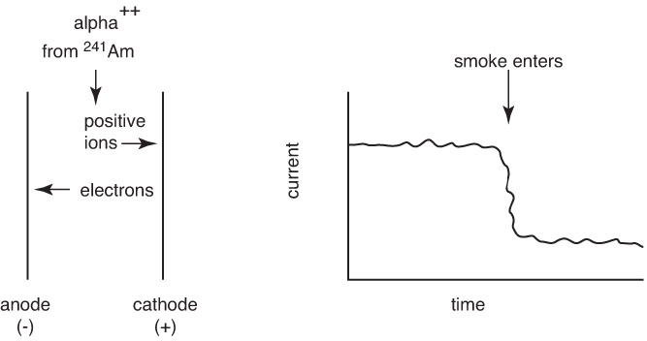
Smoke Alarms
Smoke buoyancy effect
Residential smoke alarms react to liquid and solid aerosols.
Ionization smoke alarm

Slide 48
Smoke Alarms
Photoelectric smoke alarm: A device that detects fire-generated aerosols by their scattering of light

Slide 49
Smoke Alarms
Smoke detectors must respond only to fairly high concentrations of particles.
Designed to respond to smoke obscuration level of 13% for gray smoke
Ionization detectors respond to half that level.
Ionization detectors will respond sooner to a flaming cellulosic fire and optical detectors sooner to a smoldering fire.

Slide 50
Smoke Alarms
Smoke will be detected well before visibility is seriously impaired.
Carbon monoxide detectors:
Electrochemical CO sensor
Semiconductor electrical resistance CO detector
Output of electrochemical cell is proportional to CO concentration.

Slide 51
Smoke Alarms
Combination smoke alarms
New generation of smoke alarms
Multiple sensors along with pattern recognition intelligence

Slide 52
Summary
Smoke, or fire effluent, consists of aerosols (soot particles and liquid droplets) and gases. Each of the smoke components, as well as the smoke itself, is characterized by its yield—that is, its mass per unit mass of fuel consumed.

Slide 53
Summary
Soot consists of mostly carbon and results from underventilated burning. Aerosol droplets result from condensation of gases that cool as they leave the vicinity of the flames. The yields can be determined by collecting and weighing the condensed matter or by measuring the scattering of a light beam. Soot yields typically range from 0.01 g/g to 0.2 g/g.

Slide 54
Summary
For a gaseous fuel, the relative tendency to form soot can be determined using the smoke-point height method. For any type of fuel, sooting is promoted by a fuel that contains halogen atoms and some aromatic bonding; it is reduced by oxygen in the chemical structure of the fuel.

Slide 55
Summary
Radiative transfer from the soot from flames and from the hot upper layer in the fire room determines the rate at which a fuel burns and the likelihood of ignition of additional combustibles that are not adjacent to the already burning item(s).

Slide 56
Summary
Both soot and aerosols reduce the ability to see in a fire. The two common metrics for smoke obscuration are the distance over which an exit sign can be seen and the level at which people cannot orient themselves and constructively identify a path to safety.

Slide 57
Summary
Soot and aerosols are the principal fire signature detected by current residential smoke alarms. Ionization smoke alarms measure the decrease in the transport of charged particles due to the presence of the soot and aerosols. Photoelectric smoke alarms measure the light scattered by the soot and aerosols.

Slide 58
Summary
The principal gaseous products from fires are H₂O and CO₂. Incomplete combustion generates CO and a mix of partially oxidized organic molecules. Nitrogen-containing fuels generate HCN, NO, and NO₂. Halogen-containing fuels generate hydrogen halides.

