Slide 1
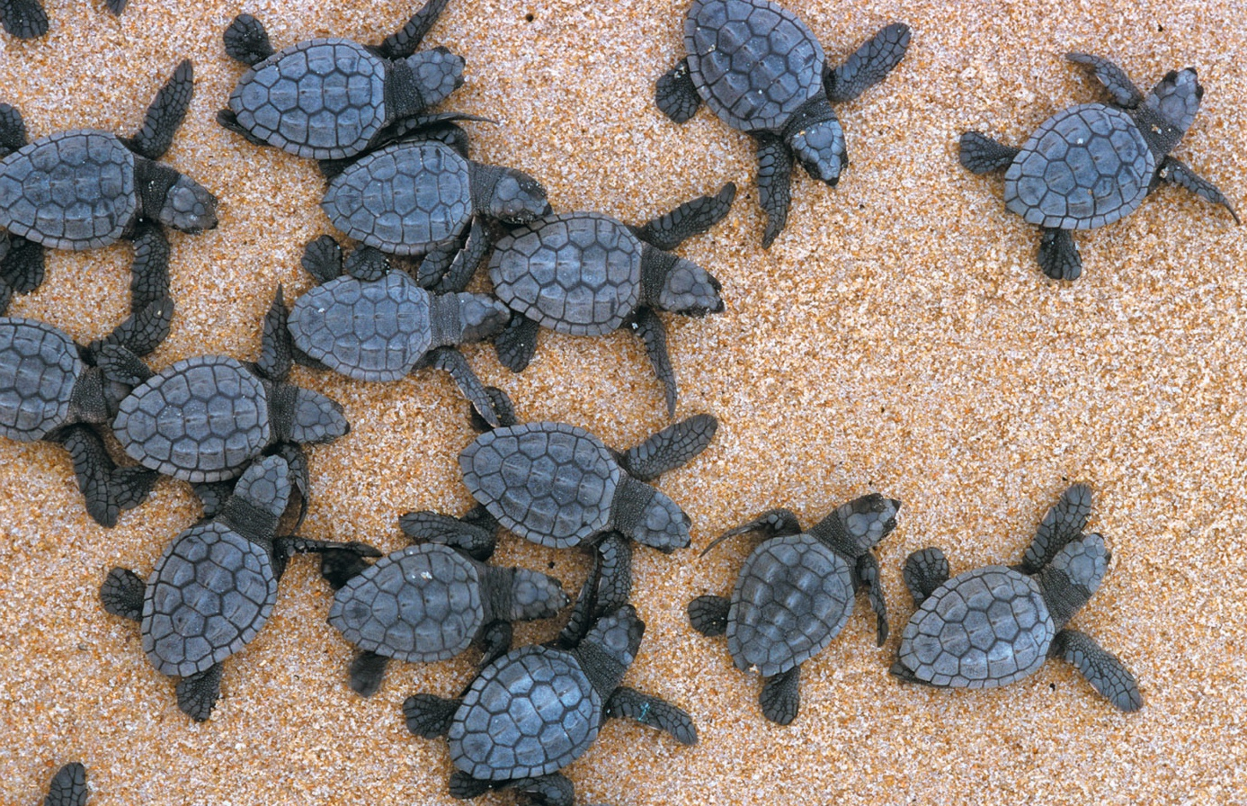
BIO10
Dr. Bradley
Small Scale Ecology

Slide 2
Population Growth
It is useful to study population growth in an idealized situation
Idealized situations help us understand the capacity of species to increase and the conditions that may facilitate this growth
Change in
population
size
Immigrants
entering
population
Emigrants
leaving
population
=
Births
+
–
Deaths
–
Immigration is the influx of new individuals from other areas
Emigration is the movement of individuals out of a population

Slide 3
Population Growth
Change in
population
size
Immigrants
entering
population
Emigrants
leaving
population
=
Births
+
–
Deaths
–
If immigration and emigration are ignored, a population’s growth rate equals birth rate minus death rate

Slide 4
Types of Population Growth
Organisms that breed year-round
  With unlimited resources
    Exponential growth
      Simple model
  With limited resources
    Logistic growth
      More complex model than Exponential growth taking into account costs associated with population density

Slide 5
Exponential Growth
Exponential growth rate is described by:
= rate of change in population size at
any instant in time
r = intrinsic growth rate

Slide 6
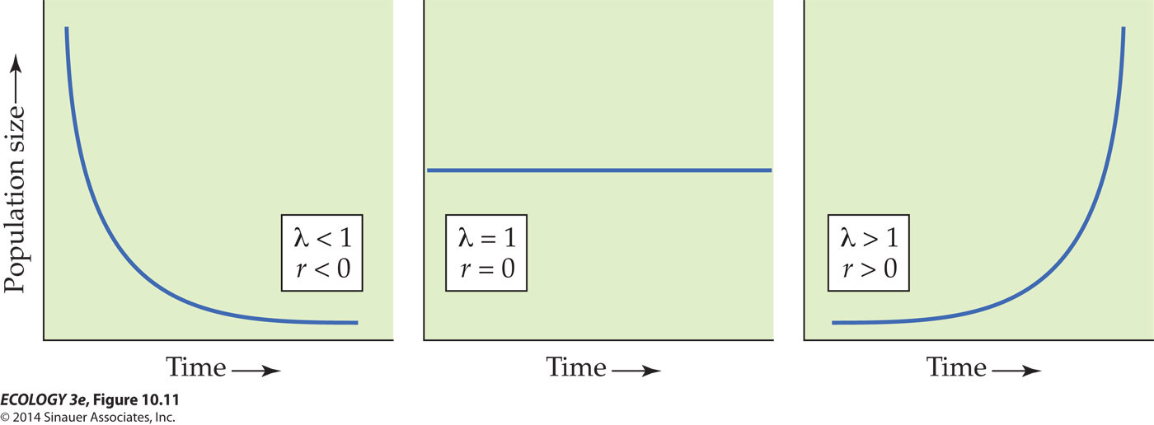
Exponential Growth
When r = 0, the population stays the same size.
When λ < 1 or r < 0, the population size will decrease.
When λ > 1 or r > 0, the population grows geometrically or exponentially.

Slide 7
Exponential Growth
When λ = 1 or r = 0, the population stays the same size.
When r < 0, the population size will decrease.
When λ > 1 or r > 0, the population grows geometrically or exponentially.

Slide 8
Exponential Growth
When λ = 1 or r = 0, the population stays the same size.
When λ < 1 or r < 0, the population size will decrease.
When r > 0, the population grows geometrically or exponentially.

Slide 9
Exponential Growth
When r = 0, the population stays the same size.
When r < 0, the population size will decrease.
When r > 0, the population grows geometrically or exponentially.

Slide 10
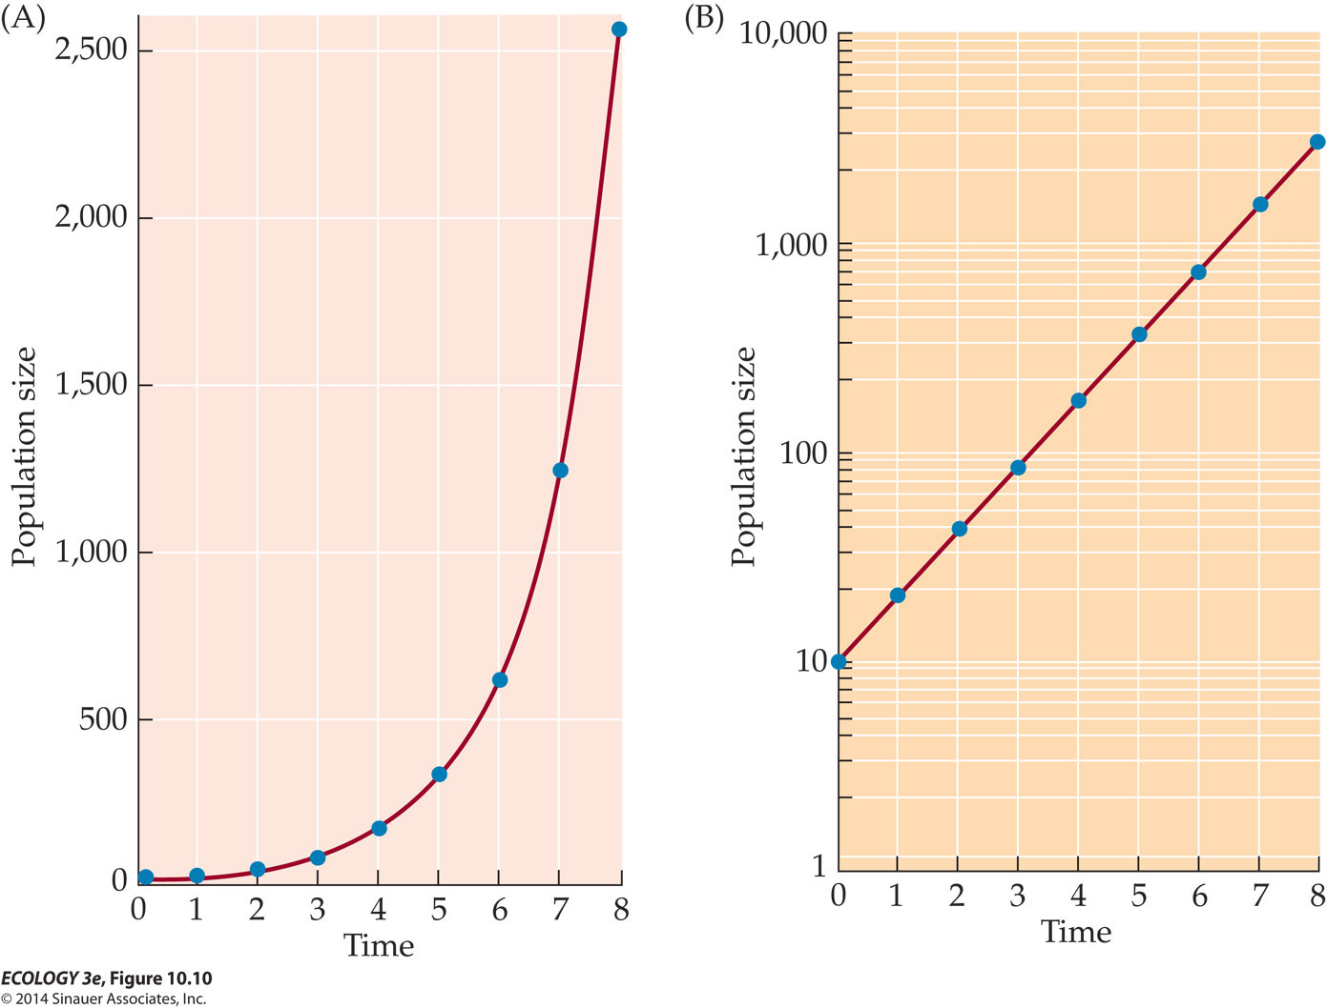
Exponential Growth
Red Line
Red Line
Exponential growth: When individuals reproduce continuously and generations can overlap and the population changes in size by a constant proportion at each instant in time.
Notes:
Look at the red line. The blue dots aren’t meaningless here, they’re just the population size at discrete time points but the population actually growth throughout the year.

Slide 12
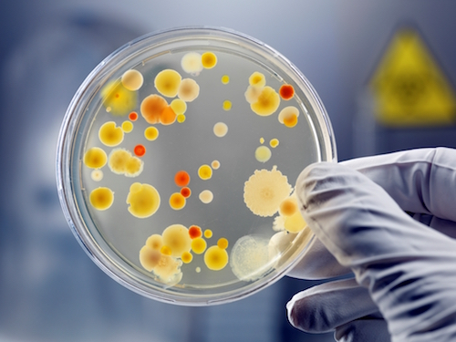
Net Reproductive Rate
Population size can be determined by
density-dependent and density-independent factors.

Slide 13
Net Reproductive Rate
Population size can be determined by
density-dependent and density-independent factors.
So far we have only talked about these!

Slide 14
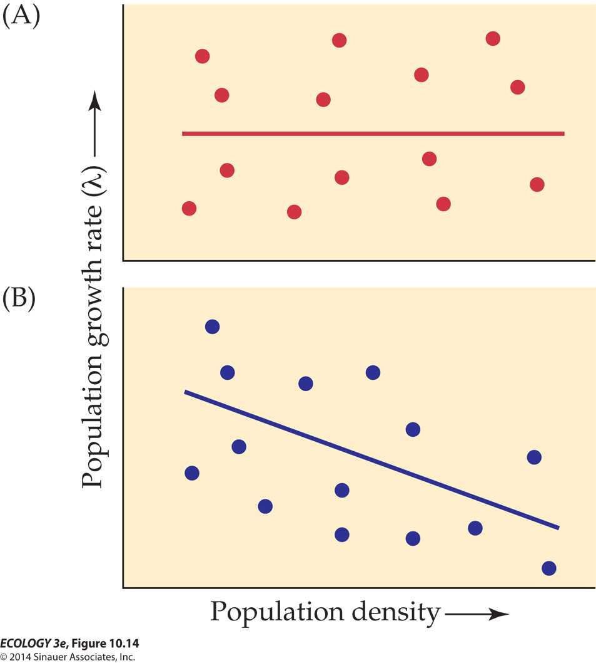
Effects of Density
Density-independent factors: Effects on birth and death rates are independent of the number of individuals in the population.
  Weather conditions, such as temperature and precipitation
  Catastrophes, such as floods or hurricanes
Notes:
14

Slide 15
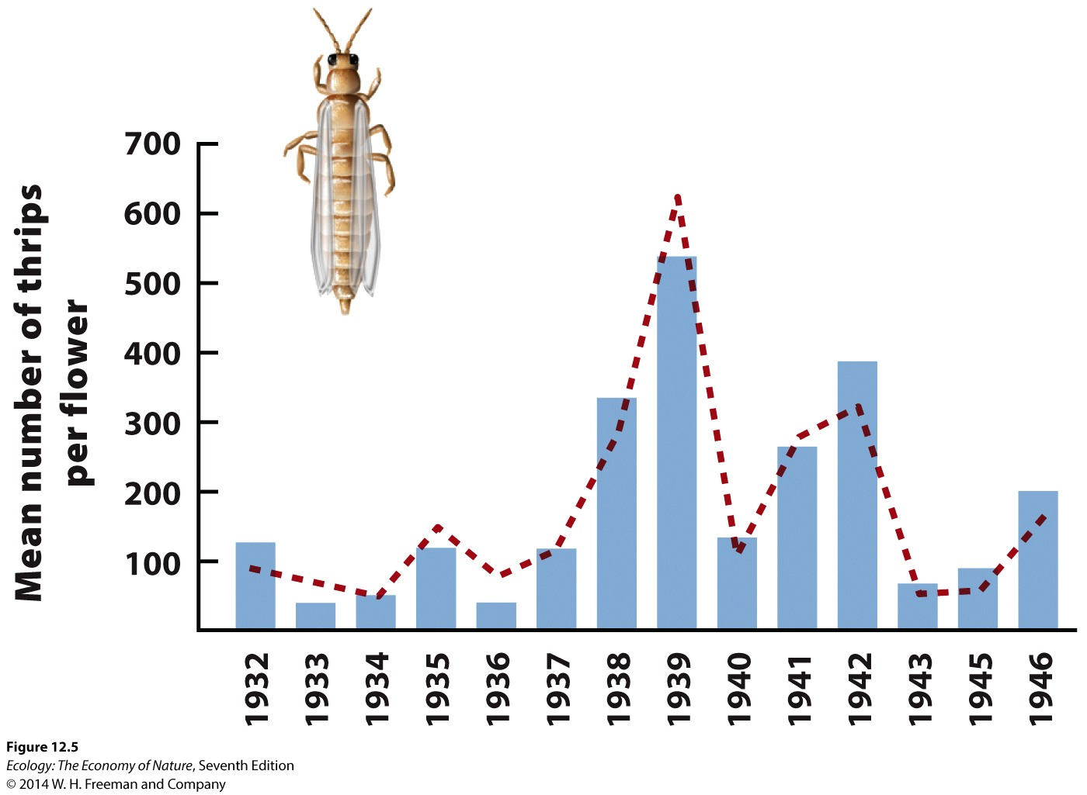
Density-Independent Changes in Population Size - Weather
Notes:
15

Slide 16
Net Reproductive Rate
Population size can be determined by
density-dependent and density-independent factors.
Now let’s talk about these!

Slide 17
Negative Effects of Density
Negative density dependence — When the rate of population growth decreases as population density increases.
Notes:
17

Slide 18
Negative Effects of Density
Density-dependent factors:
  Birth, death, and dispersal rates change as the density of the population changes.
As density increases, birth rates often decrease, death rates increase, and dispersal (emigration) increases, all of which tend to decrease population size.
Notes:
18

Slide 19
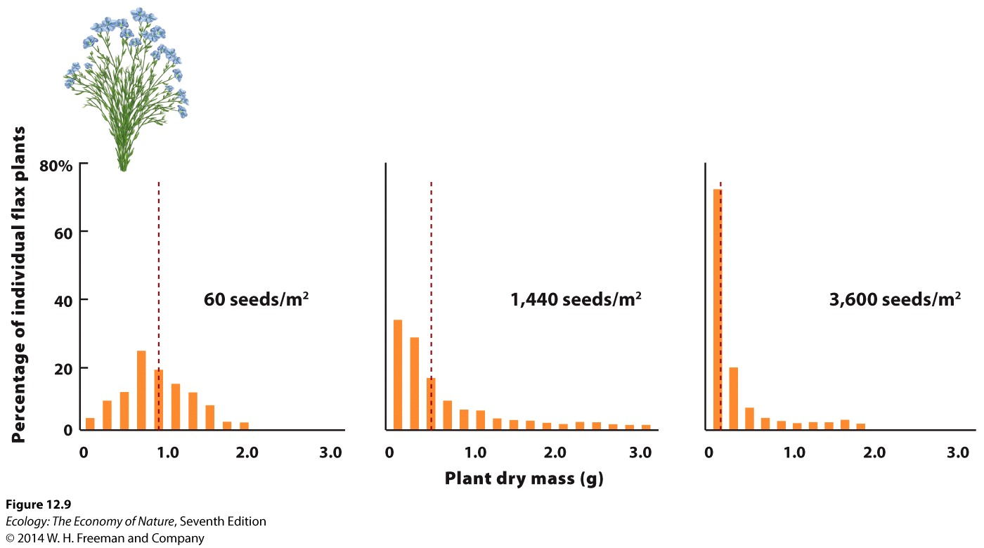
Density Dependent Fitness Effects
Low Density
Medium Density
High Density
Notes:
19

Slide 20
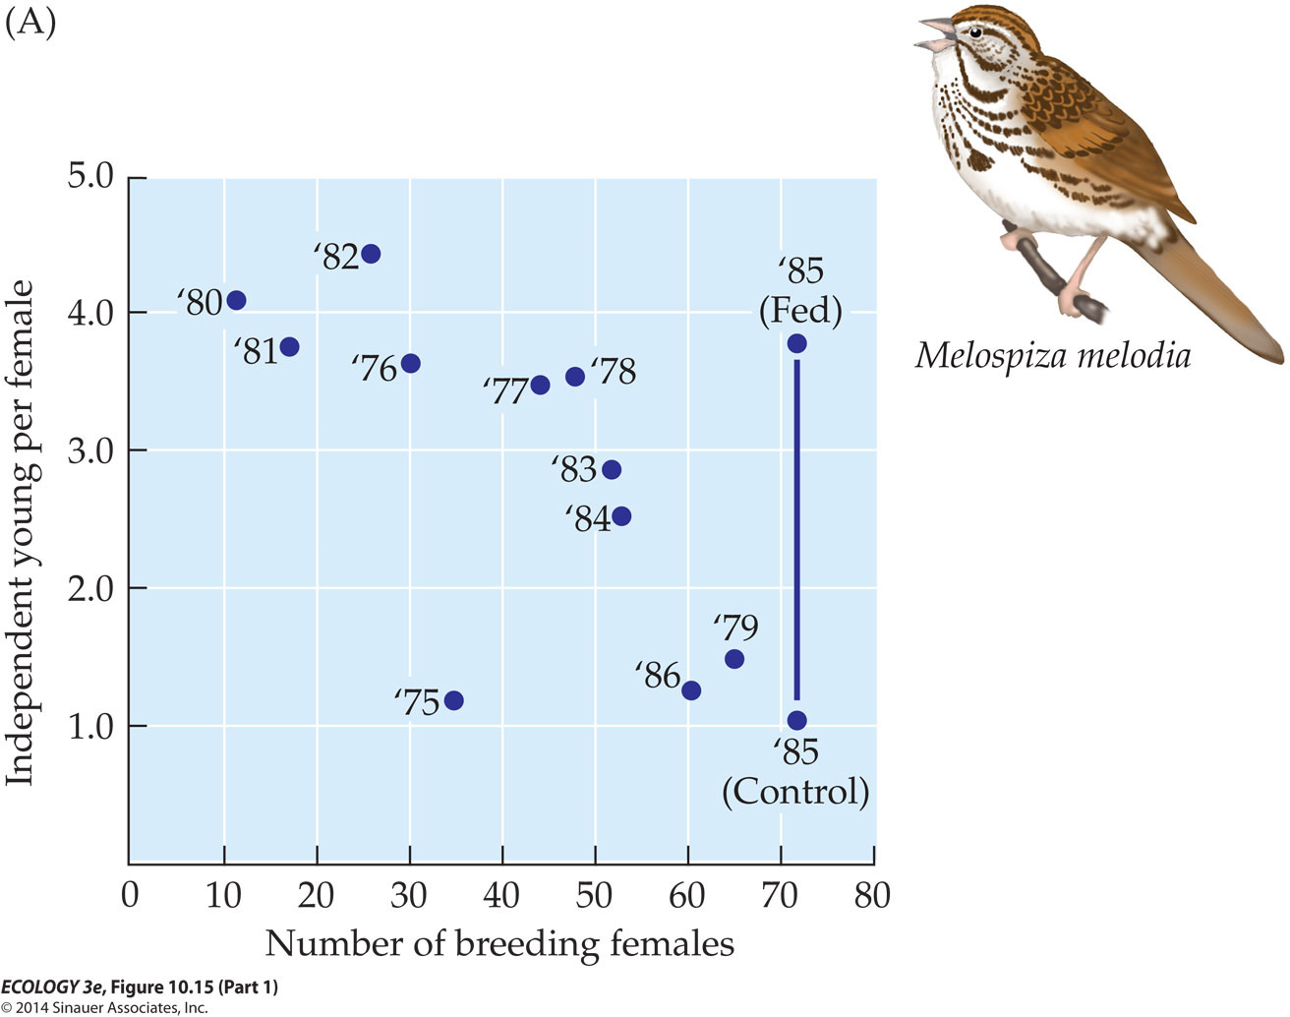
Density Dependent Reproduction Rate
Notes:
20

Slide 21
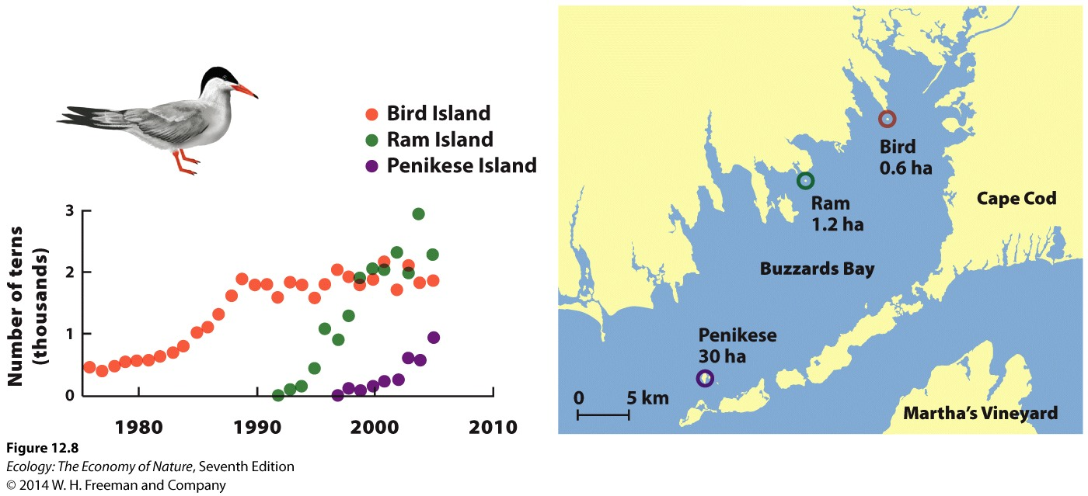
Density Dependent Dispersal
Notes:
21

Slide 22
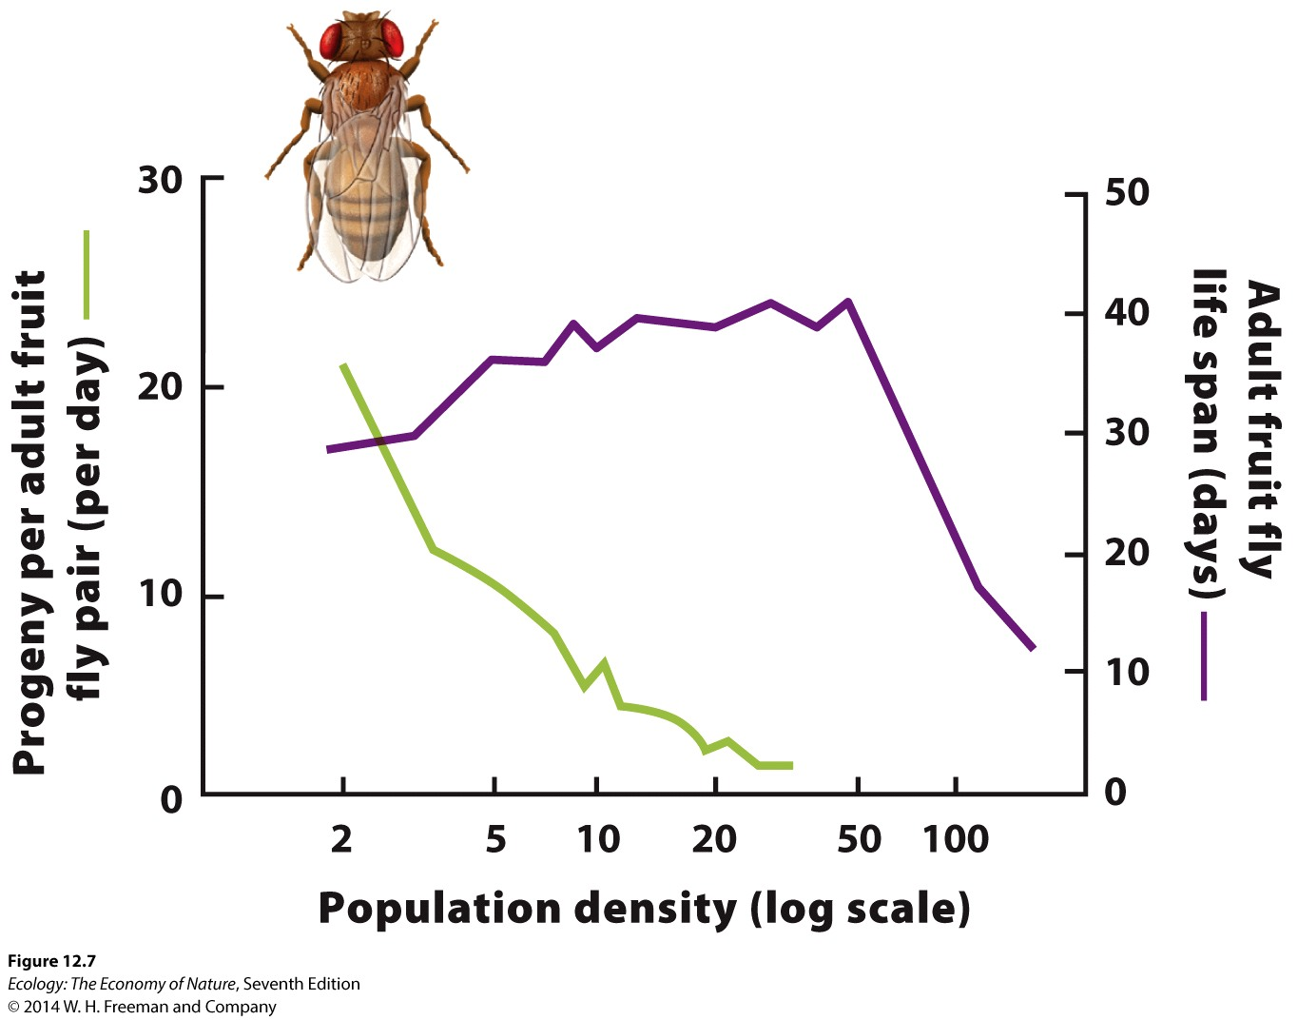
Density Dependent Reproduction & Survival Rates
Notes:
22

Slide 23
Density-dependent Factors Limit Exponential Growth at High Density

Slide 24
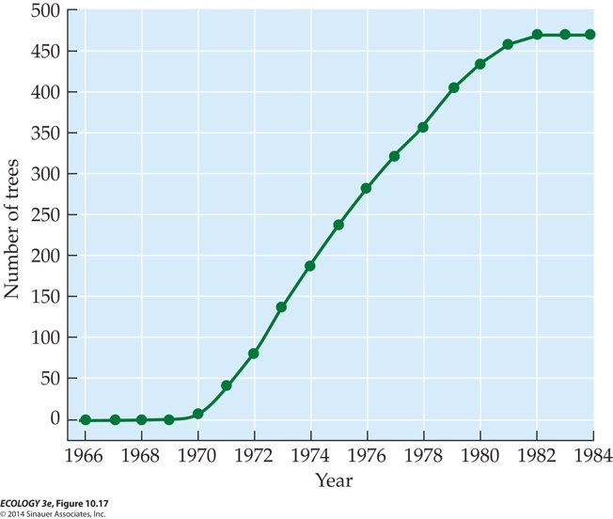
Density-dependent Factors Limit Exponential Growth at High Density

Slide 26
Types of Population Growth
Organisms that breed year-round
  With unlimited resources
    Exponential growth
      Simple model
  With limited resources
    Logistic growth
      More complex model than Exponential growth taking into account costs associated with population density

Slide 27

Logistic Growth
Logistic growth: Population increases rapidly, then stabilizes at:
(K) the carrying capacity (maximum population size that can be supported indefinitely by the environment).
Notes:
27

Slide 28
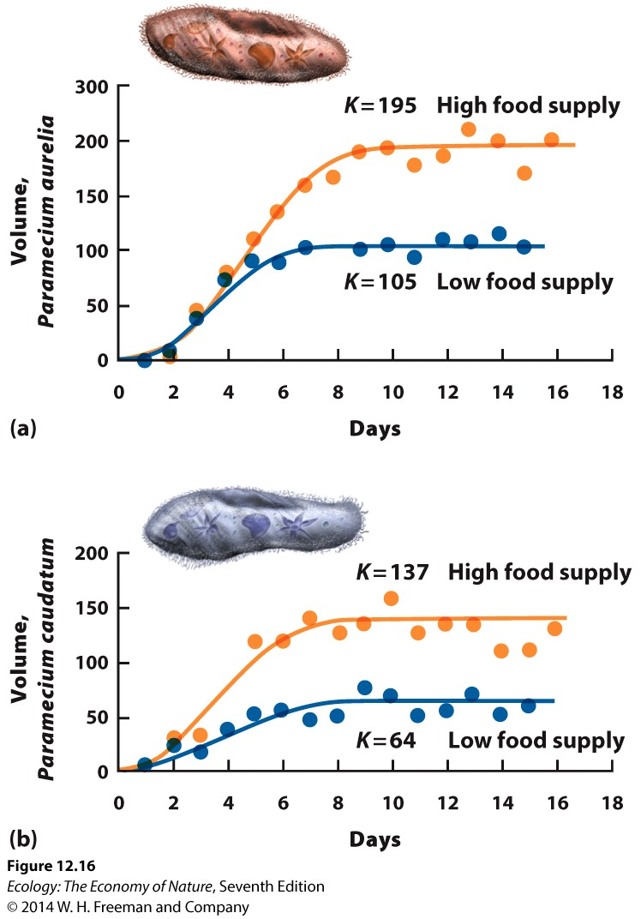
Logistic Growth
Logistic growth: Population increases rapidly, then stabilizes at the carrying capacity (maximum population size that can be supported indefinitely by the environment).
Notes:
28

Slide 29
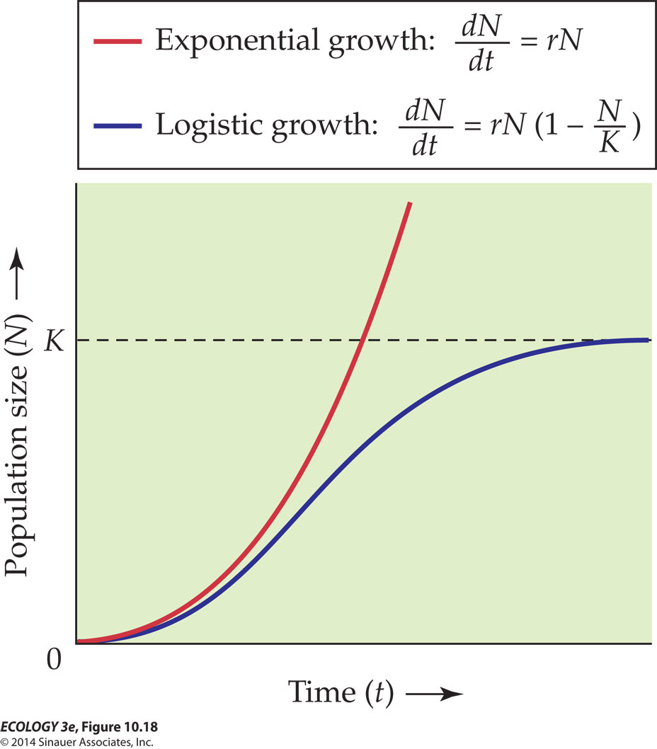
Logistic Growth
The logistic equation assumes that r declines as N increases:
N = population density
r = per capita growth rate
K = carrying capacity
The logistic equation assumes that r declines as N increases:
N = population density
r = per capita growth rate
K = carrying capacity
Unutilized Portion
(or Over Utilized Portion) of Carrying Capacity
Growth eventually falls to zero
Inflection point
Early growth is exponential
Notes:
29

Slide 31
Life History Continua:
Speed of Life or Development
r-selection and K-selection describe two ends of a reproductive strategy continuum.
K
r
Notes:
31

Slide 32
r-selection & K-selection
What sort of abiotic/biotic conditions are associated with this part of the growth curve?
K
What sort of abiotic/biotic conditions are associated with this part of the growth curve?
r
Notes:
32

Slide 33
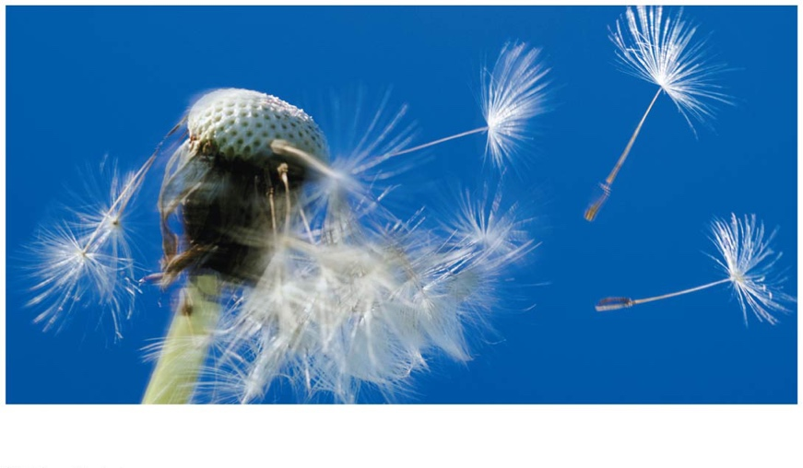
Life History Continua:
Speed of Life or Development
r is the intrinsic rate of increase of a population.
r-selection: Selection for high population growth rates; an advantage in newly disturbed habitats and uncrowded condition.
r
Notes:
33

Slide 34
r-Selection
r-selected (“live fast, die young”):
  Short life spans, rapid development, early maturation, low parental investment, high reproduction rates
  Most insects, small vertebrates such as mice, weedy plant species
r
Notes:
34

Slide 35
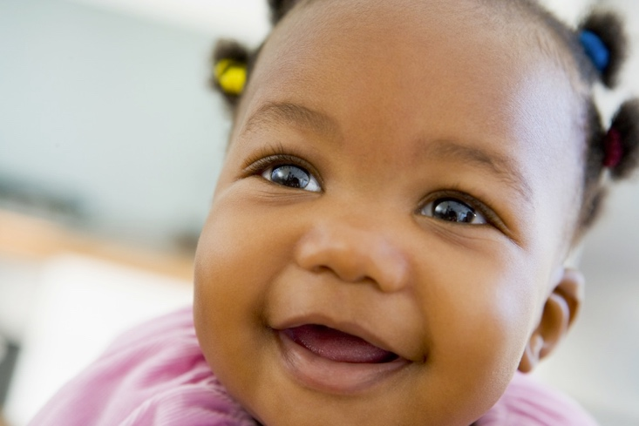
Life History Continua:
Speed of Life or Development
K is the carrying capacity for a population.
K-selection: Selection for lower growth rates in populations that are at or near K; an advantage in crowded conditions; efficient reproduction is favored.
K
Notes:
35

Slide 36
K-Selection
K-selected (“slow and steady”):
  Long-lived, develop slowly, late maturation, invest heavily in each offspring, low reproduction rates
  Large mammals, reptiles such as tortoises and crocodiles, and long-lived plants such as oak and maple trees
K
Notes:
36

Slide 38
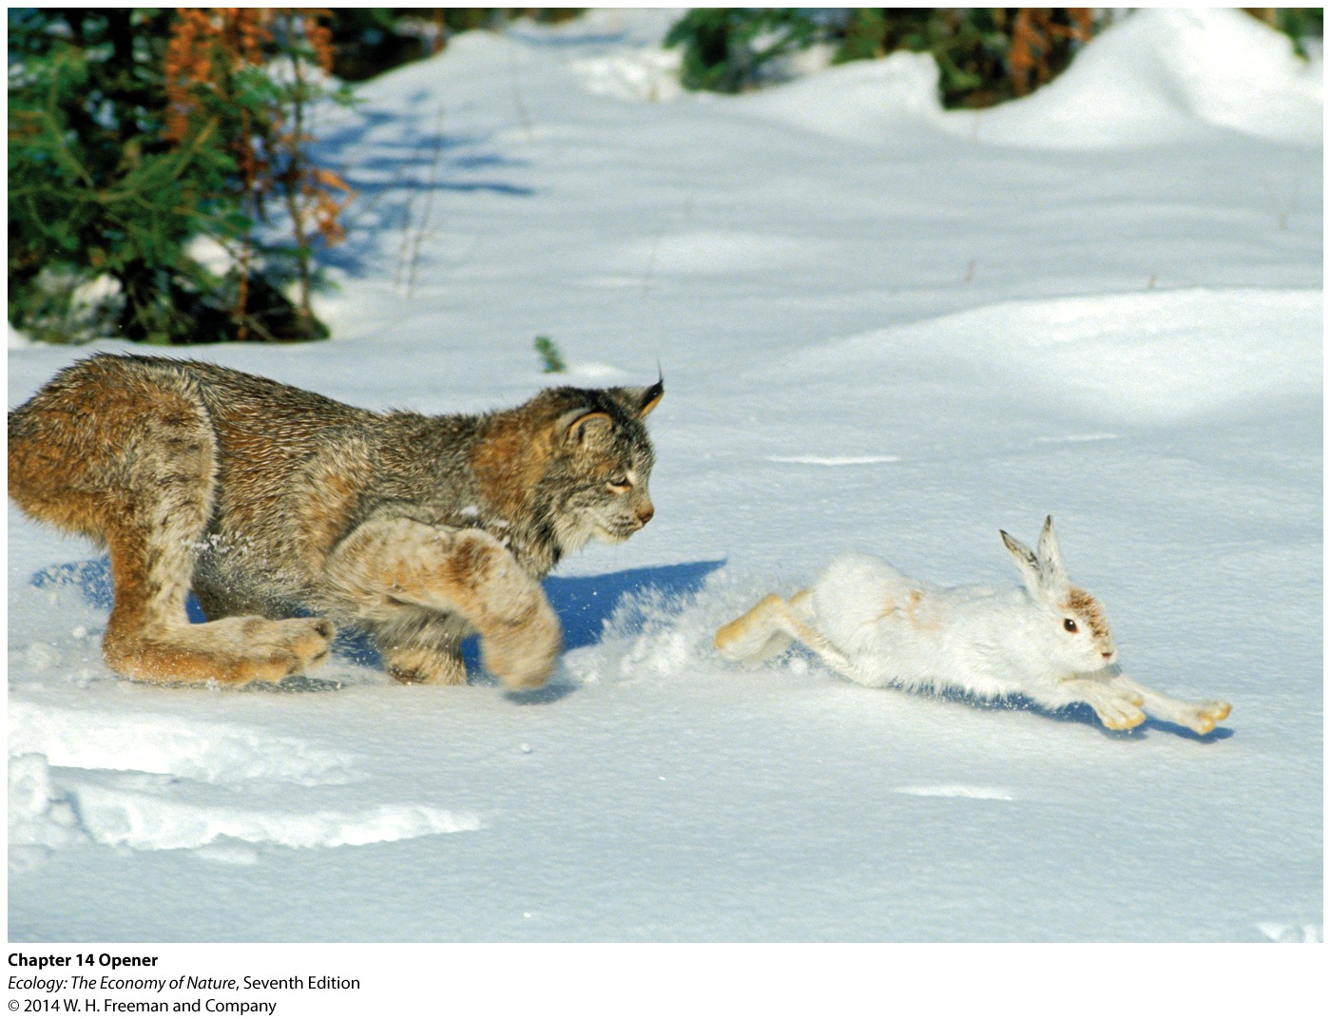
Diet Breadth in Predators
Most predators eat a broad range of prey species and are called generalists.

Slide 39
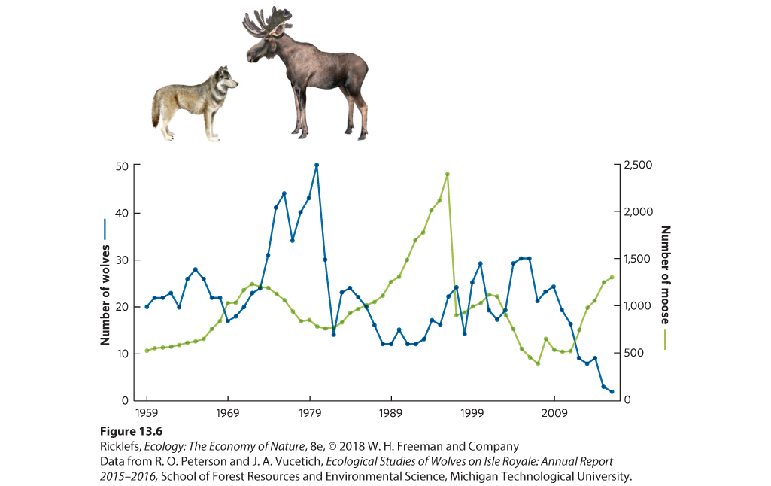
Diet Breadth in Predators
Generalist predator diet can become constrained however...
Populations of predators and their prey can each directly impact the population of the other.
This is particularly true when the predator has few species of prey to choose from and the prey are taken by few species of predators.

Slide 40
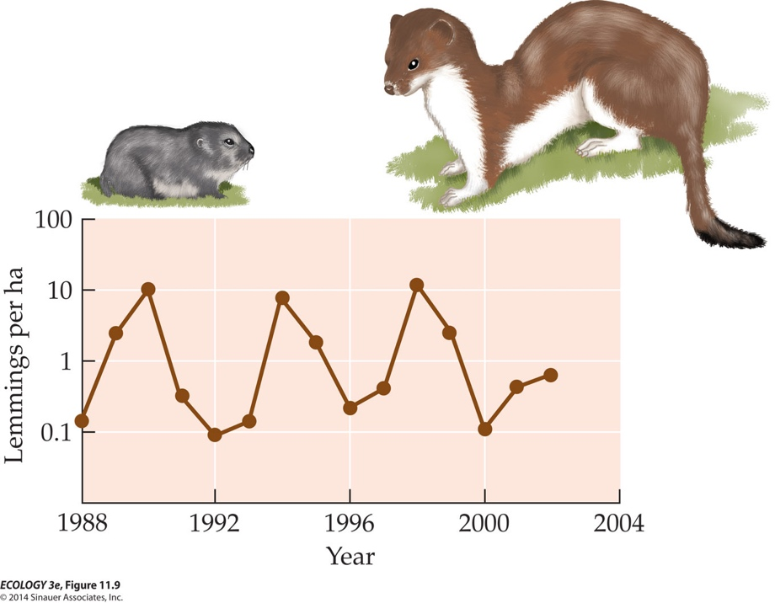
Population cycles
Some populations have alternating periods of high and low abundance at regular intervals.
Populations of small rodents, such as lemmings and voles, typically reach a peak every 3–5 years
Notes:
40

Slide 41
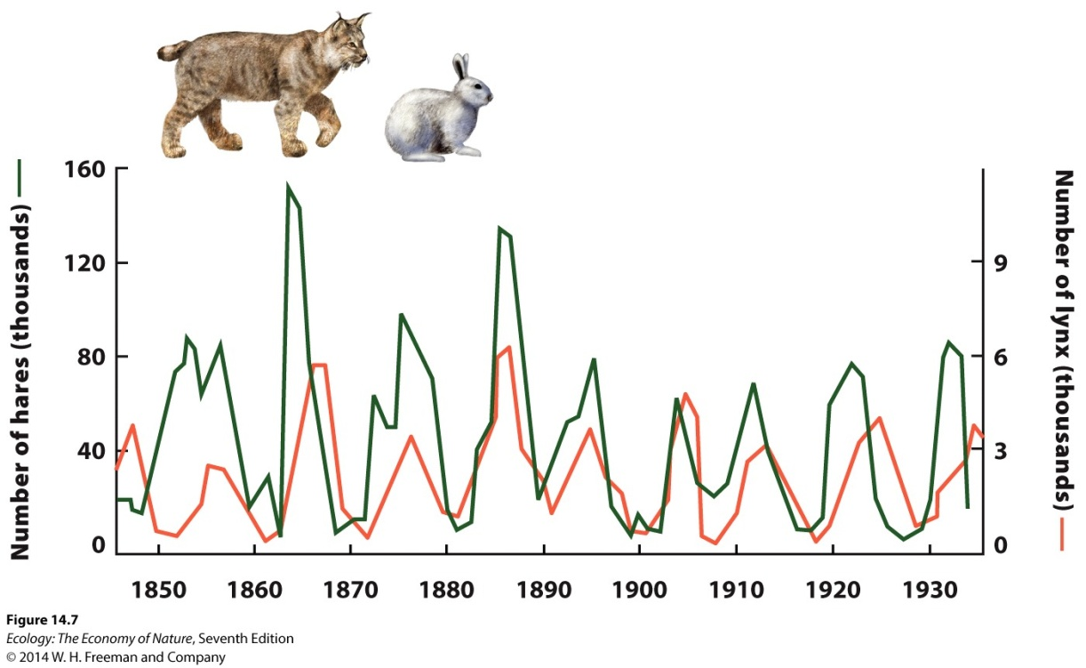
Population cycles
The synchrony of population cycles between consumers and the populations they consume suggests that these oscillations are the result of interactions between them.
Example:
Snowshoe hares and Canada lynx predators exhibit population cycles of 9–10 years, with lynx cycles lagging 2 years behind hare cycles.
Other large herbivores in the boreal and tundra regions of Canada (e.g., muskrats, grouse) also have population cycles of 9–10 years. Smaller herbivores tend to have 4-year cycles.

Slide 42
What explains these cycles? **Effects of Density**
Density-dependent factors:
  Birth, death, and dispersal rates change as the density of the population changes.
As density increases, birth rates often decrease, death rates increase, and dispersal (emigration) increases, all of which tend to decrease population size.
Notes:
42

Slide 44
Different type of interaction - Competition
An interaction between individuals in which each is harmed by their shared use of a limiting resource.
In competition (-/- interaction), both parties are harmed by competing for a resource in limited supply
  Both parties are harmed
Notes:
44

Slide 45
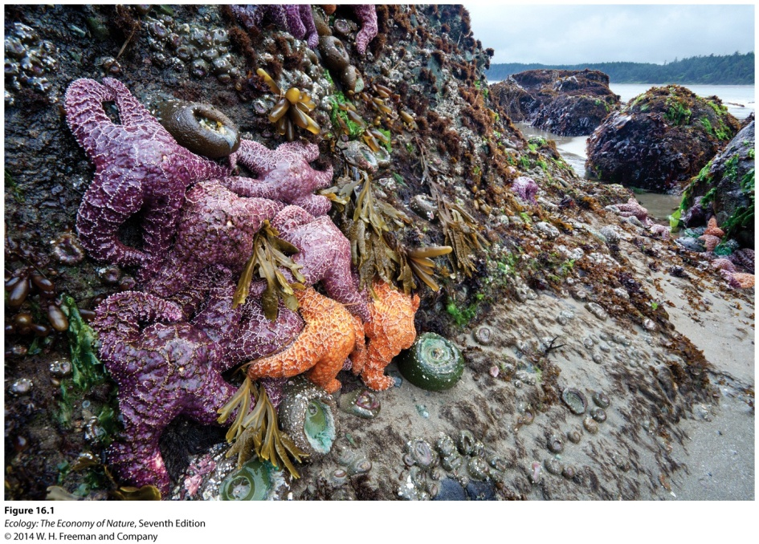
What is a resource?
Resource: anything an organism consumes or uses that causes an increase in population growth rate when it becomes more available.
Resources for plants can include sunlight, water, and soil nutrients.
Resources for animals can include food, water, and space for nesting or refuge.
Example:
Mussels and barnacles in the intertidal zone compete for space on rocks.
As space decreases, the growth and fecundity of adults declines.

Slide 46
Types of competition
Intraspecific competition: competition among individuals of the same species.
Negative density dependence is a common type of intraspecific competition, where an increase in a population’s density causes a decline in the growth rate of the population.
Interspecific competition: competition among individuals of different species.
Interspecific competition can cause the population of one species to decline and eventually die out.

Slide 47


Competitive exclusion
Competitive exclusion principle: two species cannot coexist indefinitely when they are both limited by the same resource.
When two species are limited by the same resource, one species is often a better competitor and survives better when resources are scarce.

Slide 48
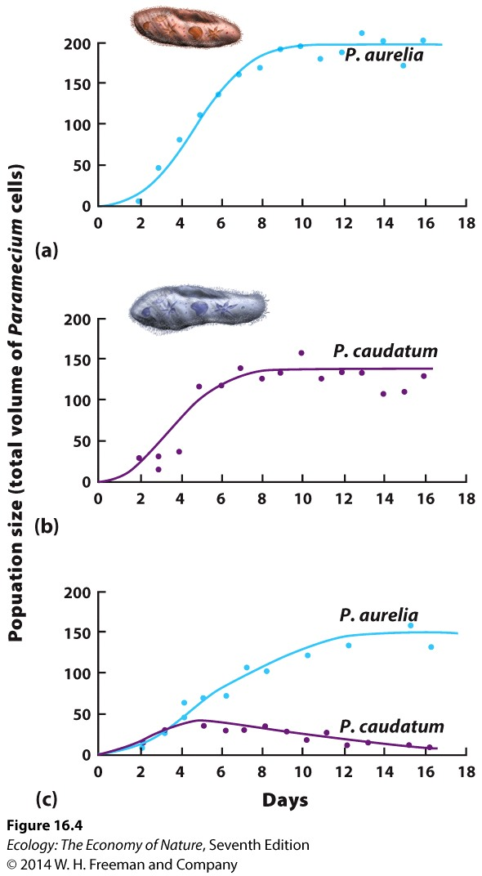
Competitive exclusion
Example:
Gause grew two species of Paramecium alone or together with a limited amount of bacteria as a resource.
When the two species of Paramecium were grown separately, both grew rapidly and reached carrying capacity.
When grown together, P. aurelia was the superior competitor and drove P. caudatum to extinction.

Slide 49
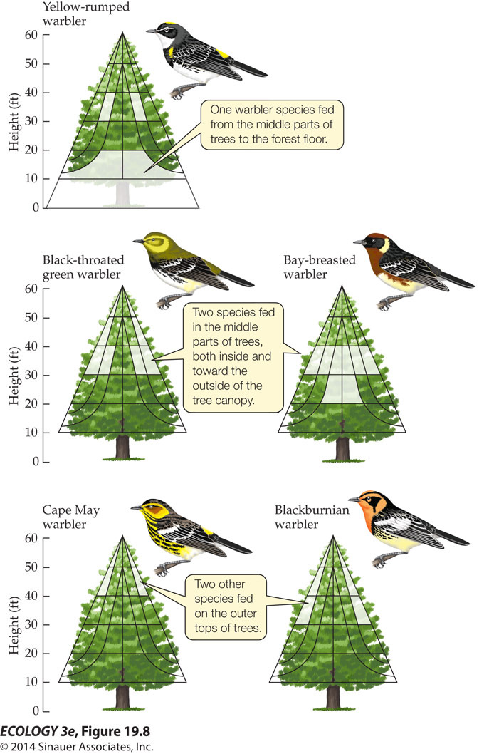
Long-Term effects of Competitive Exclusion in Warblers
MacArthur (1958) studied resource partitioning in a community of warblers in New England forests.
He recorded feeding habits, nesting locations, and breeding territories.
When he mapped the locations of warbler activity he found that the birds were using different parts of the habitat in different ways.

Slide 51
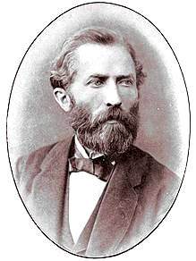
Symbiosis
Anton De Bary (1879)
  Symbiosis is… “a phenomenon in which dissimilar organisms live together…”
Symbionts: Organisms that live in or on other organisms.
More than half of Earth’s species are symbionts.

Slide 52
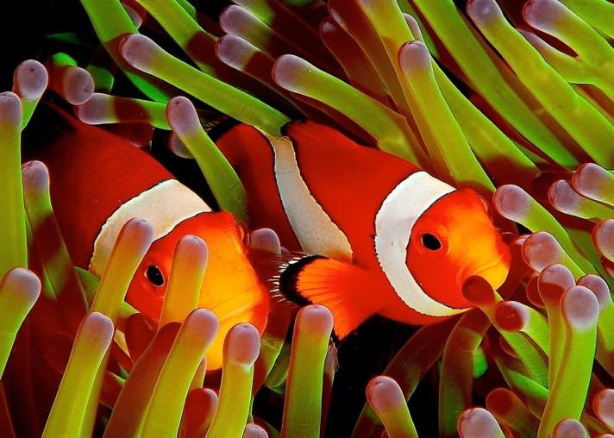
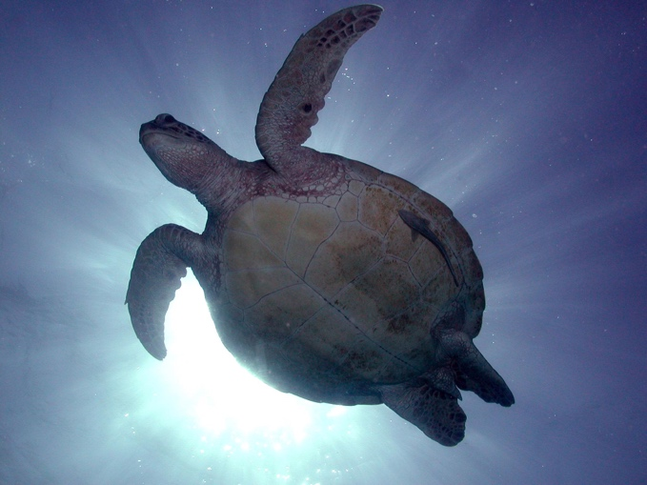
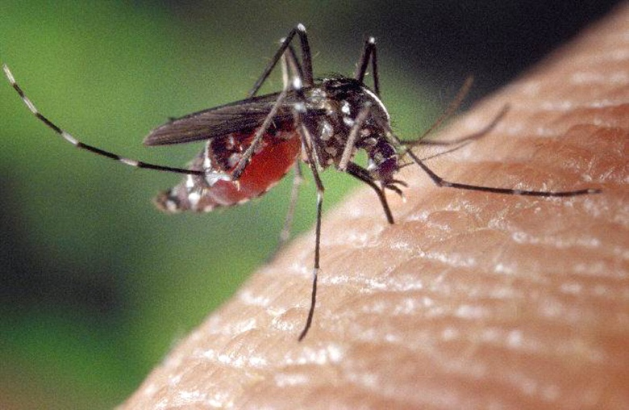
Types of symbiosis: cost-benefit analyses
Mutualism ➔ Commensalism ➔ Amensalism ➔ Parasitism

Slide 53
Types of symbiosis: cost-benefit analyses
Mutualism ➔ Commensalism ➔ Amensalism ➔ Parasitism
More mutualistic
More antagonistic

Slide 54
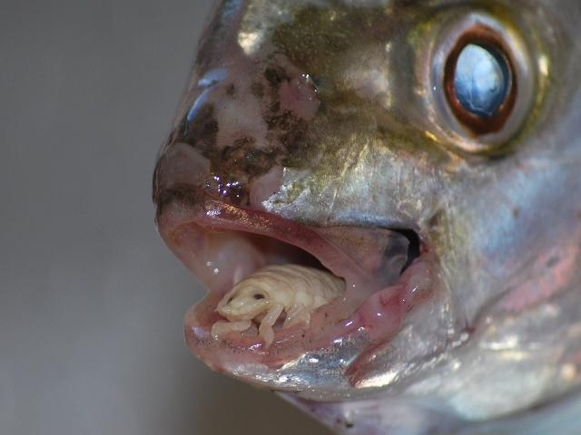
Types of symbiosis: cost-benefit analyses
Parasitism (+,-):
  One organism, the parasite, derives nourishment from another organism, its host, which is harmed in the process
    Host is usually not killed
    Unlike predators, parasites usually have a higher reproductive rate than their hosts.
Mutualism ➔ Commensalism ➔ Amensalism ➔ Parasitism

Slide 55
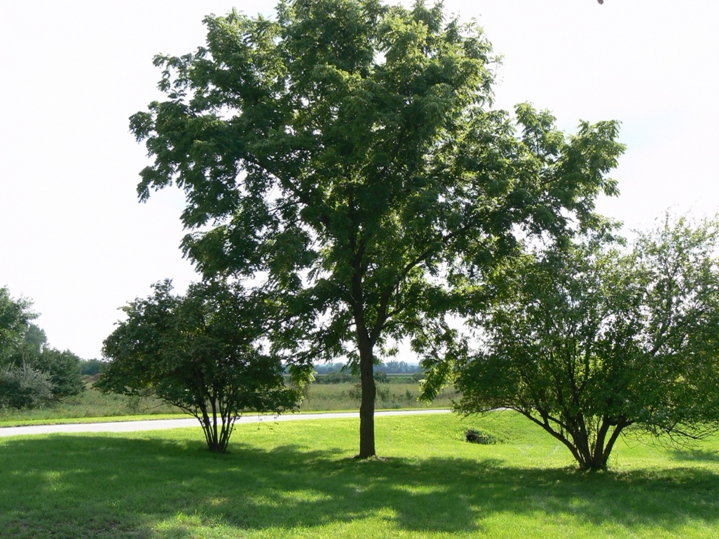
Types of symbiosis: cost-benefit analyses
Amensalism (-,0):
  Association in which one party is harmed (-) and the other is neither benefited nor is
  harmed (0)
  Harm is usually driven by a product of the other party
Mutualism ➔ Commensalism ➔ Amensalism ➔ Parasitism

Slide 56
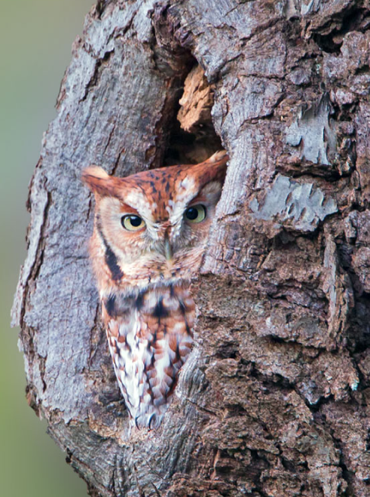
Types of symbiosis: cost-benefit analyses
Mutualism ➔ Commensalism ➔ Amensalism ➔ Parasitism
Commensalism (+,0):
  Association in which one party
  benefits (+) and the other is
  neither benefited nor is
  harmed (0)

Slide 57
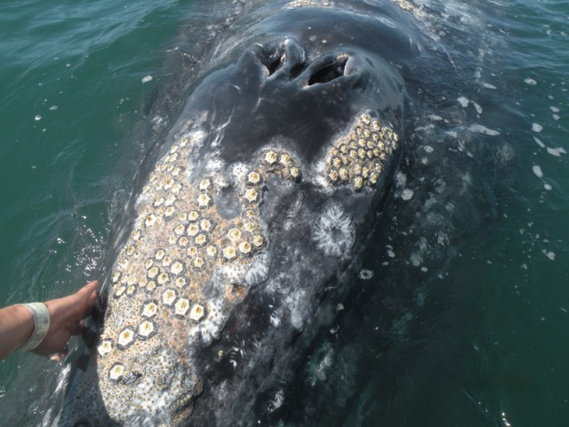
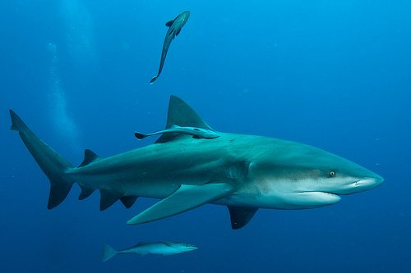
Types of symbiosis: cost-benefit analyses
Mutualism ➔ Commensalism ➔ Amensalism ➔ Parasitism
Commensalism (+,0):
  Association in which one party
  benefits (+) and the other is
  neither benefited nor is
  harmed (0)
Types:
  Phoresy
  One organism attaching to another
  for transportation

Slide 58
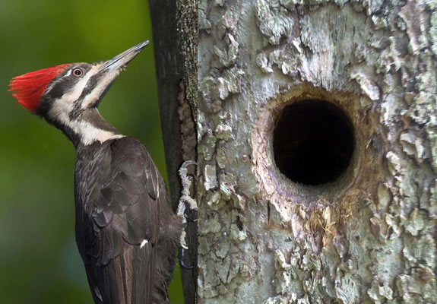
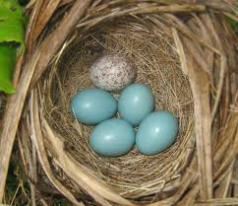
Types of symbiosis: cost-benefit analyses
Mutualism ➔ Commensalism ➔ Amensalism ➔ Parasitism
Commensalism (+,0):
  Association in which one party
  benefits (+) and the other is
  neither benefited nor is
  harmed (0)
Types:
  Inquilinism
  One organism using another for housing
  without causing harm
    ex. microbes living on human skin
    ex. “social parasites” living within the nest
    of another organism

Slide 59
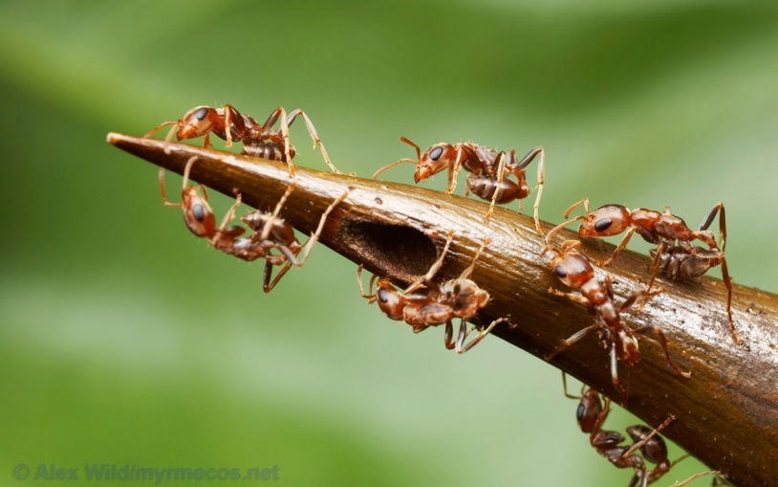
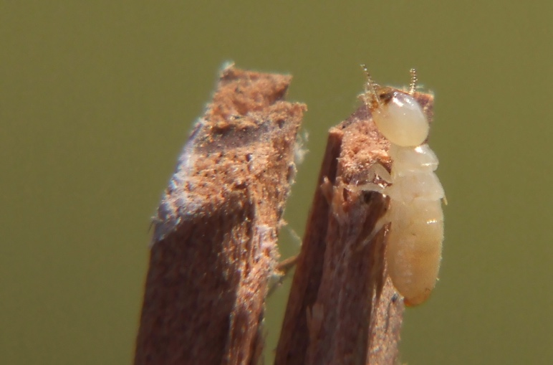
Types of symbiosis: cost-benefit analyses
Mutualism (+,+):
  Association in which both parties benefit
  Does not require any special concern for the well-being of the partner
Mutualism ➔ Commensalism ➔ Amensalism ➔ Parasitism

Slide 60
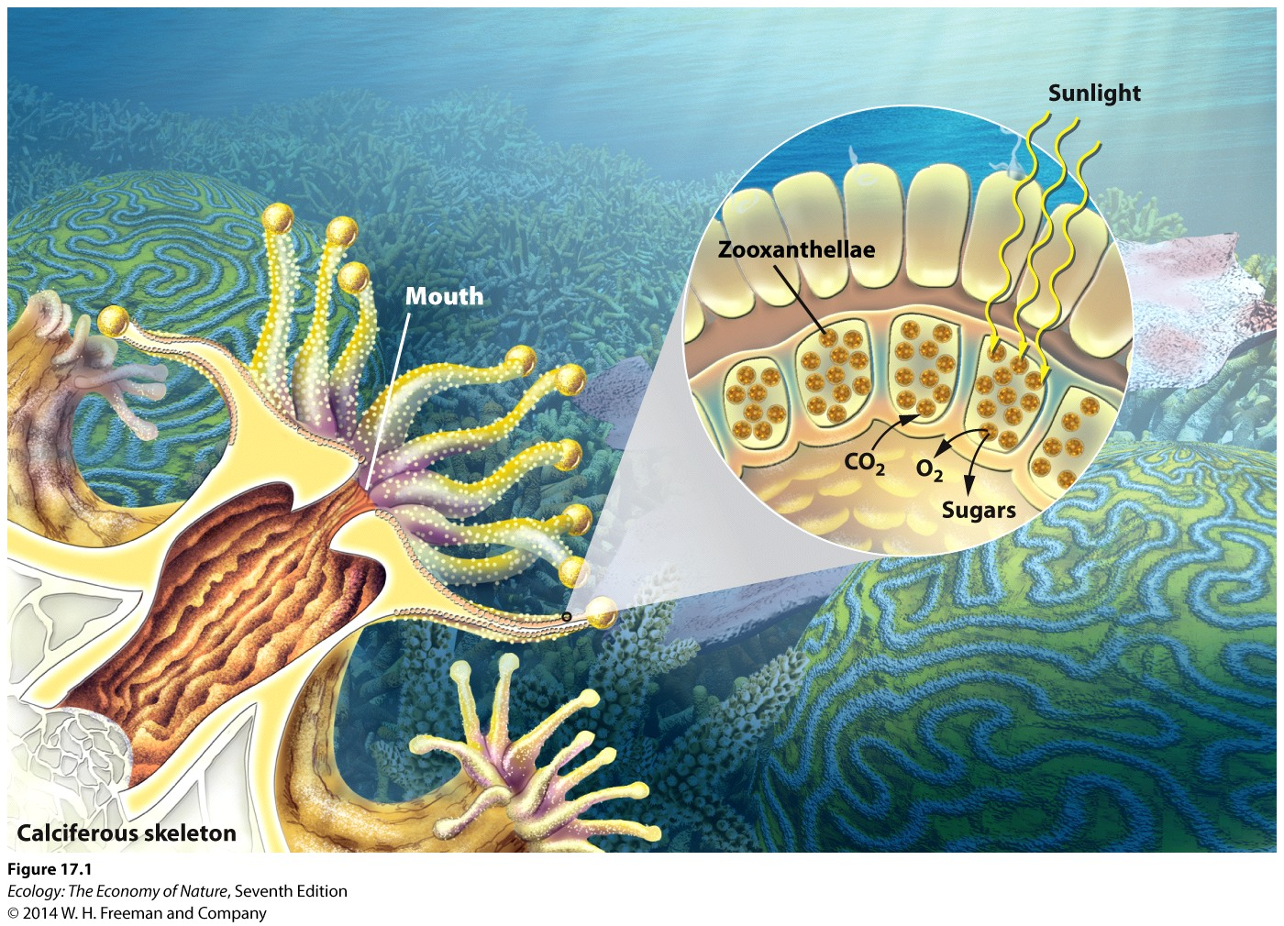
Coral – Algal Mutualism
Corals provide a home for photosynthetic algae called zooxanthellae.
The coral catches food with its tentacles and emits CO₂ that the algae use for photosynthesis.
The algae produces sugars and O₂ which are consumed by the coral.

Slide 61
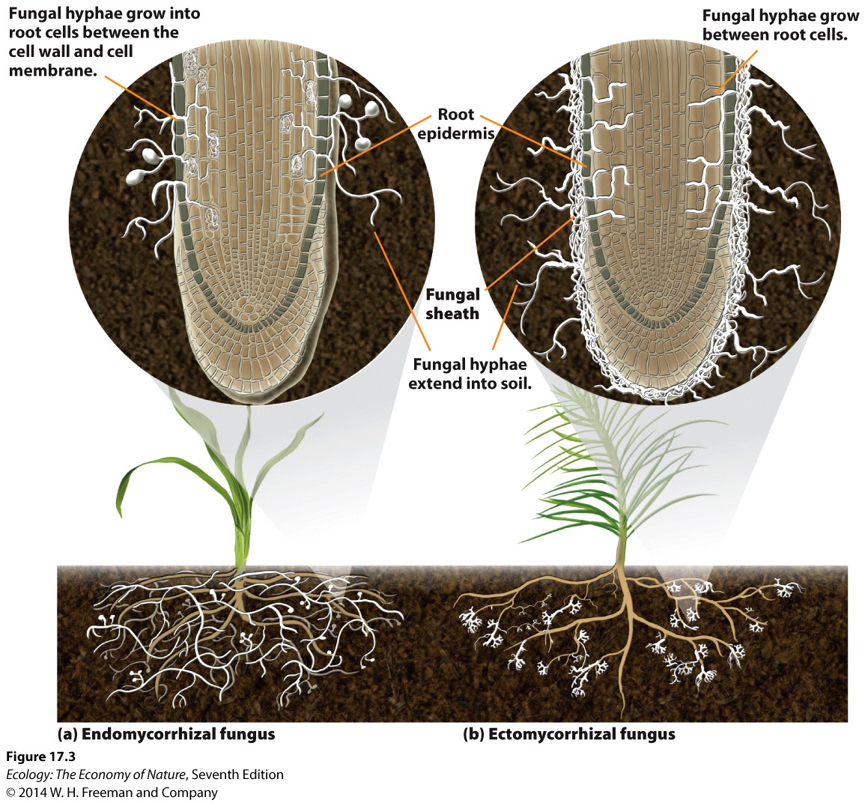
Mycorrhizal Fungi
Many plants rely on mutualisms with fungi and bacteria to help them obtain nutrients.
Fungal hyphae provide plants with soil minerals (e.g., nitrogen) and water; plants provide the fungi with sugars from photosynthesis.
Mycorrhizal fungi: fungi that surround plant roots and help plants obtain water and minerals.

Slide 62
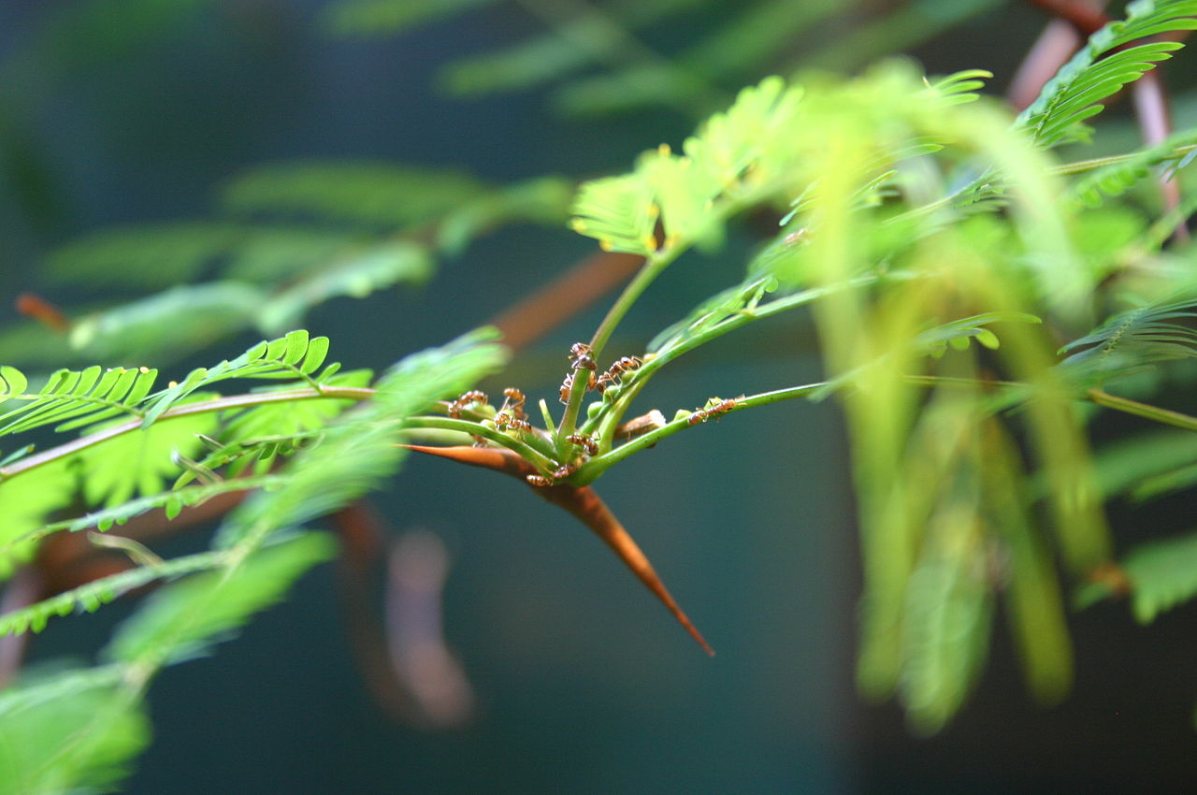
Acacia – Ant Mutualism

Slide 63
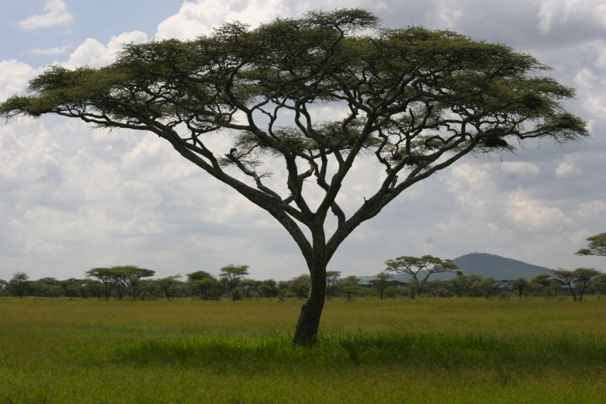
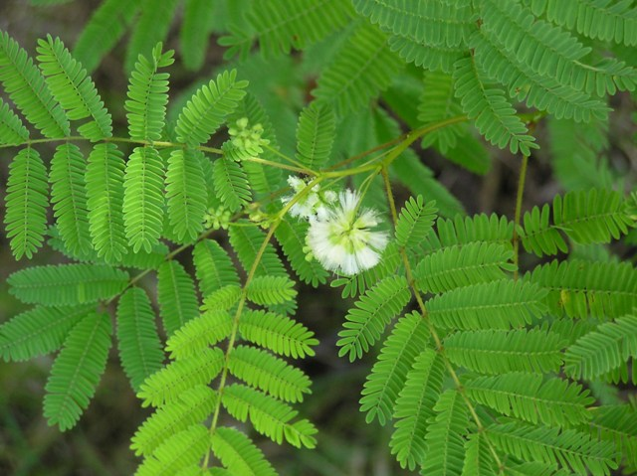
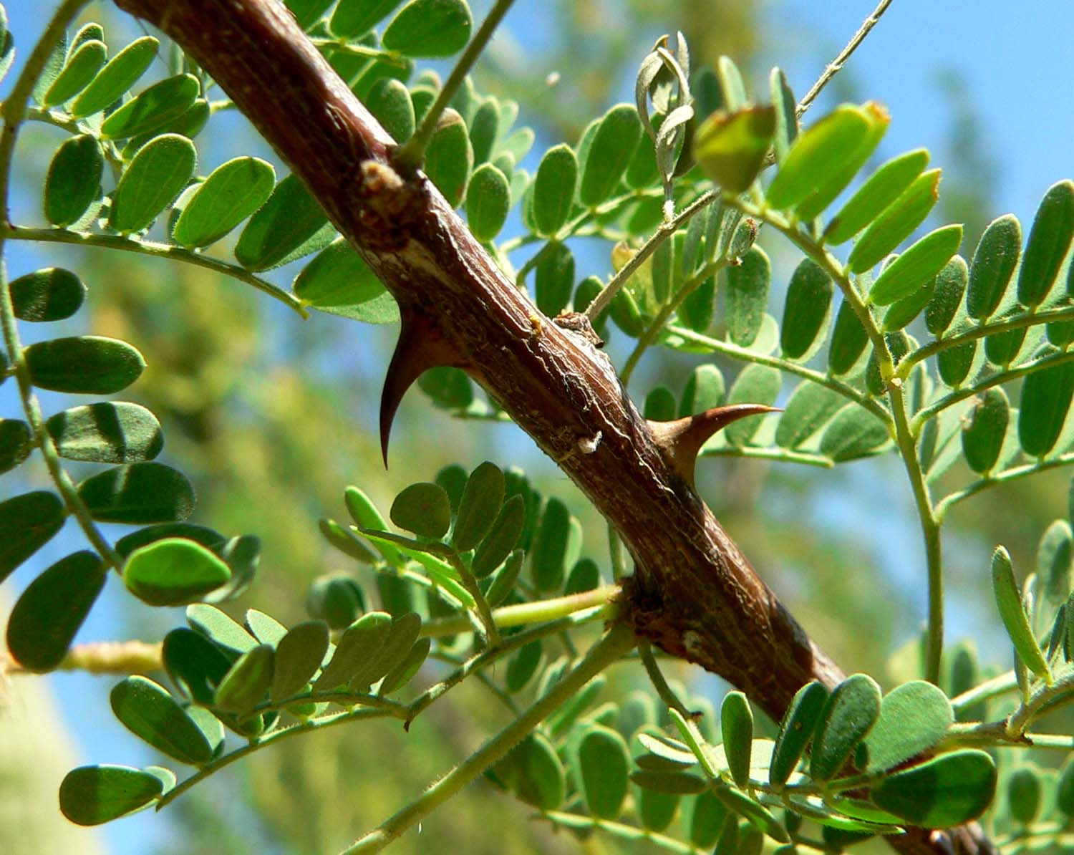
Acacia Tree Host
Genus of trees found from temperate – tropic regions
Prone to herbivory

Slide 64
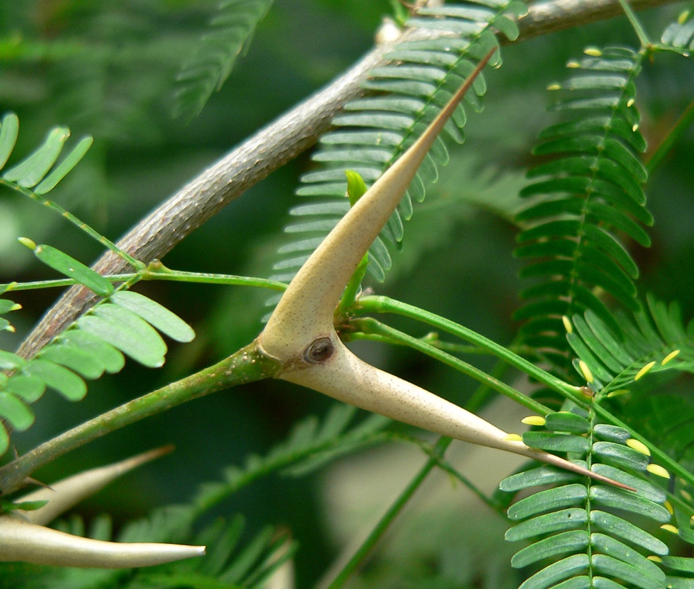
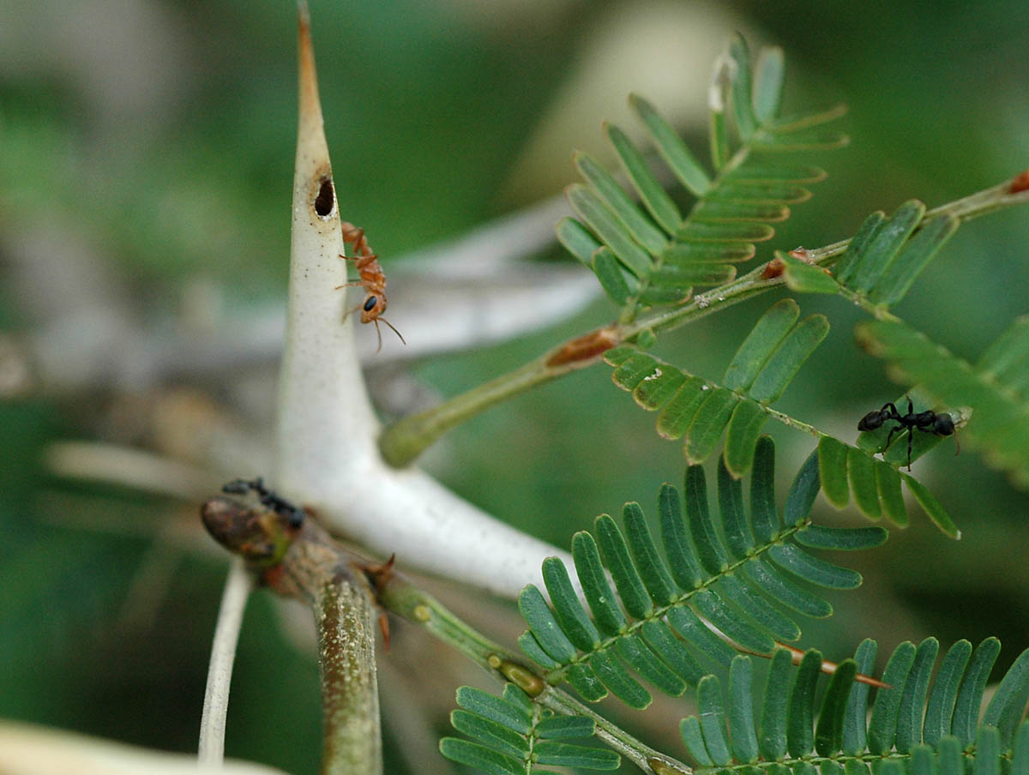
Acacia cornigera
Bullhorn Acacia
Native to Mexico & Central America
Deficient in anti-herbivory alkaloids
Symbiotic relationship with Pseudomyrmex ferruginea ant

Slide 65
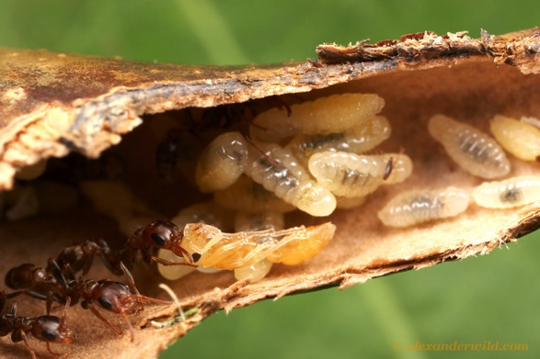
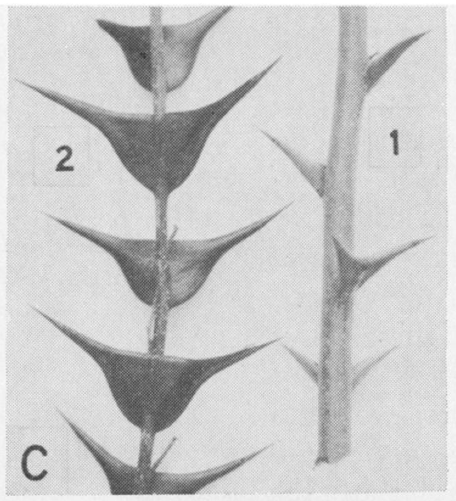
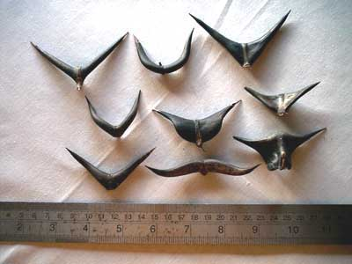
Dormatia
Hollow thorns to house ants and larvae
Larger in plants that associate with ants
Host plant can limit ant population by limiting number and size of thorns

Slide 66
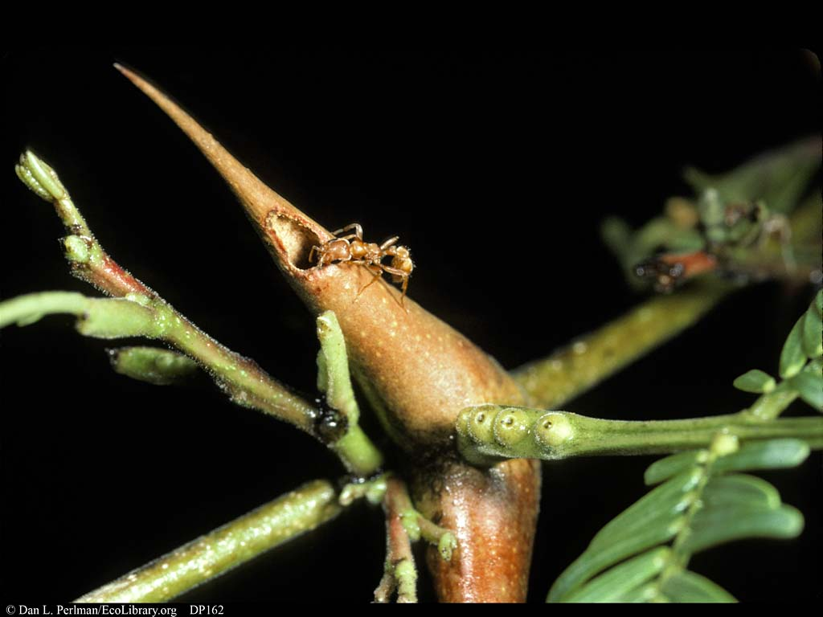
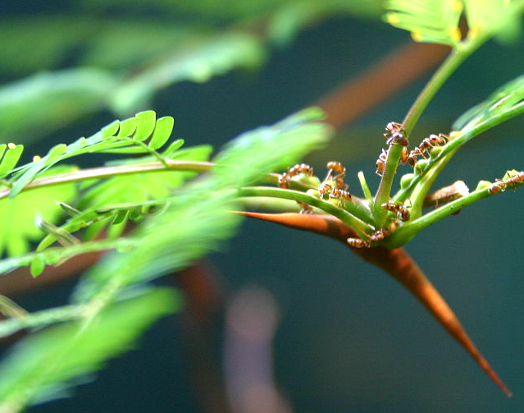
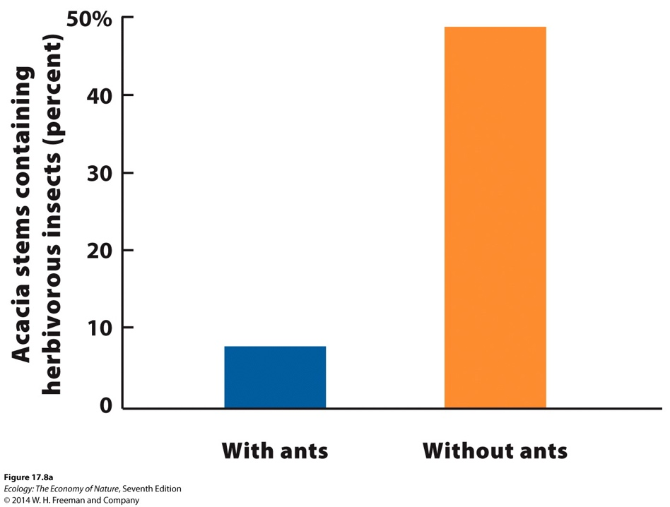
Ants as Defense
24 hours a day ¼ of ants actively protecting plant or gathering food
Ants release an alarm pheromone when plant is attacked and aggressively attack herbivores
Unfamiliar odor or moving the plant can cause the ants to swarm toward the potential threat
Herbivores can smell the pheromone and avoid the colonized trees

Slide 68
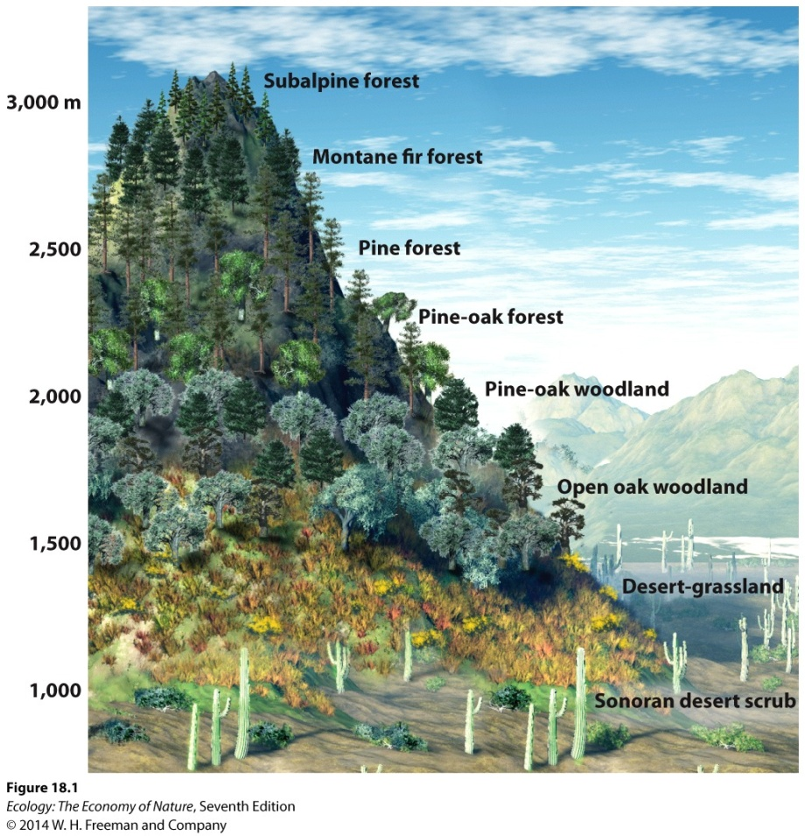
Communities and boundaries
A community is an assemblage of species living together in an area.
Species composition changes across a landscape; with changes in environmental conditions, some species are better able to survive.
The zone in which each species grows reflects different tolerance ranges for various environmental conditions, and the ability to compete with other species.

Slide 69

Communities and boundaries
Community zonation also occurs in aquatic communities.

Slide 70
Categorizing communities
Communities are often categorized by their dominant organisms or by physical conditions that affect the distribution of species.
Examples:
Beech-maple forest communities of Ontario are dominated by beech and maple; sagebrush communities of Wyoming are dominated by sagebrush.
Aquatic systems are often categorized by physical characteristics (e.g., stream or lake communities) or by dominant organisms (e.g., coral reef communities).

Slide 71

Climax Community
Climax community: the final seral stage in the process of succession; generally composed of organisms that dominate in a given biome.
Competitively superior species
Highly K selected
Persist over many years
Provide stability that can be maintained indefinitely
Can never be replaced except by disturbance
Succession in a community can
take weeks or months
(e.g., succession of decomposers
on a dead animal) or hundreds
of years (e.g., succession of a forest).

Slide 72
Disturbance - an Agent of Change
Discrete events that injure or kill some individuals and create opportunities for other individuals.
    Disrupts ecosystems, communities, population structure, changes resource or substrate availability, or changes the physical environment.

Slide 73

Disturbance - an Agent of Change
Discrete events that injure or kill some individuals and create opportunities for other individuals.

Slide 74

Disturbance - an Agent of Change
Discrete events that injure or kill some individuals and create opportunities for other individuals.

Slide 75

Disturbance - an Agent of Change
Discrete events that injure or kill some individuals and create opportunities for other individuals.

Slide 76
Succession
Succession the process by which the species composition of a community changes over time.
  Initiated by a disturbance

Slide 77



Primary succession
Primary succession: the development of communities in habitats that are initially devoid of plants and organic soil, such as such dunes, lava flows, and bare rock.
Such habitats are colonized by species that require no soil (e.g., mosses) and can live on rock surfaces (e.g., drought-tolerant grasses).
Early colonizers produce organic matter that helps in the creation of soil that generates more hospitable conditions for other species.

Slide 78


Secondary succession
Secondary succession: the development of communities in disturbed habitats that contain no plants but still contain organic soil (e.g., plowed fields, forests uprooted by a hurricane).

Slide 79

Example of Secondary succession
Example:
Henry Oosting observed secondary succession in a chronosequence of abandoned agricultural fields in Duke Forest.

Slide 80

Succession
Succession the process by which the species composition of a community changes over time.
  Initiated by a disturbance

Slide 81

Succession in Glacial Bays

Slide 82

Primary Succession in Glacial Bays

Slide 83

Primary Succession in Glacial Bays
Glacier
Bay
Alaska
0
5
10
15
Kilometers

Slide 84

Primary Succession in Glacial Bays
1941
1
Pioneer stage
Glacier
Bay
Alaska
0
5
10
15
Kilometers

Slide 85

Primary Succession in Glacial Bays
1941
1907
1
Pioneer stage
2
Dryas stage
Glacier
Bay
Alaska
0
5
10
15
Kilometers

Slide 86

Primary Succession in Glacial Bays
1941
1907
1
Pioneer stage
1860
2
Dryas stage
Glacier
Bay
Alaska
0
5
10
15
Kilometers
3
Alder stage

Slide 87

Primary Succession in Glacial Bays
1941
1907
1
Pioneer stage
1860
2
Dryas stage
Glacier
Bay
Alaska
1760
0
5
10
15
Kilometers
4
Spruce stage
3
Alder stage

