Slide 1
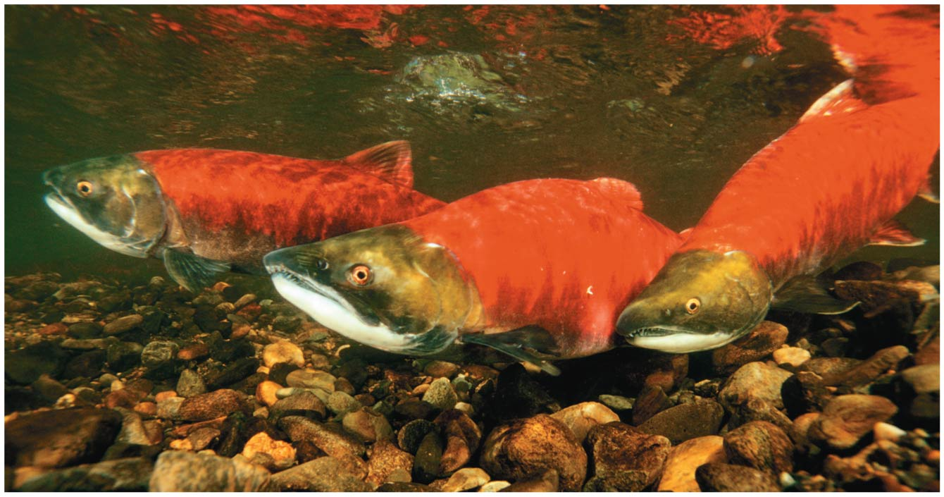
BIO10
Dr. Bradley
Animal
Physiology

Slide 2
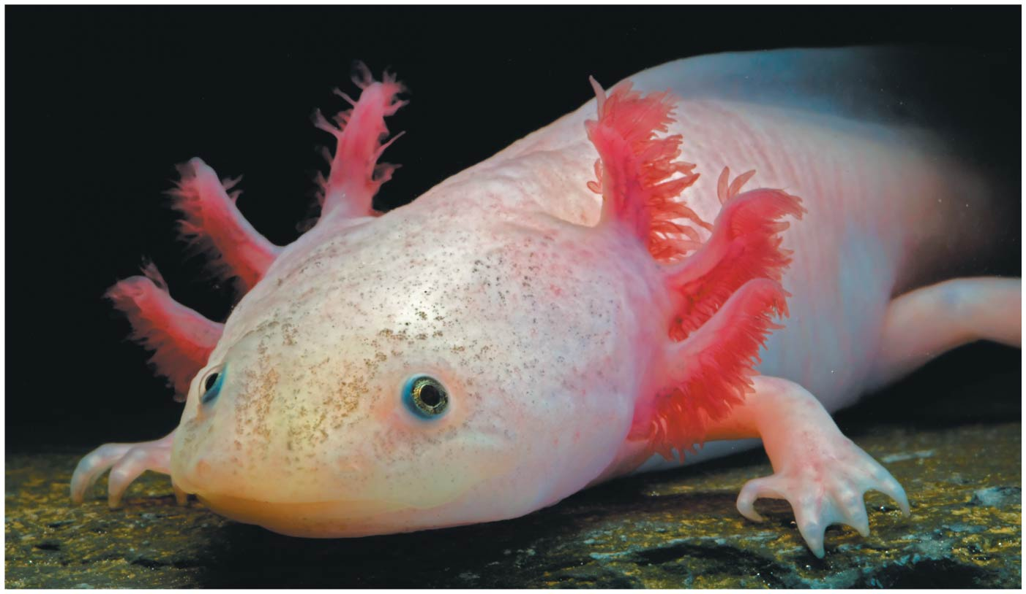
Trading Places
Every organism must exchange substances with its environment
Exchanges ultimately occur at the cellular level by crossing the plasma membrane
In unicellular organisms, these exchanges occur directly with the environment

Slide 3
Trading Places
For most cells of multicellular organisms, direct exchange with the environment is not possible
Gills are an example of a specialized exchange system in animals
    O₂ diffuses from the water into blood vessels
    CO₂ diffuses from blood into the water
Internal transport and gas exchange are functionally related in most animals

Slide 4
Circulatory systems link exchange surfaces with cells throughout the body
Small molecules can move between cells and
their surroundings by diffusion
Diffusion is only efficient over small distances because the time it takes to diffuse is proportional to the square of the distance
In some animals, many or all cells are in direct contact with the environment
In most animals, cells exchange materials with the environment via a fluid-filled circulatory system

Slide 5
Gastrovascular Cavities
Some animals lack a circulatory system
Some cnidarians have elaborate gastrovascular cavities that function in both digestion and distribution of substances throughout the body
The body wall that encloses the gastrovascular cavity is only two cells thick
Flatworms have a gastrovascular cavity and a flat body that minimizes diffusion distances

Slide 6
Open and Closed Circulatory Systems
A circulatory system has
  A circulatory fluid
  A set of interconnecting vessels
  A muscular pump, the heart
The circulatory system connects the fluid that surrounds cells with the organs that exchange gases, absorb nutrients, and dispose of wastes
Circulatory systems can be open or closed

Slide 7
In insects, other arthropods, and some molluscs, circulatory fluid called hemolymph bathes the organs directly in an open circulatory system
In a closed circulatory system, blood is confined to vessels and is distinct from the interstitial fluid
Annelids, cephalopods, and vertebrates have
closed circulatory systems

Slide 8
Organization of Vertebrate Circulatory Systems
Humans and other vertebrates have a closed circulatory system called the cardiovascular system
The three main types of blood vessels are arteries, veins, and capillaries
Blood flow is one way in these vessels

Slide 9
Arteries branch into arterioles and carry blood away from the heart to capillaries
Networks of capillaries called capillary beds are the sites of chemical exchange between the blood and interstitial fluid
Venules converge into veins and return blood from capillaries to the heart

Slide 10
Arteries and veins are distinguished by the direction of blood flow, not by O₂ content
Vertebrate hearts contain two or more chambers
Blood enters through an atria and is pumped out through ventricles

Slide 11
Single Circulation
Bony fishes, rays, and sharks have single circulation with a two-chambered heart
In single circulation, blood leaving the heart passes through two capillary beds before returning

Slide 12
Double Circulation in Amphibians
Amphibians, reptiles, and mammals have double circulation
Oxygen-poor and oxygen-rich blood are pumped separately from the right and left sides of the heart
In amphibians, oxygen-poor blood flows through a pulmocutaneous circuit to pick up oxygen through the lungs and skin

Slide 13
Double Circulation in Reptiles & Mammals
In reptiles and mammals, oxygen-poor blood flows through the pulmonary circuit to pick up oxygen through the lungs
Oxygen-rich blood delivers oxygen through the systemic circuit
Double circulation maintains higher blood pressure in the organs than does single circulation

Slide 14
Mammalian Circulation
Contraction of the right ventricle pumps blood to the lungs via the pulmonary arteries
The blood flows through capillary beds in the left and right lungs and loads O₂ and unloads CO₂
Oxygen-rich blood returns from the lungs via the pulmonary veins to the left atrium of the heart

Slide 15
Mammalian Circulation
Oxygen-rich blood flows into the left ventricle and is pumped out to body tissues via the systemic circuit
Blood leaves the left ventricle via the aorta, which conveys blood to arteries leading throughout the body

Slide 16
Mammalian Circulation
Further branches lead to capillary beds in the abdominal organs and hind limbs
O₂ diffuses from blood to tissues, and CO₂ diffuses from tissues to blood
Capillaries rejoin, forming venules, conveying blood to veins
Oxygen-poor blood from the body is channeled into right atrium

Slide 17
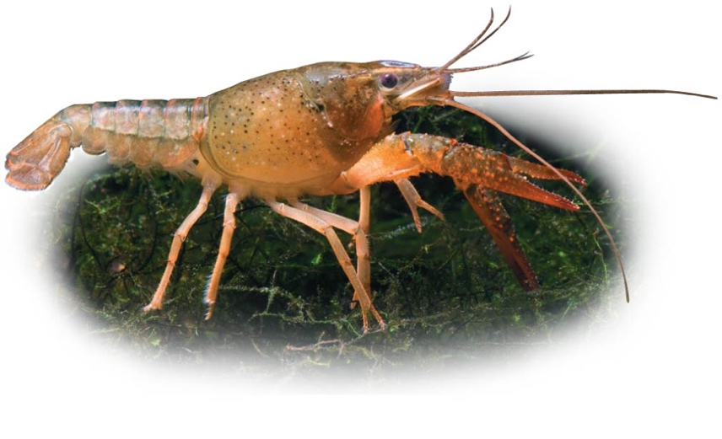
Respiratory Media & Surfaces
Breathing air is relatively easy and need not be very efficient
In a given volume, there is less O₂ available in water than in air
Obtaining O₂ from water requires greater efficiency than air breathing
Gas exchange across respiratory surfaces takes place by diffusion
Respiratory surfaces vary by animal and can include the skin, gills, tracheae, and lungs

Slide 18
Gills in Aquatic Animals
Gills are outfoldings of the body that create a large surface area for gas exchange
Ventilation moves the respiratory medium over the respiratory surface
Aquatic animals move through water or move water over their gills for ventilation

Slide 19
Fish gills use a countercurrent exchange system, where blood flows in the opposite direction to water passing over the gills
Blood is always less saturated with O₂ than the water it meets
In fish gills, more than 80% of the O₂ dissolved in the water is removed as water passes over the respiratory surface

Slide 20
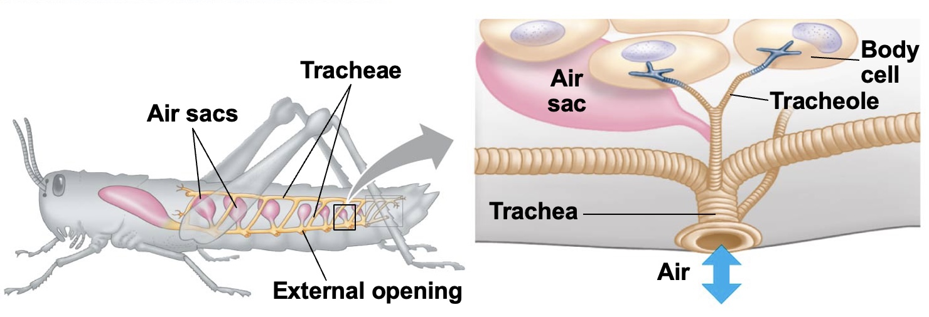
Tracheal Systems in Insects
The tracheal system of insects consists of a network of branching tubes throughout the body
The tracheal tubes supply O₂ directly to body cells
The respiratory and circulatory systems are separate
Larger insects must ventilate their tracheal system to meet O₂ demands

Slide 21
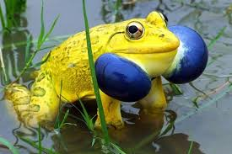
Lungs
Lungs are an infolding of the body surface
The circulatory system (open or closed) transports gases between the lungs and the rest of the body
The size and complexity of lungs correlate with an animal’s metabolic rate

Slide 22
Mammalian Respiratory Systems: A Closer Look
A system of branching ducts conveys air to
the lungs
Air inhaled through the nostrils is filtered, warmed, humidified, and sampled for odors
The pharynx directs air to the lungs and food to
the stomach

Slide 23
Mammalian Respiratory Systems: A Closer Look
Air passes through the pharynx, larynx, trachea, bronchi, and bronchioles to the alveoli, where gas exchange occurs
Cilia and mucus line the epithelium of the air ducts and move particles up to the pharynx
This “mucus escalator” cleans the respiratory system and allows particles to be swallowed into the esophagus

Slide 24
Mammalian Respiratory Systems: A Closer Look
Gas exchange takes place in alveoli, air sacs at the tips of bronchioles
Oxygen diffuses through the moist film of the epithelium and into capillaries
Carbon dioxide diffuses from the capillaries across the epithelium and into the air space

Slide 25
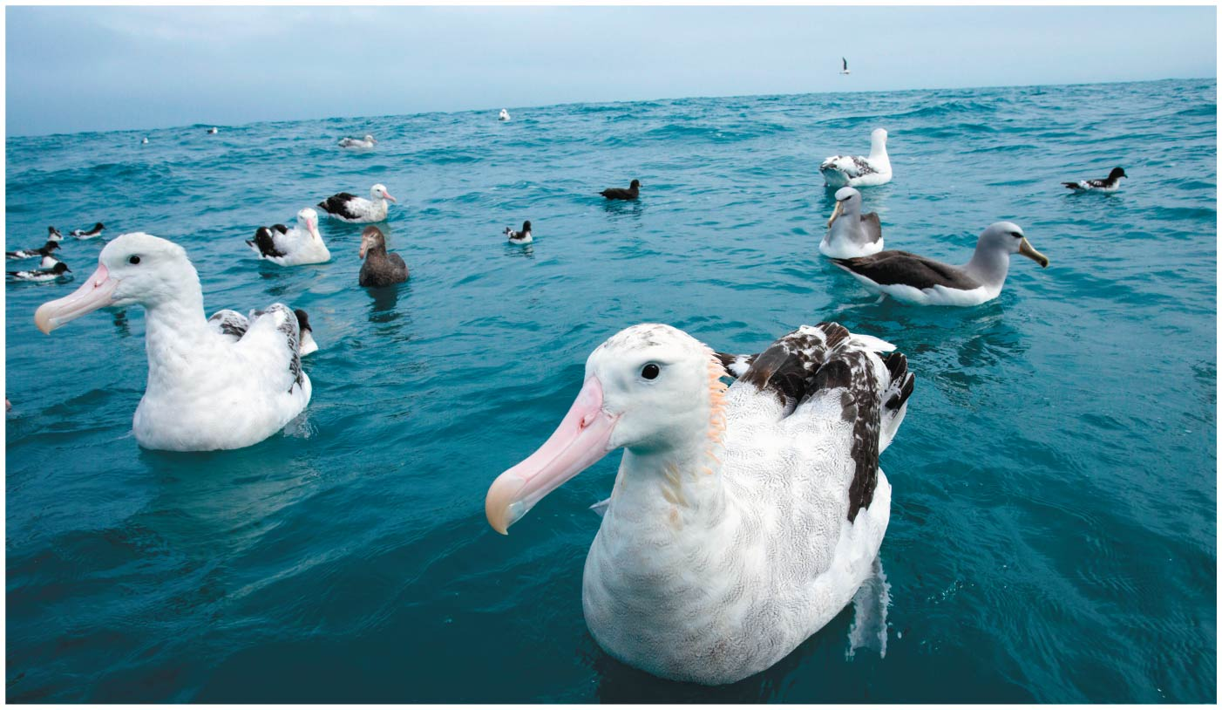
Physiological systems of animals operate in a fluid environment
Relative concentrations of water and solutes must be maintained within fairly narrow limits
Osmoregulation controls solute concentrations and balances water gain and loss

Slide 26
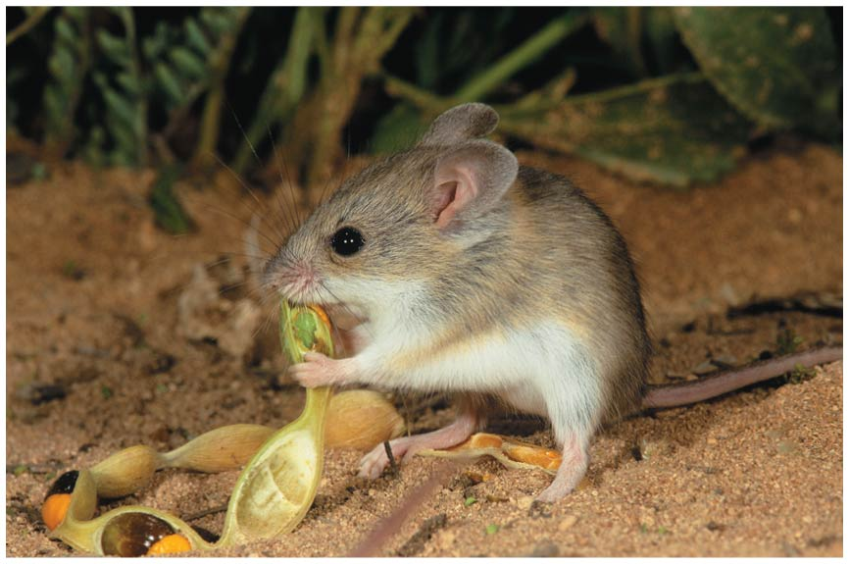
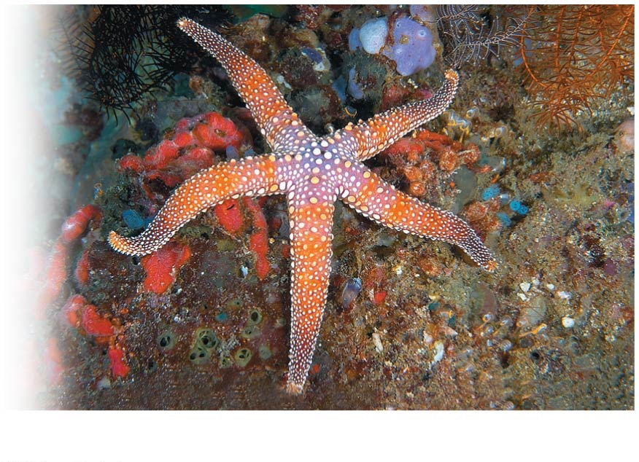
Desert and marine animals face desiccating environments that can quickly deplete body water
Freshwater animals survive by conserving solutes and absorbing salts from their surroundings
Excretion rids the body of nitrogenous metabolites and other waste products

Slide 27
Osmoregulation balances the uptake and loss of water and solutes
Osmoregulation is based largely on balancing the uptake and loss of water and solutes
The driving force for movement of water and solutes is a concentration gradient of one or more solutes across the plasma membrane

Slide 28
Osmosis and Osmolarity
Water enters and leaves cells by osmosis
Osmolarity, the solute concentration of a solution, determines the movement of water across a selectively permeable membrane
If two solutions are isoosmotic, water molecules will cross the membrane at equal rates in both directions

Slide 29
If two solutions differ in osmolarity, the net flow of water is from the hypoosmotic (less concentrated) to the hyperosmotic (more concentrated) solution

Slide 30
Osmoregulatory Challenges and Mechanisms
Animals can maintain water balance in one of two ways
Osmoconformers are isoosmotic with their surroundings and do not regulate their osmolarity
Osmoregulators expend energy to control water uptake and loss in a hyperosmotic or hypoosmotic environment

Slide 31
Marine Animals
Most marine invertebrates are osmoconformers
Many marine vertebrates and some marine invertebrates are osmoregulators
Marine bony fishes are hypoosmotic to seawater
They balance water loss by drinking large amounts of seawater and eliminating the ingested salts through their gills and kidneys

Slide 32
Freshwater Animals
Freshwater animals constantly take in water by osmosis from their hypoosmotic environment
They lose salts by diffusion and maintain water balance by drinking almost no water and excreting large amounts of dilute urine
Salts lost by diffusion are replaced in foods and by uptake across the gills

Slide 33
Land Animals
Adaptations to reduce water loss are key to survival on land
Body coverings of most terrestrial animals help prevent dehydration
Desert animals get major water savings from simple anatomical features and behaviors such as a nocturnal lifestyle
Land animals maintain water balance by eating moist food and producing water metabolically through cellular respiration

Slide 34
An animal’s nitrogenous wastes reflect its phylogeny and habitat
Among the most significant wastes are nitrogenous breakdown products of proteins and nucleic acids
Some animals convert toxic ammonia (NH₃) to less toxic compounds prior to excretion
Animals excrete nitrogenous wastes in different forms: ammonia, urea, or uric acid
These differ in toxicity and the energy costs of producing them

Slide 35
Ammonia
Animals that excrete nitrogenous wastes as ammonia need access to lots of water
In many invertebrates, ammonia release occurs across the whole body surface

Slide 36
Urea
Most terrestrial mammals and many marine species excrete urea, which is less toxic than ammonia
In vertebrates, urea is produced in the liver
The circulatory system carries urea to the kidneys, where it is excreted
Conversion of ammonia to urea is energetically expensive; excretion of urea requires less water than ammonia

Slide 37
Uric Acid
Insects, land snails, and many reptiles, including birds, mainly excrete uric acid
Uric acid is relatively nontoxic and does not dissolve readily in water
It can be secreted as a paste with little water loss
Uric acid is more energetically expensive to produce than urea

Slide 38
Diverse excretory systems are variations on a tubular theme
Excretory systems regulate solute movement between internal fluids and the external environment
These systems are central to homeostasis
Systems that perform basic excretory functions vary widely among animal groups
They usually involve a complex network of tubules

Slide 39
Excretory Processes
Most excretory systems produce urine by refining a filtrate derived from body fluids
Key functions of most excretory systems
  Filtration: Filtering of body fluids
  Reabsorption: Reclaiming valuable solutes
  Secretion: Adding nonessential solutes and wastes to the filtrate
  Excretion: Processed filtrate containing nitrogenous wastes is released from the body

Slide 40
Kidneys
Kidneys, the excretory organs of vertebrates, function in both excretion and osmoregulation
The numerous tubules of kidneys are highly organized
The vertebrate excretory system also includes ducts and other structures that carry urine from the tubules out of the kidney and out of the body

Slide 41
Kidneys

Slide 42
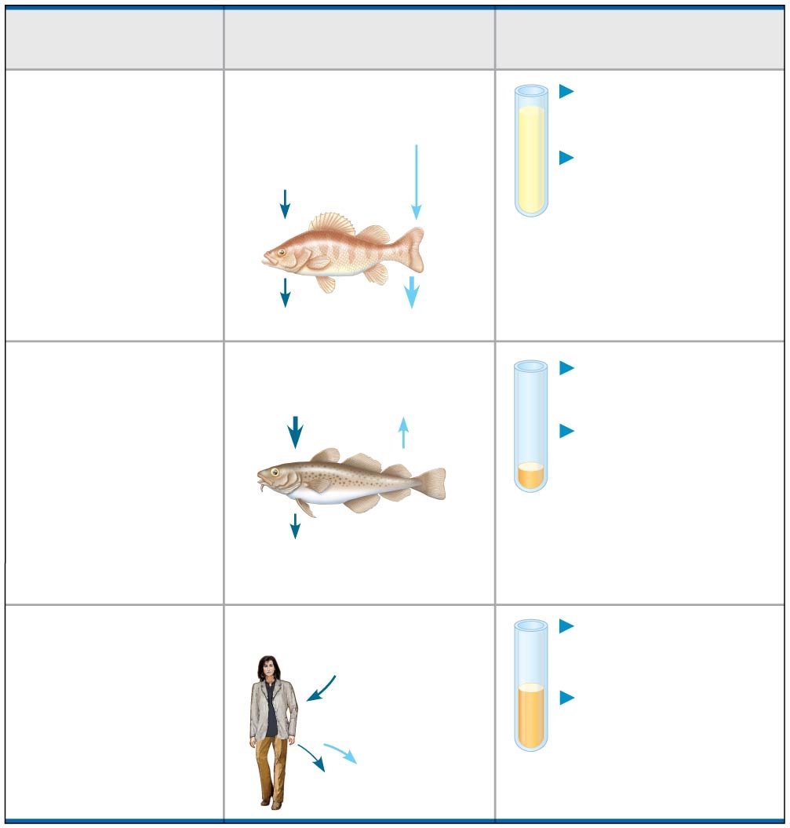
Animal
Inflow/Outflow
Urine
Freshwater
fish. Lives in
water less
concentrated
than body
fluids; fish
tends to gain
water, lose salt
Does not drink water
Large volume
of urine
Salt in
(active trans-
port by gills)
H₂O in
Urine is less
concentrated
than body
fluids
Salt out
H₂O out
Marine bony
fish. Lives in
water more
concentrated
than body
fluids; fish
tends to lose
water, gain salt
Drinks water
Small volume
of urine
Salt in
H₂O out
Urine is
slightly less
concentrated
than body
fluids
Salt out (active
transport by gills)
Terrestrial
vertebrate.
Terrestrial
environment;
tends to lose
body water
to air
Drinks water
Moderate
volume of urine
Salt in
(by mouth)
Urine is more
concentrated
than body
fluids
H₂O and salt out
Notes:
Figure 44.UN02 Summary of key concepts: osmoregulation

Slide 43
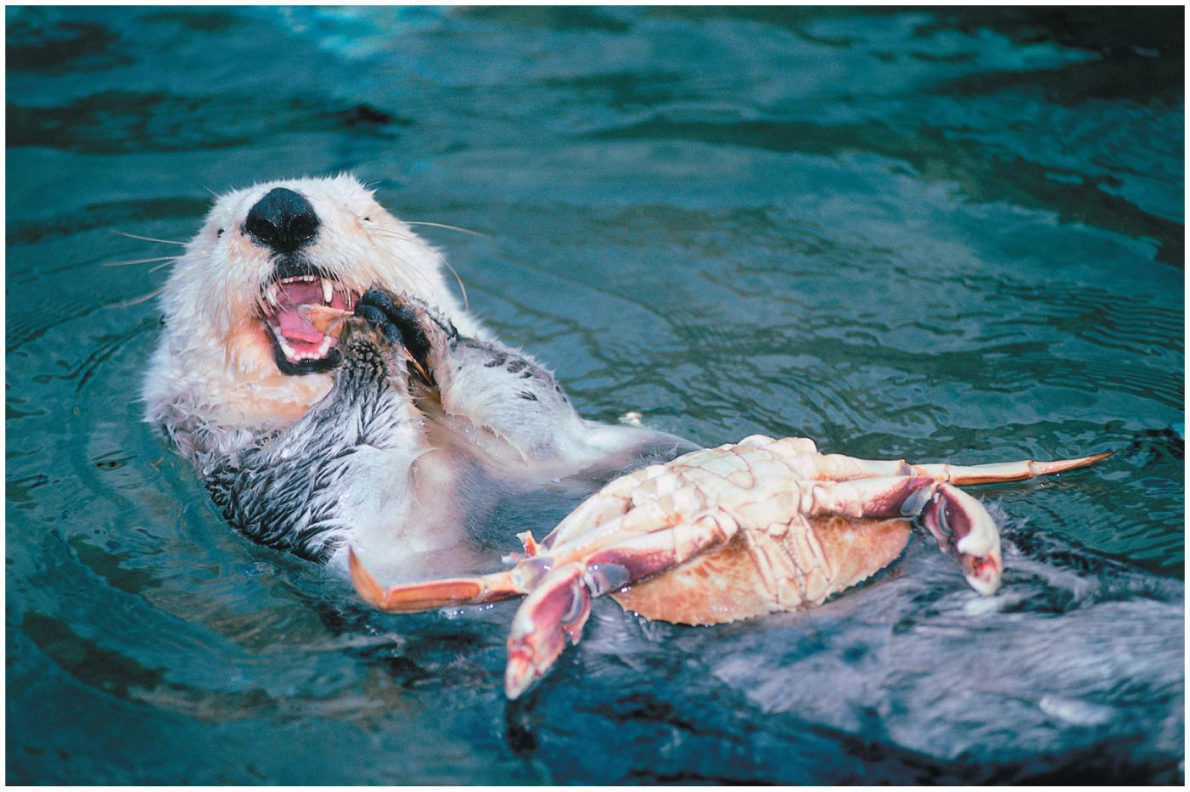
The Need to Feed
Food is taken in, taken apart, and taken up in the process of animal nutrition
In general, animals fall into three categories:
  Herbivores eat mainly plants or algae
  Carnivores eat other animals
  Omnivores regularly consume animals as well as plants or algae
Most animals are also opportunistic feeders

Slide 44
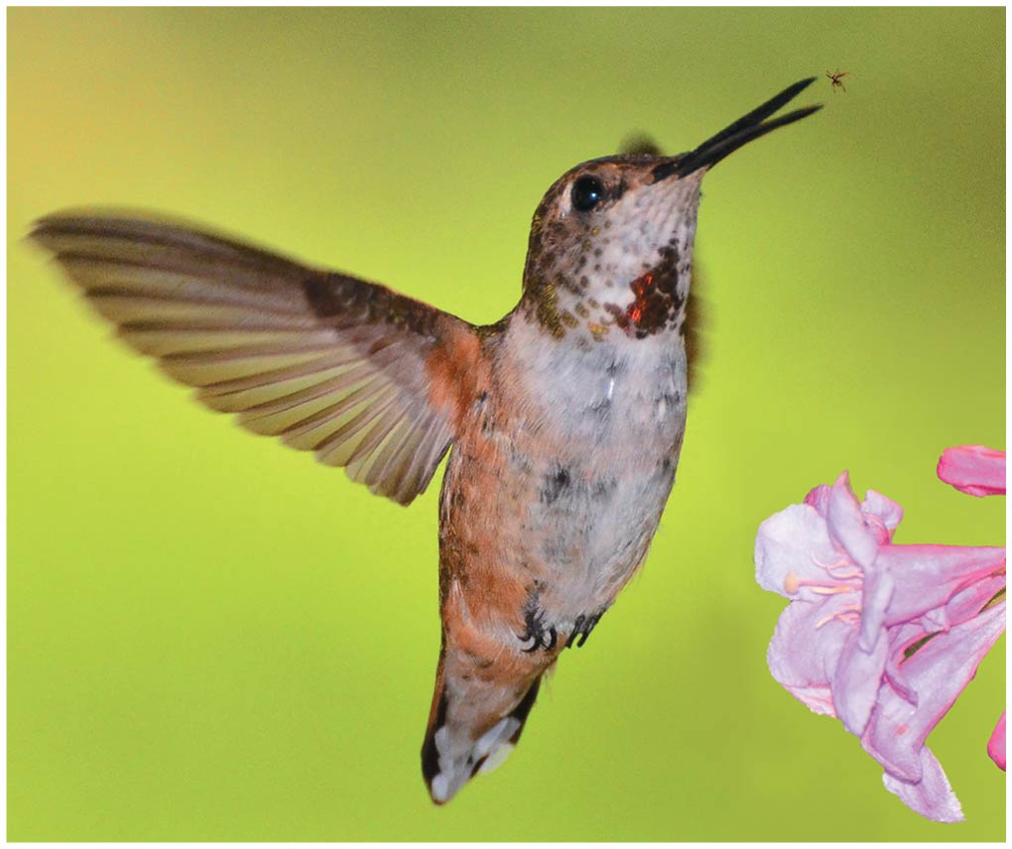
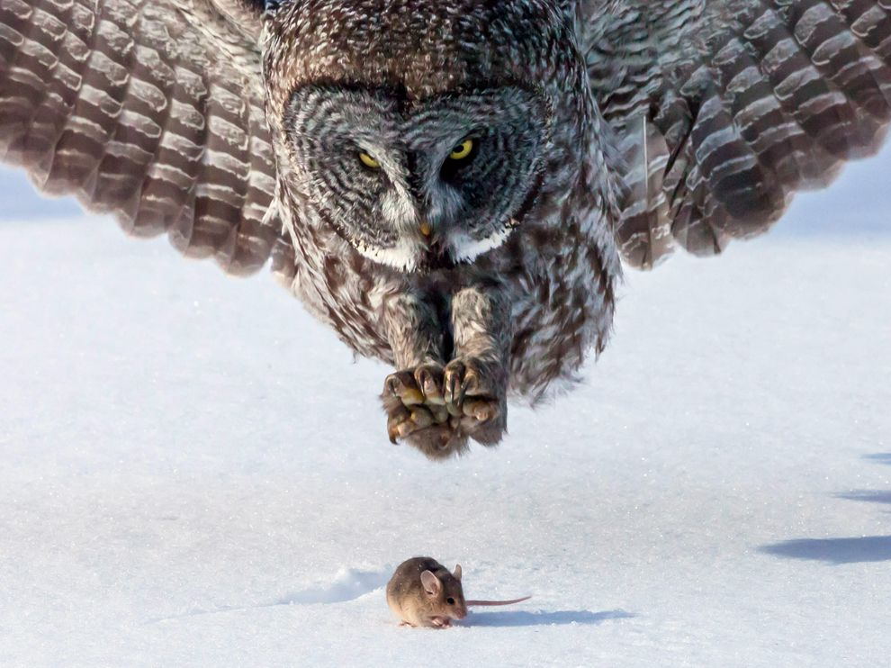
Food processing involves ingestion, digestion, absorption, and elimination
Ingestion is the act of eating or feeding
Feeding mechanisms differ widely among animal species

Slide 45
Filter Feeders
Many aquatic animals are filter feeders, which sift small food particles from the water

Slide 46
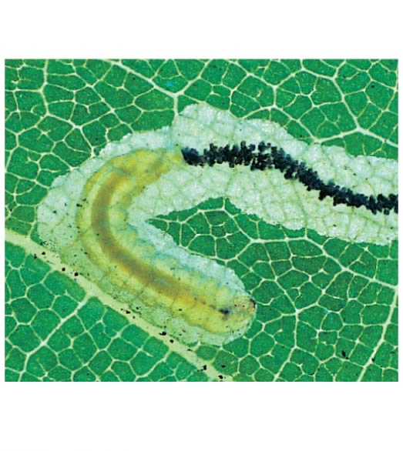
Substrate Feeders
Substrate feeders are animals that live in or on their food source
Substrate feeding
Caterpillar
Feces

Slide 47
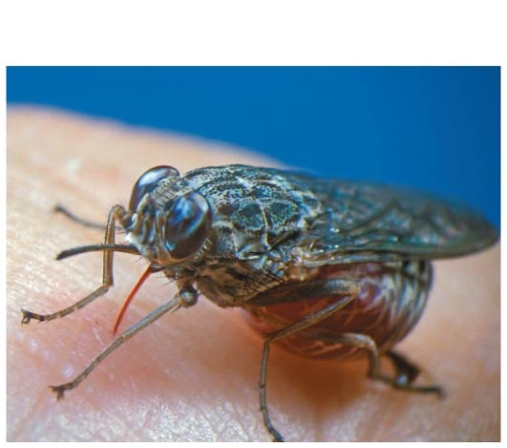
Fluid Feeders
Fluid feeders suck nutrient-rich fluid from a living host
Fluid feeding

Slide 48
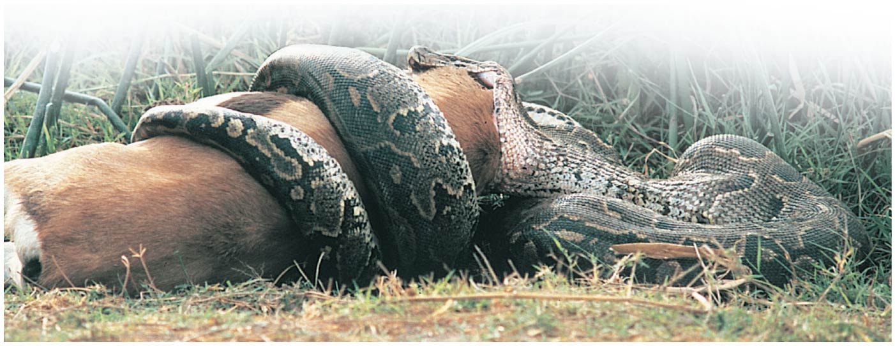
Bulk Feeders
Bulk feeders eat relatively large pieces of food
Bulk feeding

Slide 49
Digestion is the process of breaking food down into molecules small enough to absorb
Mechanical digestion, chewing or grinding, increases the surface area of food
Chemical digestion splits food into small molecules that can pass through membranes; these are used to build larger molecules
In chemical digestion, the process of enzymatic hydrolysis splits bonds in molecules with the addition of water

Slide 50
Absorption is uptake of small molecules by body cells
Elimination is the passage of undigested material out of the digestive system

Slide 51
Digestive Compartments
Most animals process food in specialized compartments
These compartments reduce the risk of an animal digesting its own cells and tissues

Slide 52
Intracellular Digestion
In intracellular digestion, food particles are engulfed by phagocytosis
Food vacuoles, containing food, fuse with lysosomes containing hydrolytic enzymes
A few animals, such as sponges, digest their food entirely by this mechanism

Slide 53
Extracellular Digestion
Extracellular digestion is the breakdown of food particles outside of cells
It occurs in compartments that are continuous with the outside of the animal’s body
Animals with simple body plans have a gastrovascular cavity that functions in both digestion and distribution of nutrients

Slide 54
More complex animals have a digestive tube with two openings, a mouth and an anus
This digestive tube is called a complete digestive tract, or an alimentary canal
It can have specialized regions that carry out digestion and absorption in a stepwise fashion

Slide 55
The Oral Cavity, Pharynx, and Esophagus
Food processing begins in the oral cavity
Salivary glands deliver saliva to lubricate food
Saliva contains mucus, a viscous mixture of water, salts, cells, and glycoproteins

Slide 56
The Oral Cavity, Pharynx, and Esophagus
The tongue movements shape food into a bolus and help with swallowing
The throat, or pharynx, is the junction that opens to both the esophagus and the trachea
The esophagus connects to the stomach
The trachea (windpipe) leads to the lungs

Slide 57
The Oral Cavity, Pharynx, and Esophagus
Swallowing causes the epiglottis to block entry to the trachea, and the bolus is guided by the larynx, the upper part of the respiratory tract
Coughing occurs when the swallowing reflex fails and food or liquids reach the windpipe

Slide 58
The Oral Cavity, Pharynx, and Esophagus
Within the esophagus, food is pushed along from the pharynx to the stomach by peristalsis, rhythmic contractions of muscles in the wall of the canal
Valves called sphincters regulate the movement of material between compartments

Slide 59
Digestion in the Stomach
The stomach stores food and processes it into a liquid suspension
The stomach secretes gastric juice
The mixture of ingested food and gastric juice is called chyme
Gastric juice has a low pH of about 2, which kills bacteria and denatures proteins
Mucus protects the stomach lining from gastric juice
Cell division adds a new epithelial layer every three days

Slide 60
Digestion in the Small Intestine
The small intestine is the longest compartment of the alimentary canal
Most digestion/absorption of food occurs here

Slide 61
Digestion in the Small Intestine
The small intestine has a huge surface area due to villi and microvilli that are exposed to the intestinal lumen
The enormous microvillar surface greatly increases the rate of nutrient absorption
Transport across the epithelial cells can be passive or active, depending on the nutrient

Slide 62
Processing in the Large Intestine
The alimentary canal ends with the large intestine
It includes the colon, caecum, and rectum
The colon leads to the rectum and anus
The cecum aids in the fermentation of plant material and connects where the small and large intestines meet
The human cecum has an extension called the appendix, which plays a minor role in immunity

Slide 63
The Colon & Rectum
The colon completes the recovery of water that began in the small intestine
Feces, the wastes of the digestive system, become more solid as they move through the colon
Feces are stored in the rectum until they can be eliminated through the anus
Two sphincters between the rectum and anus control bowel movements

Slide 64
Evolutionary adaptations of vertebrate digestive systems correlate with diet
Digestive systems of vertebrates are variations on a theme
However, there are adaptations associated with the animal’s diet

Slide 65
Dental Adaptations
Dentition, an animal’s assortment of teeth, is one example of structural variation reflecting diet
The success of mammals is due in part to their dentition, which is specialized for different diets
Nonmammalian vertebrates generally have less specialized teeth

Slide 66
Stomach and Intestinal Adaptations
Many carnivores have large, expandable stomachs
Herbivores and omnivores generally have longer alimentary canals than carnivores, reflecting the longer time needed to digest vegetation

Slide 67
Before next class
  Finish reading all of Ch15
  Finish reading Sections 16.1, 16.2, & 16.3
  Start reading all of Ch17

