Slide 1
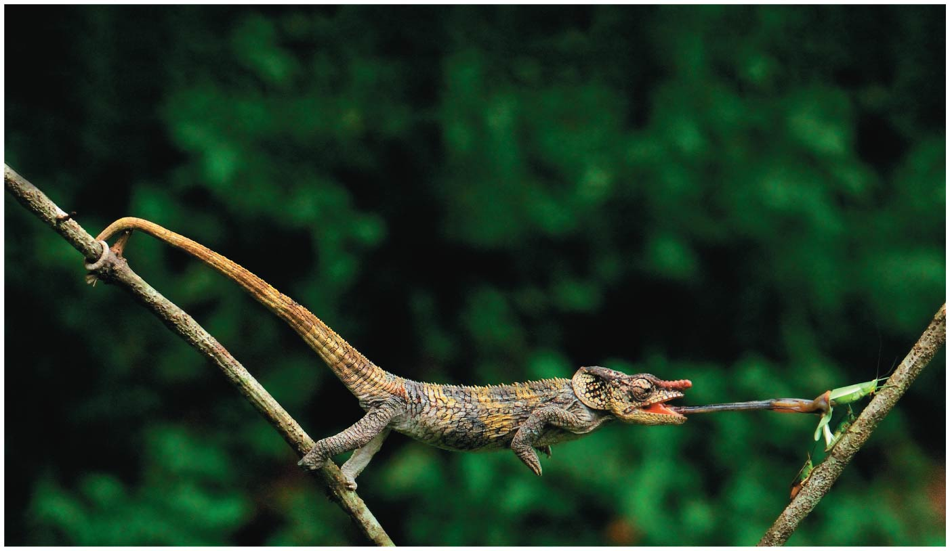
BIO10
Dr. Bradley
Animals

Slide 2
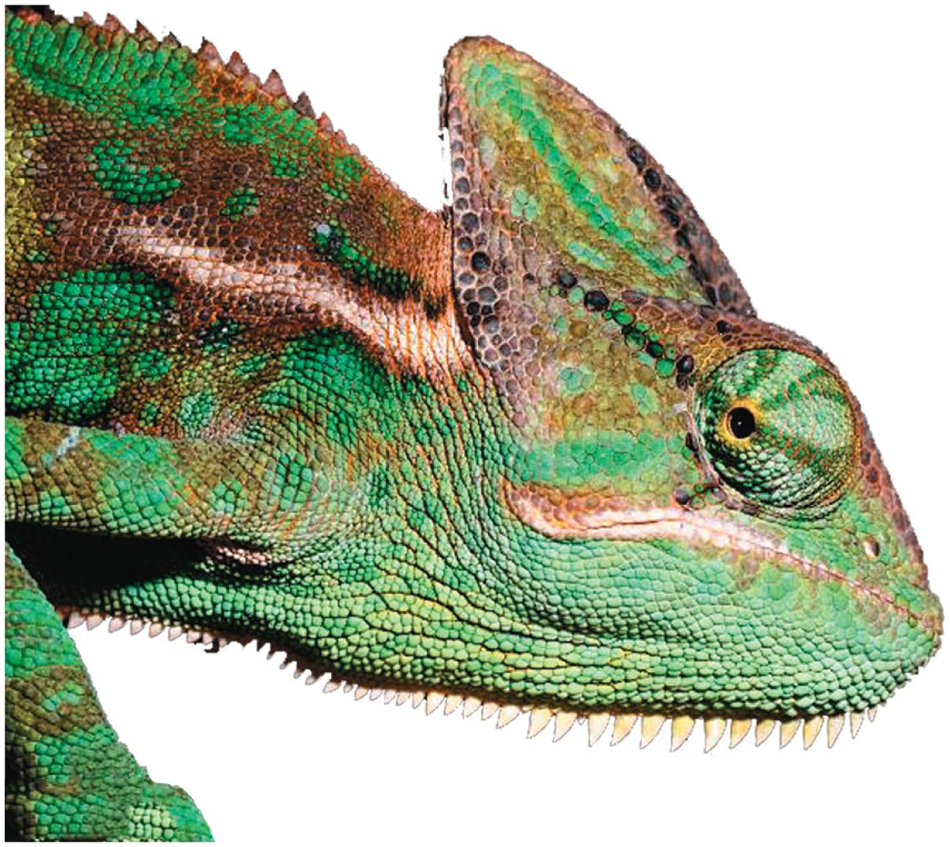
Animals
In general, animals are efficient consumers of other organisms
Most have adaptations that help them to detect, capture, eat, and digest other organisms
  For example, the chameleon captures insect prey with its long, sticky, quick-moving tongue

Slide 3
Animals are multicellular, heterotrophic eukaryotes with tissues
Several characteristics, taken together, sufficiently define the animal kingdom
  Animals are heterotrophs that ingest their food
  Animals are multicellular eukaryotes
  Cells are supported by structural proteins such as collagen
  Nervous tissue and muscle tissue are unique, defining characteristics of animals

Slide 4
Most animals have at least one larval stage
A larva is sexually immature and morphologically distinct from the adult; it eventually undergoes metamorphosis to become a juvenile
A juvenile resembles an adult, but is not yet sexually mature

Slide 5
The history of animals spans more than half a billion years
Biologists have identified 1.3 million living animal species to date; far more are estimated to exist
The common ancestor of all living animals likely lived about 770 million years ago

Slide 6
Steps in the Origin of Multicellular Animals
Morphological and molecular evidence points to a group of protists called choanoflagellates as the closest living relatives to animals
The common ancestor may have resembled modern choanoflagellates

Slide 7
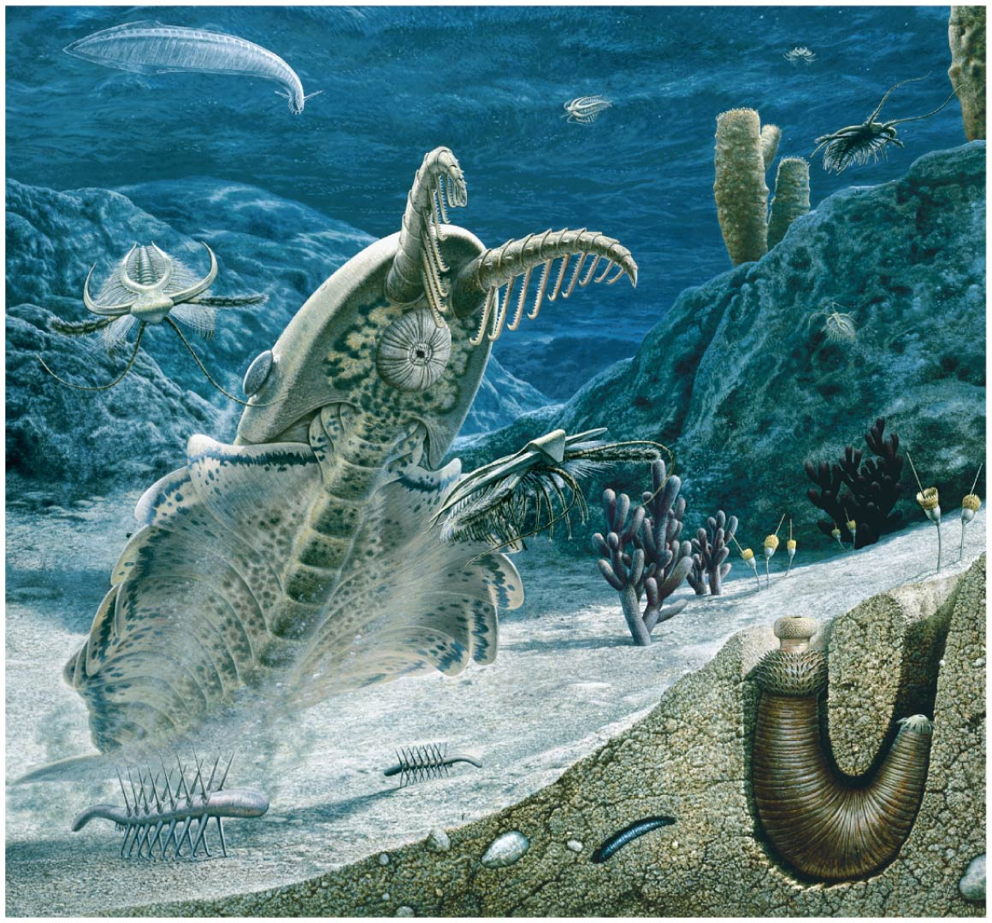
The Cambrian explosion (535–525 million years ago) marks the earliest fossil appearance of many major groups of living animals

Slide 8
Animals can be characterized by “body plans”
Zoologists sometimes categorize animals according to a body plan, a set of morphological and developmental traits
Some body plans have been conserved, while others have changed multiple times over the course of evolution

Slide 9
Symmetry
Animals can be categorized according to the symmetry of their bodies, or lack of it
Some animals have radial symmetry, the type of symmetry found in a flowerpot
Radially symmetrical animals have a top and a bottom, but no front and back, or left and right
  Radial animals are often sessile or planktonic (drifting or weakly swimming)

Slide 10
Symmetry
The two-sided symmetry of a shovel is an example of bilateral symmetry
Bilaterally symmetrical animals have
  A dorsal (top) side and a ventral (bottom) side
  A right and left side
  Anterior (front) and posterior (back) ends
Many also have sensory equipment, such as a brain, concentrated in their anterior end
  Bilateral animals typically move actively and have a central nervous system

Slide 11
Tissues
Animal body plans also vary according to the organization of the animal’s tissues
Tissues are collections of specialized cells isolated from other tissues
During development, germ layers give rise to the tissues and organs of the animal embryo

Slide 12
Ectoderm is the germ layer covering the embryo’s surface
Endoderm is the innermost germ layer and lines the developing digestive tube, called the archenteron

Slide 13
Diploblastic animals have only ectoderm and endoderm
  These include cnidarians and a few other groups
Triploblastic animals also have an intermediate tissue layer called mesoderm
  All bilaterally symmetrical animals are triploblastic

Slide 14
Body Cavities
Most triploblastic animals possess a body cavity
A true body cavity is called a coelom and is derived from mesoderm
Coelomates are animals that possess a true coelom

Slide 15
Body Cavities
A pseudocoelom is a body cavity derived from the mesoderm and endoderm
Triploblastic animals that possess a pseudocoelom are called pseudocoelomates

Slide 16
Body Cavities
Triploblastic animals that lack a body cavity are called acoelomates

Slide 17
A body cavity has many functions
  Fluid cushions the suspended organs
  Fluid acts like a skeleton against which muscles can work
  The cavity enables internal organs to grow and move independently of the outer body wall

Slide 18
Protostome and Deuterostome Development
Based on early development, many animals can be categorized as having protostome development or deuterostome development
These developmental modes differ in cleavage, coelom formation, and steps of development
Protostome
Deuterostome

Slide 19
Protostome and Deuterostome Development

Slide 20
Sponges are basal animals that lack tissues

Slide 21
Sponges are basal animals that lack tissues
Animals in the phylum Porifera are known informally as sponges
They are sedentary and live in marine waters or fresh water
Sponges are filter feeders, capturing food particles suspended in the water that passes through their body
Water is drawn through pores into a cavity called the spongocoel and out through an opening called the osculum
Most sponges are hermaphrodites with sequential hermaphroditism

Slide 22
Cnidarians are an ancient phylum of eumetazoans

Slide 23
Cnidarians are an ancient phylum of eumetazoans
All animals except sponges and a few other groups belong to the clade Eumetazoa
  animals with true tissues
Phylum Cnidaria is one of the oldest groups in this clade
Cnidarians have diversified into a wide range of both sessile and motile forms including jellies, corals, and hydras
They exhibit a relatively simple diploblastic, radial body plan
The basic body plan of a cnidarian is a sac with a central digestive compartment, the gastrovascular cavity
A single opening functions as mouth and anus

Slide 24
Cnidarians are an ancient phylum of eumetazoans
There are two variations on the body plan: the sessile polyp and motile medusa
A polyp adheres to the substrate by the aboral end of its body
A medusa has a bell-shaped body with its mouth on the underside
Medusae do not attach to the substrate but move freely

Slide 25
Cnidarians are an ancient phylum of eumetazoans
Phylum Cnidaria diverged into two major clades, Medusozoa and Anthozoa, early in its evolutionary history

Slide 26
Cnidarians are an ancient phylum of eumetazoans
Cnidarians are carnivores that use tentacles to capture prey
The tentacles are armed with cnidocytes, unique cells that function in defense and capture of prey
Nematocysts are specialized organelles within cnidocytes that eject a stinging thread

Slide 27
Bilaterian animals have bilateral symmetry and triploblastic development

Slide 28
Bilaterian animals have bilateral symmetry and triploblastic development
Most have a coelom and a digestive tract with two openings
The clade Bilateria contains
  Lophotrochozoa
  Ecdysozoa
  Deuterostomia

Slide 29
Lophotrochozoans have the widest range of animal body forms

Slide 30
Lophotrochozoans have the widest range of animal body forms
Lophotrochozoa includes the
  Flatworms
  Rotifers
  Acanthocephalans
  Ectoprocts
  Brachiopods
  Molluscs
  Annelids

Slide 31
Flatworms
Flatworms have a flattened body shape that places all cells close to water in the surrounding environment or in their gut
Structures that are flattened, folded, or branched or that have projections maximize the surface area across which gas exchange can occur

Slide 32
Flatworms
Free-living members of phylum Platyhelminthes live in marine, freshwater, and damp terrestrial habitats
Many flatworms are parasites, such as flukes and tapeworms
Unlike most triploblastic animals, flatworms are acoelomates (animals that lack a body cavity)
Flatworms have a gastrovascular cavity with one opening

Slide 33
Molluscs
Phylum Mollusca includes snails and slugs, oysters and clams, and octopuses and squids
Most molluscs are marine, though some inhabit fresh water and some snails and slugs are terrestrial
Molluscs are soft-bodied animals, but most are protected by a calcium carbonate shell

Slide 34
Molluscs
All molluscs have a similar body plan with three main parts
  Muscular foot
  Visceral mass
  Mantle
Many molluscs also have a water-filled mantle cavity and feed using a straplike radula

Slide 35
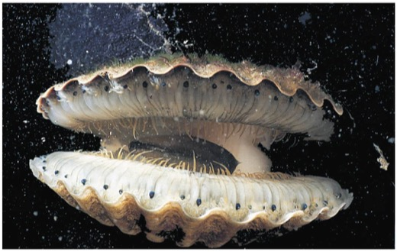
Molluscs
Four of the major classes of molluscs are
  Polyplacophora (chitons)
  Gastropoda (snails and slugs)
  Bivalvia (clams, oysters, and other bivalves)
  Cephalopoda (squids, octopuses, cuttlefish, and chambered nautiluses)

Slide 36

Bivalves
The mantle cavity of a bivalve contains gills that are used for feeding as well as gas exchange
Most species are sedentary, but some have limited motility

Slide 37
Bivalves
Bivalves are aquatic and include many species of clams, oysters, mussels, and scallops
They have a shell divided into two halves drawn together by adductor muscles
Some bivalves have eyes and sensory tentacles along the edge of their mantle

Slide 38
Cephalopods
Cephalopods are active marine predators with beak-like jaws surrounded by tentacles
The foot is modified into a muscular excurrent siphon and part of the tentacles
The shell is reduced and internal or missing in most species, except the chambered nautiluses
Cephalopods have a closed circulatory system, well-developed sense organs, and a complex brain

Slide 39
Annelids
Annelids are coelomates with bodies composed of a series of fused rings
The phylum Annelida was traditionally divided into three clades
  Polychaeta (polychaetes)
  Oligochaeta (oligochaetes)
  Hirudinea (leeches)
Recent molecular analyses indicate that the annelids can be divided into two major clades
  Errantia
  Sedentaria

Slide 40
Errantians
Most members of clade Errantia are mobile marine predators or grazers
Many errantians have a pair of paddle-like or ridge-like structures called parapodia on each body segment
Each parapodium has numerous bristles made of chitin

Slide 41
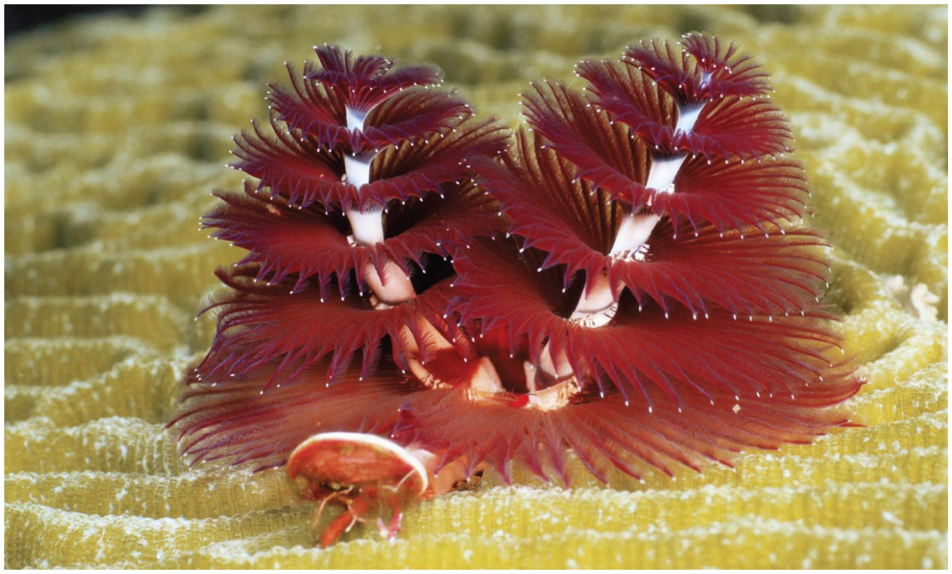
Sedentarians
Sedentarians tend to be less mobile than errantians
Some species burrow into the substrate, while others live in protective tubes
Tube-dwelling sedentarians often have elaborate gills or tentacles used for filter feeding
This clade also contains the leeches and the earthworms

Slide 42
Earthworms
Earthworms eat through soil, extracting nutrients as the soil moves through the alimentary canal
Earthworms are hermaphrodites but cross-fertilize
Some reproduce asexually by fragmentation

Slide 43
Ecdysozoans are the most species-rich animal group

Slide 44
Ecdysozoans are the most species-rich animal group
Ecdysozoans are covered by a tough coat called a cuticle
The cuticle is shed or molted through a process called ecdysis
The two largest phyla are nematodes and arthropods

Slide 45
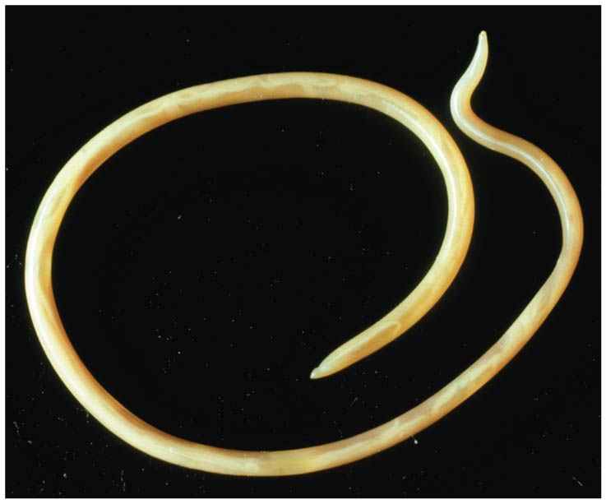
Nematodes
Nematodes, or roundworms, are found in most aquatic habitats, in the soil, in moist tissues of plants, and in body fluids and tissues of animals
They have an alimentary canal, but lack a circulatory system
Body wall muscles are all longitudinal, and their contraction produces a thrashing motion

Slide 46
Arthropods
Zoologists estimate that there are about a billion billion (10¹⁸) arthropods living on Earth
More than 1 million species have been described, and two out of every three known species of animals are arthropods
Members of the phylum Arthropoda are found in nearly all habitats of the biosphere

Slide 47
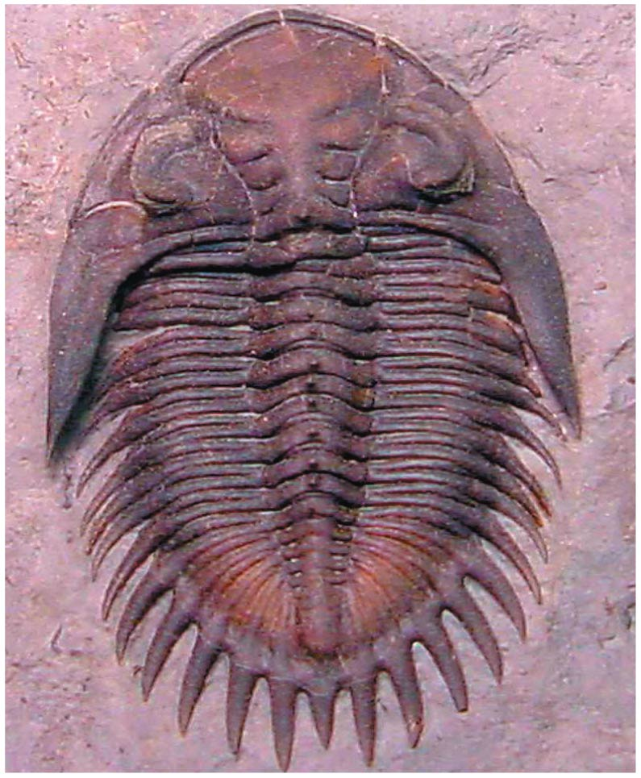
Arthropod Origins
The arthropod body plan consists of a segmented body, hard exoskeleton, and jointed appendages
This body plan dates to the Cambrian explosion (535–525 million years ago)
Early arthropods show little variation from segment to segment

Slide 48
Arthropods
The body of an arthropod is completely covered by the cuticle, an exoskeleton made of layers of protein and the polysaccharide chitin
When an arthropod grows, it molts its exoskeleton
Evolution of the exoskeleton in early arthropods enabled them to be among the first animals to colonize land
  Its relative impermeability to water helped prevent desiccation
  Its strength provided support without reliance on the buoyancy of water

Slide 49
Arthropods
Arthropods have eyes, olfactory receptors, and antennae that function in touch and smell
Arthropods have an open circulatory system in which hemolymph is circulated into the spaces surrounding the tissues and organs
A variety of organs specialized for gas exchange have evolved in arthropods

Slide 50
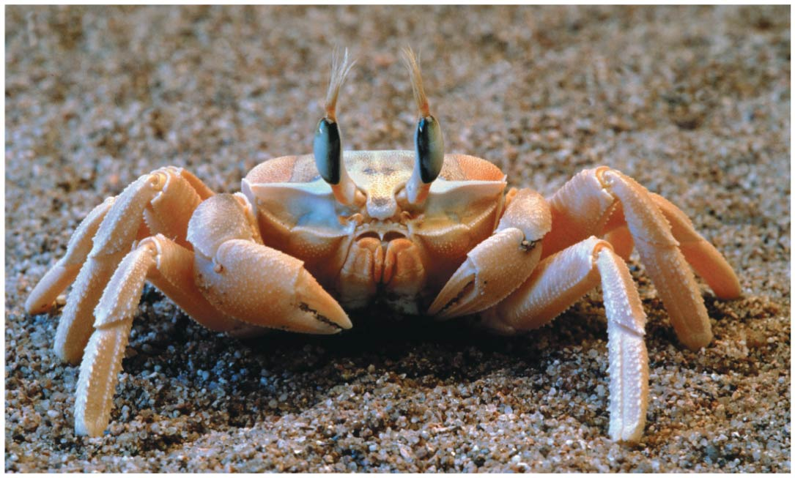
Arthropods
Morphological and molecular evidence suggests that living arthropods consist of three major lineages that diverged early in the phylum’s evolution
  Chelicerates (sea spiders, horseshoe crabs, scorpions, ticks, mites, and spiders)
  Myriapods (centipedes and millipedes)
  Pancrustaceans (lobsters and other crustaceans, as well as insects and their relatives)

Slide 51
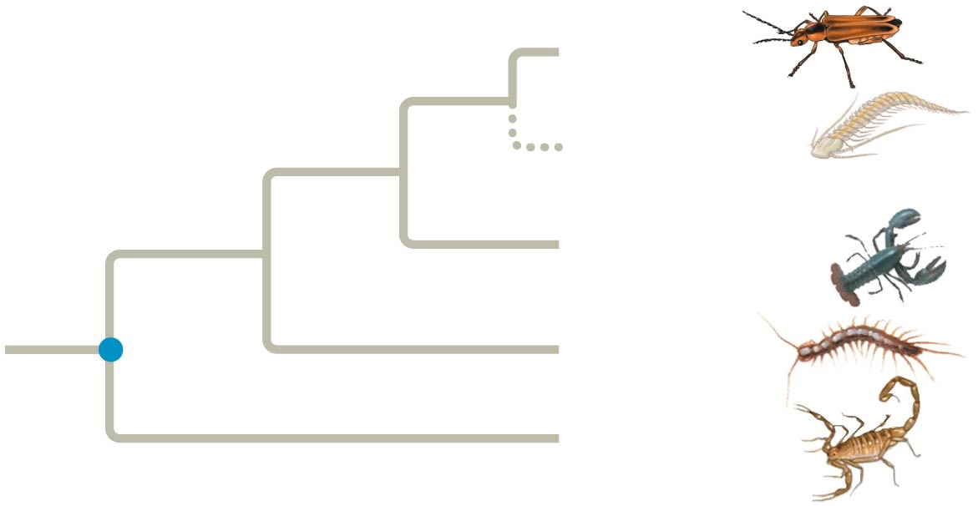
Arthropods
Common ancestor
of Pancrustia
Insects
Common ancestor
of arthropods
Remipedians
(a crustacean group)
Other
crustaceans
Myriapods
(centipedes and
millipedes)
Chelicerates
(scorpions, ticks,
mites, and spiders)

Slide 52
Spiders
Arachnids have six pairs of appendages: the chelicerae, the pedipalps, and four pairs of walking legs
Gas exchange in spiders occurs in respiratory organs called book lungs
Many spiders produce silk, a liquid protein, from specialized abdominal glands

Slide 53
Insects
Hexapoda is an enormous clade including insects and their relatives
Insects live in almost every terrestrial habitat and in fresh water; flying insects fill the air
They are rare in marine habitats
The internal anatomy of an insect includes several complex organ systems

Slide 54
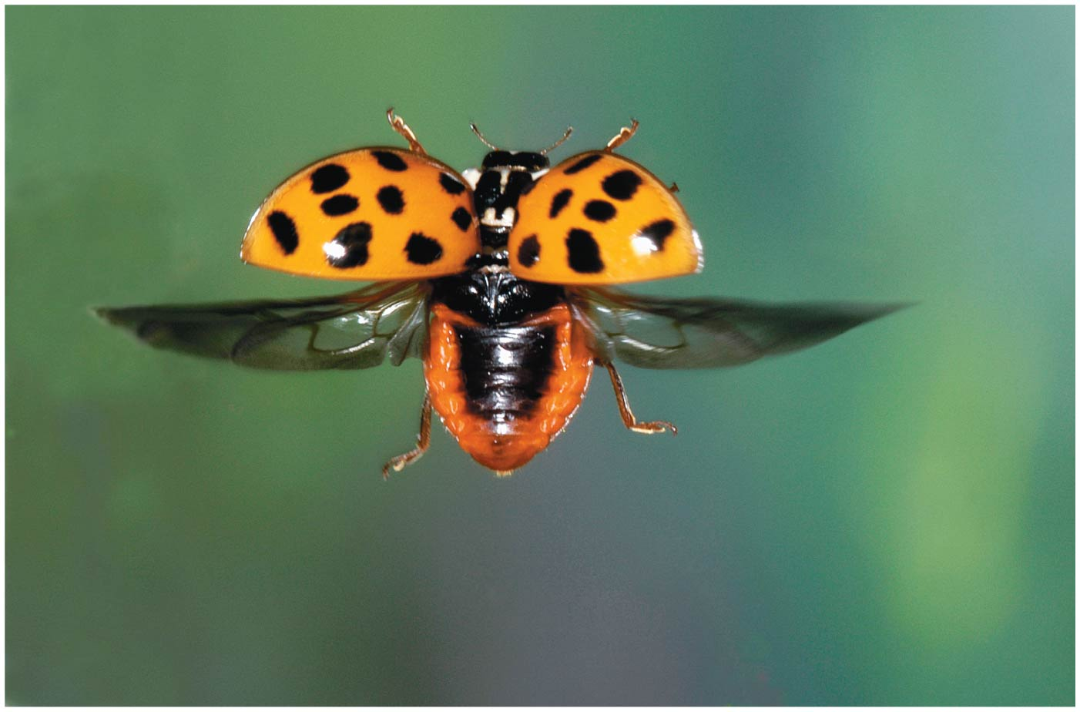
Insects
Insects diversified rapidly following the evolution of flight 359–252 million years ago
An animal that can fly can escape predators, find food, and disperse to new habitats much faster than organisms that can only crawl
Insects evolved flight without sacrificing a pair of walking legs because wings are an extension of the cuticle

Slide 55
Insects
Periods of rapid insect diversification followed radiations of the plants on which they fed
The diversity of insect mouthparts in the fossil record indicates that specialized modes of feeding evolved in response to gymnosperm diversification
A later insect radiation appears to have been stimulated by the expansion of flowering plants about 100 million years ago

Slide 56
Echinoderms and chordates are deuterostomes

Slide 57
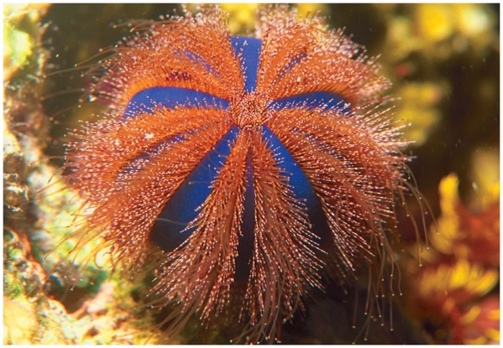
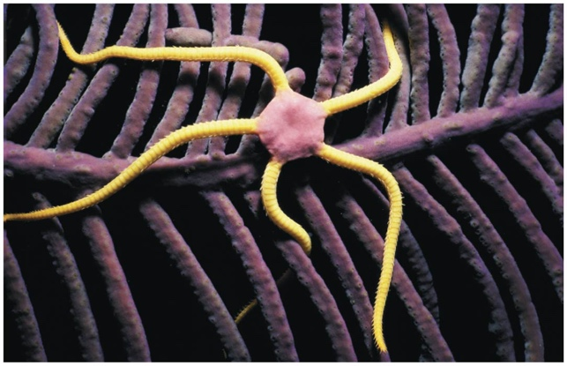
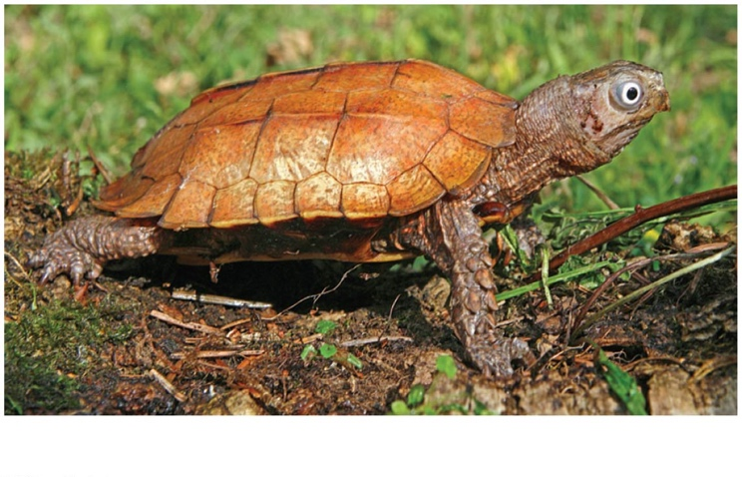
Echinoderms and chordates are deuterostomes
Echinoderms (phylum Echinodermata) include sea stars and sea urchins
Vertebrates (animals that have a backbone) are members of phylum Chordata
Echinoderms and chordates constitute the clade Deuterostomia

Slide 58
Echinoderms
Sea stars and most other echinoderms are slow-moving or sessile marine animals
A thin epidermis covers an endoskeleton of hard calcareous plates
Echinoderms have a unique water vascular system, a network of hydraulic canals branching into tube feet that function in locomotion and feeding
Males and females are usually separate, and sexual reproduction is external

Slide 59
Echinoderms
Most adult echinoderms appear to have radial symmetry with multiples of five
Their symmetry is not truly radial; the opening of the water vascular system is not central
Echinoderm larvae have bilateral symmetry

Slide 60
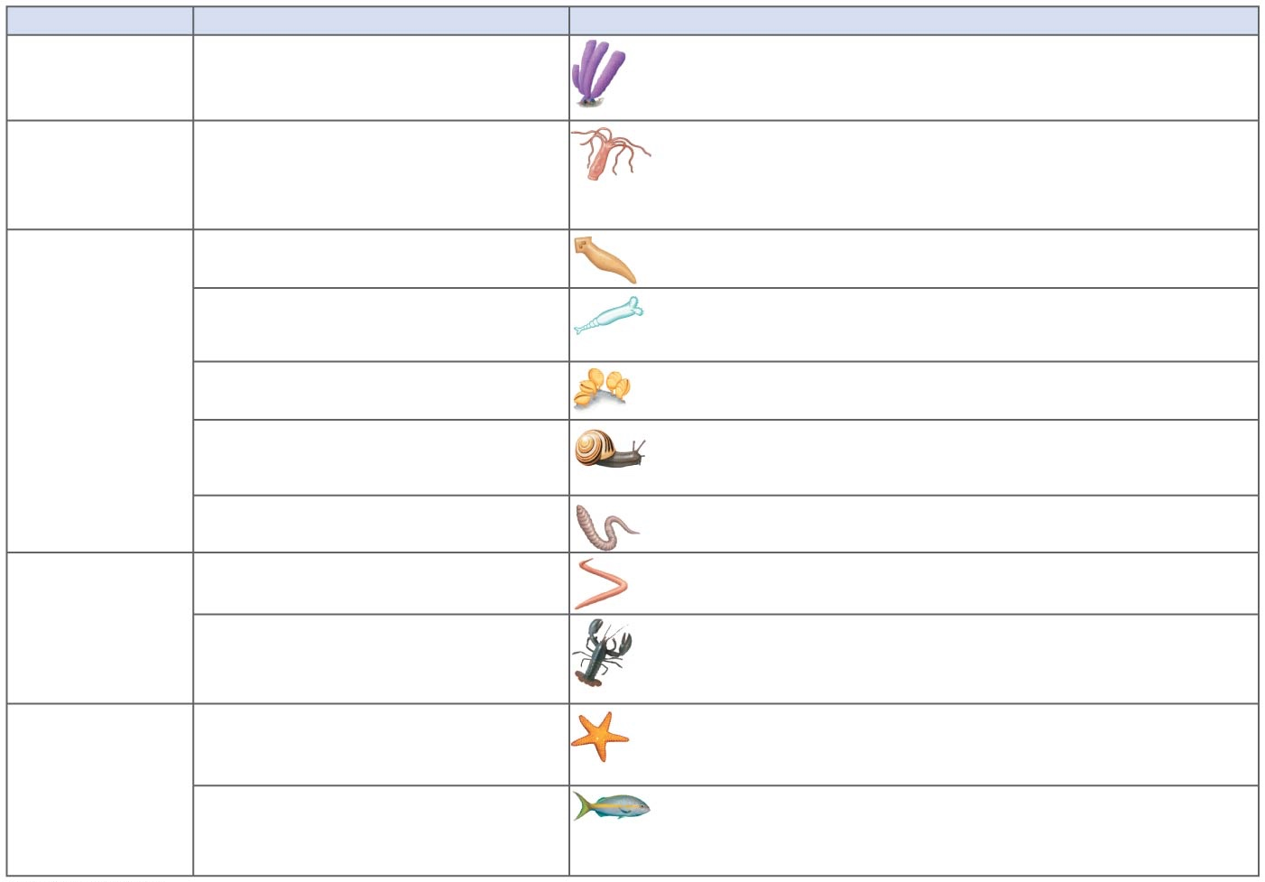
Phylum
Description
Porifera (sponges)
Lack tissues; have choanocytes
(collar cells—flagellated cells that ingest bacteria and
tiny food particles)
Cnidaria (hydras, jellies, sea
anemones, corals)
Unique stinging structures (nematocysts) housed in
specialized cells (cnidocytes); diploblastic; radially
symmetrical; gastrovascular cavity (digestive
compartment with a single opening)
Platyhelminthes (flatworms)
Dorsoventrally flattened acoelomates; gastrovascular
cavity or no digestive tract
Syndermata (rotifers and
acanthocephalans)
Pseudocoelomates. Rotifers have alimentary canal
(digestive tube with mouth and anus) and jaws (trophi);
acanthocephalans are parasites of vertebrates
Lophotrochozoa
Lophophorates: Ectoprocta,
Brachiopoda
Coelomates with lophophores (feeding structures
bearing ciliated tentacles)
Mollusca (clams, snails, squids)
Coelomates with three main body parts (muscular foot,
visceral mass, mantle); coelom reduced; most have
hard shell made of calcium carbonate
Metazoa
Eumetazoa
Annelida (segmented worms)
Coelomates with segmented body wall and internal
organs (except digestive tract, which is unsegmented)
Bilateria
Nematoda (roundworms)
Cylindrical pseudocoelomates with tapered ends;
no circulatory system; undergo ecdysis
Ecdysozoa
Arthropoda (spiders, centipedes,
crustaceans, and insects)
Coelomates with segmented body, jointed appendages,
and exoskeleton made of protein and chitin
Deuterostomia
Echinodermata (sea stars,
sea urchins)
Coelomates with bilaterally symmetrical larvae and
five-part body organization as adults; unique water
vascular system; endoskeleton
Chordata (lancelets, tunicates,
vertebrates)
Coelomates with notochord; dorsal, hollow nerve cord;
pharyngeal slits; post-anal tail (see Chapter 34)
Notes:
Figure 33.UN07 Summary of key concepts: animal groups

Slide 61
Chordates have a notochord and a dorsal, hollow nerve cord

Slide 62
Chordates have a notochord and a dorsal, hollow nerve cord
Chordates (phylum Chordata) are bilaterian animals that belong to Deuterostomia
Chordates comprise all vertebrates and two groups of invertebrates:
  Urochordates
  Cephalochordates

Slide 63
Chordates
Phylum Chordata consists of two basal groups of invertebrates as well as vertebrates
Chordates are bilaterally symmetrical coelomates with segmented bodies
Chordates did not evolve from echinoderms, but have evolved separately from them for at least 500 million years

Slide 64
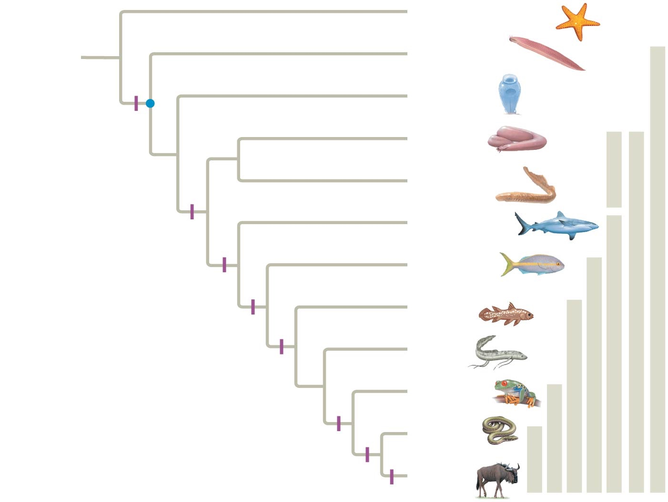
Echinodermata
ANCESTRAL
DEUTEROSTOME
Cephalochordata
Chordates
Urochordata
Notochord
Myxini
Cyclostomes
Vertebrates
Common
ancestor of
chordates
Petromyzontida
Vertebrae
Chondrichthyes
Gnathostomes
Actinopterygii
Osteichthyans
Jaws, mineralized skeleton
Actinistia
Lobe-fins
Lungs or lung derivatives
Dipnoi
Lobed fins
Amphibia
Tetrapods
Limbs with digits
Reptilia
Amniotes
Amniotic egg
Mammalia
Milk
Notes:
Figure 34.2 Phylogeny of living chordates

Slide 65
Chordates
Every animal from this point until the end of the lecture is a chordate

Slide 66
Derived Characters of Chordates
All chordates share a set of derived characters
Some species have some of these traits only during embryonic development
Four key characters of chordates
  Notochord
  Dorsal, hollow nerve cord
  Pharyngeal slits or clefts
  Muscular, post-anal tail

Slide 67
Notochord
The notochord is a longitudinal, flexible rod between the digestive tube and nerve cord
It provides skeletal support throughout most of the length of a chordate
In most vertebrates, a more complex, jointed skeleton develops, and the adult retains only remnants of the embryonic notochord

Slide 68
Dorsal, Hollow Nerve Cord
The nerve cord of a chordate embryo develops from a plate of ectoderm that rolls into a tube dorsal to the notochord
The nerve cord develops into the central nervous system: the brain and the spinal cord

Slide 69
Pharyngeal Slits or Clefts
In all chordate embryos, grooves form along the outer surface of the pharynx called pharyngeal clefts
In most chordates, these grooves develop into pharyngeal slits that open to the outside of the body

Slide 70
Pharyngeal Slits or Clefts
Functions of pharyngeal slits
  Suspension-feeding structures in many invertebrate chordates
  Gas exchange in vertebrates (except vertebrates with limbs, the tetrapods)
  Develop into parts of the ear, head, and neck in tetrapods

Slide 71
Muscular, Post-Anal Tail
Chordates have a tail posterior to the anus
In many species, the tail is greatly reduced during embryonic development
The tail contains skeletal elements and muscles
It provides propelling force in many aquatic species

Slide 73
Cephalochordate example: Lancelets
Invertebrate chordate
Lancelets (Cephalochordata) are named for their bladelike shape
They are marine suspension feeders that retain characteristics of the chordate body plan as adults

Slide 75
Urochordate example: Tunicate
Invertebrate chordate
More closely related to Vertebrates than are lancelets
Tunicates most resemble chordates during their larval stage, which may last only a few minutes
As an adult, a tunicate draws in water through an incurrent siphon, filtering food particles
When attacked, tunicates, or “sea squirts,” shoot water through their excurrent siphon

Slide 76
Vertebrates
Every animal from this point until the end of the lecture is a vertebrate (chordate that has a backbone – or at least vertebrae)

Slide 77
Vertebrates
A skeletal system and complex nervous system have allowed vertebrates efficiency at two essential tasks
  Capturing food
  Evading predators
Vertebrates have the following derived characters
  Vertebrae enclosing a spinal cord
  An elaborate skull

Slide 78
Vertebrates
Ancestral vertebrates lacked jaws
Only two lineages of jawless vertebrates remain today: the hagfishes and the lampreys
  Lack a backbone but do have vertebrae

Slide 80
Myxini example: Hagfish
Chordate with vertebrae
Jawless vertebrates that have a cartilaginous skull, reduced vertebrae, and a flexible rod of cartilage derived from the notochord
Small brain, eyes, ears, and tooth-like formations
Marine & most are bottom-dwelling scavengers

Slide 82
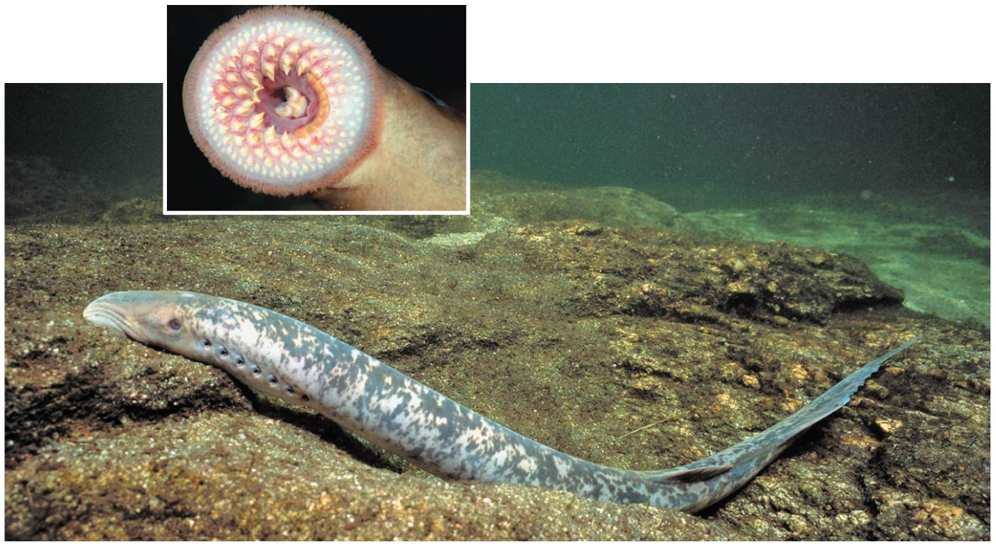
Petromyzontida example: Lamprey
Chordate with vertebrae
Parasites that feed by clamping their mouth onto a live fish
Inhabit various marine and freshwater habitats
Have cartilaginous segments surrounding the notochord and arching partly over the nerve cord

Slide 83
Gnathostomes
Every animal from this point until the end of the lecture is a gnathostome (vertebrate that has jaws)

Slide 84
Gnathostomes
Vertebrates with jaws
Jawed vertebrates, or gnathostomes, outnumber jawless vertebrates
  include sharks, ray-finned fishes, lobe-finned fishes, amphibians, reptiles (including birds), and mammals
  named for their jaws, hinged structures that, especially with the help of teeth, are used to grip food items firmly and slice them
Earliest gnathostomes appear in the fossil record about 440 million years ago

Slide 85
Gnathostomes
The jaws are hypothesized to have evolved by modification of skeletal rods that supported the pharyngeal (gill) slits
Other characters common to gnathostomes
  An enlarged forebrain associated with enhanced smell and vision
  In aquatic gnathostomes, the lateral line system, which is sensitive to vibrations

Slide 86
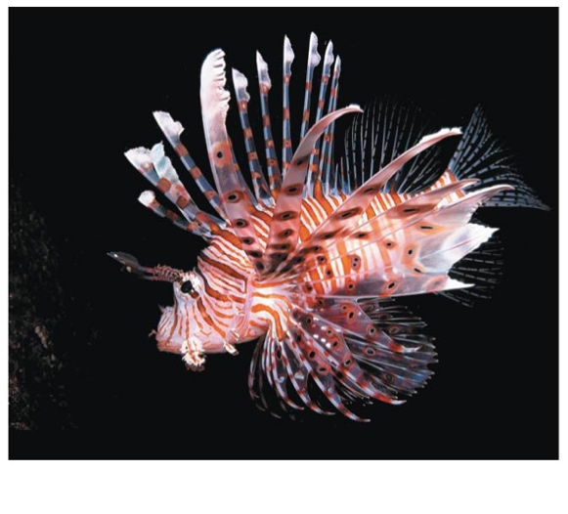
Gnathostomes
Two lineages of jawed vertebrates survive today: chondrichthyans & osteichtyans
  Chondrichthyans: Sharks, Rays, Skates, Ratfish
  Osteichthans: ray-finned fishes, lobe-finned fishes, lungfish, and tetrapods

Slide 87
Gnathostomes
Two lineages of jawed vertebrates survive today: chondrichthyans & osteichtyans
  Chondrichthyans: Sharks, Rays, Skates, Ratfish
  Osteichthans: ray-finned fishes, lobe-finned fishes, lungfish, and tetrapods

Slide 89
Gnathostome example:
Chondrichthyan examples: Sharks, Rays, Skates
Vertebrates with jaws

Slide 90
Osteichtyans
Every animal from this point until the end of the lecture is a osteichthyan (gnathostome that has a boney endoskeleton)

Slide 91
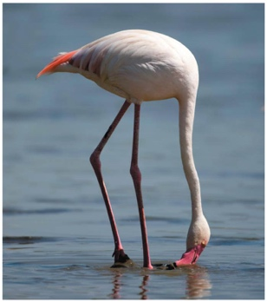
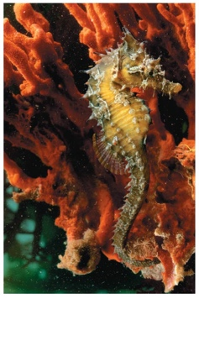
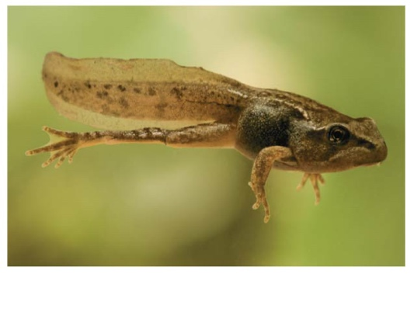
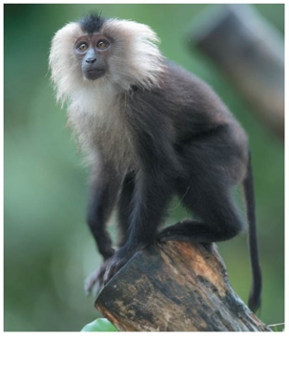
Gnathostome example:
Osteichthyans
All osteichthyans have a bony endoskeleton
Include the bony fishes and tetrapods
  Bony fishes and lobe-finned “fishes”

Slide 93
Osteichthyan example:
Ray-Finned Fishes (Actinopterygii)
Gnathostomes with bones
Actinopterygii, the ray-finned fishes, include nearly all the familiar aquatic osteichthyans
The fins, supported mainly by long, flexible rays, are modified for maneuvering, defense, and other functions
Ray-finned fishes originated during the Silurian period (444 to 416 mya)

Slide 94
Ray-Finned Fishes (Actinopterygii)
Gnathostomes with bones
Most fishes breathe by drawing water over gills
Fishes control their buoyancy with an air sac known as a swim bladder
  Ancestral form of lungs

Slide 95
Lobe-Finned
(or Sarcopterygii)
Every animal from this point until the end of the lecture is a Lobe-Finned “fish” (Osteichthyan that has a lobed fins or leg-like things)

Slide 97
Lob-Finned Fishes example: (Actinistia)
Gnathostomes with bones
The lobe-fins also originated in the Silurian period (444 to 416 million years ago)
They have muscular pelvic and pectoral fins that they use to swim and “walk” underwater across the substrate

Slide 98
Lob-Finned Fishes example: (Actinistia)
Gnathostomes with bones
Three lineages survive and include coelacanths (Actinistia), lungfishes (Dipnoi), and tetrapods (Tetrapoda)
Coelacanths were thought to have become extinct 75 million years ago, but a living coelacanth was caught off the coast of South Africa in 1938

Slide 100
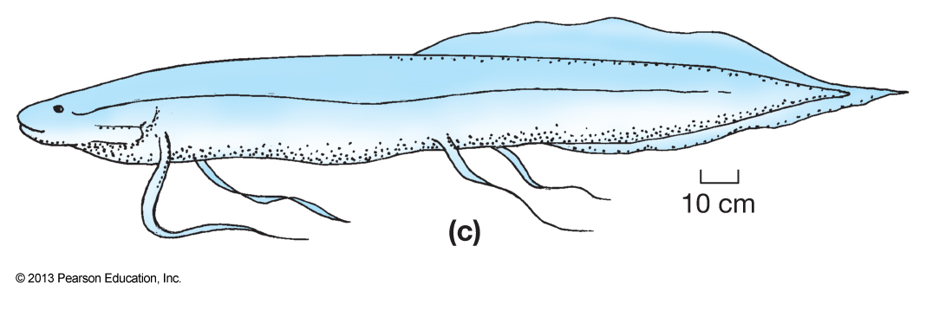
Lob-Finned Fishes example:
Lung Fishes (Dipnoi)
Gnathostomes with bones
Though gills are the main organs for gas exchange, they can also surface to gulp air into their lungs
The third surviving lineage of lobe-fins are tetrapods, a group that adapted to life on land

Slide 101
Tetrapods
Every animal from this point until the end of the lecture is a tetrapod (osteichthyan with four limbs)

Slide 102
Tetrapods
Tetrapods have some specific adaptations
  Four limbs, and feet with digits
  A neck, which allows separate movement of the head
  Fusion of the pelvic girdle to the backbone
  The absence of gills (except some aquatic species)
  Ears for detecting airborne sounds

Slide 104
Tetrapod example:
Amphibians (Amphibia)
Osteichthyan with four limbs
frogs
salamanders and newts
caecilians
Amphibians (class Amphibia) are represented by about 6,000 species in three clades
  Urodela (salamanders and newts)
  Anura (frogs and toads)
  Apoda (caecilians)

Slide 105
Biphasic Life History
Amphibian means “both ways of life,” referring to the metamorphosis of an aquatic larva into a terrestrial adult
Tadpoles are herbivores that lack legs, but legs, lungs, external eardrums, and adaptations for carnivory may all arise during metamorphosis
Most amphibians have moist skin that complements the lungs in gas exchange

Slide 106
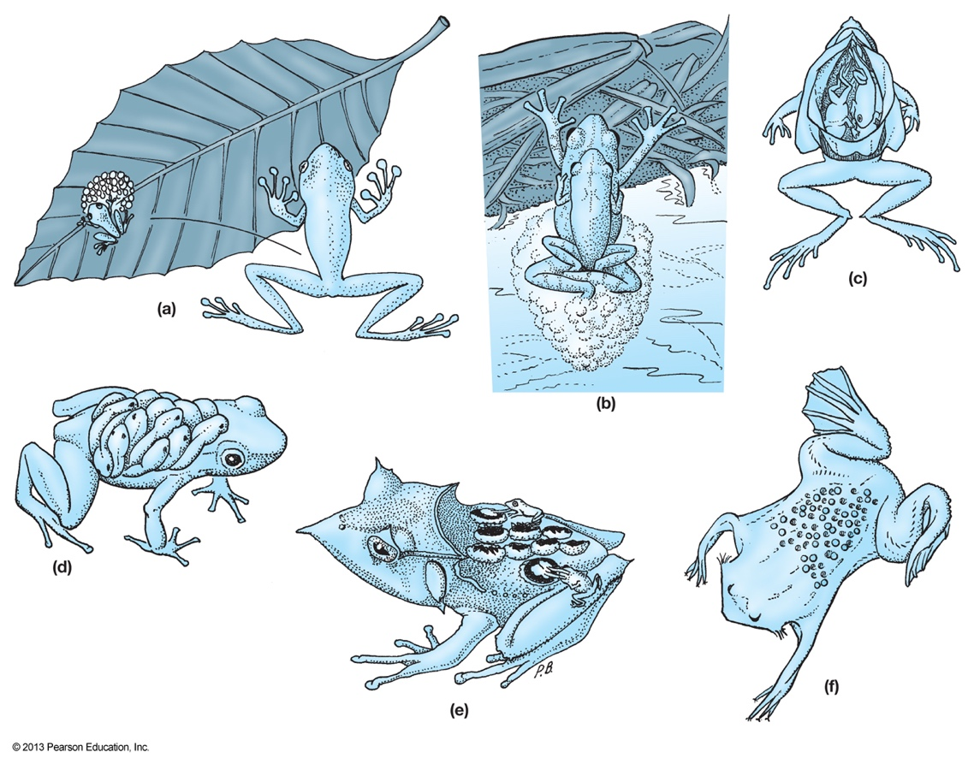
Reproduction Requires Water
Fertilization is external in most species, and the eggs require a moist environment
In some species, males or females care for the eggs on their back, in their mouth, or in their stomach

Slide 107
Amniotes
Every animal from this point until the end of the lecture is an amniote (tetrapod with an amniotic egg)

Slide 108
Amniotes
Tetrapod with amniotic egg
Amniotes are a group of tetrapods whose living members are the reptiles, including birds, and mammals
Living amphibians and amniotes split from a common ancestor about 350 million years ago

Slide 109
Amniotic Egg
Tetrapod with amniotic egg
Amniotes are named for the major derived character of the clade, the amniotic egg, which contains membranes that protect the embryo

Slide 111
Amniote example: Reptiles
Tetrapod with amniotic egg
The reptile clade includes the tuataras, lizards, snakes, turtles, crocodilians, birds, and some extinct groups
Reptiles have scales that create a waterproof barrier
Most reptiles lay shelled eggs on land
Most reptiles are ectothermic, absorbing external heat as the main source of body heat
  regulate their body temperature through behavioral adaptations
Fossil evidence indicates that the earliest reptiles lived about 310 million years ago

Slide 112
Amniote example: Reptiles
Tetrapod with amniotic egg
The diapsids consisted of two main lineages: the lepidosaurs and the archosaurs
The lepidosaurs include tuataras, lizards, snakes, and extinct marine mososaurs
The archosaur lineage produced the crocodilians, pterosaurs, and dinosaurs (and birds)

Slide 113
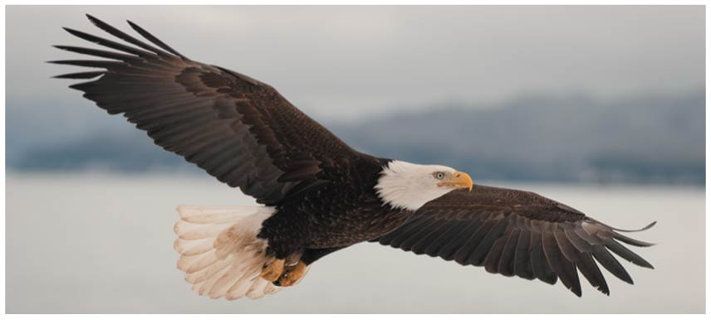
Birds (Aves) which are Reptiles...
Tetrapod with amniotic egg
Birds are archosaurs, but almost every feature of their reptilian anatomy has undergone modification in their adaptation to flight

Slide 114
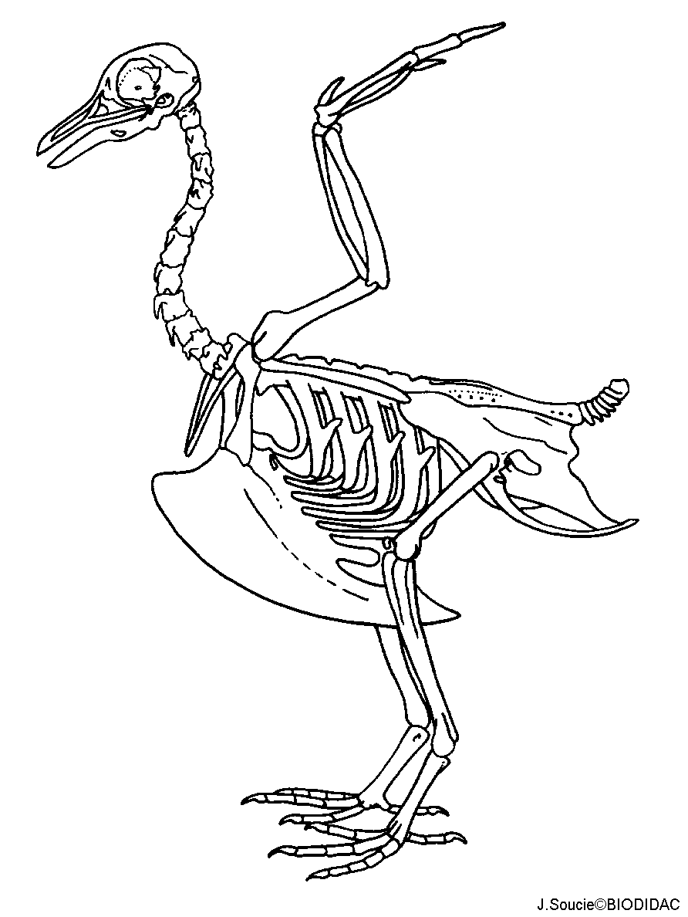
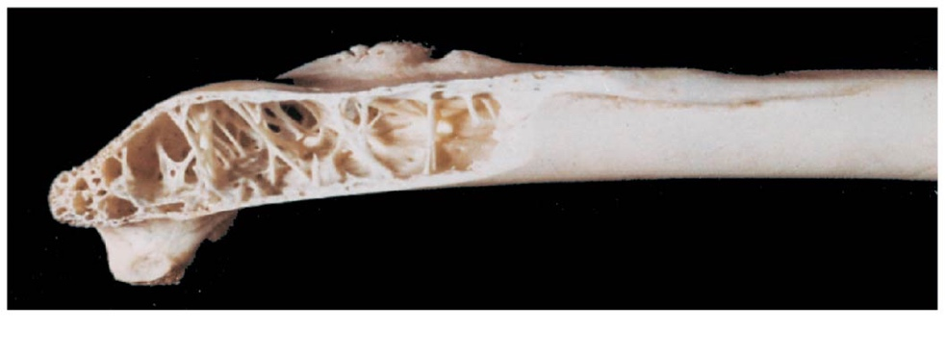
Birds (Aves) which are Reptiles...
Tetrapod with amniotic egg
Wings
Feathers
Endothermic
Scales on legs
No teeth
Lack of a bladder
Small gonads
Many bones are air-filled
Keeled sternum
  Flight muscle attachment
Keeled sternum

Slide 115
Mammals
Every animal from this point until the end of the lecture is a Mammal (amniote that has hair and produces milk)

Slide 116
Mammals (Mammalia)
Mammals have
  Mammary glands, which produce milk
  Hair
  A high metabolic rate, due to endothermy
  A larger brain than other vertebrates of equivalent size
  Differentiated teeth
Mammals are synapsids (one hole in the each temporal bone)
In the evolution of mammals from early synapsids, two bones that formerly made up the jaw joint were incorporated into the mammalian middle ear

