Slide 1
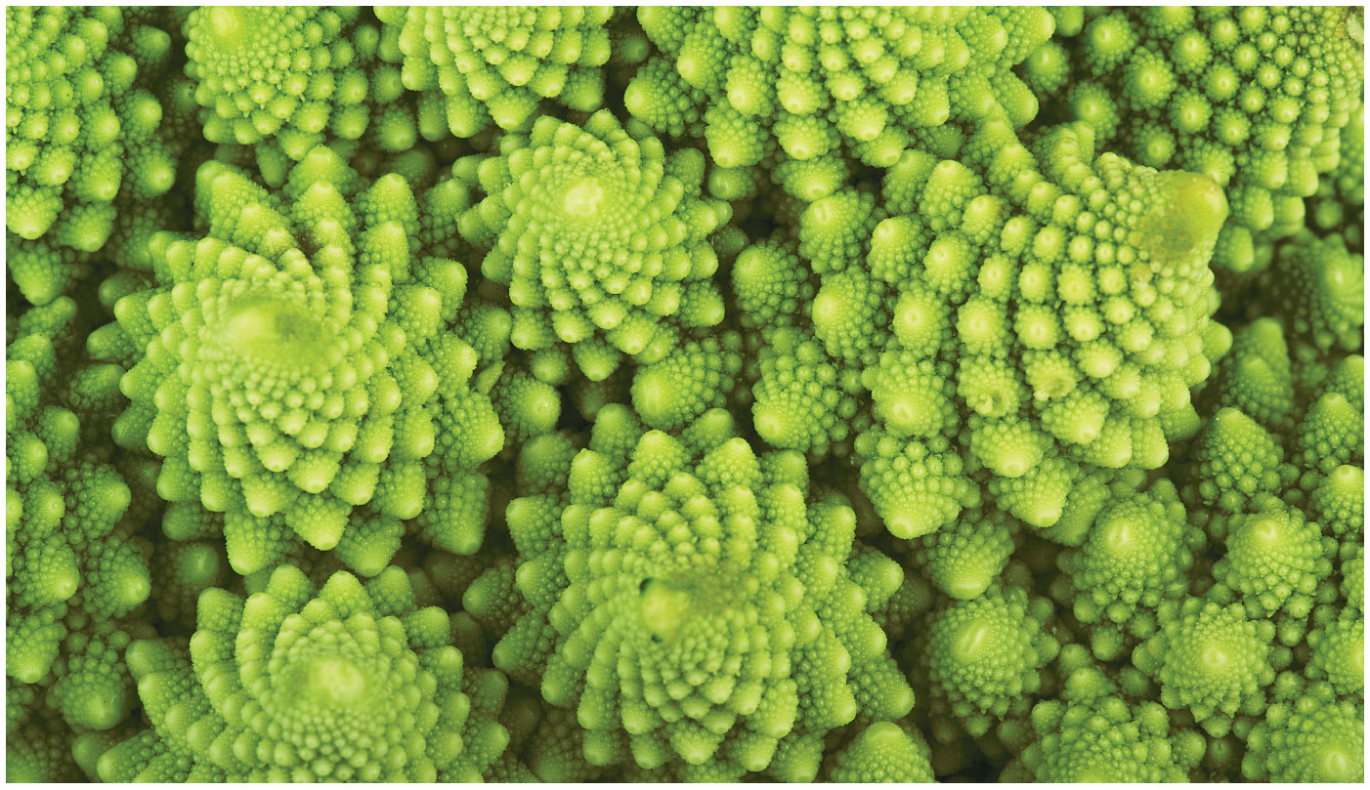
BIO10
Dr. Bradley
Plants Part 2

Slide 2
Roots & Shoots
Roots rely on sugar produced by photosynthesis in the shoot system
Shoots rely on water and minerals absorbed by the root system

Slide 3
Shoots
A stem is a plant organ consisting of
  an alternating system of nodes, the points at which leaves are attached
  internodes, the stem segments between nodes
The growing shoot tip, or apical bud, causes elongation of a young shoot
An axillary bud is a structure that has the potential to form a lateral branch, thorn, or flower
The primary function of the stem is to elongate and orient the shoot to maximize photosynthesis

Slide 4
Shoots
Many plants have modified stems that perform alternate functions (e.g., rhizomes, stolons, tubers)

Slide 5
Dermal, Vascular, and Ground Tissues
Roots, stems, and leaves are composed of three tissue types: dermal, vascular, and ground tissues
Each of these three tissue types forms a tissue system
Each tissue system is continuous throughout the plant

Slide 6
Dermal, Vascular, and Ground Tissues
In nonwoody plants, the dermal tissue system consists of the epidermis
A waxy coating called the cuticle helps prevent water loss from the epidermis
In woody plants, protective tissues called periderm (bark) replace the epidermis in older regions of stems and roots

Slide 7
Dermal, Vascular, and Ground Tissues
The vascular tissue system facilitates the transport of materials through the plant and provides mechanical support
The two vascular tissues are xylem and phloem
Xylem conducts water and dissolved minerals upward from roots into the shoots
Phloem transports sugars from where they are made (primarily leaves) to storage structures or sites of growth

Slide 8
Dermal, Vascular, and Ground Tissues
The vascular tissue of a root or stem is collectively called the stele
In angiosperms, the stele of the root is a solid central vascular cylinder
The stele of stems and leaves is divided into vascular bundles, strands of xylem and phloem

Slide 9
Dermal, Vascular, and Ground Tissues
Tissues that are neither dermal nor vascular are the ground tissue system
Ground tissue internal to the vascular tissue is pith; ground tissue external to the vascular tissue is cortex
Ground tissue includes cells specialized for storage, photosynthesis, support, and transport

Slide 11
Water-Conducting Cells of the Xylem
The two types of water-conducting cells, tracheids and vessel elements, are dead at maturity
Tracheids are long, thin cells with tapered ends found in the xylem of all vascular plants

Slide 12
Water-Conducting Cells of the Xylem
Vessel elements are common to most angiosperms, and a few gymnosperms and seedless vascular plants
Vessel elements align end to end to form long pipes called vessels
The end walls of vessel elements have perforation plates that allow water to flow freely through the vessels

Slide 13
Sugar-Conducting Cells of the Phloem
Cells of the phloem are alive at maturity, but lack organelles
In seedless vascular plants and gymnosperms, sugars are transported through sieve cells
In angiosperms, sugars are transported in sieve tubes, chains of cells called sieve-tube elements
Sieve plates are the porous end walls between sieve-tube elements that allow fluid to flow between cells along the sieve tube
Each sieve-tube element is connected to a companion cell to serve the adjacent sieve-tube element

Slide 14
Primary Growth of Shoots
A shoot apical meristem is a dome-shaped mass of dividing cells at the shoot tip
The leaves of the apical bud protect the meristem
Axillary buds develop from meristematic cells at the bases of the leaf

Slide 15
Primary Growth of Shoots
Axillary buds are kept dormant by chemical communication from the apical bud
The closer an axillary bud is to the active apical bud, the more inhibited it is
Axillary buds are released from this apical dominance if the shoot tip is removed or shaded
Lateral shoots emerge from axillary buds that have been released from dormancy

Slide 16
Leaves
The leaf is the main photosynthetic organ of most vascular plants
Leaves intercept light, exchange gases, dissipate heat, and defend the plant from herbivores and pathogens
Leaf shape may be simple or compound

Slide 17
Leaves
Leaves generally consist of a flattened blade and a stalk called the petiole, which joins the leaf to a node of the stem
Monocots and eudicots differ in the arrangement of veins, the vascular tissue of leaves
  Most monocots have parallel veins
  Most eudicots have branching veins

Slide 18
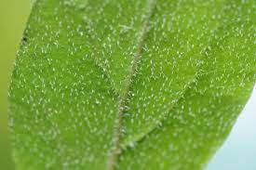
Trichomes
Hairlike trichomes are outgrowths of the shoot epidermis that can reduce water loss and reflect light
Trichomes can also help defend against insects

Slide 19
Leaf Growth & Anatomy
Leaves develop along the sides of the shoot apical meristem
The epidermis in leaves is interrupted by stomata
  pores that allow CO₂ and O₂ exchange between the air and the photosynthetic cells in a leaf
Stomata are also major avenues for evaporative loss of water
Each stomatal pore is flanked by two guard cells, which regulate its opening and closing

Slide 20
Leaf Growth & Anatomy
Mesophyll is sandwiched between the upper and lower epidermis
The mesophyll of eudicots has two layers:
  The palisade mesophyll in the upper part of the leaf
  The spongy mesophyll in the lower part of the leaf; the loose arrangement allows for gas exchange

Slide 21
Leaf Growth & Anatomy
The vascular tissue of each leaf is continuous with the vascular tissue of the stem
Veins are the leaf’s vascular bundles and function as the leaf’s skeleton
Each vein in a leaf is enclosed by a protective bundle sheath

Slide 22
Leaf Growth & Anatomy
As a tree or woody shrub ages, the older layers of secondary xylem, the heartwood, no longer transport water and minerals
The outer layers, known as sapwood, still transport materials through the xylem
Older secondary phloem (bark) sloughs off and does not accumulate

Slide 23
Roots
A root is an organ with important functions:
  Anchoring the plant
  Absorbing minerals and water
  Storing carbohydrates
The primary root is the first root to emerge
The primary root branches to form lateral roots, which improve anchorage and water absorption
Tall plants with large shoot masses generally have a taproot system
The taproot generally develops from the primary root and functions in anchoring the plant in the soil
Absorption primarily occurs in the tips of the lateral roots

Slide 24
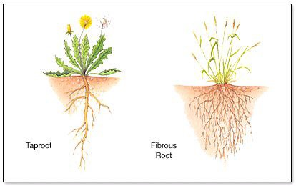
Roots
Small or trailing plants generally have a fibrous root system that spreads out like a thick mat below the soil surface
The primary root dies early on and does not form a taproot
Adventitious roots arise from the stem and give rise to many branching lateral roots

Slide 25
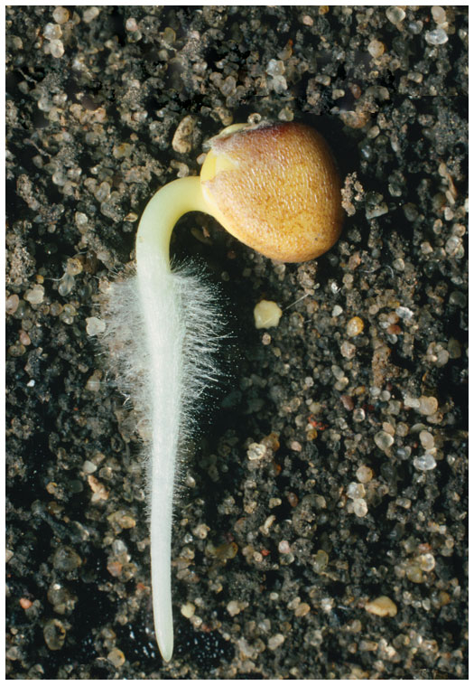
Roots
In most plants, absorption of water and minerals occurs primarily near the tips of roots
Root hairs, finger-like extensions of epidermal cells, form near the root tip and increase the absorptive surface of the root
Most root systems form mycorrhizal associations

Slide 26
Primary Growth of Roots
The root tip is covered by a root cap, which protects the root apical meristem as the root pushes through soil
Growth occurs just behind the root tip, in three zones of cells:
  Zone of cell division
  Zone of elongation
  Zone of differentiation, or maturation

Slide 27
Primary Growth of Roots
The primary growth of roots produces the epidermis, ground tissue, and vascular tissue
Root hairs, epidermal cells modified for absorption, make up 70–90% of the total root surface area

Slide 28
Primary Growth of Roots
The innermost layer of the cortex is called the endodermis
The endodermis regulates passage of substances from the soil into the vascular cylinder

