Slide 1
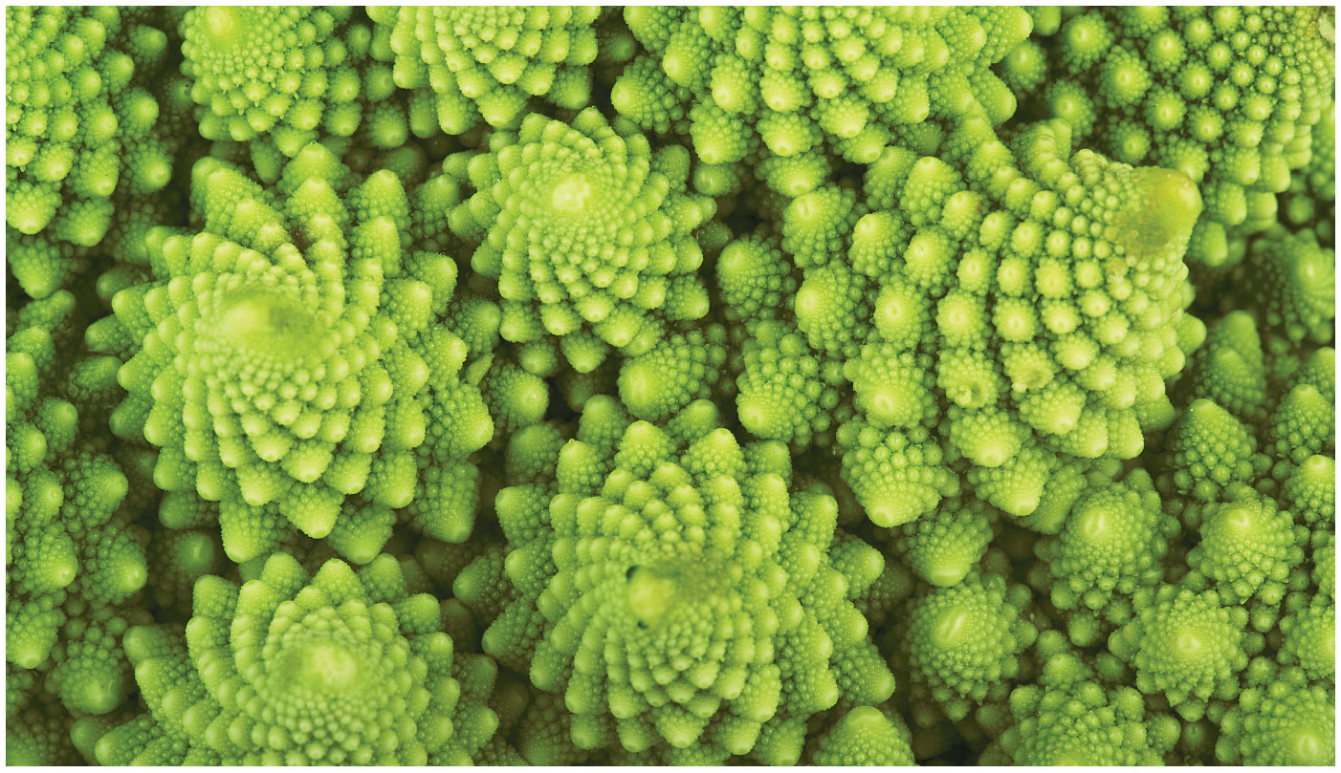
BIO10
Dr. Bradley
Plants

Slide 2
Before next class
  Read:
    Ch14 (all of it) – we’ll keep talking about Plants on Wednesday

Slide 3
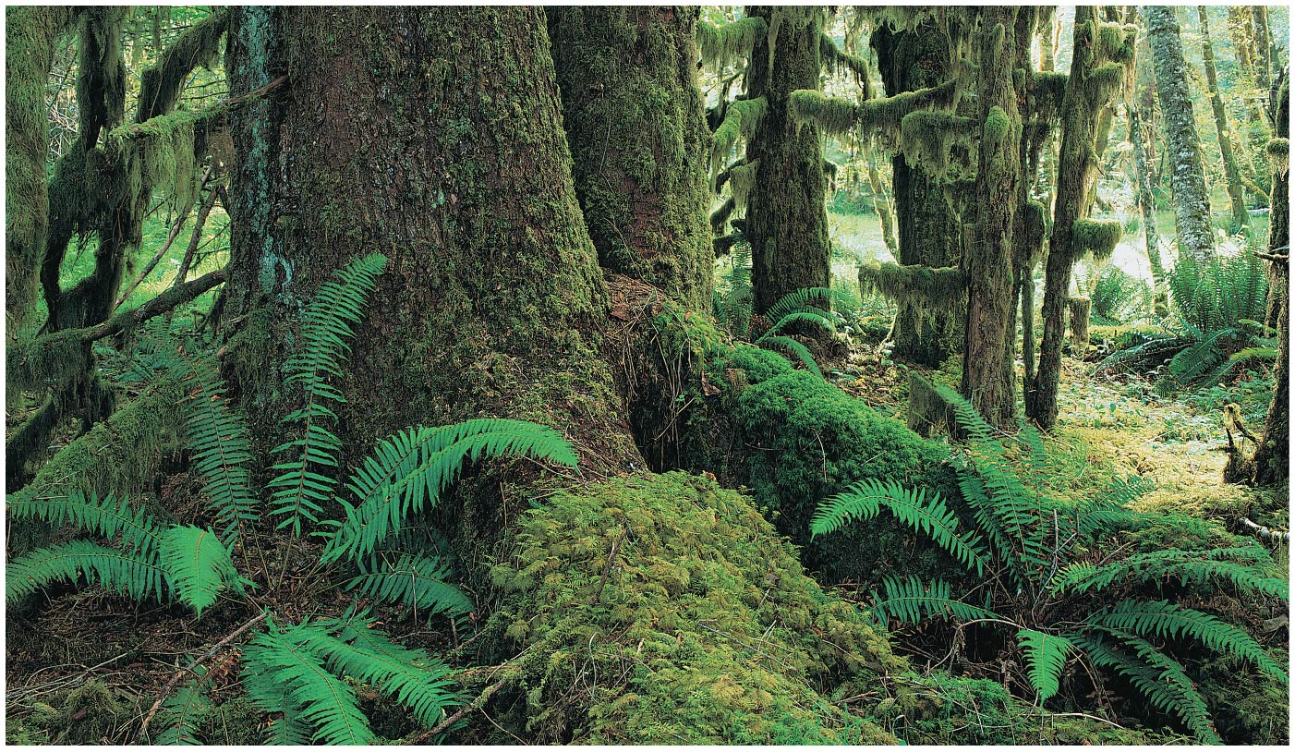
Plants
Small plants, fungi, and animals emerged on land only within the last 500 million years
Most present-day plants live on land, though a few species returned to aquatic habitats
Plants supply oxygen and are the ultimate source of most food eaten by land animals

Slide 4
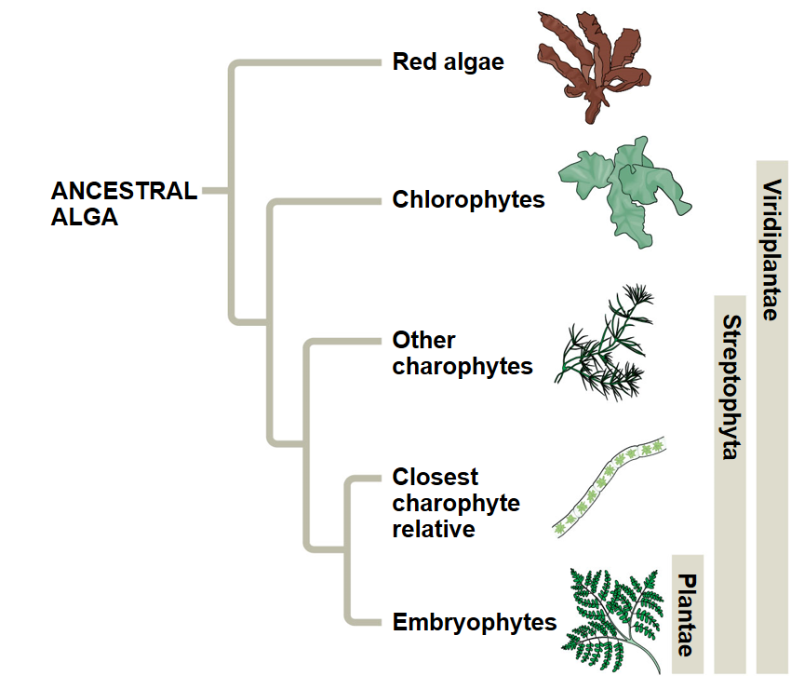
The placement of the boundary dividing plants from algae is the subject of ongoing debate
Until this debate is resolved, we define plants as embryophytes, plants with embryos

Slide 5
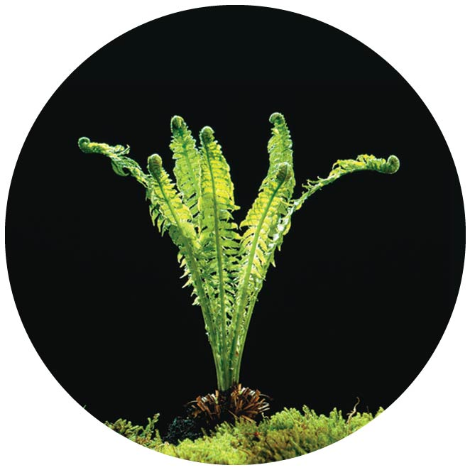
Plants are well adapted to life on land
Green algae are the closest relatives of plants
The move to land provided benefits:
  unfiltered sunlight
  more plentiful CO₂
  nutrient-rich soil
Land also presented challenges:
  a scarcity of water
  lack of structural support against gravity
Plants diversified as adaptations evolved that enabled them to thrive on land despite challenges

Slide 6
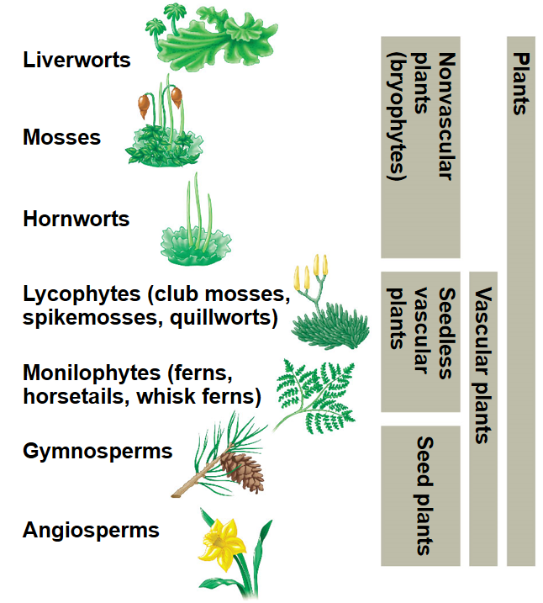
Overview of Types of Plants

Slide 7
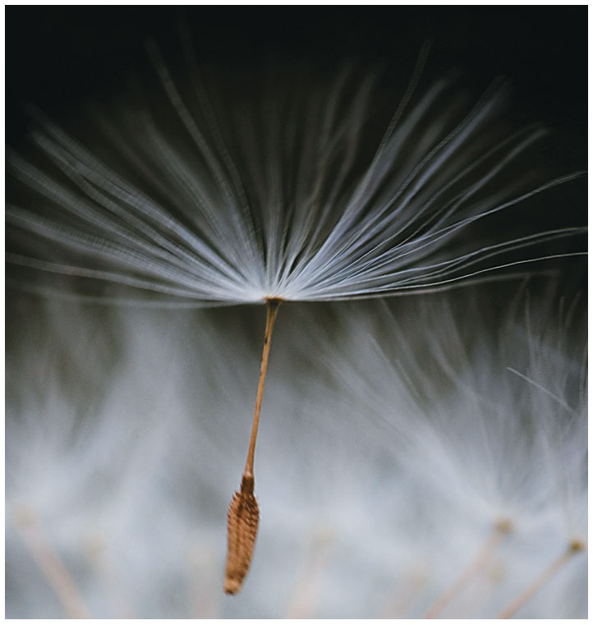
What Makes Plants Unique
Five key traits appear in nearly all plants but are absent in the algal ancestor
  Alternation of generations
  Multicellular & dependent embryos
  Walled spores produced in sporangia
  Multicellular gametangia
  Apical meristems

Slide 8
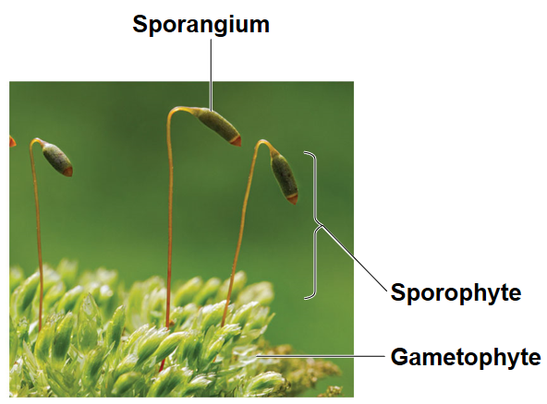
Alternation of Generations
Plants alternate between two multicellular generations, a reproductive cycle called alternation of generations
The gametophyte generation is haploid and produces haploid gametes by mitosis
Fusion of a sperm and egg gives rise to the diploid sporophyte, which produces haploid spores by meiosis
Spores develop into gametophytes

Slide 9
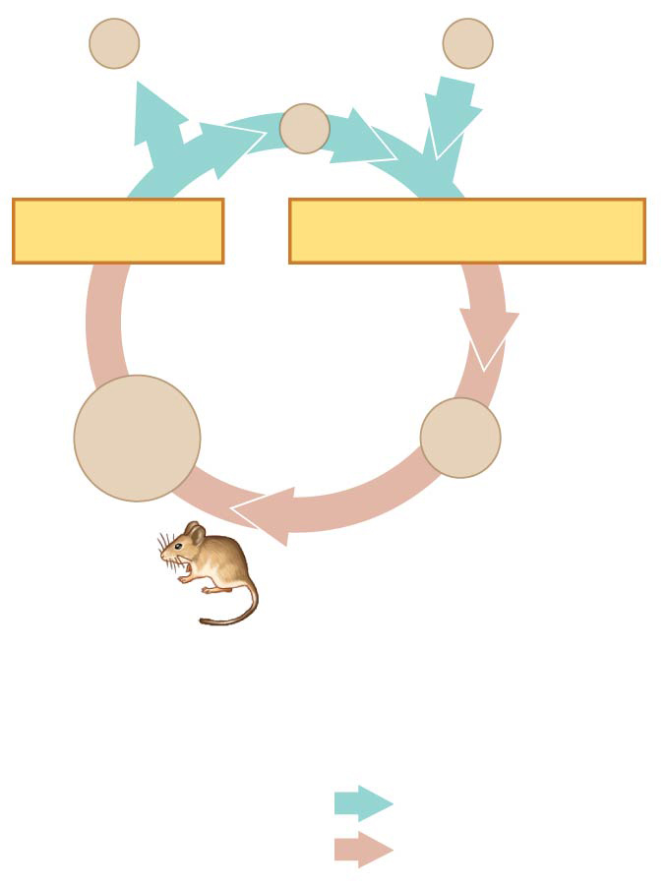
Reminder
In animals, gametes are the only haploid cells
Produced by meiosis and undergo no further cell division before fertilization
Gametes fuse to form a diploid zygote that divides by mitosis to develop into a multicellular organism
n
Gametes
n
n
MEIOSIS
FERTILIZATION
Zygote
2n
2n
Mitosis
Diploid
multicellular
organism
Key
Haploid (n)
(a)
Animals
Diploid (2n)

Slide 10
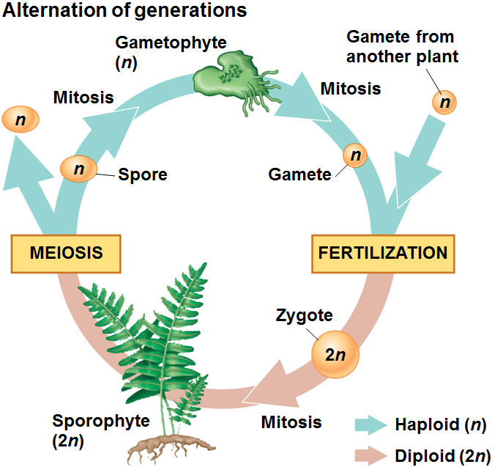
Alternation of Generations
Plants alternate between two multicellular generations, a reproductive cycle called alternation of generations
The gametophyte generation is haploid and produces haploid gametes by mitosis
Fusion of a sperm and egg gives rise to the diploid sporophyte, which produces haploid spores by meiosis
Spores develop into gametophytes

Slide 11
Multicellular & Dependent Embryos
The diploid embryo is retained within the tissue of the female gametophyte
Nutrients are transferred from parent to embryo through placental transfer cells
Plants are called embryophytes because of the dependency of the embryo on the parent

Slide 12
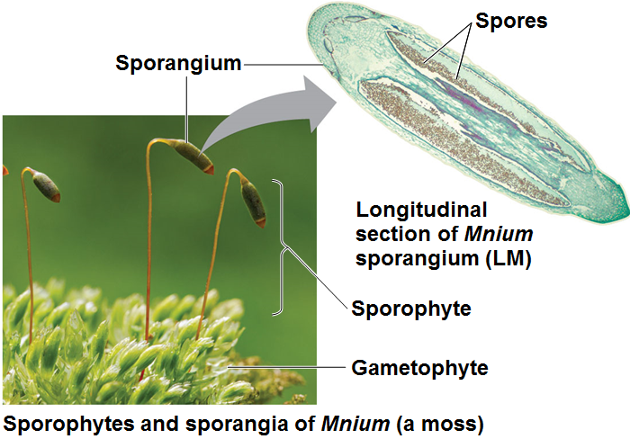
Walled Spores Produced in Sporangia
The sporophyte produces spores in organs called sporangia
Diploid cells called sporocytes undergo meiosis to generate haploid spores
Spore walls are resistant to harsh environments

Slide 13
Multicellular Gametangia
Gametes are produced within organs called gametangia
Female gametangia, called archegonia (plural), produce a single nonmotile egg
Male gametangia, called antheridia, produce and release sperm
Fertilization takes place within the archegonium (singular)

Slide 14
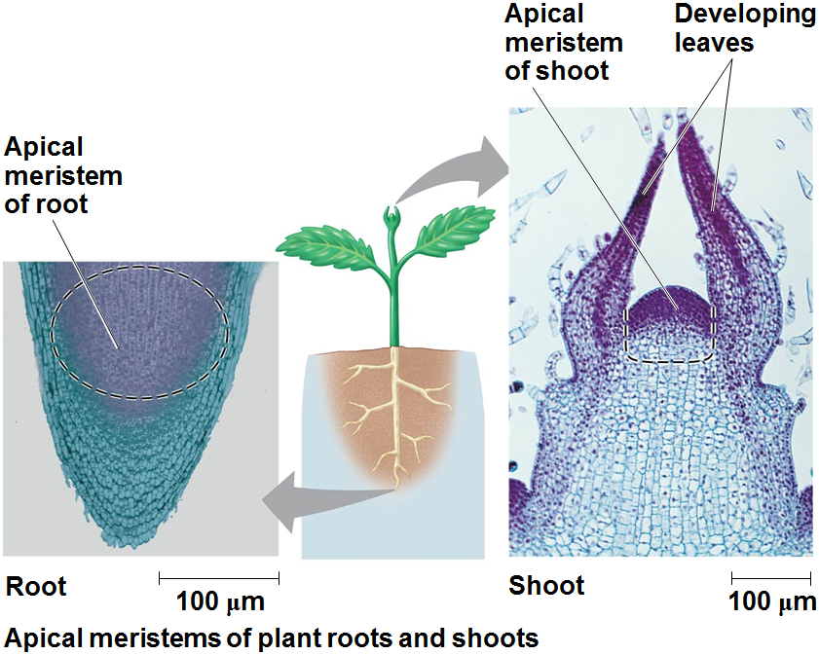
Apical Meristems
Plants sustain continual growth in length by repeated cell division within the apical meristems
Cells from the apical meristems differentiate into various tissues

Slide 15
Additional derived traits include
  the cuticle, a waxy covering of the epidermis
  stomata, specialized cells that allow for gas exchange between the outside air and the plant

Slide 16
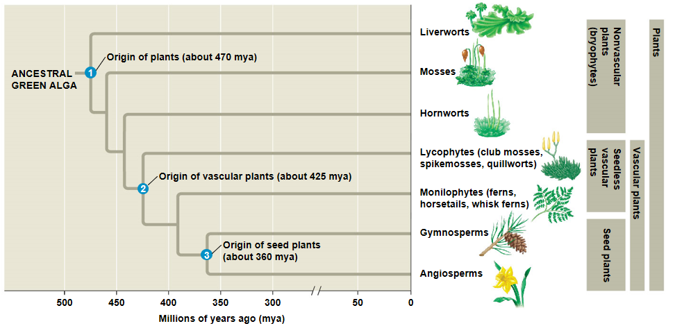

Slide 17
Most plants have vascular tissue, cells joined into tubes for the transport of water and nutrients; these constitute the vascular plants
Nonvascular plants are commonly called bryophytes

Slide 18
Seedless vascular plants can be divided into clades:
  Lycophytes (club mosses and their relatives)
  Monilophytes (ferns and their relatives)

Slide 19
A seed is an embryo and nutrients surrounded by a protective coat
Seed plants form a clade and can be divided into further clades
  Gymnosperms produce seeds that are not enclosed in chambers
  Angiosperms produce seeds that develop inside chambers that originate within flowers

Slide 20
Bryophytes are represented today by three phyla of small, herbaceous (nonwoody) plants
  Liverworts, phylum Hepatophyta
  Mosses, phylum Bryophyta
  Hornworts, phylum Anthocerophyta

Slide 21
In all three bryophyte phyla, gametophytes are larger and longer-living than sporophytes
Sporophytes are typically present only part of the time

Slide 22
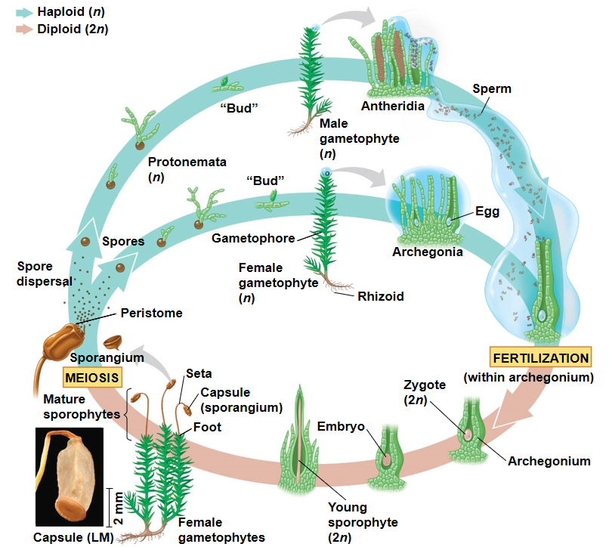
Life Cycle of Mosses
A spore germinates into a gametophyte composed of a protonema and one or more gamete-producing gametophores
The height of gametophytes is constrained by lack of vascular tissues
Rhizoids anchor gametophytes to substrate
Mature gametophytes produce flagellated sperm in antheridia and an egg in each archegonium
Sperm swim through a film of water to reach and fertilize the egg
Many bryophytes also reproduce asexually

Slide 23
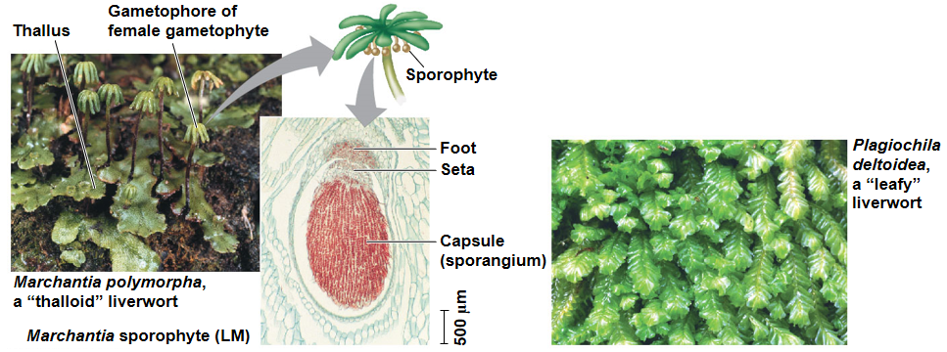
Bryophyte sporophytes never live independently of the gametophyte; they are the smallest and simplest sporophytes of all extant plant groups
A sporophyte consists of a foot, a seta (stalk), and a sporangium, also called a capsule, which discharges spores through a peristome
Hornwort and moss sporophytes have stomata; liverworts do not
Liverworts (Phylum Hepatophyta)

Slide 25
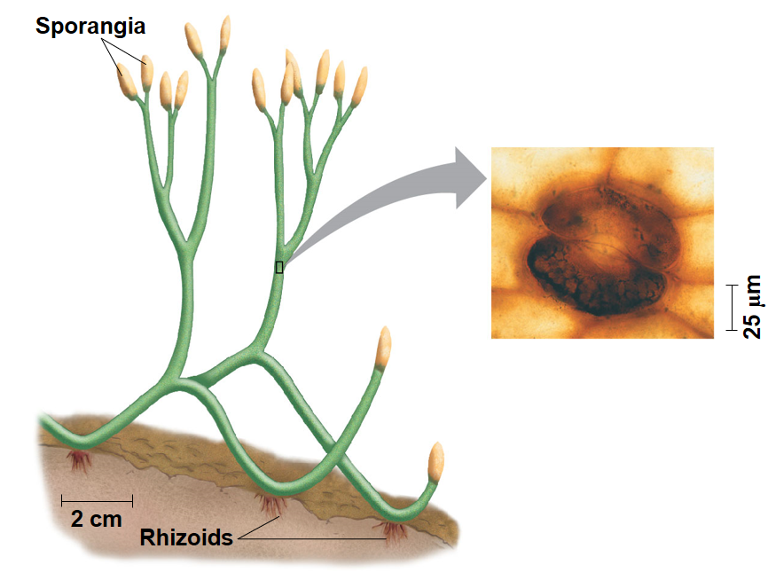
Early vascular plants had independent, branching sporophytes
Extant vascular plants are characterized by
  life cycles with dominant sporophytes
  vascular tissues called xylem and phloem
  well-developed roots and leaves
  spore-bearing leaves called sporophylls

Slide 26
In contrast with bryophytes, sporophytes of seedless vascular plants are the larger, more complex generation
  For example, in ferns, the familiar leafy plants are the sporophytes; the gametophytes are tiny plants that grow on or below the soil surface

Slide 27
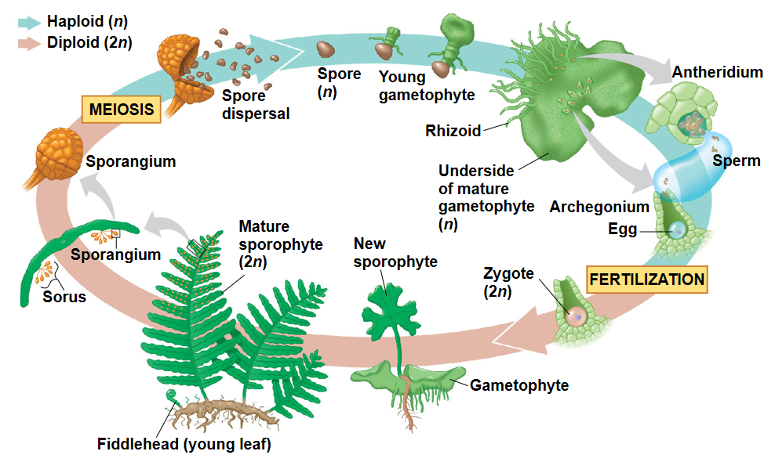
Life Cycle of a Fern

Slide 28
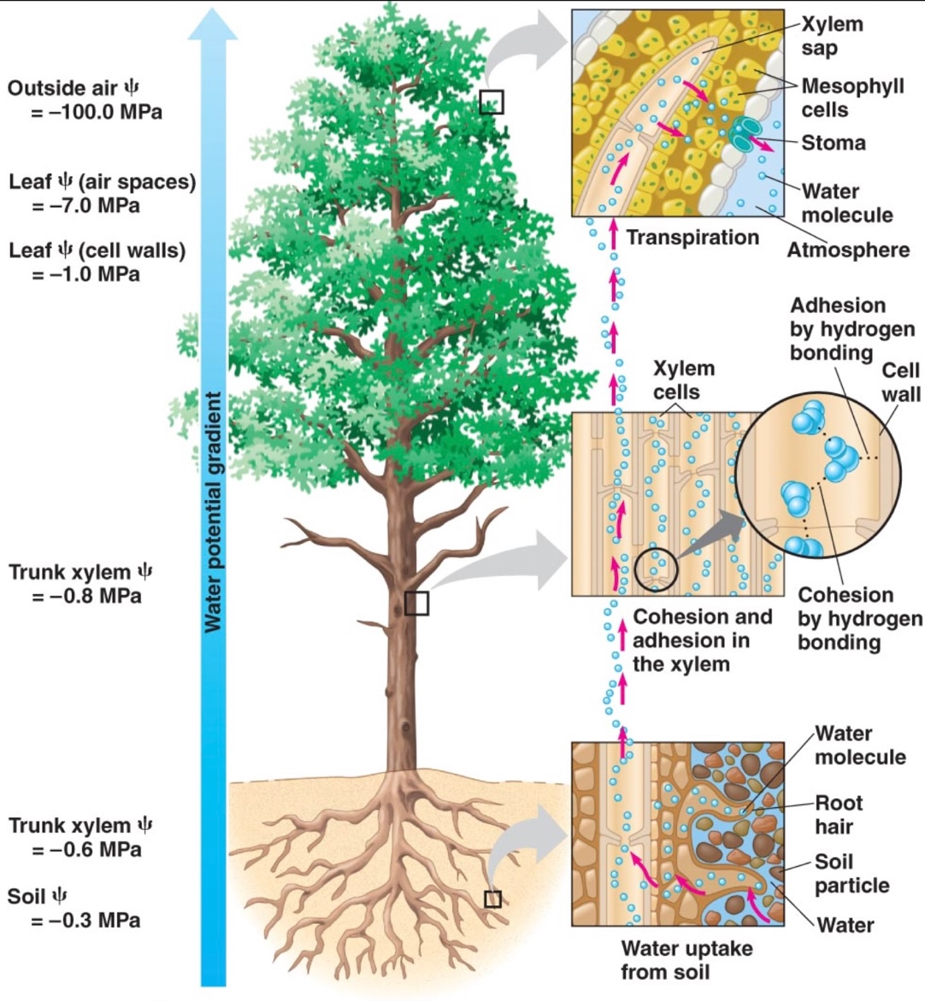
Vascular plants have two types of vascular tissue: xylem and phloem
Xylem conducts most of the water and minerals Water-conducting cells provide structural support
Phloem has cells arranged into tubes that distribute sugars, amino acids, and other organic products
Vascular tissue allowed for increased height, which provided an evolutionary advantage

Slide 29
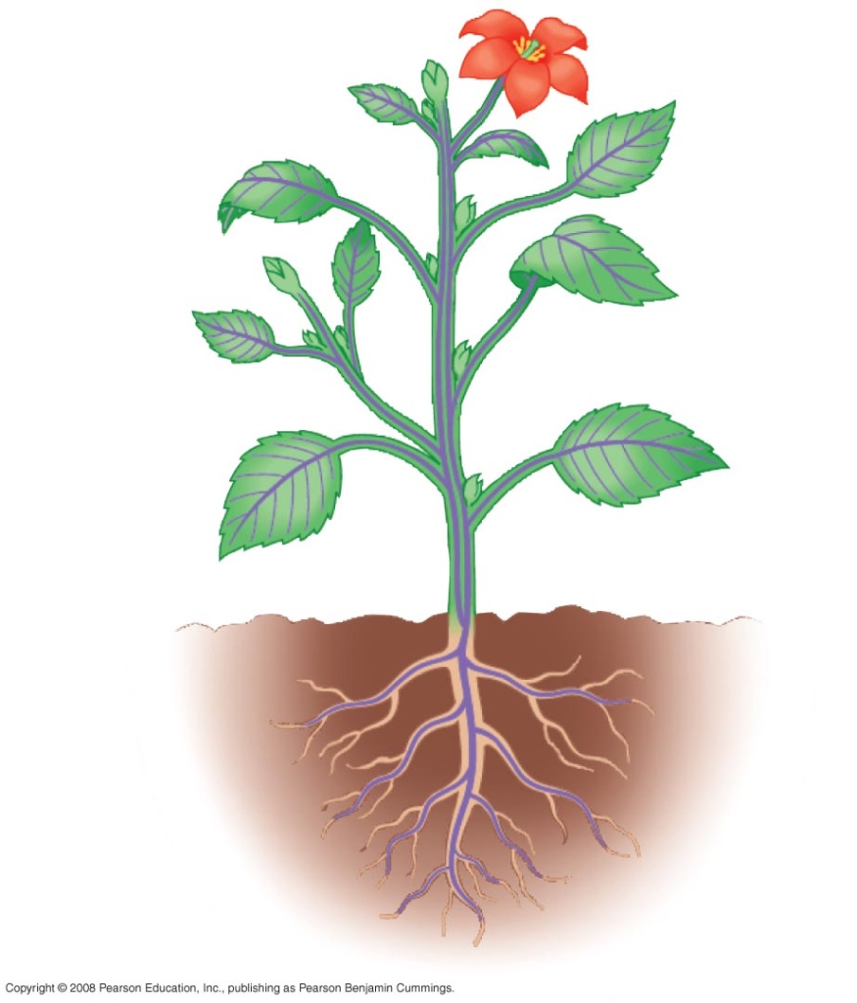
Roots are organs that anchor vascular plants
They enable vascular plants to absorb water and nutrients from the soil

Slide 30
Leaves are organs that increase the surface area of vascular plants, thereby capturing more solar energy that is used for photosynthesis
Leaves are categorized by two types:
  Microphylls, small, often spine-shaped leaves with a single vein
  Megaphylls, larger leaves with a highly branched vascular system

Slide 31
Ferns are the most widespread seedless vascular plants, with more than 12,000 species
They are most diverse in the tropics but also thrive in temperate forests
Horsetails were diverse during the Carboniferous period, but are now restricted to the genus Equisetum
Whisk ferns resemble ancestral vascular plants but are closely related to modern ferns

Slide 32
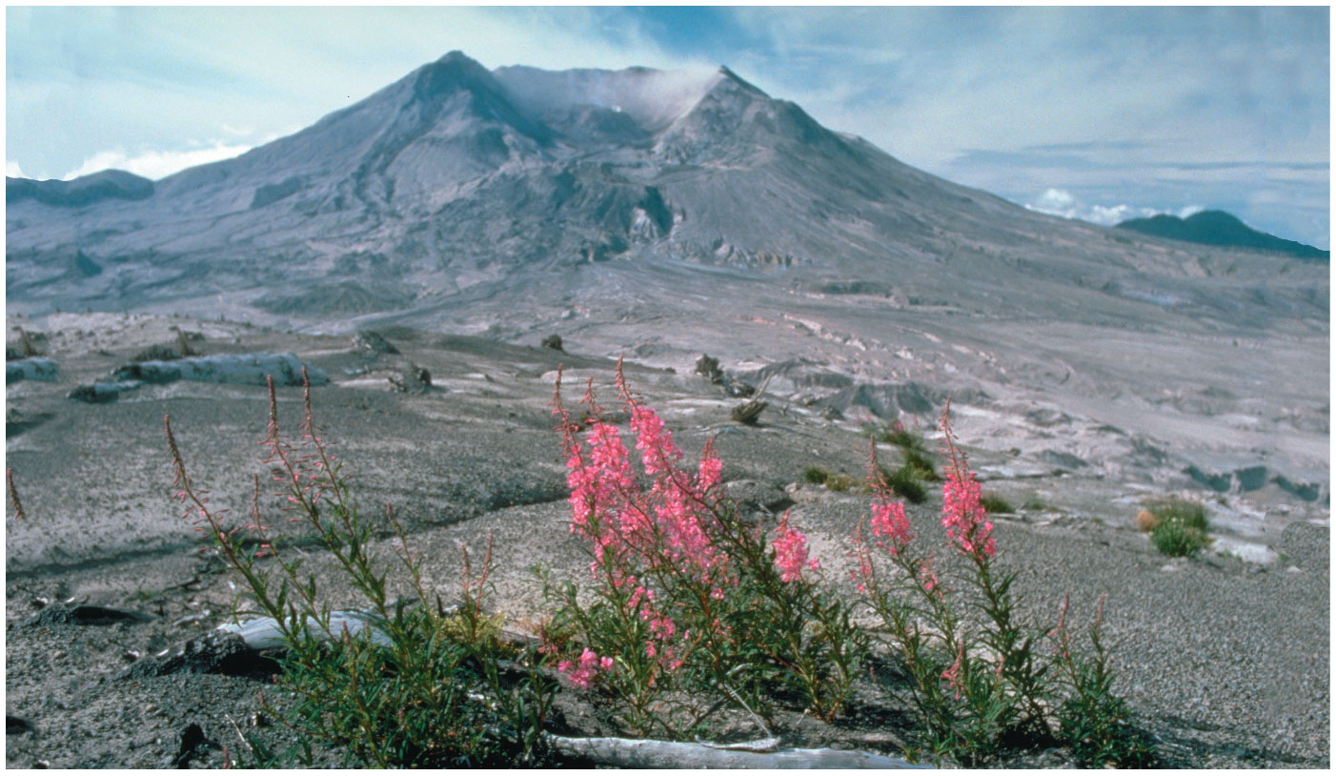
Seed Plants
Seeds changed the course of plant evolution, enabling their bearers to become the dominant producers in most terrestrial ecosystems
Seed plants originated about 360 million years ago
A seed consists of an embryo and nutrients surrounded by a protective coat
Seeds can disperse over long distances by wind or other means

Slide 33
Seeds and pollen grains are key adaptations for life on land
In addition to seeds, the following are common to all seed plants
  Reduced gametophytes
  Heterospory
  Ovules
  Pollen

Slide 34
Seeds and pollen grains are key adaptations for life on land
The gametophytes of seed plants are microscopic
They develop within the walls of spores that are retained within tissues of the parent sporophyte
This arrangement protects the developing gametophyte from environmental stress and enables it to obtain nutrients from the sporophyte

Slide 36
Pollen and Production of Sperm
Gymnosperms means “naked seeds”
Most gymnosperms are cone-bearing plants called conifers

Slide 37
Living seed plants can be divided into two clades: gymnosperms and angiosperms
The gymnosperms consist of four phyla:
  Cycadophyta (cycads)
  Ginkgophyta (one living species: Ginkgo biloba)
  Gnetophyta (three genera: Gnetum, Ephedra, Welwitschia)
  Coniferophyta (conifers, such as pine, fir, and redwood)

Slide 38
Phylum Cycadophyta
Individuals have large cones and palmlike leaves
Unlike most seed plants, cycads have flagellated sperm
These thrived during the Mesozoic, but most of the few surviving species are endangered

Slide 39
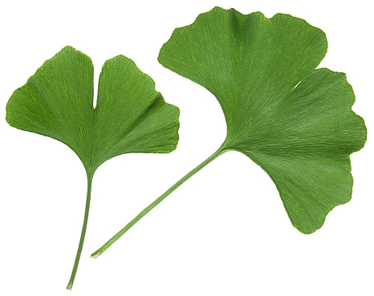
Phylum Ginkgophyta
This phylum consists of a single living species, Ginkgo biloba
Like the cycads, this group also has flagellated sperm
It has a high tolerance to air pollution and is a popular ornamental tree

Slide 40
Phylum Gnetophyta
This phylum comprises three genera: Gnetum, Ephedra, and Welwitschia
Species vary in appearance, and some are tropical, whereas others live in deserts

Slide 41
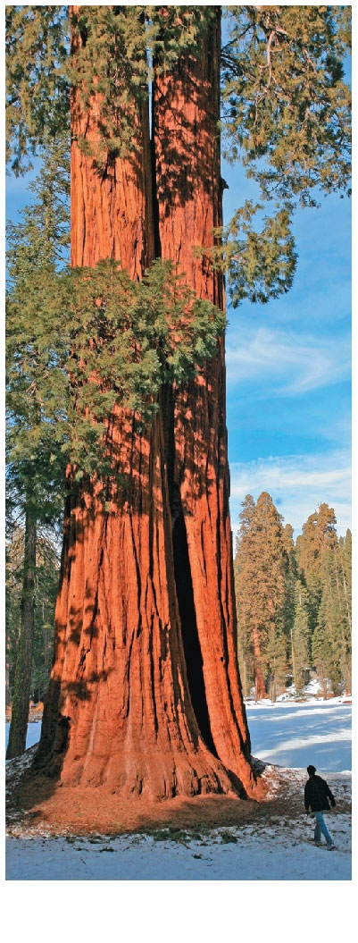
Conifers
Phylum Coniferophyta
This phylum is the largest of the gymnosperm phyla
Most species have woody cones, but a few have fleshy cones
Most conifers are evergreens and can carry out photosynthesis all year round
Sequoia

Slide 42
Gymnosperms
An ovule consists of a megasporangium, megaspore, and one or more protective integuments
Gymnosperm megasporangia have one integument
Angiosperm megasporangia usually have two integuments

Slide 43
Pollen and Production of Sperm
A microspore develops into a pollen grain that consists of a male gametophyte enclosed within the pollen wall
Pollination is the transfer of pollen to the part of a seed plant containing the ovules
A germinated pollen grain produces a pollen tube that discharges sperm into the female gametophyte within the ovule
Pollen eliminates the need for a film of water and can be dispersed great distances by air or animals

Slide 44
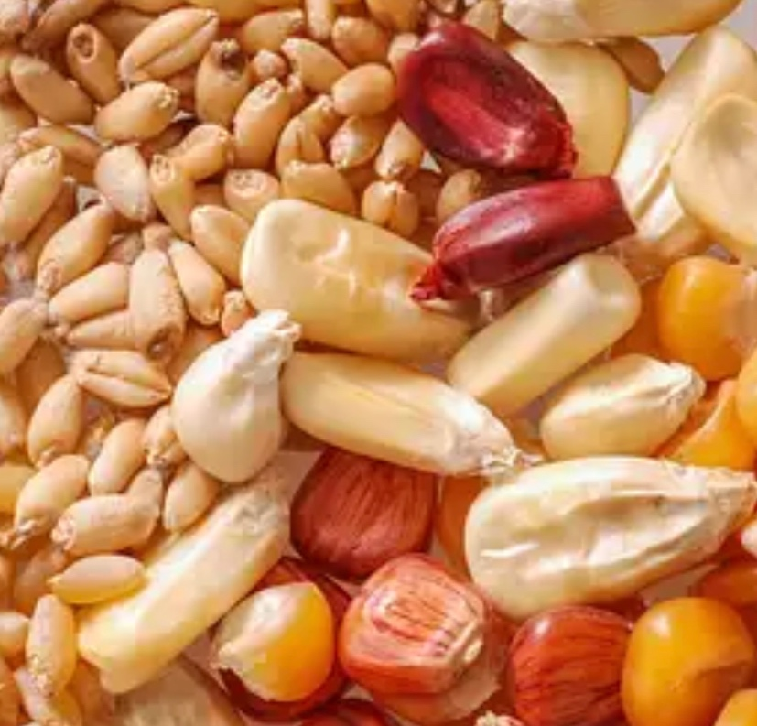
Seeds
Seeds provide some evolutionary advantages over spores
  They may remain dormant for days to years, until conditions are favorable for germination
  They have a supply of stored food
  They may be transported long distances by wind or animals

Slide 45
Life Cycle of a Pine
Three key features of the gymnosperm life cycle are
  miniaturization of their gametophytes
  production of seeds, a dispersible stage in the life cycle
  the transfer of sperm to ovules by pollen

Slide 46
Life Cycle of a Pine
The pine tree is the sporophyte that produces sporangia in male and female cones
Pollen cones are small and consist of modified leaves that bear microsporangia
Cells called microsporocytes undergo meiosis to produce haploid microspores inside the microsporangia
Each microspore develops into a pollen grain

Slide 47
Life Cycle of a Pine
Ovulate cones are larger and consist of both modified leaves and modified stem tissue
Within each ovule, megasporocytes undergo meiosis to produce haploid megaspores
Megaspores develop into female gametophytes, which are retained within the megasporangia

Slide 48
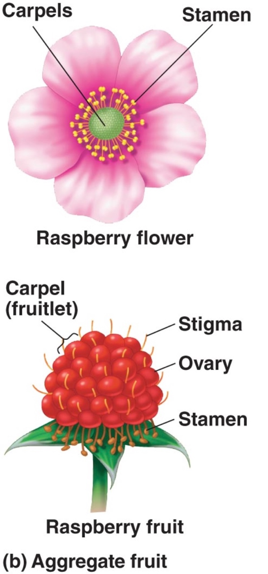
The reproductive adaptations of angiosperms include flowers and fruits
Angiosperms are seed plants with reproductive structures called flowers and fruits
They are the most widespread and diverse of all plants

Slide 49
The reproductive adaptations of angiosperms include flowers and fruits
All angiosperms are classified in a single phylum, Anthophyta
The flower is an angiosperm structure specialized for sexual reproduction
Many species are pollinated by insects or animals, while some species are wind-pollinated

Slide 50
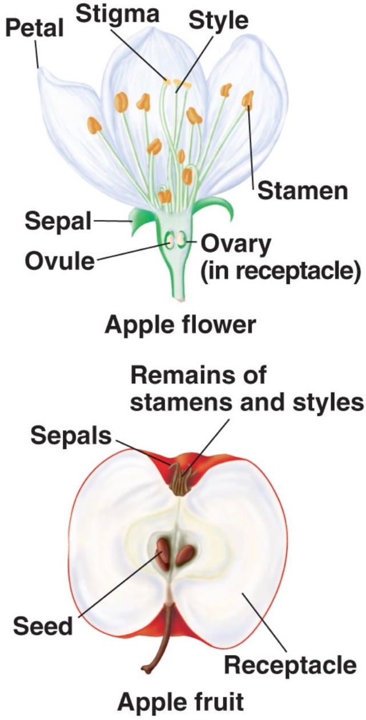
The reproductive adaptations of angiosperms include flowers and fruits
A flower is a specialized shoot with up to four types of modified leaves called floral organs:
  Sepals, which enclose the flower
  Petals, which are often brightly colored to attract pollinators; wind-pollinated flowers generally lack brightly colored parts
  Stamens, the male reproductive organs
  Carpels, the female reproductive organs

Slide 51
The reproductive adaptations of angiosperms include flowers and fruits
A stamen consists of a stalk called a filament, with a sac called an anther
Microspores, which are produced in the anthers, develop into pollen grains containing the male gametophytes

Slide 52
The reproductive adaptations of angiosperms include flowers and fruits
A carpel consists of an ovary at the base of a style leading up to a sticky stigma, where pollen is received
The ovary contains the female gametophyte(s) within the ovule(s)
Fertilized ovules develop into seeds
The term pistil can be used to refer to a single carpel or two or more fused carpels

Slide 53
Flowers are variable in shape, size, color, and odor
  For example, some flowers have radial symmetry, while others have bilateral symmetry
  In radial symmetry, any imaginary line through the central axis divides the flower into two equal parts
  In bilateral symmetry, a flower can only be divided into two equal parts by a single imaginary line

Slide 54
A fruit is formed when the ovary wall thickens and matures
Fruits protect seeds and aid in their dispersal
Mature fruits can be either fleshy or dry

Slide 55
Various fruit adaptations help disperse seeds
Seeds can be carried by wind, water, or animals to new locations

Slide 56
Angiosperm Lifecycle
The flower of the sporophyte is composed of both male and female structures
Male gametophytes are contained within pollen grains produced by the microsporangia of anthers
The female gametophyte, or embryo sac, develops within an ovule contained within an ovary at the base of a stigma
Most flowers have mechanisms to ensure cross-pollination between flowers from different plants of the same species

Slide 57
Angiosperm Lifecycle
A pollen grain that has landed on a stigma germinates, and the pollen tube of the male gametophyte grows down to the ovary
The ovule is entered through a pore called the micropyle
Double fertilization occurs when the pollen tube discharges two sperm into the female gametophyte within an ovule

Slide 58
Angiosperm Lifecycle
One sperm fertilizes the egg, while the other combines with two nuclei in the central cell of the female gametophyte and initiates development of food-storing endosperm
The triploid endosperm nourishes the developing embryo
Within a seed, the embryo consists of a root and one or two seed leaves called cotyledon

Slide 59
Monocots
Monocots
About one-quarter of angiosperms, about 70,000 species, are monocots
The largest groups are the orchids, grasses, and palms

Slide 60
Eudicots
Eudicots
More than two-thirds of angiosperms, about 170,000 species, are eudicots
Eudicots include the large legume family and the economically important rose family

