Slide 1
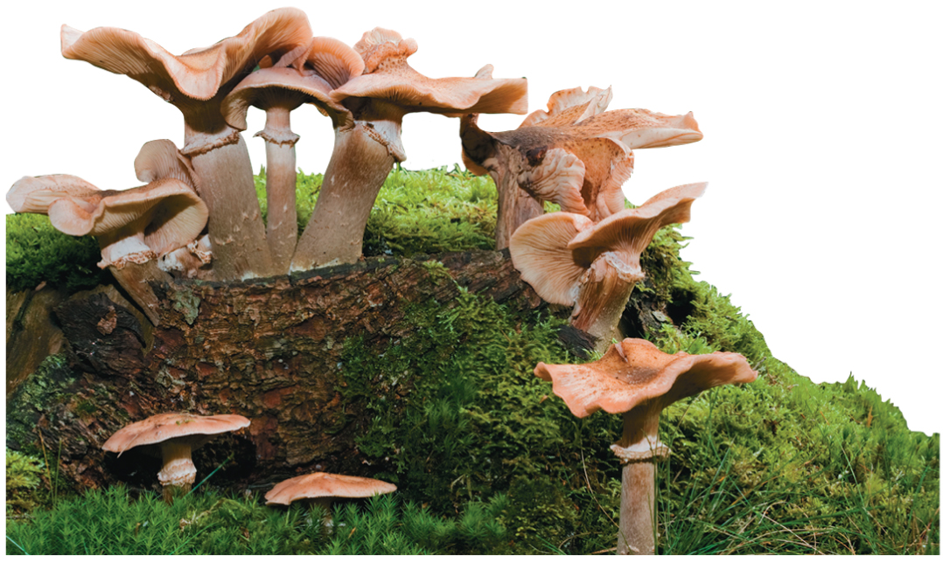
BIO10
Dr. Bradley
Fungi

Slide 2
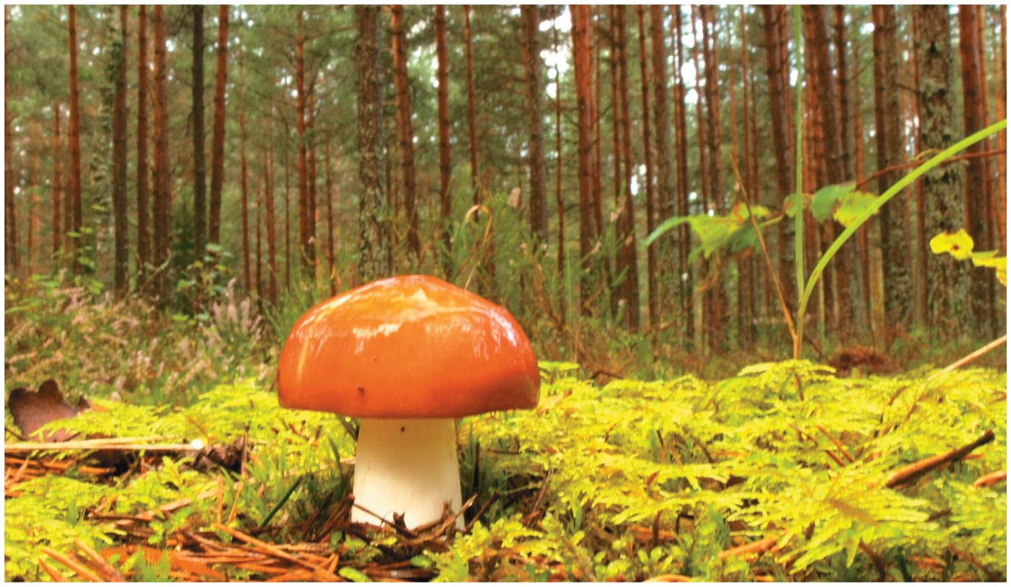
Fungi & Plants: Hidden Networks
The mushrooms you see on the forest floor are just the aboveground parts of a vast network of underground filaments
Fungal filaments absorb nutrients from the soil, transfer them to trees, and receive sugars in return
They are essential for the well-being of most terrestrial ecosystems because they break down organic material and recycle vital nutrients

Slide 3
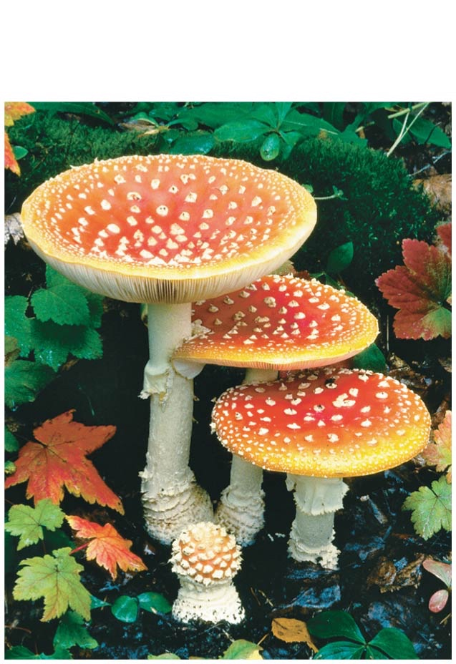
Fungi are heterotrophs that feed by absorption
Despite their diversity, fungi share key traits, most importantly the way in which they derive nutrition
Fungi are heterotrophs that absorb nutrients from outside of their bodies
Fungi use enzymes to break down a large variety of complex molecules into smaller organic compounds

Slide 4
Fungi exhibit diverse lifestyles: decomposers, parasites, and mutualists
  Decomposers break down and absorb nutrients from nonliving organic material
  Parasitic fungi absorb nutrients from living hosts
  Mutualistic fungi absorb nutrients from hosts and reciprocate with actions that benefit the host

Slide 5
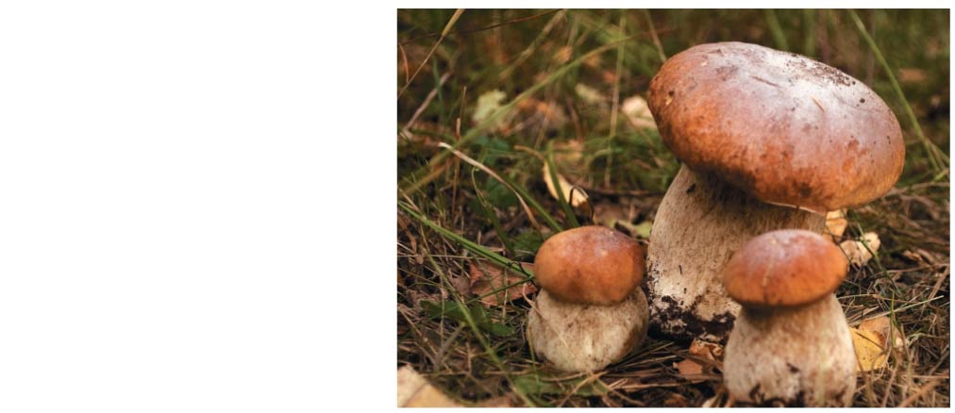
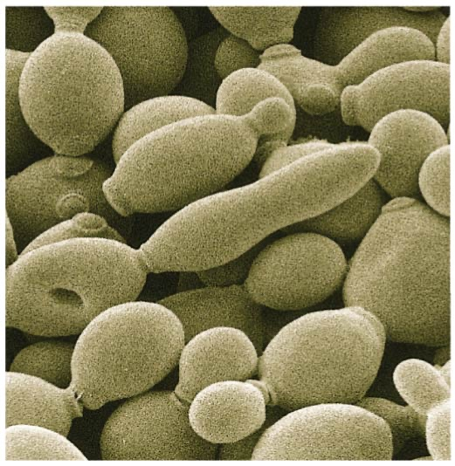
Fungal Body Structure
The most common body structures are multicellular filaments and single cells (yeasts)
Some species grow as either filaments or yeasts; others grow as both

Slide 6
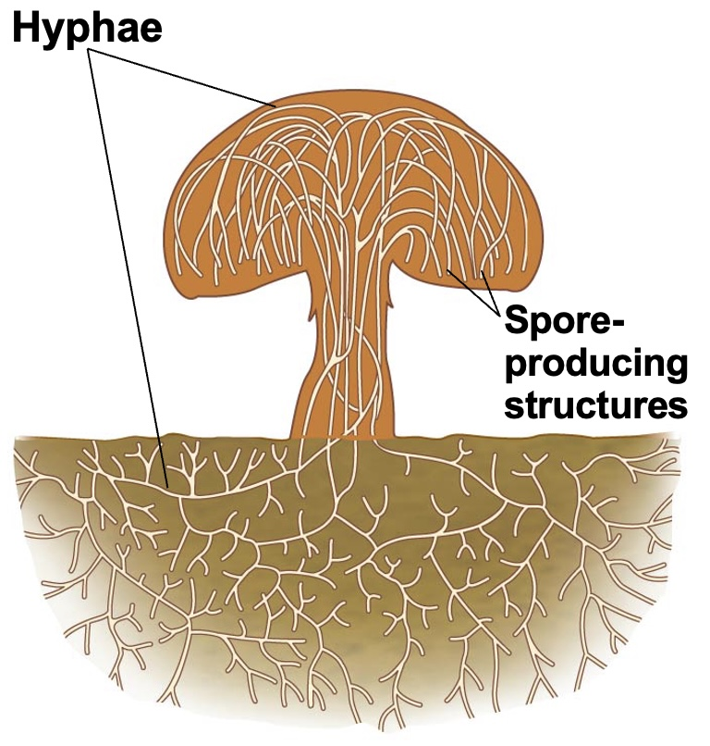
The morphology of multicellular fungi enhances their ability to absorb nutrients
The body of fungi form networks of branched hyphae adapted for absorption
Hyphae have tubular cell walls strengthened with chitin

Slide 7
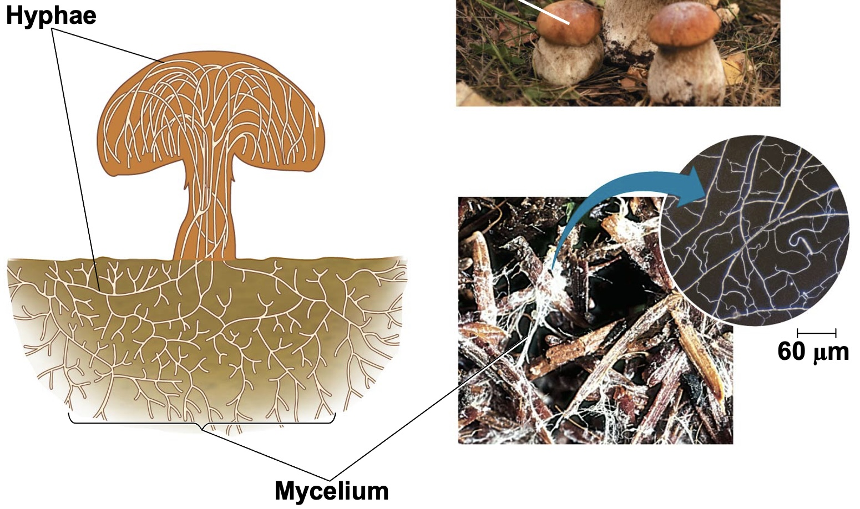
Fungal hyphae form an interwoven mass called a mycelium
The structure of a mycelium maximizes surface-to-volume ratio, making feeding very efficient

Slide 8
Most fungi have hyphae divided into cells by septa, with pores allowing cell-to-cell movement of organelles
Coenocytic fungi lack septa and have a continuous cytoplasmic mass with hundreds or thousands of nuclei

Slide 9
Specialized Hyphae in Mycorrhizal Fungi
Some fungi have specialized hyphae for feeding on live animals
Others have specialized non-branching hyphae called haustoria that allow them to extract nutrients from plants
Mutualistic fungi have branching hyphae such as arbuscules that they use to exchange nutrients with plant hosts

Slide 10
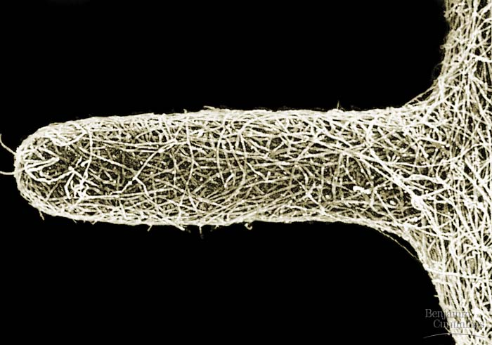
Mycorrhizae are mutually beneficial relationships between fungi and plant roots
Ectomycorrhizal fungi form sheaths of hyphae over a root and typically grow into the extracellular spaces of the root cortex
Arbuscular mycorrhizal fungi extend arbuscules through the root cell wall and into tubes formed by invagination of the plasma membrane
Mycorrhizal fungi deliver phosphate and minerals to plants and most vascular plants have mycorrhizae

Slide 11
Fungi produce spores through sexual or asexual life cycles
Fungi propagate themselves by producing vast numbers of spores, either sexually or asexually
Spores can be carried long distances by wind or water; they will germinate if they land in moist conditions with available food

Slide 12
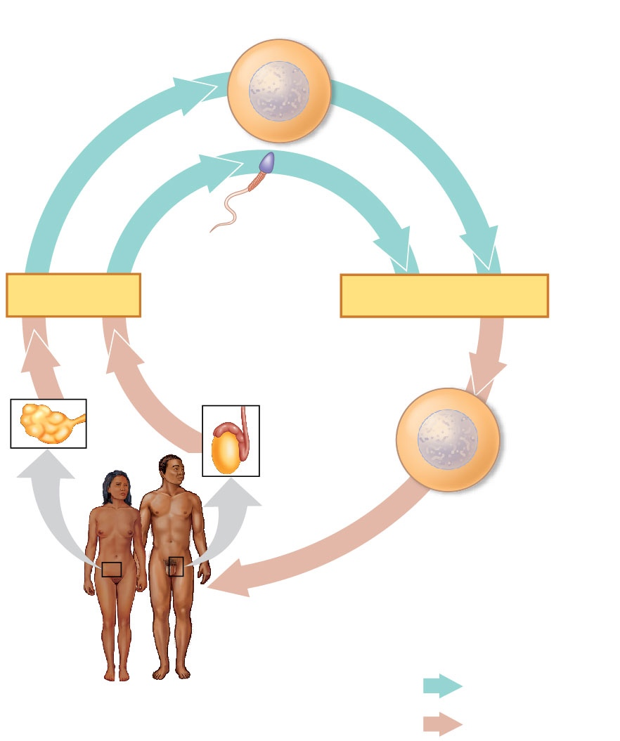
Reminder
Haploid gametes (n = 23)
Egg (n)
Reminder about animals like us…
The life cycle alternates between the processes of meiosis and fertilization to produce haploid and diploid stages of the life cycle
Sperm (n)
MEIOSIS
FERTILIZATION
Testis
Ovary
Diploid
zygote
(2n = 46)
Mitosis and
development
Multicellular diploid
adults (2n = 46)
Haploid (n)
Diploid (2n)
Notes:
Figure 13.5 The human life cycle

Slide 13
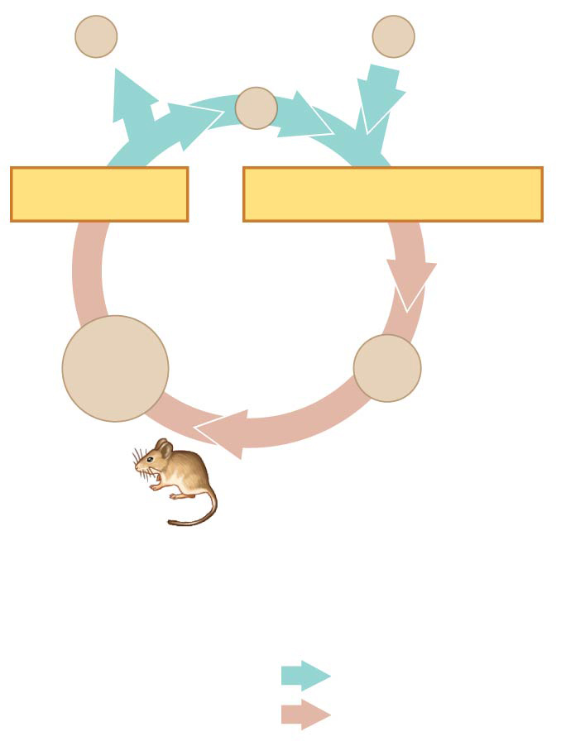
Reminder
In animals, gametes are the only haploid cells
Produced by meiosis and undergo no further cell division before fertilization
Gametes fuse to form a diploid zygote that divides by mitosis to develop into a multicellular organism
n
Gametes
n
n
MEIOSIS
FERTILIZATION
Zygote
2n
2n
Mitosis
Diploid
multicellular
organism
Key
Haploid (n)
(a)
Animals
Diploid (2n)

Slide 14
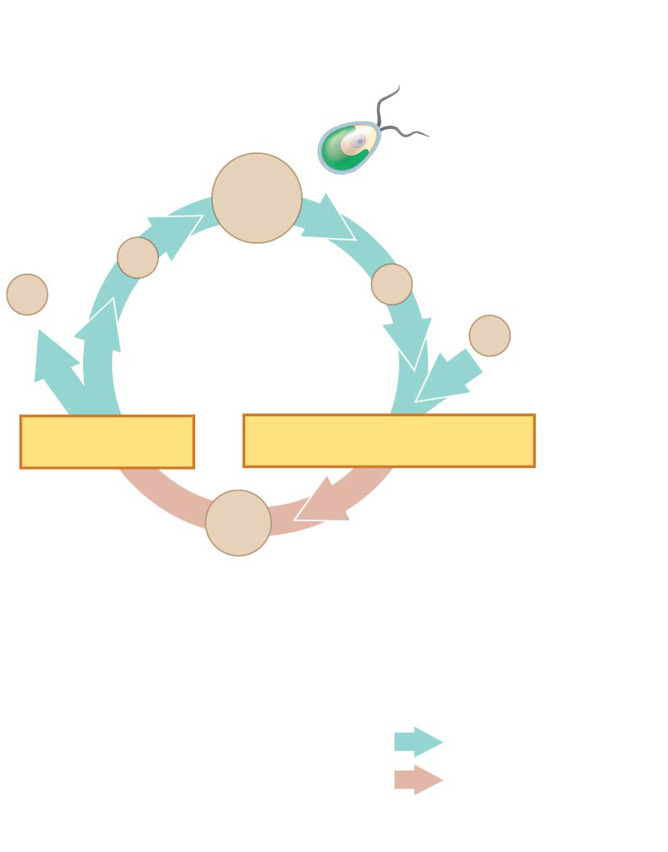
Haploid unicellular or
multicellular organism
In most fungi and some protists, the only diploid stage is the single-celled zygote; there is no multicellular diploid stage
The zygote produces haploid cells by meiosis
Each haploid cell grows by mitosis into a haploid multicellular organism
The haploid adult produces gametes by mitosis
Mitosis
n
Mitosis
n
n
n
Gametes
n
MEIOSIS
FERTILIZATION
2n
Zygote
Key
Haploid (n)
(c)
Most fungi and
some protists
Diploid (2n)

Slide 15
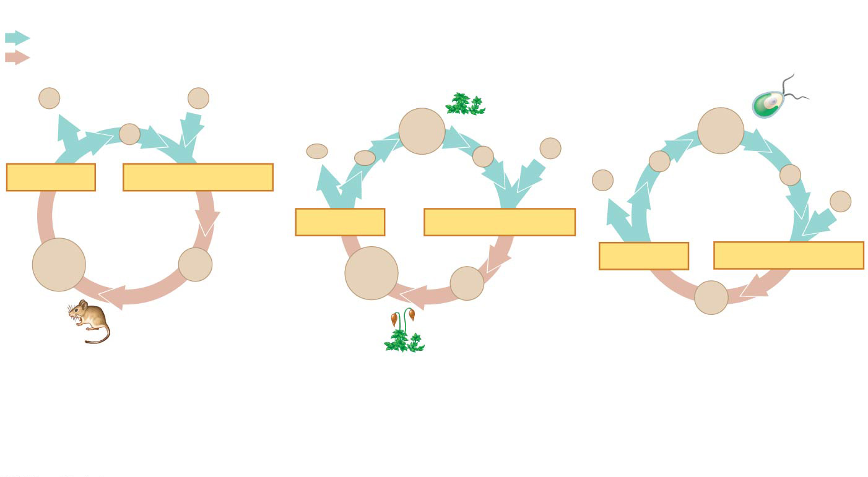
Key
Haploid (n)
Diploid (2n)
MEIOSIS
FERTILIZATION
MEIOSIS
FERTILIZATION
MEIOSIS
FERTILIZATION
(a)
Animals
(c)
Most fungi and
some protists
Only diploid cells can undergo meiosis
Notes:
Read slide first first:
Depending on the type of life cycle, either haploid or diploid cells can divide by mitosis
However, only diploid cells can undergo meiosis

Slide 16
Depending on the organism haploid OR diploid cells can undergo mitosis
Key
Haploid (n)
Diploid (2n)
Mitosis
Mitosis
MEIOSIS
FERTILIZATION
MEIOSIS
FERTILIZATION
MEIOSIS
FERTILIZATION
Mitosis
Mitosis
(a)
Animals
(c)
Most fungi and
some protists
Notes:
Read slide first first:
Depending on the type of life cycle, either haploid or diploid cells can divide by mitosis
However, only diploid cells can undergo meiosis

Slide 17
Key
Haploid (n)
Diploid (2n)
Mitosis
Mitosis
Mitosis
Mitosis
MEIOSIS
FERTILIZATION
MEIOSIS
FERTILIZATION
MEIOSIS
FERTILIZATION
Mitosis
Mitosis
(a)
Animals
(c)
Most fungi and
some protists
Depending on the organism gametes can be made via meiosis or mitosis
Notes:
Read slide first first:
Depending on the type of life cycle, either haploid or diploid cells can divide by mitosis
However, only diploid cells can undergo meiosis

Slide 18
Other fungi that can reproduce asexually are yeasts, which are single cells
Instead of producing spores, yeasts reproduce asexually by simple cell division and the pinching of “bud cells” from a parent cell
Some fungi can grow as both yeasts and as filamentous mycelia

Slide 19
The ancestor of fungi was an aquatic, single-celled, flagellated protist
Fungi and animals are more closely related to each other than they are to plants or other eukaryotes

Slide 20
Fungi have radiated into a diverse set of lineages
Recent studies estimate fungal diversity at around 1.5 million species

Slide 21
Chytrids
Chytrids (phylum Chytridiomycota) are found in terrestrial, freshwater, and marine habitats including hydrothermal vents
They can be decomposers, parasites, or mutualists
Molecular evidence supports the hypothesis that chytrids diverged early in fungal evolution
Chytrids are unique among fungi in having flagellated spores, called zoospores

Slide 22
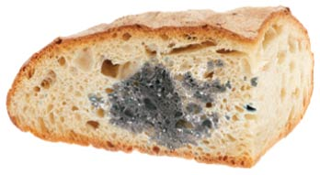
Zygomycetes
The zygomycetes (phylum Zygomycota) include fast-growing molds, parasites, and commensal symbionts
The life cycle of black bread mold (Rhizopus stolonifer) is fairly typical of the phylum
Its hyphae are coenocytic
Asexual sporangia produce haploid spores
Some zygomycetes, such as Pilobolus,
can actually “aim” and shoot their sporangia toward bright light

Slide 23
Glomeromycetes
The glomeromycetes (phylum Glomeromycota) were once considered zygomycetes
Nearly all species of glomeromycetes form arbuscular mycorrhizae

Slide 24
Ascomycetes
Ascomycetes (phylum Ascomycota) live in marine, freshwater, and terrestrial habitats
Ascomycetes produce sexual spores in saclike asci contained in fruiting bodies called ascocarps
Ascomycetes are commonly called sac fungi
Ascomycetes vary in size and complexity from unicellular yeasts to elaborate cup fungi and morels

Slide 25
Ascomycetes include plant pathogens, decomposers, and symbionts
More than 25% of all ascomycete species form symbiotic associations with green algae or cyanobacteria called lichens
Ascomycetes reproduce asexually by enormous numbers of asexual spores called conidia

Slide 26
Basidiomycetes
Basidiomycetes (phylum Basidiomycota) include mushrooms, puffballs, and shelf fungi
Some basidiomycetes form mycorrhizae, and others are plant parasites
The phylum is defined by a clublike structure called a basidium, a transient diploid stage in the life cycle
Many basidiomycetes are decomposers of wood
The mycelium can reproduce sexually by producing fruiting bodies called basidiocarps
White mushrooms found in the supermarket are examples of basidiocarps

Slide 27
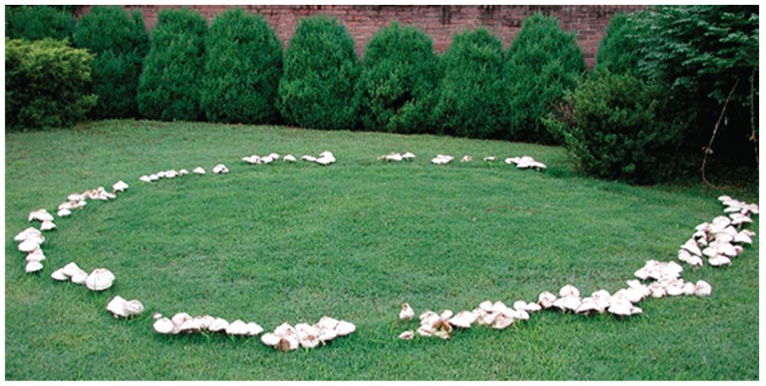
Basidiomycetes can produce mushrooms within a few hours
Some species produce rings of mushrooms called “fairy rings” that appear literally overnight

Slide 28
Fungi play key roles in nutrient cycling, ecological interactions, and human welfare
Fungi interact with other organisms as decomposers, mutualists, and pathogens

Slide 29
Fungi as Decomposers
Fungi are efficient decomposers of organic material including cellulose and lignin
They perform essential recycling of chemical elements between the living and nonliving world
Without these critical decomposers, life as we know it would cease

Slide 30
Fungi as Mutualists
Fungi form mutualistic relationships with plants, algae, cyanobacteria, and animals
Mutualistic fungi absorb nutrients from the host organism and reciprocate with actions that benefit the host

Slide 31
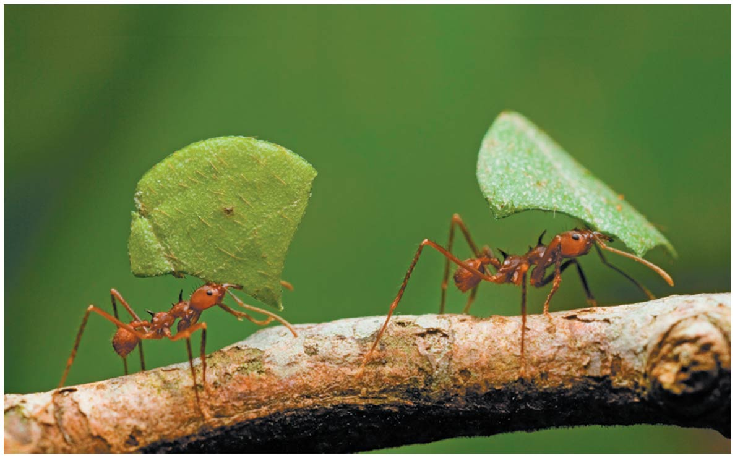
Fungus-Animal Mutualisms
Some fungi share their digestive services with animals
These fungi help break down plant material in the guts of cows and other grazing mammals
Many species of ants use the digestive power of fungi by raising them in “farms”

Slide 32
Lichens
A lichen is a symbiotic association between a photosynthetic microorganism and a fungus
The photosynthetic component is green algae or cyanobacteria
The fungal component is most often an ascomycete

Slide 33
Lichens
Millions of photosynthetic cells are held in a mass of fungal hyphae
Algae or cyanobacteria occupy an inner layer below the lichen surface
The symbioses are so complete that lichens are given scientific names
The algae provide carbon compounds, cyanobacteria also provide organic nitrogen, and fungi provide the environment for growth

Slide 34
Fungi as Parasites
About 30% of known fungal species are parasites or pathogens, mostly on or in plants
Each year, 10% to 50% of the world’s fruit harvest is lost due to fungi
Some fungi that attack food crops are toxic to humans

Slide 35
The general term for a fungal infection in animals is mycosis
Ringworm and athlete’s foot are examples of human mycoses
Systemic mycoses spread through the body
  For example, coccidioidomycosis produces tuberculosis-like symptoms
Some mycoses are opportunistic
  For example, Candida albicans, which causes yeast infections
The chytrid Batrachochytrium dendrobatidis has been implicated in the decline or extinction of about 200 species of amphibians worldwide

Slide 36
Practical Uses of Fungi
Humans eat many fungi and use others to make cheeses, alcoholic beverages, and bread
Some fungi are used to produce antibiotics for the treatment of bacterial infections
  For example, the ascomycete Penicillium

Slide 37
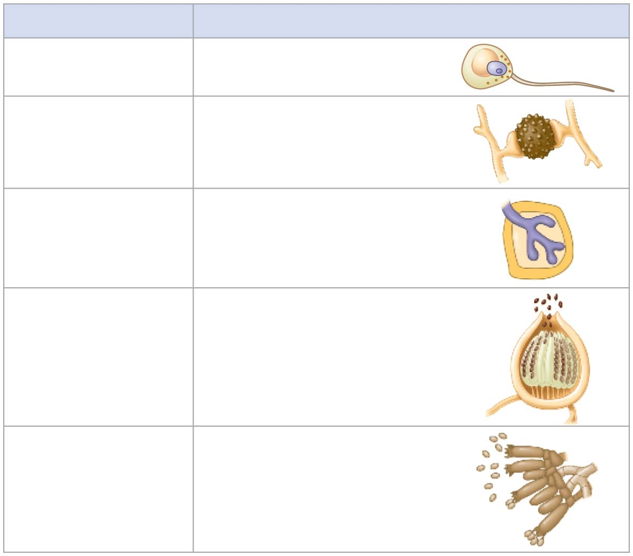
Fungal Phylum
Distinguishing Features
Chytridiomycota
(chytrids)
Flagellated spores
Zygomycota
(zygomycetes)
Resistant zygosporangium
as sexual stage
Glomeromycota
(arbuscular
mycorrhizal fungi)
Arbuscular mycorrhizae
formed with plants
Ascomycota
(ascomycetes)
Sexual spores (ascospores)
borne internally in sacs
called asci; vast numbers
of asexual spores (conidia)
produced
Basidiomycota
(basidiomycetes)
Elaborate fruiting body
(basidiocarp) containing
many basidia that
produce sexual spores
(basidiospores)
Notes:
Figure 31.UN07 Summary of key concepts: fungi lineages

Slide 38
Before next class
  Read sections:
    Ch13.4 (fungi) – if you haven’t already...
    Ch14 (all of it) – we’ll talk about Plants next week

