Slide 1
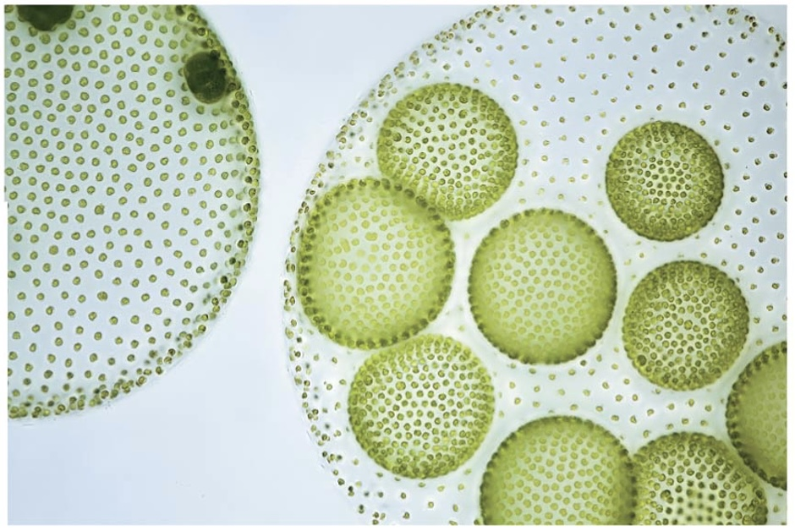
BIO10
Dr. Bradley
Protists

Slide 2
Before next class
  Read sections:
    Ch13.3 (protists)
    Ch13.4 (fungi) – which we will talk about next...

Slide 3
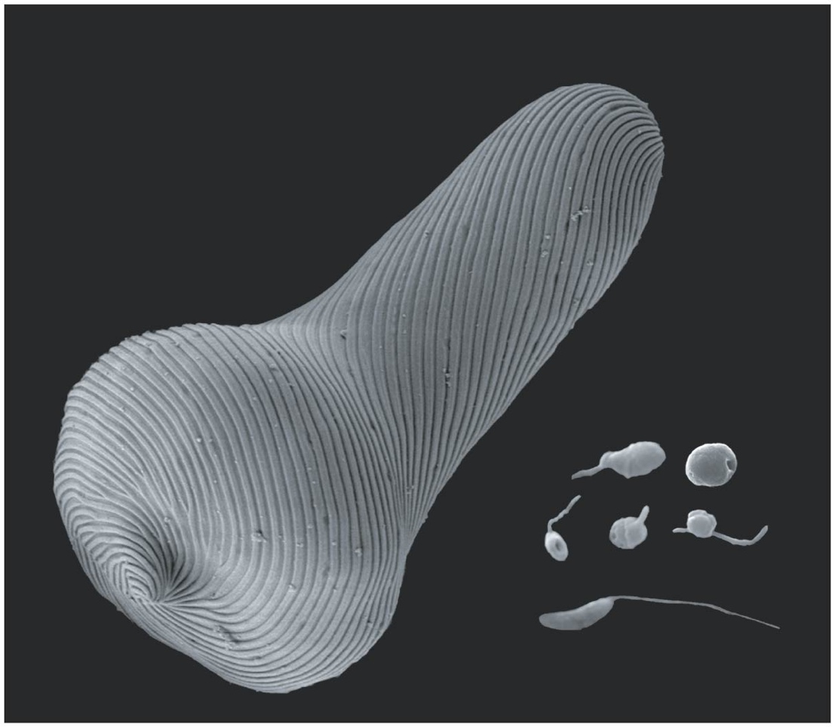
Protists: Living Small
Even a low-power microscope can reveal a great variety of organisms in a drop of pond water
Protist is the informal name of the group of mostly unicellular eukaryotes
Advances in eukaryotic systematics have caused the classification of protists to change significantly
Protists constitute a polyphyletic group, and Protista is no longer a kingdom

Slide 4
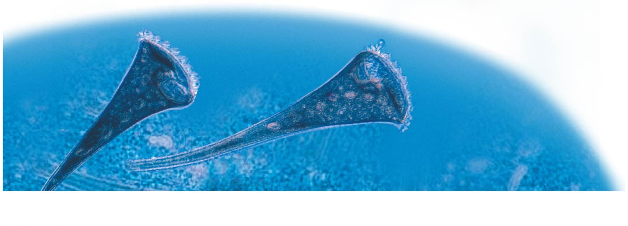
Most eukaryotes are single-celled organisms
Protists are eukaryotes
Eukaryotic cells have organelles and are more complex than prokaryotic cells
It is important to bear in mind that
  Most eukaryotes are protists
  Most protists are unicellular

Slide 5
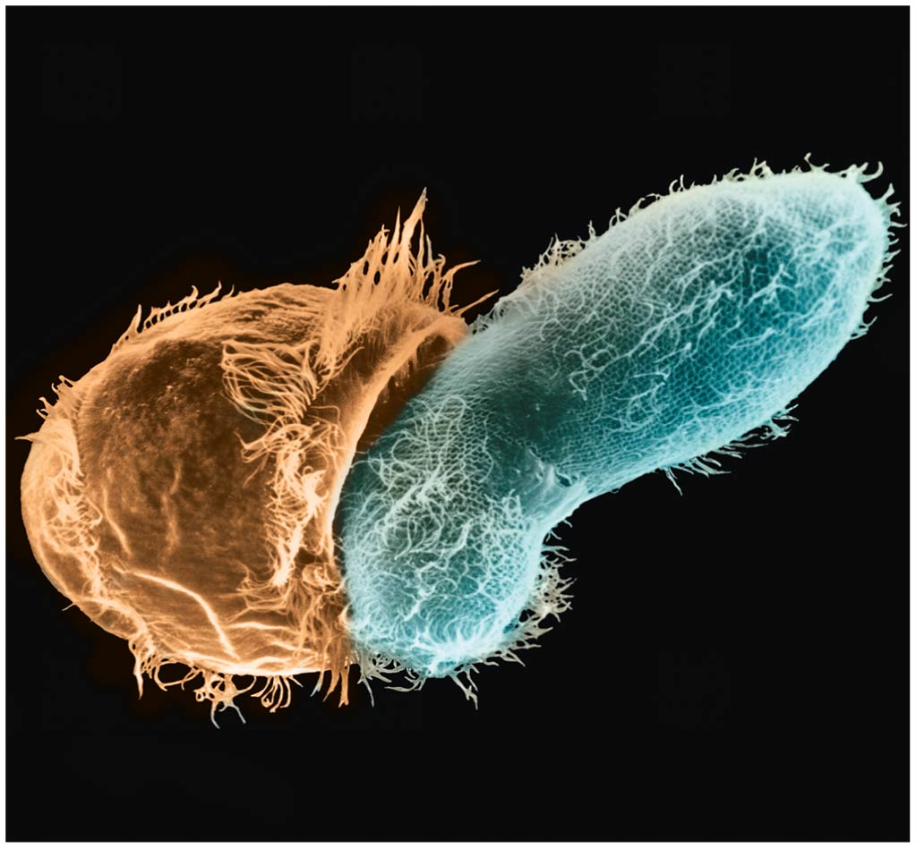
Structural and Functional Diversity in Protists
Protists exhibit more structural and functional diversity than any other group of eukaryotes
Though most protists are unicellular, there are some colonial and multicellular species
Single-celled protists can be very complex, as all biological functions are carried out by organelles in each individual cell

Slide 6
Protists, the most nutritionally diverse of all eukaryotes, include
  Photoautotrophs, which contain chloroplasts
  Heterotrophs, which absorb organic molecules or ingest larger food particles
  Mixotrophs, which combine photosynthesis and heterotrophic nutrition

Slide 7
Four Supergroups of Eukaryotes
Our understanding of the evolutionary relationships among protist groups continues to change rapidly

Slide 10
Endosymbiosis in Eukaryotic Evolution
There is now considerable evidence that much protist diversity has its origins in endosymbiosis
Endosymbiosis is a relationship between two species in which one organism lives inside the cell or cells of the other organism (the host)

Slide 11
Mitochondria and plastids are derived from prokaryotes that were engulfed by the ancestors of early eukaryotic cells
Mitochondria evolved earlier by endosymbiosis of a heterotrophic prokaryote
Plastids evolved later by endosymbiosis of a photosynthetic prokaryote
The plastid-bearing lineage of protists evolved into two lineages of photosynthetic protists, red and green algae

Slide 13
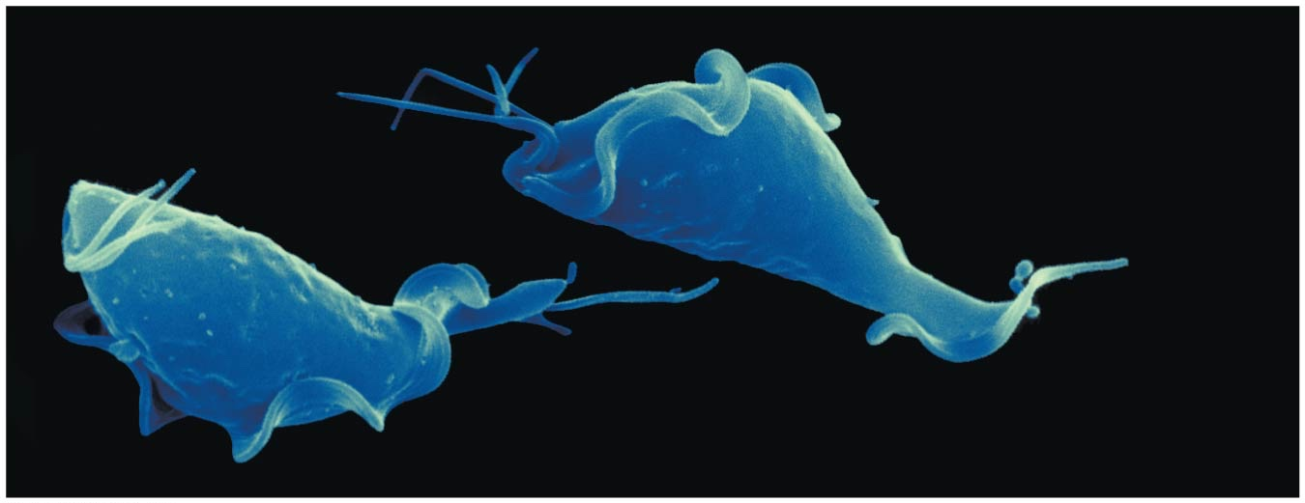
Excavates have modified mitochondria and a unique flagella
The clade Excavata is characterized by its cytoskeleton
Some members have an “excavated” feeding groove on one side of the body
The excavates include three groups but we will focus on the euglenozoans
Flagella
Undulating
membrane
5 µm

Slide 14
Euglenozoans
Euglenozoa is a diverse clade that includes predatory heterotrophs, photosynthetic autotrophs, mixotrophs, and parasites
The main feature distinguishing them as a clade is a spiral or crystalline rod inside their flagella
This clade includes the euglenids

Slide 15
Euglenids (example of a Euglenozoan)
Euglenids have one or two flagella that emerge from a pocket at one end of the cell
Some species are mixotrophs; they can be autotrophic or heterotrophic depending on environmental conditions

Slide 16
SAR is a highly diverse group of protists defined by DNA similarities
SAR is a monophyletic supergroup named for the first letters of its three major clades:
  Stramenopiles
  Alveolates
  Rhizarians
This group is one of the most controversial of the four supergroups

Slide 17
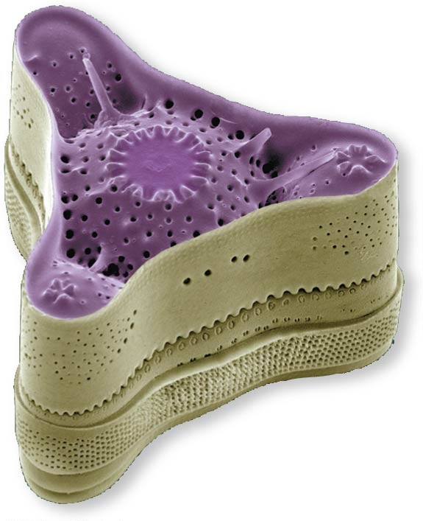
Diatoms (example of a Stramenopile [SAR])
Diatoms are unicellular algae with a unique two-part, glass-like wall of silicon dioxide
Diatoms are a major component of phytoplankton and are highly diverse
After a diatom bloom, many dead individuals fall to the ocean floor, where decomposition is slow
40 µm

Slide 18
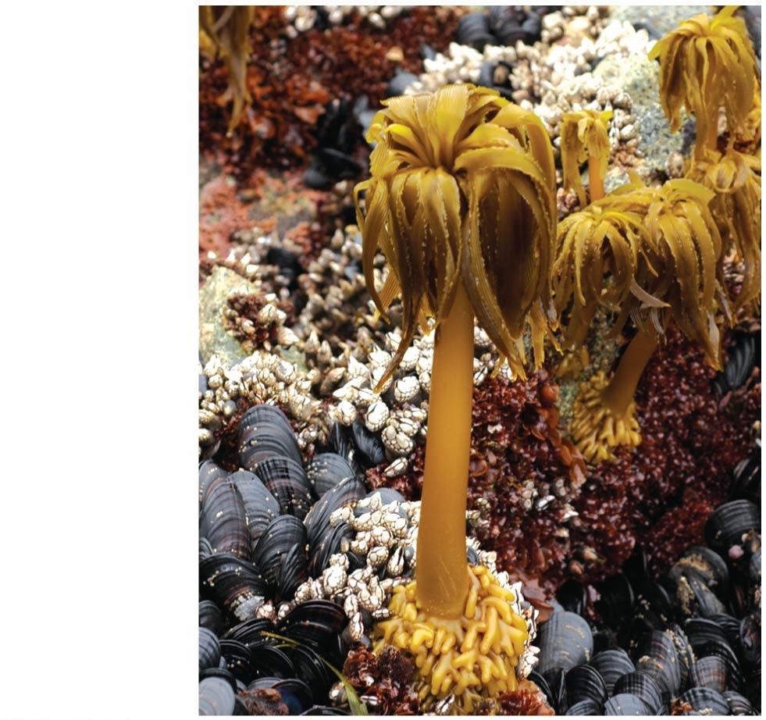
Brown Algae (example of a Stramenopile [SAR])
Brown algae are the largest and most complex algae
All are multicellular, and most are marine
Brown algae include many species commonly called “seaweeds”

Slide 19
Brown Algae (example of a Stramenopile [SAR])
Brown algal seaweeds have plantlike structures: the rootlike holdfast, which anchors the alga, and a stemlike stipe, which supports the leaflike blades
Some have gas-filled, bubble-shaped floats to keep their photosynthetic structures near the water surface
However, unlike plants, brown algae lack true tissues and organs

Slide 20
Alveolates [SAR]
Alveolates have membrane-enclosed sacs (alveoli) just under the plasma membrane
The alveolates include
  Dinoflagellates
  Ciliates
  Apicomplexans
    But we will not
    focus on these...

Slide 21
Dinoflagellates (example of a Alveolate [SAR])
Dinoflagellates have two flagella, and each cell is reinforced by cellulose plates
They are abundant components of both marine and freshwater phytoplankton
They are a diverse group of aquatic phototrophs, mixotrophs, and heterotrophs
Toxic “red tides” are caused by dinoflagellate blooms

Slide 22
Ciliates (example of a Alveolate [SAR])
Ciliates, a large varied group of protists, are named for their use of cilia to move and feed
Most ciliates are predators of bacteria or other protists
A distinctive feature is the presence of two types of nuclei: tiny micronuclei and large macronuclei

Slide 23
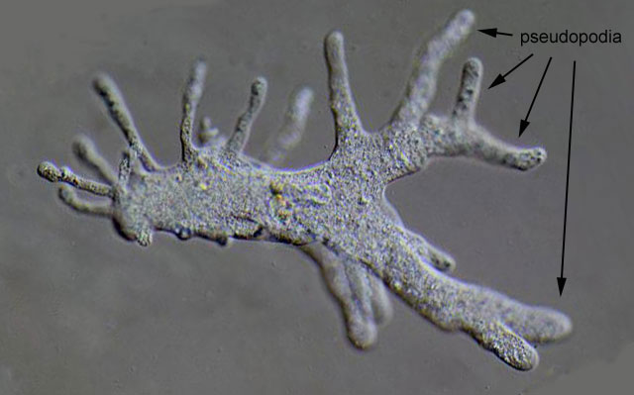
Rhizarians [SAR]
Many species of rhizarians are amoebas
Amoebas are protists that move and feed by pseudopodia, extensions of the cell surface
Rhizarian amoebas differ from amoebas in other clades by having threadlike pseudopodia

Slide 24
Radiolarians (example of a Rhizarian [SAR])
Radiolarians, mostly marine protists, have delicate, symmetrical internal skeletons generally made of silica
Pseudopodia reinforced by microtubules radiate from the central body of radiolarians
Cytoplasm covering the microtubules engulf prey that become attached to the pseudopodia

Slide 25
Cercozoans (example of a Rhizarian [SAR])
Cercozoans are a large group of amoeboid and flagellated protists with threadlike pseudopodia
They are common in marine, freshwater, and soil ecosystems
Most are heterotrophs, including parasites and predators
Paulinella chromatophora is a cercozoan autotroph with a unique photosynthetic structure called a chromatophore
This structure evolved from a different cyanobacterium than the plastids of other photosynthetic eukaryotes

Slide 26
Archaeplastida (Red algae and green algae) are the closest relatives of plants
Plastids arose when a heterotrophic protist acquired a bacterial endosymbiont
The photosynthetic descendants of this ancient protist evolved into red algae and green algae
Plants are descended from the green algae
Archaeplastida is the supergroup that includes red algae, green algae, and plants

Slide 27
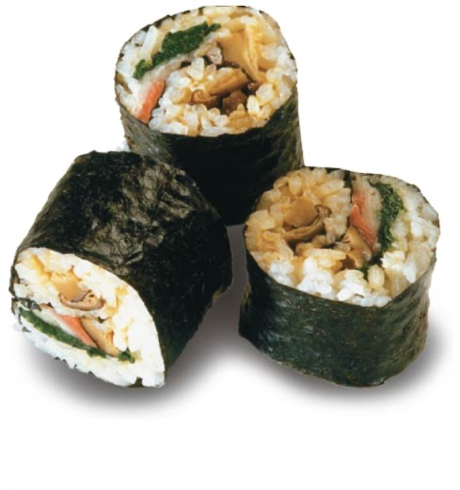
Red Algae
Red algae are reddish in color due to an accessory pigment called phycoerythrin, which masks the green of chlorophyll
The color varies from greenish-red in shallow water to dark red or almost black in deep water
Red algae are usually multicellular; the largest are seaweeds
Red algae are the most abundant large algae in coastal waters of the tropics
Nori

Slide 28
Green Algae
Green algae are named for their grass-green chloroplasts
Plants and green algae are closely related
Green algae are a paraphyletic group
The two main groups are the charophytes and the chlorophytes
Charophytes are most closely related to plants

Slide 29
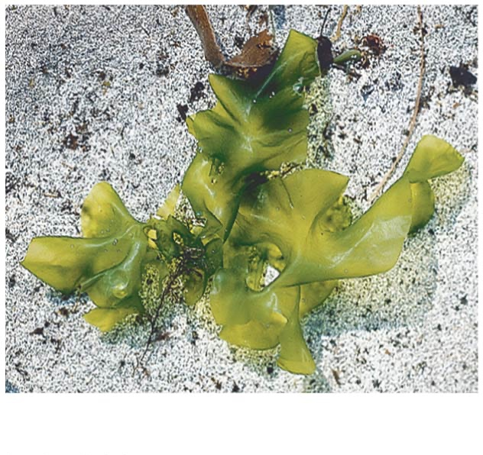
Green Algae
Most chlorophytes live in fresh water, although many are marine
Other chlorophytes live in damp soil, as symbionts in lichens, or in environments exposed to intense visible and ultraviolet radiation
2 cm
Ulva, or sea lettuce

Slide 30
Green Algae
Larger size and greater complexity evolved in green algae by
  the formation of colonies from individual cells (e.g., Zygnema)
  the formation of true multicellular bodies by cell division and differentiation (e.g., Ulva)
  the repeated division of nuclei with no cytoplasmic division (e.g., Caulerpa)

Slide 31
Unikonts are closely related to fungi and animals
The supergroup Unikonta includes:
  Animals
  Fungi
  some protists
This group includes two clades: the amoebozoans and the opisthokonts (animals, fungi, and related protists)
The root of the eukaryotic tree remains controversial
  It is unclear whether unikonts separated from other eukaryotes relatively early or late

Slide 32
Slime Molds (example of a Unikont)
Slime molds, or mycetozoans, were once thought to be fungi due to their spore-producing fruiting bodies
This resemblance between slime molds and fungi is a result of convergent evolution
Slime molds include two lineages, plasmodial slime molds and cellular slime molds

Slide 33
Plasmodial Slime Molds
Many species of plasmodial slime molds are brightly pigmented, usually yellow or orange
They form a unicellular feeding mass called a plasmodium (not to be confused with malarial Plasmodium)
The plasmodium is undivided by plasma membranes and contains many diploid nuclei

Slide 34
Cellular Slime Molds
Cellular slime molds form multicellular aggregates in which cells are separated by their membranes
Cells feed individually but can aggregate to migrate and form a fruiting body

Slide 35
Protists play key roles in ecological communities
Protists are found in diverse aquatic and moist terrestrial environments
Protists play two key roles in their habitats: that of symbiont and that of producer

Slide 36
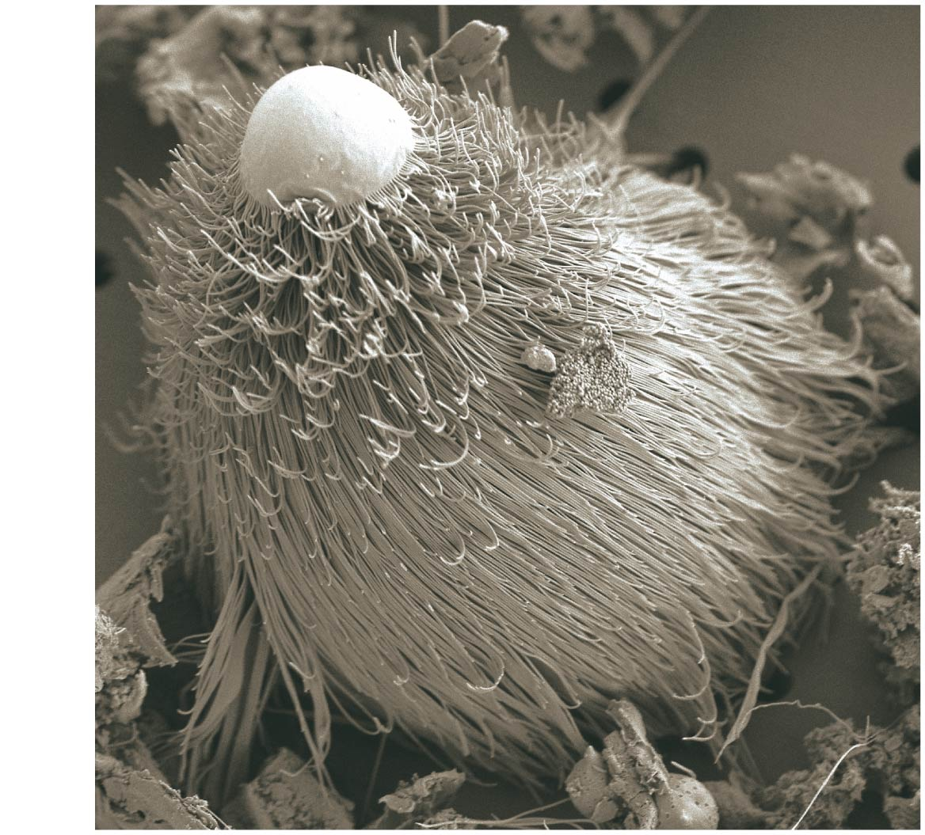
Symbiotic Protists
Some protist symbionts benefit their hosts
  Dinoflagellates nourish coral polyps that build reefs
  Wood-digesting protists inhabit the gut of termites
This organism lives in the gut of termites and certain cockroaches and enable the hosts to digest wood.

Slide 37
Photosynthetic Protists
Many protists are important producers that obtain energy from the sun to convert CO₂ to organic compounds
In aquatic communities, photosynthetic protists and prokaryotes are the main producers
Photosynthetic protists are limited by nutrients; populations can explode when limiting nutrients are added

Slide 38
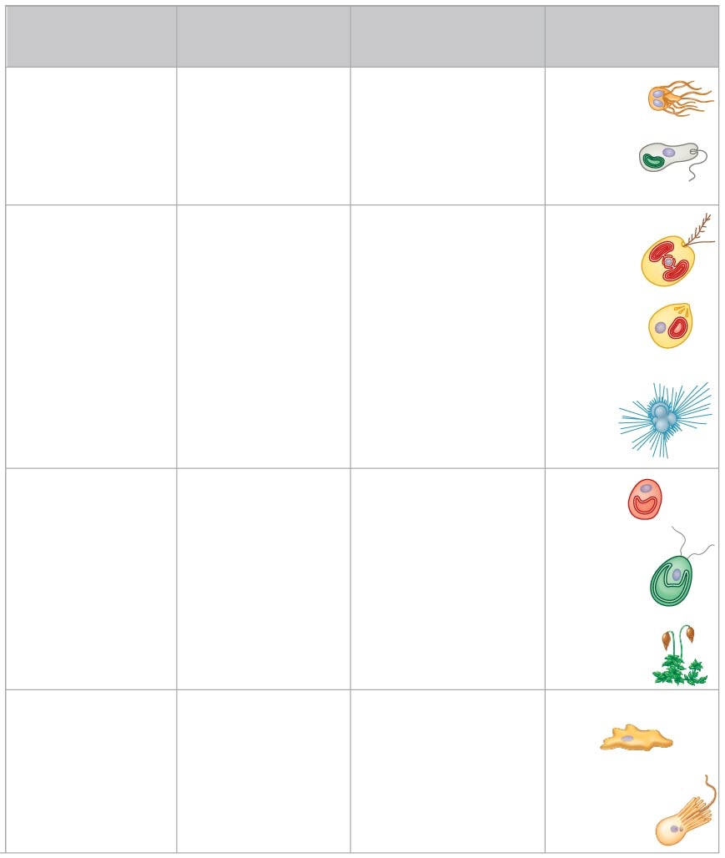
Eukaryote
Supergroup
Key Morphological
Characteristics
Major Groups
Specific Examples
Excavata
Diplomonads and
parabasalids
Modified mitochondria
Giardia,
Trichomonas
Euglenozoans
Spiral or crystalline rod
inside flagella
Trypanosoma,
Euglena
Kinetoplastids
Euglenids
“SAR” Clade
Stramenopiles
Hairy and smooth flagella
Phytophthora,
Laminaria
Diatoms
Golden algae
Brown algae
Alveolates
Membrane-enclosed sacs
(alveoli) beneath plasma
membrane
Pfiesteria,
Plasmodium,
Paramecium
Dinoflagellates
Apicomplexans
Ciliates
Rhizarians
Amoebas with threadlike
pseudopodia
Globigerina
Radiolarians
Forams
Cercozoans
Archaeplastida
Red algae
Phycoerythrin (photosyn-
thetic pigment)
Porphyra
Green algae
Plant-type chloroplasts
Chlamydomonas,
Ulva
Plants
Mosses, ferns,
conifers,
flowering
plants
Amoebozoans
Amoebas with lobe-
shaped or tube-shaped
pseudopodia
Amoeba, Dictyostelium
Unikonta
Slime molds
Tubulinids
Entamoebas
Choanoflagellates,
nucleariids,
animals,
fungi
Opisthokonts

Slide 39
Before next class
  Read sections:
    Ch13.3 (protists)
    Ch13.4 (fungi) – which we will talk about next...

