Slide 1
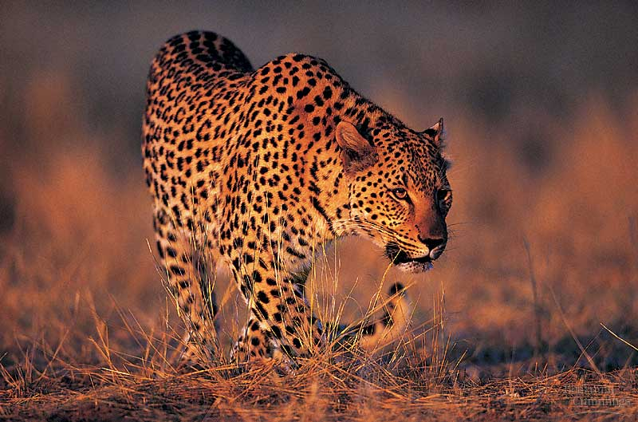
BIO10
Evolution
Part 2
Dr. Bradley
Notes:
Pick up on slide 28 for friday

Slide 2
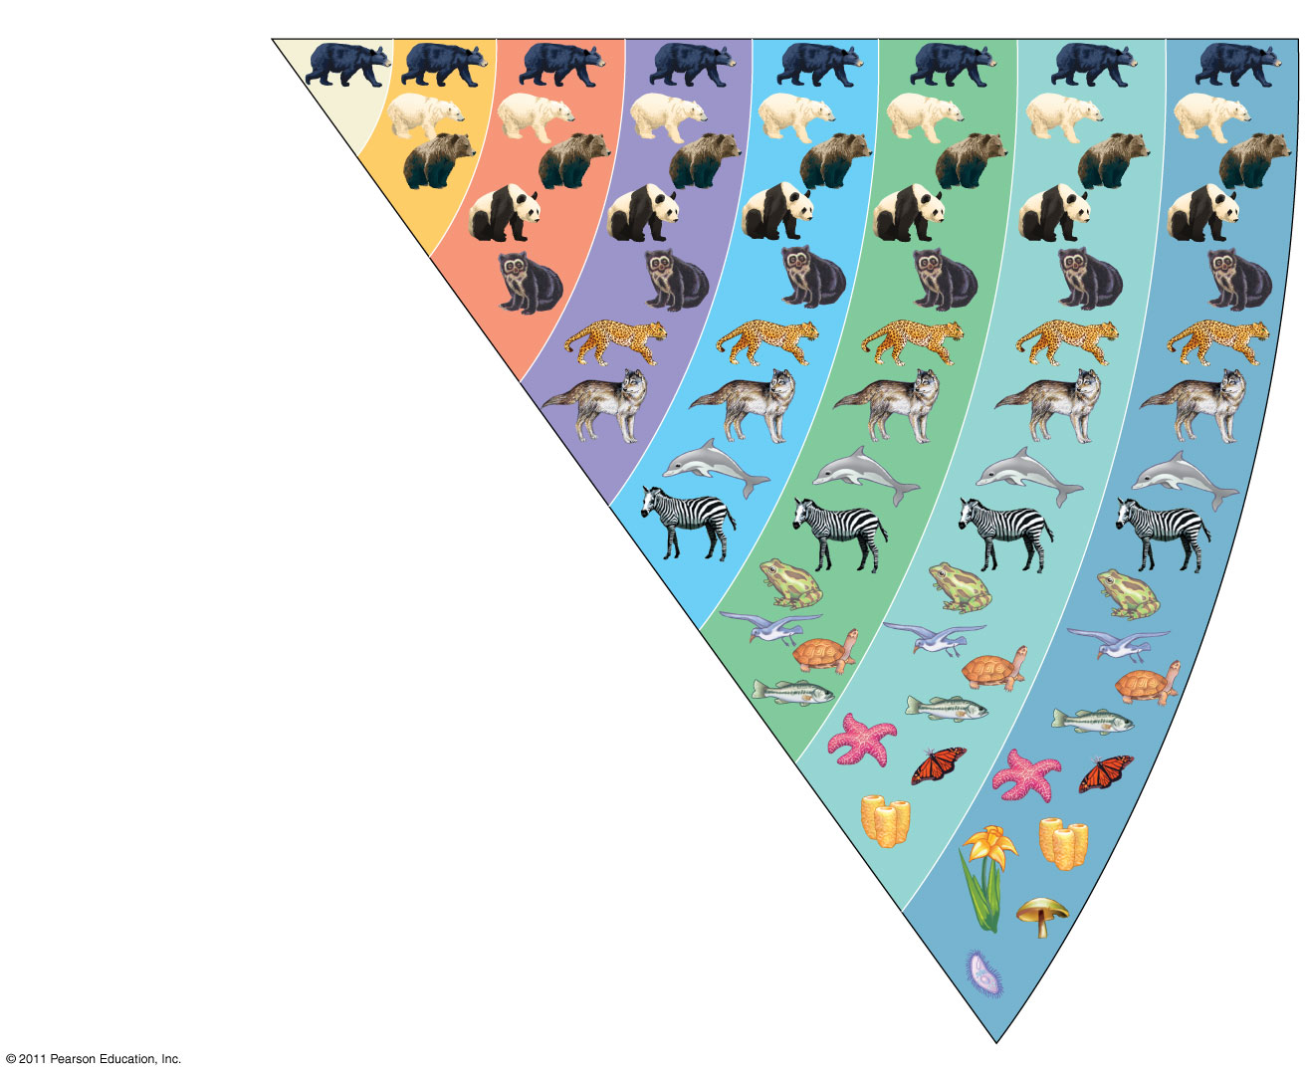
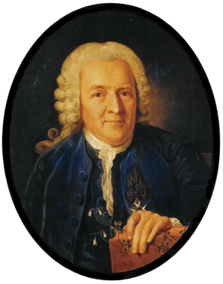
Species
Genus
Family
Order
Class
Phylum
Kingdom
Domain
Ursus americanus
(American black bear)
Ursus
Ursidae
Carnivora
Carolus Linnaeus
Mammalia
Linnaeus tried to find order within the diversity of life
Sought to define and classify species based on structural differences
Didn’t know or understand species to be related to each other as we do today
Chordata
Animalia
Eukarya
Notes:
Figure 1.14 Classifying life.

Slide 3
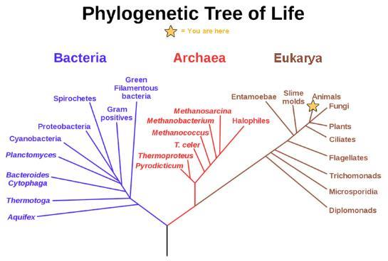
Phylogenetic Trees
The tree shows the separation of living organisms into three domains: Bacteria, Archaea, and Eukarya.
Bacteria and Archaea are organisms without a nucleus or other organelles surrounded by a membrane and, therefore, are prokaryotes.
Notes:
First theme is the set of unifying levels of biological organization

Slide 4
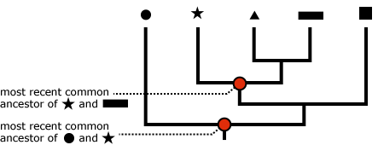
How To Read Phylogenetic Trees
A phylogenetic tree represents a hypothesis about evolutionary relationships
Each branch point represents the divergence of two species

Slide 5
How To Read Phylogenetic Trees
Sister taxa are groups that share an immediate common ancestor
A rooted tree includes a branch to represent the last common ancestor of all taxa in the tree
A basal taxon diverges early in the history of a group and originates near the common ancestor of the group
A polytomy is a branch from which more than two groups emerge
  Where the evidence of the order of lineage splitting isn’t clear

Slide 6
How To Read Phylogenetic Trees
Phylogenetic trees show patterns of descent, not phenotypic similarity
It should not be assumed that a taxon evolved from the taxon next to it
Tree branches can be rotated around a branch point without changing the evolutionary relationships

Slide 7
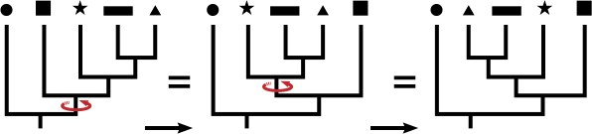
How To Read Phylogenetic Trees
Phylogenetic trees show patterns of descent, not phenotypic similarity
It should not be assumed that a taxon evolved from the taxon next to it
Tree branches can be rotated around a branch point without changing the evolutionary relationships

Slide 8
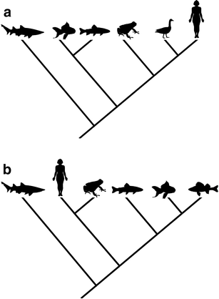
How To Read Phylogenetic Trees
Phylogenetic trees show patterns of descent, not phenotypic similarity
It should not be assumed that a taxon evolved from the taxon next to it
Tree branches can be rotated around a branch point without changing the evolutionary relationships
Both of these trees to the left show exactly the same hypothetical relationship

Slide 9
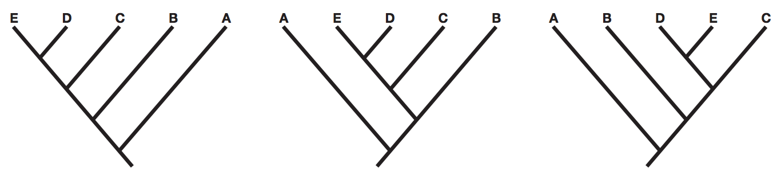
A
B
C
How do these
trees differ?
They are all
the same
A, B, C, D, & E all share a common ancestor and thus are related. E&A are related but not as closely as E&B, or E&C or E&D. E&B are related but not as closely as E&C, and E&D. E&C are related but not as closely as E&D.

Slide 10
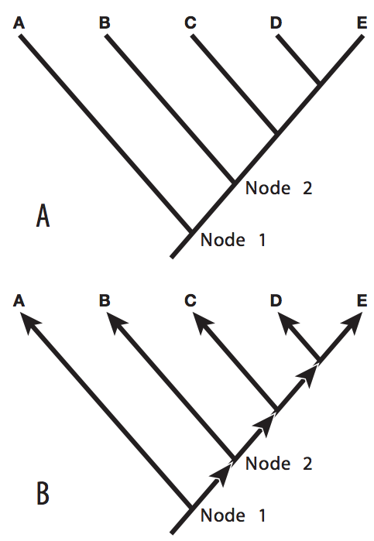
Who is the closest relative to E?
D
Who is the closest relative to A?
All are equally unrelated to A

Slide 11
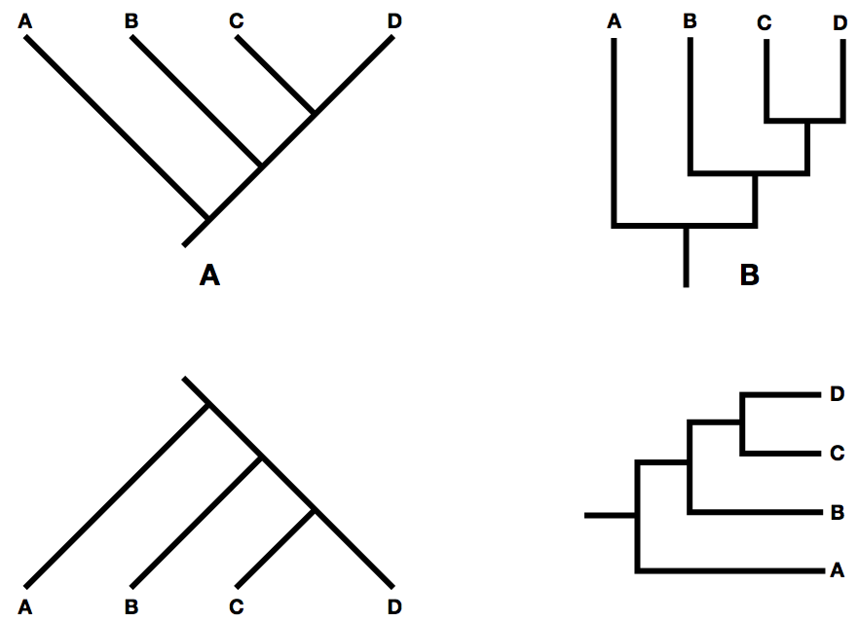
How do these
trees differ?
They are all
the same

Slide 12
How do these
trees differ?
(a) & (b) are the same, but (c) hypothesizes that
C & B are more closely related than C & D

Slide 13
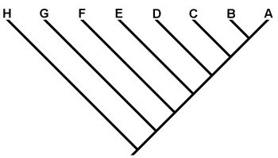
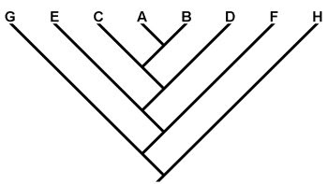
A
B
How do these
trees differ?
They are both
the same

Slide 14
True or False?
Lizards are more closely related to salamanders than lizards are to humans.
False

Slide 15
True or False?
Lizards are more closely related to salamanders than lizards are to humans.
False

Slide 16
True or False?
Salamanders are as closely related to humans as salamanders are to lizards.
True

Slide 17
True or False?
Salamanders are as closely related to humans as salamanders are to lizards.
True

Slide 18
True or False?
Salamanders are equally related to lizards as salamanders are to humans.

Slide 19
True or False?
Salamanders are equally related to lizards as salamanders are to humans.
True

Slide 20
True or False?
Goats are equally related to humans as goats are to lizards.

Slide 21
True or False?
Goats are equally related to humans as goats are to lizards.
False

Slide 22
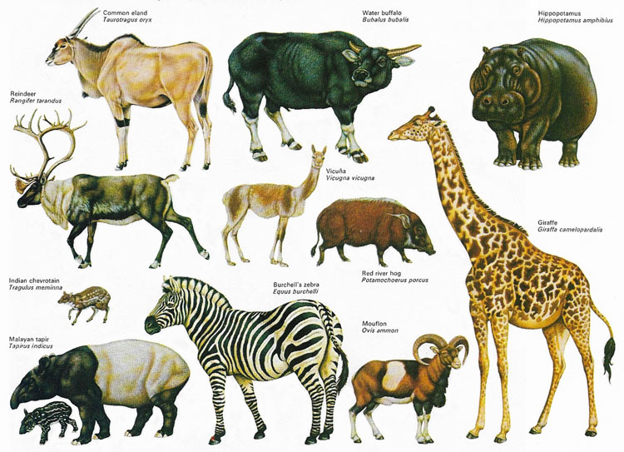

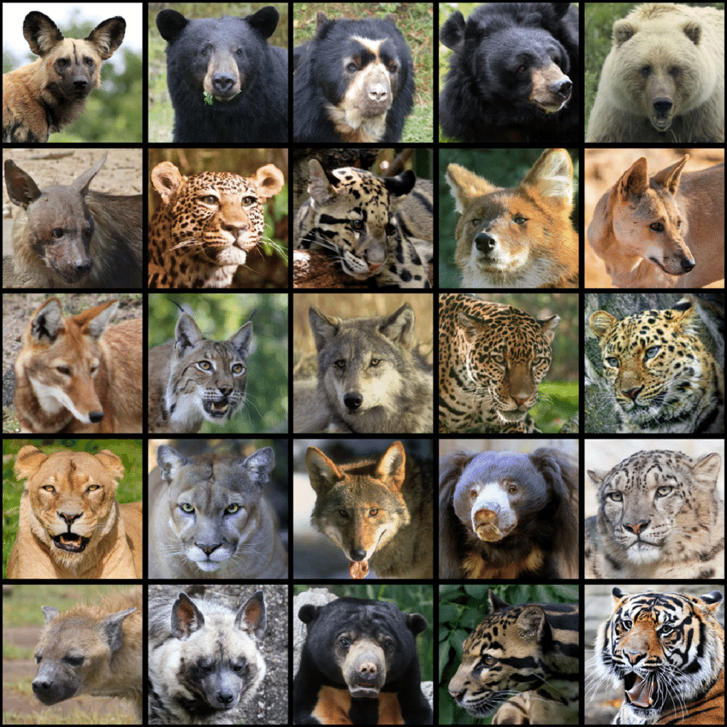
Carl Linnaeus grouped organisms by how similarly they appear
A clade is a group of species that includes an ancestral species and all its descendants
Clades can be nested in larger clades
“Marine Mammals”
Ungulates
Carnivores

Slide 23
Carl Linnaeus grouped organisms by how similarly they appear
A clade is a group of species that includes an ancestral species and all its descendants
Clades can be nested in larger clades
“Marine Mammals”
Ungulates
Whales & Seals
Carnivores

Slide 24
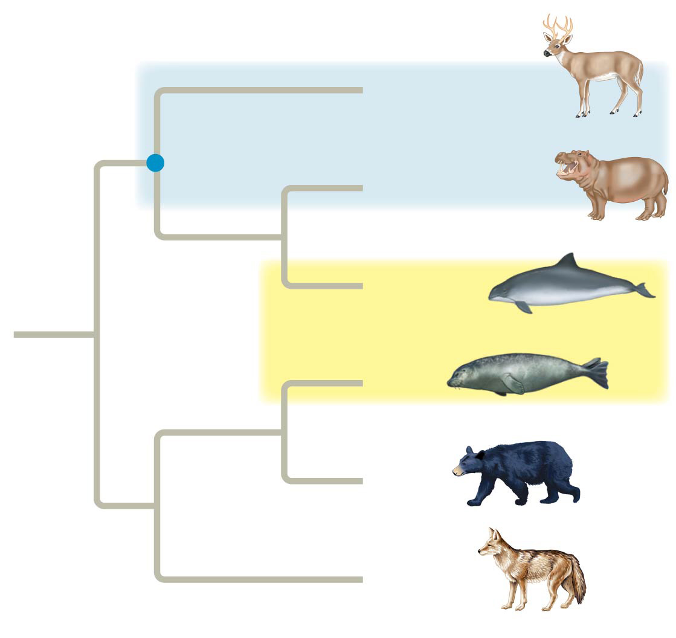
Phylogenetics groups organisms by how closely related they are
Paraphyletic group
Common
ancestor of
even-toed
ungulates
Other even-toed
ungulates
Hippopotamuses
Cetaceans
Seals
Bears
Other
carnivores
Polyphyletic group
Linnaeus wouldn’t have grouped bears and seals together (or whales and elk...) but phylogenetics does
Notes:
Thursdays’ class finished here on 2/16

Slide 25
Phylogenetics groups organisms by how closely related they are
Paraphyletic group
Common
ancestor of
even-toed
ungulates
Other even-toed
ungulates
Artiodactyla
Hippopotamuses
Cetaceans
Seals
Bears
Carnivora
Other
carnivores
Polyphyletic group
Linnaeus wouldn’t have grouped bears and seals together (or whales and elk...) but phylogenetics does

Slide 26
Homologies
Phenotypic and genetic similarities due to shared ancestry are called homologies
Organisms with similar morphologies or DNA sequences are likely to be more closely related than organisms with different structures or sequences

Slide 27
Analogies
When constructing a phylogeny, systematists need to distinguish whether a similarity is the result of homology or analogy
Homology is similarity due to shared ancestry
Analogy is similarity due to convergent evolution
  Convergent evolution occurs when similar environmental pressures and natural selection produce similar (analogous) adaptations in organisms from different evolutionary lineages

Slide 28
Homology can be distinguished from analogy by comparing fossil evidence and the degree of complexity
The more elements that are similar in two complex structures, the more likely it is that they are homologous

Slide 29
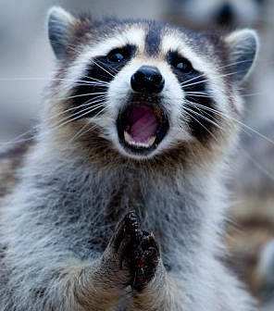
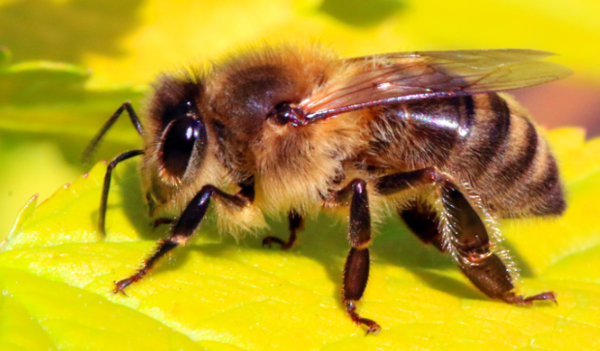
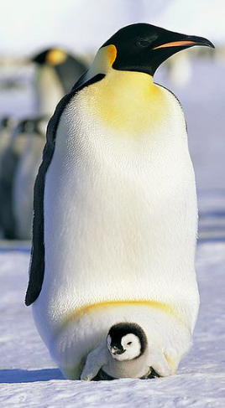
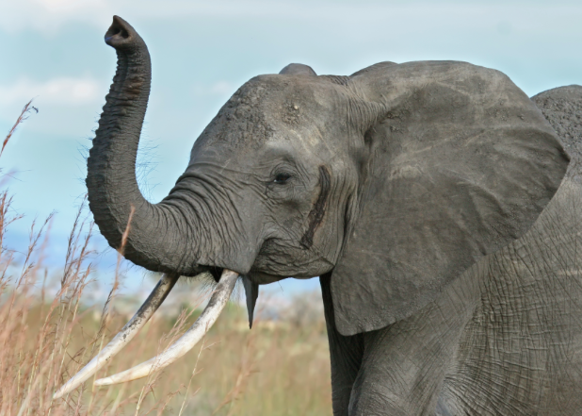

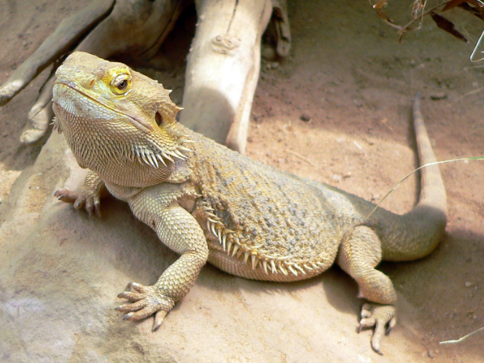
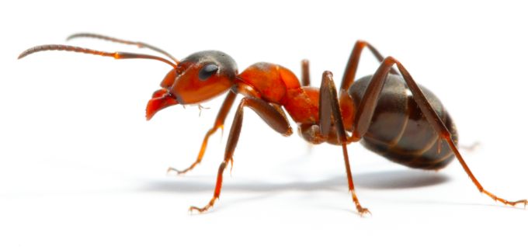
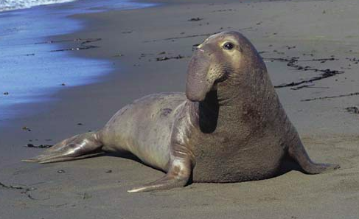
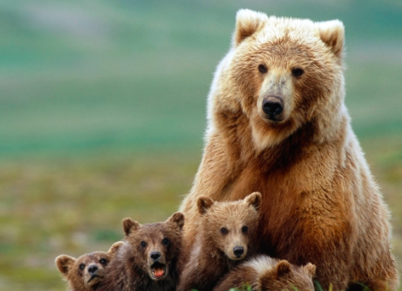
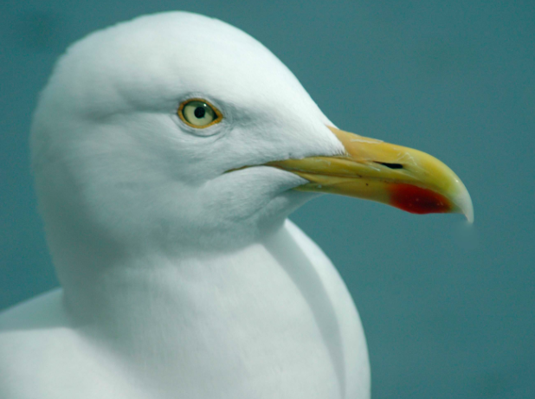
Homology is similarity due to shared ancestry
Analogy is similarity due to convergent evolution
What shared traits are examples of each?
Notes:
Let’s build a phylogeny!

Slide 30
Examples of Phylogenetic Groupings
A shared ancestral character is a character that originated in an ancestor of the taxon
A shared derived character is an evolutionary novelty unique to a particular clade

Slide 31
Phylogenetic Tree of Birds & Relatives

Slide 32
Phylogenetic Tree of Birds & Relatives
Parsimony assumes that the tree that requires the fewest evolutionary events (appearances of shared derived characters) is the most likely
The best hypotheses for phylogenetic trees fit the most data: morphological, molecular, and fossil
We can predict features of an ancestor from features of its descendants

Slide 33
Phylogenetic Tree of Birds & Relatives
Birds and crocodiles share several features: four-chambered hearts, song, nest building, and brooding
Where is the most likely place on this phylogeny for theses traits to appear?
What is the most parsimonious explanation for how these traits evolved?

Slide 34
Phylogenetic Tree of Birds & Relatives
Birds and crocodiles share several features: four-chambered hearts, song, nest building, and brooding
The fossil record confirms that the common ancestor of all dinosaurs, birds, and crocodiles had most of these traits
Singing songs isn’t supported yet but likely due to parsimony

Slide 35
Clades & Cladistics
Cladistics groups organisms by common descent
A clade is a group of species that includes an ancestral species and all its descendants
Clades can be nested in larger clades

Slide 36
Clades & Cladistics
A valid clade is monophyletic, signifying that it consists of the ancestor species and all its descendants

Slide 37
Clades & Cladistics
A paraphyletic grouping consists of an ancestral species and some, but not all, of the descendants
Notes:
Biologists avoid defining polyphyletic groups and instead reclassify organisms if evidence suggests they are polyphyletic

Slide 38
Clades & Cladistics
A polyphyletic grouping includes distantly related species but does not include their most recent common ancestor
  Polyphyletic groups are distinguished from paraphyletic groups by the fact that they do not include the most recent common ancestor

Slide 39
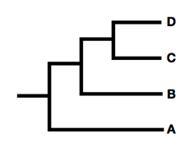
Review
Snakes
Lizards
Fish
Prokaryotes
Is the circled taxon monophyletic?

Slide 40
Review
c
Snakes
b
Lizards
a
Fish
Prokaryotes
Is the circled taxon monophyletic?

Slide 41
Review
c
Snakes
b
Lizards
a
Fish
Prokaryotes
Is the circled taxon monophyletic?
What taxon is circled above?

Slide 42
Review
Snakes
Lizards
Fish
Prokaryotes
Is the circled taxon monophyletic?
What taxon is circled above?

Slide 43
Review
Snakes
Lizards
Fish
Prokaryotes
Is the circled taxon monophyletic?

