Slide 1
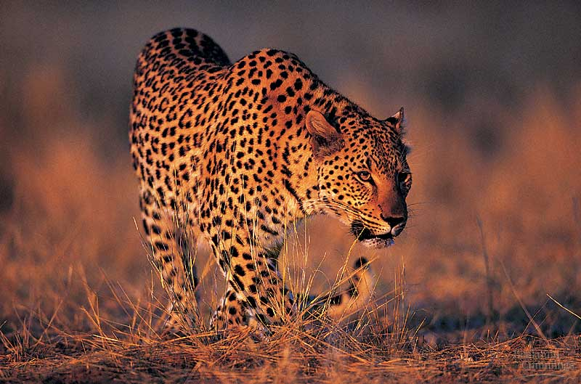
BIO10
Evolution
Part 1
Dr. Bradley

Slide 2
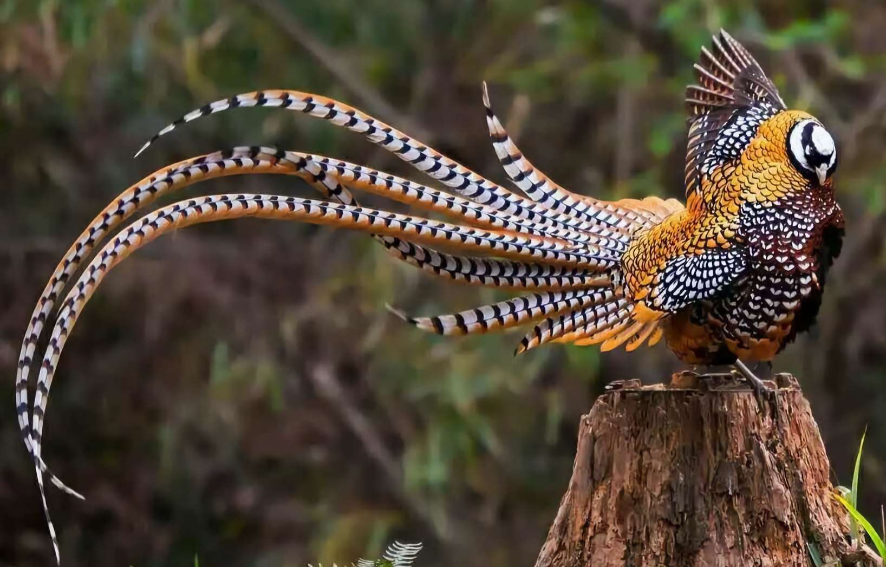

Slide 3
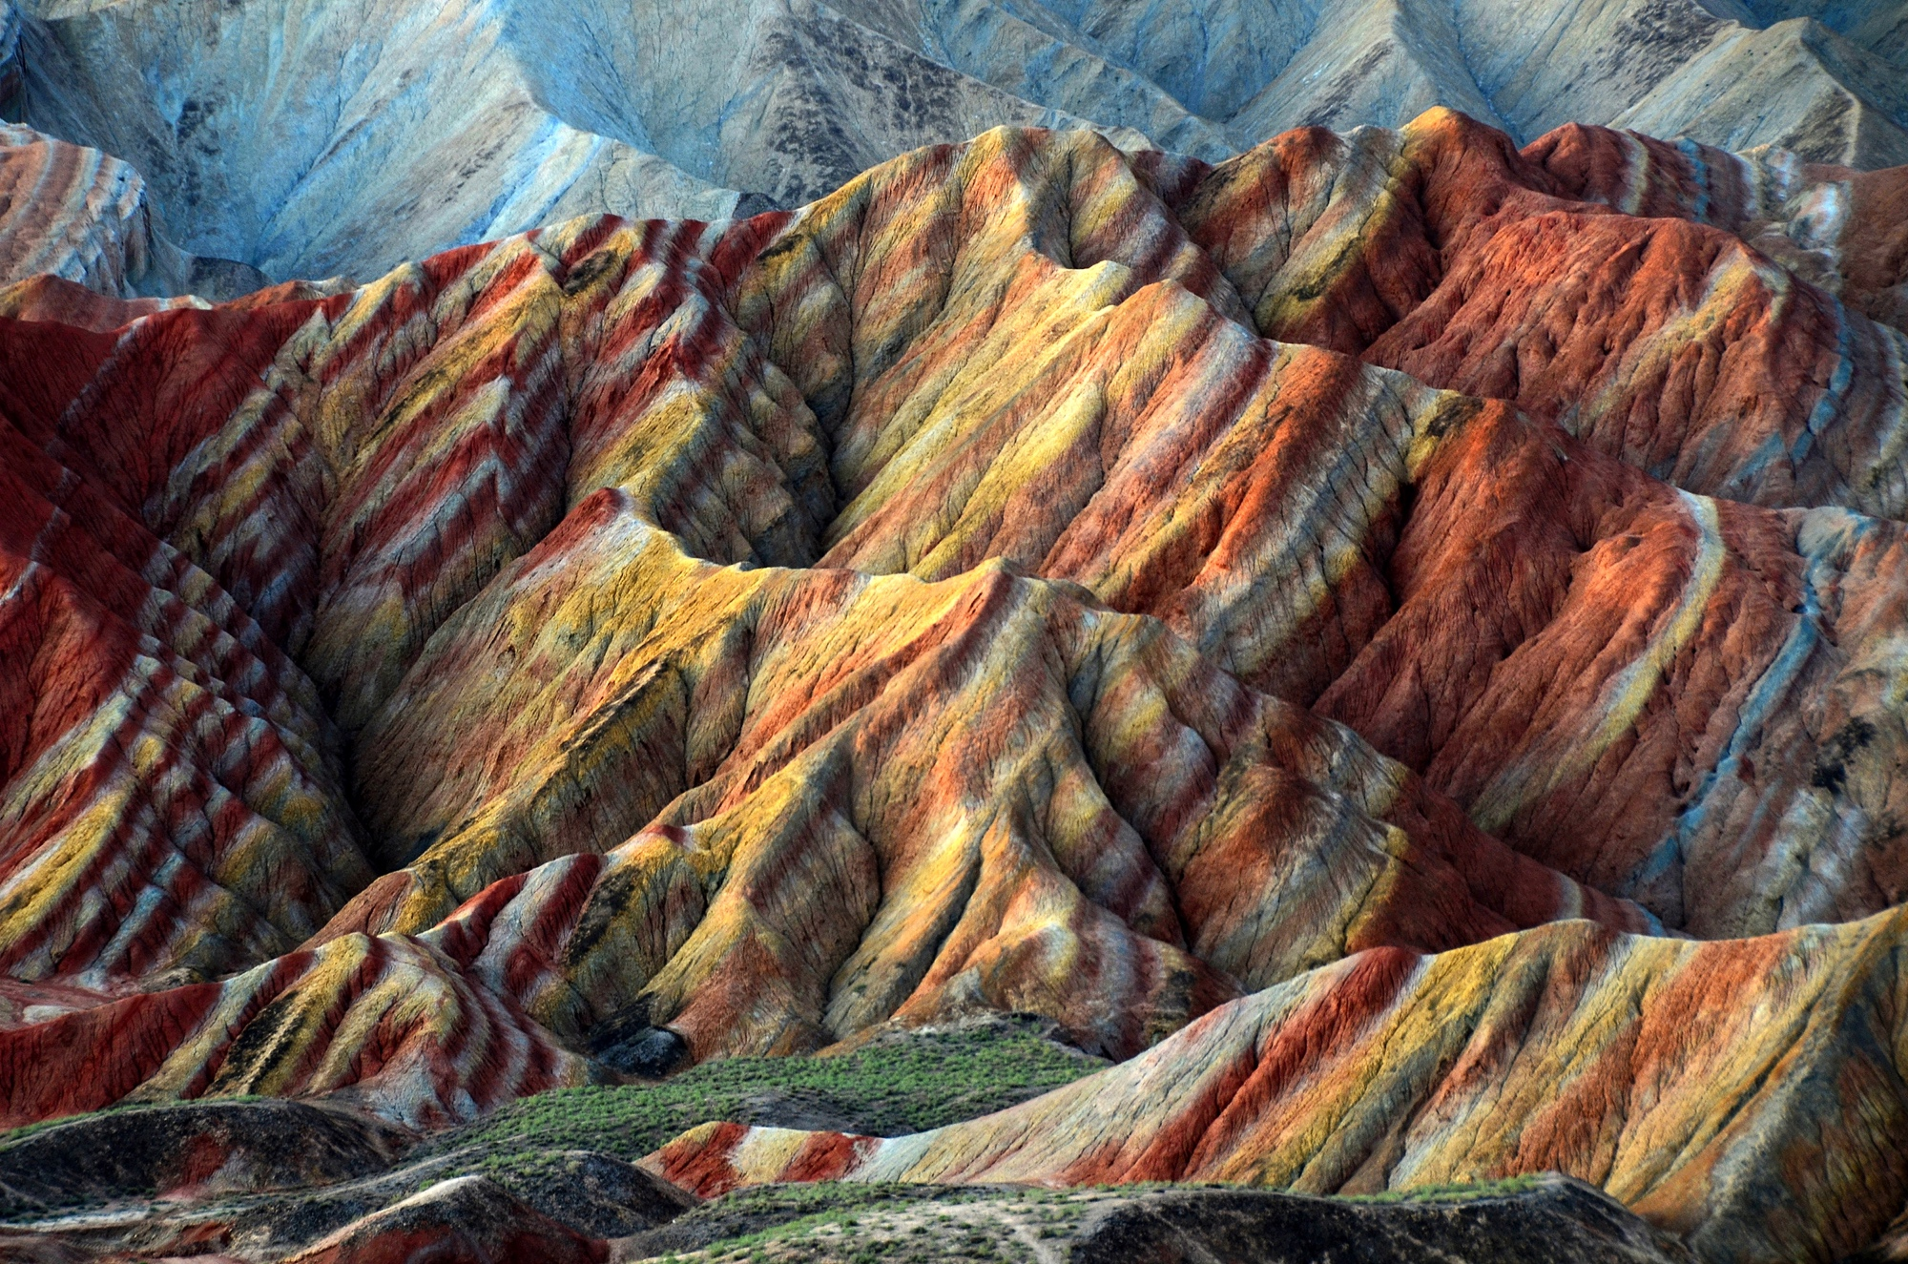

Slide 4
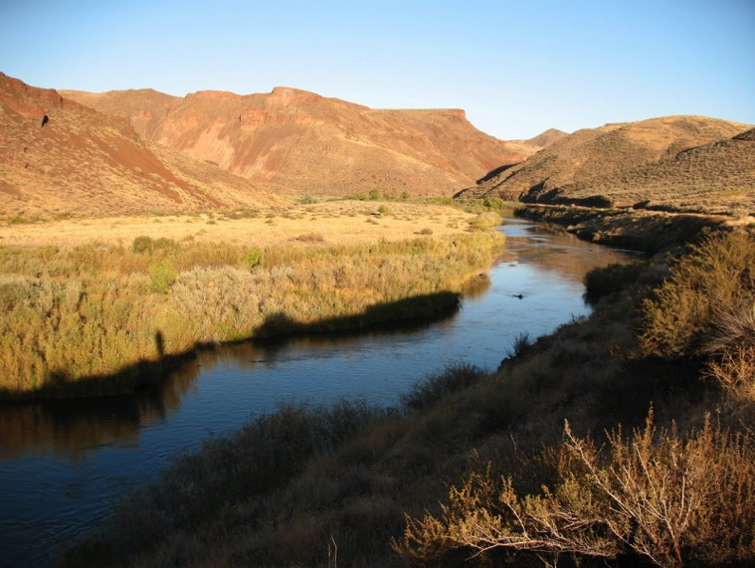
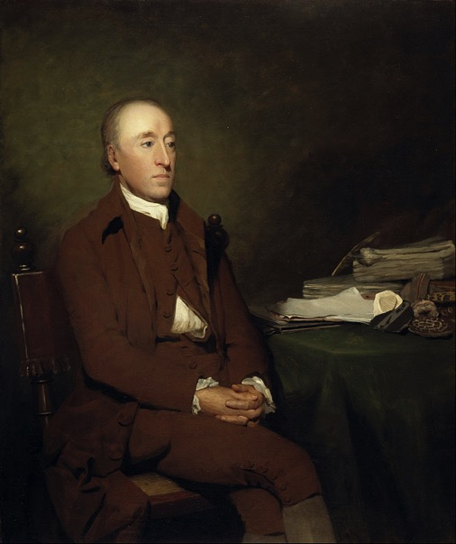
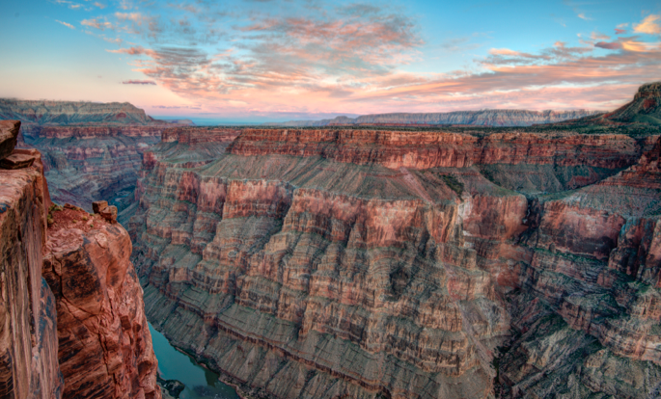
James Hutton
Proposed Gradualism & Uniformitarianism to explain geologic formations
Ideas floating around in Darwin’s head...

Slide 5
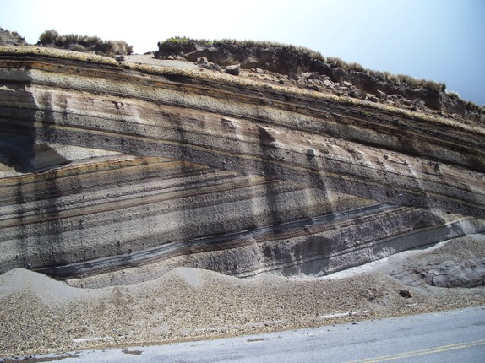
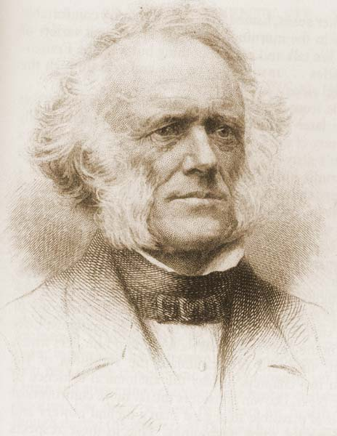
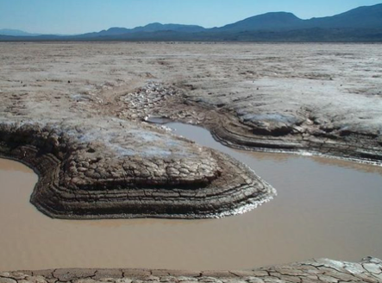
Charles Lyell
Ideas floating around in Darwin’s head...
Popularized Uniformitarianism
Greatly influenced Darwin’s thinking
Suggested Earth was much older than previously believed to be

Slide 6
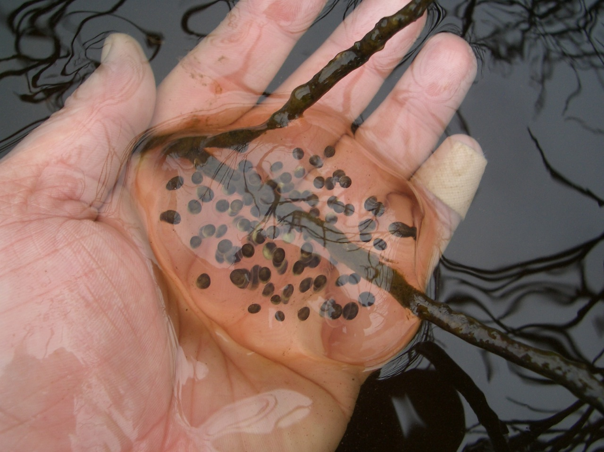
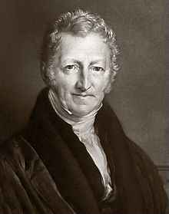
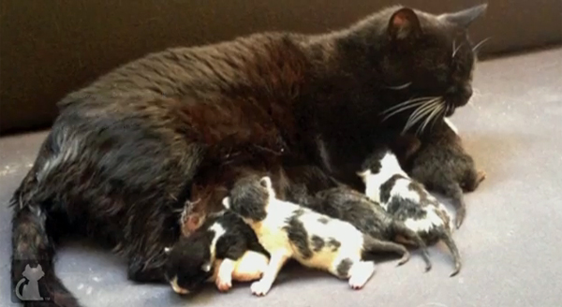
Ideas floating around in Darwin’s head...
Thomas Malthus
Can you imagine how many kittens or salamanders there would be covering the earth if every single offspring survived and reproduced ?
Part of life is the drive to produce as many offspring as you can, and this usually means more offspring than could possibly survive.

Slide 7
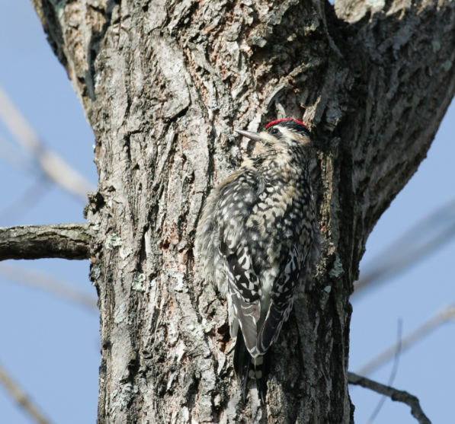
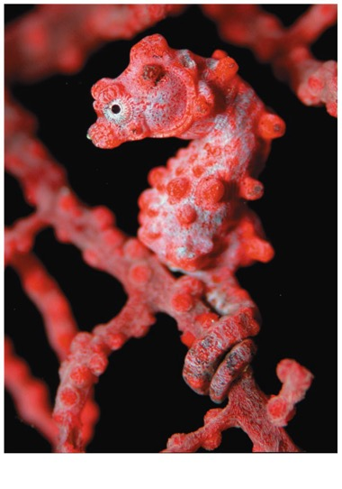
Fitness
Darwin observed that individuals that are more well suited to their environment (more well matched) tend to leave more offspring (more fit)

Slide 8
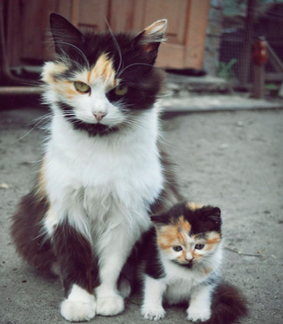
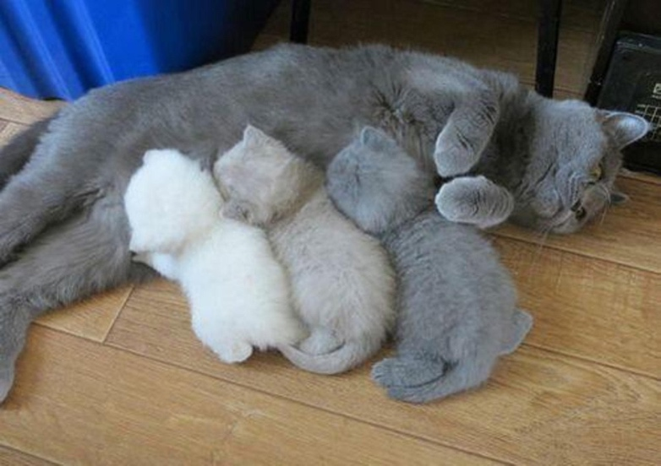
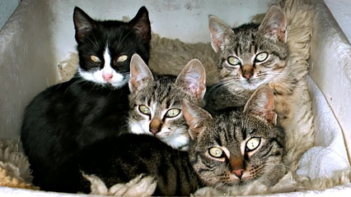
Heredity
Offspring tend to resemble the parents
Offspring vary in how much they look like the parents

Slide 9
Four Things are Necessary for Evolution by Natural Selection
  More individuals are born than can survive so there is competition for survival and reproduction
  Individuals vary in traits (variation)
  Those traits are heritable (heritable variation)
  Individuals with some traits causes those individuals to experience higher survival and reproductive success (fitness)
  Over generations, the proportion of individuals with fit/adaptive traits increases in the population

Slide 10
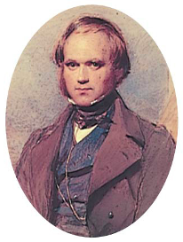
Darwin was influenced by Thomas
Malthus who pointed out that in nature species tend to produce more offspring than can be supported by the environment leading to competition for limited
resources between individuals within a population
They also realized that there was phenotypic variation
within individuals of population, not just among species
Darwin then concluded that those individuals with the most advantageous traits would have a greater chance of surviving and thus would produce more progeny
These progeny would inherit the advantageous traits
from their parents
Therefore, the frequency of favorable traits within a population would increase with every new generation
Thus, species do not need to possess an inner drive to evolve
Instead, Darwin proposed that all species are constantly subjected to “natural selection” by the environment and therefore must be evolving
p473

Slide 11
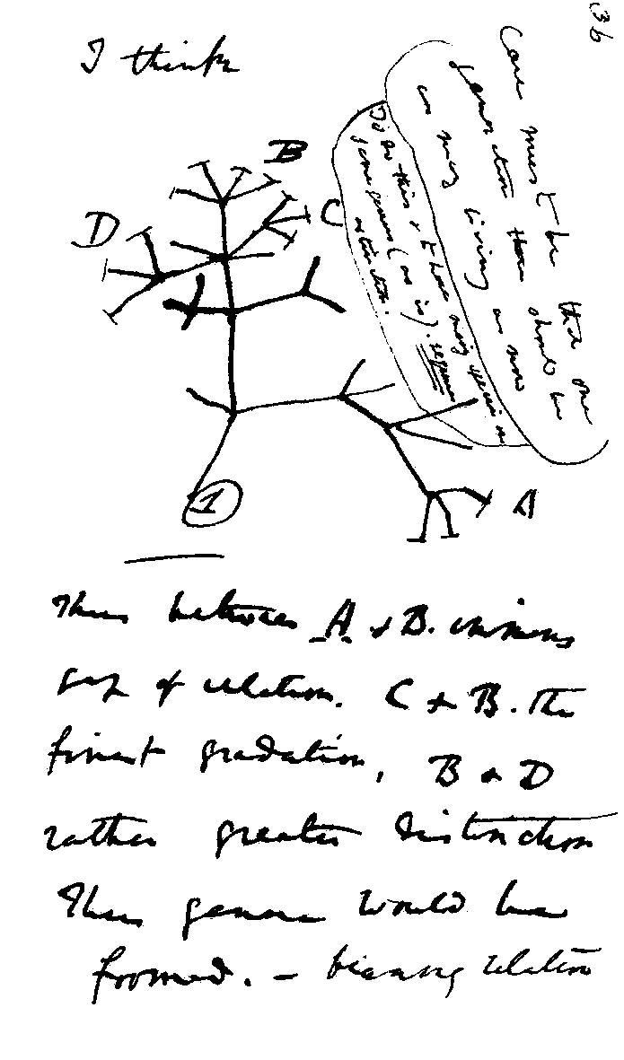
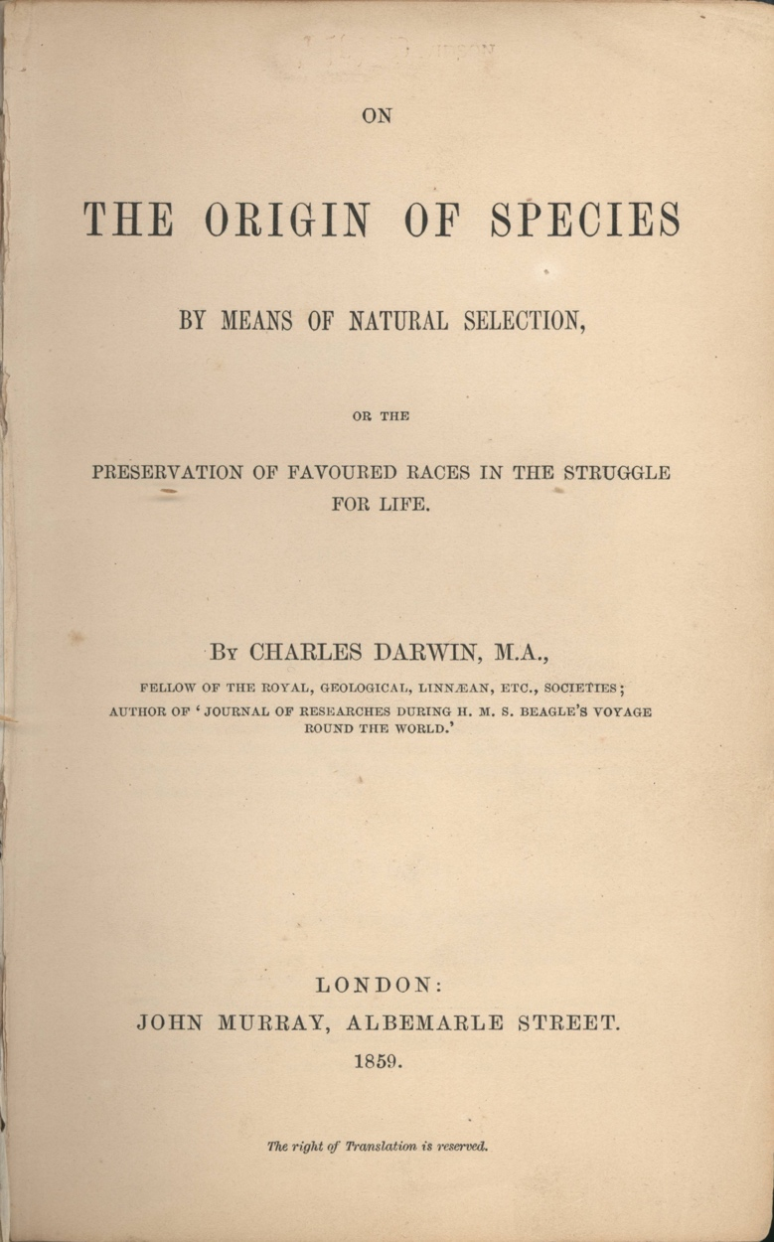
Descent with Modification
How do we know all life has a shared ancestry?

Slide 12
Mechanism of Genetic Inheritance & DNA as the Unifying Language of Life

Slide 13
Unity Underlying Diversity:
Shared Traits Across Domains

Slide 14
Unity Underlying Diversity:
Genetic Homologies

Slide 15
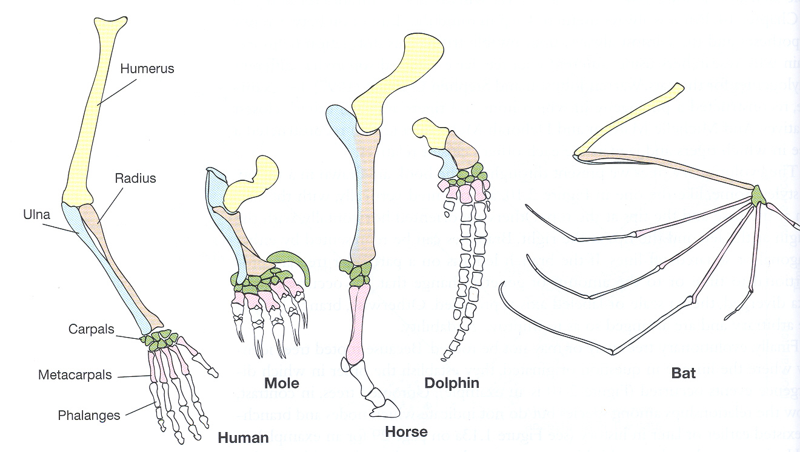
Unity Underlying Diversity:
Structural Homologies

Slide 16
Unity Underlying Diversity:
Structural Homologies

Slide 17
Unity Underlying Diversity:
Vestigial Structures

Slide 18
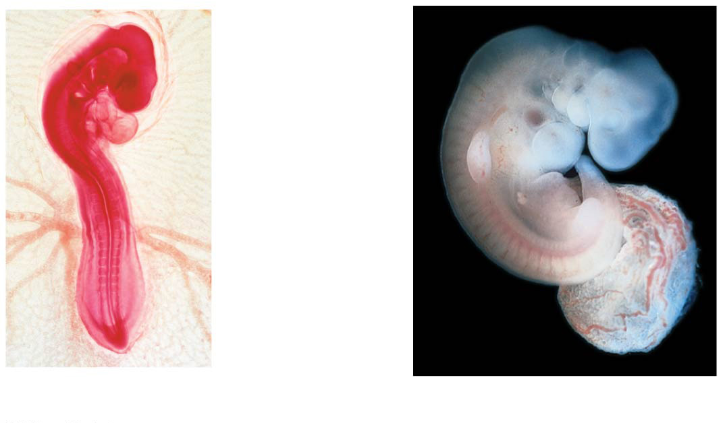
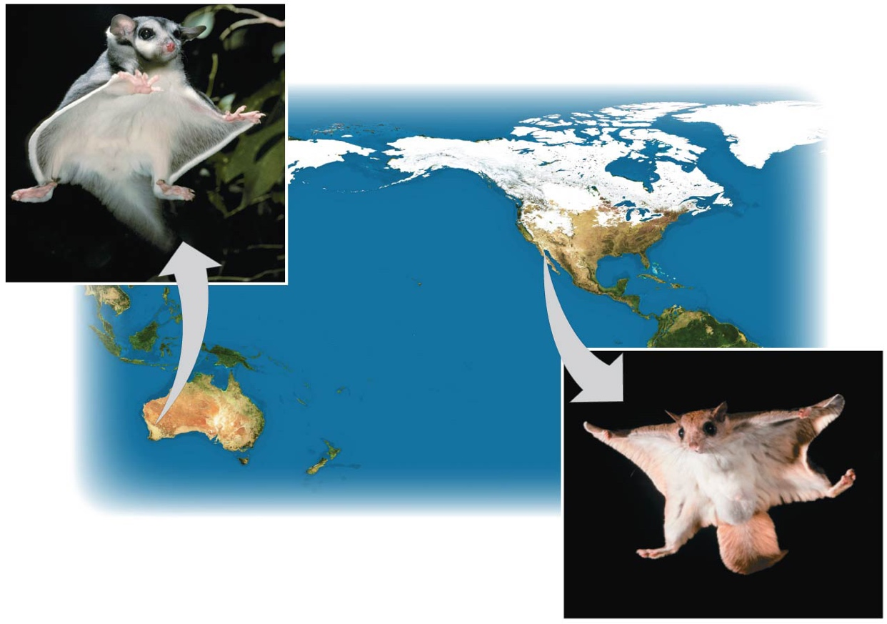
Developmental similarities
between highly diverged
organisms
Pharyngeal
arches
Post-anal
tail
Chick embryo (LM)
Human embryo
Convergent evolution
suggests that the products of natural selection are not random
Sugar
glider
NORTH
AMERICA
AUSTRALIA
Flying squirrel

Slide 19
Niche
A populations relationship to habitat and individuals of the population behave in that habitat
Allows for:
  Ecological Equivalents
  Empty Niches
Notes:
19

Slide 20
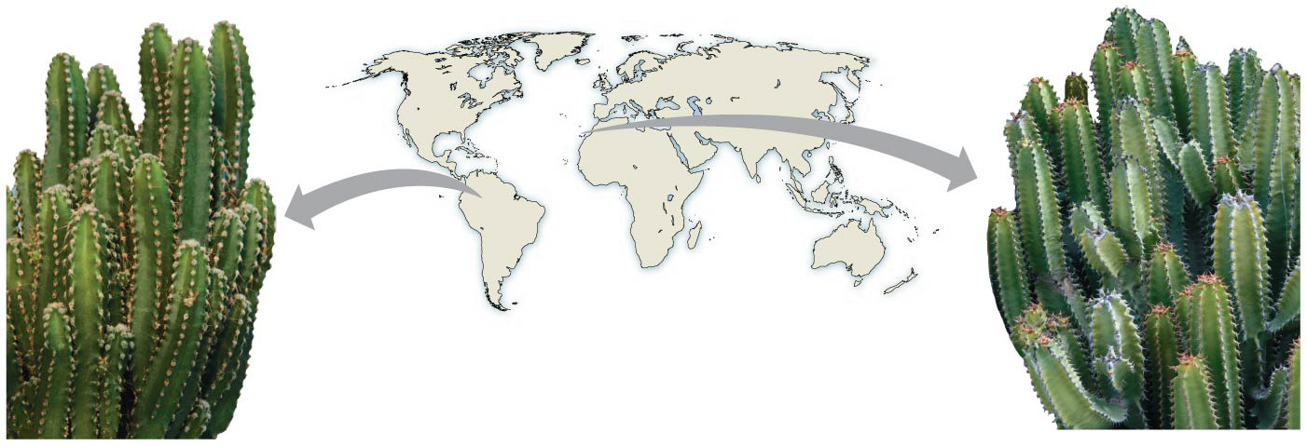
Ecological Equivalents
Two or more distantly related species with very similar niche characteristics
Occur in two completely different locations
An Example of convergent evolution
Euphorbia
canariensis
Cereus sp.
Notes:
20

Slide 21
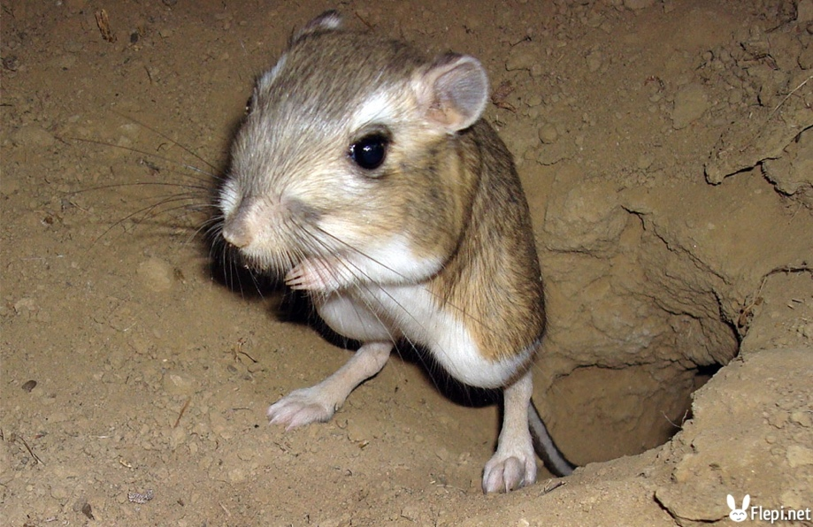
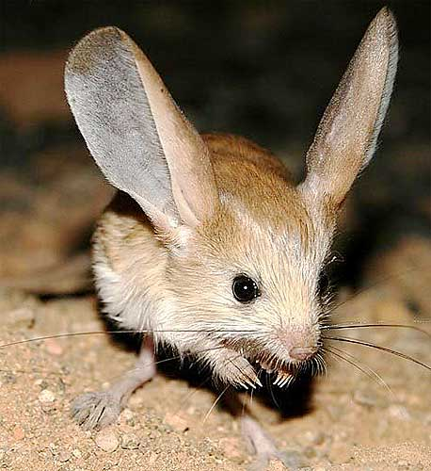
Ecological Equivalents
Two or more distantly related species with very similar niche characteristics
Occur in two completely different locations
An Example of convergent evolution
Kangaroo Rat (North America)
Jeroba
(Africa)
Notes:
21

Slide 22
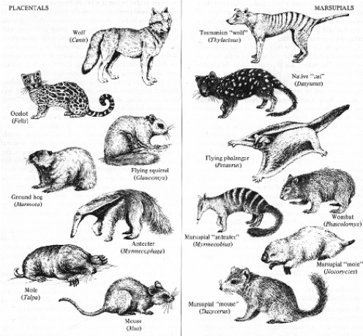
Ecological Equivalents
Marsupals
Placentals
Notes:
22

Slide 23
Empty Niches
When a suitable species for a niche does not occur within a location
  Perhaps because it never dispersed there
  Perhaps because it was yet unable to evolve there
Notes:
23

Slide 24
Evolution & Population Genetics

Slide 25
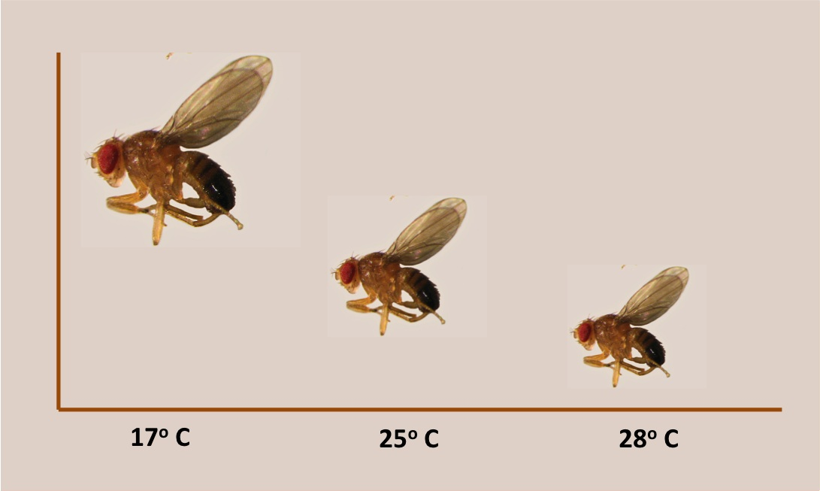
What is phenotypic plasticity?
Phenotypic plasticity: the ability of a single genotype to produce multiple phenotypes.
Example: Phenotype of body size.

Slide 26
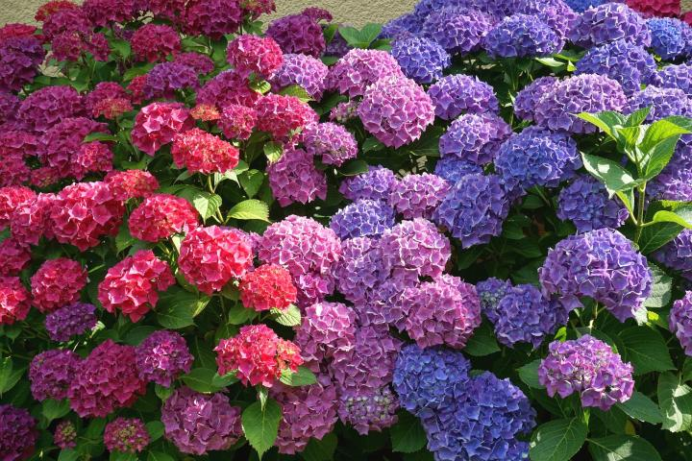
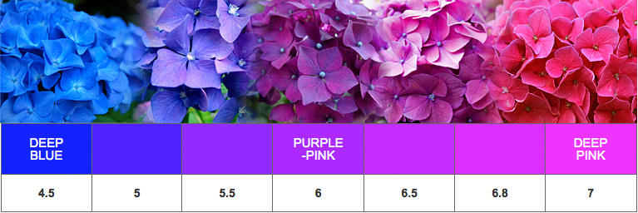
What is phenotypic plasticity?
Phenotypic plasticity: the ability of a single genotype to produce multiple phenotypes.
Phenotypic plasticity: the ability of a single genotype to produce multiple phenotypes.
Example: Phenotype flower color changing with pH of soil.

Slide 27
How can phenotypic plasticity slow down the speed of evolution?
Phenotypic plasticity: the ability of a single genotype to produce multiple phenotypes.
What would happen to a population of Hydrangeas if pollinators would only visit purple flowers? Would the population evolve to have more purple flowers?
Example: Phenotype flower color changing with pH of soil.

Slide 28
What Are Populations?
A population is a localized group of individuals capable of interbreeding and producing fertile offspring
A gene pool consists of all the alleles for all loci in a population

Slide 29
Causes of Microevolution
Mutation
Gene Flow
Genetic Drift (non random sampling)
  Demographic Bottlenecks
  Founder Effects (in new populations)
Selection
  Natural
  Artificial
  Sexual

Slide 30
Causes of Microevolution:
Mutation
Change in nucleotide sequence in the DNA
Can result in creation of new alleles
Only those that occur in cells that undergo meiosis (occurring in the germ line) will be passed on to offspring

Slide 31
Causes of Microevolution:
Mutation
Unpredictable process
Typically deleterious
  Some new alleles are beneficial
  But new alleles are usually deleterious
    But only if they are displayed
    Recessive deleterious traits can hide in heterozygotes within the population

Slide 32
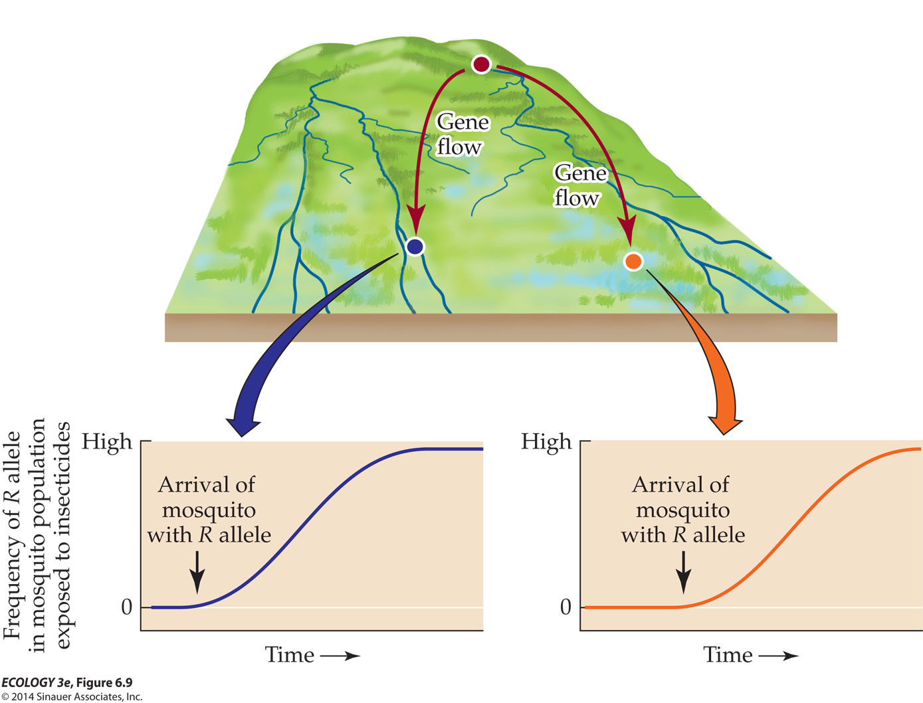
Causes of Microevolution: Gene Flow
Movement of alleles into or out of a population (into or out of a gene pool...)
  Caused by immigration and emigration of individuals
  Caused by movement of gametes (for example, pollen)
Gene flow tends to reduce variation among/between populations over time
Can increase or decrease the fitness of a population over time

Slide 33
Causes of Microevolution:
Genetic Drift
Genetic drift describes how allele frequencies fluctuate unpredictably from one generation to the next due to chance events
  i.e. how they “drift” from what would be expected from one generation to the next
Genetic drift tends to reduce genetic variation through losses of alleles
  Primarily a problem faced by small populations
    The smaller a sample, the greater the chance of random deviation from a predicted result

Slide 34

Genetic Drift in Small Populations
C^{R}C^{R}
C^{R}C^{R}
C^{R}C^{W}
C^{R}C^{R}
C^{R}C^{R}
C^{W}C^{W}
C^{R}C^{W}
C^{R}C^{W}
C^{R}C^{R}
C^{R}C^{W}

Slide 35
Genetic Drift in Small Populations
Individuals highlighted in yellow reproduce
C^{R}C^{R}
C^{R}C^{R}
C^{R}C^{W}
C^{R}C^{R}
C^{R}C^{R}
C^{W}C^{W}
C^{R}C^{W}
C^{R}C^{W}
C^{R}C^{R}
C^{R}C^{W}
Generation 1
p (frequency of C^{R}) = 0.7
q (frequency of C^{W}) = 0.3

Slide 36
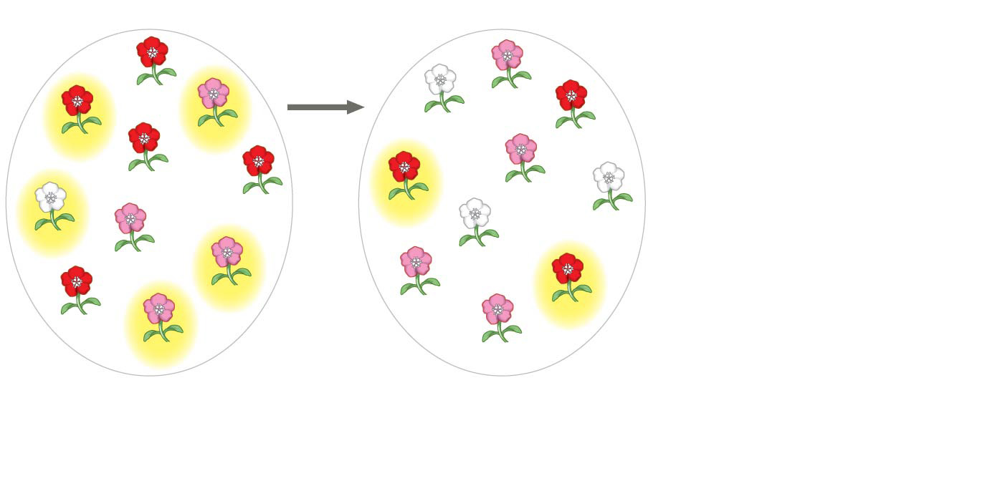
Genetic Drift in Small Populations
5 plants
leave
offspring
C^{R}C^{R}
C^{R}C^{W}
C^{R}C^{W}
C^{W}C^{W}
C^{R}C^{R}
C^{R}C^{R}
C^{R}C^{R}
C^{R}C^{W}
C^{R}C^{R}
C^{R}C^{R}
C^{W}C^{W}
C^{W}C^{W}
C^{W}C^{W}
C^{R}C^{W}
C^{R}C^{W}
C^{R}C^{W}
C^{R}C^{R}
C^{R}C^{R}
C^{R}C^{W}
C^{R}C^{W}
Generation 1
p (frequency of C^{R}) = 0.7
q (frequency of C^{W}) = 0.3
Generation 2
p = 0.5
q = 0.5
Microevolution: Change in frequency of p & q alleles

Slide 37
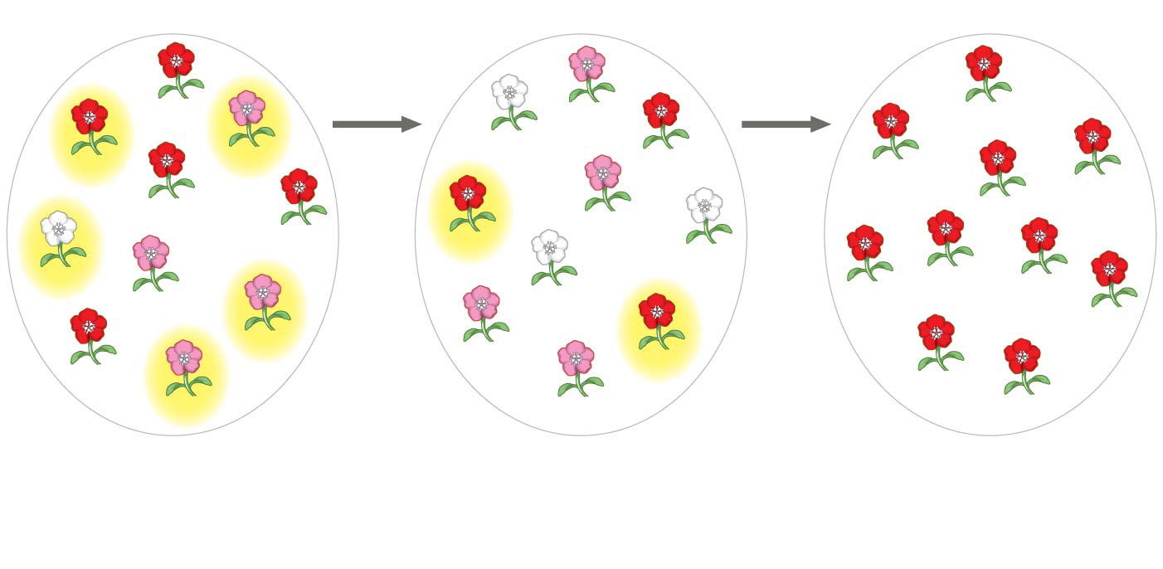
Genetic Drift in Small Populations
5 plants
leave
offspring
2 plants
leave
offspring
C^{R}C^{R}
C^{R}C^{W}
C^{R}C^{R}
C^{R}C^{W}
C^{W}C^{W}
C^{R}C^{R}
C^{R}C^{R}
C^{R}C^{R}
C^{R}C^{R}
C^{R}C^{R}
C^{R}C^{W}
C^{R}C^{R}
C^{R}C^{R}
C^{R}C^{R}
C^{W}C^{W}
C^{W}C^{W}
C^{W}C^{W}
C^{R}C^{R}
C^{R}C^{R}
C^{R}C^{R}
C^{R}C^{W}
C^{R}C^{R}
C^{R}C^{W}
C^{R}C^{W}
C^{R}C^{R}
C^{R}C^{R}
C^{R}C^{R}
C^{R}C^{W}
C^{R}C^{W}
C^{R}C^{R}
Generation 1
p (frequency of C^{R}) = 0.7
q (frequency of C^{W}) = 0.3
Generation 2
p = 0.5
q = 0.5
Generation 3
p = 1.0
q = 0.0
Gene Fixation: all individuals in a population are homozygous for the same allele (this is not good)

Slide 38
Causes of Microevolution:
Genetic Drift
Genetic drift leads to a loss of genetic variation within populations
Genetic drift can cause deleterious or beneficial alleles to become fixed
  But fixed alleles limit ability of population to adapt to a changing environment
Two examples of Genetic Drift:
  Demographic Bottlenecks and Founder Effects

Slide 39
Causes of Microevolution:
Genetic Drift (Demographic Bottlenecks)
Dramatic decrease in size of population
  Can be caused by a flood, fire, storm, or some other “chance” event
  Survival of event potentially tied to luck not fitness
By chance alone some alleles might be overrepresented among the survivors
Some alleles might be lost altogether among the survivors

Slide 40
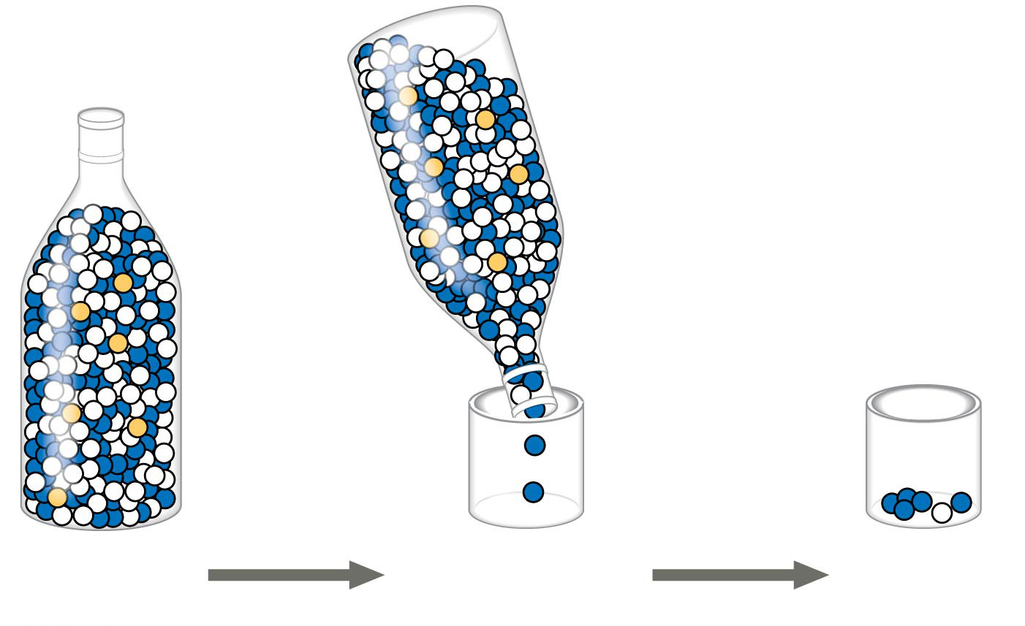
Causes of Microevolution:
Genetic Drift (Demographic Bottlenecks)
≈49% blue alleles
≈49% white alleles
≈2% yellow alleles
Complete loss of the gold allele and an overrepresentation of the blue allele
Only the lucky make it through the bottleneck
Original
population
Bottlenecking
event
Surviving
population
A non-random sampling event caused the surviving population to not be representative of the original population

Slide 41
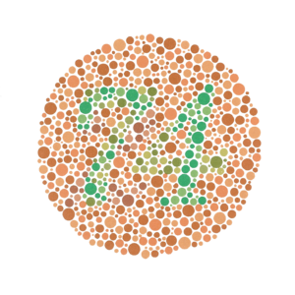
Causes of Microevolution:
Genetic Drift (Founder Effects)
Imagine a conference for scientists and eye doctors studying colorblindness that is held one year on a cruise ship
Population on ship is representative of USA
    ≈8% of males
    ≈0.05% of females
Colorblind people in the USA:
≈8% of males (2/25)
≈0.05% of females (0.00125/25)
≈4% of population

Slide 42
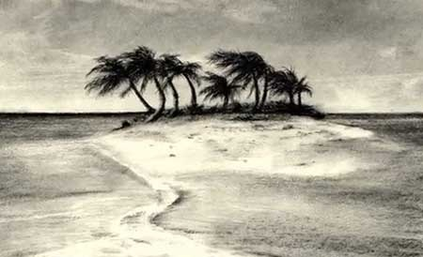
Causes of Microevolution:
Genetic Drift (Founder Effects)
Establishment of a new population by a small number of individuals
Imagine a shipwreck leading to the founding of an island population made up of 25 males and 25 females
  Just due to chance
    4/25 males are colorblind
    1/25 females are colorblind
Colorblind people in the USA:
≈8% of males (2/25)
≈0.05% of females (0.00125/25)
≈4% of population
Colorblind people on this island: ≈20% of population
A non-random sampling event caused the surviving population to not be representative of the original population

Slide 43
Causes of Microevolution (Summary)
Mutation
Gene Flow
Genetic Drift (non random sampling)
  Demographic Bottlenecks
  Founder Effects (in new populations)
Selection
  Natural Selection
  Artificial Selection
  Sexual Selection
Principally only
affects small
populations
The only mechanism that regularly
causes Adaptive Evolution
We aren’t going to talk about these in this section

Slide 44
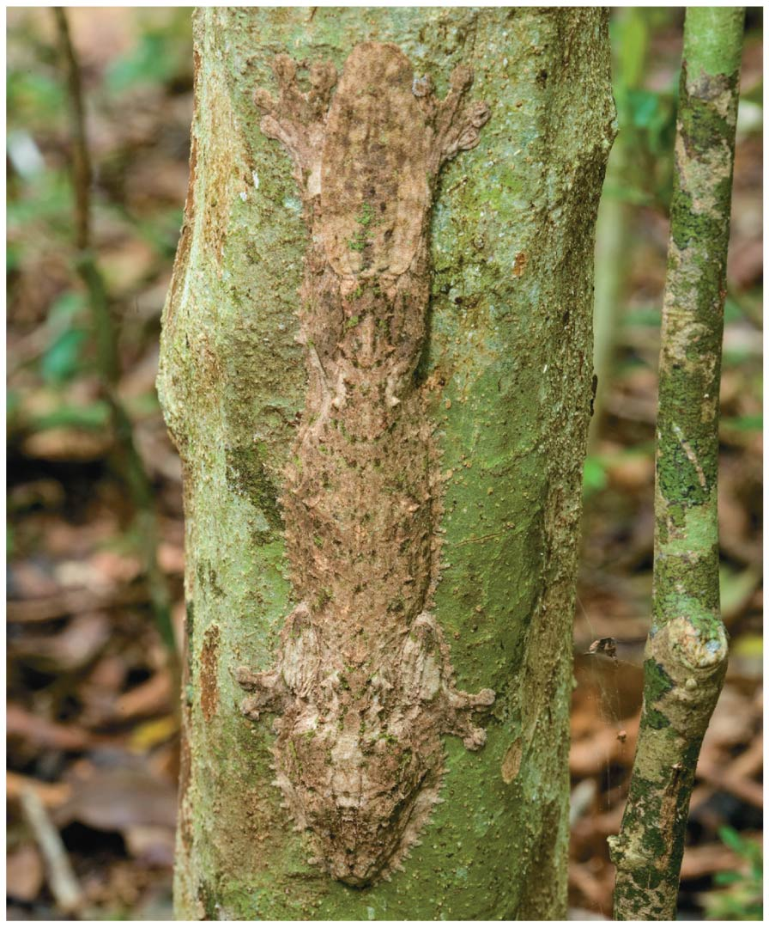
Adaptive Evolution
“Natural Selection is the only mechanism that consistently causes adaptive evolution”

Slide 45
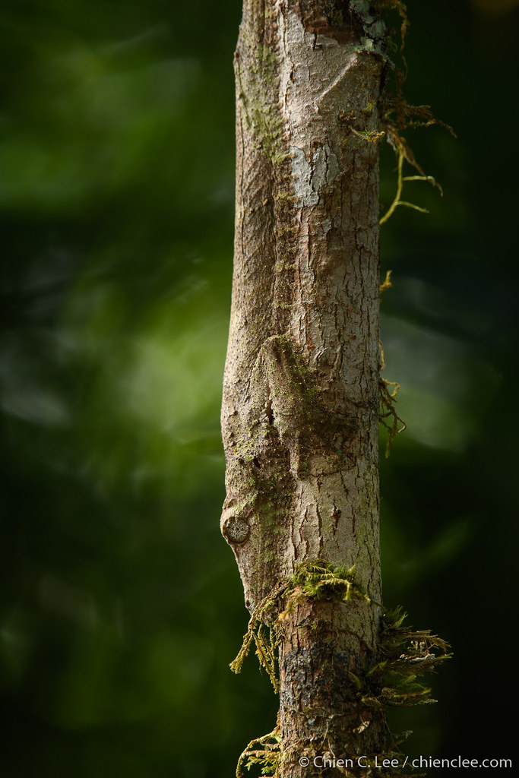
Adaptive Evolution
Adaptive evolution occurs as the match between a species and its environment increases
  Because the environment can change, adaptive evolution is a continuous process
Other types of evolution do not consistently lead to adaptive evolution
  They can increase or decrease the match between an organism and its environment

Slide 46
Types of Selection
The only mechanism that regularly
causes Adaptive Evolution
Natural Selection
  Four main types
    Directional Selection
    Stabilizing Selection
    Disruptive Selection
Sexual Selection
Artificial Selection
Tends to reduce genetic
variation in a population
Tends to preserve genetic variation in a population
Regularly causes maladaptive evolution,
selecting for phenotypes less well
matched to the environment

Slide 47
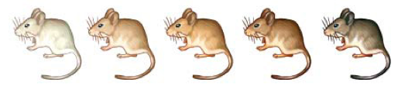
Three of the Types of Natural Selection
favors individuals at one extreme end of the phenotypic range
favors individuals at both extremes of the phenotypic range
favors intermediate variants and acts against extreme phenotypes

Slide 48
Vocab
Speciation – an evolutionary process when one species splits into two or more species
Hybrids – the offspring of crosses between different species

Slide 49
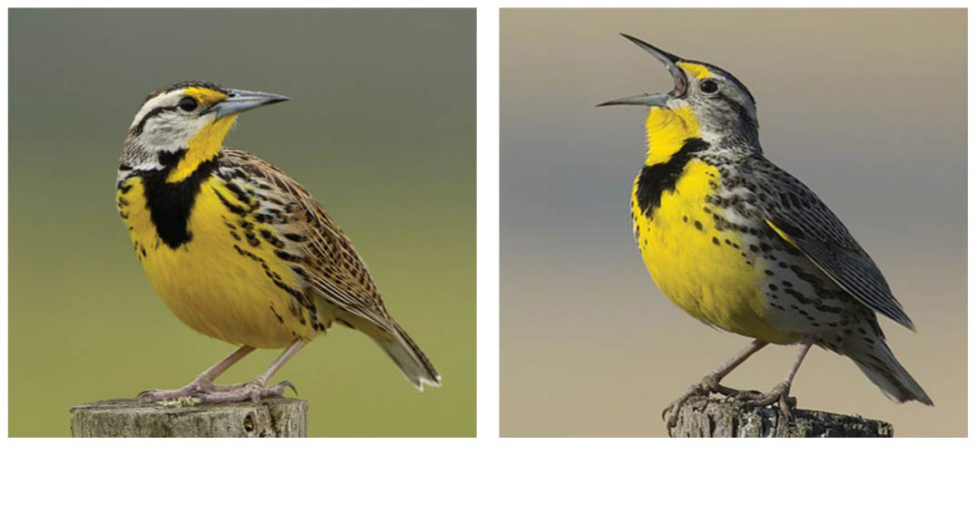
Biological Species Concept (BSC)
Defined as
  a group of populations where
    1) whose members have the potential to interbreed in nature and produce viable, fertile offspring
    2) whose members do not breed successfully with members of other populations
Eastern meadowlark
Western meadowlark

Slide 50
Biological Species Concept (BSC)
Gene flow between populations holds a species together genetically
Lack of possible gene flow between species defines boundaries of a species
Eastern meadowlark
Western meadowlark

Slide 51
So What Causes Speciation
(when using the Biological Species Concept to determine a species)?
Reproductive Isolation

Slide 52
Reproductive Isolation
Reproductive isolation is the existence of biological factors (“barriers”) that impede two species from producing viable, fertile offspring

Slide 53
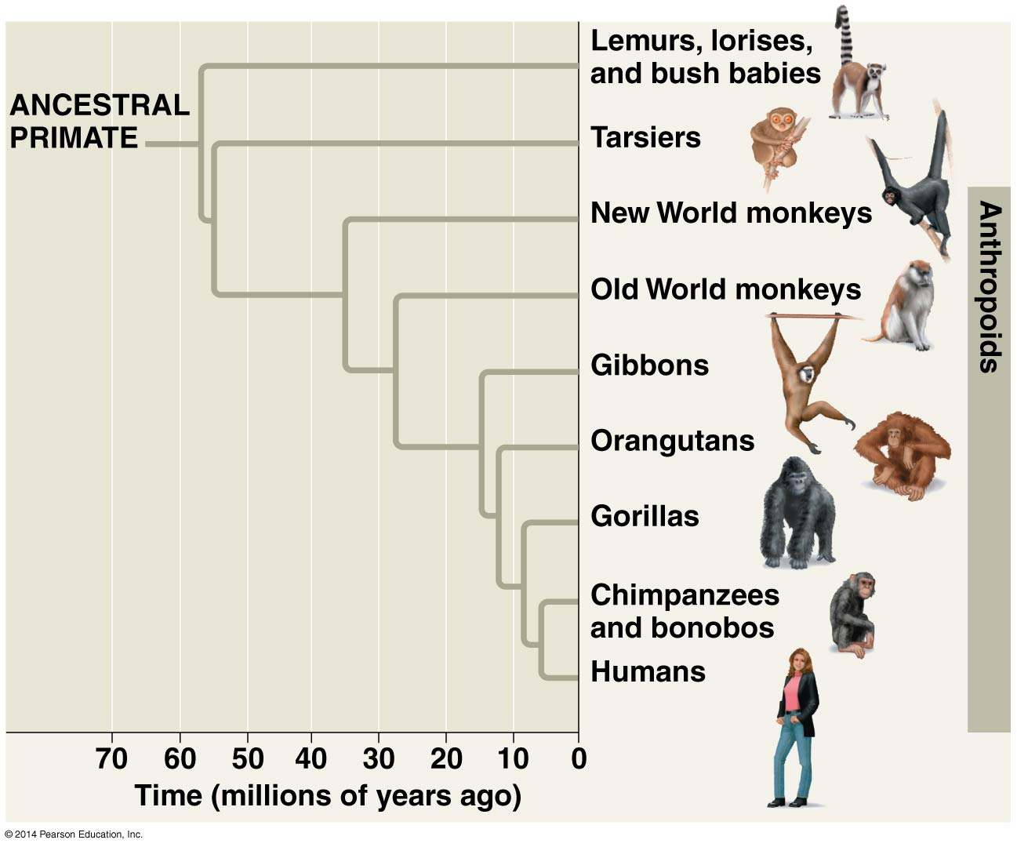
Speciation: the origin of new species from existing species

Slide 54
Vocab
Allopatric – separate non-overlapping areas
Sympatric – within the same geographical area, without separation
Range of Species A
&
Range of Species B
Range of Species A
Range of Species B
Allopatric
Sympatric

Slide 55
Speciation
BARRIER
gene flow is interrupted or reduced when a population is divided by a physical barrier into geographically isolated subpopulations (separate an non-overlapping)
speciation takes place in geographically overlapping populations (without separation)

Slide 56
Allopatric Speciation
BARRIER
gene flow is interrupted or reduced when a population is divided by a physical barrier into geographically isolated subpopulations (separate an non-overlapping)
speciation takes place in geographically overlapping populations (without separation)

Slide 57
Example of Allopatric Speciation
Reproductive isolation may arise as a by-product of genetic divergence
  For example, isolated populations of mosquitofish have evolved reproductive isolation as a result of selection under different levels of predation

Slide 58
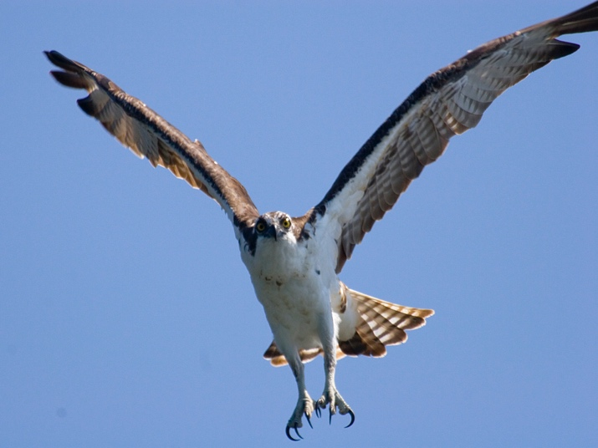
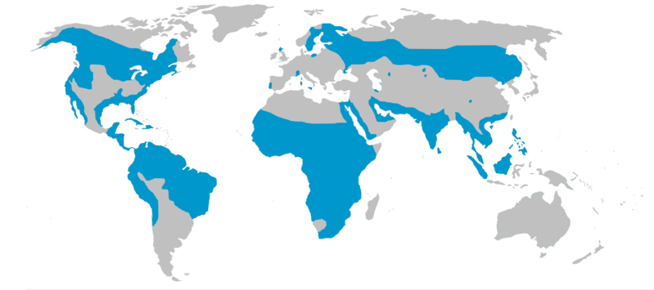
Allopatric speciation: important considerations
The effectiveness of a geographic barrier to impede or eliminate gene flow depends on the locomotion and other characteristics of individuals

Slide 59
Evolutionarily – what starts the process of speciation?
Speciation is initiated by a barrier to gene flow...

Slide 60
Speciation
What caused
a “barrier to gene flow” here?
What caused
a “barrier to gene flow” here?
BARRIER
“BARRIER”

Slide 61
Sympatric Speciation
Takes place in geographically overlapping populations
Sympatric speciation can occur if gene flow is reduced by factors including
  Primarily Habitat differentiation and polyploidy
“BARRIER”

Slide 62
Habitat Differentiation
Habitat ≠ location
Habitat ≠ location
Habitat ≠ location
Habitat ≠ location
Habitat ≠ location
Within the same location
  When a subpopulation exploits a habitat or resource not utilized by the parent population
  May result in habitat isolation (prezygotic barrier) resulting in sympatric speciation
Habitat ≠ location
Habitat ≠ location
Habitat ≠ location
Habitat ≠ location
Habitat ≠ location
Habitat ≠ location
Habitat ≠ location

Slide 63
Habitat Differentiation
Within the same location
  When a subpopulation exploits a habitat or resource not utilized by the parent population
  May result in habitat isolation (prezygotic barrier) resulting in sympatric speciation
Habitat ≠ location

Slide 64
Habitat Differentiation in the Apple Maggot Fly
Ancestral lineage consumed and reproduced near hawthorn berries
Upon introduction of apple trees to North America, some individuals consumed and reproduced near apple trees
Now considered two subspecies on path towards speciation
Habitat ≠ location

Slide 65
Polyploidy
Two different types cause sympatric speciation
  Both are most common in plants
  Both are most common in organisms that can undergo sexual or asexual reproduction

Slide 66
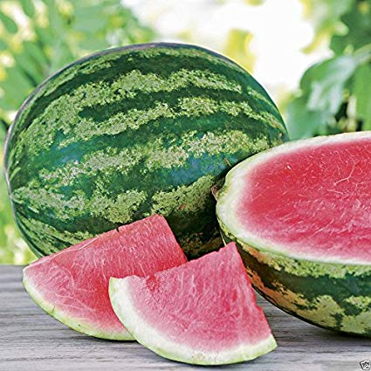
Autopolyploidy
a new species with more than two chromosome sets, derived from a single species
  4n individual cannot reproduce with 2n individual
  4n individual can asexually reproduce
  4n individual can sexually reproduce with other 4n individuals
Examples:
  Many species of watermelons, bananas, apples, etc.

Slide 67
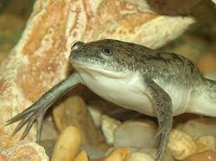
Allopolyploidy
a species with multiple sets of chromosomes derived from different species
Sterile hybrid cannot sexually reproduce
But can asexually reproduce
Asexual reproduction can result in errors resulting in diploid state which can reproduce asexually or sexually
Examples:
  Many species of wheat, cotton, peanuts, African clawed frog.

Slide 68
Summary of Speciation
In allopatric speciation, geographic isolation restricts gene flow between populations
Reproductive isolation may then arise by natural selection, genetic drift, or sexual selection in the isolated populations
  Even if contact is restored between populations, interbreeding is prevented
In sympatric speciation, a reproductive barrier isolates a subset of a population restricting gene flow without geographic separation from the parent species
Sympatric speciation can result from polyploidy, natural selection, sexual selection, or habitat differentiation

Slide 69
Adaptive Radiation

Slide 70
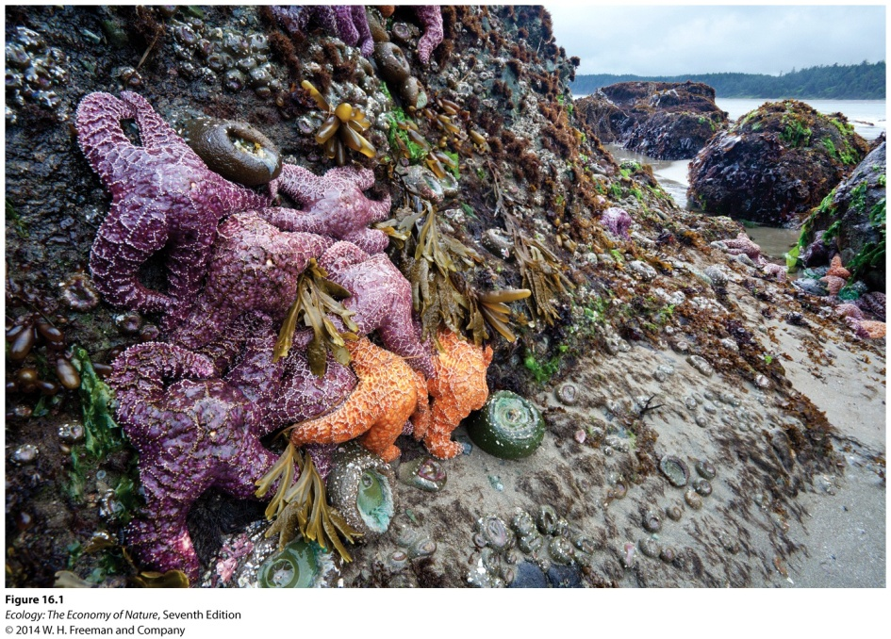
Resources
Resource: anything an organism consumes or uses that causes an increase in population when it becomes more available.
Resources for plants can include sunlight, water, and soil nutrients.
Resources for animals can include food, water, and space for nesting or refuge.

Slide 71
Competition
An interaction between individuals in which each is harmed by their shared use of a resource.
In competition (-/- interaction), both parties are harmed by competing for a resource in limited supply
  Both parties are harmed
Notes:
71

Slide 72


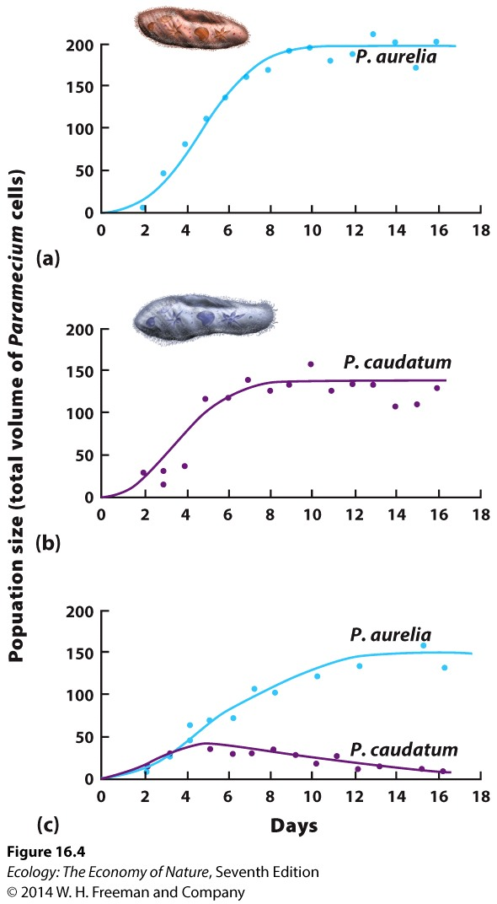
Competitive exclusion
Example:
Gause grew two species of Paramecium alone or together with a limited amount of bacteria as a resource.
When the two species of Paramecium were grown separately, both grew rapidly and reached carrying capacity.
When grown together, P. aurelia was the superior competitor and drove P. caudatum to extinction.

Slide 73
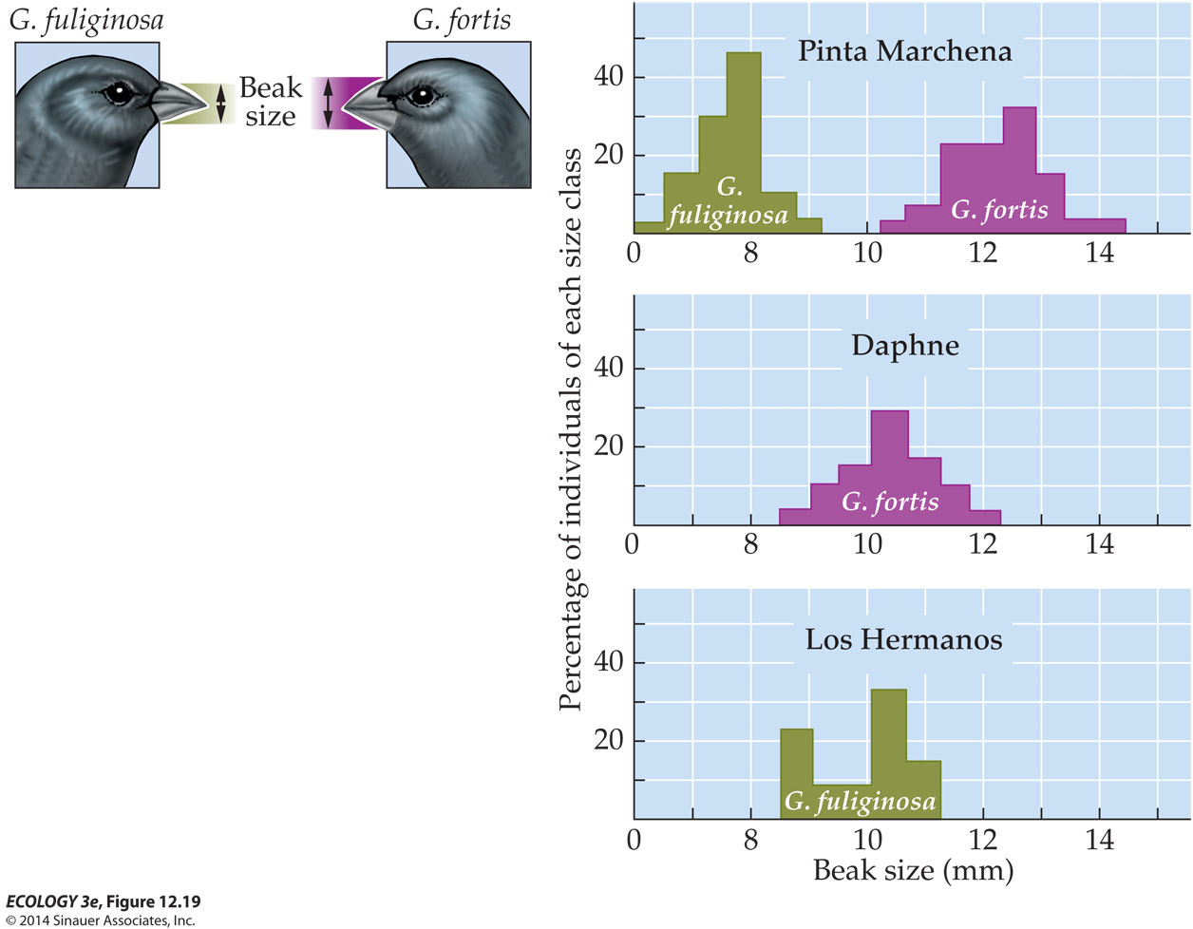
Character Displacement: Avoiding Biotic Stress of Competition
Coexistence w/ ongoing competition
What are the potential outcomes of prolonged character displacement within a population over evolutionary time?
No competition
No competition
Competition Between Closely Related Species
Notes:
73

Slide 74
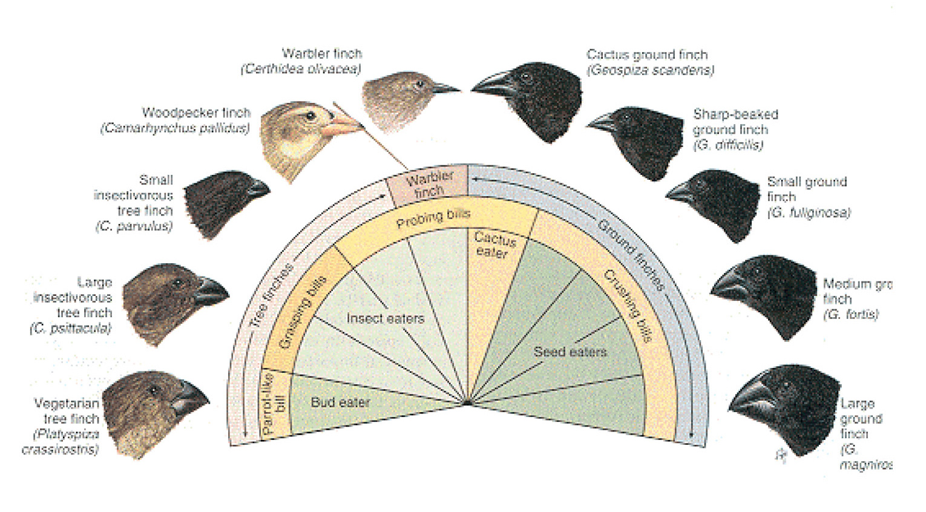
Ten species of Darwin’s Finches from Isla Santa Cruz, each with different bill size and feeding habits.

Slide 75
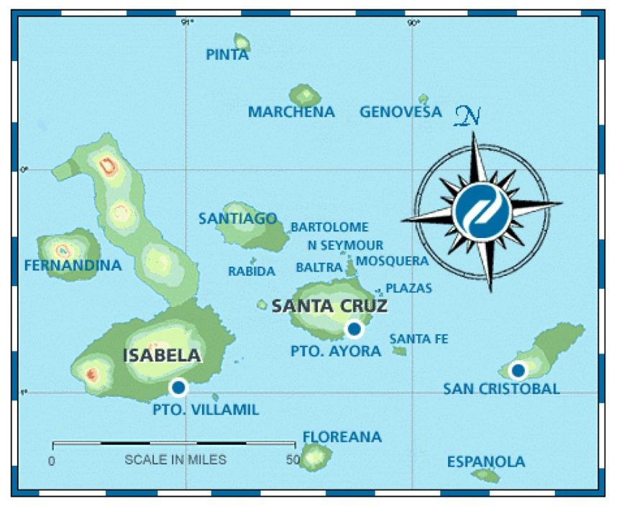
Adaptive Radiation
“Adaptive radiation strictly speaking refers to more or less simultaneous divergence of numerous lines from much the same adaptive type into different, also diverging adaptive zones.”

