Slide 1
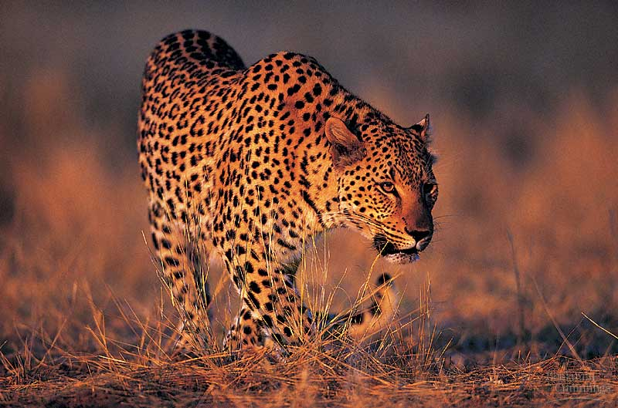
BIO10
Evolution Lab
Dr. Bradley
Notes:
Pick up on slide 28 for friday

Slide 2
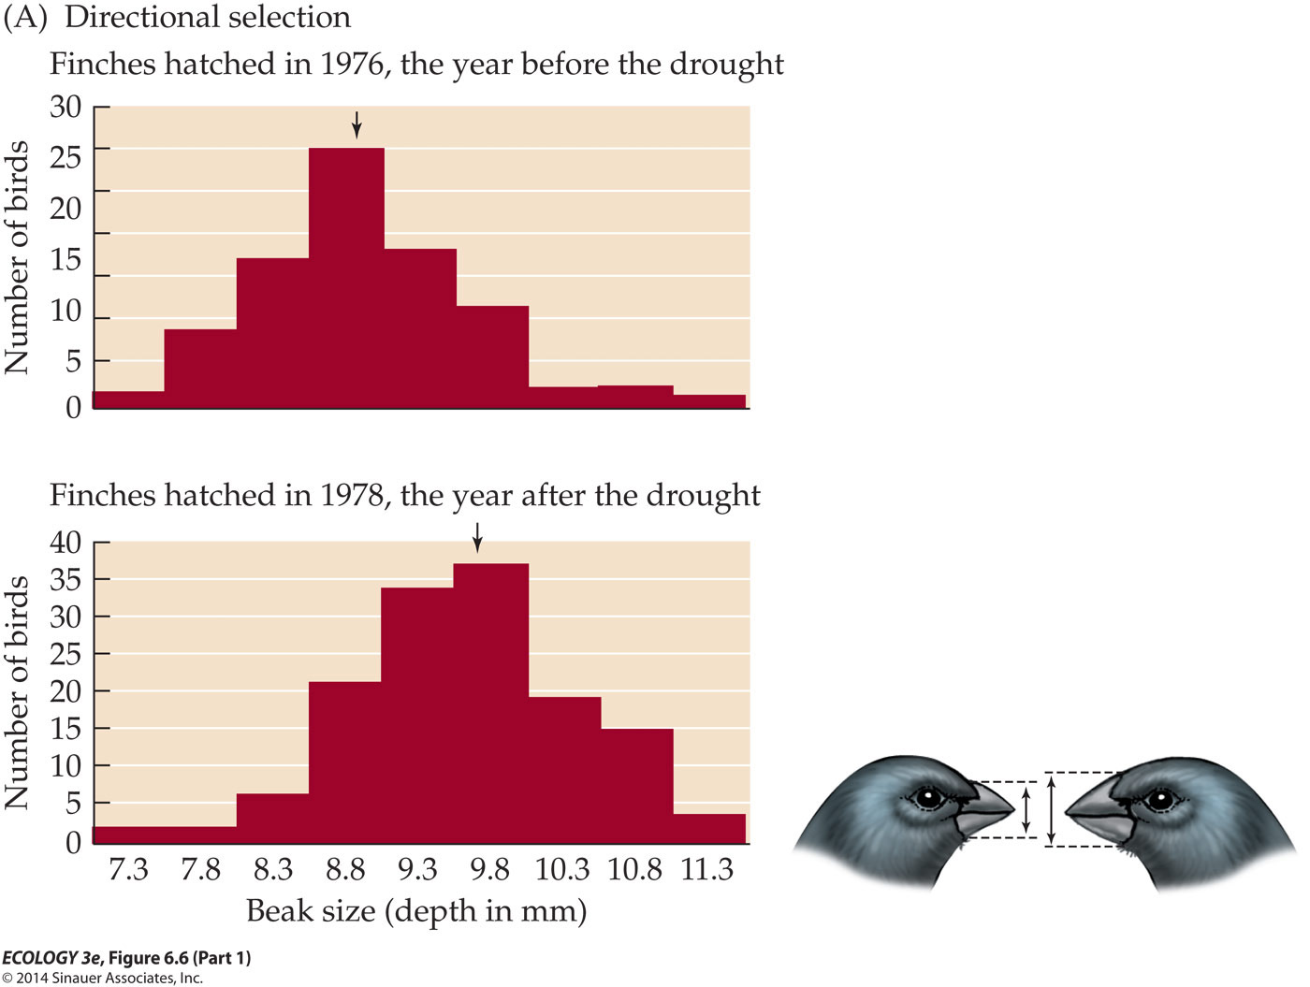
Evolution is...
Darwin used a phrase made up of only three words to define evolution
Decent with Modification
Individuals hatched in 1978 were decedents of individuals hatched in 1976 but the decedents looked like modified forms with bigger beaks.
Notes:
Microevolution

Slide 3
Microevolution is…
Change in allele frequency of a population over time
Between 1976 and 1978 the proportion of the big-beak allele increased in the gene-pool and the proportion of the small-beak allele decreased
Notes:
Microevolution

Slide 4

What is Frequency?
How often something appears.
  Proportion
  Fraction
  Ratio
  Odds
  Prevalence
By convention we often refer to alleles as having frequencies of p and q which have to add up to 100% or 1.0.
  Example: p = 0.3 & q = 0.7

Slide 5
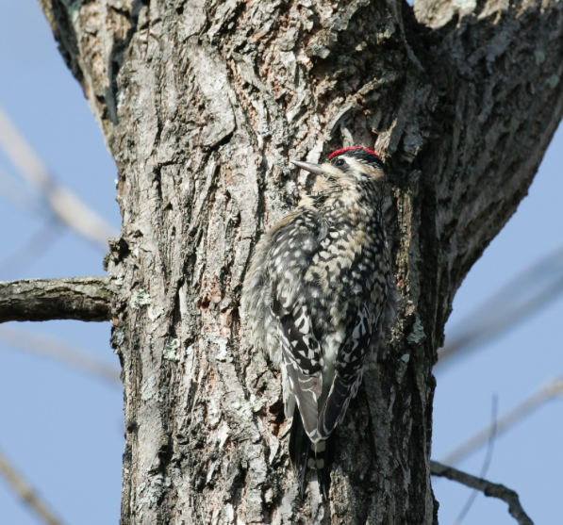
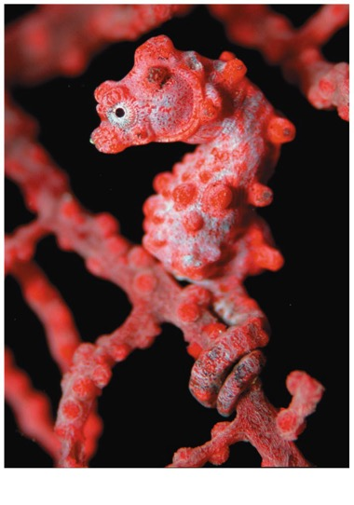
Fitness
Darwin observed that individuals that are more well suited to their environment (more well matched) tend to leave more offspring (more fit)

Slide 6
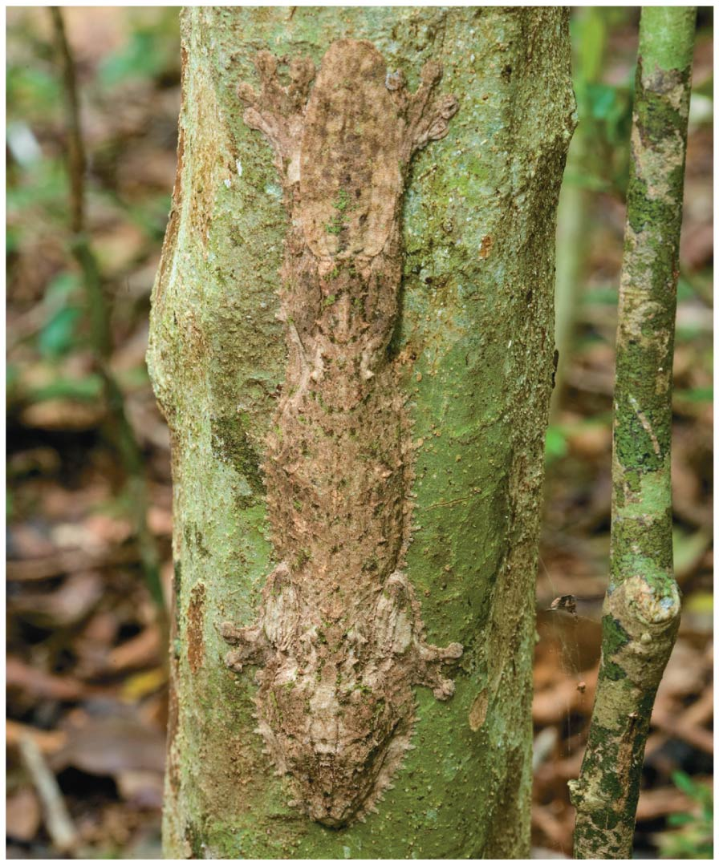
Adaptive Evolution
“Natural Selection is the only mechanism that consistently causes adaptive evolution”
What is it about the environment that makes this phenotype “fit?”
Would this phenotype be fit if the environment were different?

Slide 7
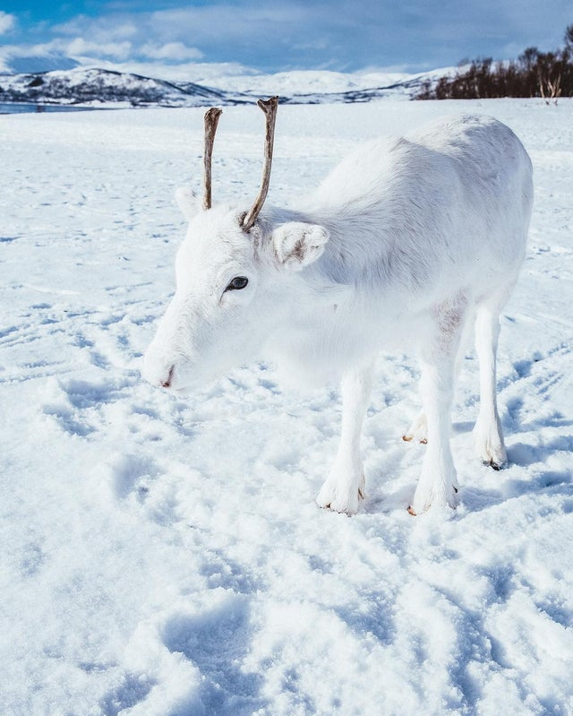
What determines if a phenotype is fit?
What is it about the environment that makes this phenotype “fit?”
Would this phenotype be fit if the environment were different?

Slide 8
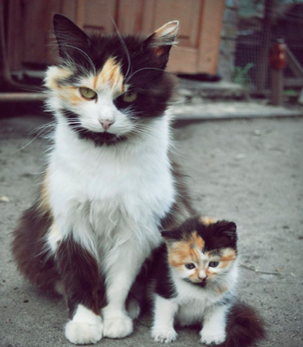
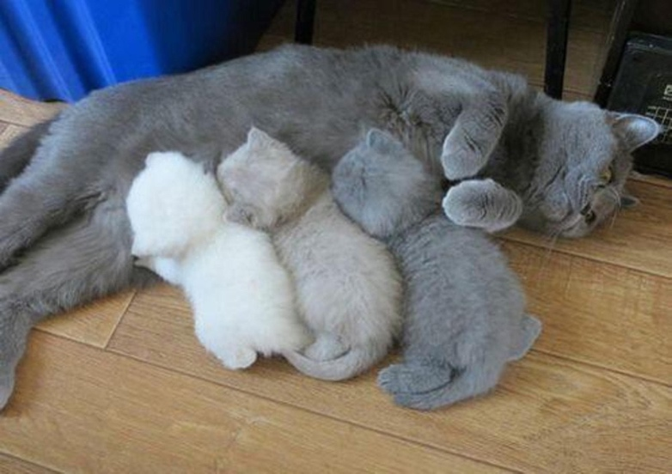
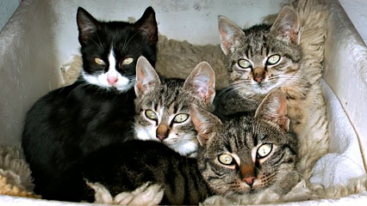
Heredity
Offspring tend to resemble the parents
Offspring vary in how much they look like the parents

Slide 9
Four Things are Necessary for Evolution by Natural Selection
  More individuals are born than can survive so there is competition for survival and reproduction
  Individuals vary in traits (variation)
  Those traits are heritable (heritable variation)
  Individuals with some traits causes those individuals to experience higher survival and reproductive success (fitness)
  Over generations, the proportion of individuals with fit/adaptive traits increases in the population

Slide 10
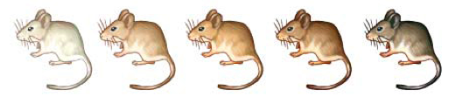
Types of Natural Selection:
Directional Selection
favors individuals at one extreme end of the phenotypic range
favors individuals at both extremes of the phenotypic range
favors intermediate variants and acts against extreme phenotypes

Slide 11
Types of Natural Selection:
Directional Selection
favors individuals at one extreme end of the phenotypic range
favors individuals at both extremes of the phenotypic range
favors intermediate variants and acts against extreme phenotypes

Slide 12
Types of Natural Selection:
Stabilizing Selection
favors individuals at one extreme end of the phenotypic range
favors individuals at both extremes of the phenotypic range
favors intermediate variants and acts against extreme phenotypes

Slide 13
Types of Natural Selection:
Disruptive Selection
favors individuals at one extreme end of the phenotypic range
favors individuals at both extremes of the phenotypic range
favors intermediate variants and acts against extreme phenotypes

Slide 14
Three of the Types of Natural Selection
favors individuals at one extreme end of the phenotypic range
favors individuals at both extremes of the phenotypic range
favors intermediate variants and acts against extreme phenotypes

