Slide 1
BIO10: Introduction to Principles of Biology
Midterm 2 Lecture Review

Slide 2
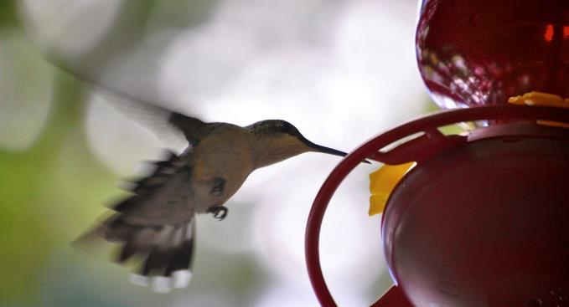
BIO10: Introduction to Principles of Biology
Dr. Paul Bradley
Energy & Membrane Transport
Part 2

Slide 3
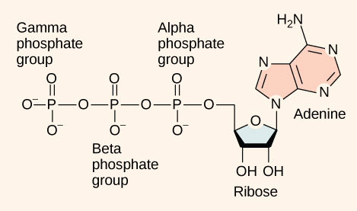
ATP
Functioning like a rechargeable battery, ATP is used to power the majority of energy-requiring cellular reactions.
When ATP is broken down, usually by the removal of its terminal phosphate group, energy is released.
This energy is used to do work by the cell, usually by the binding of the released phosphate to another molecule, thus activating it.

Slide 4
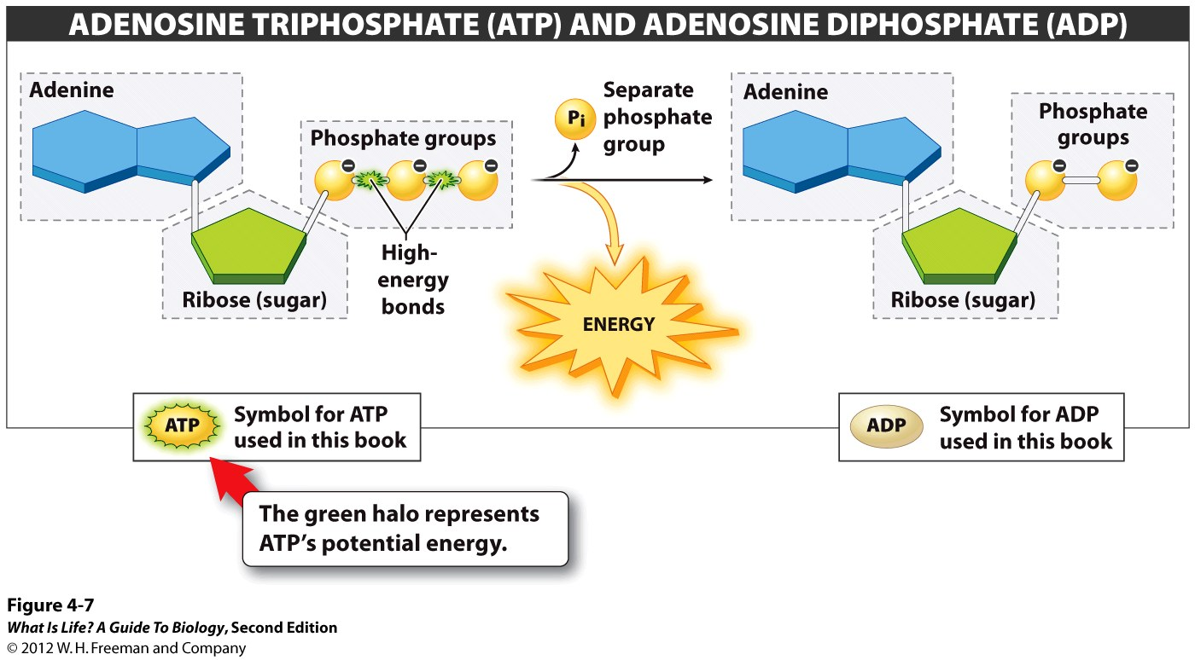
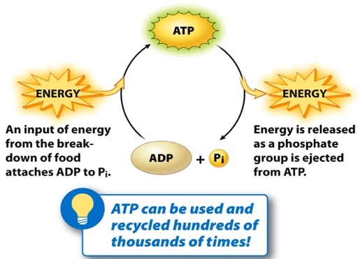
ATP
At the heart of ATP is a molecule of adenosine monophosphate (AMP), which is composed of an adenine molecule bonded to both a ribose molecule and a single phosphate group.
Ribose is a five-carbon sugar found in RNA and AMP is one of the nucleotides in RNA.
The addition of a second phosphate group to this core molecule results in adenosine diphosphate (ADP).
The addition of a third phosphate group forms adenosine triphosphate (ATP).
The addition of a phosphate group to a molecule requires a high amount of energy and results in a high-energy bond. Phosphate groups are negatively charged and thus repel one another when they are arranged in series, as they are in ADP and ATP. This repulsion makes the ADP and ATP molecules inherently unstable.

Slide 5
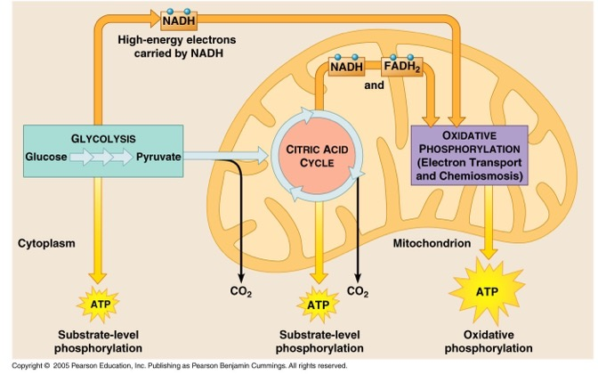

Slide 6
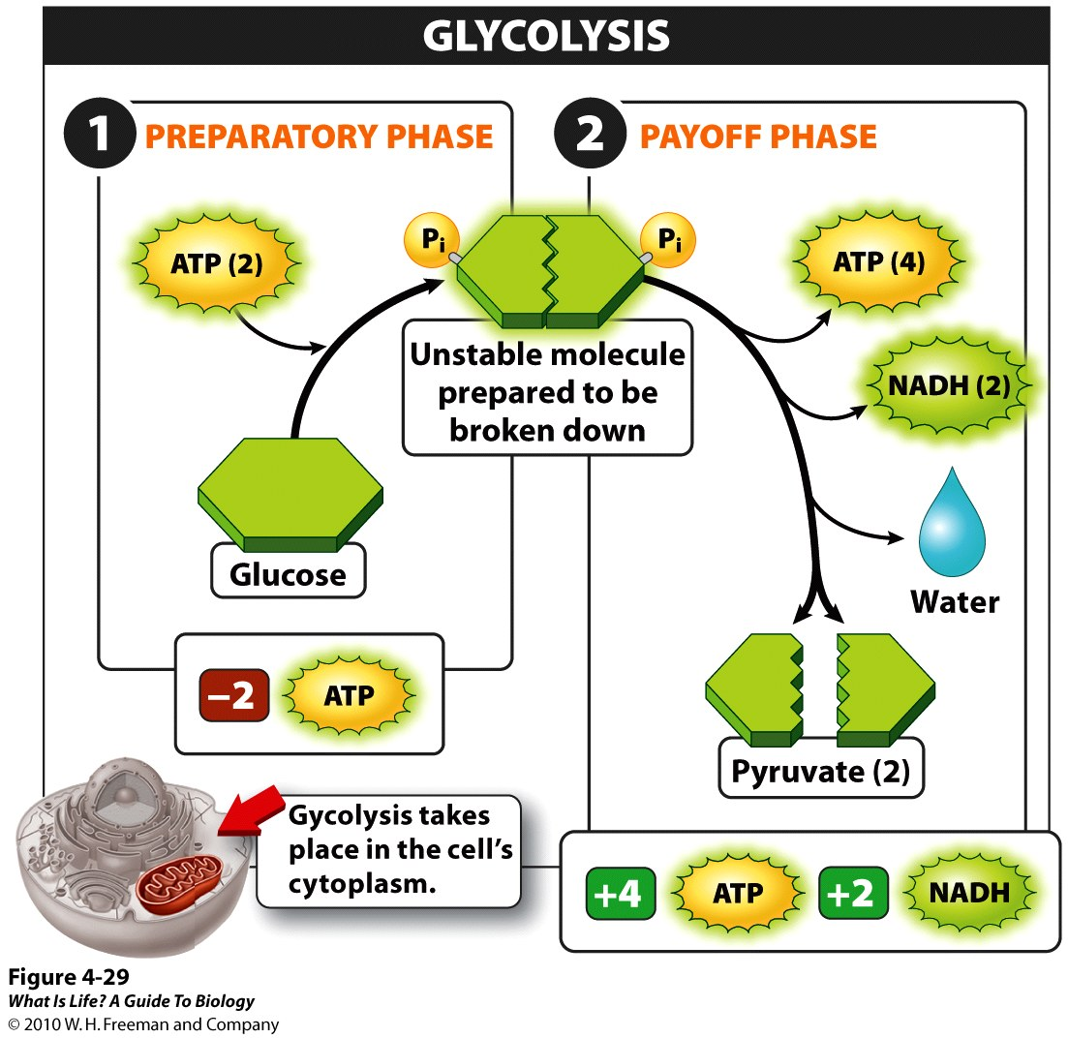
Glycolysis
Nearly all of the energy used by living things comes to them in the bonds of the sugar such as glucose.
Glycolysis is the first step in the breakdown of glucose to extract energy.
  takes place in the cytoplasm of most prokaryotic and all eukaryotic cells.
  begins with the six-carbon, ring-shaped structure of a single glucose molecule and ends with two molecules of a three-carbon sugar called pyruvate.
Glycolysis consists of two distinct phases.
In the first part of the glycolysis pathway, energy is used to make adjustments so that the six-carbon sugar molecule can be split evenly into two three-carbon pyruvate molecules.
In the second part of glycolysis, ATP and nicotinamide-adenine dinucleotide (NADH) are produced.
If the cell cannot catabolize the pyruvate molecules further, it will harvest only two ATP molecules from one molecule of glucose.
In glycolysis, a glucose molecule is converted into two pyruvate molecules.

Slide 7
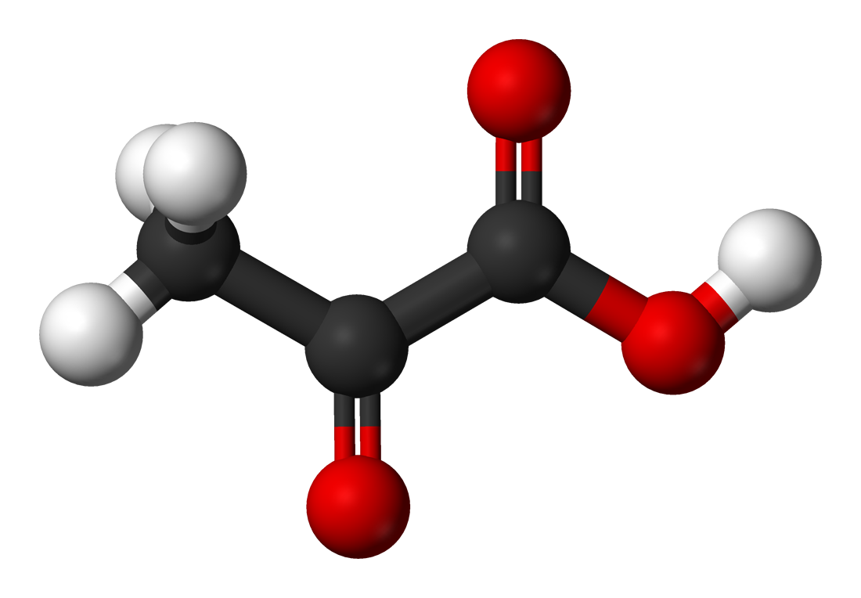
Pyruvate
Pyruvate (or Pyruvic acid) can be converted
  back to a carbohydrate (such as glucose) via gluconeogenesis.
  or to fatty acids through a reaction with acetyl-CoA.
  can also be used to construct the amino acid alanine.
  can be converted into ethanol or lactic acid via fermentation.
Pyruvate supplies energy to cells through the citric acid cycle (also known as the Krebs cycle) when oxygen is present (aerobic respiration)
  Or can ferments to produce lactate (lactic acid) when oxygen is lacking.

Slide 8
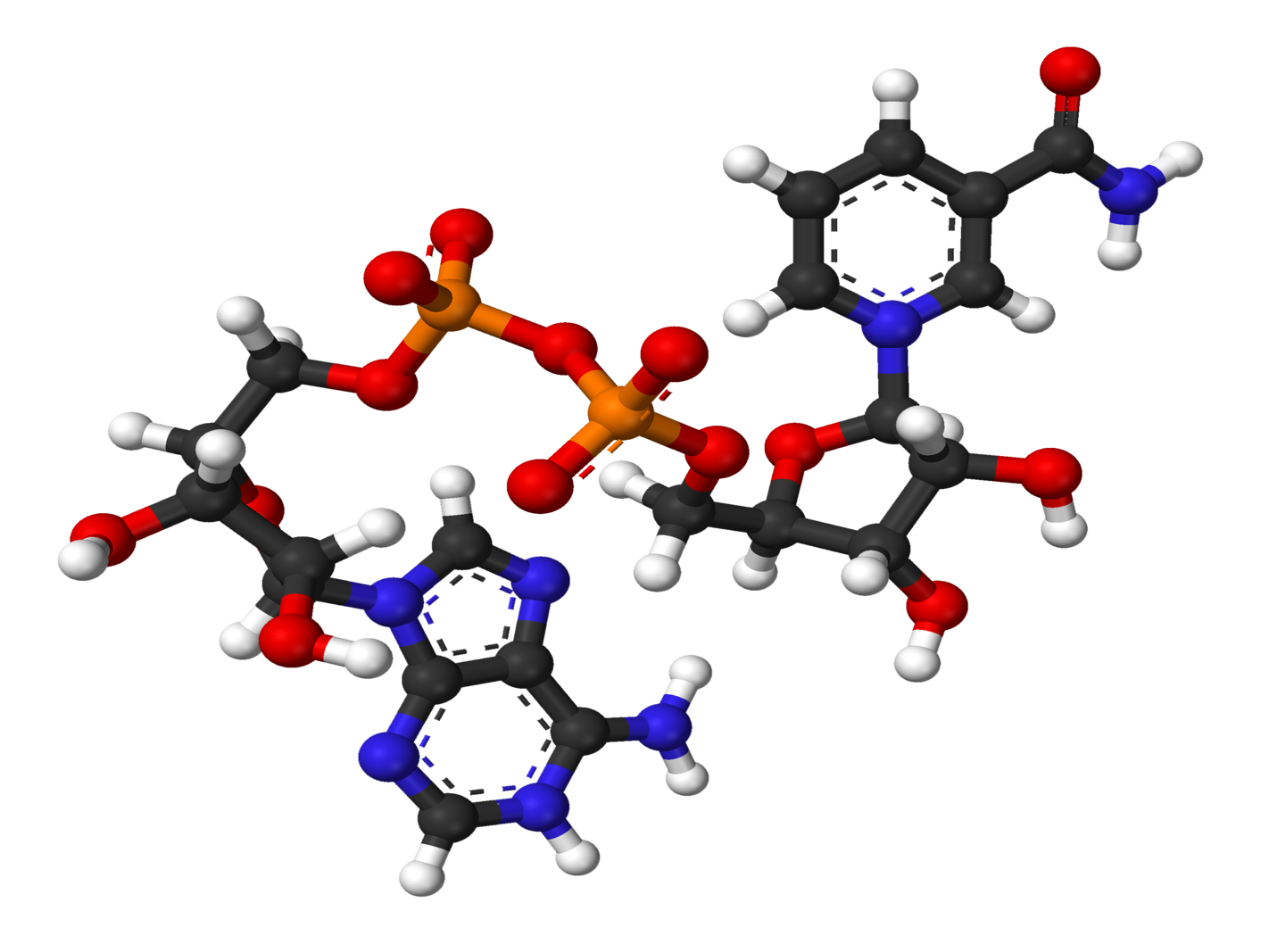
NAD+ / NADH
NAD+ / NADH is a coenzyme central to metabolism and is found in all living cells.
Consists of two nucleotides joined through their phosphate groups.
Main function is carrying electrons from one reaction to another.

Slide 9
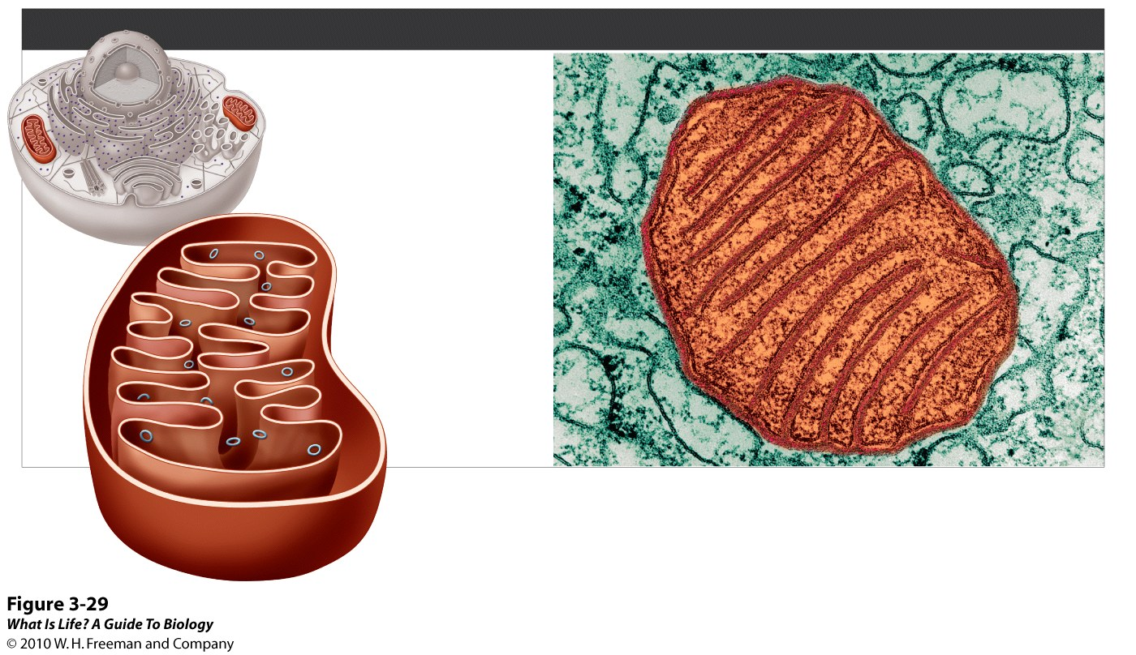
Most Eukaryotes also do Aerobic Respiration
MITOCHONDRIA
FUNCTIONS
• Act as all-purpose
energy converters
• Harvest energy to be
used for cellular functions
DNA
Matrix
Outer
membrane
Inner
membrane
Intermembrane
space
✪
Cells such as muscle and liver cells, which use a lot of energy, can have up to 2,000 mitochondria!
Notes:
FIGURE 3-29 Mitochondria: the cell's all-purpose energy converters.

Slide 10
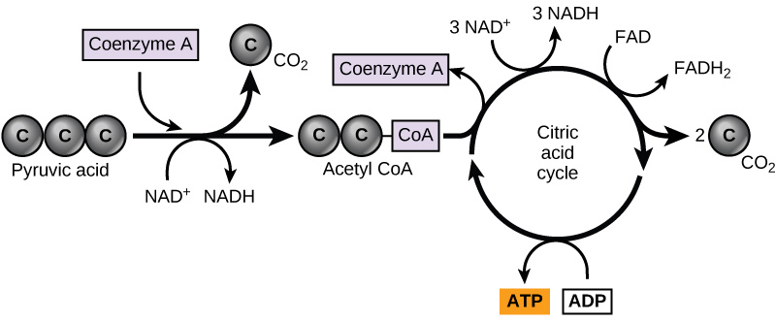
Citric Acid Cycle (Krebs Cycle)
Pyruvate produced at the end of glycolysis are transported into mitochondria, where cellular respiration occurs.
If oxygen is available, aerobic respiration will go forward.
  pyruvate will be transformed into a two-carbon acetyl group (by removing a molecule of carbon dioxide) that will be picked up by a carrier compound called coenzyme A (CoA).
  The resulting compound is called acetyl CoA and its major function is to deliver the acetyl group derived from pyruvate to the next pathway in glucose catabolism.
Pyruvate is converted into acetyl-CoA before entering the citric acid cycle.

Slide 11
Citric Acid Cycle (Krebs Cycle)
The citric acid cycle is a closed loop:
  The last part of the pathway regenerates the compound used in the first step. The eight steps of the cycle are a series of chemical reactions that produces
    two carbon dioxide molecules
    one ATP molecule (or an equivalent)
    reduced forms (NADH and FADH₂) of NAD+ and FAD+.
Pyruvate is converted into acetyl-CoA before entering the citric acid cycle.

Slide 12
Citric Acid Cycle (Krebs Cycle)
Two carbon atoms come into the citric acid cycle from each acetyl group.
Two carbon dioxide molecules are released on each turn of the cycle.
It takes two turns of the cycle to process the equivalent of one glucose molecule.
Each turn of the cycle forms three high-energy NADH molecules and one high-energy FADH₂ molecule.
These high-energy carriers will connect with the last portion of aerobic respiration to produce ATP molecules.
One ATP (or an equivalent) is also made in each cycle.
Pyruvate is converted into acetyl-CoA before entering the citric acid cycle.

Slide 13
Oxidative Phosphorylation
Most of the ATP generated from a process that begins with passing electrons through a series of chemical reactions to a final electron acceptor, oxygen.
These reactions take place in the inner membrane of the mitochondria of eukaryotic organisms and on the inner part of the cell membrane of prokaryotic organisms.
The energy of the electrons is harvested and used to generate an electrochemical gradient across the inner mitochondrial membrane.
The potential energy of this gradient is used to generate ATP.
Pyruvate is converted into acetyl-CoA before entering the citric acid cycle.

Slide 14
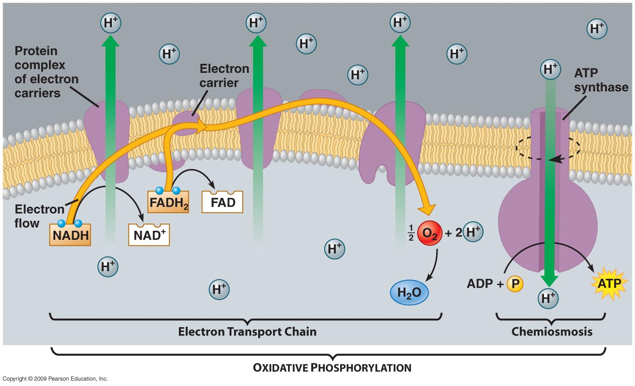
Oxidative Phosphorylation
ATP synthase is a complex, molecular machine that uses an H⁺ gradient to regenerate ATP from ADP.
Notes:
The flow of hydrogen ions through ATP synthase is called chemiosmosis, because the ions move from an area of high to low concentration through a semi-permeable structure.

Slide 16
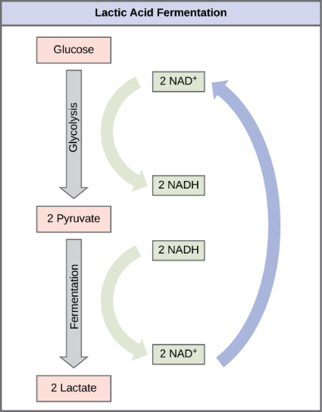
Lactic Acid Fermentation
If aerobic respiration does not occur, NADH must be reoxidized to NAD+ for reuse as an electron carrier for glycolysis to continue.
Processes that use an organic molecule to regenerate NAD+ from NADH are collectively referred to as fermentation.

Slide 17
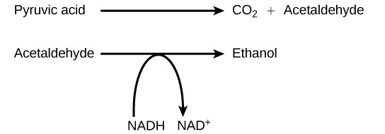
Alcohol Fermentation
Another fermentation process is alcohol fermentation which produces ethanol.
In the first reaction, a carboxyl group is removed from pyruvic acid, releasing carbon dioxide as a gas. The loss of carbon dioxide reduces the molecule by one carbon atom, making acetaldehyde.
The second reaction removes an electron from NADH, forming NAD+ and producing ethanol from the acetaldehyde, which accepts the electron.

Slide 18
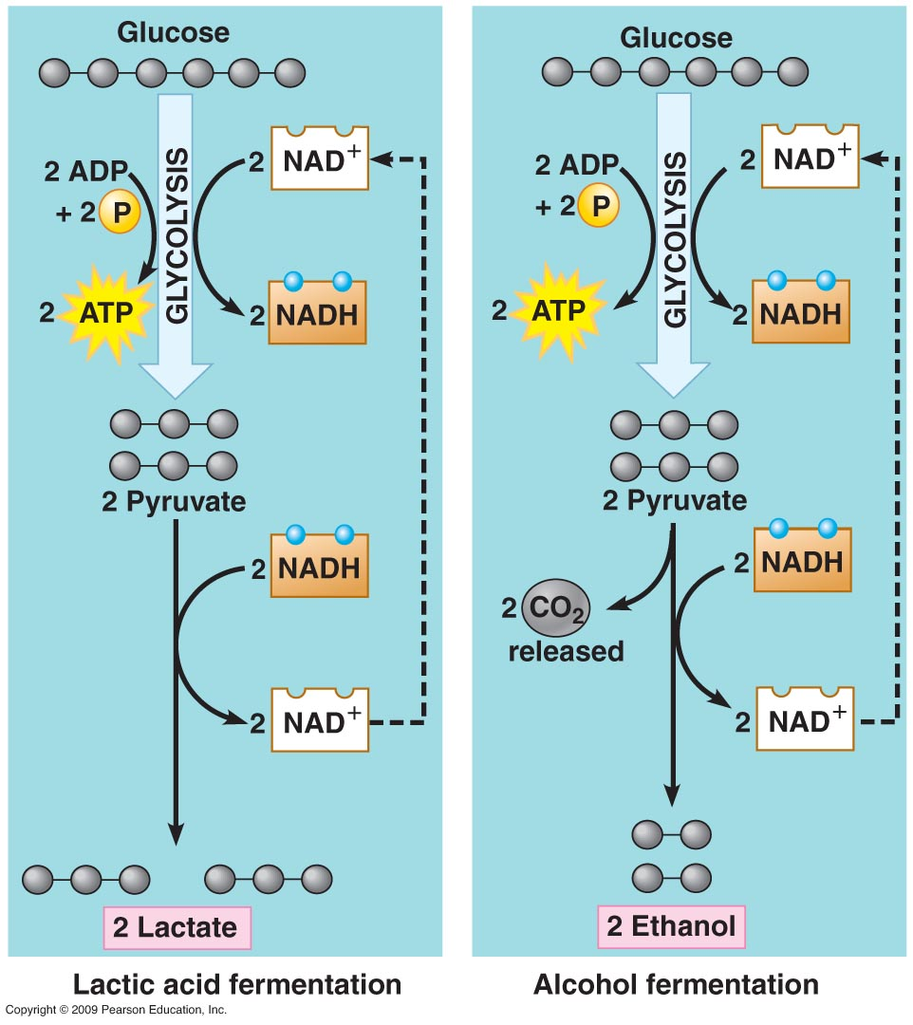
Fermentation Comparison

Slide 19
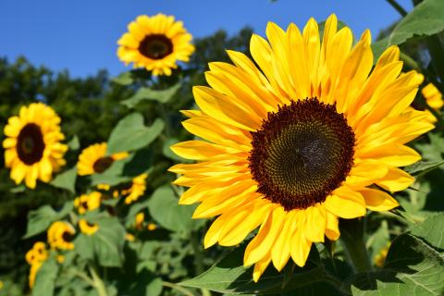
BIO10: Introduction to Principles of Biology
Dr. Paul Bradley
Photosynthesis

Slide 20
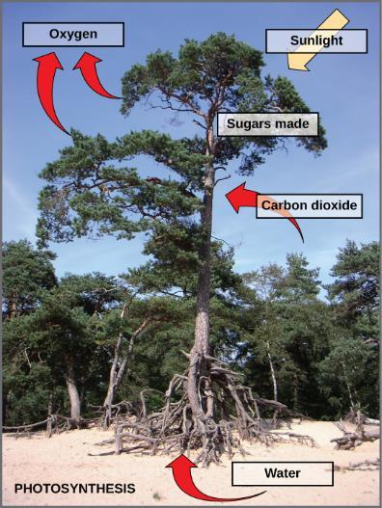
Photosynthesis
Requires:
  Sunlight
  carbon dioxide
  water
Releases
  Oxygen
Produces
  carbohydrates like glucose
Photosynthesis uses solar energy, carbon dioxide, and water to release oxygen and to produce energy-storing sugar molecules.

Slide 21
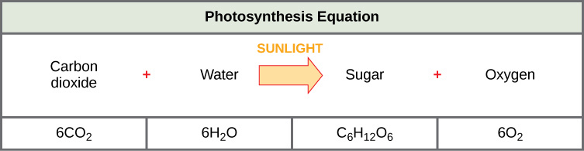
Photosynthesis
The process of photosynthesis can be represented by an equation, wherein carbon dioxide and water produce sugar and oxygen using energy from sunlight.

Slide 22
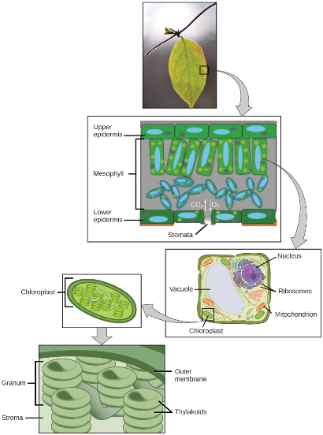
Photosynthesis
In plants, photosynthesis takes place primarily in leaves, which consist of many layers of cells and have differentiated top and bottom sides.
The process of photosynthesis occurs in a middle layer called the mesophyll.
The gas exchange of carbon dioxide and oxygen occurs through small, regulated openings called stomata.
  Usually found on the bottom of the leaf
In all autotrophic eukaryotes, photosynthesis takes place inside an organelle called a chloroplast.
  Chloroplasts have a double (inner and outer) membrane.
  Within the chloroplast is a third membrane that forms stacked, disc-shaped structures called thylakoids.
  Embedded in the thylakoid membrane are molecules of chlorophyll, a pigment (a molecule that absorbs light) through which the entire process of photosynthesis begins.
  The thylakoid membrane encloses an internal space called the thylakoid space.
  A stack of thylakoids is called a granum, and the space surrounding the granum is called stroma (not to be confused with stomata, the openings on the leaves).
Not all cells of a leaf carry out photosynthesis. Cells within the middle layer of a leaf have chloroplasts, which contain the photosynthetic apparatus.

Slide 23
Photosynthesis
Photosynthesis takes place in two stages
  The light reactions and the Calvin cycle.
Light reactions (or light-dependent reactions) take place at the thylakoid membrane, chlorophyll absorbs energy from sunlight and then converts it into chemical energy with the use of water
Calvin cycle takes place in the stroma, the chemical energy derived from the light-dependent reactions drives both the capture of carbon in carbon dioxide molecules and the subsequent assembly of sugar molecules
The two reactions use carrier molecules to transport the energy from one to the other.
  The carriers that move energy from the light-dependent reactions to the Calvin cycle reactions can be thought of as “full” because they bring energy.
  After the energy is released, the “empty” energy carriers return to the light-dependent reactions to obtain more energy.

Slide 24
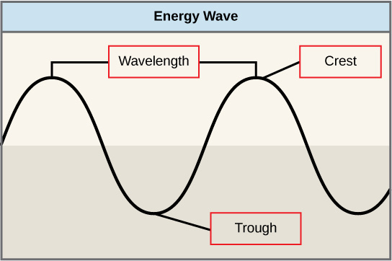
Light Waves
The manner in which solar energy travels can be described and measured as waves.
The amount of energy of a wave can be determined by measuring its wavelength
  the distance between two consecutive, similar points in a series of waves, such as from crest to crest or trough to trough

Slide 25
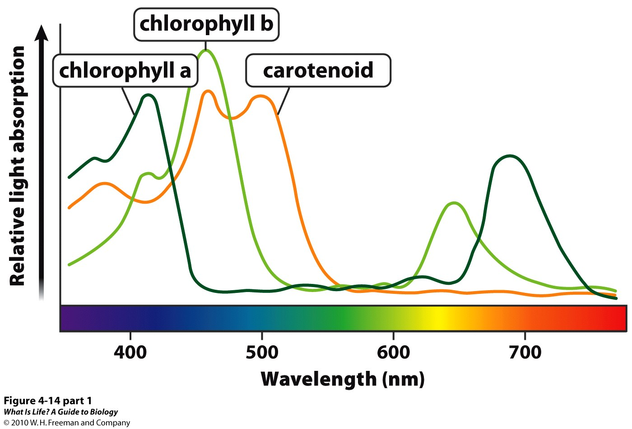
Pigments
Different kinds of pigments exist, and each absorbs only certain wavelengths (colors) of visible light. Pigments reflect the color of the wavelengths that they cannot absorb.
All photosynthetic organisms contain a pigment called chlorophyll a, which humans see as the common green color associated with plants.
  Chlorophyll a absorbs wavelengths from either end of the visible spectrum (blue and red), but not from green.
  Because green is reflected, chlorophyll appears green.
Other pigment types include chlorophyll b (which absorbs blue and red-orange light) and the carotenoids.
  Each type of pigment can be identified by the specific pattern of wavelengths it absorbs from visible light, which is its absorption spectrum.

Slide 26
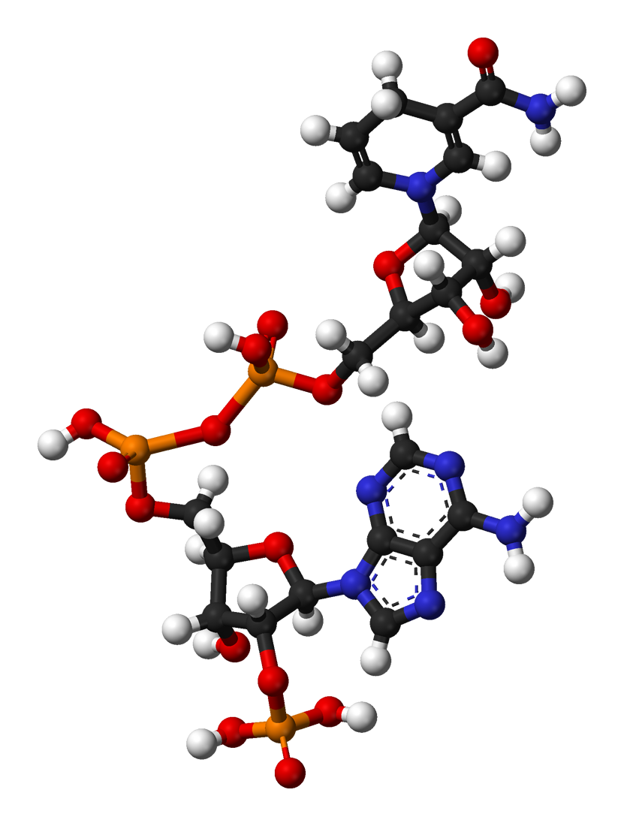
NADP+ / NADPH
Similar (but different!) player to NAD+ / NADH utilized in cellular respiration
A cofactor used in anabolic reactions, such as the Calvin cycle, which require NADPH as a reducing agent or “hydrogen source”
NADP+ differs from NAD+ by the presence of an additional phosphate group

Slide 27
Two Stages of Photosynthesis
Light Reactions (or light-dependent reactions)
  Convert light energy into chemical energy used by the Calvin cycle
Calvin Cycle
  Make sugar molecules

Slide 28
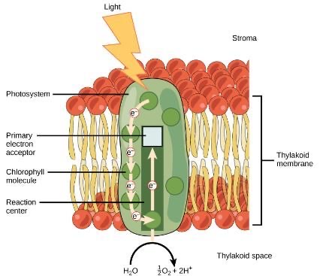
Light Reaction
The light-dependent reactions begin in a grouping of pigment molecules and proteins called a photosystem
  exist in the membranes of thylakoids
A pigment molecule absorbs one photon which travels until it reaches a molecule of chlorophyll
  Causes an electron in the chlorophyll to become “excited”
The energy given to the electron allows it to break free from the chlorophyll molecule
  Chlorophyll is therefore said to “donate” an electron
For every two donated electrons in the chlorophyll, a molecule of water is split
This split of water releases two electrons AND results in the formation of oxygen (O₂) and hydrogen ions (H+) in the thylakoid space
  The replacing of the electrons enables chlorophyll to respond to another photon

Slide 29
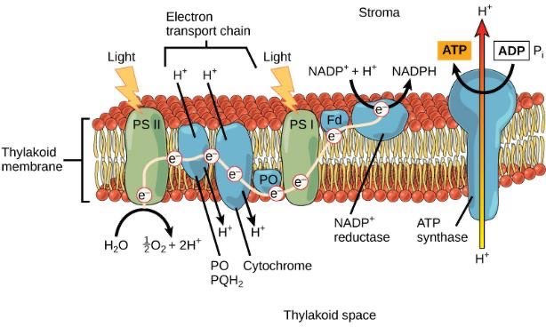
Light Reaction
In eukaryotes and some prokaryotes, two photosystems exist.
  The first is called photosystem II (discovered and named second but used first)
Photosystem II transfers the free electron from earlier in the reaction to the first in a series of proteins inside the thylakoid membrane called the electron transport chain
As the electron passes along these proteins, energy from the electron fuels membrane pumps that actively move hydrogen ions (H+) against their concentration gradient from the stroma into the thylakoid space
The electron is then accepted by a pigment molecule in the next photosystem, which is called photosystem I (discovered first but used second)

Slide 30
Making Chemical Energy (ATP & NADPH)
The buildup of hydrogen ions in the thylakoid space forms an electrochemical gradient because of the difference in the concentration of protons (H+) and the difference in the charge across the membrane that they create.
This potential energy is harvested and stored as chemical energy in ATP through chemiosmosis
  via the transmembrane enzyme ATP synthase, just as in the mitochondrion
The energy generated by the hydrogen ion stream allows ATP synthase to attach a third phosphate to ADP, which forms a molecule of ATP via photophosphorylation.

Slide 31
Making NADPH
The remaining function of the light-dependent reaction is to generate the other energy-carrier molecule, NADPH
As the electron from the electron transport chain arrives at photosystem I, it is reenergized with another photon captured by chlorophyll
The energy from this electron drives the formation of NADPH from NADP+ and a hydrogen ion (H+)
Now that the solar energy is stored in energy carriers (ATP & NADPH), it can be used to make a sugar molecule...

Slide 32
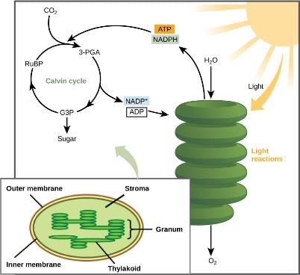
Calvin Cycle
After the energy from the sun is converted and packaged into ATP and NADPH, the cell has the fuel needed to build food in the form of carbohydrate molecules like glucose.
In plants, carbon dioxide (CO₂) enters the chloroplast through the stomata and diffuses into the stroma of the chloroplast—the site of the Calvin cycle reactions where sugar is synthesized.
Light-dependent reactions harness energy from the sun to produce ATP and NADPH. These energy-carrying molecules travel into the stroma where the Calvin cycle reactions take place.

Slide 33
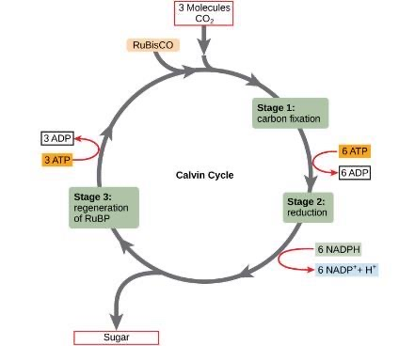
Calvin Cycle
The Calvin cycle reactions can be organized into three basic stages:
  Fixation
  Reduction
  Regeneration
Two other chemicals are present to initiate the Calvin cycle:
  an enzyme abbreviated RuBisCO
  ribulose bisphosphate (RuBP)
The Calvin cycle has three stages. In stage 1, the enzyme RuBisCO incorporates carbon dioxide into an organic molecule. In stage 2, the organic molecule is reduced. In stage 3, RuBP, the molecule that starts the cycle, is regenerated so that the cycle can continue.

Slide 34
Calvin Cycle - Fixation
RuBisCO catalyzes a reaction between CO₂ and RuBP
  forms a six-carbon compound that is immediately converted into two three-carbon compounds
  This process is called carbon fixation, because CO₂ is “fixed” from its inorganic form into organic molecules
The Calvin cycle has three stages. In stage 1, the enzyme RuBisCO incorporates carbon dioxide into an organic molecule. In stage 2, the organic molecule is reduced. In stage 3, RuBP, the molecule that starts the cycle, is regenerated so that the cycle can continue.

Slide 35
Calvin Cycle - Reduction
ATP and NADPH use their stored energy to convert the three-carbon compound, 3-PGA, into another three-carbon compound called G3P.
  The molecules of ADP and NAD+, resulting from the reaction, return to the light-dependent reactions to be re-energized
The Calvin cycle has three stages. In stage 1, the enzyme RuBisCO incorporates carbon dioxide into an organic molecule. In stage 2, the organic molecule is reduced. In stage 3, RuBP, the molecule that starts the cycle, is regenerated so that the cycle can continue.

Slide 36
Calvin Cycle - Regeneration
One of the G3P molecules leaves the Calvin cycle to contribute to the formation of glucose (C₆H₁₂O₆)
The remaining G3P molecules regenerate RuBP, which enables the system to prepare for the carbon-fixation step
  ATP is also used in the regeneration of RuBP
In summary, it takes six turns of the Calvin cycle to fix six carbon atoms from CO₂ to make glucose.
  These six turns require energy input from 12 ATP molecules and 12 NADPH molecules in the reduction step and 6 ATP molecules in the regeneration step
The Calvin cycle has three stages. In stage 1, the enzyme RuBisCO incorporates carbon dioxide into an organic molecule. In stage 2, the organic molecule is reduced. In stage 3, RuBP, the molecule that starts the cycle, is regenerated so that the cycle can continue.

Slide 37
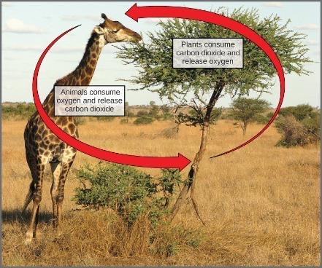
The Energy Cycle
The overall reaction for photosynthesis:
6 CO₂ + 6 H₂O → C₆H₁₂O₆ + 6 O₂
The overall reaction for cellular respiration:
6 O₂ + C₆H₁₂O₆ → 6 CO₂ + 6 H₂O
These two processes are reciprocals of each other
  Photosynthesis produces oxygen as a byproduct
  Respiration produces carbon dioxide as a byproduct.

Slide 38
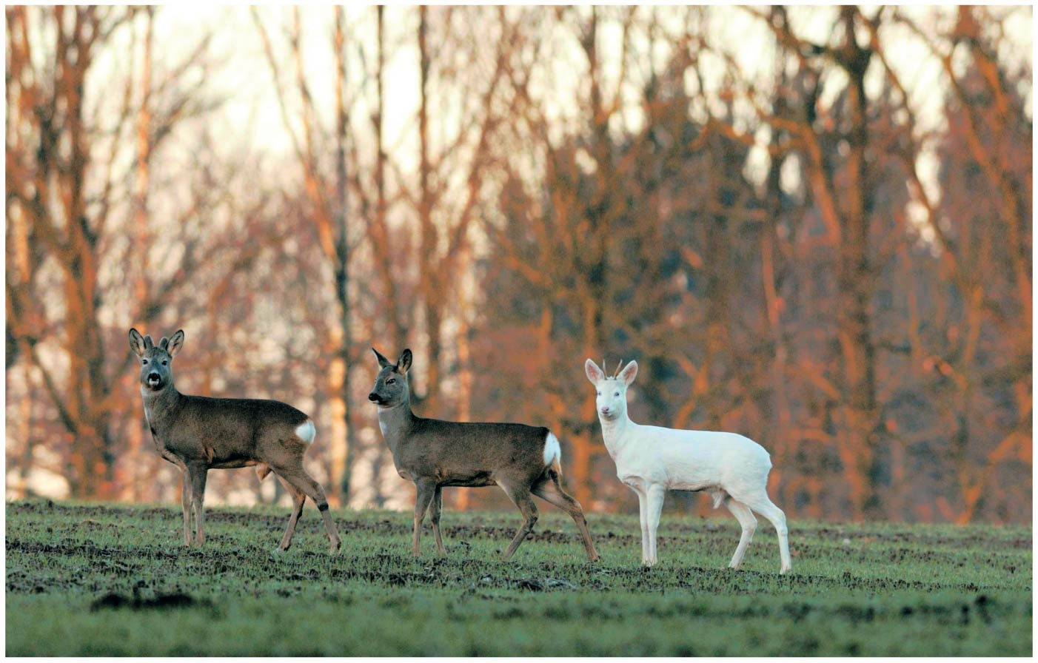
BIO10
Dr. Paul Bradley
Protein Synthesis

Slide 39
Nucleic Acids
Nucleic Acids make up genes
There are two types of nucleic acids
  Deoxyribonucleic acid (DNA)
  Ribonucleic acid (RNA)

Slide 40
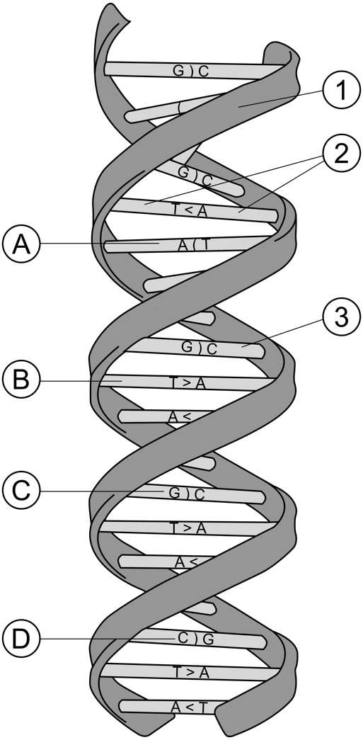
Nucleic Acids
Nucleic acids are made up of polynucleotides
  Each polynucleotide is made of nucleotides
  Each nucleotide is made up of
    a pentose sugar (deoxyribose in DNA)
    one or more phosphate groups
    a nitrogenous base
      Adenine (in DNA and RNA)
      Cytosine (in DNA and RNA)
      Guanine (in DNA and RNA)
      Thymine (in DNA)
      Uracil (in RNA)

Slide 41
Nucleotides
a nitrogenous base
a pentose sugar
one or more phosphate groups (not shown here)

Slide 42
Interior Side
Exterior Side

Slide 43
Base Pairing
Watson & Crick determined that
  adenine (A) paired only with thymine (T)
  guanine (G) paired only with cytosine (C)
Thus in any organism the amount of A = T, and the amount of G = C

Slide 44
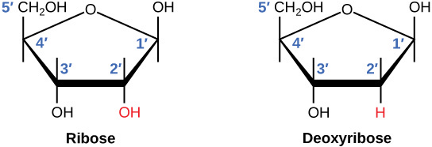
RNA vs DNA
The difference between the ribose found in RNA and the deoxyribose found in DNA is that ribose has a hydroxyl group at the 2' carbon.

Slide 45
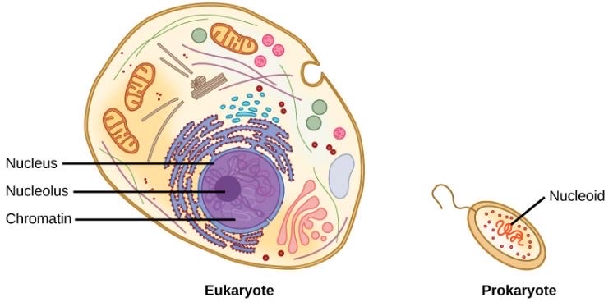
Eukaryotic vs Prokaryotic
A eukaryote contains a well-defined nucleus, whereas in prokaryotes, the chromosome lies in the cytoplasm in an area called the nucleoid.

Slide 46
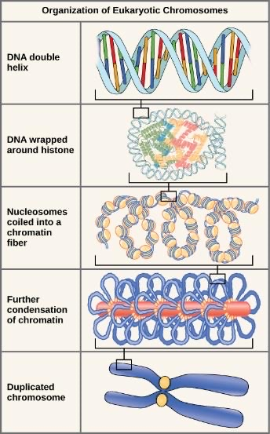
How DNA is Packaged

Slide 47
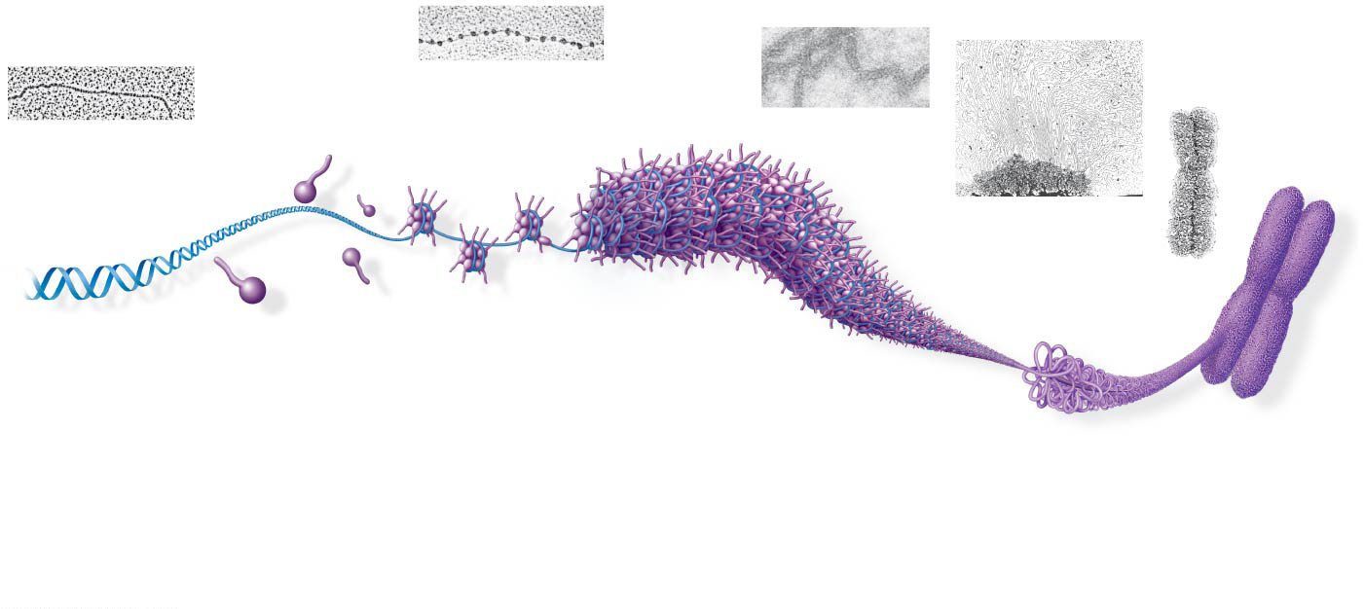
DNA Molecule
Nucleosome
Histone Protein
Chromatin
Chromosome

Slide 48
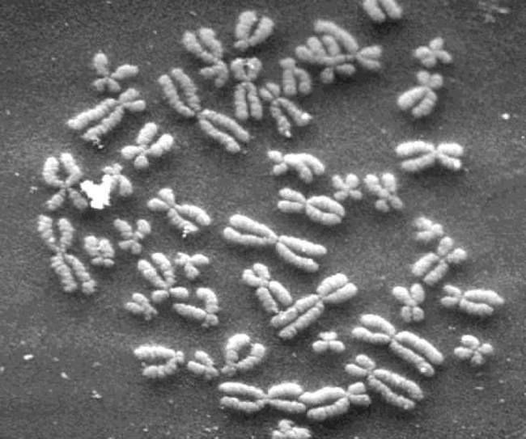
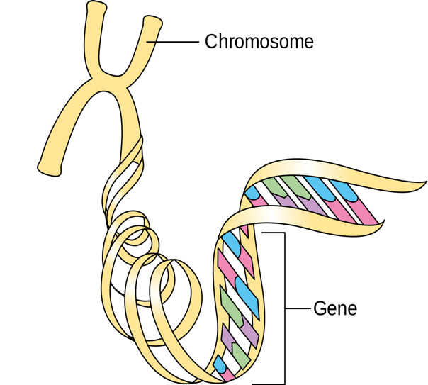

Slide 49
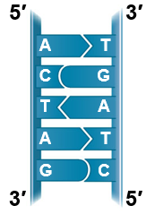
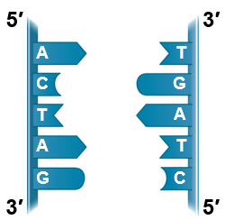
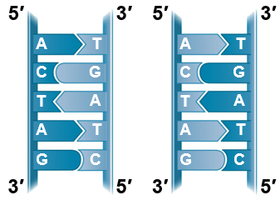
Base Pairing to a Template Strand
Watson and Crick’s semiconservative model of replication predicts that each daughter molecule will have one old strand (“conserved” from the parent molecule) and one newly made strand
Parental
molecule
Separation of
parental strands
into templates
Formation of new
strands complementary
to template strands

Slide 50
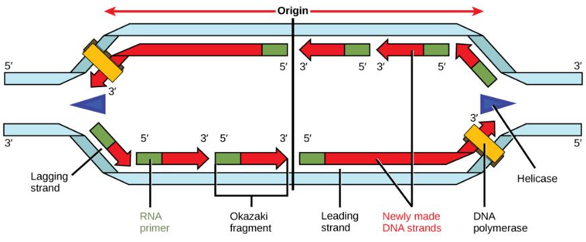
Synthesizing a New DNA Strand
Enzymes called DNA polymerases catalyze the synthesis of new DNA at a replication fork

Slide 51
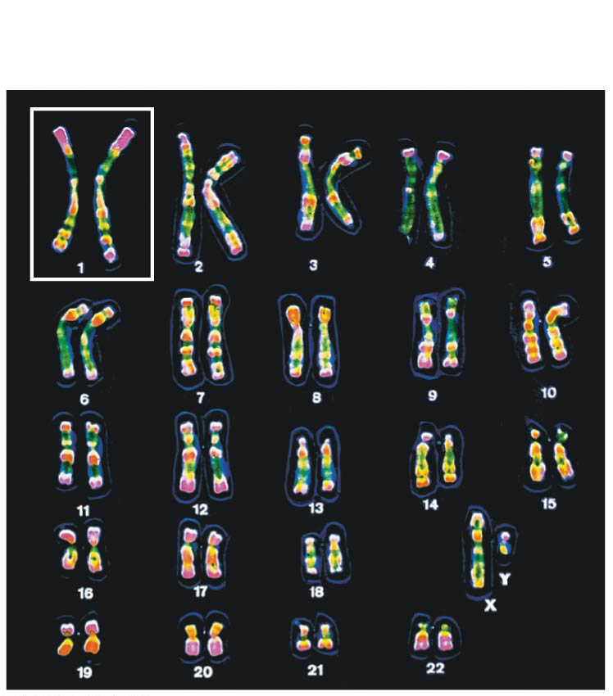
Karyotype
The two chromosomes in each pair are called homologous chromosomes, or homologs
Chromosomes in a homologous pair are the same length and shape and carry genes controlling the same inherited characters
  But not necessarily the same traits (alleles)
Genes are the units of heredity and are made up of segments of DNA
A gene’s specific position along a chromosome is called the locus

Slide 52
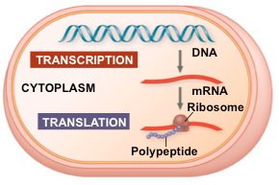
The Flow of Genetic Information in the Cell
The information content of DNA is in the form of specific nucleotide sequences
The DNA inherited by an organism leads to specific traits by dictating the synthesis of proteins
Proteins are the links between genotype and phenotype
Gene expression, is the process by which DNA directs protein synthesis through transcription and translation
Notes:
52

Slide 53

Basic Principles of Transcription and Translation
Transcription is the synthesis of RNA by the enzyme RNA polymerase using information coded within DNA
Transcription of a gene produces a messenger RNA (mRNA)
Translation is the synthesis of a polypeptide, using information coded within the mRNA
Ribosomes are huge protein/RNA enzyme complexes that carry out translation
DNA
RNA
Protein
Central dogma is the concept that cells are governed by information flow: DNA → RNA → protein
Notes:
53

Slide 54
Bridge Between Genes and Proteins
Messenger RNA (mRNA) is the bridge between genes and the proteins for which they code
In eukaryotes, the nuclear envelop separates the processes of transcription and translation
  mRNA undergoes processing before leaving the nucleus

Slide 55
It’s important to realize that gene regulatory protein binding to DNA is sequence specific
Therefore, these proteins bind to discrete sites along the DNA
For instance, RNA polymerase binds to a specific DNA sequence that represents a promoter
This positions the RNA polymerase at the start of a gene and points the enzyme in the right direction

Slide 56
Three Stages of Transcription
RNA polymerase attaches to and pries apart DNA strands at the promoter and joins together the RNA nucleotides to perform mRNA synthesis
Reads the DNA template strand from the 3′ → 5′ direction
The RNA is complementary to the DNA template strand
  except that uracil substitutes for thymine
The transcription unit is the stretch of DNA that is transcribed

Slide 57
RNA Polymerase
As RNA polymerase moves along the DNA, it untwists the double helix, 10 to 20 bases at a time
Nucleotides are added to the 3′ end of the
growing mRNA molecule

Slide 58
mRNA Processing in Eukaryotes
Enzymes in the eukaryotic nucleus modify pre-mRNA before it reaches the cytoplasm
Both ends of the primary transcript are usually altered
Interior sections of the molecule are cut out, and the remaining parts spliced together

Slide 59
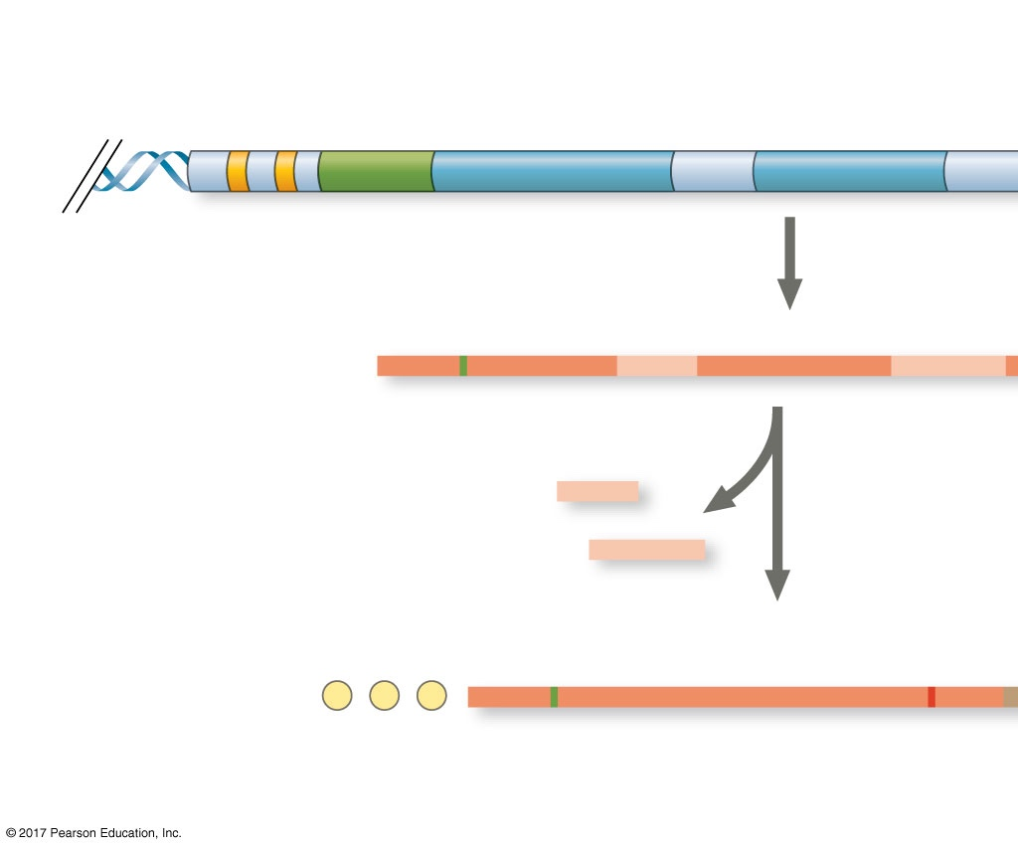
Typical Eukaryotic Gene and Its Transcript
Transcription
start site
Poly-A signal
sequence
Exon
Intron
Exon
Intron
Exon
DNA
Promoter
Transcription
Poly-A
signal
Primary RNA
transcript
(pre-mRNA)
Cleaved 3′
end of
primary
transcript
Exon
Intron
Exon
Intron
Exon
5′
RNA processing
Intron RNA
Coding segment
mRNA
G
P
P
P
AAA···AAA
3′
5′ Cap
5′ UTR
Start
codon
Stop
codon
3′ UTR
Poly-A
tail

Slide 60
mRNA Processing

Slide 61
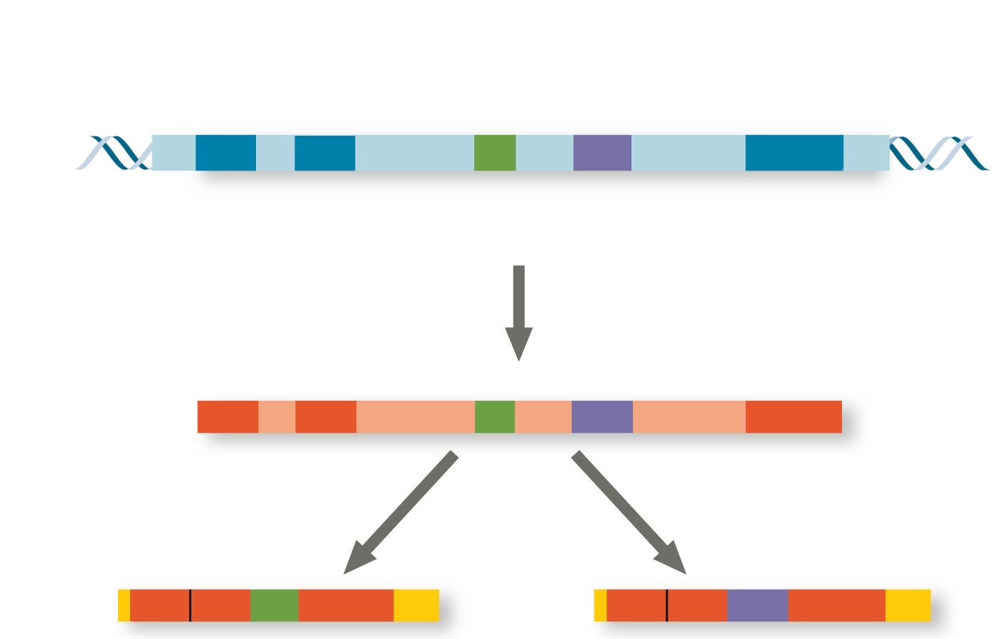
Alternative mRNA Splicing
Exons
DNA
1 2 3 4 5
Troponin T gene
Primary
RNA
transcript
1 2 3 4 5
RNA splicing
mRNA
1 2 3 5
OR
1 2 4 5

Slide 62
Transcription & Translation
Transcription is the synthesis of RNA using information in DNA
  produces messenger RNA (mRNA)
Translation is the synthesis of a polypeptide, using information in the mRNA
Ribosomes are the sites of translation

Slide 63
Transcription & Translation
Transcription is the synthesis of RNA using information in DNA
  produces messenger RNA (mRNA)
Translation is the synthesis of a polypeptide, using information in the mRNA
Ribosomes are the sites of translation

Slide 64
Triplet Code
The flow of information from gene to protein is based on a triplet code: a series of nonoverlapping, three-nucleotide “words”
The “words” of a gene are transcribed into complementary nonoverlapping three-nucleotide words of mRNA
These “words” are then translated into a chain of amino acids, forming a polypeptide

Slide 65
Codons
Each codon specifies the amino acid (one of 20) to be placed at the corresponding position along a polypeptide
64 Codons (4³ = 64)
  61 codons code for amino acids
  1 codon is the “start codon” when it isn’t in the middle of a gene
  3 codons are “stop” codons to end translation
The genetic code is redundant
  more than one codon may specify a particular amino acid
But the genetic code is not ambiguous
  no codon specifies more than one amino acid

Slide 66
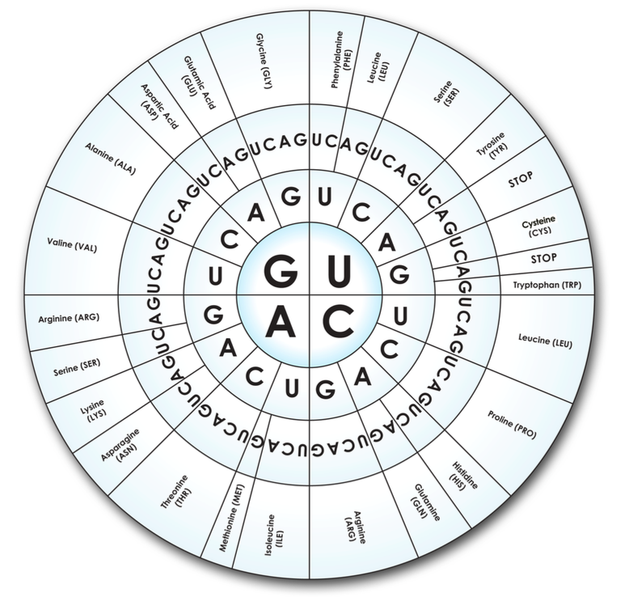
Codons
Each codon specifies the amino acid (one of 20) to be placed at the corresponding position along a polypeptide
64 Codons (4³ = 64)
  61 codons code for amino acids
  1 codon is the “start codon” when it isn’t in the middle of a gene
  3 codons are “stop” codons to end translation
The genetic code is redundant
  more than one codon may specify a particular amino acid
But the genetic code is not ambiguous
  no codon specifies more than one amino acid

Slide 67
Translation is the RNA-directed synthesis of a polypeptide: a closer look
A cell translates an mRNA message into protein with the help of transfer RNA (tRNA) and Ribosomes
tRNAs transfer amino acids to the growing polypeptide that’s being synthesize by a ribosome
Notes:
67

Slide 68
Ribosomes

Slide 69
Ribosomes
Anticodon

Slide 70
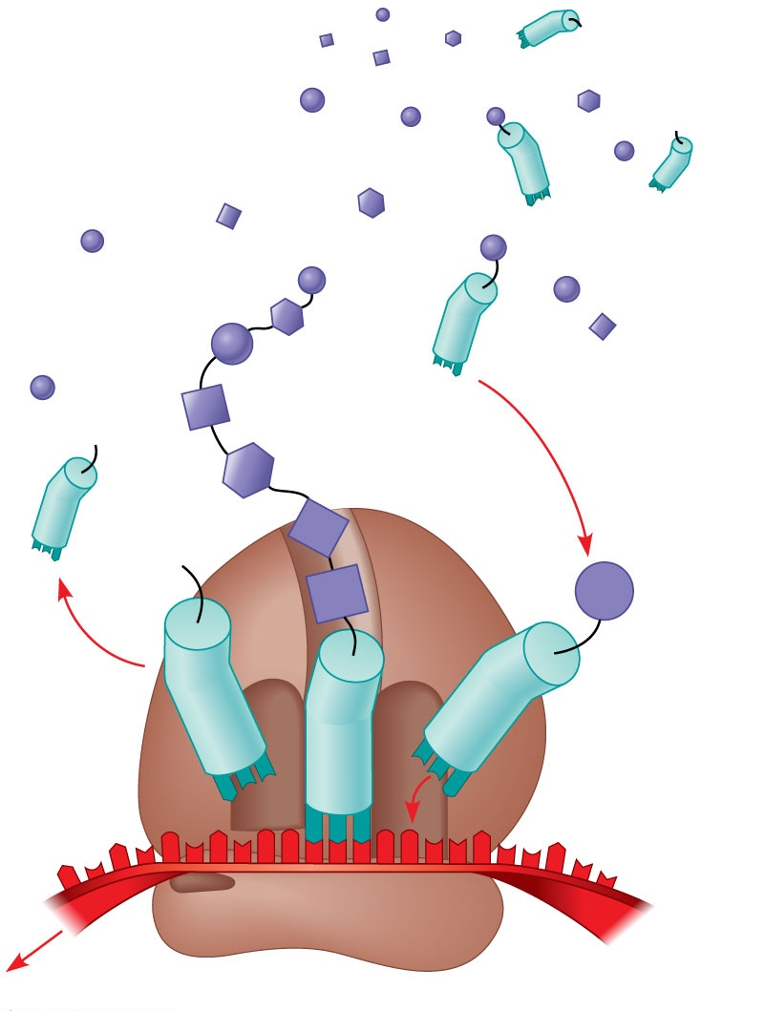
Molecules of tRNA are not identical
  Each carries a specific amino acid on one end
  Each has an anticodon on the other end; the anticodon base-pairs with a complementary codon on mRNA
Amino
acids
Polypeptide
tRNA with
amino acid
attached
Ribosome
Trp
Phe
Gly
tRNA
C
C
C
C
C
G
Anticodon
A
C
G
A
A
A
G
U
G
G
U
U
U
G
G
C
5′
Codons
3′
mRNA
Notes:
Figure 17.14 Translation: the basic concept.

Slide 71
Translation
Process by which genetic information flows from mRNA to protein
Ribosomes
  Translate an mRNA message into protein

Slide 72
Ribosomes
Translation proceeds along the mRNA in a 5′ → 3′ direction
(Codons are read from the mRNA in the 5′ → 3′ direction)

Slide 73
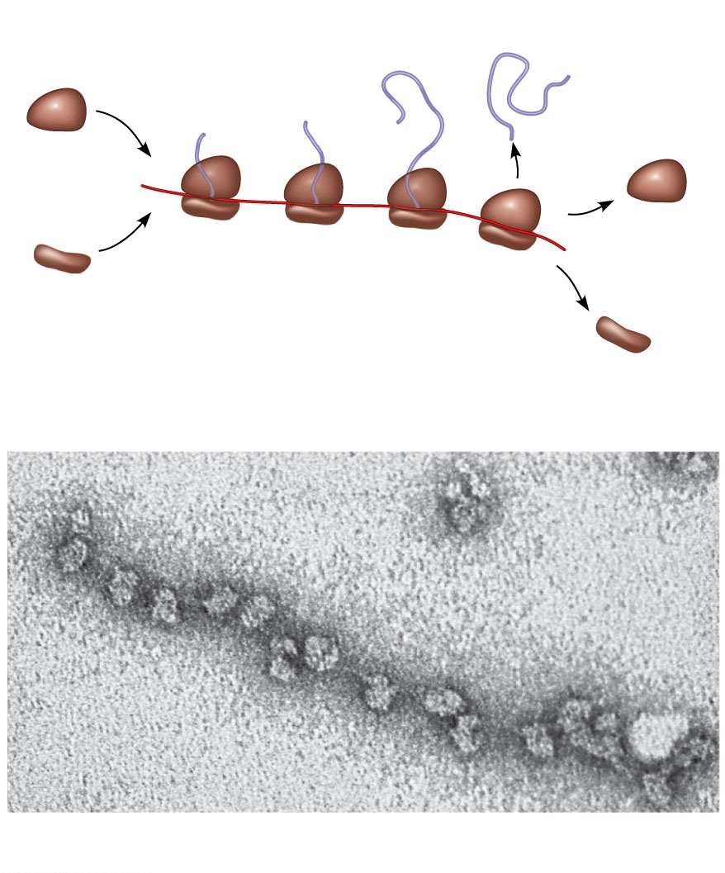
Polyribosomes
Completed
polypeptide
Growing
polypeptides
Incoming
ribosomal
subunits
A number of ribosomes can translate a single mRNA simultaneously, forming a polyribosome (or polysome)
Polyribosomes enable a cell to make many copies of a polypeptide very quickly
Polyribosome
Start of
mRNA
(5′ end)
End of
mRNA
(3′ end)
(a)
Ribosomes
mRNA
(b)
0.1 μm

Slide 74
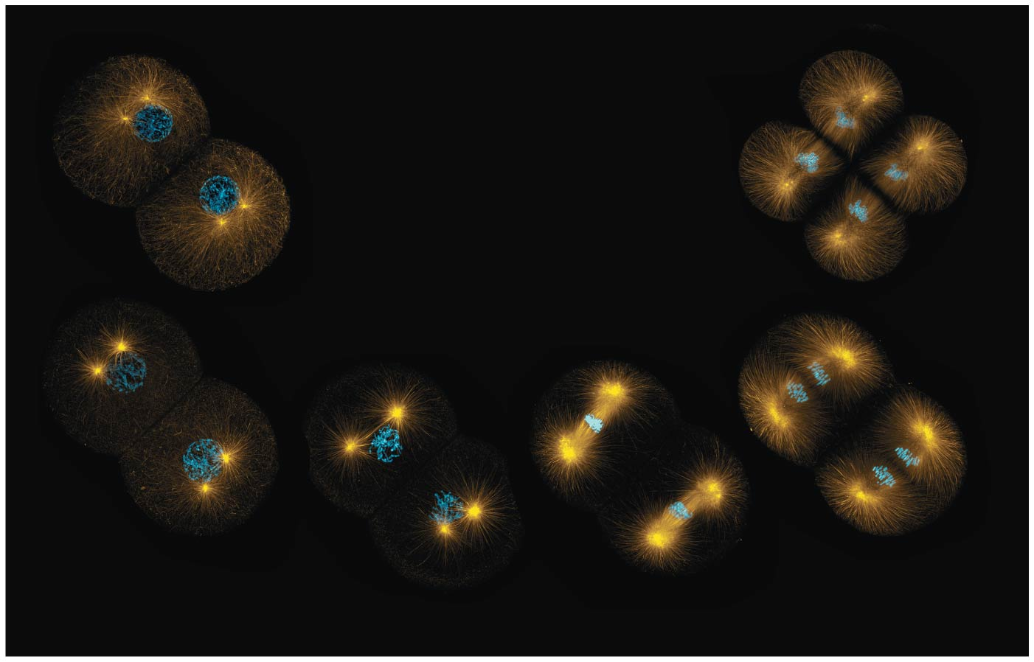
BIO10
Dr. Bradley
Mitosis

Slide 75
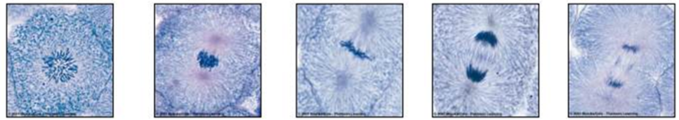
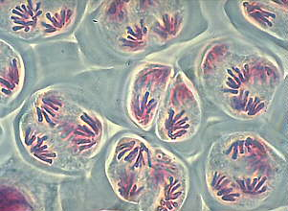
There are different forms of cell division
Mitosis:
A cell division results in diploid daughter cells with identical genetic information, DNA
Meiosis:
A special type of division produces haploid non-distinct daughter cells called gametes or germ
cells (sperm and egg cells)

Slide 76
Every eukaryotic species has a characteristic number of chromosomes in each cell nucleus
Somatic cells (non-reproductive cells) have two sets of chromosomes
These are duplicated via mitosis
Gametes or germ cells (reproductive cells: sperm and eggs) have half as many chromosomes as somatic cells
These are duplicated via meiosis

Slide 77
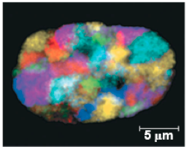
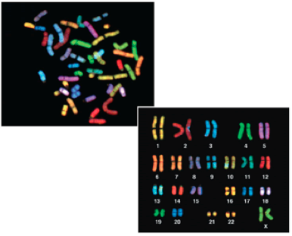
Most chromatin is loosely packed in the nucleus during interphase and condenses prior to mitosis
Loosely packed chromatin is called euchromatin
During interphase a few regions of chromatin (centromeres and telomeres) are highly condensed into heterochromatin
Dense packing of the heterochromatin makes it difficult for the cell to express genetic information coded in these regions
Karyotype: organized picture of heterochromatin

Slide 78

Chromosomes
Sister
chromatids
Each sister chromatid is attached along their lengths by proteins called cohesins
Centromere
0.5 μm
The narrow “waist” of the chromosome where the two chromatids are most closely attached

Slide 79

The Cell Cycle
Interphase (about 90% of the cell cycle) can be divided into subphases
  G₁ phase (“first gap”)
  S phase (“synthesis”)
  G₂ phase (“second gap”)
The cell grows during all three phases, but chromosomes are duplicated only during the S phase
Chromosomes only look like this during a brief moment right here!
“Duplication” ≠ doubling of chromosomes
“Duplication” = creating a sister chromatid after DNA (molecule) replication
“Duplication” = creating a second (identical) DNA molecule within a chromosome

Slide 80

One Chromosome after “duplication”
Two Sister Chromatids
  Each with one identical copy of a DNA molecule
  Two entire DNA molecules total
Each replicated DNA molecule with genes for various traits, but each is identical to the other and each share genes in the same linear sequence

Slide 81


Replication begins at sites called origins of replication, where the two DNA strands are separated, and then proceeds in both directions
Origin of replication in an E. coli cell
Origins of replication in a eukaryotic cell
Notes:
Figure 16.12 Origins of replication in E. coli and eukaryotes

Slide 82
0.5 µm
Chromosomes
DNA molecules
Chromo-
some arm
Chromosome
“duplication”
(including DNA
synthesis)
Centromere
Sister
chromatids
Separation of
sister chromatids
Centromere
Sister chromatids
Notes:
Figure 12.4 Chromosome duplication and distribution during cell division

Slide 83
Mitotic Phase
Mitosis and then cytokinesis

Slide 84

Mitosis is conventionally and arbitrarily divided into 5 phases
G₂ of
Interphase
Anaphase
Telophase and
Cytokinesis
Prophase
Prometaphase
Metaphase
Notes:
Figure 12.6 The mitotic division of an animal cell

Slide 85


G₂ of Interphase
Prophase
Prometaphase
G₂ of Interphase
Prophase
Prometaphase
Centrosomes
(with centriole
pairs)
Chromatin
(duplicated)
Early mitotic
spindle
Aster
Centromere
Fragments
of nuclear
envelope
Nonkinetochore
microtubules
Nucleolus
Nuclear
envelope
Plasma
membrane
Chromosome, consisting
of two sister chromatids
Kinetochore
Kinetochore
microtubule

Slide 86


Metaphase
Anaphase
Telophase and Cytokinesis
Metaphase
plate
Cleavage
furrow
Nucleolus
forming
Metaphase
Anaphase
Telophase and Cytokinesis
Daughter
chromosomes
Nuclear
envelope
forming
Spindle
Centrosome at
one spindle pole

Slide 87

Cytokinesis: A Closer Look
In animal cells, cytokinesis occurs by a process known as cleavage, forming a cleavage furrow
In plant cells, a cell plate forms during cytokinesis
100 µm
Vesicles
forming
cell plate
Wall of
parent cell
1 µm
Cleavage furrow
Cell plate
New cell wall
Contractile ring of
microfilaments
Daughter cells
Daughter cells
(a) Cleavage of an animal cell (SEM)
(b) Cell plate formation in a plant cell (TEM)

Slide 88


G₁
S
Cytokinesis
Mitosis
G₂
MITOTIC (M)
PHASE
Prophase
Telophase
and
Cytokinesis
Prometaphase
Anaphase
Metaphase

Slide 89

Mitosis in Plants

Slide 90

Nucleus
Chromosomes
condensing
Nucleolus
Chromosomes
10 µm
1
Prophase
2
Prometaphase
Cell plate
3
Metaphase
4
Anaphase
5
Telophase

Slide 91

BIO10
Dr. Bradley
Meiosis

Slide 92

Natural Selection favors entities that leave descendants: Reproduction
two options:
  asexual reproduction
    creation of offspring without the fusion of egg and sperm
  sexual reproduction
    creation of an offspring by fusion of haploid gametes, male sperm and female eggs, to form a diploid zygote

Slide 93

Asexual Reproduction
(e.g., binary fission, clonal fragmentation, budding)
Budding or fission is a simple form of asexual reproduction found only among invertebrates
New individuals arise from outgrowths of existing ones
Hydra

Slide 94
Natural Selection favors entities that leave descendants: Reproduction
two options:
  asexual reproduction
    creation of offspring without the fusion of egg and sperm
  sexual reproduction
    creation of an offspring by fusion of haploid gametes, male sperm and female eggs, to form a diploid zygote

Slide 95

Key
Haploid gametes (n = 23)
Sexual Reproduction in Animals
Haploid (n)
Egg (n)
Diploid (2n)
Gametes are the only types of human cells produced by meiosis, rather than mitosis
Meiosis results in one set of chromosomes in each gamete
Fertilization and meiosis alternate in sexual life cycles to maintain chromosome number
Sperm (n)
MEIOSIS
FERTILIZATION
Ovary
Testis
Diploid
zygote
(2n = 46)
Mitosis and
development
Multicellular diploid
adults (2n = 46)
p. 257

Slide 96
Make sure you can differentiate chromosomes made up of pairs of sister chromatids from pairs of homologous chromosomes

Slide 97

In humans the sex chromosomes, which determine the sex of the individual, are called X and Y
Human females have a homologous pair of X chromosomes (XX)
Human males have one X and one Y chromosome (XY)
The remaining 22 pairs of chromosomes are called autosomes
Humans have 23 sets (or pairs) of chromosomes

Slide 98
Each pair of homologous chromosomes includes one chromosome from each parent
A diploid cell (2n) has two sets of chromosomes
For humans, the diploid number is 46 (2n = 46)

Slide 99
A gamete (sperm or egg) contains a single set of chromosomes and is haploid (n)
For humans, the haploid number is 23 (n = 23)

Slide 100

Interphase
Meiosis reduces the number of chromosome sets from diploid to haploid
The two cell divisions (Meiosis I and Meiosis II)
The two cell divisions result in four daughter cells, rather than the two daughter cells in mitosis
Each daughter cell has only half as many chromosomes as the parent cell
  And thus each daughter cell is genetically unique from the parental cell
The chromatids are sorted into four haploid daughter cells
Pair of
homologous
chromosomes
in diploid
parent cell
Chromosomes
duplicate
Pair of duplicated
homologous
chromosomes
Sister
chromatids
Diploid cell with
duplicated
chromosomes
Meiosis I
1
Homologous
chromosomes
separate
Haploid cells with
duplicated chromosomes
Meiosis II
2
Sister chromatids
separate
Haploid cells with unduplicated chromosomes

Slide 101

Meiosis I & Meiosis II
MEIOSIS I: Separates
homologous chromosomes
MEIOSIS II: Separates
sister chromatids
Telophase I
and
Cytokinesis
Telophase II
and
Cytokinesis
Prophase I
Metaphase I
Anaphase I
Prophase II
Metaphase II
Anaphase II

Slide 102
Prophase I
Each chromosome pairs with its homolog and crossing over occurs
Metaphase I
Pairs of homologs line up at the metaphase plate, with one chromosome facing each pole
Anaphase I
Pairs of homologous chromosomes separate
One chromosome of each pair moves toward opposite poles, guided by the spindle apparatus
Sister chromatids remain attached at the centromere and move as one unit toward the pole
Telophase I and Cytokinesis
Each half of the
cell has a haploid set of chromosomes; each chromosome still consists of two sister chromatids
Cytokinesis occurs forming two haploid daughter cells

Slide 103
Prophase II
A spindle apparatus forms
Chromosomes (each still composed of two chromatids) move toward the metaphase plate
Metaphase II
The sister chromatids are arranged at the metaphase plate
Because of crossing over in meiosis I, the two sister chromatids of each chromosome are no longer genetically identical
The kinetochores of sister chromatids attach to microtubules extending from the poles
Anaphase II
The sister chromatids separate
The sister chromatids of each chromosome now move as individual chromosomes toward opposite poles
Telophase II and Cytokinesis
The chromosomes arrive at opposite poles
Nuclei form, and the chromosomes begin decondensing
Cytokinesis separates the cytoplasm
At the end of meiosis, there are four daughter cells, each with a haploid set of chromosomes
Each daughter cell is genetically distinct from the others and from the parent cell

Slide 104
Crossing Over
Crossing over combines DNA inherited from each parent
Contributes to genetic variation by combining DNA from two parents into a single chromosome
In humans an average of one to three crossover events occurs per chromosome

Slide 105
Crossing Over in Meiosis I

Slide 106

Crossing Over in Meiosis I
Crossover
Crossover
3
Chiasmata
Crossing over results in each chromosome being a mix of genetic material from maternal and paternal genomes
4

Slide 107

MITOSIS
MEIOSIS
Parent cell
Chiasma
MEIOSIS I
Prophase
Prophase I
Homologous
chromosome
pair
Chromosome
duplication
Chromosome
duplication
Duplicated
chromosome
2n = 6
Individual
chromosomes
line up.
Pairs of
homologous
chromosomes
line up.
Metaphase I
Metaphase
Anaphase I
Anaphase
Telophase
Sister
chromatids
separate.
Homologs
separate.
Telophase I
Daughter
cells of
meiosis I
Sister
chroma-
tids
separate.
MEIOSIS
II
2n
2n
Daughter cells
of mitosis
n
n
n
n
Daughter cells of meiosis II

Slide 108
Three events are unique to meiosis, and all three occur in meiosis I
  Synapsis and crossing over in prophase I: Homologous chromosomes physically connect and exchange genetic information
  Homologous pairs at the metaphase plate
  Separation of homologs during anaphase I

Slide 109

Notes:
Figure 13.10b A comparison of mitosis and meiosis (part 2: mitosis vs. meiosis table)

Slide 110
Where Does Variation Come From?
Mutations (changes in an organism’s DNA) are the original source of genetic diversity
But the behavior of chromosomes during meiosis and fertilization is responsible for most of the variation that arises in each generation
Three mechanisms contribute to genetic variation
  Crossing over (we just covered this)
  Independent assortment of chromosomes
  Random fertilization

Slide 111
Independent Assortment of Chromosomes
Homologous pairs of chromosomes orient randomly at metaphase I of meiosis
In independent assortment, each pair of chromosomes sorts maternal and paternal homologs into daughter cells independently of the other pairs

Slide 112

Independent Assortment of Chromosomes
Possibility 1
Possibility 2
Two equally probable
arrangements of
chromosomes at
metaphase I
Metaphase II
Daughter
cells
Combination 1
Combination 2
Combination 3
Combination 4

Slide 113
Independent Assortment of Chromosomes
The number of combinations possible when chromosomes assort independently into gametes is 2^{n}, where n is the haploid number
For humans (n = 23), there are more than
8 million (2²³) possible combinations of how chromosomes can be lined up at the metaphase plate during Meiosis I

Slide 114
Where Does Variation Come From?
Mutations (changes in an organism’s DNA) are the original source of genetic diversity
But the behavior of chromosomes during meiosis and fertilization is responsible for most of the variation that arises in each generation
Three mechanisms contribute to genetic variation
  Crossing over
  Independent assortment of chromosomes
  Random fertilization

Slide 115

Random Fertilization
Random fertilization adds to genetic variation because any sperm can fuse with any ovum (unfertilized egg)
The fusion of two gametes (each with more than 8 million possible chromosome combinations from independent assortment) produces a zygote with any of about 70 trillion diploid combinations
  i.e. From the same parents, you could have 70 trillion siblings and each would be genetically unique

Slide 116

BIO10
Dr. Bradley
Genetics

Slide 117




We are going to talk about these in detail next – Mendel’s peas
Discrete traits
(or discontinuous variation)
Quantitative traits
(or continuous variation)
Traits that are distinct and discontinuous which do not have intermediate forms or versions, like earlobe-type or blood-type status
Traits that can blend from one intermediate forms or version to another like height or skin color

Slide 118
Gregor’s Experiment
True breeding plants:
  These are plants that always produce offspring that look like the parent.
Hybrids:
  The offspring of a mating between two true-breeding individuals that have different traits.
P Generation (true breeding):
  Plants used in first-generation crosses were called P, or parental generation.
F1 Generation (hybrids):
  These offspring were called the F1, or the first filial (filial = daughter or son), generation.
F2 Generation:
  F1 plants that mated with other F1 plants produced the F2, or second filial, generation.

Slide 119
First Concept
Alternative versions of genes (alleles) account for variations in inherited characters
For example, the gene for flower color in pea plants exists in two versions (alleles)
  One for purple flowers
  One for white flowers

Slide 120
Second Concept
For each character, an organism has two alleles
  One inherited from each parent
The two alleles may be identical, as in the true-breeding plants of Mendel’s P generation
  These individuals are homozygous
Alternatively, the two alleles may differ, as in the F₁ hybrids
  These individuals are heterozygous

Slide 121
Third Concept
If the two alleles differ, then one (the dominant allele) determines the organism’s appearance, and the other (the recessive allele) has no noticeable effect on appearance
The F₁ plants had purple flowers because the allele for that trait is dominant

Slide 122

Phenotype & Genotype
Phenotypes are physical expressions of traits that are transmitted by alleles.
Capital letters typically represent dominant alleles and lowercase letters represent recessive alleles.
The phenotypic ratios are the ratios of visible characteristics.
The genotypic ratios are the ratios of gene combinations in the offspring, and these are not always distinguishable in the phenotypes.

Slide 123
Fourth Concept
Law of Segregation
The two alleles for a heritable character separate (segregate) during gamete formation and end up in different gametes
  Thus, an egg or a sperm gets only one of the two alleles that are present in the organism
Possible combinations of sperm and egg can be shown using a Punnett square
  A capital letter represents a dominant allele, and a lowercase letter represents a recessive allele

Slide 124

Mendel observed the same pattern of inheritance in six other pea plant characters, each represented by two traits
Mendel developed a hypothesis to explain the 3:1 inheritance pattern he observed in F₂ offspring using four related concepts

Slide 125
Types of Dominance
Complete dominance
  occurs when phenotypes of the heterozygote and dominant homozygote are identical

Slide 126
Types of Dominance
Incomplete dominance
  the phenotype of F₁ hybrids is somewhere between the phenotypes of the two parental varieties

