Slide 1
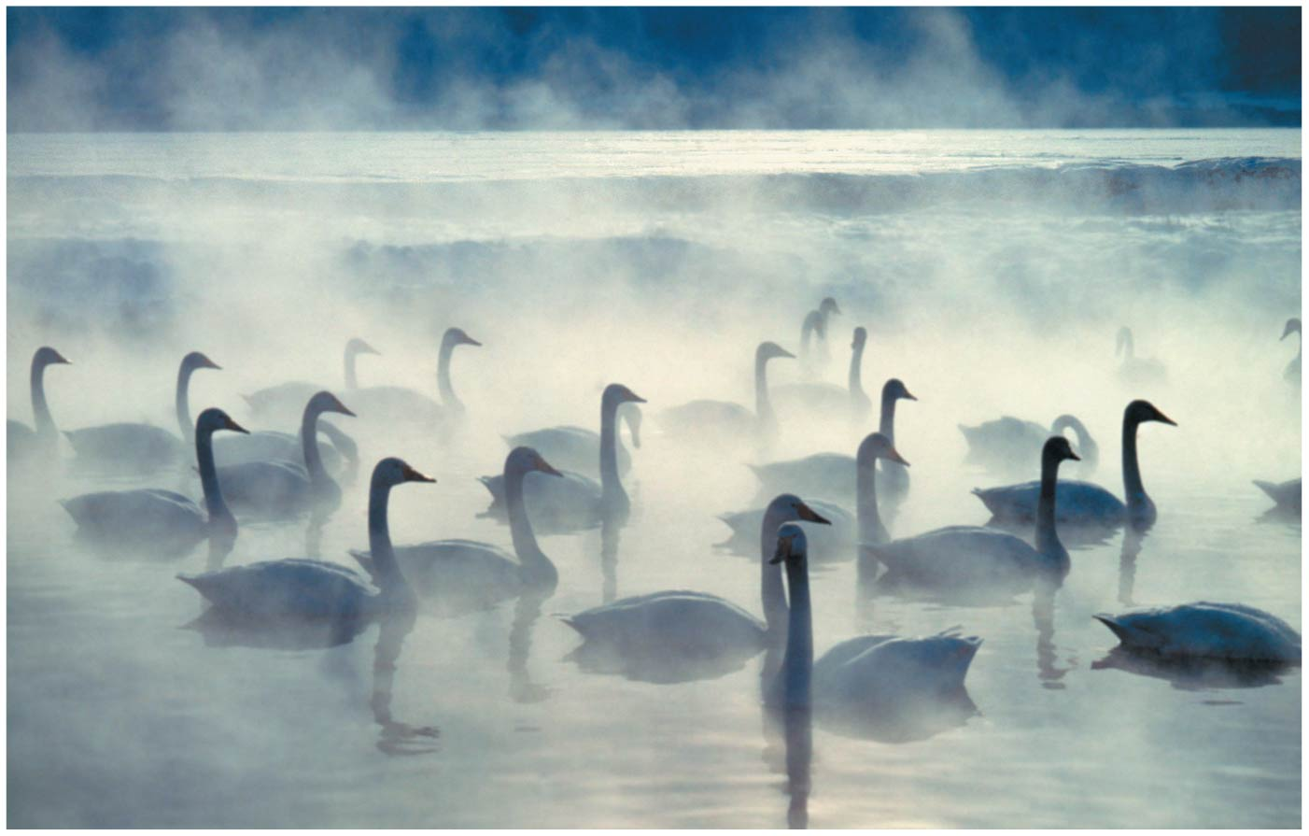
BIO10
Dr. Bradley
Genetics

Slide 2

Darwin didn’t understand HOW inheritance worked but he could see that somehow offspring often looked like a BLENDED version of the parents...

Slide 3
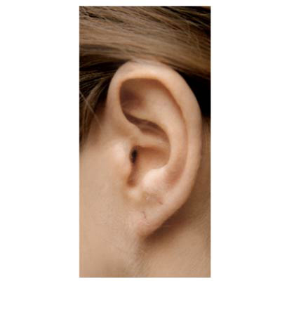
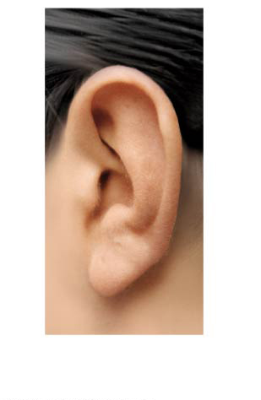
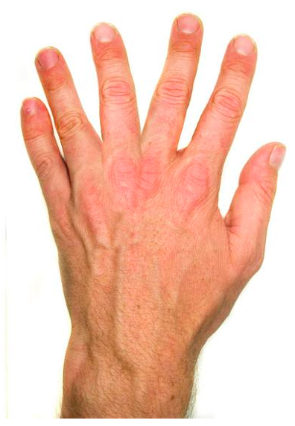

Discrete traits
(or discontinuous variation)
Quantitative traits
(or continuous variation)
Traits that are distinct and discontinuous which do not have intermediate forms or versions, like earlobe-type or blood-type status
Traits that can blend from one intermediate forms or version to another like height or skin color

Slide 4
We are going to talk about these in detail next – Mendel’s peas
Discrete traits
(or discontinuous variation)
Quantitative traits
(or continuous variation)
Traits that are distinct and discontinuous which do not have intermediate forms or versions, like earlobe-type or blood-type status
Traits that can blend from one intermediate forms or version to another like height or skin color

Slide 5
Gregor’s Experiment
True breeding plants:
  These are plants that always produce offspring that look like the parent.
Hybrids:
  The offspring of a mating between two true-breeding individuals that have different traits.
P Generation (true breeding):
  Plants used in first-generation crosses were called P, or parental generation.
F1 Generation (hybrids):
  These offspring were called the F1, or the first filial (filial = daughter or son), generation.
F2 Generation:
  F1 plants that mated with other F1 plants produced the F2, or second filial, generation.

Slide 6
Gregor’s Experiment
True breeding plants:
  These are plants that always produce offspring that look like the parent.
Hybrids:
  The offspring of a mating between two true-breeding individuals that have different traits.
P Generation (true breeding):
  Plants used in first-generation crosses were called P, or parental generation.
F1 Generation (hybrids):
  These offspring were called the F1, or the first filial (filial = daughter or son), generation.
F2 Generation:
  F1 plants that mated with other F1 plants produced the F2, or second filial, generation.

Slide 7
First Concept
Alternative versions of genes (alleles) account for variations in inherited characters
For example, the gene for flower color in pea plants exists in two versions (alleles)
  One for purple flowers
  One for white flowers

Slide 8
Second Concept
For each character, an organism has two alleles
  One inherited from each parent
The two alleles may be identical, as in the true-breeding plants of Mendel’s P generation
  These individuals are homozygous
Alternatively, the two alleles may differ, as in the F₁ hybrids
  These individuals are heterozygous

Slide 9
Third Concept
If the two alleles differ, then one (the dominant allele) determines the organism’s appearance, and the other (the recessive allele) has no noticeable effect on appearance
The F₁ plants had purple flowers because the allele for that trait is dominant

Slide 10
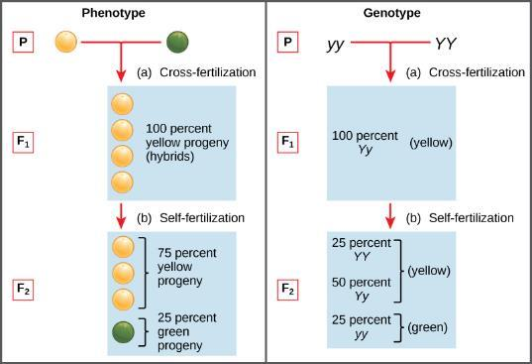
Phenotype & Genotype
Phenotypes are physical expressions of traits that are transmitted by alleles.
Capital letters typically represent dominant alleles and lowercase letters represent recessive alleles.
The phenotypic ratios are the ratios of visible characteristics.
The genotypic ratios are the ratios of gene combinations in the offspring, and these are not always distinguishable in the phenotypes.

Slide 11
Fourth Concept
Law of Segregation
The two alleles for a heritable character separate (segregate) during gamete formation and end up in different gametes
  Thus, an egg or a sperm gets only one of the two alleles that are present in the organism
Possible combinations of sperm and egg can be shown using a Punnett square
  A capital letter represents a dominant allele, and a lowercase letter represents a recessive allele

Slide 12
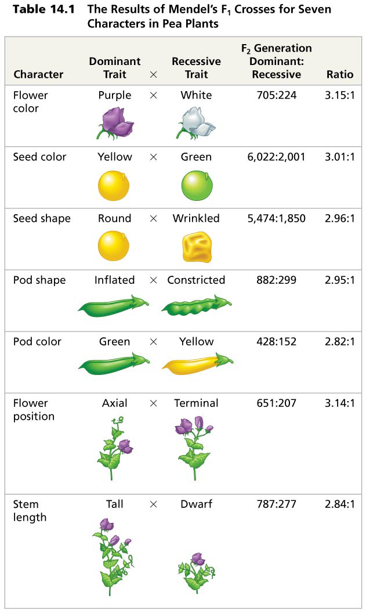
Mendel observed the same pattern of inheritance in six other pea plant characters, each represented by two traits
Mendel developed a hypothesis to explain the 3:1 inheritance pattern he observed in F₂ offspring using four related concepts

Slide 13
Types of Dominance
Complete dominance
  occurs when phenotypes of the heterozygote and dominant homozygote are identical

Slide 14
Types of Dominance
Incomplete dominance
  the phenotype of F₁ hybrids is somewhere between the phenotypes of the two parental varieties

Slide 15
No Information past here will be on the second lecture midterm
Information past here will be on the second lab midterm though...

Slide 16
Types of Dominance
Codominance
  two dominant alleles affect the phenotype in separate, distinguishable ways

Slide 17
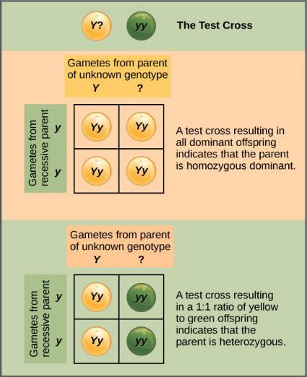
Test Cross
When a trait is governed by complete dominance...
  The recessive trait can ONLY be displayed if the individual is homozygous for the recessive trait
  The dominant trait can however be displayed if the individual is:
    Heterozygous for both traits
    Homozygous for the dominant trait
  A test cross lets you determine which of the above it actually is

Slide 18
Fifth Concept
Law of Independent Assortment
Genes do not influence each other with regard to the sorting of alleles into gametes.
In other words, genes are sorted independently of each other.
This can be illustrated by the dihybrid cross, a cross between two true-breeding parents that express different traits for two characteristics.

Slide 19
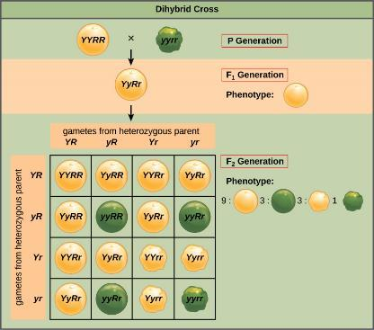
Fifth Concept
Law of Independent Assortment
Genes do not influence each other with regard to the sorting of alleles into gametes.
In other words, genes are sorted independently of each other.
This can be illustrated by the dihybrid cross, a cross between two true-breeding parents that express different traits for two characteristics.

Slide 20
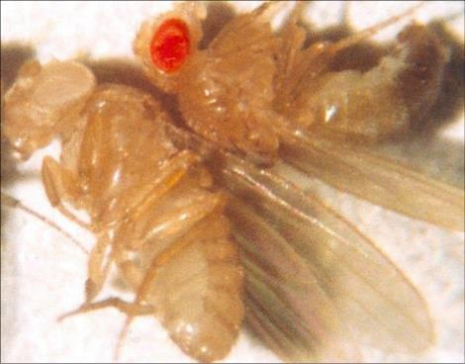
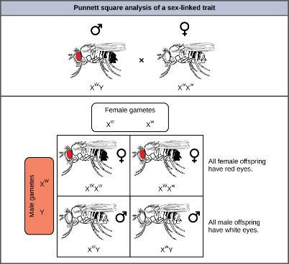
Sex-Linked Traits
When a gene being examined is present on the X, but not the Y, chromosome, it is X-linked.
Eye color in Drosophila, the common fruit fly, was the first X-linked trait to be identified.
In flies the wild-type eye color is red (XW) and is dominant to white eye color (Xw).
Males are said to be hemizygous, in that they have only one allele for any X-linked characteristic.
  Hemizygosity makes descriptions of dominance and recessiveness irrelevant for XY males.
Drosophila males lack the white gene on the Y chromosome; that is, their genotype can only be XWY or XwY.
In contrast, females have two allele copies of this gene and can be XWXW, XWXw, or XwXw.

Slide 21
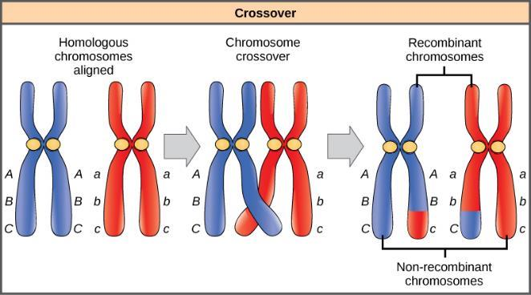
Linked Genes
Genes that are located on separate, non-homologous chromosomes will always sort independently.
However, each chromosome contains hundreds or thousands of genes.
The segregation of alleles into gametes can be influenced by linkage, in which genes that are located physically close to each other on the same chromosome are more likely to be inherited as a pair.
However, because of the process of recombination, or “crossover,” it is possible for two genes on the same chromosome to behave independently, or as if they are not linked.

Slide 22
Polygenic Inheritance & Epistasis
Mendel’s studies in pea plants implied every characteristic was distinctly and completely controlled by a single gene.
In fact, single observable characteristics are almost always under the influence of multiple genes (each with two or more alleles) acting in unison. For example, at least eight genes contribute to eye color and at least three genes that code for skin color in humans.
Cases in which inheritance for a characteristic like skin color or human height depend on the combined effects of numerous genes are called polygenic inheritance.
Quantitative traits
(or continuous variation)
Traits that can blend from one intermediate forms or version to another like height or skin color

Slide 23
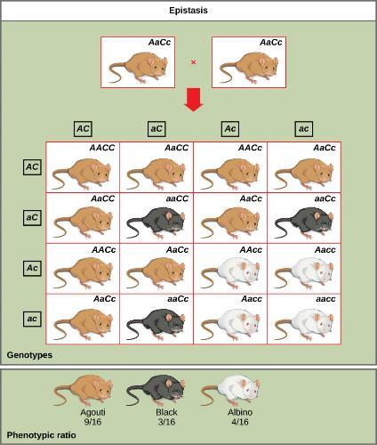
Polygenic Inheritance & Epistasis
In epistasis, the interaction between genes is antagonistic, such that one gene masks or interferes with the expression of another.
An example of epistasis is pigmentation in mice. The wild-type coat color, agouti (AA) is dominant to solid-colored fur (aa). However, a separate gene C, when present as the recessive homozygote (cc), negates any expression of pigment from the A gene and results in an albino mouse.

