Slide 1
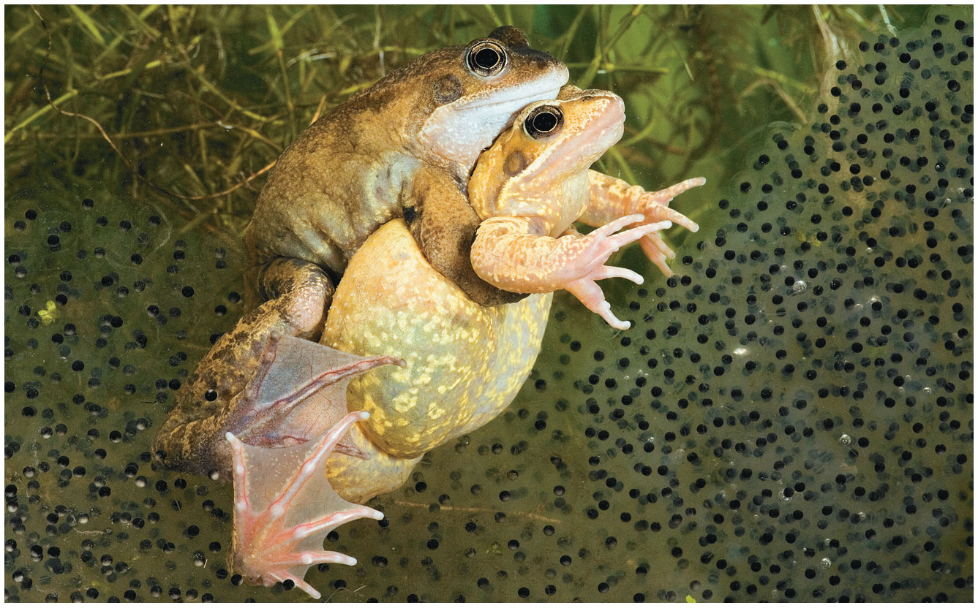
BIO10
Dr. Bradley
Meiosis

Slide 2
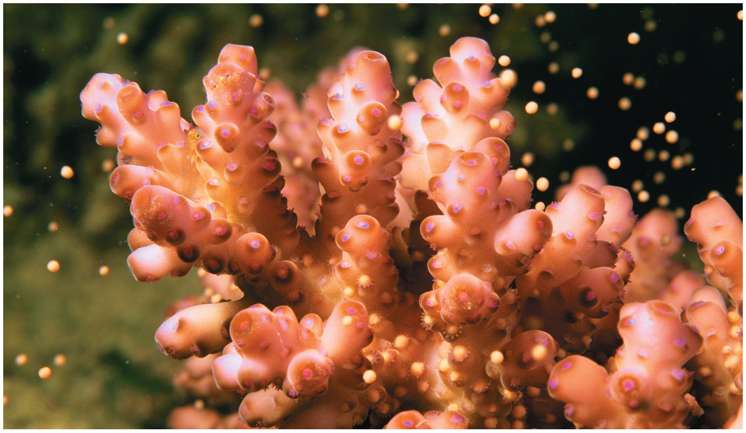
Natural Selection favors entities that leave descendants: Reproduction
A population outlives its members only by reproduction, the generation of new individuals from existing ones

Slide 3
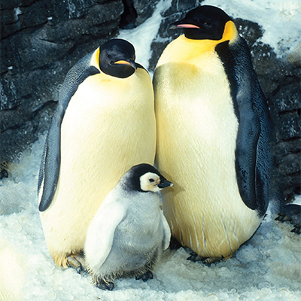
Natural Selection favors entities that leave descendants: Reproduction
two options:
  asexual reproduction
    creation of offspring without the fusion of egg and sperm
  sexual reproduction
    creation of an offspring by fusion of haploid gametes, male sperm and female eggs, to form a diploid zygote

Slide 4
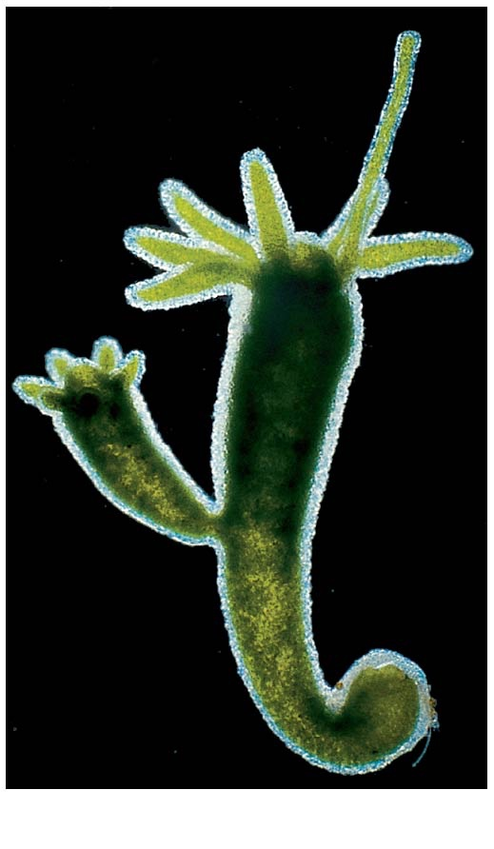
Asexual Reproduction
(e.g., binary fission, clonal fragmentation, budding)
Which type of cell division is needed? Mitosis!
How many parents are involved? Only one!
How similar is an offspring to the parent? Identical!
How similar are offspring to each other? Identical!
Hydra

Slide 5
Asexual Reproduction
(e.g., binary fission, clonal fragmentation, budding)
Budding or fission is a simple form of asexual reproduction found only among invertebrates
New individuals arise from outgrowths of existing ones
Hydra

Slide 6
Natural Selection favors entities that leave descendants: Reproduction
two options:
  asexual reproduction
    creation of offspring without the fusion of egg and sperm
  sexual reproduction
    creation of an offspring by fusion of haploid gametes, male sperm and female eggs, to form a diploid zygote

Slide 7
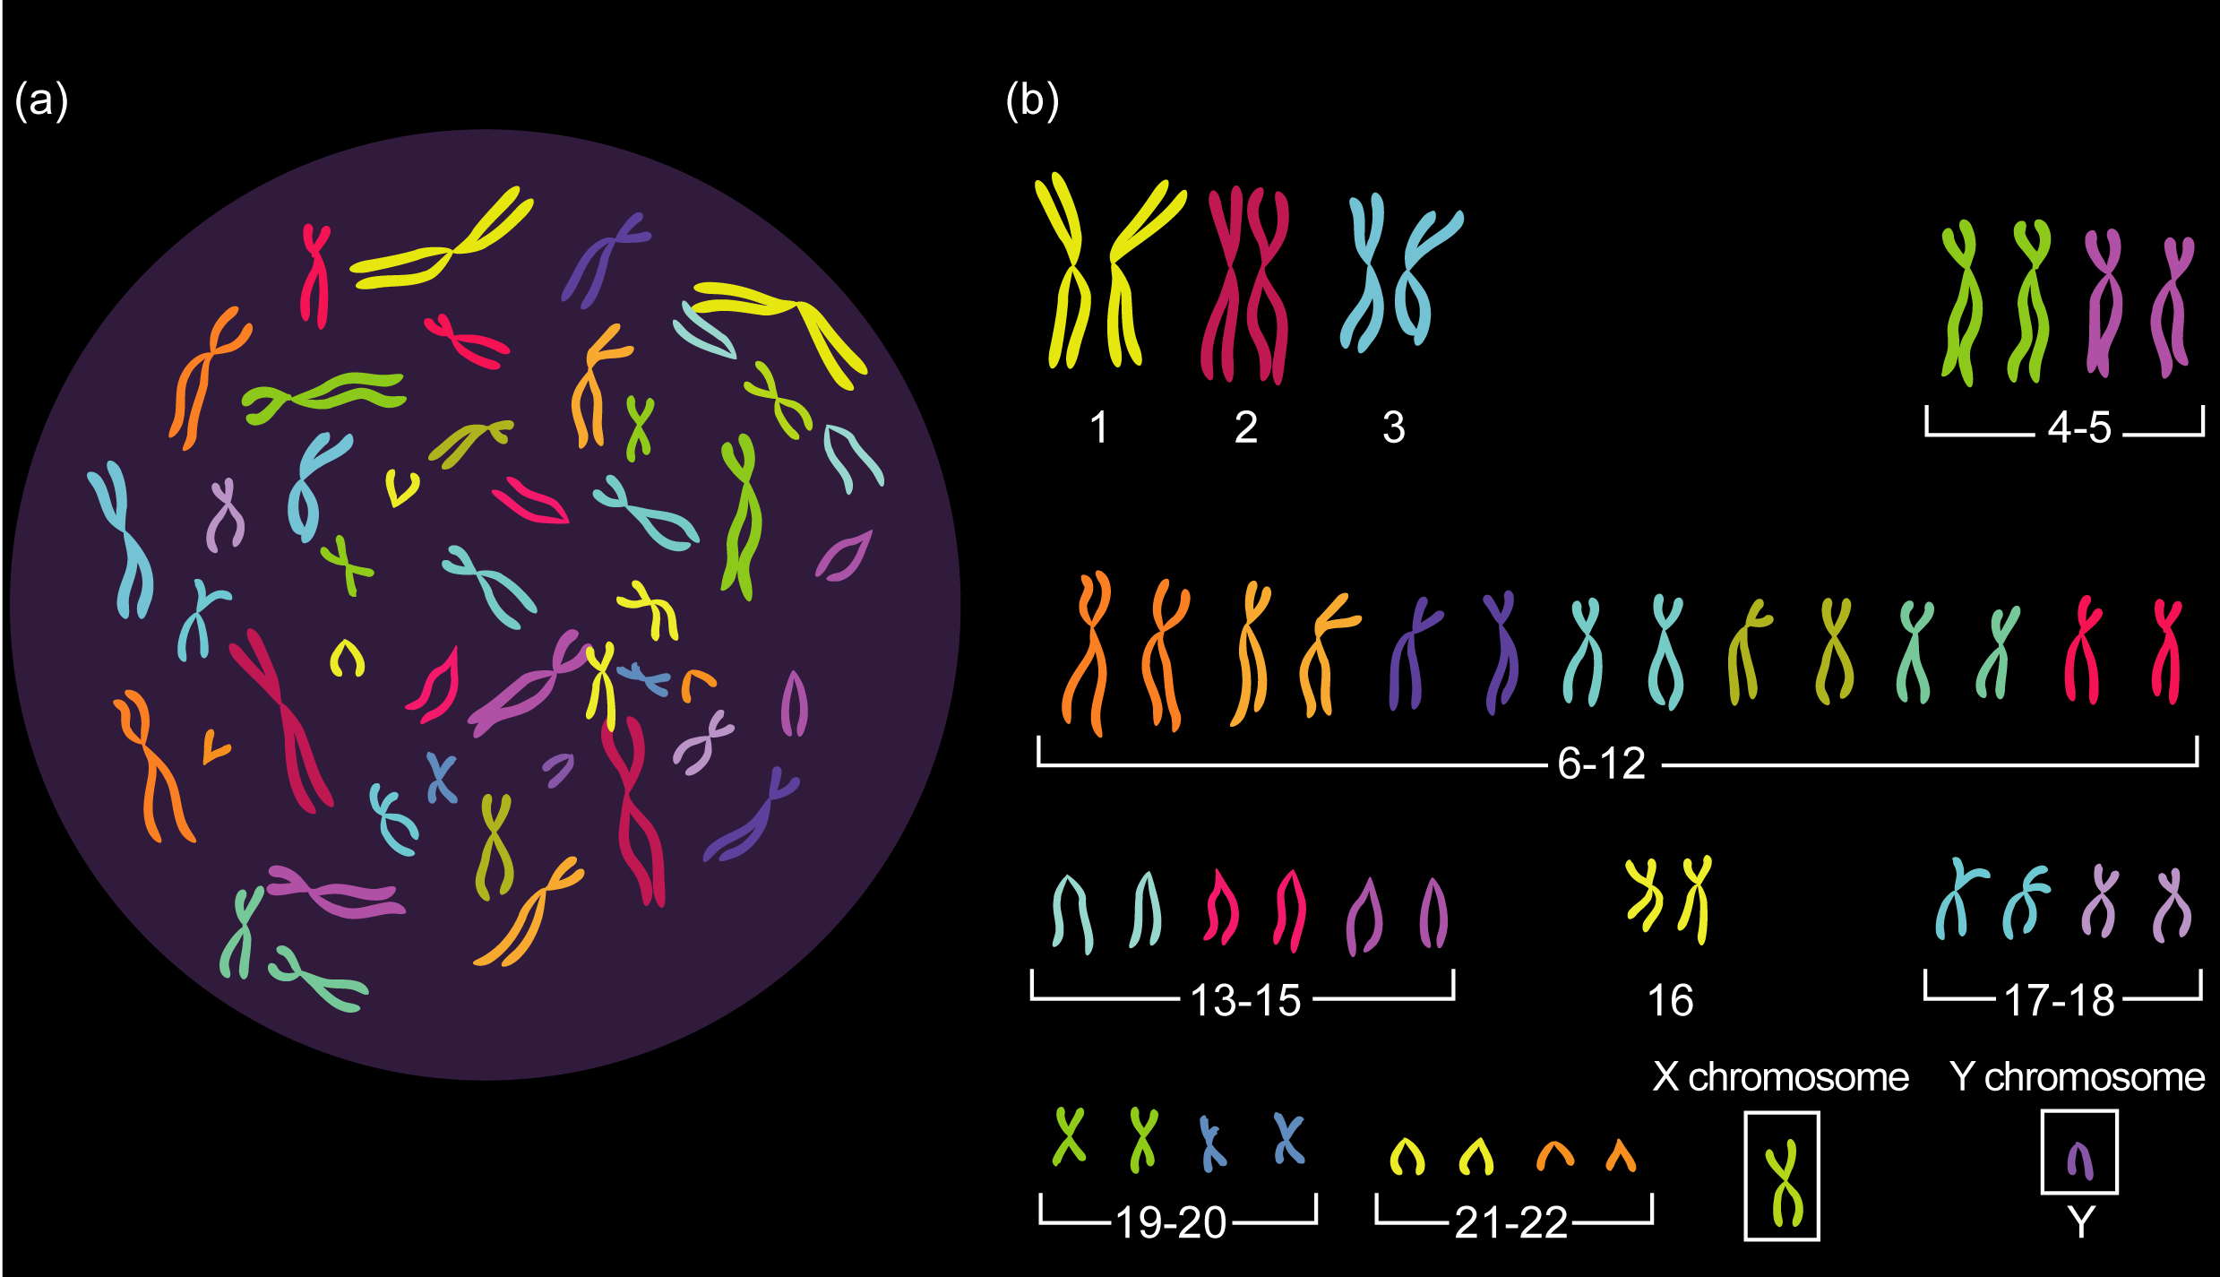
Somatic cells in humans
  have 23 pairs (sets) of chromosomes

Slide 8
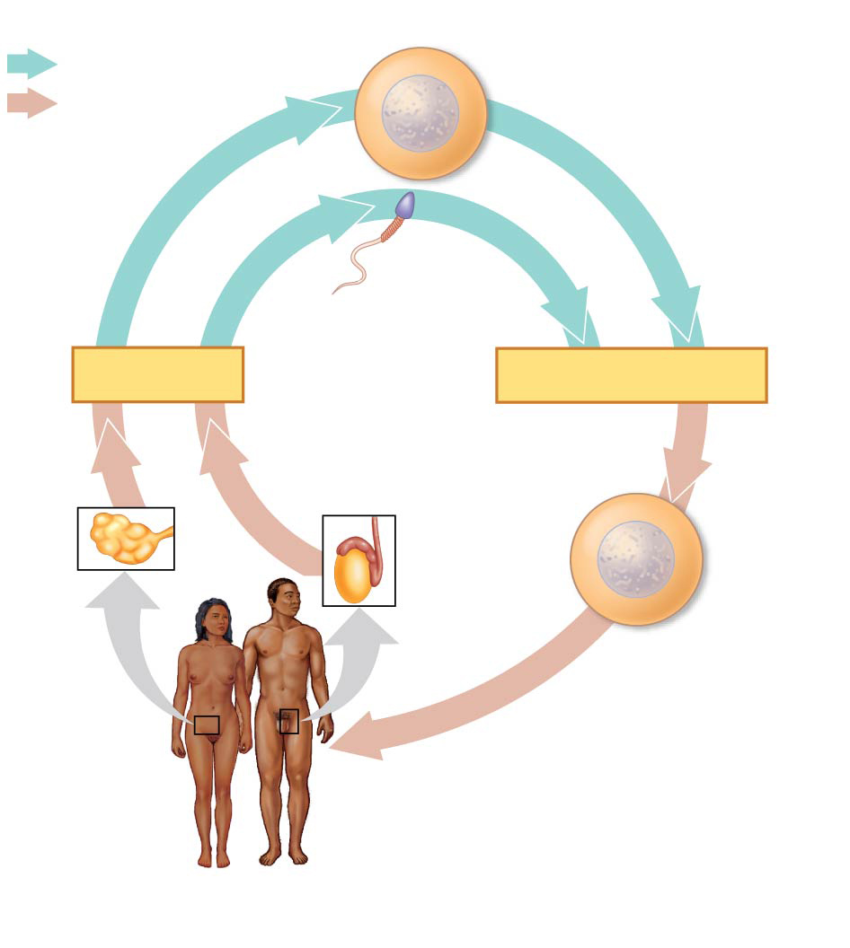
Key
Haploid gametes (n = 23)
Sexual Reproduction in Animals
Haploid (n)
Egg (n)
Diploid (2n)
Gametes are the only types of human cells produced by meiosis, rather than mitosis
Meiosis results in one set of chromosomes in each gamete
Fertilization and meiosis alternate in sexual life cycles to maintain chromosome number
Sperm (n)
MEIOSIS
FERTILIZATION
Ovary
Testis
Diploid
zygote
(2n = 46)
Mitosis and
development
Multicellular diploid
adults (2n = 46)
p. 257

Slide 9
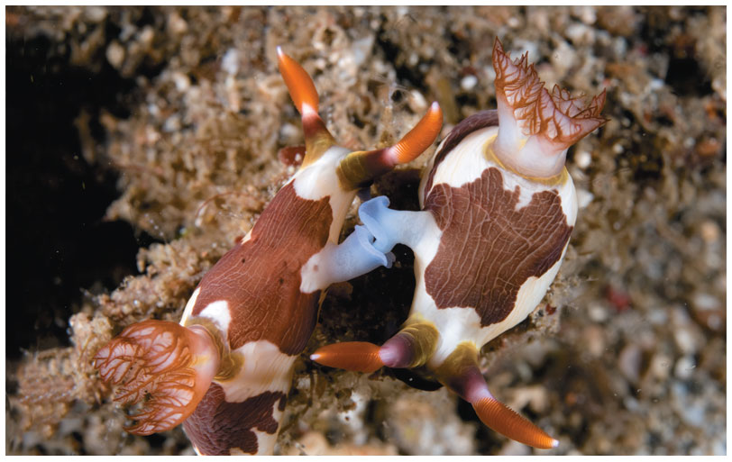
Variation in Patterns of Sexual Reproduction
For many sexually reproducing animals, finding a partner for reproduction can be challenging
In hermaphroditism, each individual has both male and female reproductive systems
Any two individuals can mate under this system, and in some species, hermaphrodites can also self-fertilize
Several organisms can change their sex under certain circumstances

Slide 10
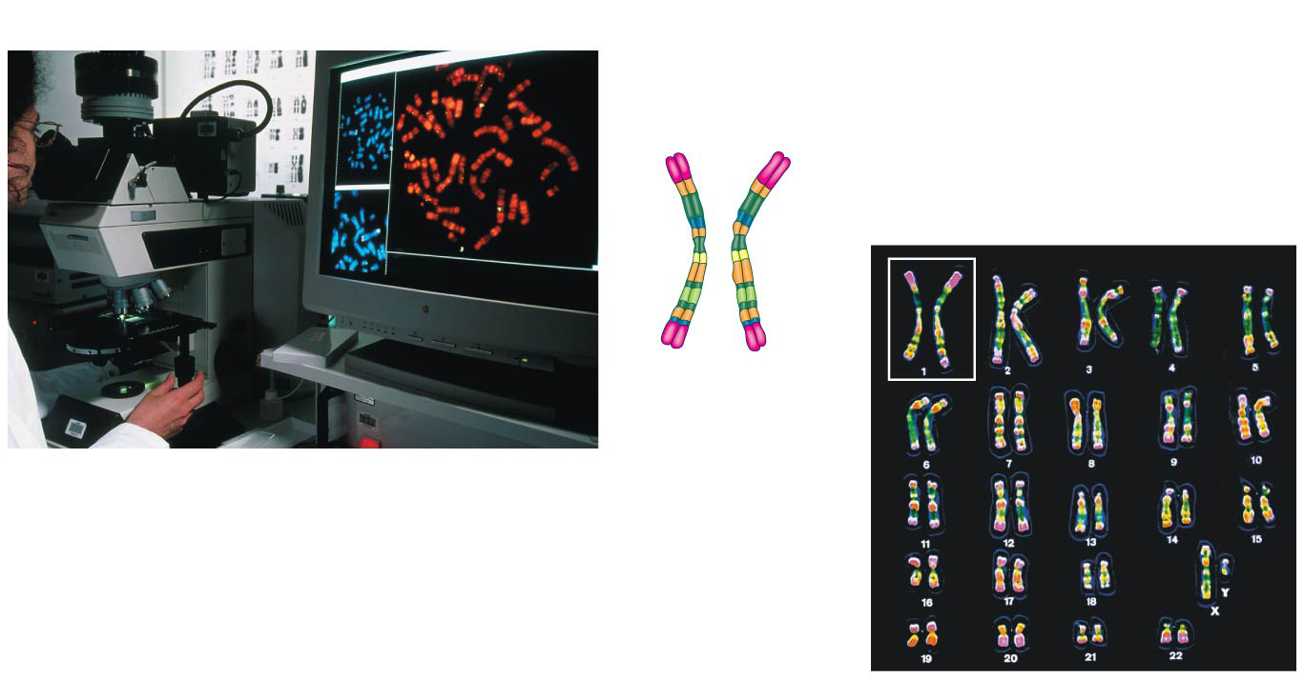
Pair of homologous
duplicated chromosomes
Centromere
5 µm
Sister
chromatids
Metaphase
chromosome

Slide 11
Make sure you can differentiate chromosomes made up of pairs of sister chromatids from pairs of homologous chromosomes

Slide 12
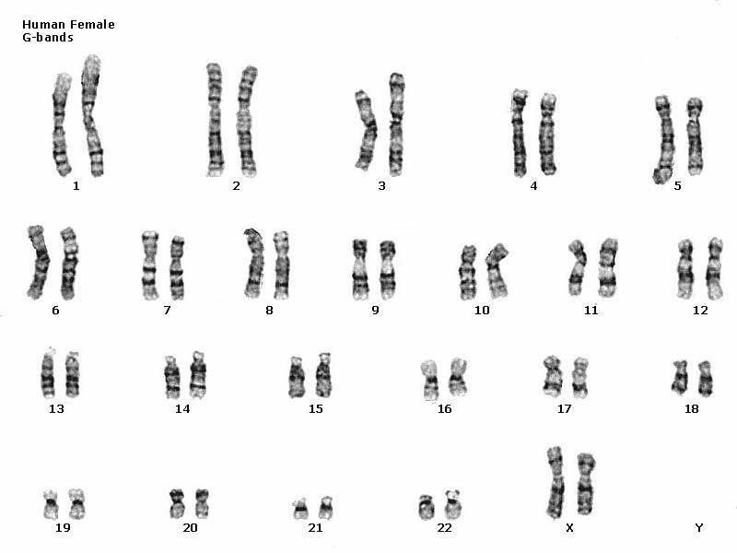
In humans the sex chromosomes, which determine the sex of the individual, are called X and Y
Human females have a homologous pair of X chromosomes (XX)
Human males have one X and one Y chromosome (XY)
The remaining 22 pairs of chromosomes are called autosomes
Humans have 23 sets (or pairs) of chromosomes

Slide 13
Each pair of homologous chromosomes includes one chromosome from each parent
A diploid cell (2n) has two sets of chromosomes
For humans, the diploid number is 46 (2n = 46)

Slide 14
A gamete (sperm or egg) contains a single set of chromosomes and is haploid (n)
For humans, the haploid number is 23 (n = 23)

Slide 15
A gamete (sperm or egg) contains a single set of chromosomes and is haploid (n)
For humans, the haploid number is 23 (n = 23)

Slide 16
Reminder: The Cell Cycle
Chromosomes are “duplicated” only during the
S phase

Slide 17
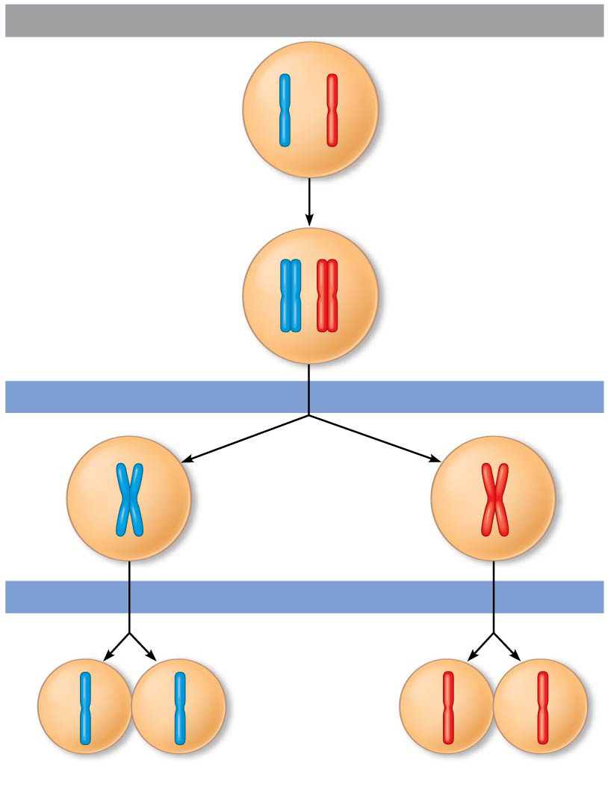
Interphase
Meiosis reduces the number of chromosome sets from diploid to haploid
The two cell divisions (Meiosis I and Meiosis II)
The two cell divisions result in four daughter cells, rather than the two daughter cells in mitosis
Each daughter cell has only half as many chromosomes as the parent cell
  And thus each daughter cell is genetically unique from the parental cell
The chromatids are sorted into four haploid daughter cells
Pair of
homologous
chromosomes
in diploid
parent cell
Chromosomes
duplicate
Pair of duplicated
homologous
chromosomes
Sister
chromatids
Diploid cell with
duplicated
chromosomes
Meiosis I
1
Homologous
chromosomes
separate
Haploid cells with
duplicated chromosomes
Meiosis II
2
Sister chromatids
separate
Haploid cells with unduplicated chromosomes

Slide 18
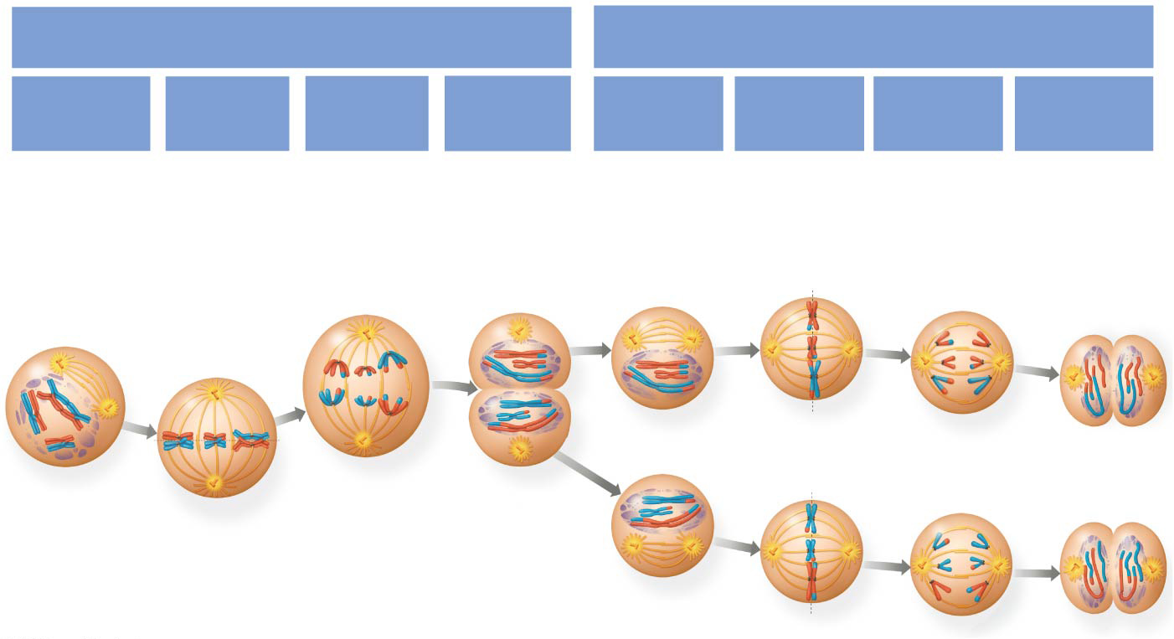
Meiosis I & Meiosis II
MEIOSIS I: Separates
homologous chromosomes
MEIOSIS II: Separates
sister chromatids
Telophase I
and
Cytokinesis
Telophase II
and
Cytokinesis
Prophase I
Metaphase I
Anaphase I
Prophase II
Metaphase II
Anaphase II

Slide 19
Prophase I
Each chromosome pairs with its homolog and crossing over occurs
Metaphase I
Pairs of homologs line up at the metaphase plate, with one chromosome facing each pole
Anaphase I
Pairs of homologous chromosomes separate
One chromosome of each pair moves toward opposite poles, guided by the spindle apparatus
Sister chromatids remain attached at the centromere and move as one unit toward the pole
Telophase I and Cytokinesis
Each half of the
cell has a haploid set of chromosomes; each chromosome still consists of two sister chromatids
Cytokinesis occurs forming two haploid daughter cells

Slide 20
Prophase II
A spindle apparatus forms
Chromosomes (each still composed of two chromatids) move toward the metaphase plate
Metaphase II
The sister chromatids are arranged at the metaphase plate
Because of crossing over in meiosis I, the two sister chromatids of each chromosome are no longer genetically identical
The kinetochores of sister chromatids attach to microtubules extending from the poles
Anaphase II
The sister chromatids separate
The sister chromatids of each chromosome now move as individual chromosomes toward opposite poles
Telophase II and Cytokinesis
The chromosomes arrive at opposite poles
Nuclei form, and the chromosomes begin decondensing
Cytokinesis separates the cytoplasm
At the end of meiosis, there are four daughter cells, each with a haploid set of chromosomes
Each daughter cell is genetically distinct from the others and from the parent cell

Slide 21
Crossing Over
Crossing over combines DNA inherited from each parent
Contributes to genetic variation by combining DNA from two parents into a single chromosome
In humans an average of one to three crossover events occurs per chromosome

Slide 22
Crossing Over in Meiosis I

Slide 23
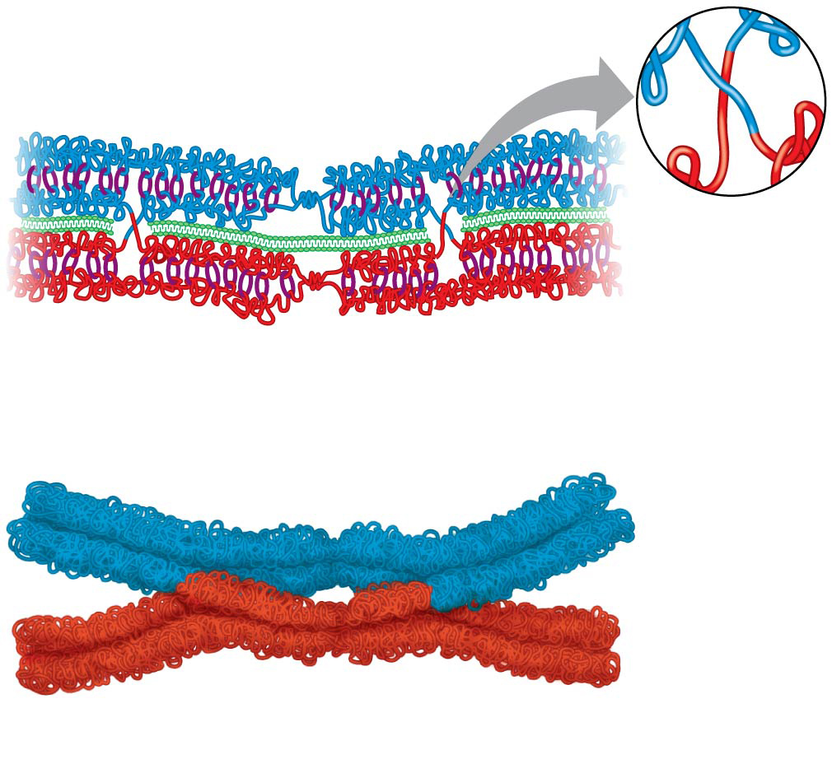
Crossing Over in Meiosis I
Crossover
Crossover
3
Chiasmata
Crossing over results in each chromosome being a mix of genetic material from maternal and paternal genomes
4

Slide 24
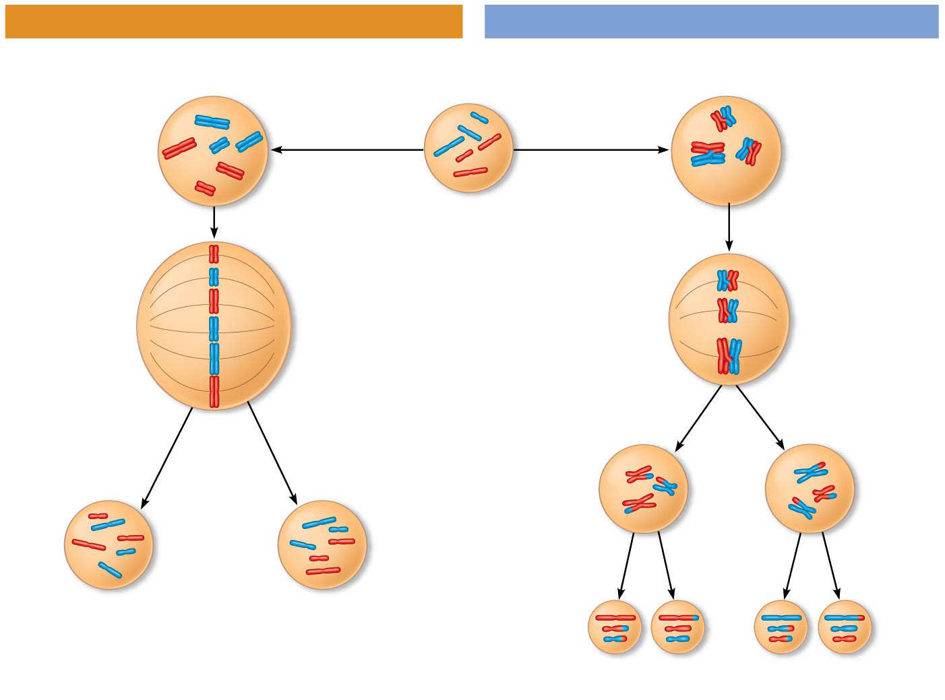
MITOSIS
MEIOSIS
Parent cell
Chiasma
MEIOSIS I
Prophase
Prophase I
Homologous
chromosome
pair
Chromosome
duplication
Chromosome
duplication
Duplicated
chromosome
2n = 6
Individual
chromosomes
line up.
Pairs of
homologous
chromosomes
line up.
Metaphase I
Metaphase
Anaphase I
Anaphase
Telophase
Sister
chromatids
separate.
Homologs
separate.
Telophase I
Daughter
cells of
meiosis I
Sister
chroma-
tids
separate.
MEIOSIS
II
2n
2n
Daughter cells
of mitosis
n
n
n
n
Daughter cells of meiosis II

Slide 25
Three events are unique to meiosis, and all three occur in meiosis I
  Synapsis and crossing over in prophase I: Homologous chromosomes physically connect and exchange genetic information
  Homologous pairs at the metaphase plate
  Separation of homologs during anaphase I

Slide 26
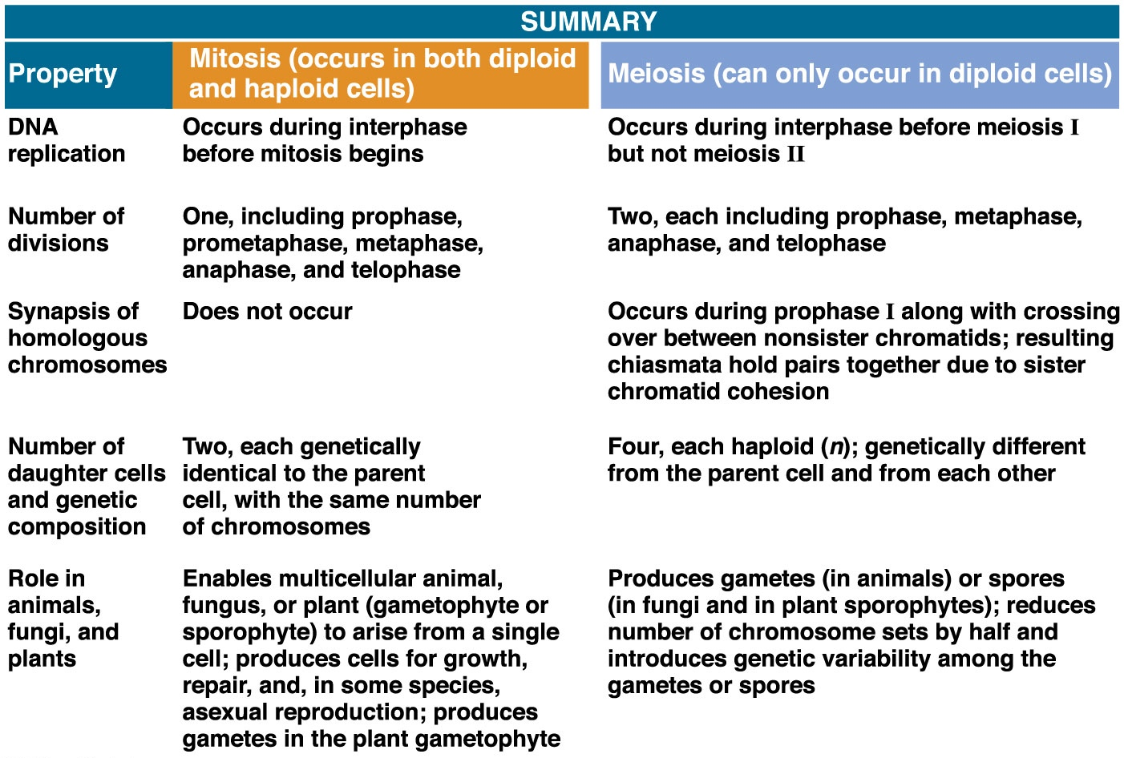
Notes:
Figure 13.10b A comparison of mitosis and meiosis (part 2: mitosis vs. meiosis table)

Slide 27
Where Does Variation Come From?
Mutations (changes in an organism’s DNA) are the original source of genetic diversity
But the behavior of chromosomes during meiosis and fertilization is responsible for most of the variation that arises in each generation
Three mechanisms contribute to genetic variation
  Crossing over
  Independent assortment of chromosomes
  Random fertilization

Slide 28
Where Does Variation Come From?
Mutations (changes in an organism’s DNA) are the original source of genetic diversity
But the behavior of chromosomes during meiosis and fertilization is responsible for most of the variation that arises in each generation
Three mechanisms contribute to genetic variation
  Crossing over (we just covered this)
  Independent assortment of chromosomes
  Random fertilization

Slide 29
Independent Assortment of Chromosomes
Homologous pairs of chromosomes orient randomly at metaphase I of meiosis
In independent assortment, each pair of chromosomes sorts maternal and paternal homologs into daughter cells independently of the other pairs

Slide 30
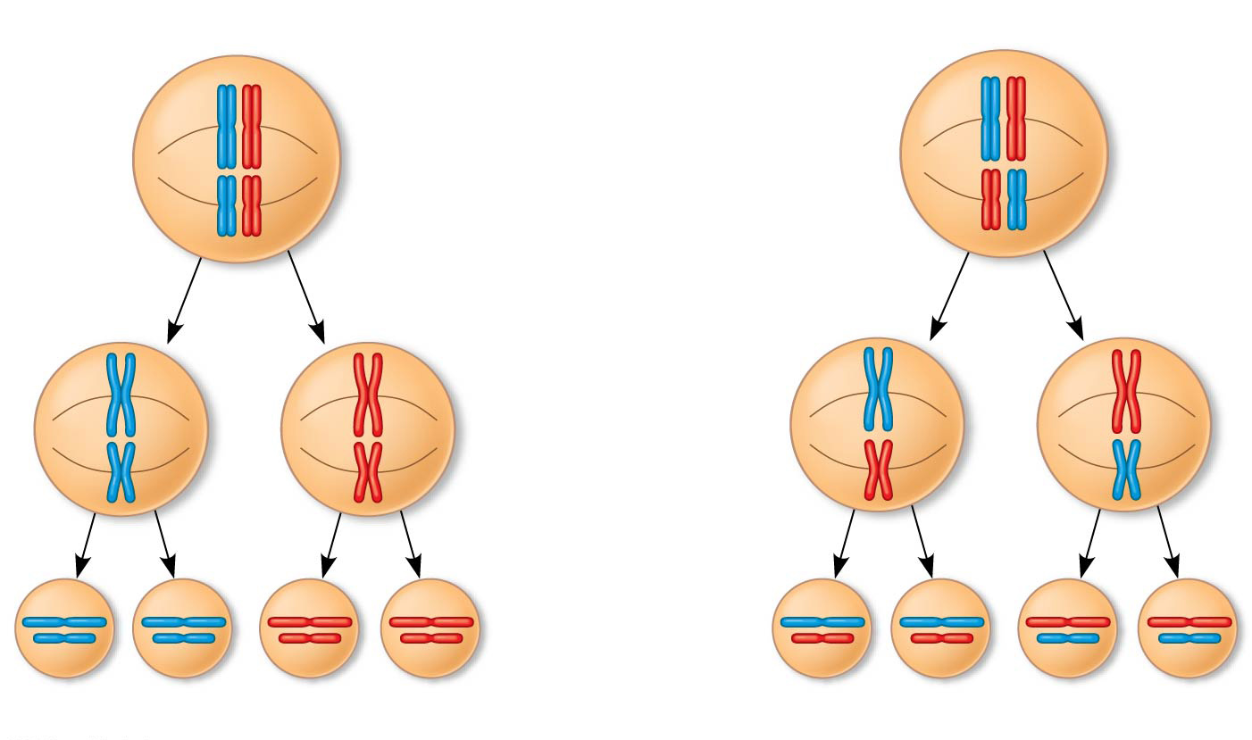
Independent Assortment of Chromosomes
Possibility 1
Possibility 2
Two equally probable
arrangements of
chromosomes at
metaphase I
Metaphase II
Daughter
cells
Combination 1
Combination 2
Combination 3
Combination 4

Slide 31
Independent Assortment of Chromosomes
The number of combinations possible when chromosomes assort independently into gametes is 2^{n}, where n is the haploid number
For humans (n = 23), there are more than
8 million (2²³) possible combinations of how chromosomes can be lined up at the metaphase plate during Meiosis I

Slide 32
Where Does Variation Come From?
Mutations (changes in an organism’s DNA) are the original source of genetic diversity
But the behavior of chromosomes during meiosis and fertilization is responsible for most of the variation that arises in each generation
Three mechanisms contribute to genetic variation
  Crossing over
  Independent assortment of chromosomes
  Random fertilization

Slide 33
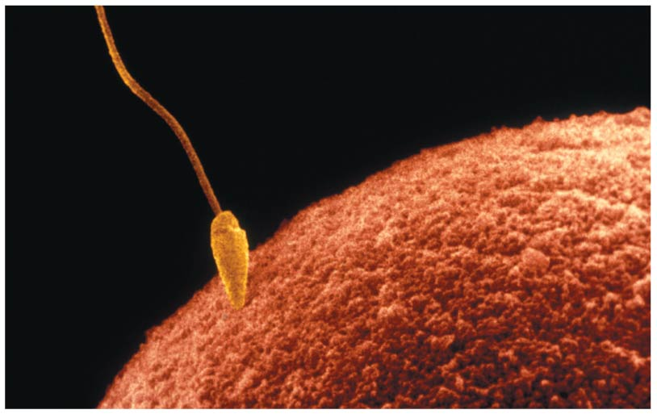
Random Fertilization
Random fertilization adds to genetic variation because any sperm can fuse with any ovum (unfertilized egg)
The fusion of two gametes (each with more than 8 million possible chromosome combinations from independent assortment) produces a zygote with any of about 70 trillion diploid combinations
  i.e. From the same parents, you could have 70 trillion siblings and each would be genetically unique

Slide 34
Review
Mutations (changes in an organism’s DNA) are the original source of genetic diversity
But the behavior of chromosomes during meiosis and fertilization is responsible for most of the variation that arises in each generation
Three mechanisms contribute to genetic variation
  Crossing over
  Independent assortment of chromosomes
  Random fertilization

