Slide 1
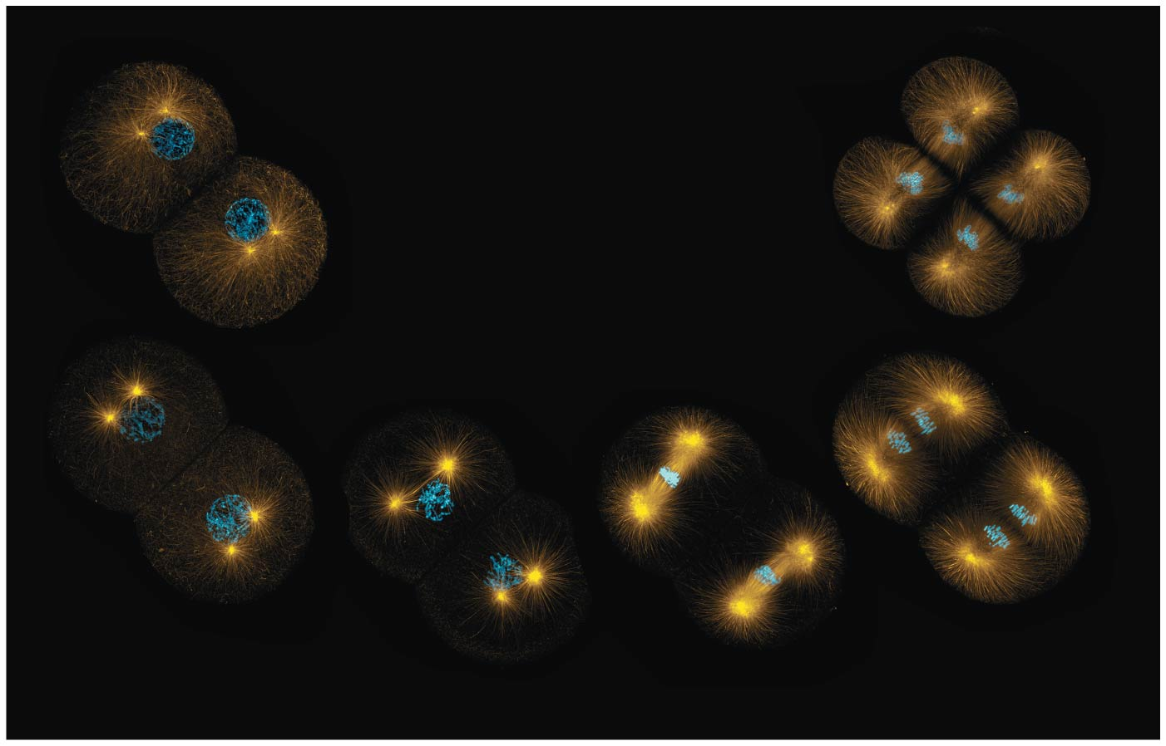
BIO10
Dr. Bradley
Mitosis

Slide 2
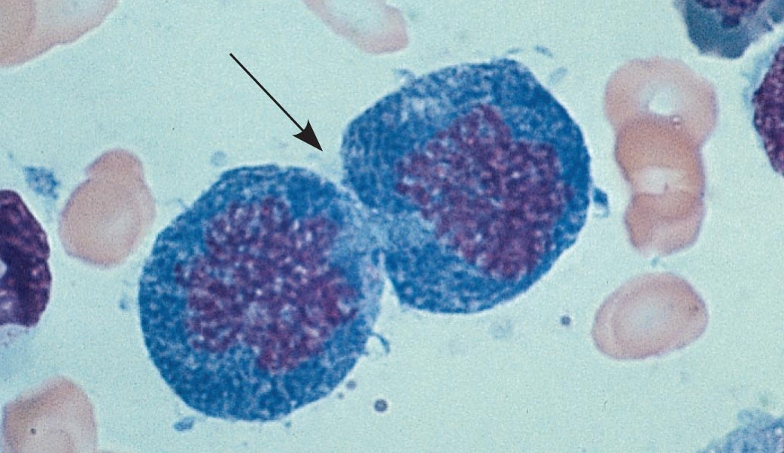
The Key Roles of Cell Division
The ability of organisms to reproduce best distinguishes living things from nonliving matter
The continuity of life is based on the reproduction of cells, or cell division

Slide 3
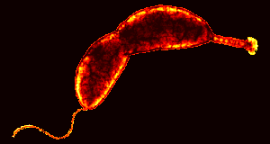
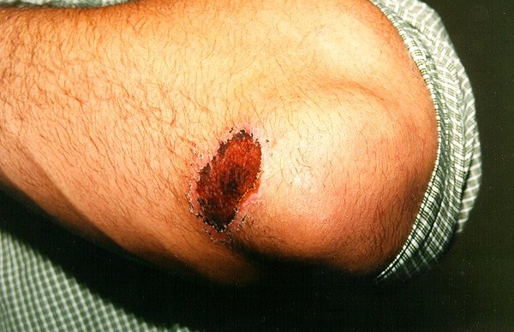
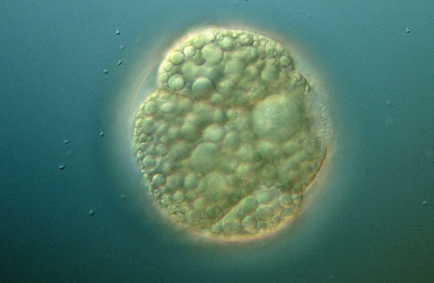
In unicellular organisms, division of one cell reproduces the entire organism
Multicellular organisms depend on cell division for:
  Development from a fertilized cell
  Growth (increased body size)
  Repair (healing)
Cell division is an integral part of the cell cycle, the life of a cell from formation to its own division

Slide 4
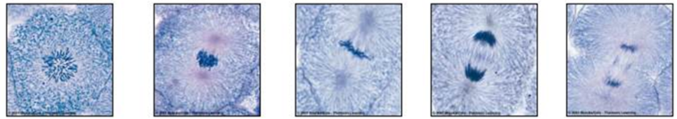
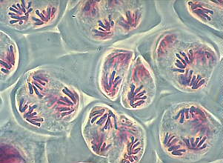
There are different forms of cell division
Mitosis:
A cell division results in diploid daughter cells with identical genetic information, DNA
Meiosis:
A special type of division produces haploid non-distinct daughter cells called gametes or germ
cells (sperm and egg cells)

Slide 5
Every eukaryotic species has a characteristic number of chromosomes in each cell nucleus
Somatic cells (non-reproductive cells) have two sets of chromosomes
These are duplicated via mitosis
Gametes or germ cells (reproductive cells: sperm and eggs) have half as many chromosomes as somatic cells
These are duplicated via meiosis

Slide 6
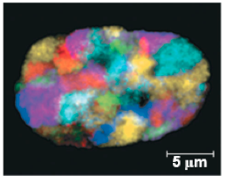
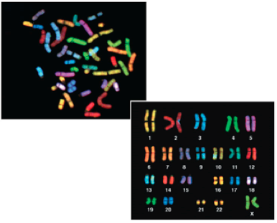
Most chromatin is loosely packed in the nucleus during interphase and condenses prior to mitosis
Loosely packed chromatin is called euchromatin
During interphase a few regions of chromatin (centromeres and telomeres) are highly condensed into heterochromatin
Dense packing of the heterochromatin makes it difficult for the cell to express genetic information coded in these regions
Karyotype: organized picture of heterochromatin

Slide 7
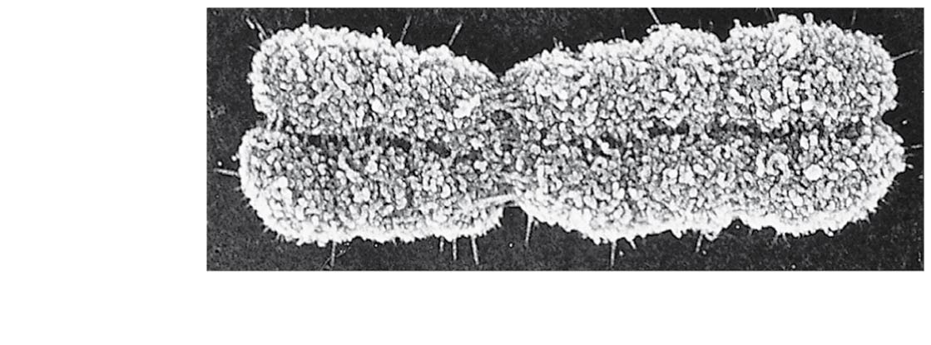
Chromosomes
Sister
chromatids
Each sister chromatid is attached along their lengths by proteins called cohesins
Centromere
0.5 μm
The narrow “waist” of the chromosome where the two chromatids are most closely attached

Slide 8

The Cell Cycle
Interphase (about 90% of the cell cycle) can be divided into subphases
  G₁ phase (“first gap”)
  S phase (“synthesis”)
  G₂ phase (“second gap”)
The cell grows during all three phases, but chromosomes are duplicated only during the S phase
Chromosomes only look like this during a brief moment right here!
“Duplication” ≠ doubling of chromosomes
“Duplication” = creating a sister chromatid after DNA (molecule) replication
“Duplication” = creating a second (identical) DNA molecule within a chromosome

Slide 9
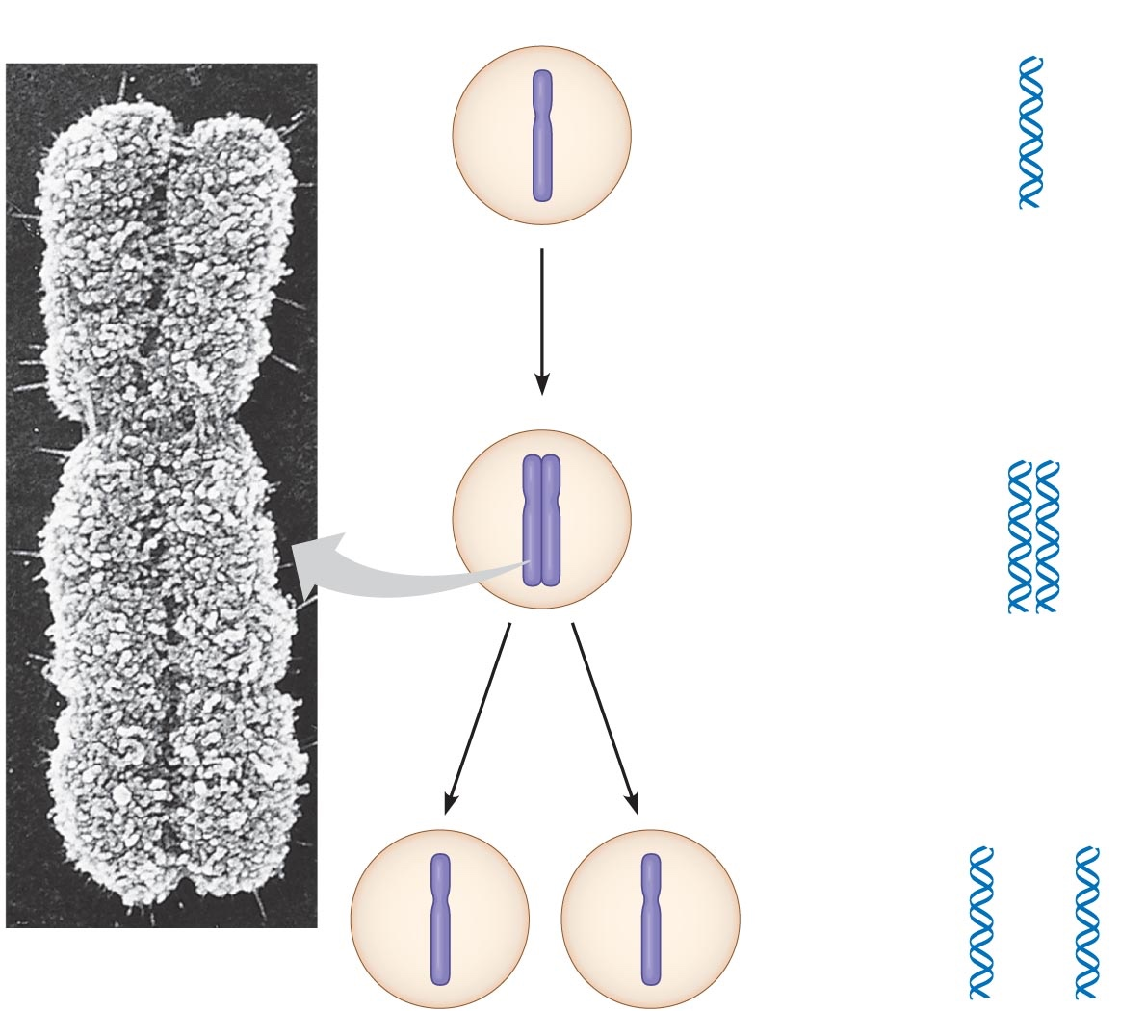
One Chromosome after “duplication”
Two Sister Chromatids
  Each with one identical copy of a DNA molecule
  Two entire DNA molecules total
Each replicated DNA molecule with genes for various traits, but each is identical to the other and each share genes in the same linear sequence

Slide 10
How does DNA replication happen?

Slide 11
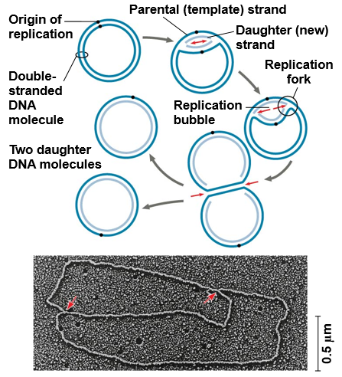
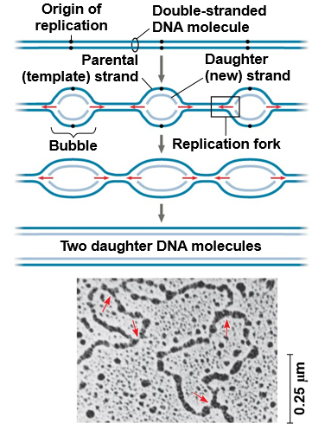
Replication begins at sites called origins of replication, where the two DNA strands are separated, and then proceeds in both directions
Origin of replication in an E. coli cell
Origins of replication in a eukaryotic cell
Notes:
Figure 16.12 Origins of replication in E. coli and eukaryotes

Slide 12
0.5 µm
Chromosomes
DNA molecules
Chromo-
some arm
Chromosome
“duplication”
(including DNA
synthesis)
Centromere
Sister
chromatids
Separation of
sister chromatids
Centromere
Sister chromatids
Notes:
Figure 12.4 Chromosome duplication and distribution during cell division

Slide 13
Mitotic Phase
Mitosis and then cytokinesis

Slide 14
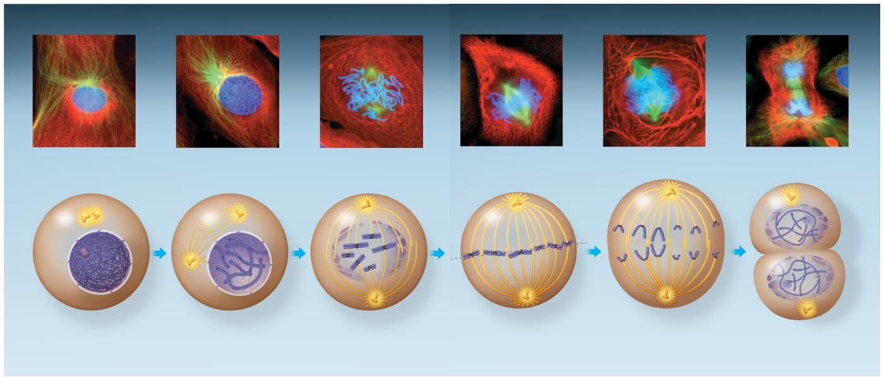
Mitosis is conventionally and arbitrarily divided into 5 phases
G₂ of
Interphase
Anaphase
Telophase and
Cytokinesis
Prophase
Prometaphase
Metaphase
Notes:
Figure 12.6 The mitotic division of an animal cell

Slide 15
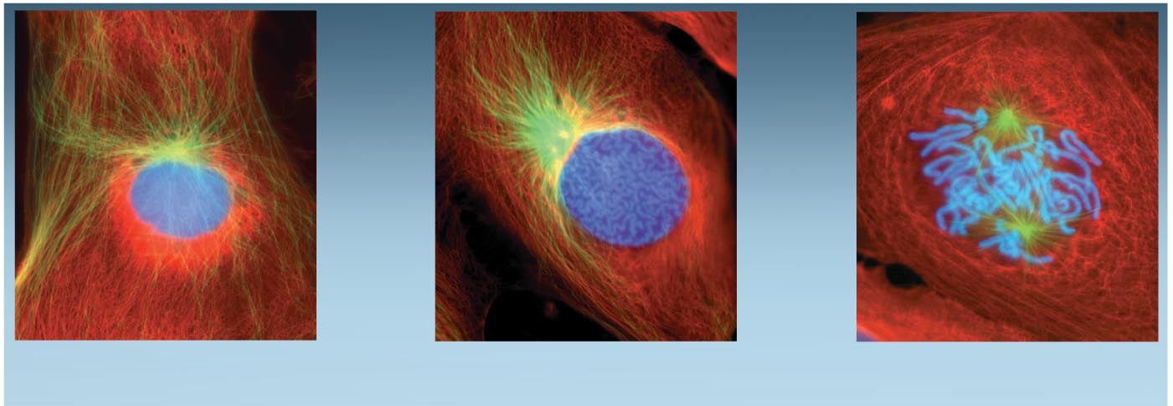
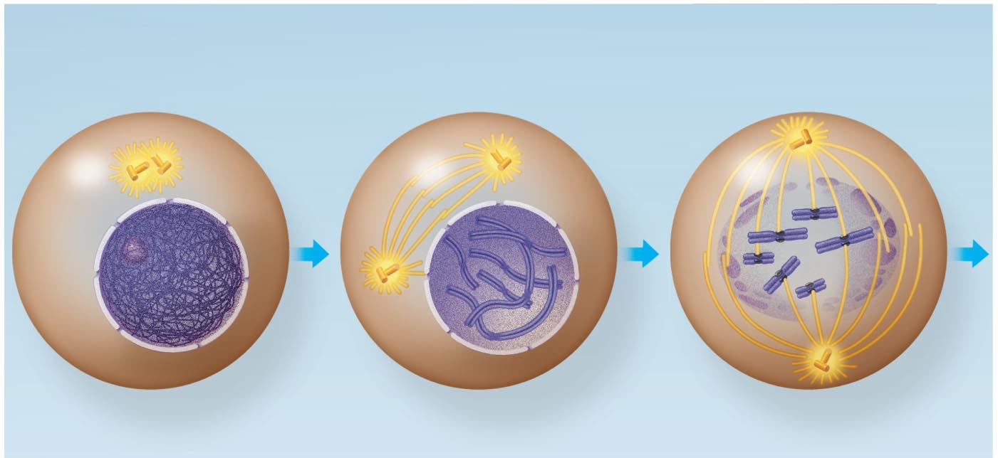
G₂ of Interphase
Prophase
Prometaphase
G₂ of Interphase
Prophase
Prometaphase
Centrosomes
(with centriole
pairs)
Chromatin
(duplicated)
Early mitotic
spindle
Aster
Centromere
Fragments
of nuclear
envelope
Nonkinetochore
microtubules
Nucleolus
Nuclear
envelope
Plasma
membrane
Chromosome, consisting
of two sister chromatids
Kinetochore
Kinetochore
microtubule

Slide 16
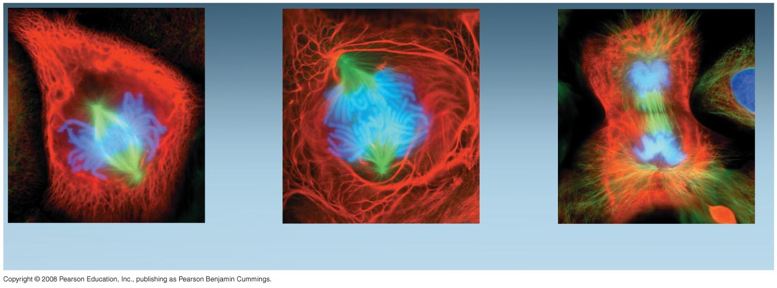
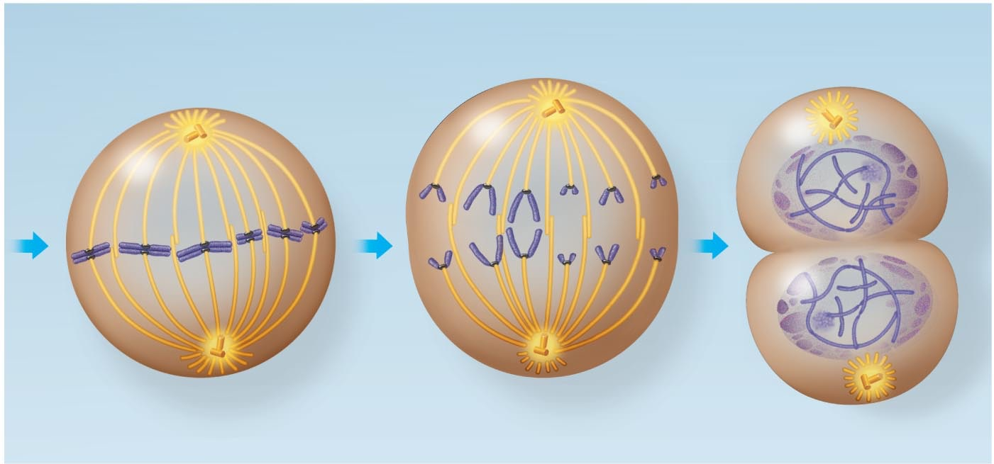
Metaphase
Anaphase
Telophase and Cytokinesis
Metaphase
plate
Cleavage
furrow
Nucleolus
forming
Metaphase
Anaphase
Telophase and Cytokinesis
Daughter
chromosomes
Nuclear
envelope
forming
Spindle
Centrosome at
one spindle pole

Slide 17
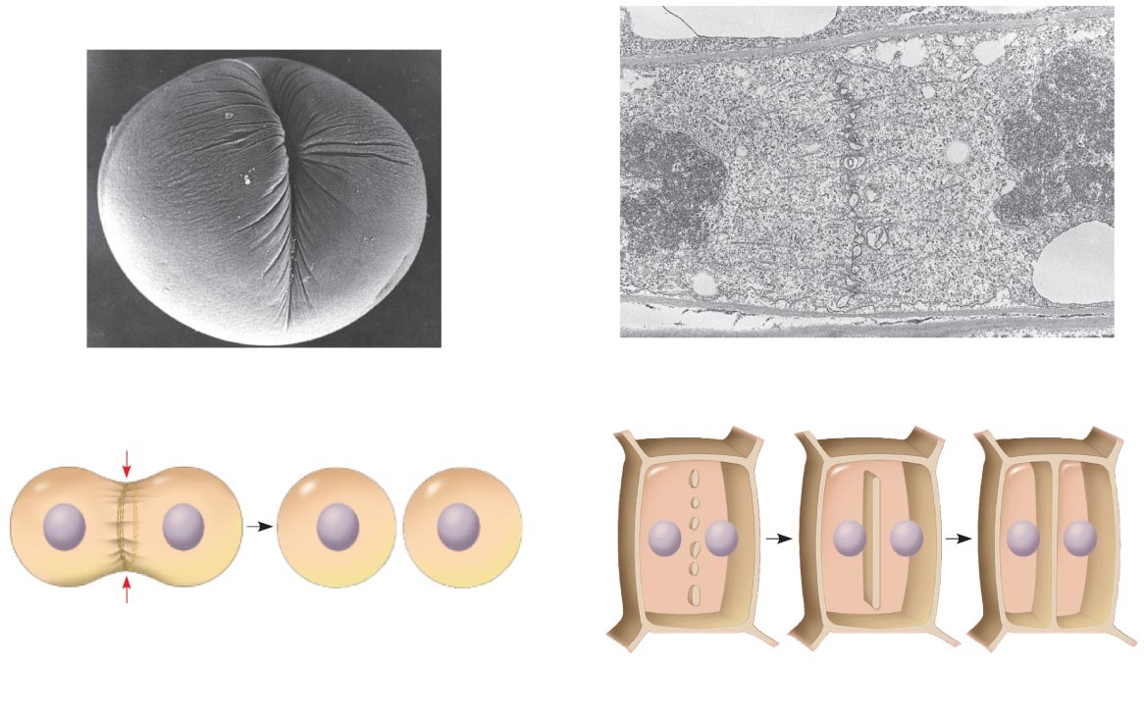
Cytokinesis: A Closer Look
In animal cells, cytokinesis occurs by a process known as cleavage, forming a cleavage furrow
In plant cells, a cell plate forms during cytokinesis
100 µm
Vesicles
forming
cell plate
Wall of
parent cell
1 µm
Cleavage furrow
Cell plate
New cell wall
Contractile ring of
microfilaments
Daughter cells
Daughter cells
(a) Cleavage of an animal cell (SEM)
(b) Cell plate formation in a plant cell (TEM)

Slide 18
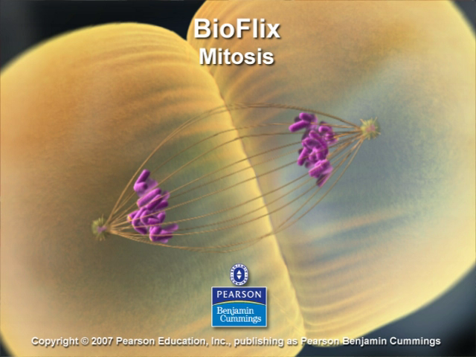

Slide 19
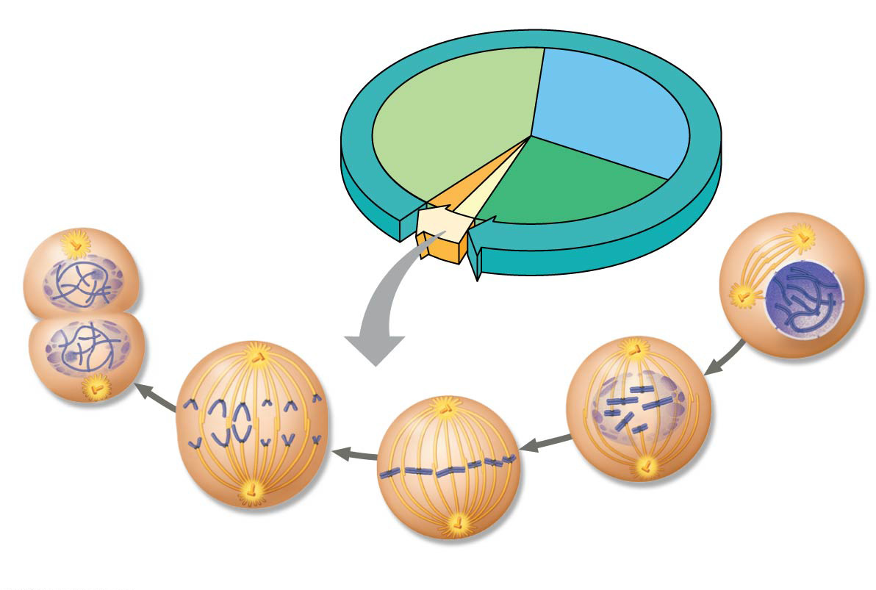

G₁
S
Cytokinesis
Mitosis
G₂
MITOTIC (M)
PHASE
Prophase
Telophase
and
Cytokinesis
Prometaphase
Anaphase
Metaphase

Slide 20
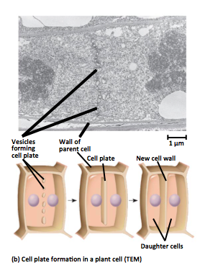
Mitosis in Plants

Slide 21
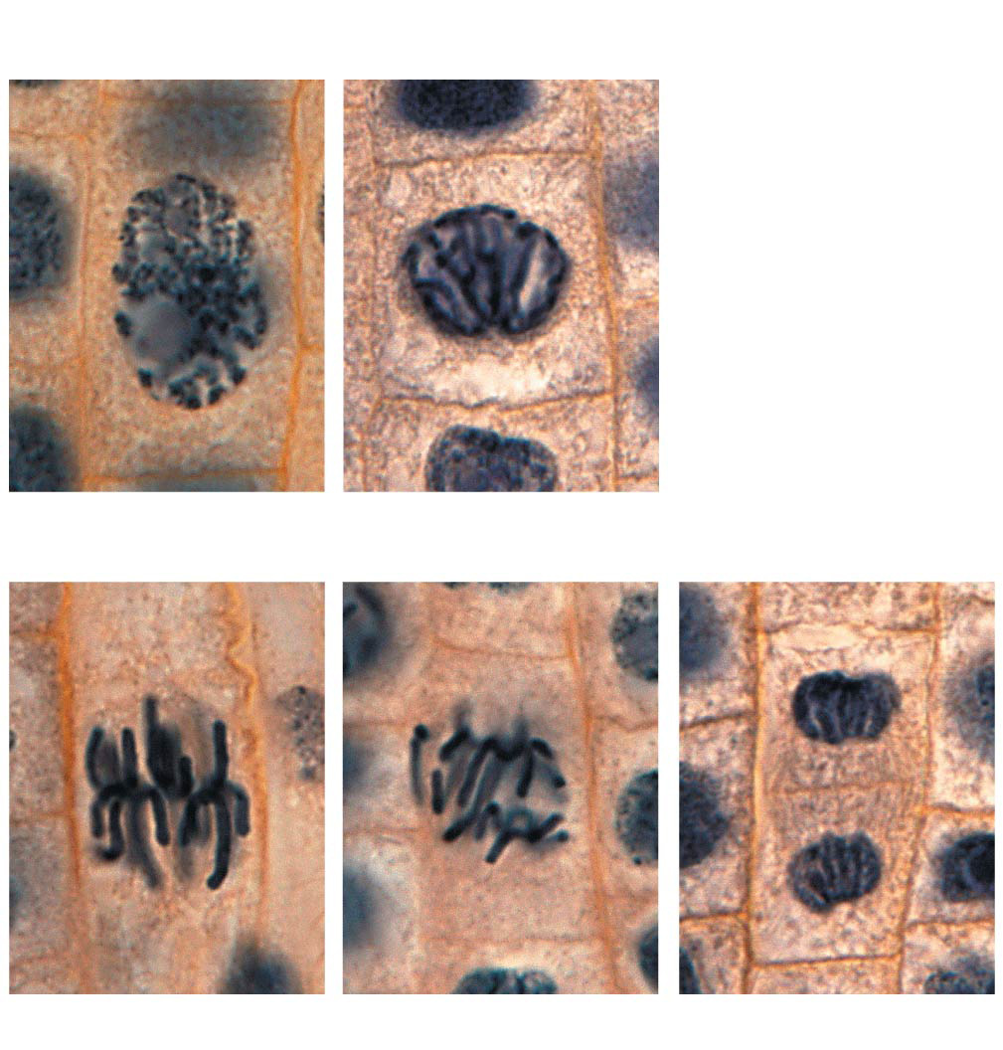
Nucleus
Chromosomes
condensing
Nucleolus
Chromosomes
10 µm
1
Prophase
2
Prometaphase
Cell plate
3
Metaphase
4
Anaphase
5
Telophase

Slide 22
