Slide 1
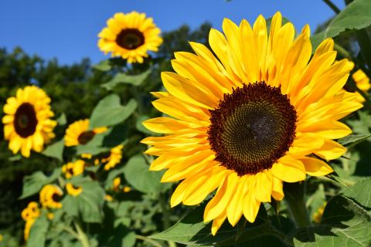
BIO10: Introduction to Principles of Biology
Dr. Paul Bradley
Photosynthesis

Slide 2
By the end of this section you will be able to:
Summarize the process of photosynthesis
Explain the relevance of photosynthesis to other living things
Identify the reactants and products of photosynthesis
Describe the main structures involved in photosynthesis

Slide 3
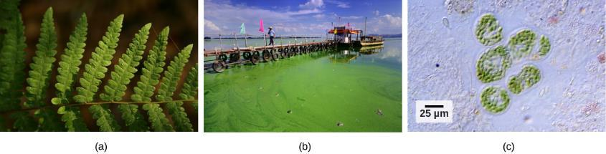
Autotrophs
An autotroph is an organism that can produce its own food:
  Plants
  Certain types of bacteria
  Algae
All organisms carrying out photosynthesis require sunlight.
(a) Plants, (b) algae, and (c) certain bacteria, called cyanobacteria, are photoautotrophs that can carry out photosynthesis

Slide 4
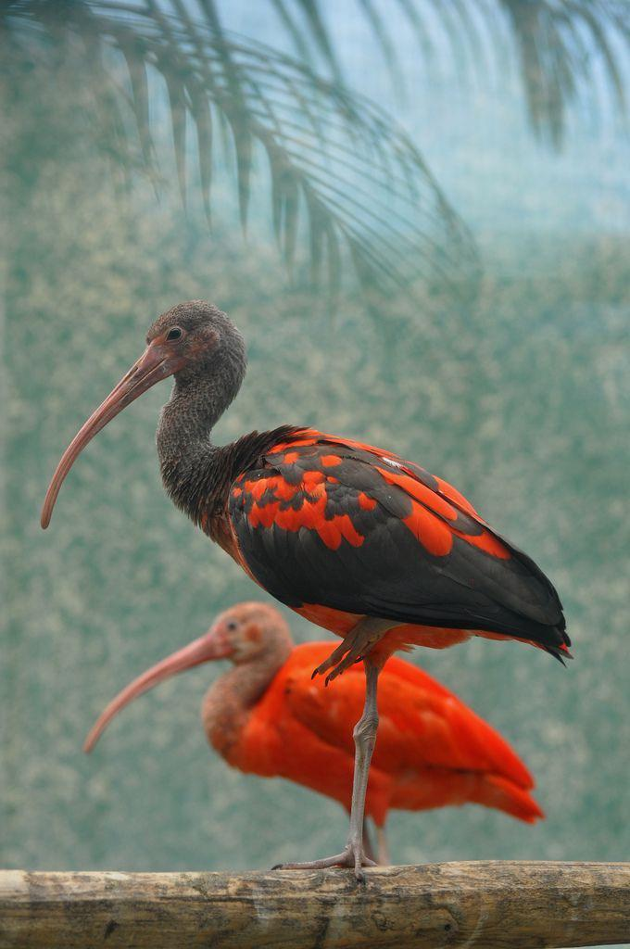
Heterotrophs
Heterotrophs are organisms incapable of photosynthesis that must therefore obtain energy and carbon from food by consuming other organisms.
Even if the food organism is another animal, this food traces its origins back to autotrophs and the process of photosynthesis.

Slide 5
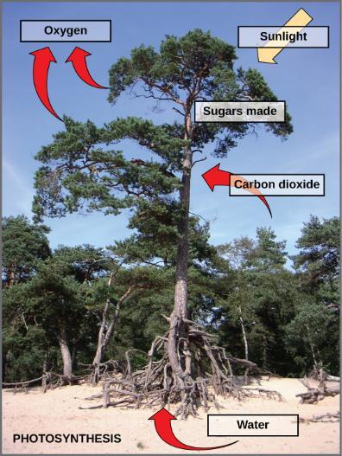
Photosynthesis
Requires:
  Sunlight
  carbon dioxide
  water
Releases
  Oxygen
Produces
  carbohydrates like glucose
Photosynthesis uses solar energy, carbon dioxide, and water to release oxygen and to produce energy-storing sugar molecules.

Slide 6
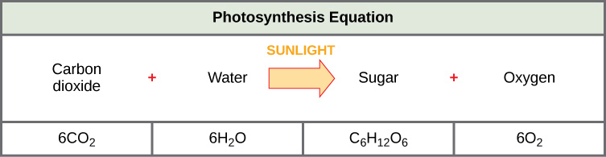
Photosynthesis
The process of photosynthesis can be represented by an equation, wherein carbon dioxide and water produce sugar and oxygen using energy from sunlight.

Slide 7
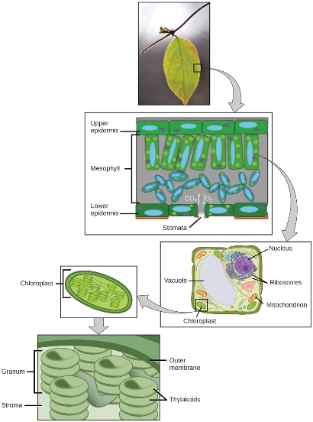
Photosynthesis
In plants, photosynthesis takes place primarily in leaves, which consist of many layers of cells and have differentiated top and bottom sides.
The process of photosynthesis occurs in a middle layer called the mesophyll.
The gas exchange of carbon dioxide and oxygen occurs through small, regulated openings called stomata.
  Usually found on the bottom of the leaf
In all autotrophic eukaryotes, photosynthesis takes place inside an organelle called a chloroplast.
  Chloroplasts have a double (inner and outer) membrane.
  Within the chloroplast is a third membrane that forms stacked, disc-shaped structures called thylakoids.
  Embedded in the thylakoid membrane are molecules of chlorophyll, a pigment (a molecule that absorbs light) through which the entire process of photosynthesis begins.
  The thylakoid membrane encloses an internal space called the thylakoid space.
  A stack of thylakoids is called a granum, and the space surrounding the granum is called stroma (not to be confused with stomata, the openings on the leaves).
Not all cells of a leaf carry out photosynthesis. Cells within the middle layer of a leaf have chloroplasts, which contain the photosynthetic apparatus.

Slide 8
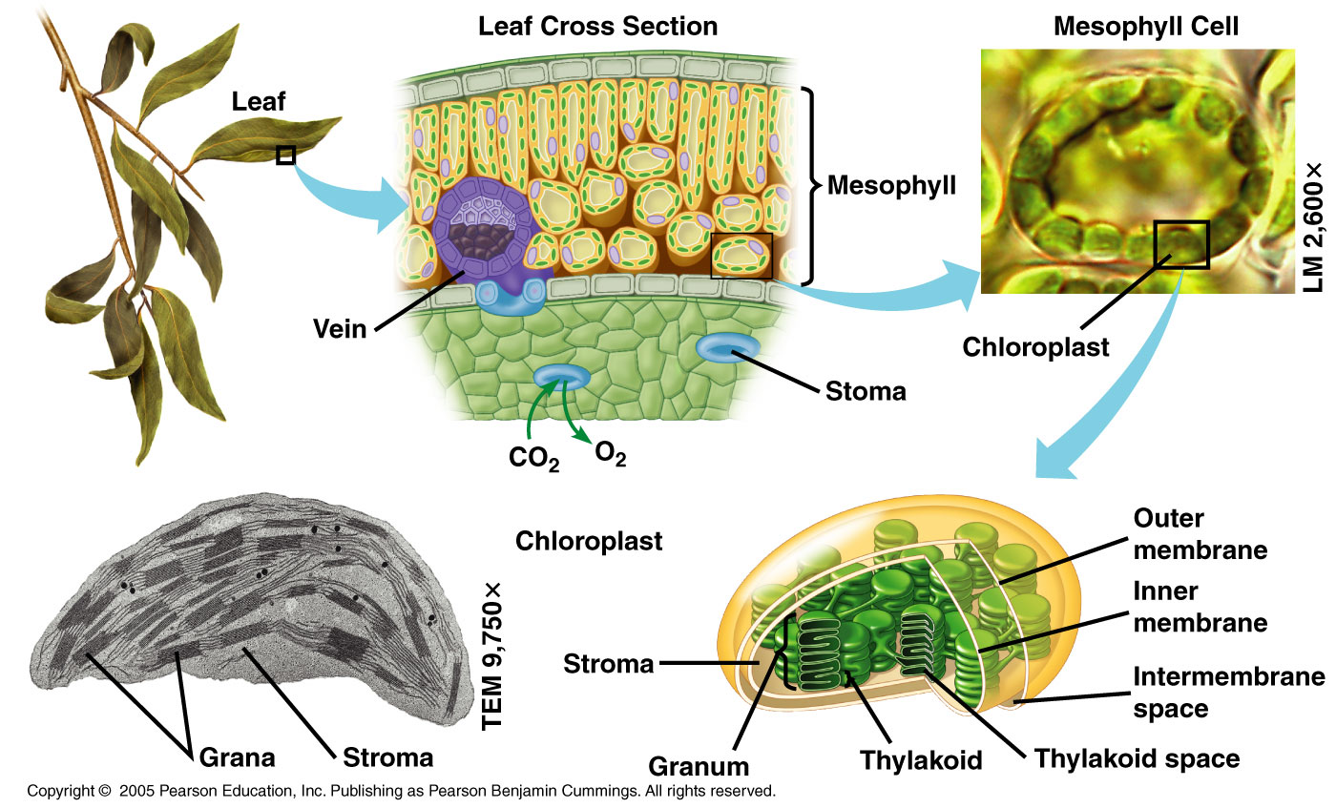
Photosynthesis

Slide 9
Photosynthesis
Photosynthesis takes place in two stages
  The light reactions and the Calvin cycle.
Light reactions (or light-dependent reactions) take place at the thylakoid membrane, chlorophyll absorbs energy from sunlight and then converts it into chemical energy with the use of water
Calvin cycle takes place in the stroma, the chemical energy derived from the light-dependent reactions drives both the capture of carbon in carbon dioxide molecules and the subsequent assembly of sugar molecules
The two reactions use carrier molecules to transport the energy from one to the other.
  The carriers that move energy from the light-dependent reactions to the Calvin cycle reactions can be thought of as “full” because they bring energy.
  After the energy is released, the “empty” energy carriers return to the light-dependent reactions to obtain more energy.

Slide 10
By the end of this section you will be able to:
Explain how plants absorb energy from sunlight
Describe how the wavelength of light affects its energy and color
Describe how and where photosynthesis takes place within a plant

Slide 11
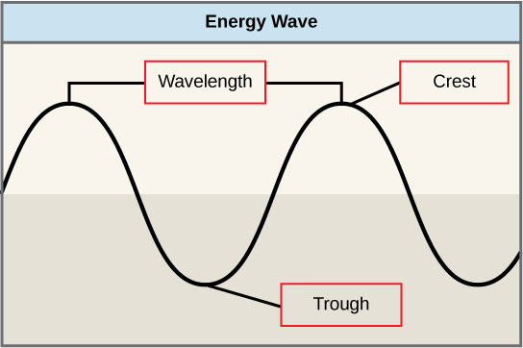
Light Waves
The manner in which solar energy travels can be described and measured as waves.
The amount of energy of a wave can be determined by measuring its wavelength
  the distance between two consecutive, similar points in a series of waves, such as from crest to crest or trough to trough

Slide 12
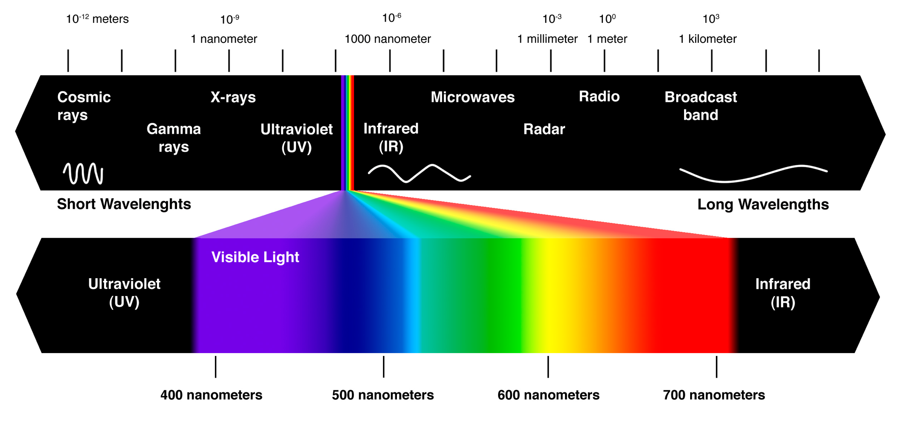
Electromagnetic Radiation (Light)
Long-term climate change results from changes in the intensity and distribution of solar radiation and changes in overall energy balance.
Current climate change is due to increased CO₂ and other gases in the atmosphere due to human activities.
This side of the figure
Shortwave Radiation = Light
Shortwave Radiation = More Energy
This side of the figure
Heat = Longwave Radiation
Less Energy = Longwave Radiation

Slide 13
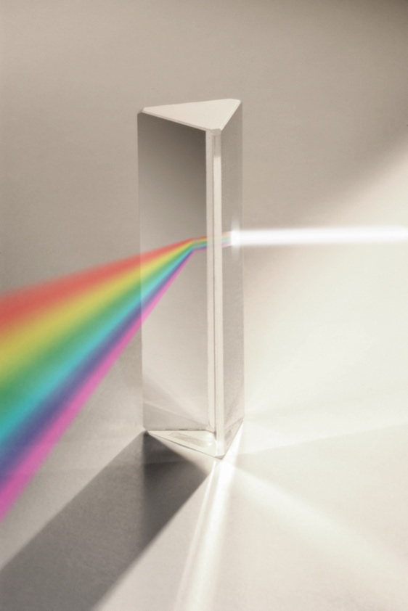
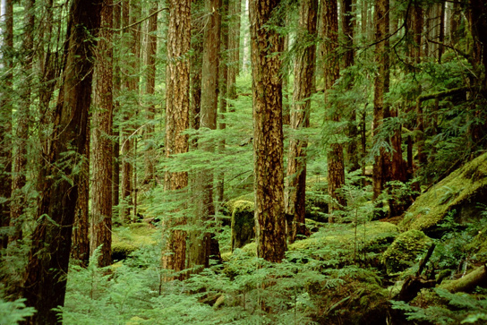
Pigments
The visible light seen by humans as white light actually exists in a rainbow of colors.
In plants, pigment molecules absorb only visible light for photosynthesis.

Slide 14
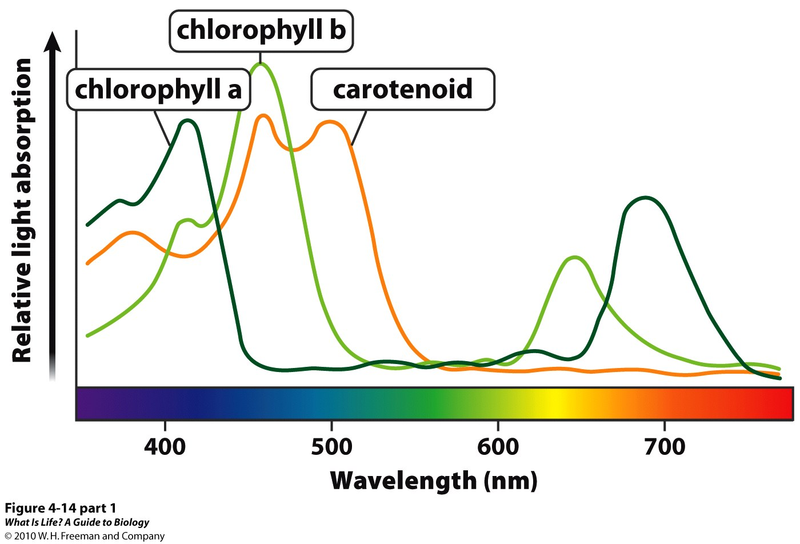
Pigments
Different kinds of pigments exist, and each absorbs only certain wavelengths (colors) of visible light. Pigments reflect the color of the wavelengths that they cannot absorb.
All photosynthetic organisms contain a pigment called chlorophyll a, which humans see as the common green color associated with plants.
  Chlorophyll a absorbs wavelengths from either end of the visible spectrum (blue and red), but not from green.
  Because green is reflected, chlorophyll appears green.
Other pigment types include chlorophyll b (which absorbs blue and red-orange light) and the carotenoids.
  Each type of pigment can be identified by the specific pattern of wavelengths it absorbs from visible light, which is its absorption spectrum.

Slide 15
Pigments
Different kinds of pigments exist, and each absorbs only certain wavelengths (colors) of visible light. Pigments reflect the color of the wavelengths that they cannot absorb.
All photosynthetic organisms contain a pigment called chlorophyll a, which humans see as the common green color associated with plants.
  Chlorophyll a absorbs wavelengths from either end of the visible spectrum (blue and red), but not from green.
  Because green is reflected, chlorophyll appears green.
Other pigment types include chlorophyll b (which absorbs blue and red-orange light) and the carotenoids.
  Each type of pigment can be identified by the specific pattern of wavelengths it absorbs from visible light, which is its absorption spectrum.

Slide 16
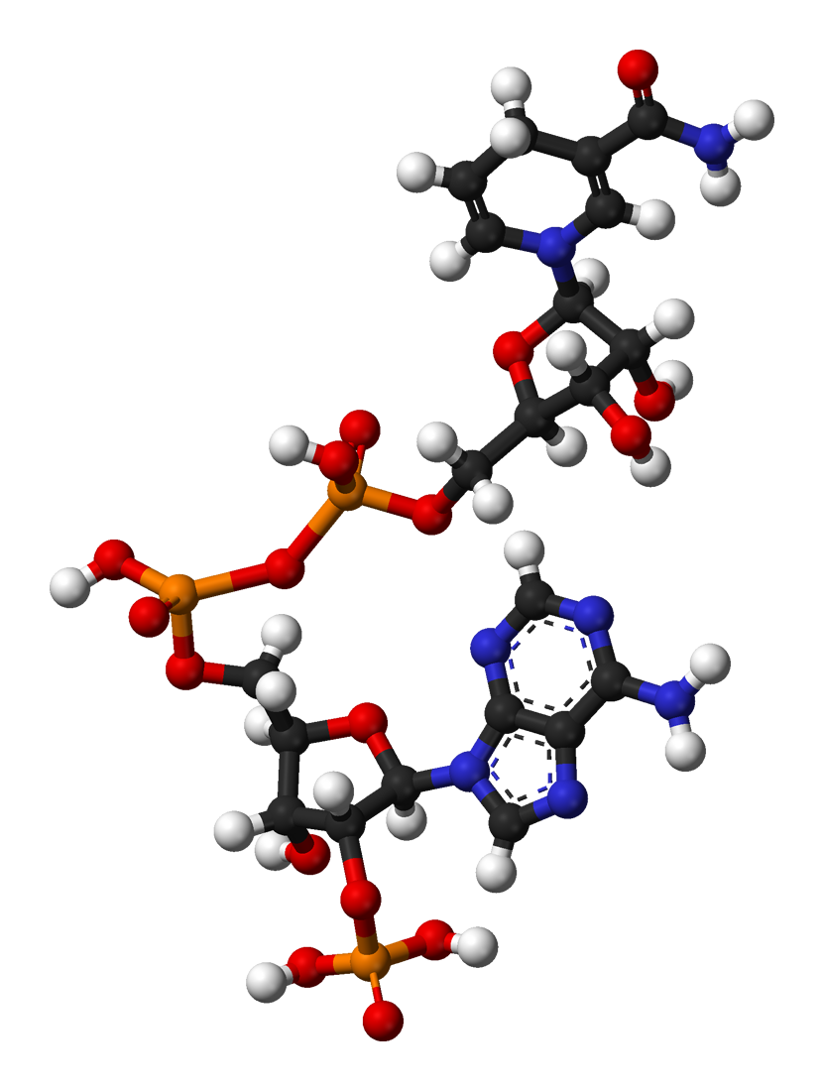
NADP+ / NADPH
Similar (but different!) player to NAD+ / NADH utilized in cellular respiration
A cofactorused in anabolic reactions, such as the Calvin cycle, which require NADPH as a reducing agent or “hydrogen source”
NADP+ differs from NAD+ by the presence of an additional phosphate group

Slide 17
Two Stages of Photosynthesis
Light Reactions (or light-dependent reactions)
  Convert light energy into chemical energy used by the Calvin cycle
Calvin Cycle
  Make sugar molecules

Slide 18
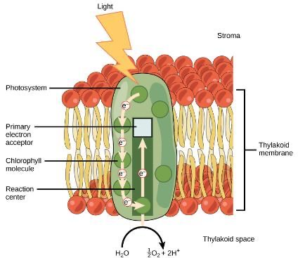
Light Reaction
The light-dependent reactions begin in a grouping of pigment molecules and proteins called a photosystem
  exist in the membranes of thylakoids
A pigment molecule absorbs one photon which travels until it reaches a molecule of chlorophyll
  Causes an electron in the chlorophyll to become “excited”
The energy given to the electron allows it to break free from the chlorophyll molecule
  Chlorophyll is therefore said to “donate” an electron
For every two donated electrons in the chlorophyll, a molecule of water is split
This split of water releases two electrons AND results in the formation of oxygen (O₂) and hydrogen ions (H+) in the thylakoid space
  The replacing of the electrons enables chlorophyll to respond to another photon

Slide 19
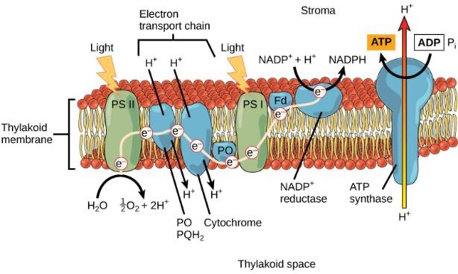
Light Reaction
In eukaryotes and some prokaryotes, two photosystems exist.
  The first is called photosystem II (discovered and named second but used first)
Photosystem II transfers the free electron from earlier in the reaction to the first in a series of proteins inside the thylakoid membrane called the electron transport chain
As the electron passes along these proteins, energy from the electron fuels membrane pumps that actively move hydrogen ions (H+) against their concentration gradient from the stroma into the thylakoid space
The electron is then accepted by a pigment molecule in the next photosystem, which is called photosystem I (discovered first but used second)

Slide 20
Making Chemical Energy (ATP & NADPH)
The buildup of hydrogen ions in the thylakoid space forms an electrochemical gradient because of the difference in the concentration of protons (H+) and the difference in the charge across the membrane that they create.
This potential energy is harvested and stored as chemical energy in ATP through chemiosmosis
  via the transmembrane enzyme ATP synthase, just as in the mitochondrion
The energy generated by the hydrogen ion stream allows ATP synthase to attach a third phosphate to ADP, which forms a molecule of ATP via photophosphorylation.

Slide 21
Making NADPH
The remaining function of the light-dependent reaction is to generate the other energy-carrier molecule, NADPH
As the electron from the electron transport chain arrives at photosystem I, it is reenergized with another photon captured by chlorophyll
The energy from this electron drives the formation of NADPH from NADP+ and a hydrogen ion (H+)
Now that the solar energy is stored in energy carriers (ATP & NADPH), it can be used to make a sugar molecule...

Slide 22
By the end of this section you will be able to:
Describe the Calvin cycle
Define carbon fixation
Explain how photosynthesis works in the energy cycle of all living organisms

Slide 23
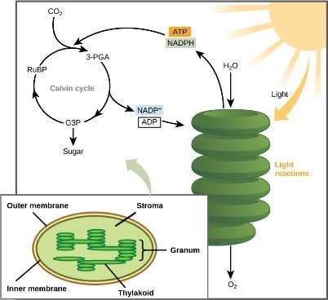
Calvin Cycle
After the energy from the sun is converted and packaged into ATP and NADPH, the cell has the fuel needed to build food in the form of carbohydrate molecules like glucose.
In plants, carbon dioxide (CO₂) enters the chloroplast through the stomata and diffuses into the stroma of the chloroplast—the site of the Calvin cycle reactions where sugar is synthesized.
Light-dependent reactions harness energy from the sun to produce ATP and NADPH. These energy-carrying molecules travel into the stroma where the Calvin cycle reactions take place.

Slide 24
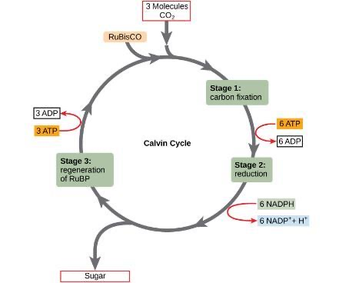
Calvin Cycle
The Calvin cycle reactions can be organized into three basic stages:
  Fixation
  Reduction
  Regeneration
Two other chemicals are present to initiate the Calvin cycle:
  an enzyme abbreviated RuBisCO
  ribulose bisphosphate (RuBP)
The Calvin cycle has three stages. In stage 1, the enzyme RuBisCO incorporates carbon dioxide into an organic molecule. In stage 2, the organic molecule is reduced. In stage 3, RuBP, the molecule that starts the cycle, is regenerated so that the cycle can continue.

Slide 25
Calvin Cycle - Fixation
RuBisCO catalyzes a reaction between CO₂ and RuBP
  forms a six-carbon compound that is immediately converted into two three-carbon compounds
  This process is called carbon fixation, because CO₂ is “fixed” from its inorganic form into organic molecules
The Calvin cycle has three stages. In stage 1, the enzyme RuBisCO incorporates carbon dioxide into an organic molecule. In stage 2, the organic molecule is reduced. In stage 3, RuBP, the molecule that starts the cycle, is regenerated so that the cycle can continue.

Slide 26
Calvin Cycle - Reduction
ATP and NADPH use their stored energy to convert the three-carbon compound, 3-PGA, into another three-carbon compound called G3P.
  The molecules of ADP and NAD+, resulting from the reaction, return to the light-dependent reactions to be re-energized
The Calvin cycle has three stages. In stage 1, the enzyme RuBisCO incorporates carbon dioxide into an organic molecule. In stage 2, the organic molecule is reduced. In stage 3, RuBP, the molecule that starts the cycle, is regenerated so that the cycle can continue.

Slide 27
Calvin Cycle - Regeneration
One of the G3P molecules leaves the Calvin cycle to contribute to the formation of glucose (C₆H₁₂O₆)
The remaining G3P molecules regenerate RuBP, which enables the system to prepare for the carbon-fixation step
  ATP is also used in the regeneration of RuBP
In summary, it takes six turns of the Calvin cycle to fix six carbon atoms from CO₂ to make glucose.
  These six turns require energy input from 12 ATP molecules and 12 NADPH molecules in the reduction step and 6 ATP molecules in the regeneration step
The Calvin cycle has three stages. In stage 1, the enzyme RuBisCO incorporates carbon dioxide into an organic molecule. In stage 2, the organic molecule is reduced. In stage 3, RuBP, the molecule that starts the cycle, is regenerated so that the cycle can continue.

Slide 28
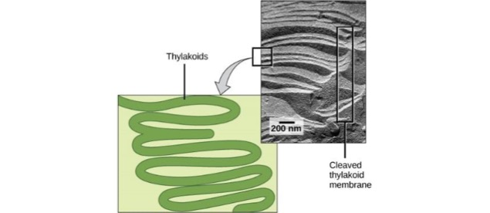
Photosynthesis in Prokaryotes
Prokaryotes lack membrane-bound organelles.
Can have infoldings of the plasma membrane for chlorophyll attachment and photosynthesis.
A photosynthetic prokaryote has infolded regions of the plasma membrane that function like thylakoids. Although these are not contained in an organelle, such as a chloroplast, all of the necessary components are present to carry out photosynthesis.

Slide 29
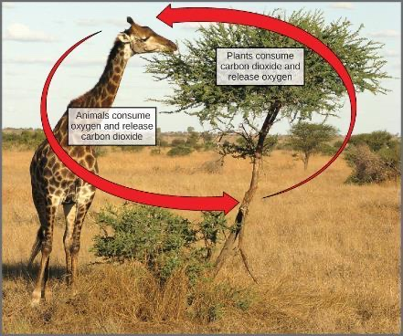
The Energy Cycle
The overall reaction for photosynthesis:
6 CO₂ + 6 H₂O → C₆H₁₂O₆ + 6 O₂
The overall reaction for cellular respiration:
6 O₂ + C₆H₁₂O₆ → 6 CO₂ + 6 H₂O
These two processes are reciprocals of each other
  Photosynthesis produces oxygen as a byproduct
  Respiration produces carbon dioxide as a byproduct.

