Slide 1
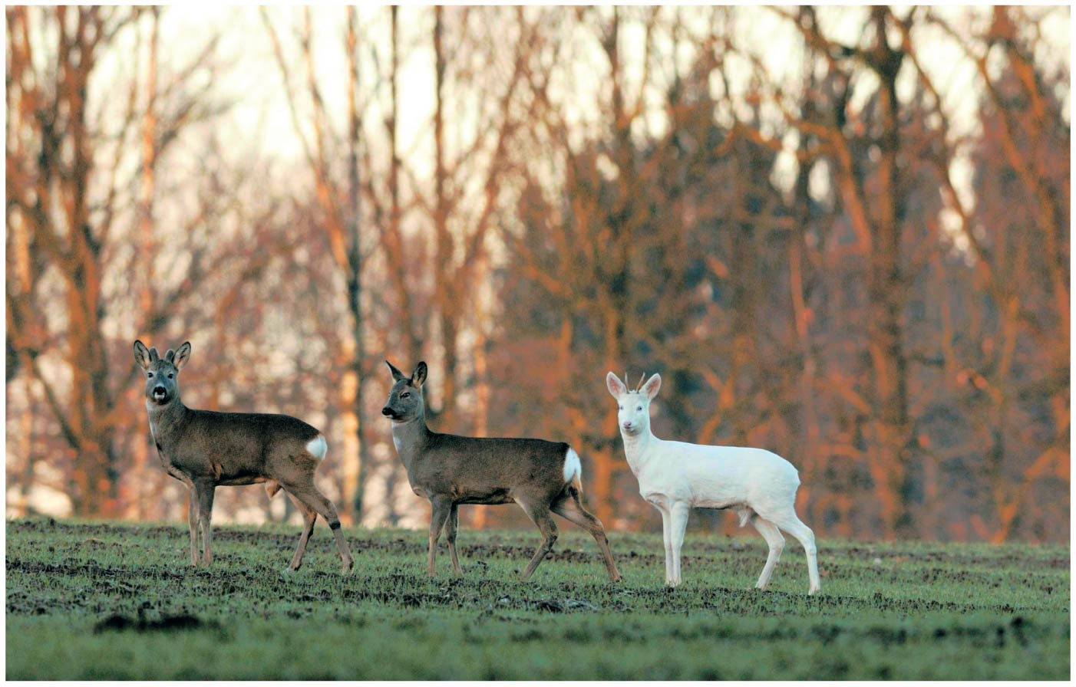
BIO10
Dr. Paul Bradley
Photosynthesis

Slide 2
By the end of this section you will be able to:
Describe the structure of DNA
Describe how eukaryotic and prokaryotic DNA is arranged in the cell

Slide 3
Nucleic Acids
Nucleic Acids make up genes
There are two types of nucleic acids
  Deoxyribonucleic acid (DNA)
  Ribonucleic acid (RNA)

Slide 4
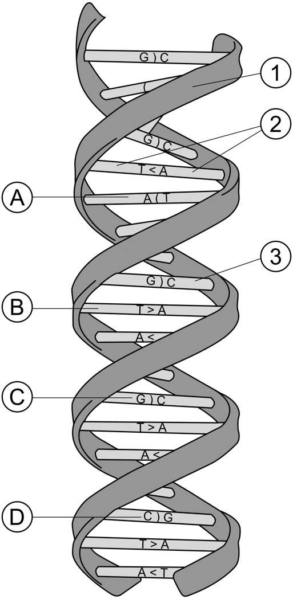
Nucleic Acids
Nucleic acids are made up of polynucleotides
  Each polynucleotide is made of nucleotides
  Each nucleotide is made up of
    a pentose sugar (deoxyribose in DNA)
    one or more phosphate groups
    a nitrogenous base
      Adenine (in DNA and RNA)
      Cytosine (in DNA and RNA)
      Guanine (in DNA and RNA)
      Thymine (in DNA)
      Uracil (in RNA)

Slide 5
Nucleotides
a nitrogenous base
a pentose sugar
one or more phosphate groups (not shown here)

Slide 6
Interior Side
Exterior Side

Slide 7
Base Pairing
  Purines only pair with pyrimidines

Slide 8
Base Pairing
Watson & Crick determined that
  adenine (A) paired only with thymine (T)
  guanine (G) paired only with cytosine (C)
Thus in any organism the amount of A = T, and the amount of G = C

Slide 9
Base Pairing
Watson & Crick determined that
  adenine (A) paired only with thymine (T)
  guanine (G) paired only with cytosine (C)
Thus in any organism the amount of A = T, and the amount of G = C

Slide 10
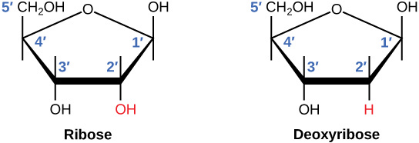
RNA vs DNA
The difference between the ribose found in RNA and the deoxyribose found in DNA is that ribose has a hydroxyl group at the 2' carbon.

Slide 11
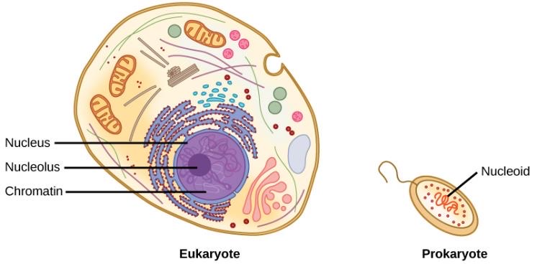
Eukaryotic vs Prokaryotic
A eukaryote contains a well-defined nucleus, whereas in prokaryotes, the chromosome lies in the cytoplasm in an area called the nucleoid.

Slide 12
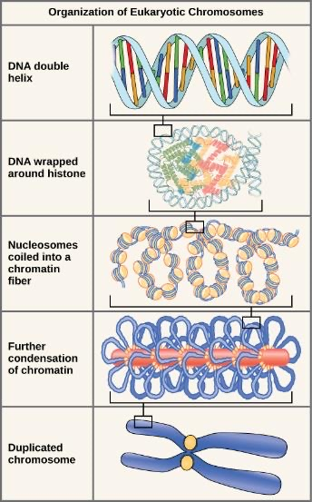
How DNA is Packaged

Slide 13
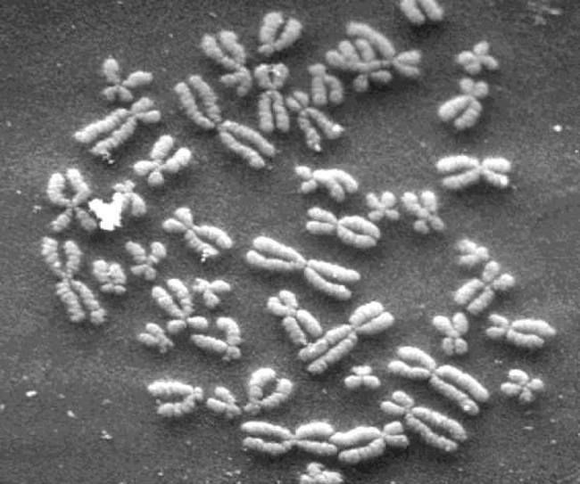
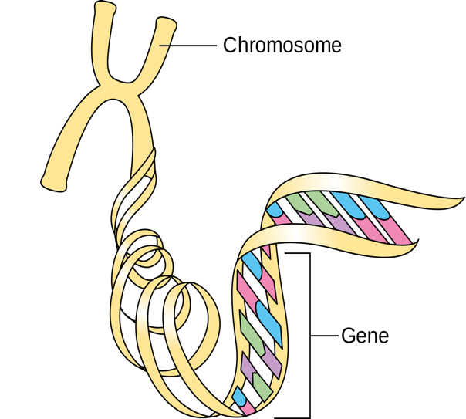

Slide 14
By the end of this section you will be able to:
Explain the process of DNA replication
Explain the importance of telomerase to DNA replication
Describe mechanisms of DNA repair

Slide 15
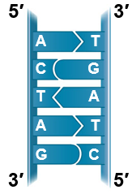
Many proteins work together in DNA replication
The relationship between structure and function is manifest in the double helix
Watson and Crick noted that the specific base pairing suggested a possible copying mechanism
Parental
molecule

Slide 16
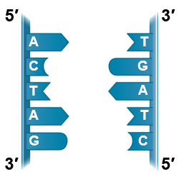
Base Pairing to a Template Strand
Since the two strands of DNA are complementary, each strand acts as a template for building a new strand in replication
In DNA replication, the parent molecule unwinds, and two new daughter strands are built based on base-pairing rules
Parental
molecule
Separation of
parental strands
into templates

Slide 17
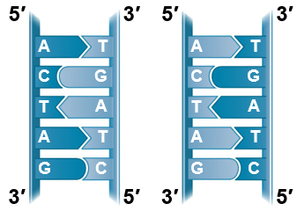
Base Pairing to a Template Strand
Watson and Crick’s semiconservative model of replication predicts that each daughter molecule will have one old strand (“conserved” from the parent molecule) and one newly made strand
Parental
molecule
Separation of
parental strands
into templates
Formation of new
strands complementary
to template strands

Slide 18
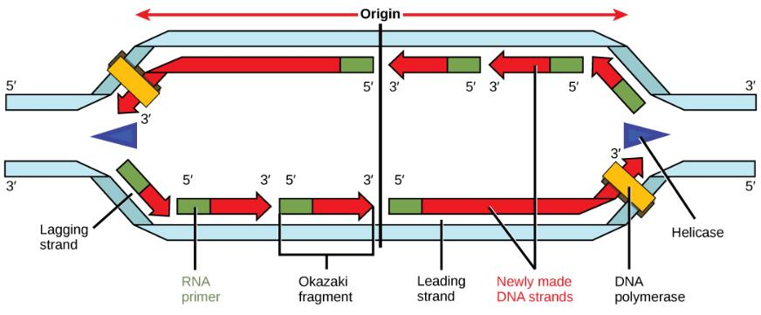
Synthesizing a New DNA Strand
Enzymes called DNA polymerases catalyze the synthesis of new DNA at a replication fork

Slide 19
Evolutionary Significance of Altered DNA Nucleotides
The error rate after proofreading and other forms of DNA repair is low but not zero
Sequence changes may become permanent and can be passed on to the next generation
These changes (mutations) are the source of the genetic variation upon which natural selection operates and are ultimately responsible for the appearance of new species

Slide 20
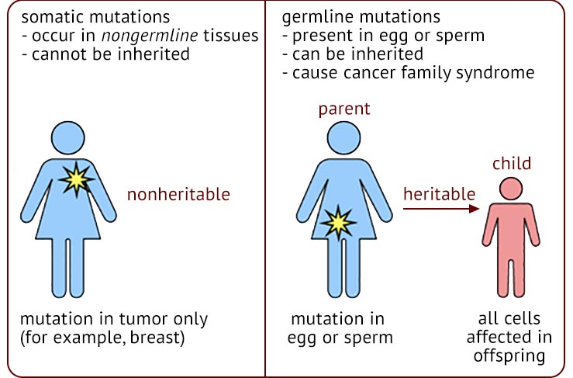
Mutations

Slide 21
BIO10
Protein Synthesis
Chapter 9

Slide 22
By the end of this section you will be able to:
Explain the central dogma
Explain the main steps of transcription
Describe how eukaryotic mRNA is processed

Slide 23
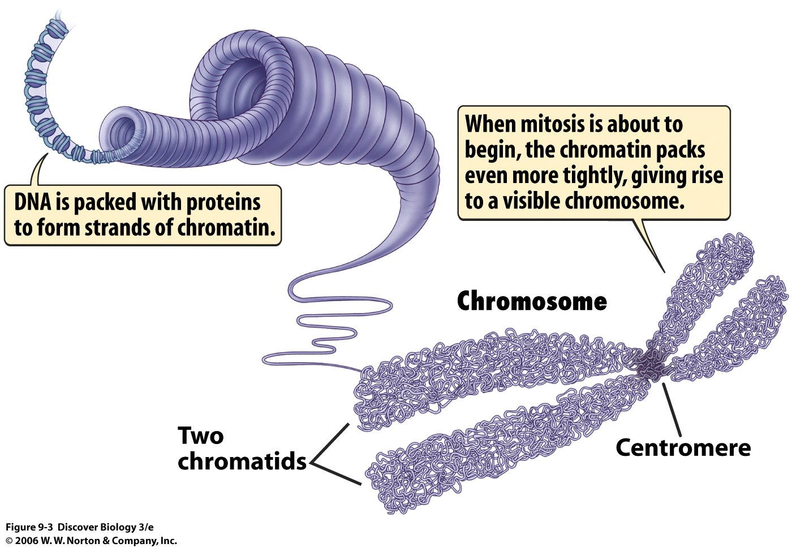
What is a Genome?
All the DNA in a cell constitutes the cell’s genome
A genome can consist of a single DNA molecule (common in prokaryotic cells) or a number of DNA molecules (common in eukaryotic cells)
DNA molecules in a cell are packaged into chromosomes
There are about 2 meters of DNA in each of your cells!
Hundreds to thousands of genes on each chromosome!

Slide 24
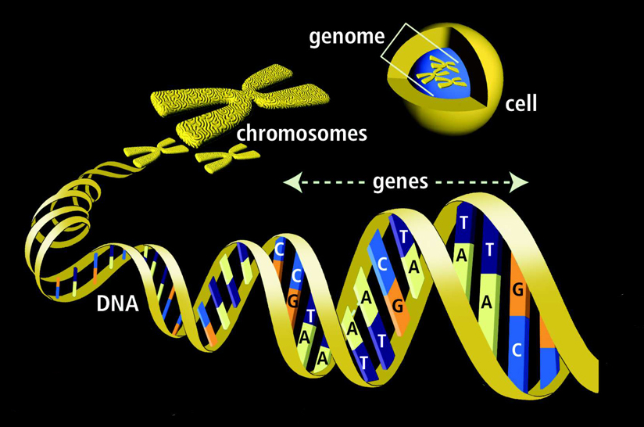
A gene is a nucleotide sequence that codes for the primary structure of a specific protein
A single chromosome usually carries thousands of different genes, each coding for a specific proteins

Slide 25
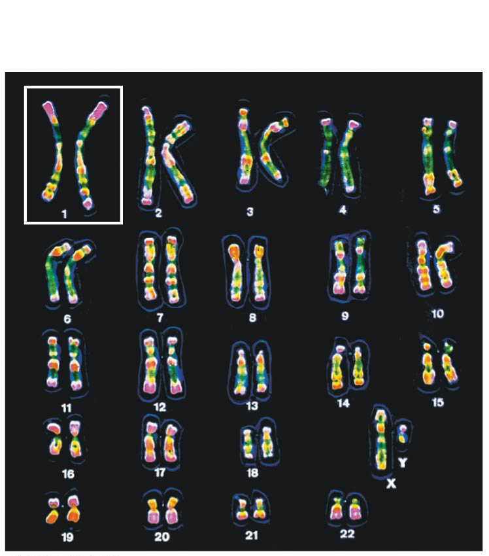
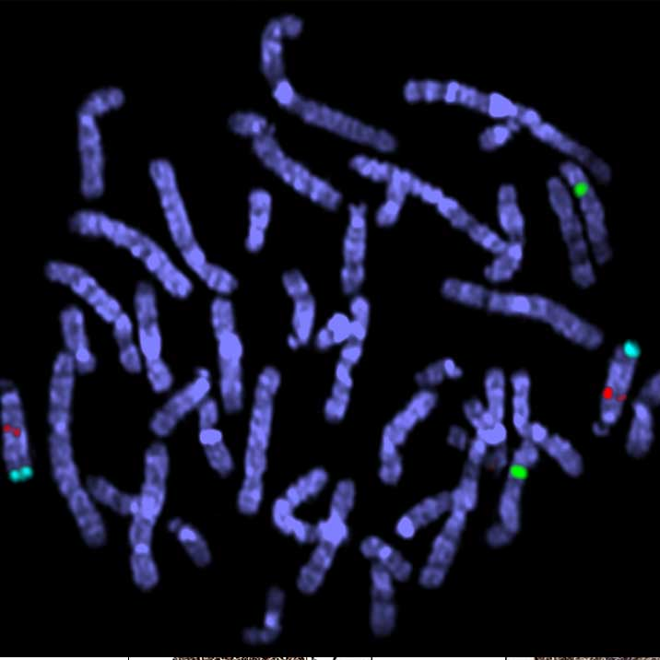
Karyotype
The two chromosomes in each pair are called homologous chromosomes, or homologs
Chromosomes in a homologous pair are the same length and shape and carry genes controlling the same inherited characters
  But not necessarily the same traits (alleles)
Genes are the units of heredity and are made up of segments of DNA
A gene’s specific position along a chromosome is called the locus

Slide 26
Karyotype
The two chromosomes in each pair are called homologous chromosomes, or homologs
Chromosomes in a homologous pair are the same length and shape and carry genes controlling the same inherited characters
  But not necessarily the same traits (alleles)
Genes are the units of heredity and are made up of segments of DNA
A gene’s specific position along a chromosome is called the locus

Slide 27
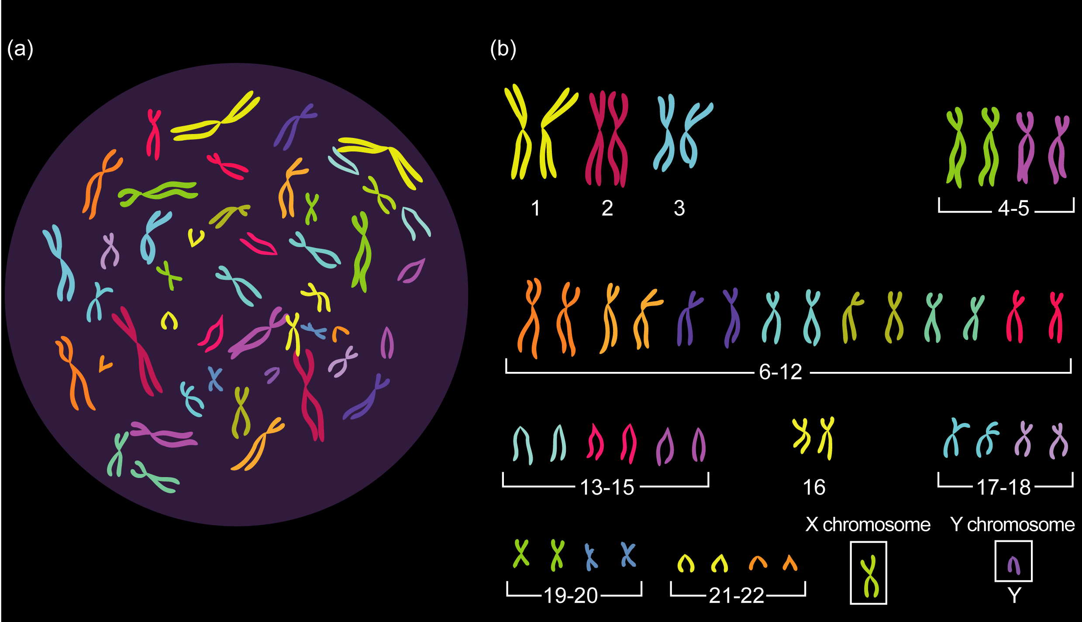
Karyotype

Slide 28
How do these differ?

Slide 29
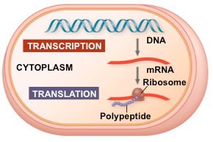
The Flow of Genetic Information in the Cell
The information content of DNA is in the form of specific nucleotide sequences
The DNA inherited by an organism leads to specific traits by dictating the synthesis of proteins
Proteins are the links between genotype and phenotype
Gene expression, is the process by which DNA directs protein synthesis through transcription and translation
Notes:
29

Slide 30
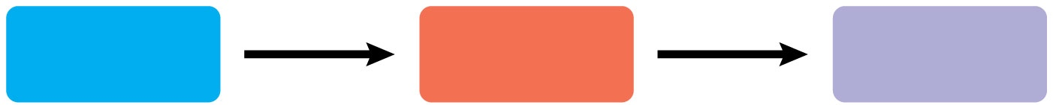
Basic Principles of Transcription and Translation
Transcription is the synthesis of RNA by the enzyme RNA polymerase using information coded within DNA
Transcription of a gene produces a messenger RNA (mRNA)
Translation is the synthesis of a polypeptide, using information coded within the mRNA
Ribosomes are huge protein/RNA enzyme complexes that carry out translation
DNA
RNA
Protein
Central dogma is the concept that cells are governed by information flow: DNA → RNA → protein
Notes:
30

Slide 31
Bridge Between Genes and Proteins
Messenger RNA (mRNA) is the bridge between genes and the proteins for which they code
In eukaryotes, the nuclear envelop separates the processes of transcription and translation
  mRNA undergoes processes before leaving the nucleus

Slide 32
Bridge Between Genes and Proteins
Messenger RNA (mRNA) is the bridge between genes and the proteins for which they code
In eukaryotes, the nuclear envelop separates the processes of transcription and translation
  mRNA undergoes processing before leaving the nucleus

Slide 33
It’s important to realize that gene regulatory protein binding to DNA is sequence specific
Therefore, these proteins bind to discrete sites along the DNA
For instance, RNA polymerase binds to a specific DNA sequence that represents a promoter
This positions the RNA polymerase at the start of a gene and points the enzyme in the right direction

Slide 34
Proteins “recognize” and bind to discrete sites mostly through H-bonds or ionic bonds formed between polar or charged amino acid side chains of the protein and nucleotide bases of the DNA

Slide 35
Three Stages of Transcription
RNA polymerase attaches to and pries apart DNA strands at the promoter and joins together the RNA nucleotides to perform mRNA synthesis
Reads the DNA template strand from the 3′ → 5′ direction
The RNA is complementary to the DNA template strand
  except that uracil substitutes for thymine
The transcription unit is the stretch of DNA that is transcribed

Slide 36
RNA Polymerase
As RNA polymerase moves along the DNA, it untwists the double helix, 10 to 20 bases at a time
Nucleotides are added to the 3′ end of the
growing mRNA molecule

Slide 37
mRNA Processing in Eukaryotes
Enzymes in the eukaryotic nucleus modify pre-mRNA before it reaches the cytoplasm
Both ends of the primary transcript are usually altered
Interior sections of the molecule are cut out, and the remaining parts spliced together

Slide 38
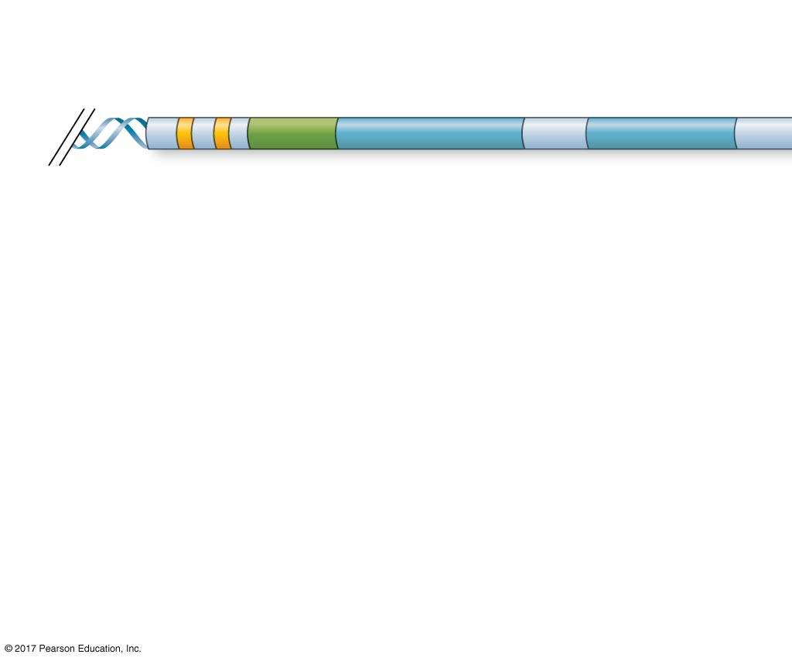
Typical Eukaryotic Gene and Its Transcript
Transcription
start site
Poly-A signal
sequence
Exon
Intron
Exon
Intron
Exon
DNA
Promoter

Slide 39
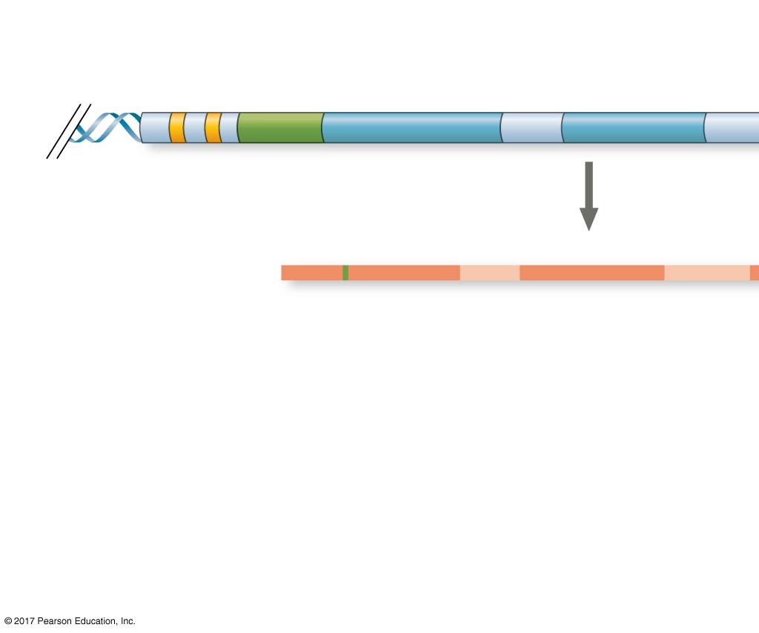
Typical Eukaryotic Gene and Its Transcript
Transcription
start site
Poly-A signal
sequence
Exon
Intron
Exon
Intron
Exon
DNA
Promoter
Transcription
Poly-A
signal
Primary RNA
transcript
(pre-mRNA)
Cleaved 3′
end of
primary
transcript
Exon
Intron
Exon
Intron
Exon
5′

Slide 40
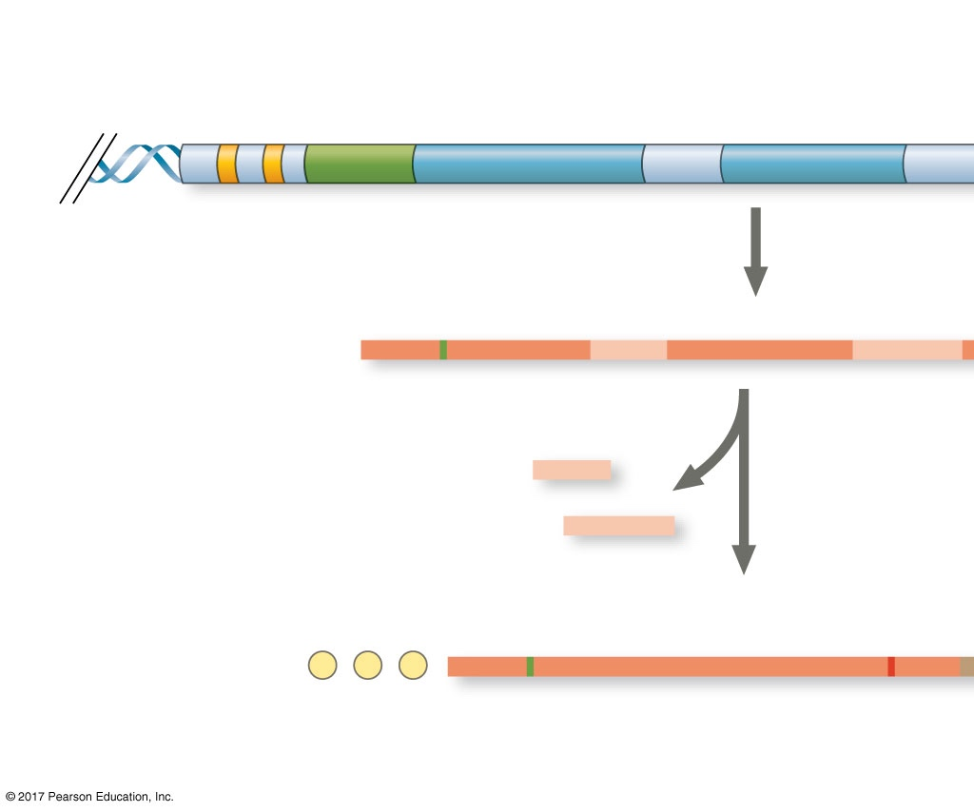
Typical Eukaryotic Gene and Its Transcript
Transcription
start site
Poly-A signal
sequence
Exon
Intron
Exon
Intron
Exon
DNA
Promoter
Transcription
Poly-A
signal
Primary RNA
transcript
(pre-mRNA)
Cleaved 3′
end of
primary
transcript
Exon
Intron
Exon
Intron
Exon
5′
RNA processing
Intron RNA
Coding segment
mRNA
G
P
P
P
AAA···AAA
3′
5′ Cap
5′ UTR
Start
codon
Stop
codon
3′ UTR
Poly-A
tail

Slide 41
mRNA Processing

Slide 42
Post-transcriptional Regulation
  In alternative RNA splicing, different mRNA molecules are produced from the same primary transcript, depending on which RNA segments are treated as exons and which as introns

Slide 43
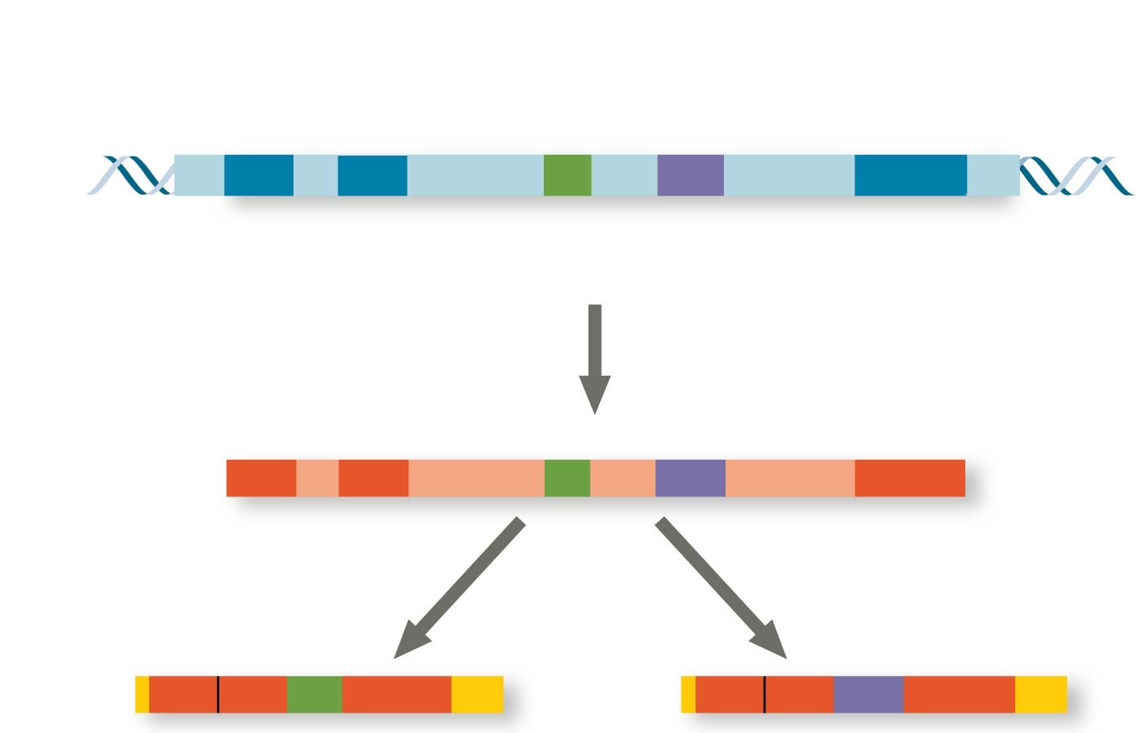
Alternative mRNA Splicing
Exons
DNA
1 2 3 4 5
Troponin T gene
Primary
RNA
transcript
1 2 3 4 5
RNA splicing
mRNA
1 2 3 5
OR
1 2 4 5

Slide 44
By the end of this section you will be able to:
Describe the different steps in protein synthesis
Discuss the role of ribosomes in protein synthesis
Describe the genetic code and how the nucleotide sequence determines the amino acid and the protein sequence

Slide 45
Common Amino Acids

Slide 46
Transcription & Translation
Transcription is the synthesis of RNA using information in DNA
  produces messenger RNA (mRNA)
Translation is the synthesis of a polypeptide, using information in the mRNA
Ribosomes are the sites of translation

Slide 47
Transcription & Translation
Transcription is the synthesis of RNA using information in DNA
  produces messenger RNA (mRNA)
Translation is the synthesis of a polypeptide, using information in the mRNA
Ribosomes are the sites of translation

Slide 48
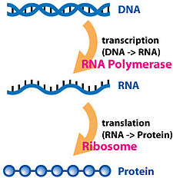
The Genetic Code
The genetic code provides the instructions for assembling amino acids into polypeptides
The sequence of nucleotides in DNA/mRNA specifies the exact primary structure of a polypeptide
Why are 3 adjacent nucleotides required to code for each of the 20 different amino acids?
Notes:
48

Slide 49
Triplet Code
The flow of information from gene to protein is based on a triplet code: a series of nonoverlapping, three-nucleotide “words”
The “words” of a gene are transcribed into complementary nonoverlapping three-nucleotide words of mRNA
These “words” are then translated into a chain of amino acids, forming a polypeptide

Slide 50
Codons
Each codon specifies the amino acid (one of 20) to be placed at the corresponding position along a polypeptide
64 Codons (4³ = 64)
  61 codons code for amino acids
  1 codon is the “start codon” when it isn’t in the middle of a gene
  3 codons are “stop” codons to end translation
The genetic code is redundant
  more than one codon may specify a particular amino acid
But the genetic code is not ambiguous
  no codon specifies more than one amino acid

Slide 51
Codons
Each codon specifies the amino acid (one of 20) to be placed at the corresponding position along a polypeptide
64 Codons (4³ = 64)
  61 codons code for amino acids
  1 codon is the “start codon” when it isn’t in the middle of a gene
  3 codons are “stop” codons to end translation
The genetic code is redundant
  more than one codon may specify a particular amino acid
But the genetic code is not ambiguous
  no codon specifies more than one amino acid

Slide 52
Codons
Each codon specifies the amino acid (one of 20) to be placed at the corresponding position along a polypeptide
64 Codons (4³ = 64)
  61 codons code for amino acids
  1 codon is the “start codon” when it isn’t in the middle of a gene
  3 codons are “stop” codons to end translation
The genetic code is redundant
  more than one codon may specify a particular amino acid
But the genetic code is not ambiguous
  no codon specifies more than one amino acid

Slide 53
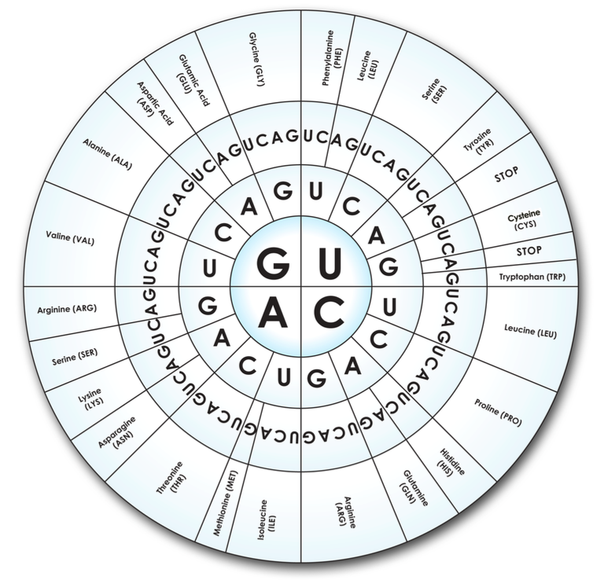
Codons
Each codon specifies the amino acid (one of 20) to be placed at the corresponding position along a polypeptide
64 Codons (4³ = 64)
  61 codons code for amino acids
  1 codon is the “start codon” when it isn’t in the middle of a gene
  3 codons are “stop” codons to end translation
The genetic code is redundant
  more than one codon may specify a particular amino acid
But the genetic code is not ambiguous
  no codon specifies more than one amino acid

Slide 54
Codons
Each codon specifies the amino acid (one of 20) to be placed at the corresponding position along a polypeptide
64 Codons (4³ = 64)
  61 codons code for amino acids
  1 codon is the “start codon” when it isn’t in the middle of a gene
  3 codons are “stop” codons to end translation
The genetic code is redundant
  more than one codon may specify a particular amino acid
But the genetic code is not ambiguous
  no codon specifies more than one amino acid

Slide 55
Translation is the RNA-directed synthesis of a polypeptide: a closer look
A cell translates an mRNA message into protein with the help of transfer RNA (tRNA) and Ribosomes
tRNAs transfer amino acids to the growing polypeptide that’s being synthesize by a ribosome
Notes:
55

Slide 56
Ribosomes

Slide 57
Ribosomes
Anticodon

Slide 58
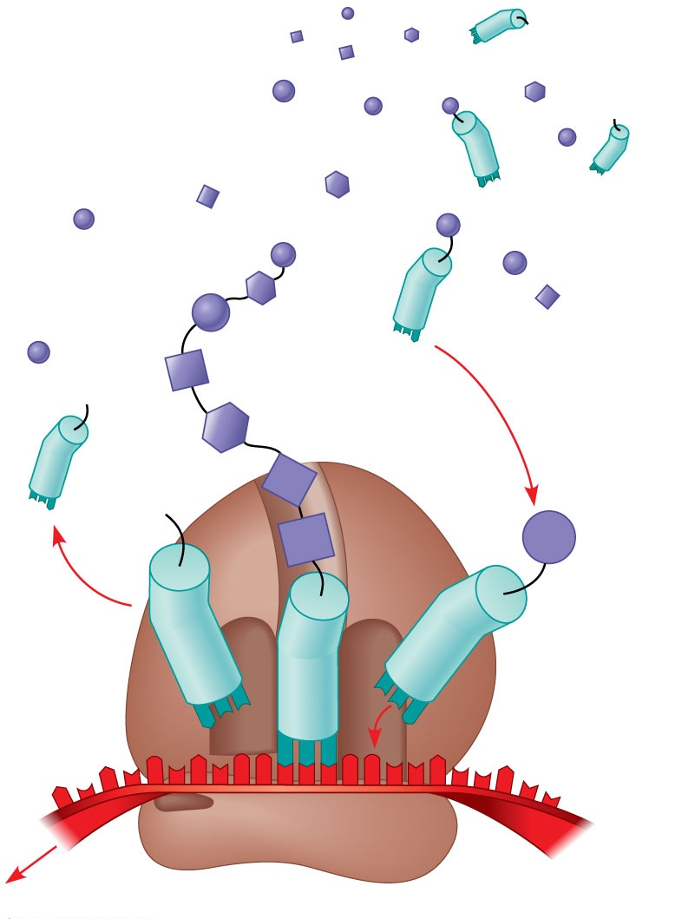
Molecules of tRNA are not identical
  Each carries a specific amino acid on one end
  Each has an anticodon on the other end; the anticodon base-pairs with a complementary codon on mRNA
Amino
acids
Polypeptide
tRNA with
amino acid
attached
Ribosome
Trp
Phe
Gly
tRNA
C
C
C
C
C
G
Anticodon
A
C
G
A
A
A
G
U
G
G
U
U
U
G
G
C
5′
Codons
3′
mRNA
Notes:
Figure 17.14 Translation: the basic concept.

Slide 59
Translation
Process by which genetic information flows from mRNA to protein
Ribosomes
  Translate an mRNA message into protein

Slide 60
Ribosomes
Translation proceeds along the mRNA in a 5′ → 3′ direction
(Codons are read from the mRNA in the 5′ → 3′ direction)

Slide 61
Ribosomes
Translation proceeds along the mRNA in a 5′ → 3′ direction
(Codons are read from the mRNA in the 5′ → 3′ direction)

Slide 62
Ribosomes
Translation proceeds along the mRNA in a 5′ → 3′ direction
(Codons are read from the mRNA in the 5′ → 3′ direction)

Slide 63
Ribosomes
Translation proceeds along the mRNA in a 5′ → 3′ direction
(Codons are read from the mRNA in the 5′ → 3′ direction)

Slide 64
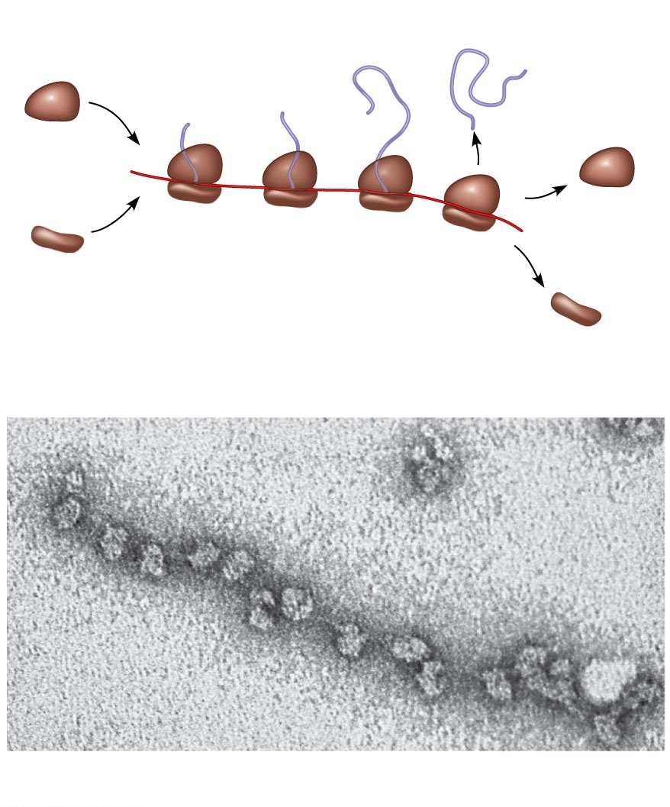
Polyribosomes
Completed
polypeptide
Growing
polypeptides
Incoming
ribosomal
subunits
A number of ribosomes can translate a single mRNA simultaneously, forming a polyribosome (or polysome)
Polyribosomes enable a cell to make many copies of a polypeptide very quickly
Polyribosome
Start of
mRNA
(5′ end)
End of
mRNA
(3′ end)
(a)
Ribosomes
mRNA
(b)
0.1 μm

Slide 65
Comparing Gene Expression in Bacteria, and Eukarya
Bacteria and eukarya differ in their RNA polymerases, termination of transcription, and ribosomes; archaea tend to resemble eukarya in these respects
Bacteria can simultaneously transcribe and translate the same gene
But in eukarya, transcription and translation are separated by the nuclear envelope
Notes:
65

Slide 66
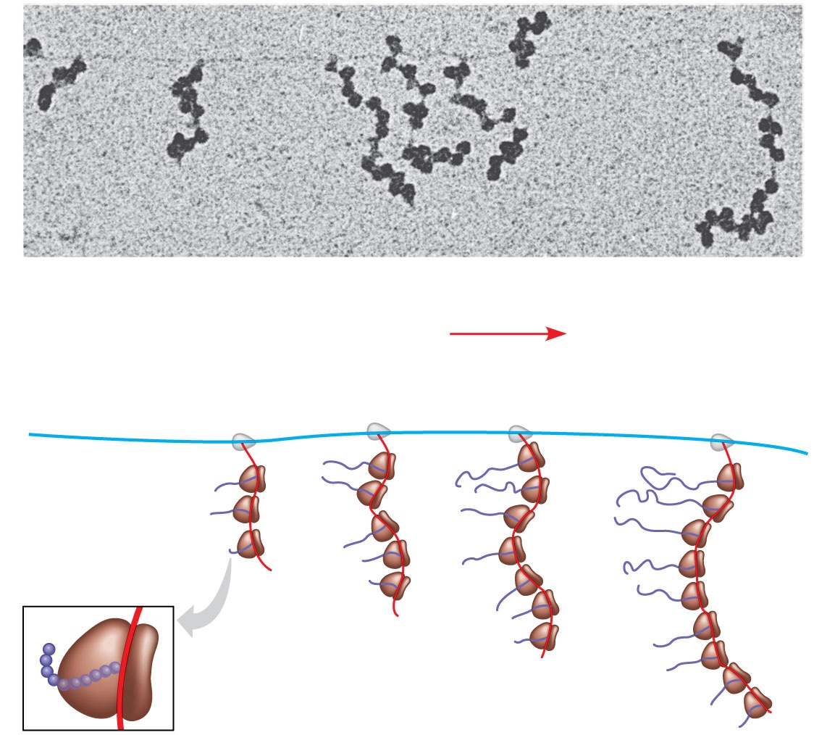
RNA polymerase
DNA
mRNA
Polyribosome
Direction of
transcription
0.25 μm
RNA
polymerase
DNA
Polyribosome
Polypeptide
(amino end)
Ribosome
mRNA
(5′ end)
Notes:
Figure 17.25 Coupled transcription and translation in bacteria.

