Slide 1
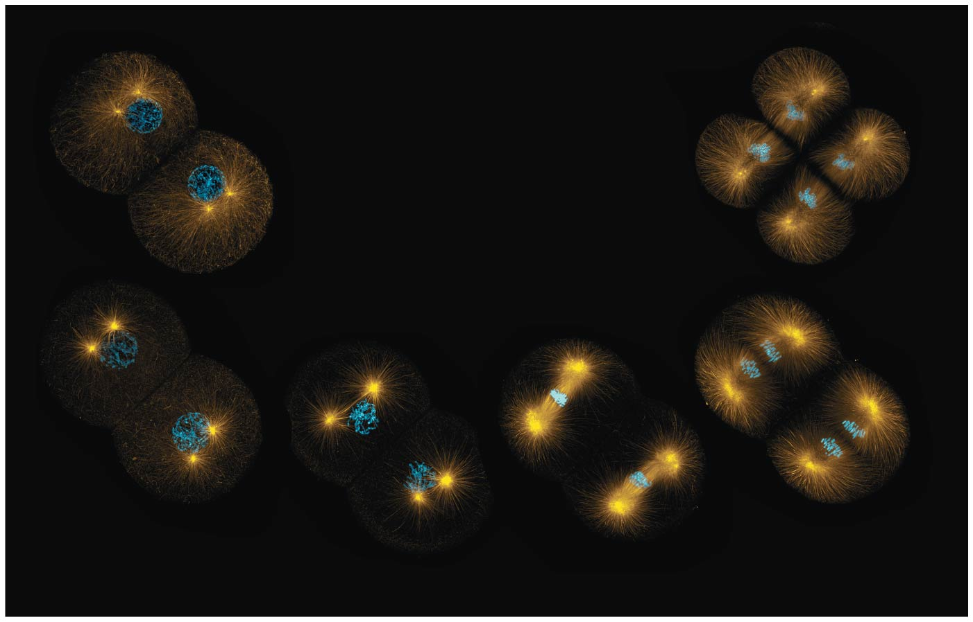
BIO10
Dr. Paul Bradley
Lab Into to
Mitosis

Slide 2
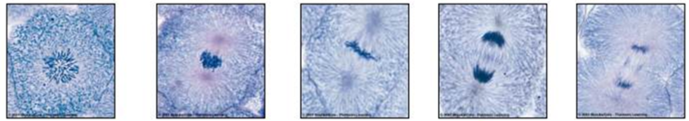
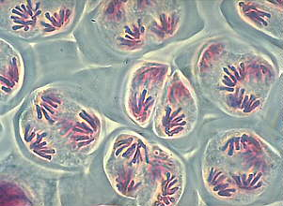
There are different forms of cell division
Mitosis:
A cell division results in diploid daughter cells with identical genetic information, DNA
Meiosis:
A special type of division produces haploid non-distinct daughter cells called gametes or germ
cells (sperm and egg cells)

Slide 3
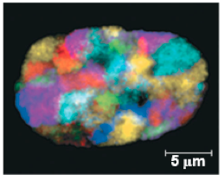
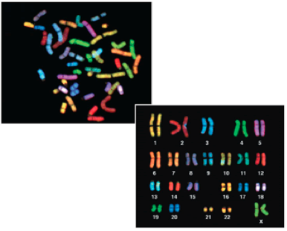
Most chromatin is loosely packed in the nucleus during interphase and condenses prior to mitosis
Loosely packed chromatin is called euchromatin
During interphase a few regions of chromatin (centromeres and telomeres) are highly condensed into heterochromatin
Dense packing of the heterochromatin makes it difficult for the cell to express genetic information coded in these regions
Karyotype: organized picture of heterochromatin

Slide 4
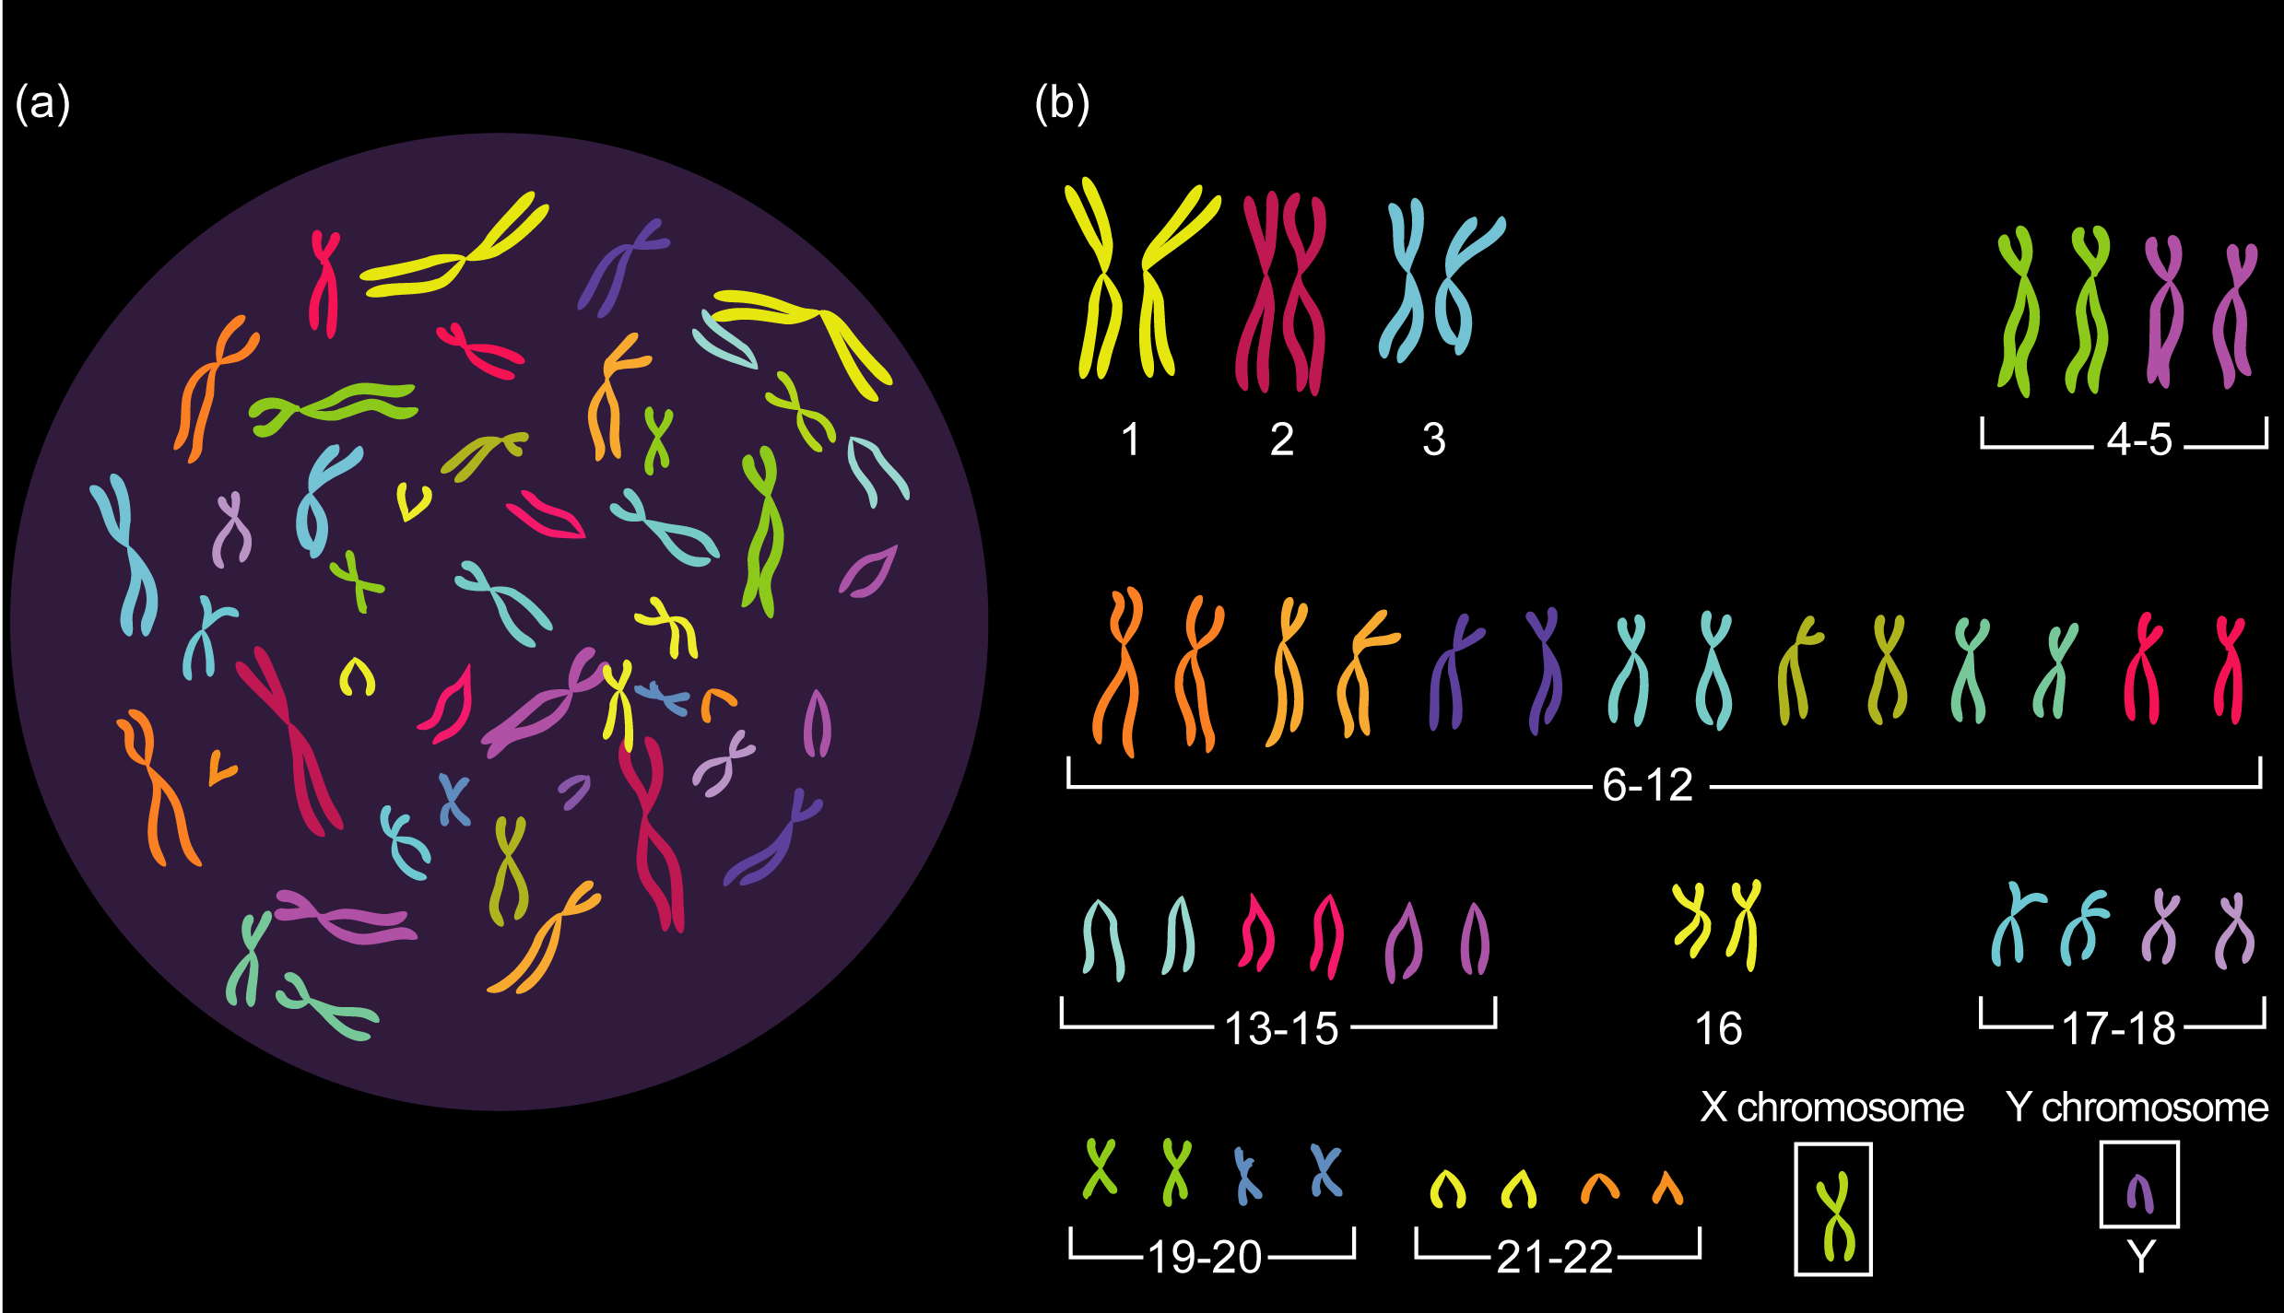
Somatic cells in humans
  have 23 pairs (sets) of chromosomes
  have 22 homologous chromosomes (homologs)
  have 1 pair of sec chromosomes
    46 Chromosomes total
    Half (23) from each parent

Slide 5
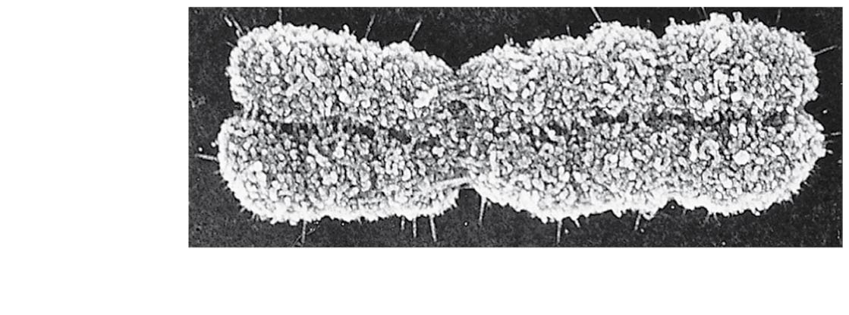
Chromosomes
Sister
chromatids
Each sister chromatid is attached along their lengths by proteins called cohesins
Centromere
0.5 μm
The narrow “waist” of the chromosome where the two chromatids are most closely attached

Slide 6

The Cell Cycle
Interphase (about 90% of the cell cycle) can be divided into subphases
  G₁ phase (“first gap”)
  S phase (“synthesis”)
  G₂ phase (“second gap”)
The cell grows during all three phases, but chromosomes are duplicated only during the S phase
Chromosomes only look like this during a brief moment right here!
“Duplication” ≠ doubling of chromosomes
“Duplication” = creating a sister chromatid after DNA (molecule) replication
“Duplication” = creating a second (identical) DNA molecule within a chromosome

Slide 7
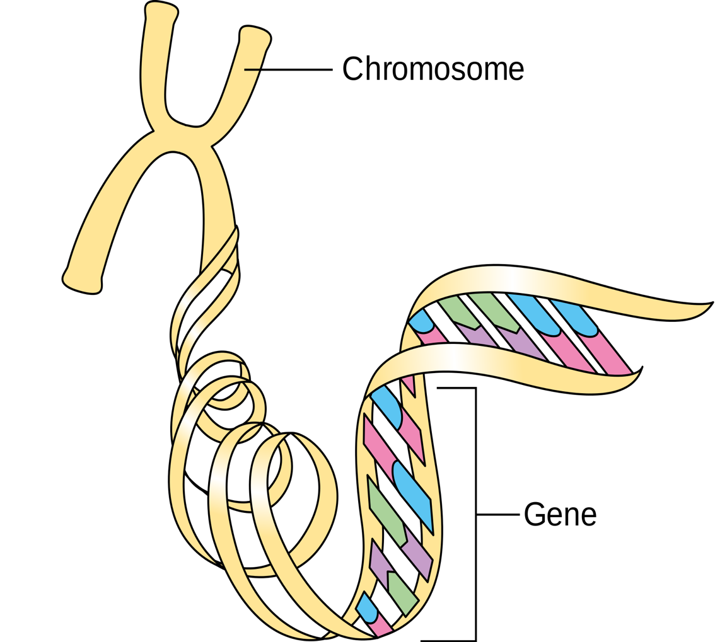
One Chromosome after “duplication”
Two Sister Chromatids
  Each with one identical copy of a DNA molecule
  Two entire DNA molecules total
Each replicated DNA molecule with genes for various traits, but each is identical to the other and each share genes in the same linear sequence

Slide 8
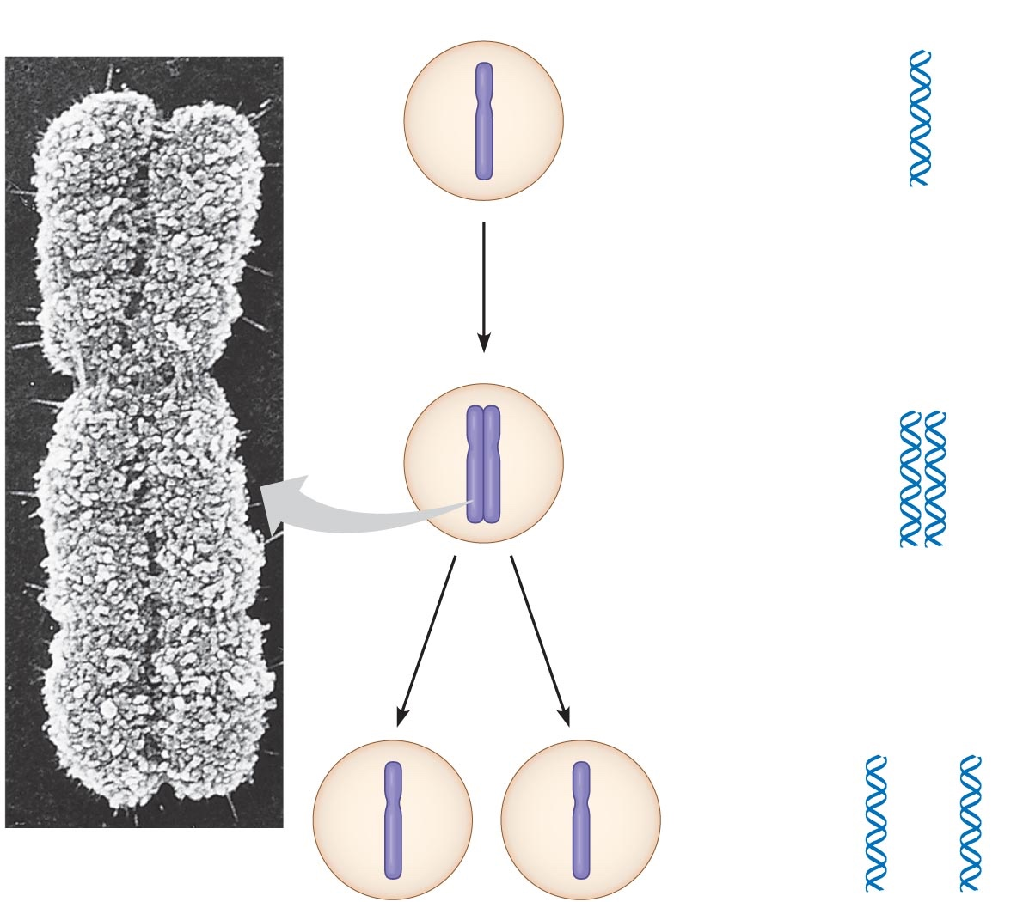
One Chromosome after “duplication”
Two Sister Chromatids
  Each with one identical copy of a DNA molecule
  Two entire DNA molecules total
Each replicated DNA molecule with genes for various traits, but each is identical to the other and each share genes in the same linear sequence

Slide 9
How does DNA replication happen?

Slide 10
Setting the Stage for Mitosis...
Let’s first talk about the S Phase
Mitosis and then cytokinesis

Slide 11
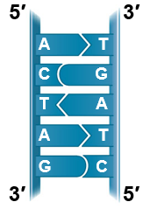
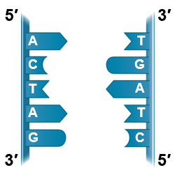
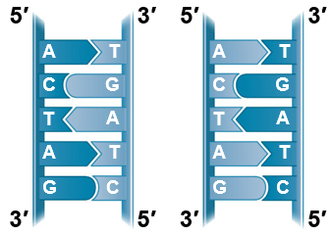
Reminder: Base Pairing to a Template Strand
Watson and Crick’s semiconservative model of replication predicts that each daughter molecule will have one old strand (“conserved” from the parent molecule) and one newly made strand
Parental
molecule
Separation of
parental strands
into templates
Formation of new
strands complementary
to template strands
This all happens in the S Phase

Slide 12
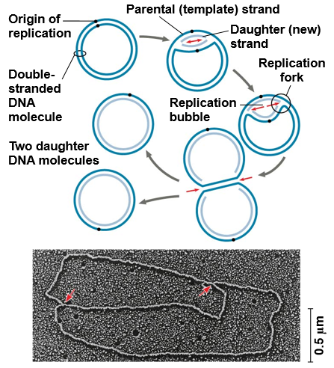
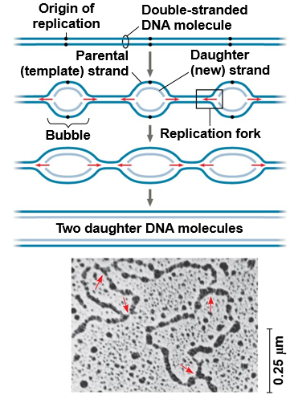
Replication begins at sites called origins of replication, where the two DNA strands are separated, and then proceeds in both directions
Origin of replication in an E. coli cell
Origins of replication in a eukaryotic cell
Notes:
Figure 16.12 Origins of replication in E. coli and eukaryotes

Slide 13
0.5 µm
Chromosomes
DNA molecules
Chromo-
some arm
Chromosome
“duplication”
(including DNA
synthesis)
Centromere
Sister
chromatids
Separation of
sister chromatids
Centromere
Sister chromatids
Notes:
Figure 12.4 Chromosome duplication and distribution during cell division

Slide 14
Mitotic Phase
Mitosis and then cytokinesis

Slide 15
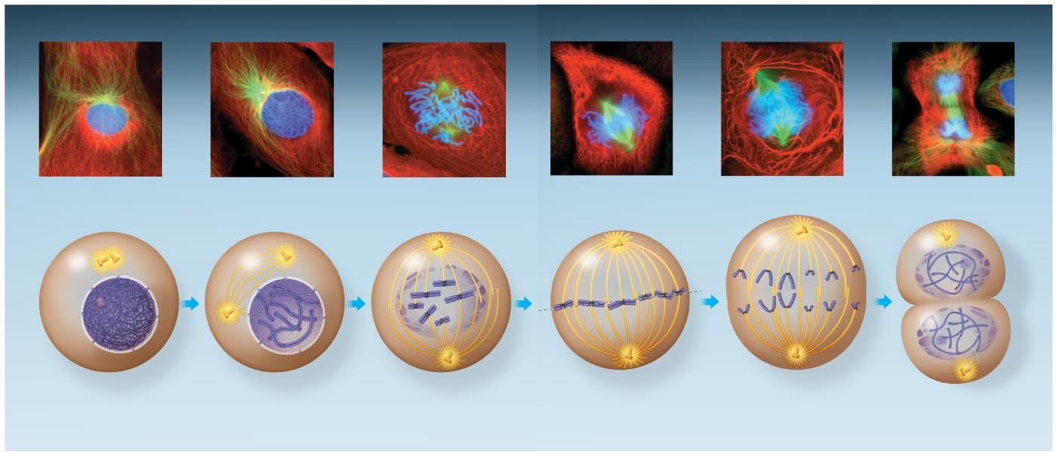
Mitosis is conventionally and arbitrarily divided into 5 phases
G₂ of
Interphase
Anaphase
Telophase and
Cytokinesis
Prophase
Prometaphase
Metaphase
Notes:
Figure 12.6 The mitotic division of an animal cell

Slide 16
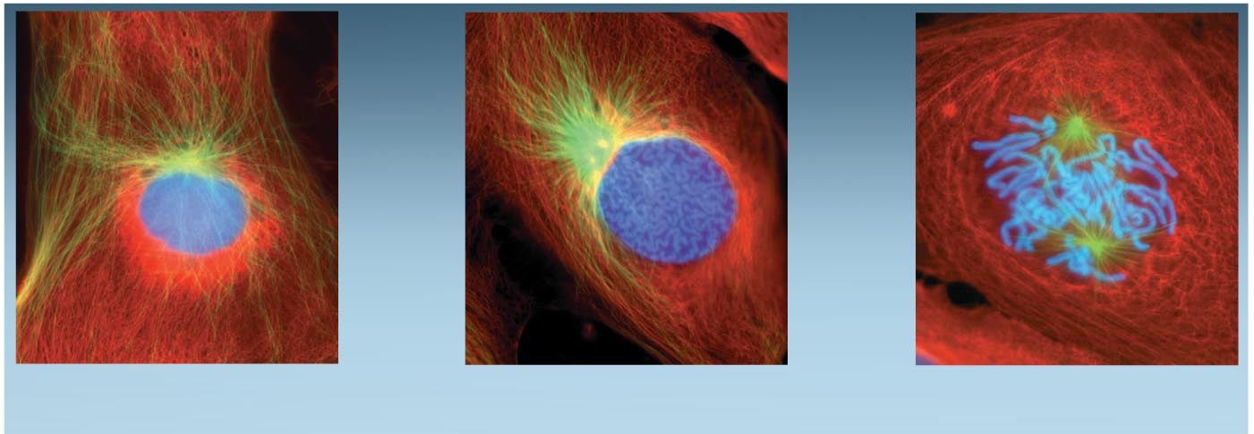
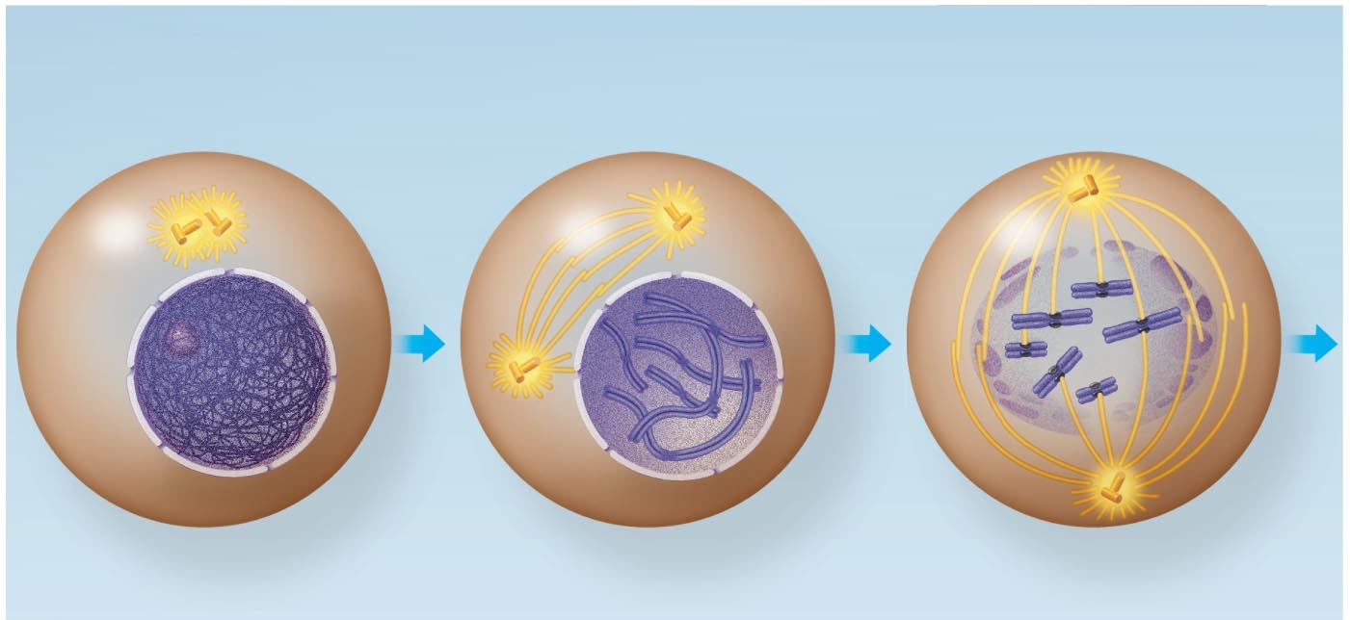
G₂ of Interphase
Prophase
Prometaphase
G₂ of Interphase
Prophase
Prometaphase
Centrosomes
(with centriole
pairs)
Chromatin
(duplicated)
Early mitotic
spindle
Aster
Centromere
Fragments
of nuclear
envelope
Nonkinetochore
microtubules
Nucleolus
Nuclear
envelope
Plasma
membrane
Chromosome, consisting
of two sister chromatids
Kinetochore
Kinetochore
microtubule

Slide 17
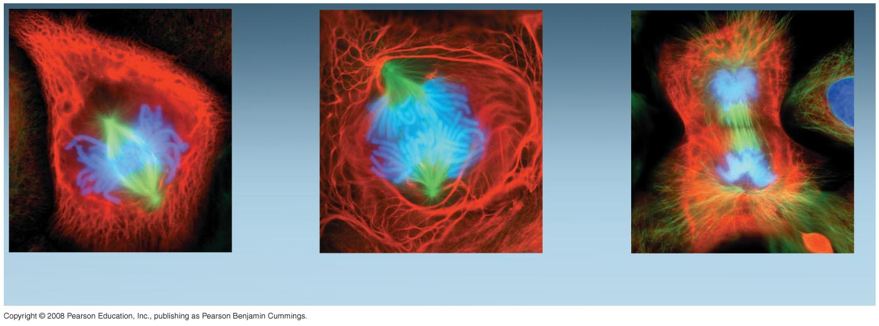
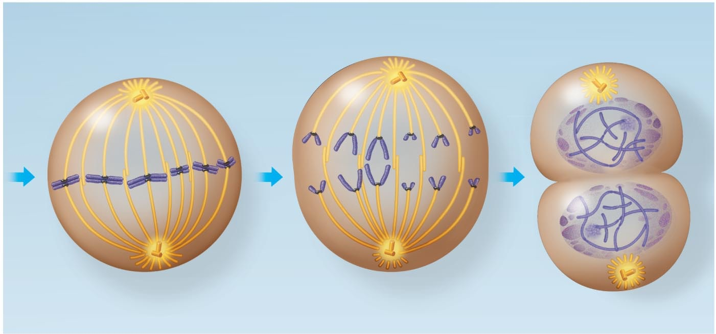
Metaphase
Anaphase
Telophase and Cytokinesis
Metaphase
plate
Cleavage
furrow
Nucleolus
forming
Metaphase
Anaphase
Telophase and Cytokinesis
Daughter
chromosomes
Nuclear
envelope
forming
Spindle
Centrosome at
one spindle pole

Slide 18
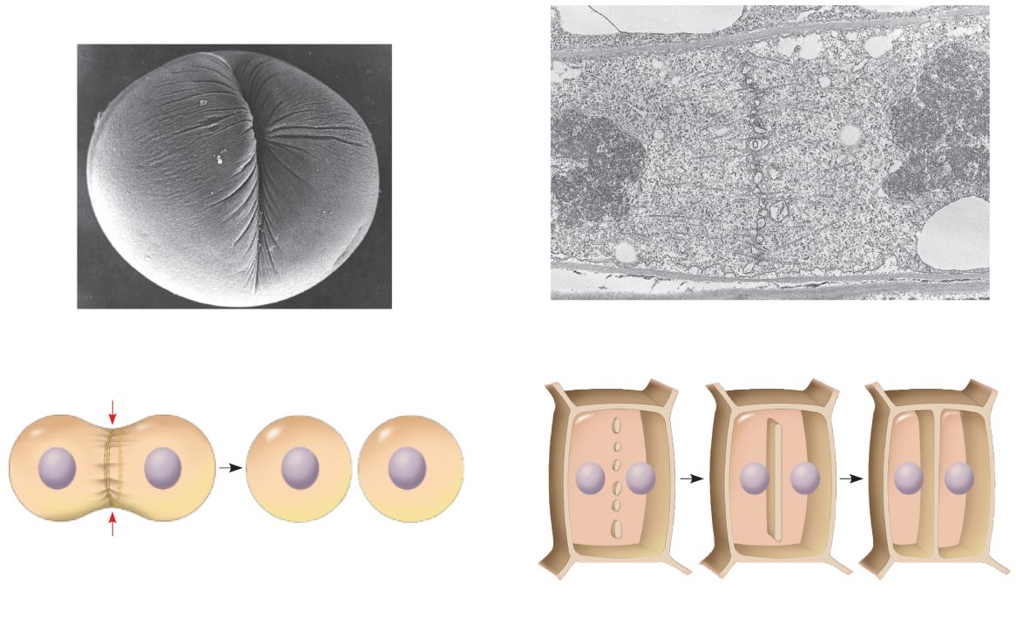
Cytokinesis: A Closer Look
In animal cells, cytokinesis occurs by a process known as cleavage, forming a cleavage furrow
In plant cells, a cell plate forms during cytokinesis
100 µm
Vesicles
forming
cell plate
Wall of
parent cell
1 µm
Cleavage furrow
Cell plate
New cell wall
Contractile ring of
microfilaments
Daughter cells
Daughter cells
(a) Cleavage of an animal cell (SEM)
(b) Cell plate formation in a plant cell (TEM)

Slide 19
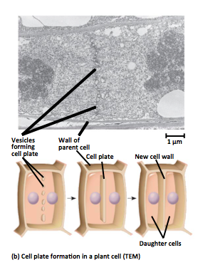
Mitosis in Plants

Slide 20
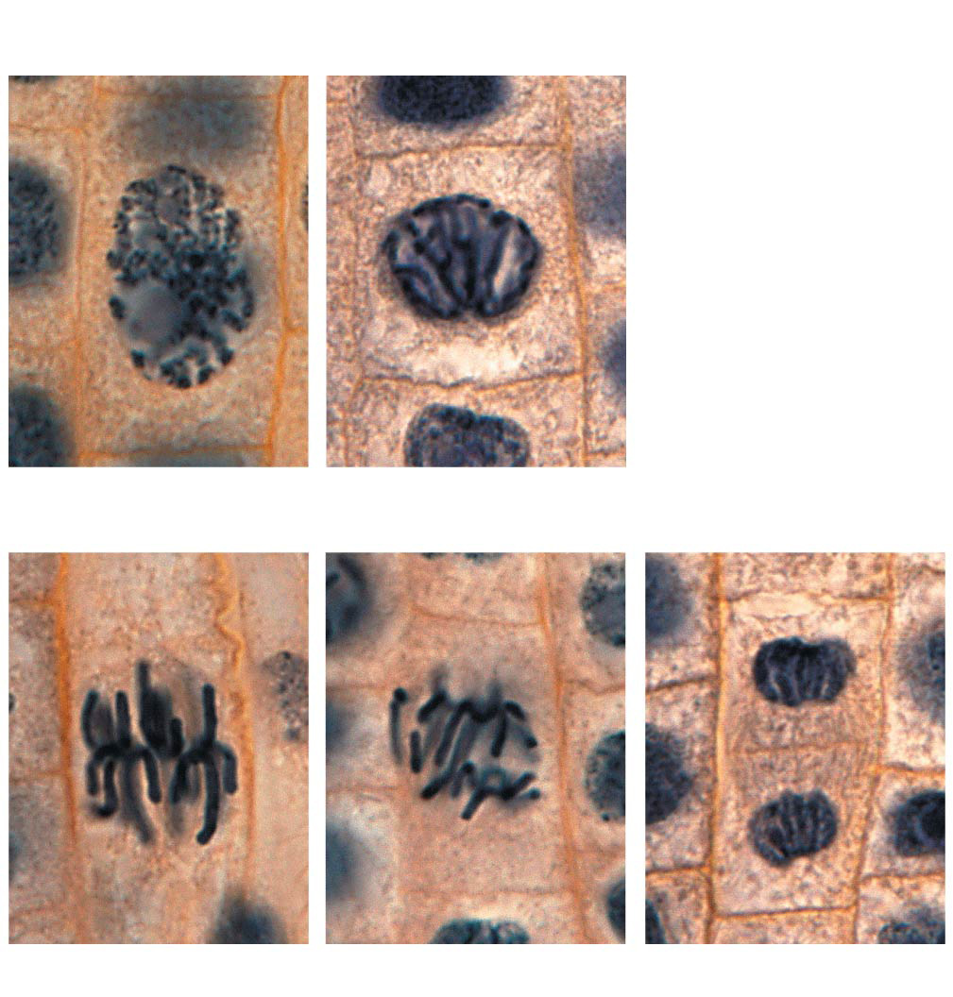
Nucleus
Chromosomes
condensing
Nucleolus
Chromosomes
10 µm
1
Prophase
2
Prometaphase
Cell plate
3
Metaphase
4
Anaphase
5
Telophase

Slide 21
