Slide 1
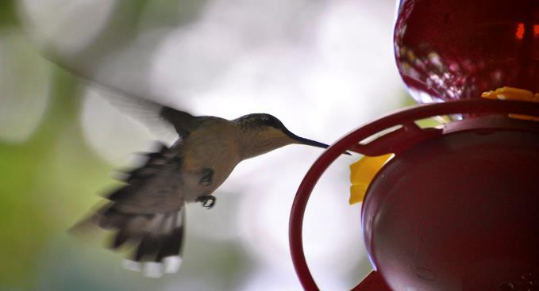
BIO10: Introduction to Principles of Biology
Dr. Paul Bradley
Energy & Membrane Transport
Part 2

Slide 2
By the end of this section you will be able to:
Explain how ATP is used by the cell as an energy source
Describe the overall result in terms of molecules produced of the breakdown of glucose by glycolysis

Slide 3
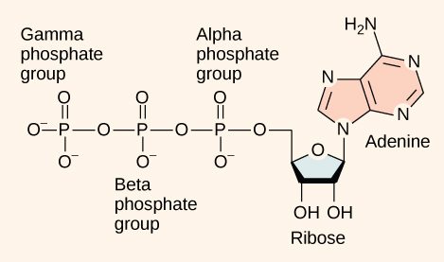
ATP
Functioning like a rechargeable battery, ATP is used to power the majority of energy-requiring cellular reactions.
When ATP is broken down, usually by the removal of its terminal phosphate group, energy is released.
This energy is used to do work by the cell, usually by the binding of the released phosphate to another molecule, thus activating it.

Slide 4
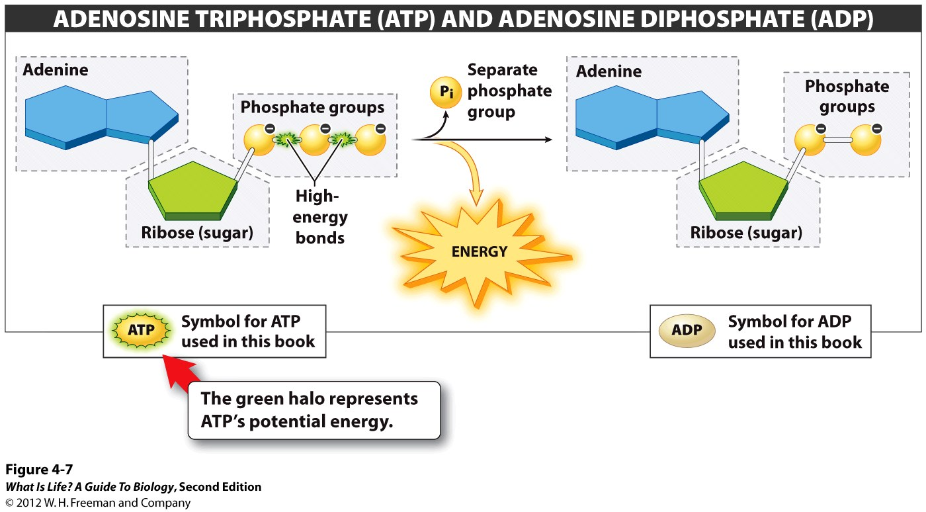
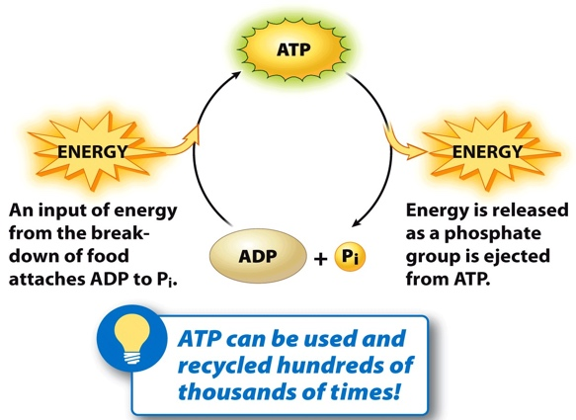
ATP
At the heart of ATP is a molecule of adenosine monophosphate (AMP), which is composed of an adenine molecule bonded to both a ribose molecule and a single phosphate group.
Ribose is a five-carbon sugar found in RNA and AMP is one of the nucleotides in RNA.
The addition of a second phosphate group to this core molecule results in adenosine diphosphate (ADP).
The addition of a third phosphate group forms adenosine triphosphate (ATP).
The addition of a phosphate group to a molecule requires a high amount of energy and results in a high-energy bond. Phosphate groups are negatively charged and thus repel one another when they are arranged in series, as they are in ADP and ATP. This repulsion makes the ADP and ATP molecules inherently unstable.

Slide 6
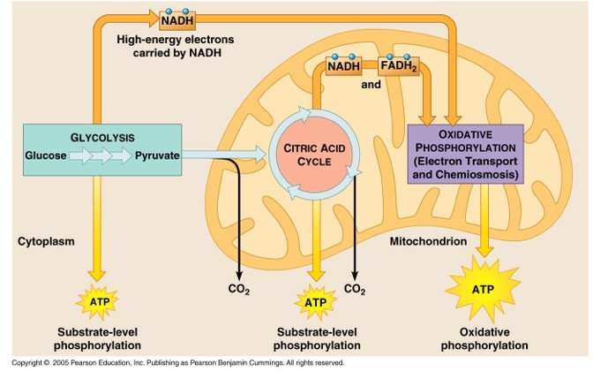

Slide 7
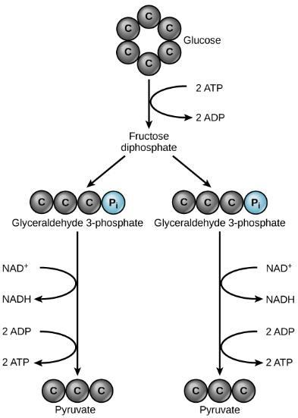
Glycolysis
Nearly all of the energy used by living things comes to them in the bonds of the sugar such as glucose.
Glycolysis is the first step in the breakdown of glucose to extract energy.
takes place in the cytoplasm of most prokaryotic and all eukaryotic cells.
begins with the six-carbon, ring-shaped structure of a single glucose molecule and ends with two molecules of a three-carbon sugar called pyruvate.
Glycolysis consists of two distinct phases.
In the first part of the glycolysis pathway, energy is used to make adjustments so that the six-carbon sugar molecule can be split evenly into two three-carbon pyruvate molecules.
In the second part of glycolysis, ATP and nicotinamide-adenine dinucleotide (NADH) are produced.
If the cell cannot catabolize the pyruvate molecules further, it will harvest only two ATP molecules from one molecule of glucose.
In glycolysis, a glucose molecule is converted into two pyruvate molecules.

Slide 8
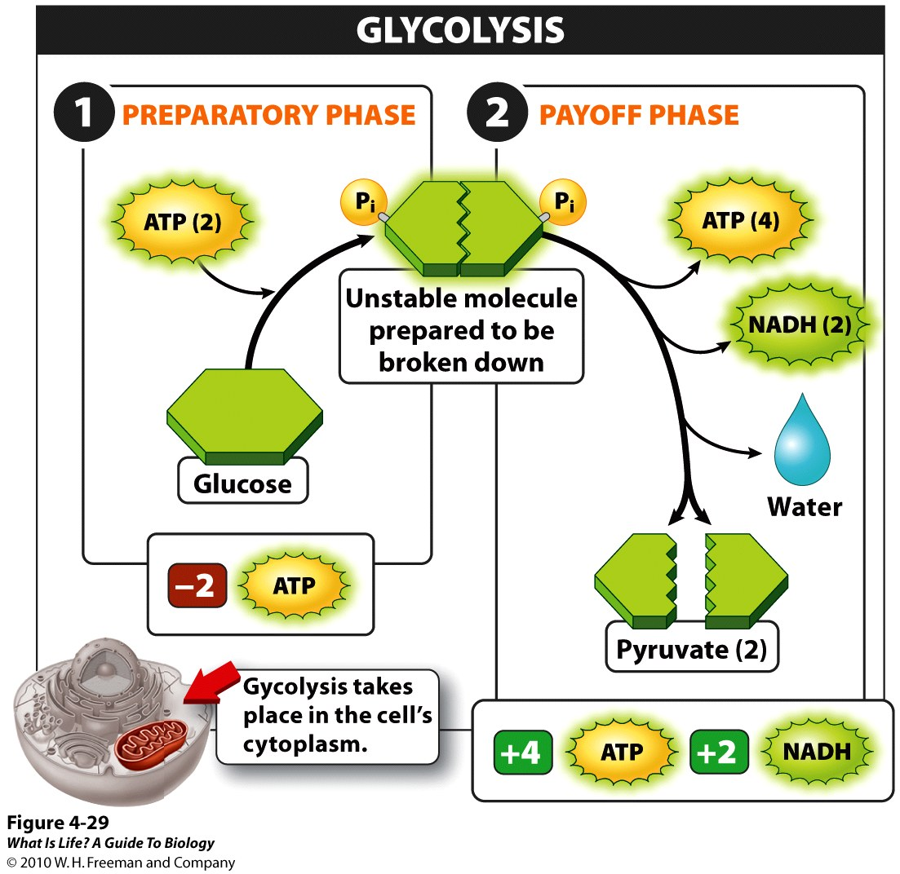

Slide 9
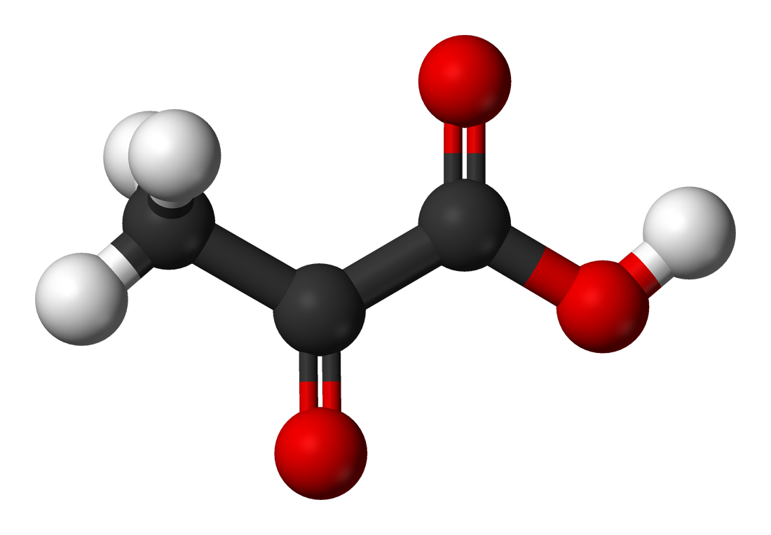
Pyruvate
Pyruvate (or Pyruvic acid) can be converted
back to a carbohydrate (such as glucose) via gluconeogenesis.
or to fatty acids through a reaction with acetyl-CoA.
can also be used to construct the amino acid alanine.
can be converted into ethanol or lactic acid via fermentation.
Pyruvate supplies energy to cells through the citric acid cycle (also known as the Krebs cycle) when oxygen is present (aerobic respiration)
Or can ferments to produce lactate (lactic acid) when oxygen is lacking.

Slide 10
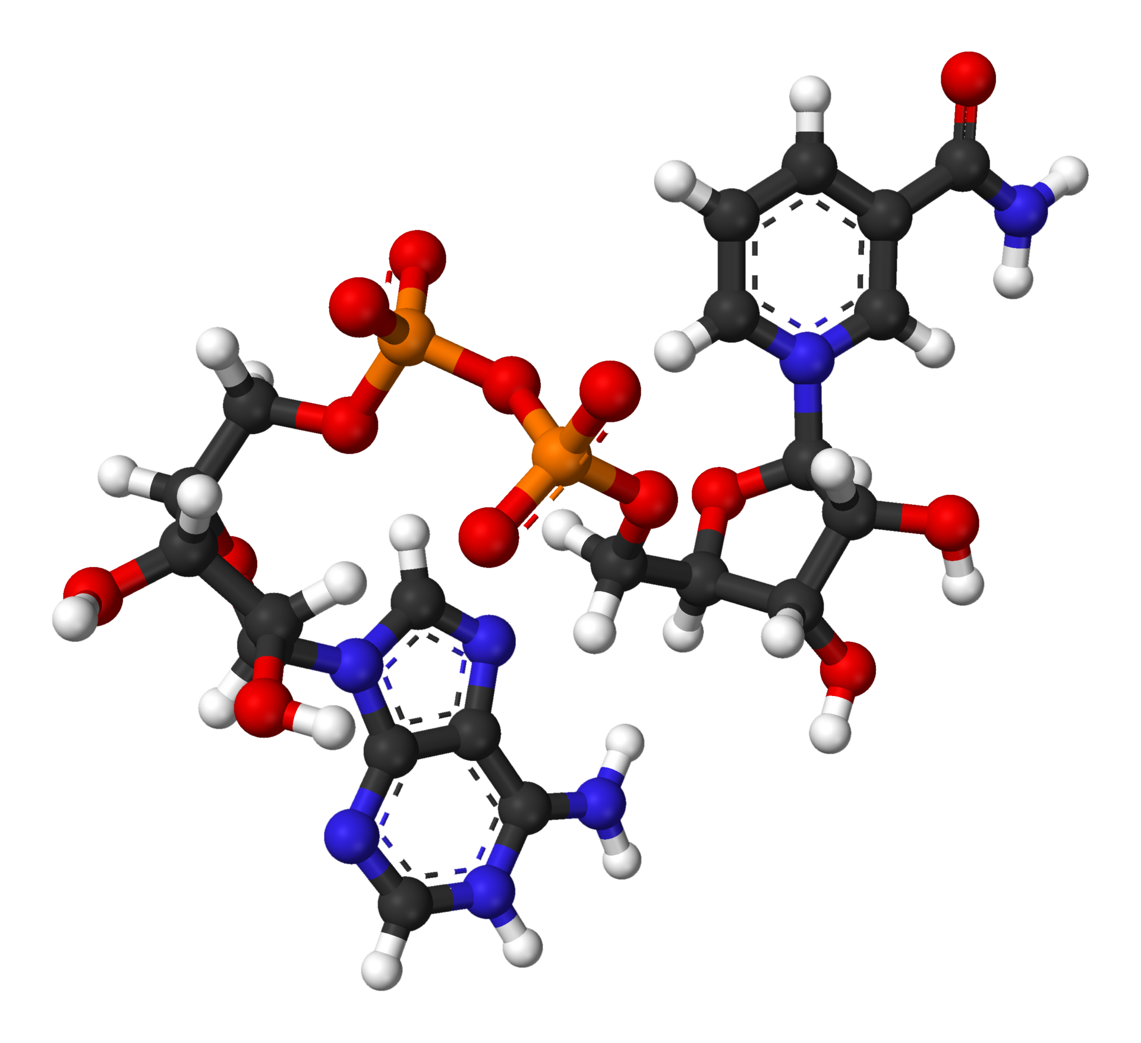
NAD+ / NADH
NAD+ / NADH is a coenzyme central to metabolism and is found in all living cells.
Consists of two nucleotides joined through their phosphate groups.
Main function is carrying electrons from one reaction to another.

Slide 11
By the end of this section you will be able to:
Describe the location of the citric acid cycle and oxidative phosphorylation in the cell
Describe the overall outcome of the citric acid cycle and oxidative phosphorylation in terms of the products of each
Describe the relationships of glycolysis, the citric acid cycle, and oxidative phosphorylation in terms of their inputs and outputs.

Slide 12
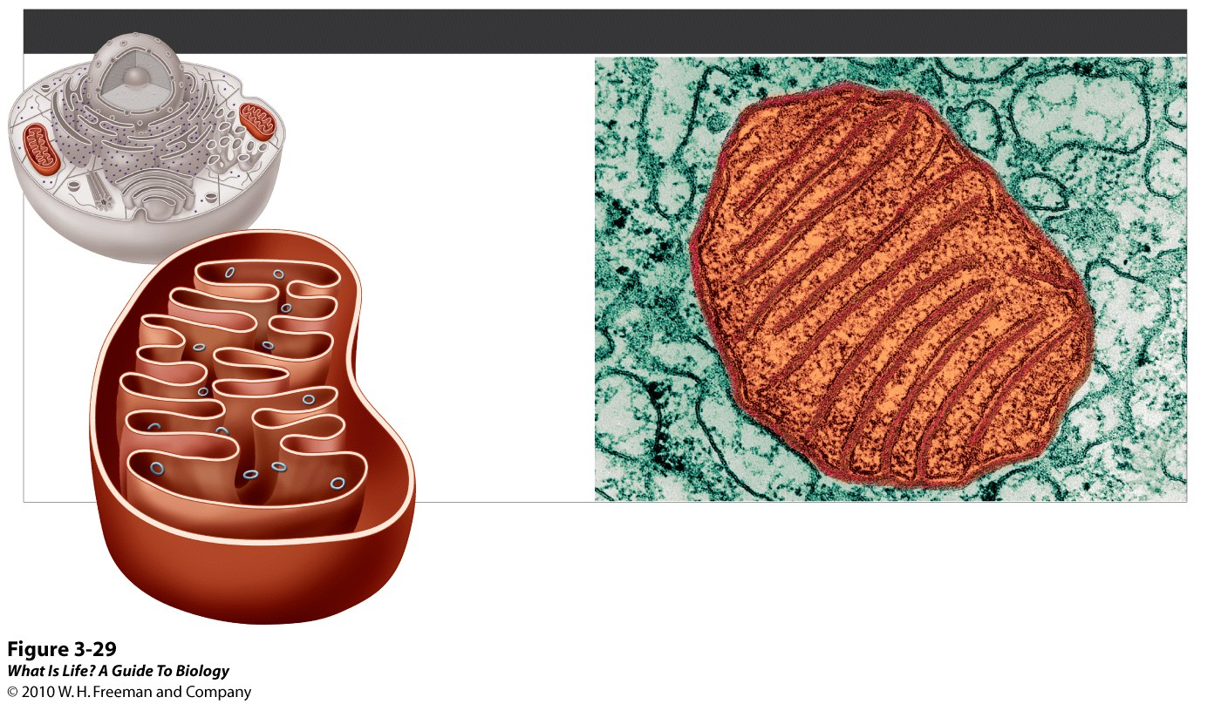
Most Eukaryotes also do Aerobic Respiration
MITOCHONDRIA
FUNCTIONS
• Act as all-purpose
energy converters
• Harvest energy to be
used for cellular functions
DNA
Matrix
Outer
membrane
Inner
membrane
Intermembrane
space
✪
Cells such as muscle and liver cells, which use a lot of energy, can have up to 2,000 mitochondria!
Notes:
FIGURE 3-29 Mitochondria: the cell's all-purpose energy converters.

Slide 13
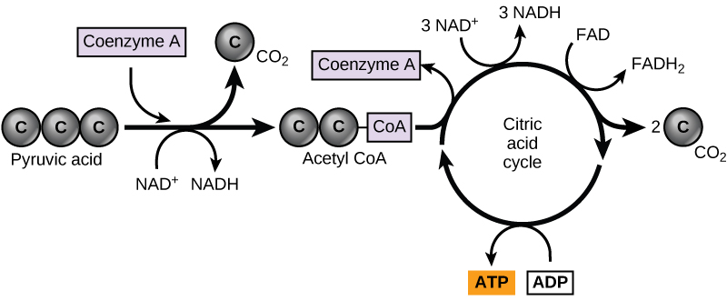
Citric Acid Cycle (Krebs Cycle)
Pyruvate produced at the end of glycolysis are transported into mitochondria, where cellular respiration occurs.
If oxygen is available, aerobic respiration will go forward.
pyruvate will be transformed into a two-carbon acetyl group (by removing a molecule of carbon dioxide) that will be picked up by a carrier compound called coenzyme A (CoA).
The resulting compound is called acetyl CoA and its major function is to deliver the acetyl group derived from pyruvate to the next pathway in glucose catabolism.
Pyruvate is converted into acetyl-CoA before entering the citric acid cycle.

Slide 14
Citric Acid Cycle (Krebs Cycle)
The citric acid cycle is a closed loop:
The last part of the pathway regenerates the compound used in the first step. The eight steps of the cycle are a series of chemical reactions that produces
two carbon dioxide molecules
one ATP molecule (or an equivalent)
reduced forms (NADH and FADH₂) of NAD+ and FAD+.
Pyruvate is converted into acetyl-CoA before entering the citric acid cycle.

Slide 15
Citric Acid Cycle (Krebs Cycle)
Two carbon atoms come into the citric acid cycle from each acetyl group.
Two carbon dioxide molecules are released on each turn of the cycle.
It takes two turns of the cycle to process the equivalent of one glucose molecule.
Each turn of the cycle forms three high-energy NADH molecules and one high-energy FADH₂ molecule.
These high-energy carriers will connect with the last portion of aerobic respiration to produce ATP molecules.
One ATP (or an equivalent) is also made in each cycle.
Pyruvate is converted into acetyl-CoA before entering the citric acid cycle.

Slide 16
Oxidative Phosphorylation
Most of the ATP generated from a process that begins with passing electrons through a series of chemical reactions to a final electron acceptor, oxygen.
These reactions take place in the inner membrane of the mitochondria of eukaryotic organisms and on the inner part of the cell membrane of prokaryotic organisms.
The energy of the electrons is harvested and used to generate an electrochemical gradient across the inner mitochondrial membrane.
The potential energy of this gradient is used to generate ATP.
Pyruvate is converted into acetyl-CoA before entering the citric acid cycle.

Slide 17
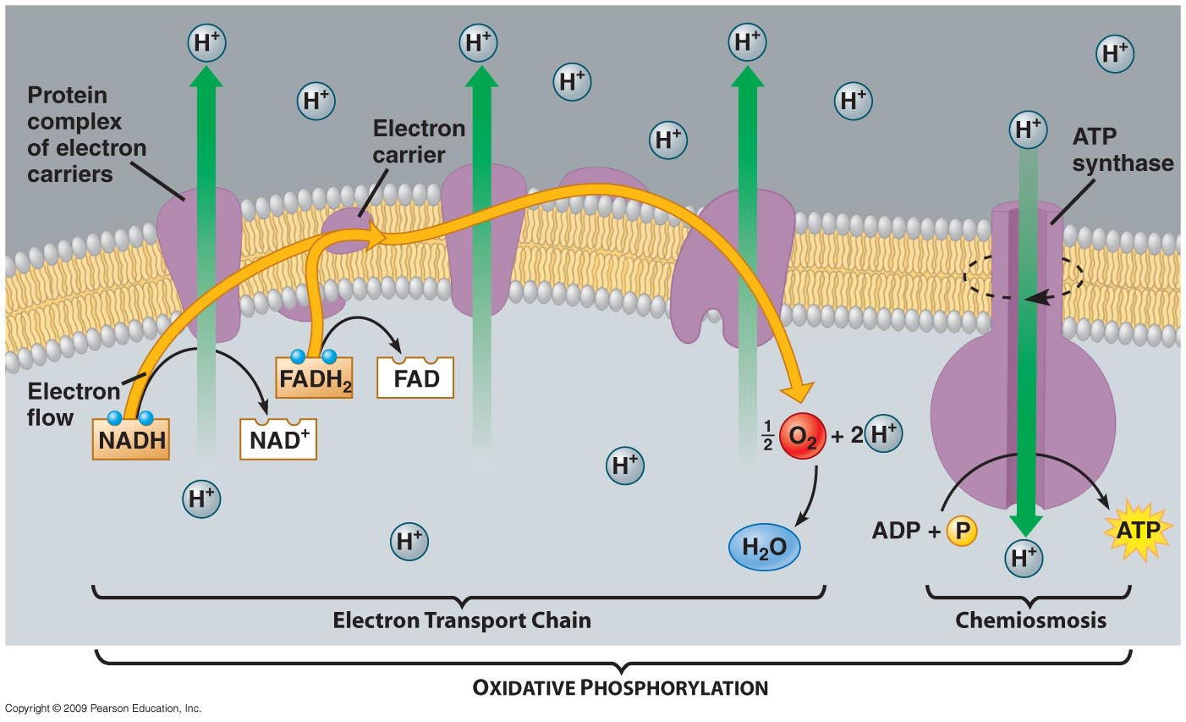
Oxidative Phosphorylation
ATP synthase is a complex, molecular machine that uses an H⁺ gradient to regenerate ATP from ADP.

Slide 18
By the end of this section you will be able to:
Discuss the fundamental difference between anaerobic cellular respiration and fermentation
Describe the type of fermentation that readily occurs in animal cells and the conditions that initiate that fermentation

Slide 19
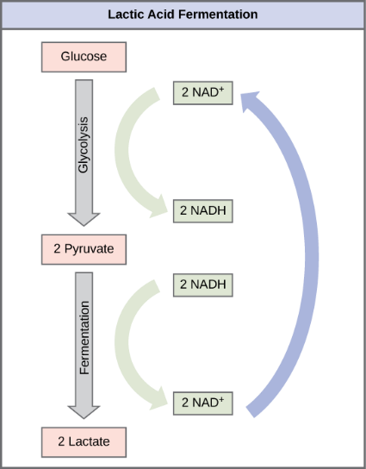
Lactic Acid Fermentation
If aerobic respiration does not occur, NADH must be reoxidized to NAD+ for reuse as an electron carrier for glycolysis to continue.
Processes that use an organic molecule to regenerate NAD+ from NADH are collectively referred to as fermentation.

Slide 20
Lactic Acid Fermentation
Used by animals and some bacteria like those in yogurt.
Also occurs routinely in mammalian red blood cells and in skeletal muscle that has insufficient oxygen supply to allow aerobic respiration to continue.
In muscles, lactic acid produced by fermentation must be removed by the blood circulation and brought to the liver for further metabolism.

Slide 21
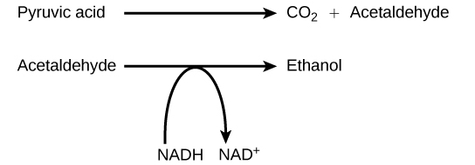
Alcohol Fermentation
Another fermentation process is alcohol fermentation which produces ethanol.
In the first reaction, a carboxyl group is removed from pyruvic acid, releasing carbon dioxide as a gas. The loss of carbon dioxide reduces the molecule by one carbon atom, making acetaldehyde.
The second reaction removes an electron from NADH, forming NAD+ and producing ethanol from the acetaldehyde, which accepts the electron.

Slide 22
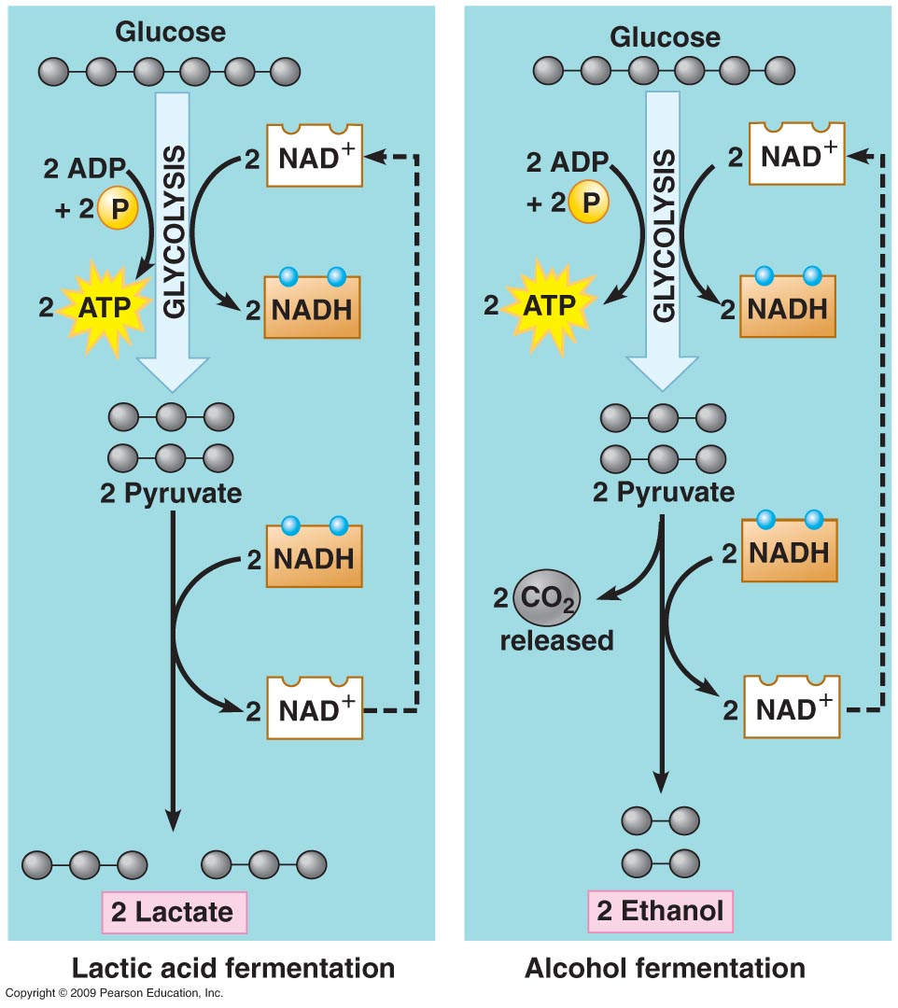
Fermentation Comparison

