Slide 1
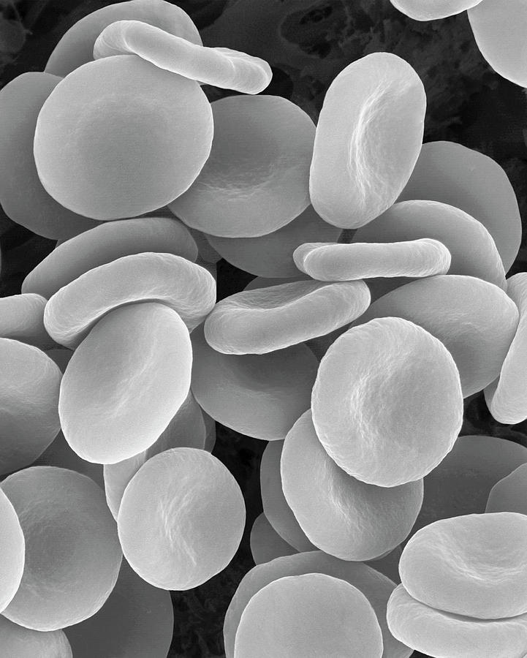
BIO10: Introduction to Principles of Biology
Dr. Paul Bradley
Cell Diversity

Slide 2
By the end of this section you will be able to:
By the end of this section, you will be able to:
  Describe the roles of cells in organisms
  Compare and contrast light microscopy and electron microscopy
    This will actually be covered in lab...
  Summarize the cell theory

Slide 3
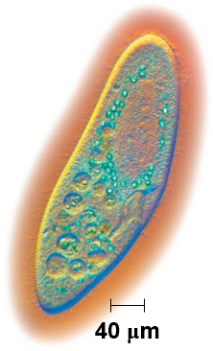
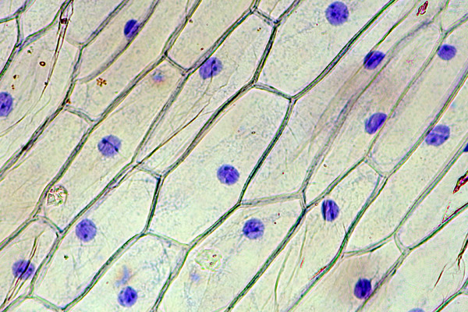
Cell Theory
In a 1665 publication Robert Hooke coined the term “cell” for the box-like structures he observed when viewing cork tissue through a lens.
In the 1670s, bacteria and protozoa were discovered.
By the late 1830s, Matthias Schleiden and Theodor Schwann proposed the unified cell theory, which states that:
  all living things are composed of one or more cells
  that the cell is the basic unit of life
  and that all new cells arise from existing cells

Slide 4
By the end of this section you will be able to:
By the end of this section, you will be able to:
  Name examples of prokaryotic and eukaryotic organisms
  Compare and contrast prokaryotic cells and eukaryotic cells
  Describe the relative sizes of different kinds of cells

Slide 5
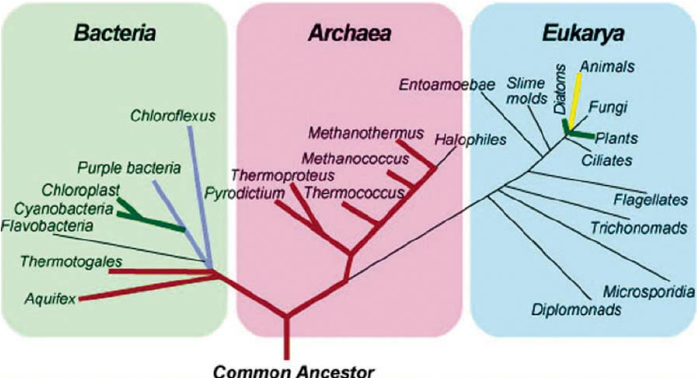
Three Domains of Life

Slide 6
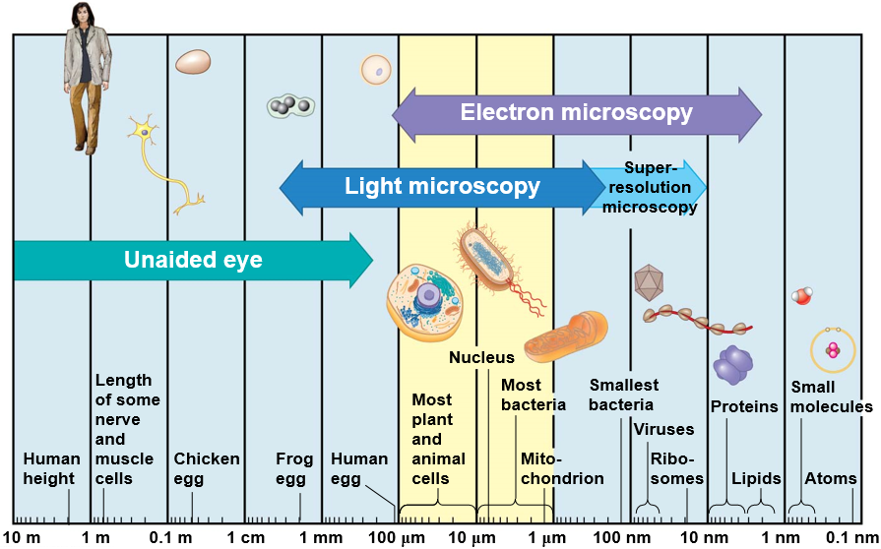
The Size Range of Cells
Eukaryotes are 10 – 100 times bigger than prokaryotes

Slide 7
Comparing Prokaryotic and Eukaryotic Cells
Cells fall into one of two broad categories:
  Prokaryotic - (pro- = before; -karyon- = nucleus)
    Predominantly single-celled organisms of the domains Bacteria and Archaea (pro- = before; -karyon- = nucleus).
  Eukaryotic - (eu- = true -karyon- = nucleus)
    Animal cells, plant cells, fungi, and protists are eukaryotes.

Slide 8
Before next class:
  Finish reading Ch3
    Including Key Terms and Chapter Summary sections
  Start reading Ch4
  We will talk about Ch4 material on Wednesday

Slide 9
BIO10: Introduction to Principles of Biology
Dr. Paul Bradley
Cell Diversity

Slide 10
Comparing Prokaryotic and Eukaryotic Cells
Basic features of all cells:
  Plasma membrane
  Semifluid substance called cytoplasm or cytosol
  DNA in Chromosomes
  Ribosomes

Slide 11
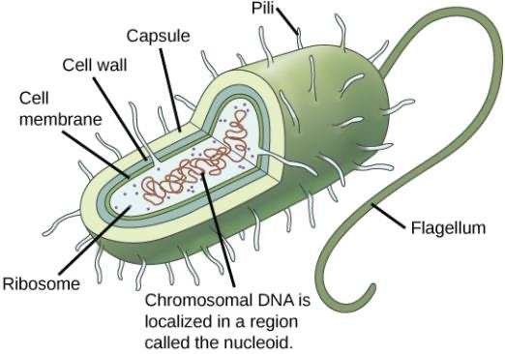
Prokaryotic cells are characterized by having:
  No nucleus
  DNA in an unbound region called the nucleoid
  No membrane-bound organelles
  Cytoplasm bound by the plasma membrane
    Some prokaryotes have flagella, pili, or fimbriae. Flagella are used for locomotion, while most pili are used to exchange genetic material during a type of reproduction called conjugation.

Slide 12
Bacterial cells are characterized by having:
Unlike Archaea and eukaryotes, bacteria have:
  a cell wall made of peptidoglycan
    comprised of sugars and amino acids
    acts as an extra layer of protection
    helps the cell maintain its shape
    prevents dehydration
  and many have a polysaccharide capsule
    enables the cell to attach to surfaces in its environment.

Slide 13
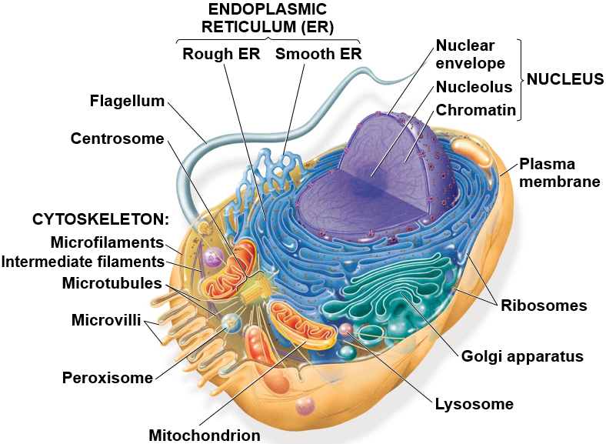
Eukaryotic cells are characterized by having:
  DNA in a nucleus that is bounded by a double membrane
Eukaryotic cells are generally much larger than prokaryotic cells
Have cytoplasm in the region between the plasma membrane and nucleus

Slide 14
Eukaryotic cells are characterized by having:
  DNA in a nucleus that is bounded by a double membrane
  Membrane-bound organelles...
...meaning “little organ,” each with a specialized cellular functions

Slide 15
By the end of this section you will be able to:
By the end of this section, you will be able to:
  Describe the structure of eukaryotic plant and animal cells
  State the role of the plasma membrane
  Summarize the functions of the major cell organelles
  Describe the cytoskeleton and extracellular matrix

Slide 16
Panoramic View of an animal Cell

Slide 17
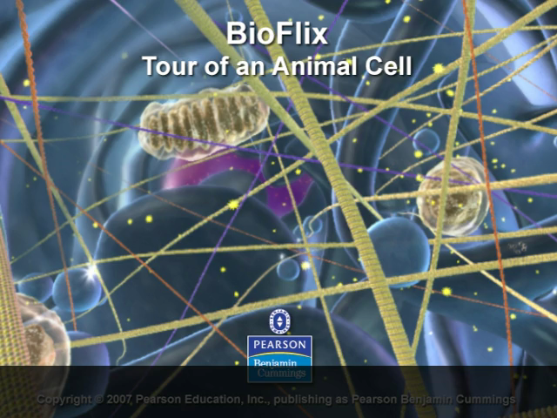
BioFlix: Tour of an Animal Cell
Notes:
https://www.youtube.com/watch?v=6ebDTpHOljU

Slide 18
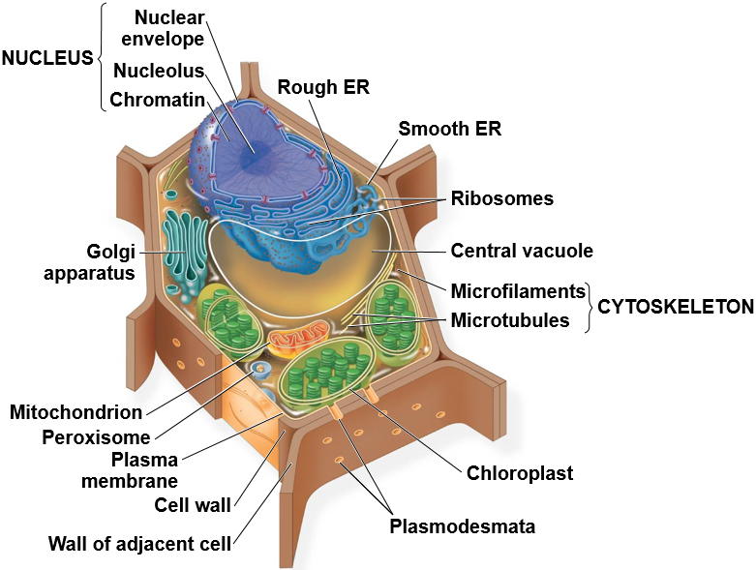
Panoramic View of a Plant Cell

Slide 19
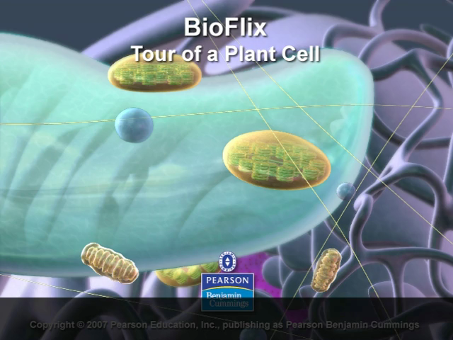
BioFlix: Tour of a Plant Cell
Notes:
https://vimeo.com/14797963
https://www.youtube.com/watch?v=JHDDk0pHEl4

Slide 20
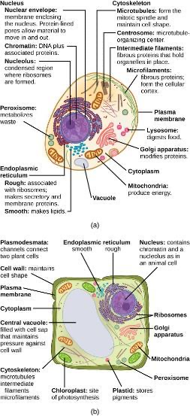

Slide 21
Organelles
All eukaryotic cells have internal membranes that divide the cell into compartments—the organelles
Plant and animal cells have most of the same organelles

Slide 22
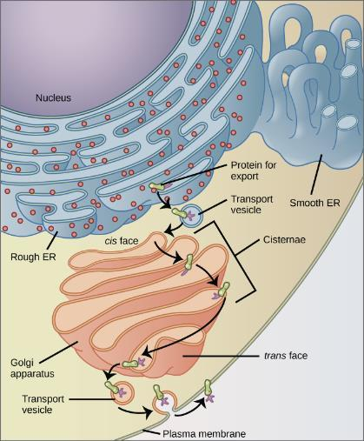
Endomembrane System
The endomembrane system is a group of membranes and organelles in eukaryotic cells that work together to modify, package, and transport lipids and proteins. It includes:
  the nuclear envelope
  lysosomes and vesicles
  the endoplasmic reticulum
  Golgi apparatus
  the plasma membrane

Slide 23
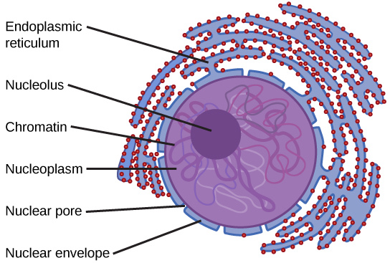
Nucleus
Typically, the nucleus is the most prominent organelle in a cell and houses the cell’s DNA in the form of chromatin
  DNA and associated proteins
The outermost boundary of the nucleus is the nuclear envelope. Notice that the nuclear envelope consists of a “double membrane”—an outer membrane and an inner membrane—in contrast to the plasma membrane, which consists of only one phospholipid bilayer.

Slide 24
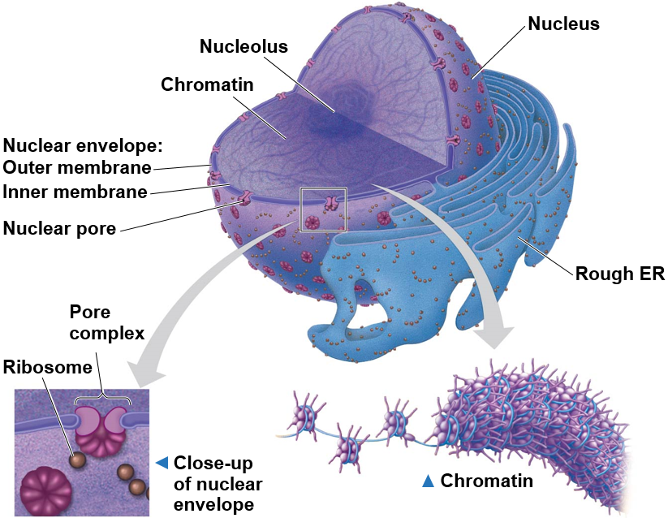
The eukaryotic cell’s genetic instructions are mostly housed in the nucleus and carried out by the ribosomes
Ribosomes use the information stored in the DNA to make proteins

Slide 25
Endoplasmic Reticulum (ER)
A series of interconnected membranes that modify proteins and synthesize lipids and is continuous with the nuclear envelope.
The rough endoplasmic reticulum has ribosomes attached to its cytoplasmic surface that give it a rough appearance when viewed through a microscope.
  also makes phospholipids for cell membranes.
  because it’s engaged in modifying proteins that will be secreted from the cell, it is abundant in cells that secrete proteins, such as the liver.
The smooth endoplasmic reticulum has few or no ribosomes on its cytoplasmic surface. The SER’s functions include synthesis of carbohydrates, lipids (including phospholipids), and steroid hormones.

Slide 26
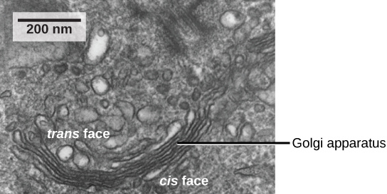
Golgi Apparatus
The Golgi apparatus in this transmission electron micrograph of a white blood cell is visible as a stack of semicircular flattened rings in the lower portion of this image. Several vesicles can be seen near the Golgi apparatus.

Slide 27
Golgi Apparatus
The vesicles that bud from the ER need to be sorted and this is done in the Golgi apparatus a series of flattened membranous sacs.
has a receiving face near the ER and a releasing face on the side away from the ER, toward the cell membrane.
The transport vesicles that form from the ER travel to the receiving face, fuse with it, and empty their contents into the lumen of the Golgi apparatus.
As the proteins and lipids travel through the Golgi, they undergo further modifications. The most frequent modification is the addition of short chains of sugar molecules. The newly modified proteins and lipids are then tagged with small molecular groups to enable them to be routed to their proper destinations.
Finally, the modified and tagged proteins are packaged into vesicles that bud from the opposite face of the Golgi.
While some of these vesicles, transport vesicles, deposit their contents into other parts of the cell where they will be used, others, secretory vesicles, fuse with the plasma membrane and release their contents outside the cell.
While some of these vesicles, transport vesicles, deposit their contents into other parts of the cell where they will be used, others, secretory vesicles, fuse with the plasma membrane and release their contents outside the cell.

Slide 28
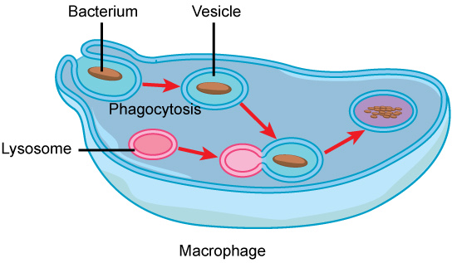
Macrophage (example of cells with lots of lysosomes)
A macrophage (an immune cell) has phagocytized a potentially pathogenic bacterium into a vesicle, which then fuses with a lysosome within the cell so that the pathogen can be destroyed. Other organelles are present in the cell, but for simplicity, are not shown.

Slide 29
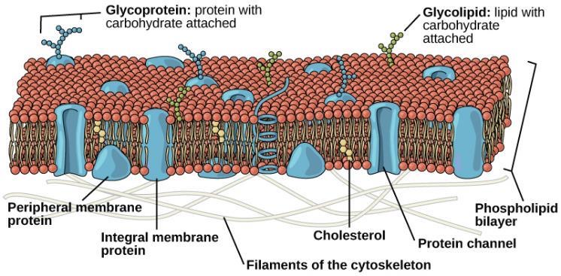
Plasma Membrane
Prokaryotes and Eukaryotes both have a plasma membrane
  made up of a phospholipid bilayer with embedded proteins
  separates the inside of the cell from its surrounding environment.
  regulates the passage of some substances
  prevents the passage of some other substances to maintain internal conditions
  actively brings in or removing others

Slide 30
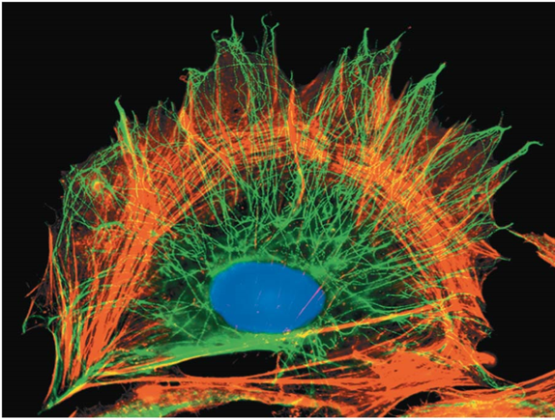
The cytoskeleton is a network of fibers that organizes structures and activities in the cell
The cytoskeleton is a network of fibers extending throughout the cytoplasm
It organizes the cell’s structures and activities, anchoring many organelles
Enables some cell types to move

Slide 31
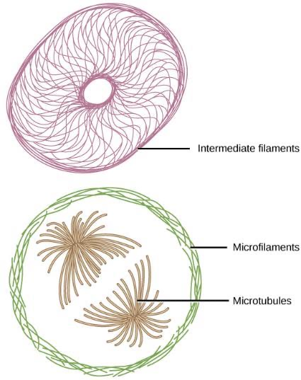
Cytoskeleton
The Cytoskeleton is a network of protein fibers that helps to:
  maintain the shape of the cell
  secures certain organelles in specific positions
  allows cytoplasm and vesicles to move within the cell
  enables unicellular organisms to move independently.
There are three types of fibers within the cytoskeleton:
  Microfilaments (also known as actin filaments)
  intermediate filaments
  microtubules
Microfilaments are the thinnest of the cytoskeletal fibers and function in moving cellular component
Intermediate filaments are of intermediate diameter and have structural functions, such as maintaining the shape of the cell and anchoring organelles
Microtubules are the thickest of the cytoskeletal fibers that guide organelle movement and are the structures that pull chromosomes to their poles during cell division
Microfilaments, intermediate filaments, and microtubules compose a cell’s cytoskeleton.

Slide 32
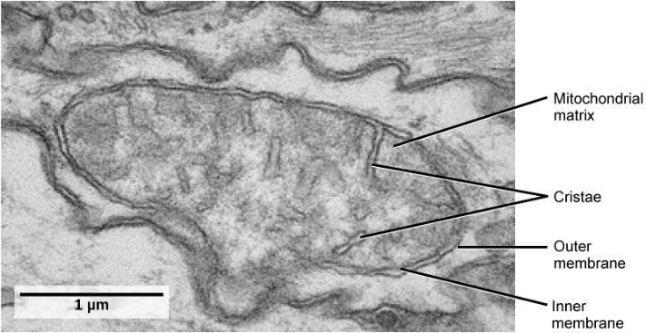
Mitochondria
This transmission electron micrograph shows a mitochondrion as viewed with an electron microscope. Notice the inner and outer membranes, the cristae, and the mitochondrial matrix.

Slide 33
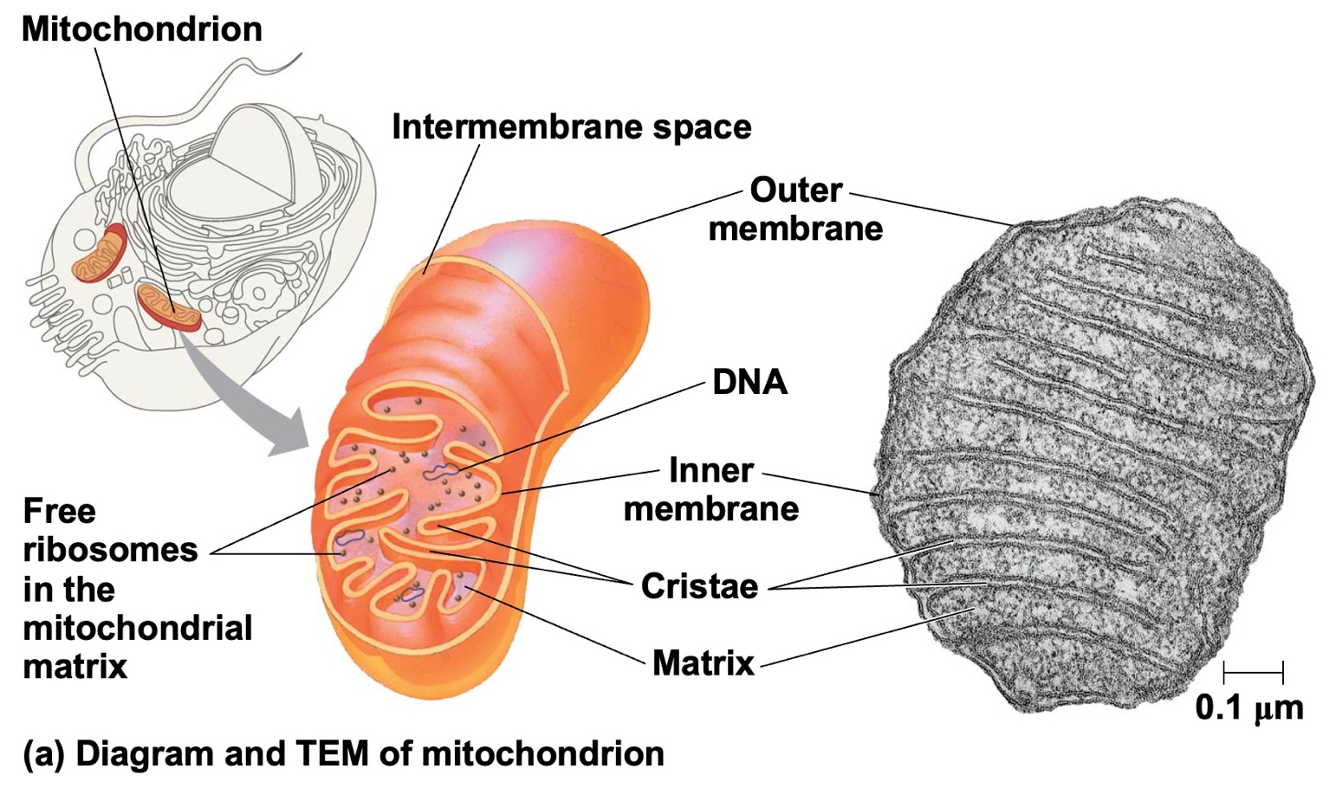
Mitochondria
Mitochondria are responsible for making adenosine triphosphate (ATP), the cell’s main energy-carrying molecule via the breakdown of glucose using cellular respiration.
Mitochondria are oval-shaped, double-membrane organelles that have their own ribosomes and DNA.
Each membrane is a phospholipid bilayer embedded with proteins. The inner layer has folds called cristae, which increase the surface area of the inner membrane. The area surrounded by the folds is called the mitochondrial matrix.

Slide 34
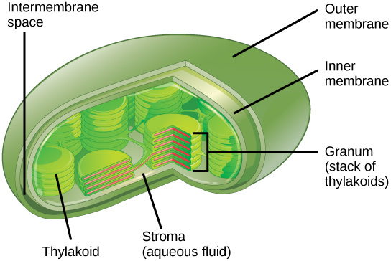
Chloroplast
Like mitochondria, chloroplasts also have their own DNA and ribosomes.
Chloroplasts function in photosynthesis and can be found in eukaryotic cells such as plants and algae.
Like mitochondria, chloroplasts have outer and inner membranes, but within the space enclosed by a chloroplast’s inner membrane is a set of interconnected and stacked, fluid-filled membrane sacs called thylakoids.
Each stack of thylakoids is called a granum.
The fluid enclosed by the inner membrane and surrounding the grana is called the stroma.

Slide 35
Fluid Mosaic Model
The fluid mosaic model of the plasma membrane structure describes the plasma membrane as a fluid combination of phospholipids, cholesterol, proteins, and carbohydrates.
The plasma membrane is a phospholipid bilayer with embedded proteins. There are other components, such as cholesterol and carbohydrates, which can be found in the membrane in addition to phospholipids and protein.

Slide 36
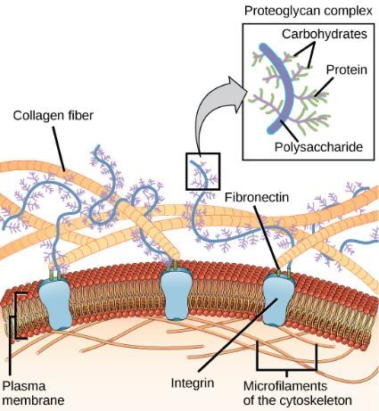
Extracellular Matrix
Most animal cells release materials into the extracellular space.
The primary components of these materials are glycoproteins and the protein collagen.
Collectively, these materials are called the extracellular matrix.
Not only does the extracellular matrix hold the cells together to form a tissue, but it also allows the cells within the tissue to communicate with each other.
The extracellular matrix consists of a network of substances secreted by cells.

Slide 37
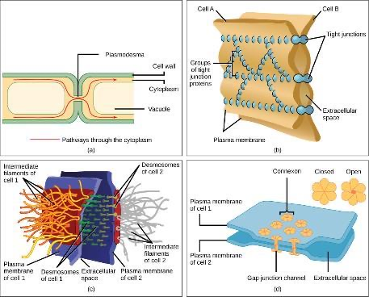
Intercellular Junctions
Cells can also communicate with each other by direct contact, referred to as intercellular junctions.
In general, long stretches of the plasma membranes of neighboring plant cells cannot touch one another because they are separated by the cell walls surrounding each cell. Plasmodesmata are numerous channels that pass between the cell walls of adjacent plant cells, connecting their cytoplasm and enabling signal molecules and nutrients to be transported from cell to cell.
A tight junction is a watertight seal between two adjacent animal cells. Proteins hold the cells tightly against each other preventing materials from leaking between the cells.
Also found only in animal cells are desmosomes, which act like spot welds between adjacent epithelial cells. They keep cells together in a sheet-like formation in organs and tissues that stretch, like the skin, heart, and muscles.
Gap junctions in animal cells are like plasmodesmata in plant cells in that they are channels between adjacent cells that allow for the transport of ions, nutrients, and other substances that enable cells to communicate.
There are four kinds of connections between cells. (a) A plasmodesma is a channel between the cell walls of two adjacent plant cells. (b) Tight junctions join adjacent animal cells. (c) Desmosomes join two animal cells together. (d) Gap junctions act as channels between animal cells.

Slide 38
Transport Across a Plasma Membrane
Plasma membranes must allow certain substances to enter and leave a cell, while preventing harmful material from entering and essential material from leaving.
Thus, plasma membranes are selectively permeable—they allow some substances through but not others.
Some cells require larger amounts of specific substances than do other cells; they must have a way of obtaining these materials from the extracellular fluids.
This may happen passively, as certain materials move back and forth, or the cell may have special mechanisms that ensure transport.
Most cells expend most of their energy, in the form of adenosine triphosphate (ATP), to create and maintain an uneven distribution of ions on the opposite sides of their membranes using active transport.
Passive transport is a naturally occurring phenomenon and does not require the cell to expend energy to accomplish the movement.
  In passive transport, substances move from an area of higher concentration to an area of lower concentration in a process called diffusion.
  A physical space in which there is a different concentration of a single substance is said to have a concentration gradient.

Slide 39
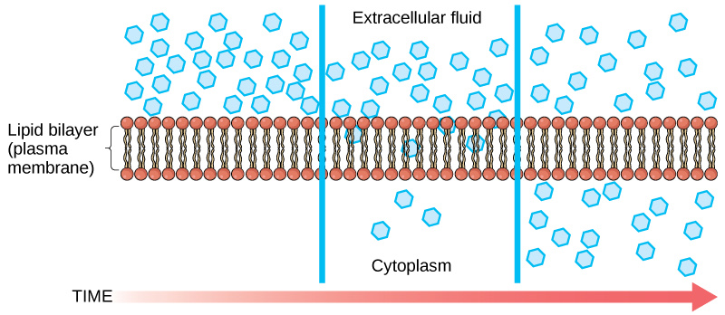
Diffusion Through a Permeable Membrane
Diffusion through a permeable membrane follows the concentration gradient of a substance -
moving the substance from an area of high concentration to one of low concentration.

Slide 40
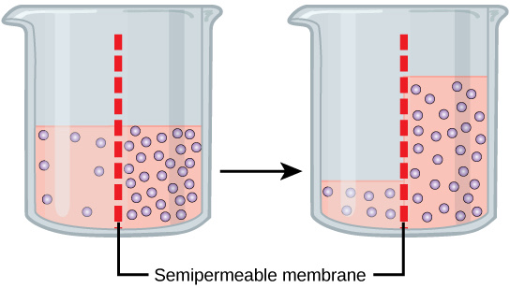
Reminder: Diffusion Through a Permeable Membrane
????
In osmosis, water always moves from an area of higher concentration (of water) to one of lower concentration (of water). In this system, the solute cannot pass through the selectively permeable membrane.

Slide 41
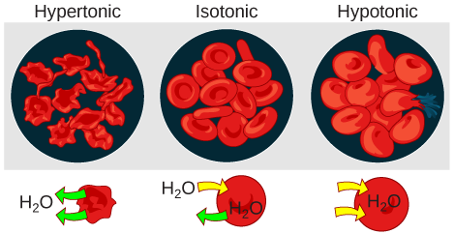
Diffusion Through a Permeable Membrane
Osmotic pressure changes the shape of red blood cells in hypertonic, isotonic, and hypotonic solutions.

Slide 42
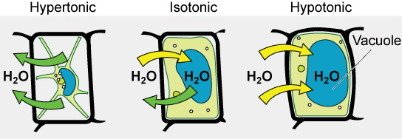
Diffusion Through a Permeable Membrane
The turgor pressure within a plant cell depends on the tonicity of the solution that it is bathed in.

Slide 43
Transport Across a Plasma Membrane
Active transport mechanisms require the use of the cell’s energy, usually in the form of adenosine triphosphate (ATP).
If a substance must move into the cell against its concentration gradient the cell must use energy to move the substance.
Some active transport mechanisms move small-molecular weight material, such as ions, through the membrane.
In addition to moving small ions and molecules through the membrane, cells also need to remove and take in larger molecules and particles.

Slide 44
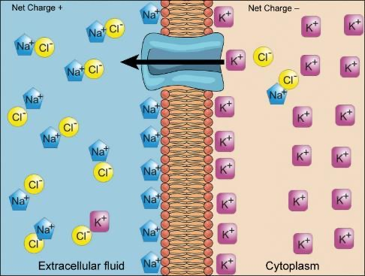
Electrochemical Gradients
Because cells contain proteins, most of which are negatively charged, there is an electrical gradient across the plasma membrane.
  The interior of living cells is electrically negative with respect to the extracellular fluid in which they are bathed
  at the same time, cells have higher concentrations of potassium (K+) and lower concentrations of sodium (Na+) than does the extracellular fluid. Thus, in a living cell, the concentration gradient and electrical gradient of Na+ promotes diffusion of the ion into the cell, and the electrical gradient of Na+ tends to drive it inward to the negatively charged interior.
The situation is more complex, however, for other elements such as potassium. The electrical gradient of K+ promotes diffusion of the ion into the cell, but the concentration gradient of K+ promotes diffusion out of the cell. The combined gradient that affects an ion is called its electrochemical gradient
Electrochemical gradients arise from the combined effects of concentration gradients and electrical gradients.

Slide 45
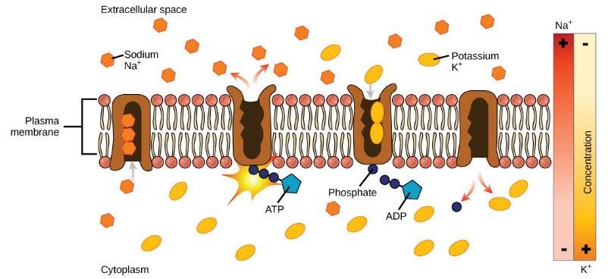
Active Transport
The sodium-potassium pump move potassium and sodium ions across the plasma membrane.

Slide 46
Active Transport
Primary active transport moves ions across a membrane and creates a difference in charge across that membrane.
  Uses ATP to move a substance, such as an ion, into the cell, and often at the same time, a second substance is moved out of the cell.
  The sodium-potassium pump, expends energy to move potassium ions into the cell and a different number of sodium ions out of the cell
  Results in a concentration and charge difference across the membrane.

Slide 47
Active Transport
Secondary active transport describes the movement of material using the energy of the electrochemical gradient established by primary active transport.
Using the energy of the electrochemical gradient created by the primary active transport system, other substances such as amino acids and glucose can be brought into the cell through membrane channels.

Slide 48
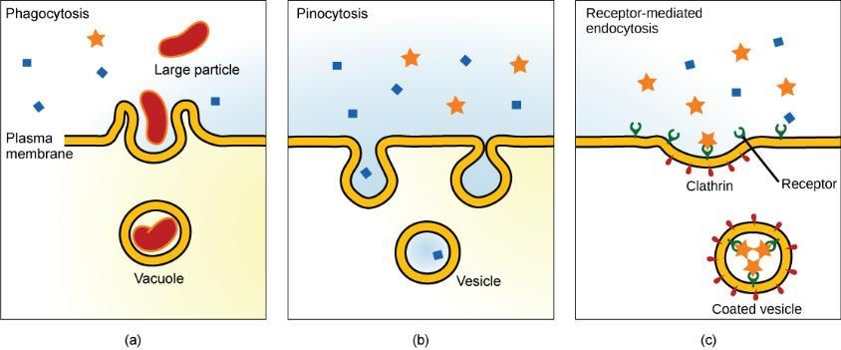
Endocytosis
Endocytosis is a type of active transport that moves particles, such as large molecules, parts of cells, and even whole cells, into a cell.
There are different variations of endocytosis, but all share a common characteristic:
The plasma membrane of the cell invaginates, forming a pocket around the target particle.
The pocket pinches off, resulting in the particle being contained in a newly created vacuole that is formed from the plasma membrane.

Slide 49
Endocytosis
Three variations of endocytosis are shown.
In one form of endocytosis, phagocytosis, the cell membrane surrounds the particle and pinches off to form an intracellular vacuole.
In another type of endocytosis, pinocytosis, the cell membrane surrounds a small volume of fluid and pinches off, forming a vesicle.
In receptor-mediated endocytosis, uptake of substances by the cell is targeted to a single type of substance that binds at the receptor on the external cell membrane.

Slide 50
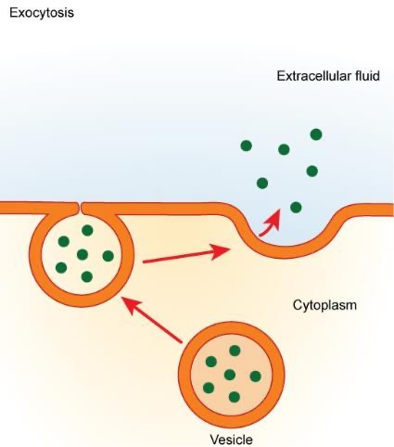
Exocytosis
Exocytosis is the opposite of the processes on the previous slides
  Its purpose is to expel material from the cell into the extracellular fluid.
  A particle enveloped in membrane fuses with the interior of the plasma membrane.
  This fusion opens the membranous envelope to the exterior of the cell, and the particle is expelled into the extracellular space
In exocytosis, a vesicle migrates to the plasma membrane, binds, and releases its contents to the outside of the cell.

