Slide 1
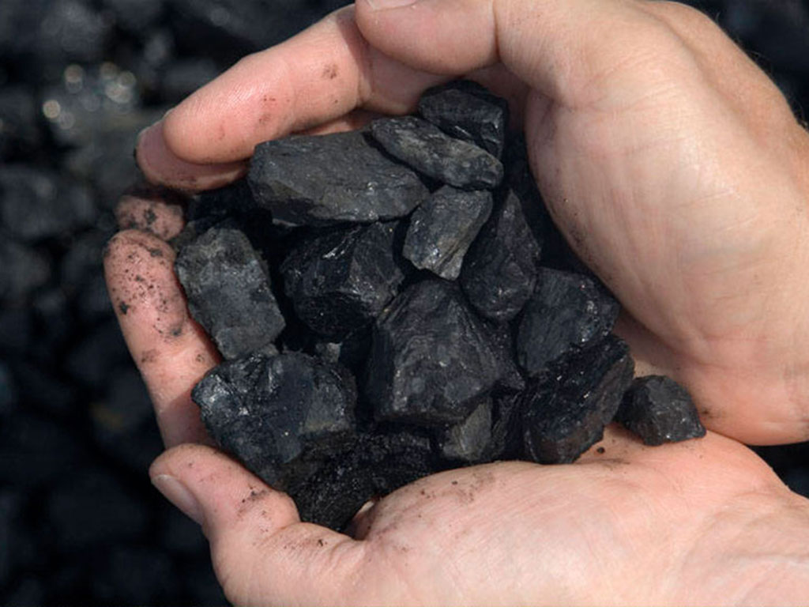
BIO10: Introduction to Principles of Biology
Dr. Paul Bradley
Biological Molecules

Slide 2
By the end of this section you will be able to:
Describe the ways in which carbon is critical to life
Explain the impact of slight changes in amino acids on organisms
Describe the four major types of biological molecules
Understand the functions of the four major types of molecules
  Carbs, Lipids, Proteins, Nucleic Acids

Slide 3
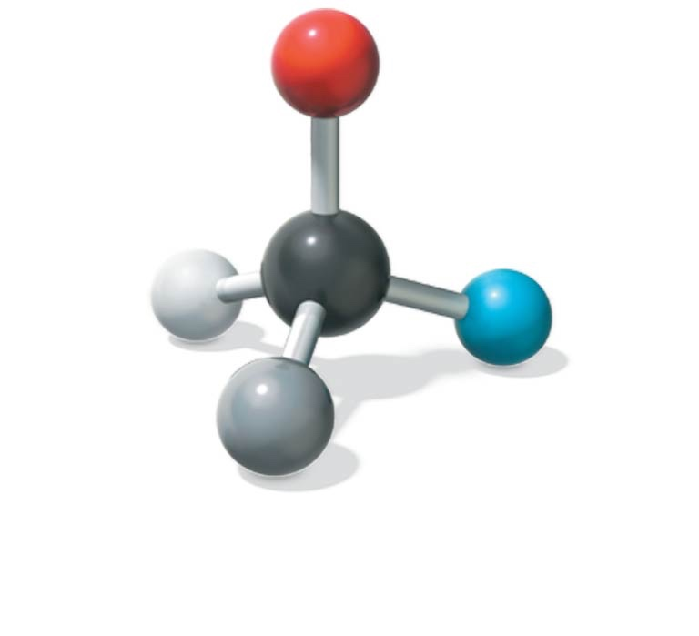
Carbon
Carbon is unparalleled in its ability to form large, complex, and varied molecules
Proteins, DNA, carbohydrates, and other molecules that distinguish living matter are all composed of carbon compounds
Carbon can bond to four other atoms or
groups of atoms, making a large variety of
molecules possible.

Slide 4
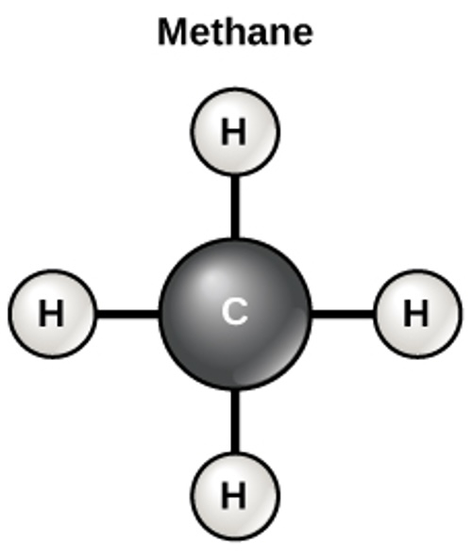
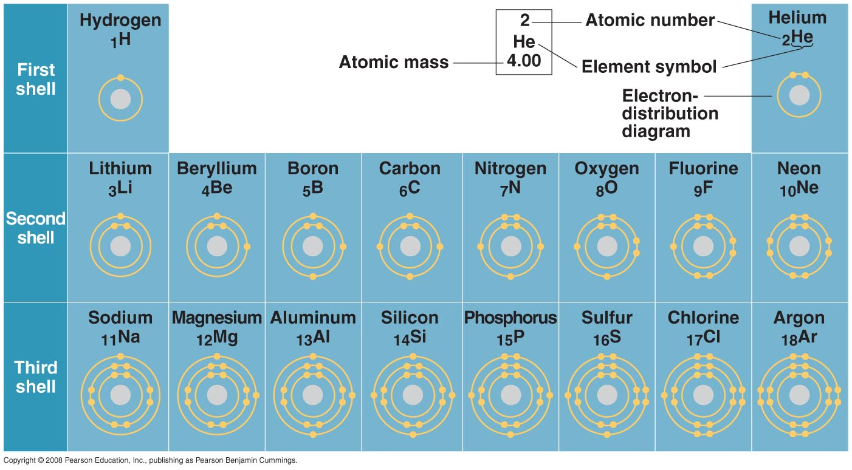
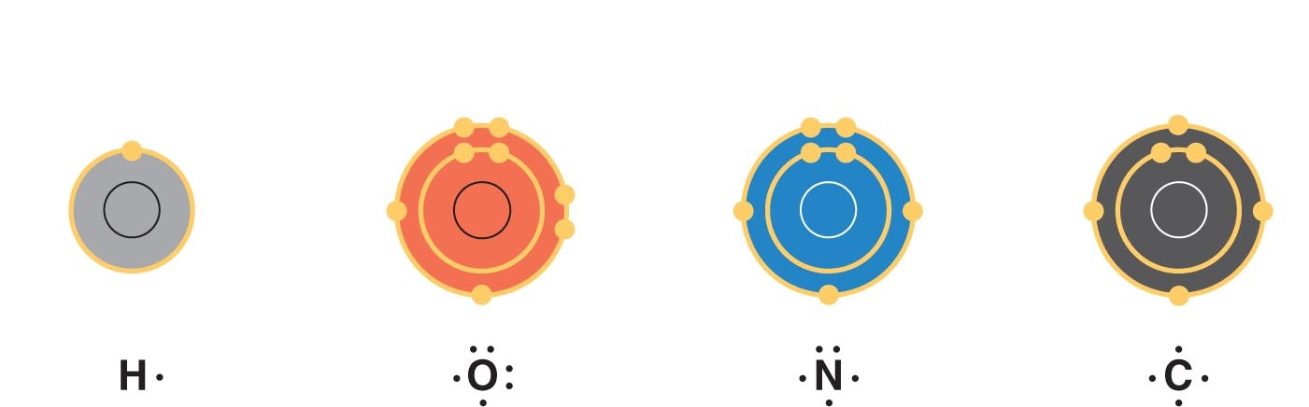
Why is all life carbon based?
The electron configuration of carbon gives it covalent compatibility with many different elements
The valences of carbon and its most frequent partners (hydrogen, oxygen, and nitrogen) are the “building code” that governs the architecture of living molecules

Slide 5
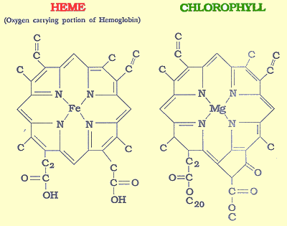
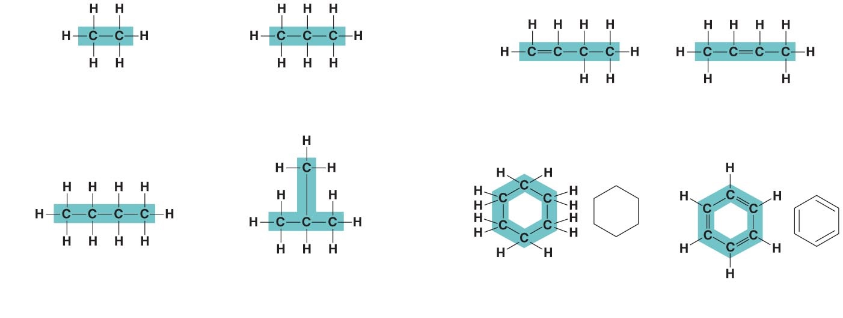
Molecular Diversity Arising from Carbon Skeleton Variation
Carbon chains form the skeletons of most organic molecules
Carbon atoms allow for cells to build complex macromolecules
variation in length
double bonds
branching
rings

Slide 6
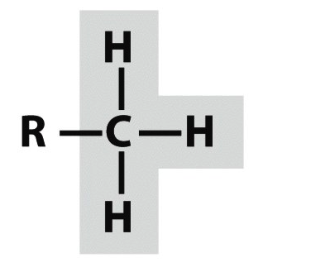
A small number of chemical groups are key to the functioning of biological molecules
Distinctive properties of organic molecules depend not only on the carbon skeleton but also on the molecular components attached to it
A number of characteristic groups are often attached to skeletons of organic molecules
Functional groups are the components of organic molecules that are most commonly involved in chemical reactions
The number and arrangement of functional groups give each macromolecule its unique properties

Slide 7
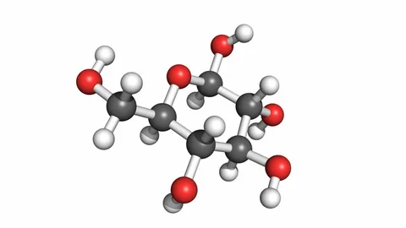
Carbohydrates
Carbohydrates provide energy to the body, particularly through glucose, a simple sugar.
Carbohydrates also have other important functions in humans, animals, and plants.
Carbohydrates can be represented by the formula (CH₂O)_{n}, where n is the number of carbon atoms in the molecule.
  In other words, the ratio of carbon to hydrogen to oxygen is 1:2:1 in carbohydrate molecules.
  Carbohydrates are classified into three subtypes: monosaccharides, disaccharides, and polysaccharides.
Sucrose (one of many carbohydrates)

Slide 8
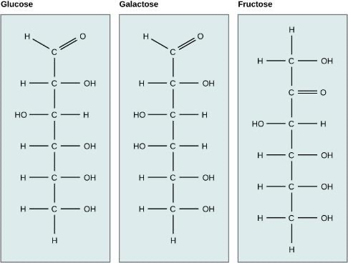
Monosaccharides (Carbs)
Monosaccharides are simple sugars, the most common of which is glucose.
The number of carbon atoms usually ranges from three to six.
Depending on the number of carbon atoms in the sugar, they may be known as trioses (three carbon atoms), pentoses (five carbon atoms), and hexoses (six carbon atoms).
Monosaccharides may exist as a:
  linear chain
  ring-shaped molecules
In most living species, glucose is an important source of energy.
  During cellular respiration, energy is released from glucose, and that energy is used to help make ATP.
  Plants synthesize glucose using photosynthesis, and the glucose, in turn, is used for the energy requirements of the plant.
Glucose, galactose, and fructose are isomeric monosaccharides, meaning that they have the same chemical formula but slightly different structures.

Slide 9
Monosaccharides (Carbs)
Galactose (part of lactose, or milk sugar) and fructose (found in fruit) are other common monosaccharides.
Glucose, galactose, and fructose all have the same chemical formula (C₆H₁₂O₆)
  But they differ structurally and chemically (and are known as isomers) because of differing arrangements of atoms in the carbon.
Glucose, galactose, and fructose are isomeric monosaccharides, meaning that they have the same chemical formula but slightly different structures.

Slide 10
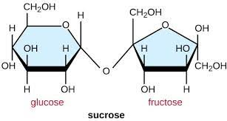
Disaccharides (Carbs)
Disaccharides form when two monosaccharides undergo a chemical reaction and combine
Common disaccharides:
  Lactose is a disaccharide consisting of the monomers glucose and galactose.
  Maltose, or malt sugar, is a disaccharide formed from two glucose molecules.
  The most common disaccharide is sucrose, or table sugar, which is composed of the monomers glucose and fructose.

Slide 11
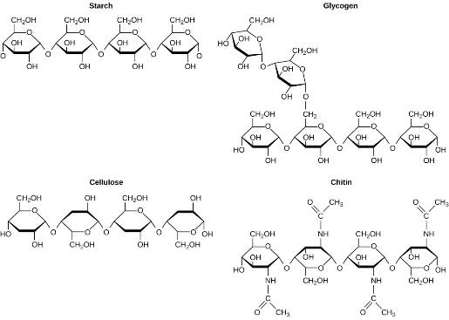
Polysaccharides (Carbs)
A long chain of monosaccharides linked by covalent bonds is known as a polysaccharide.
The chain may be branched or unbranched, and it may contain different types of monosaccharides.
Examples:
  Starch
  Glycogen
  Cellulose
  Chitin
Although their structures and functions differ, all polysaccharide carbohydrates are made up of monosaccharides and have the chemical formula (CH₂O)n.

Slide 12
Starch (Carbs)
Starch is the stored form of sugars in plants and is made up of amylose and amylopectin
  both polymers of glucose
Plants are able to synthesize glucose, and the excess glucose is stored as starch in different plant parts, including roots and seeds.
The starch that is consumed by animals is broken down into smaller molecules, such as glucose.
The animal cells can then absorb the glucose.
Although their structures and functions differ, all polysaccharide carbohydrates are made up of monosaccharides and have the chemical formula (CH₂O)n.

Slide 13
Glycogen (Carbs)
Glycogen is a multibranched
polysccharide of glucose
that serves as a form of energy storage in animals, fungi, and bacteria.
It represents the main storage form of glucose in the body.
Although their structures and functions differ, all polysaccharide carbohydrates are made up of monosaccharides and have the chemical formula (CH₂O)n.

Slide 14
Cellulose (Carbs)
Cellulose is one of the most abundant biological molecules and make up the cell walls of plants
Cellulose is made up of glucose monomers that are linked by bonds between particular carbon atoms in the glucose molecule.
The molecular shape is extended long chains giving cellulose its rigidity and high tensile strength—which is so important to plant cells.
Enzymes called cellulases can break down cellulose into glucose that can be used as an energy source by the animal.
Although their structures and functions differ, all polysaccharide carbohydrates are made up of monosaccharides and have the chemical formula (CH₂O)n.

Slide 15
Chitin (Carbs)
Arthropods, such as insects, spiders, and crabs, have an exoskeleton, which protects their internal body parts made of the biological macromolecule chitin, which is a nitrogenous carbohydrate.
It is made of repeating units of a modified sugar containing nitrogen.
Although their structures and functions differ, all polysaccharide carbohydrates are made up of monosaccharides and have the chemical formula (CH₂O)n.

Slide 16
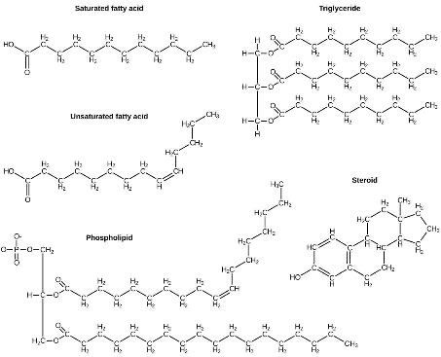
Lipids
Lipids include a diverse group of compounds that are united by a common feature – they are nonpolar and thus are hydrophobic.
  This is because they are hydrocarbons that include only nonpolar carbon-carbon or carbon-hydrogen bonds.
Lipids include fats, oils, waxes, phospholipids, and steroids.
Lipids include fats, such as triglycerides, which are made up of fatty acids and glycerol, phospholipids, and steroids.

Slide 17
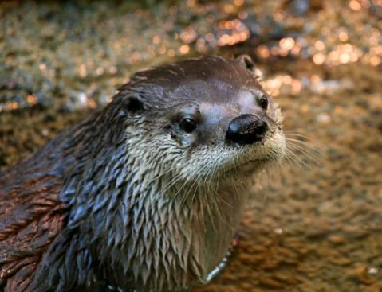
Lipids
Lipids perform many different functions in a cell.
  Cells store energy for long-term use in the form of lipids called fats.
  Lipids also provide insulation from the environment for plants and animals
    They help keep aquatic birds and mammals dry because of their water-repelling nature.
Hydrophobic lipids in the fur of aquatic mammals, such as this river otter, protect them from the elements.

Slide 18
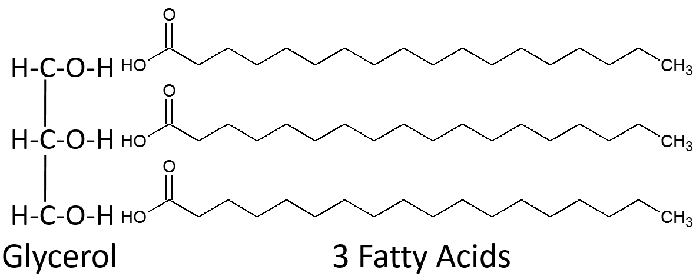
Fats (Lipid)
A fat molecule, such as a triglyceride, consists of two main components—glycerol and fatty acids.
Glycerol is an organic compound with three carbon atoms, five hydrogen atoms, and three hydroxyl (–OH) groups.
Fatty acids have a long chain of hydrocarbons to which an acidic carboxyl group is attached, hence the name “fatty acid.”
The number of carbons in the fatty acid may range from 4 to 36; most common are those containing 12–18 carbons.

Slide 19
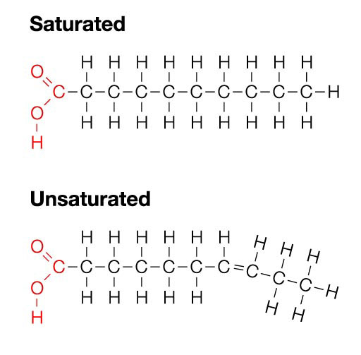
Saturated & Unsaturated Fatty Acids (Lipid)
Fatty acids may be saturated or unsaturated.
In a fatty acid chain, if there are only single bonds between neighboring carbons in the hydrocarbon chain, the fatty acid is saturated with hydrogen; in other words, the number of hydrogen atoms attached to the carbon skeleton is maximized.
When the hydrocarbon chain contains a double bond, the fatty acid is an unsaturated fatty acid.
Most unsaturated fats are liquid at room temperature and are called oils.
  If there is one double bond in the molecule, then it is known as a monounsaturated fat (e.g., olive oil), and if there is more than one double bond, then it is known as a polyunsaturated fat (e.g., canola oil).

Slide 20
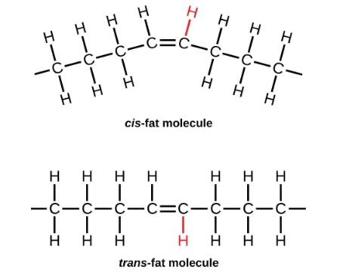
Saturated & Unsaturated Fatty Acids (Lipid)
Saturated fats tend to get packed tightly and are solid at room temperature.
Unsaturated fats or oils are usually of plant origin and contain unsaturated fatty acids.
  The double bond causes a bend or a “kink” that prevents the fatty acids from packing tightly, keeping them liquid at room temperature.
  Olive oil, corn oil, canola oil, and cod liver oil are examples of unsaturated fats.).
In the food industry, oils are artificially hydrogenated to make them semi-solid, leading to less spoilage and increased shelf life.
Margarine, some types of peanut butter, and shortening are examples of artificially hydrogenated trans-fats.
  May lead to an increase in levels of low-density lipoprotein (LDL), or “bad” cholesterol
During the hydrogenation process, the orientation around the double bonds is changed, making a trans-fat from a cis-fat. The orientation of the double bonds affects the chemical properties of the fat.

Slide 21
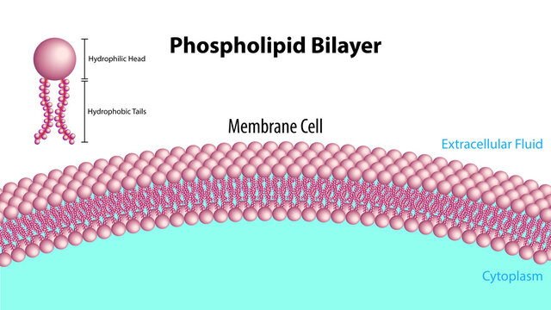
Phospholipids (Lipid)
Phospholipids are the major constituent of the plasma membrane of the cell.
Like fats, they are composed of fatty acid chains attached to a glycerol or similar backbone.
A phospholipid has both hydrophobic and hydrophilic regions.
  The fatty acid chains are hydrophobic and exclude themselves from water, whereas the phosphate is hydrophilic and interacts with water.
The fatty acids of phospholipids face inside, away from water, whereas the phosphate group can face either the outside environment or the inside of the cell, which are both aqueous.
Cells are surrounded by a membrane, which has a bilayer of phospholipids.

Slide 22
Steriods & Waxes (Lipid)
Steroids have a ring structure and are hydrophobic.
All steroids have four, linked carbon rings and several of them, like cholesterol, have a short tail.
  Ex: Cholesterol which is a key component of the plasma membranes of animal cells.
Waxes are made up of a hydrocarbon chain with an alcohol (–OH) group and a fatty acid.
Animals have waxes such as beeswax.
Plants also have waxes, such as the coating on their leaves, that helps prevent them from drying out.

Slide 23
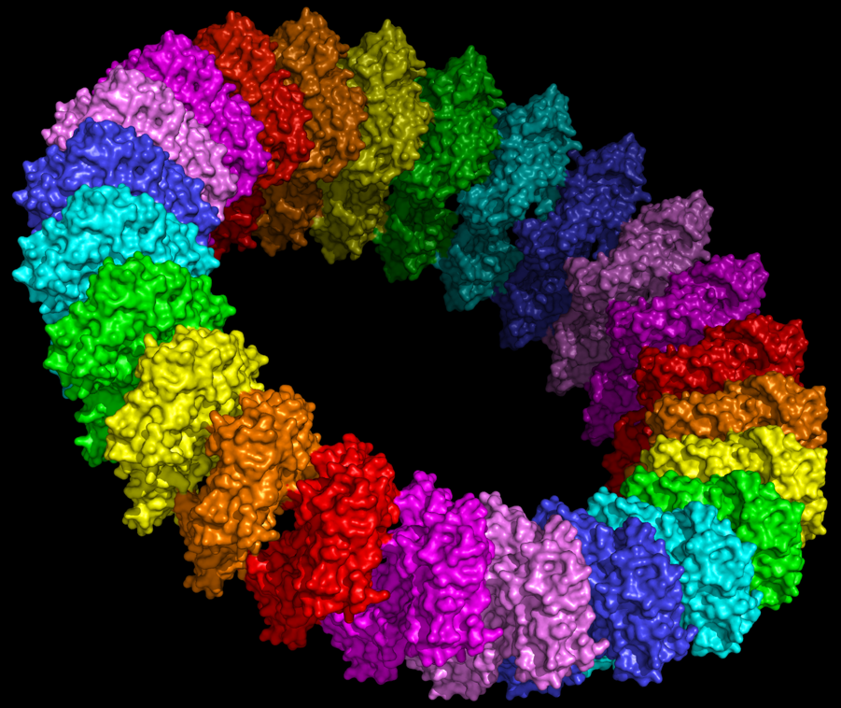
Proteins
Biologically functional molecules consisting of one or more polypeptides
Account for more than 50% of the dry mass of most cells
Functions include defense, storage, transport, cellular communication, movement, or structural support

Slide 24
Enzymes (Protein)
Enzymes are a type of protein that acts
as a catalyst to speed up chemical reactions
Enzymes can perform their functions repeatedly, functioning as workhorses that carry out the processes of life

Slide 25
What are we talking about again?
These!
These!
Amino acids – Peptides – Polypeptides - Proteins
These!
More than one of...
More than one of...
More than one of...

Slide 26
What are we talking about again?
These!
These!
Amino acids – Peptides – Polypeptides - Proteins
These!
More than one of...
More than one of...
More than one of...
Monomer
Polymer
Polymer
Polymer

Slide 27
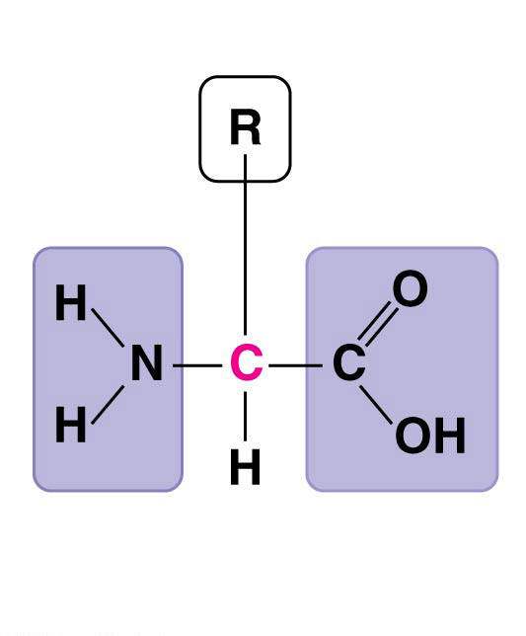
Polypeptides (Protein)
A protein consists of one or more polypeptides
Polypeptides are polymers built from a set of monomers made up of 20 different amino acids
Amino acids are organic molecules with carboxyl and amino groups

Slide 28
Amino Acids (Building Blooks of Proteins)
Amino acids differ in their properties due to differing side chains, called R groups
The R groups characterize the 20 different amino acids
Side chain (R group)
𝛂 carbon
Amino
group
Carboxyl
group
Backbone

Slide 29
Common Amino Acids

Slide 30
Proteins: Primary Structure
The primary structure of a protein is its unique sequence of amino acids
Like the order of words in a set of instructions or a recipe

Slide 31
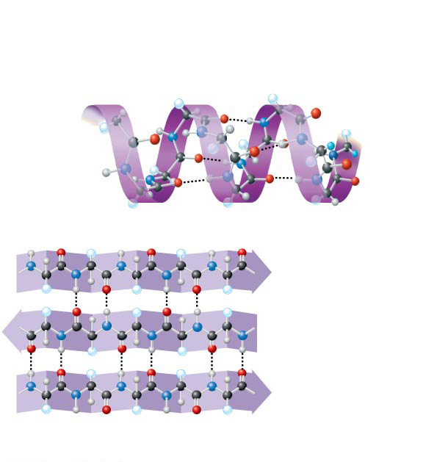
Proteins: Secondary Structure
Secondary structure, consists of coils and folds in the polypeptide chain
  Result from hydrogen bonds between parts of the polypeptide backbone
  Examples include
  α helix and a folded structure called a
  β pleated sheet
Secondary
Structure
𝛂 helix
Hydrogen bond
𝛃 strand
Hydrogen
bond
𝛃 pleated sheet
Constitutes the polypeptide backbone

Slide 32
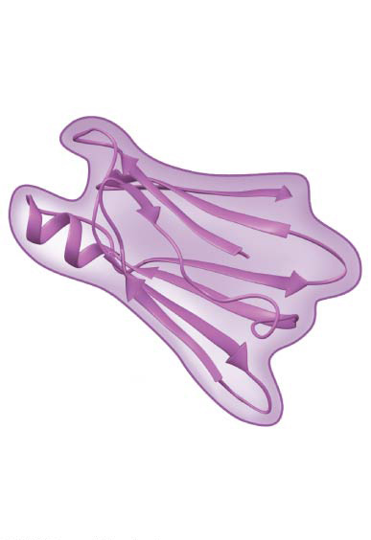
Proteins: Tertiary Structure
Tertiary structure, the overall shape of a polypeptide
  Results from interactions between R groups
  hydrogen bonds, disulfide bonds, ionic bonds, hydrophobic interactions, and van der Waals interactions
Tertiary
Structure
R group

Slide 33
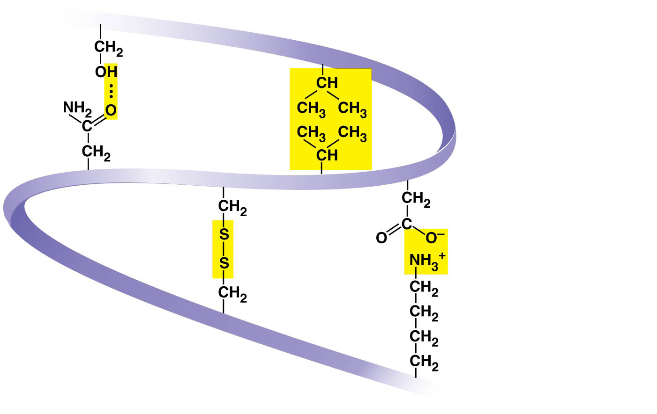
Hydrogen
bond
Hydrophobic
interactions and
Van der Waals
interactions
Disulfide
bridge
Ionic bond
The tertiary structure of proteins is dependent on the interactions of R-groups
Polypeptide
backbone

Slide 34
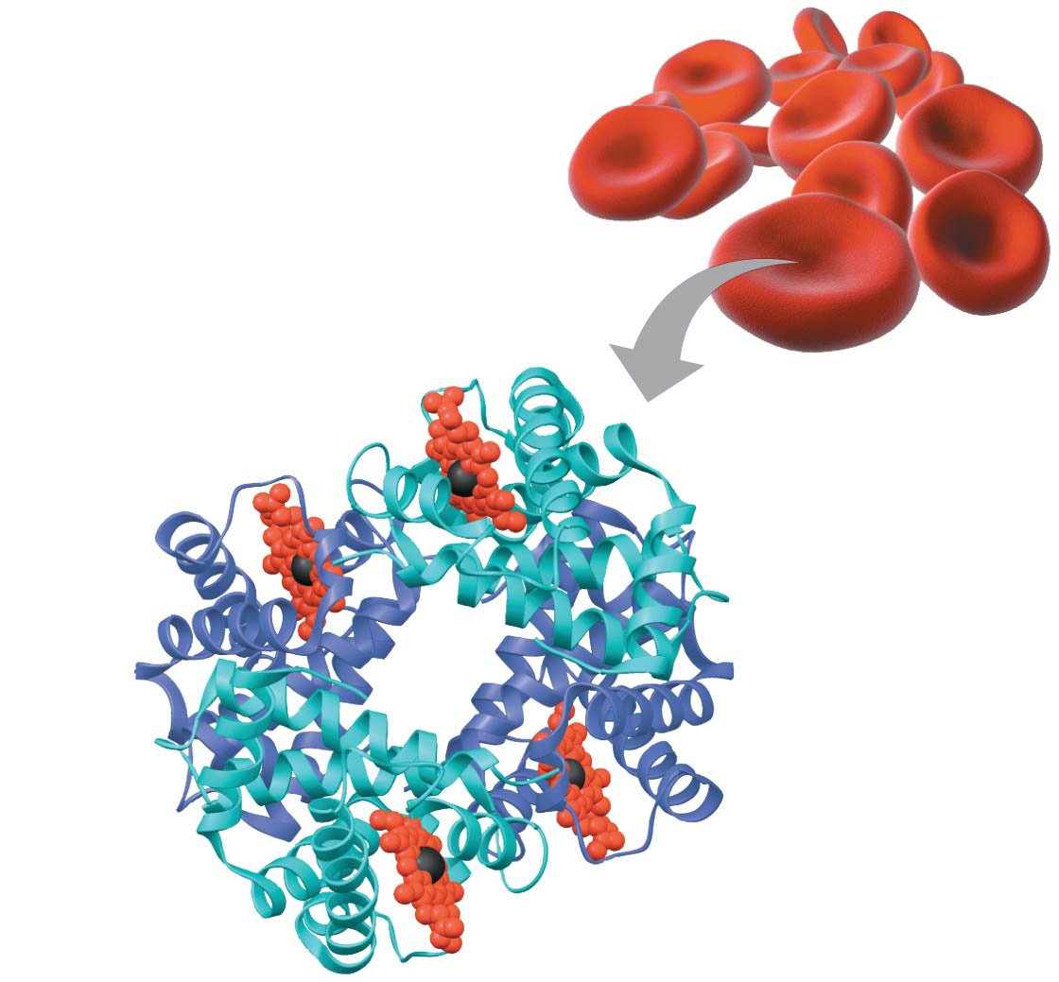
Proteins: Quaternary Structure
Quaternary structure results when two or more polypeptide chains form one macromolecule
Hemoglobin is a globular protein consisting of four polypeptides
  two alpha and two beta chains
Heme
Iron
𝛃 subunit
𝛂 subunit
𝛂 subunit
𝛃 subunit
Hemoglobin

Slide 35
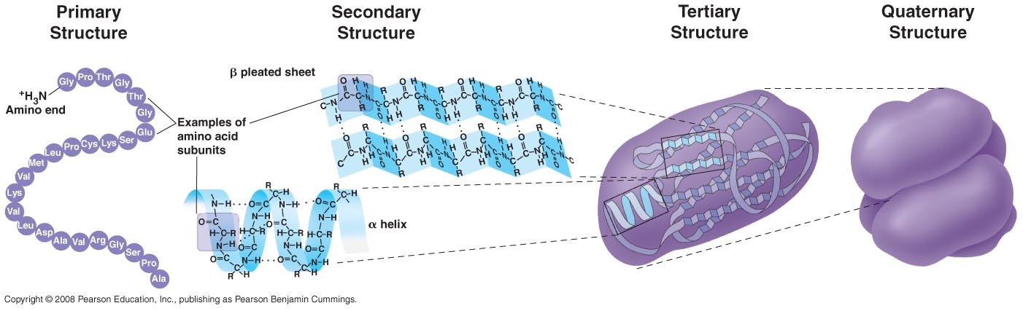
Four Levels of Structure
Each subsequent level of structure is guided by the preceding level

Slide 36
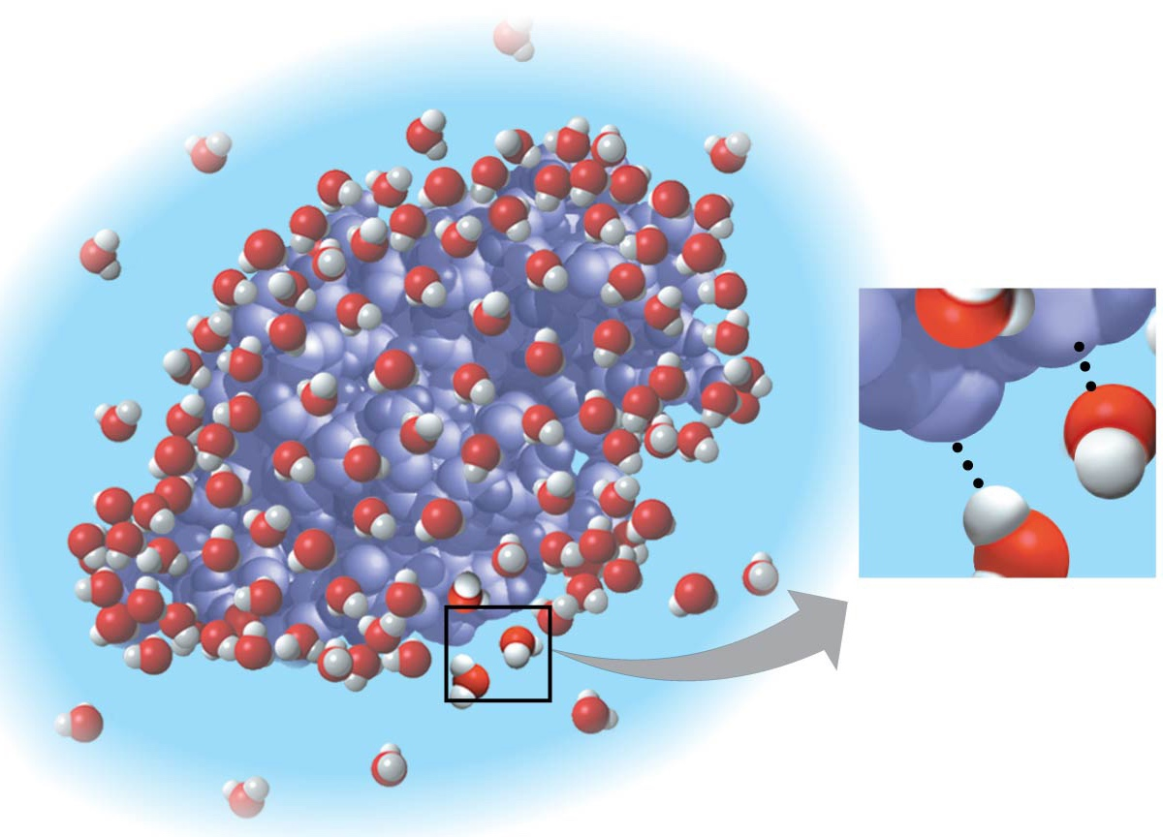
Polar bonds contribute to the solvent properties of water and dramatically affect protein structure
Nonpolar amino acids
tend to be buried inside
the folded polypeptide so they avoid interacting with water
δ+
δ−
δ−
δ+

Slide 37
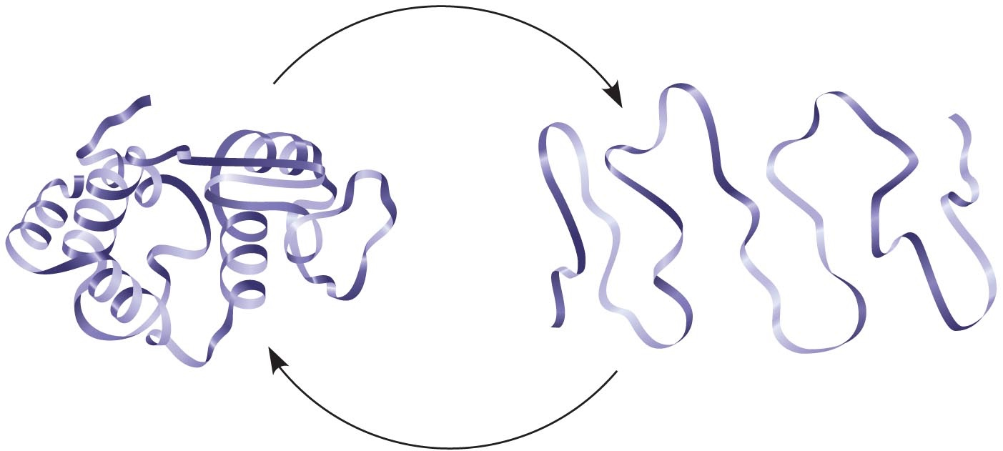
What Determines Protein Structure?
In addition to primary structure, physical and chemical conditions can affect structure
Alterations in pH, salt concentration, temperature, or other environmental factors can cause a protein to unravel
This loss of a protein’s native structure is called denaturation
A denatured protein is biologically inactive
Denaturation
Normal protein
Renaturation
Denatured protein

Slide 38
Nucleic Acids
Nucleic Acids make up genes
There are two types of nucleic acids
  Deoxyribonucleic acid (DNA)
  Ribonucleic acid (RNA)

Slide 39
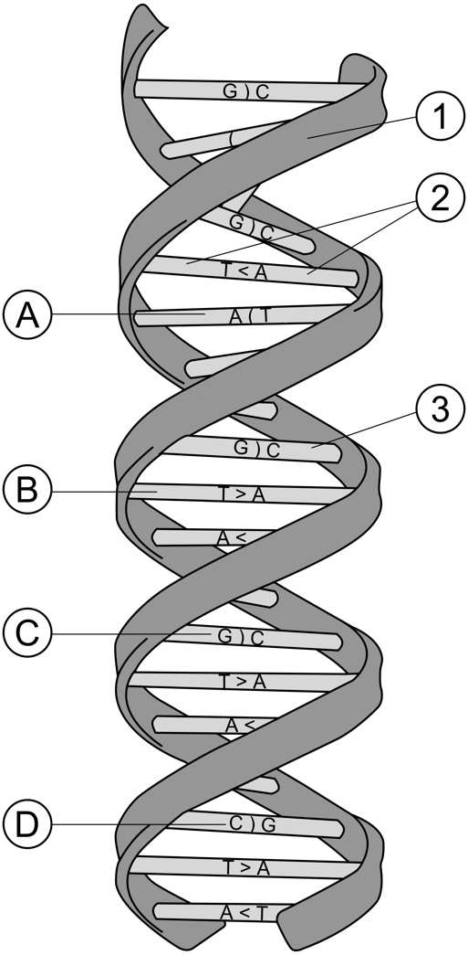
Nucleic Acids
Nucleic acids are made up of polynucleotides
  Each polynucleotide is made of nucleotides
  Each nucleotide is made up of
    a pentose sugar (deoxyribose in DNA)
    one or more phosphate groups
    a nitrogenous base
      Adenine (in DNA and RNA)
      Cytosine (in DNA and RNA)
      Guanine (in DNA and RNA)
      Thymine (in DNA)
      Uracil (in RNA)

Slide 40
Nucleotides
a nitrogenous base
a pentose sugar
one or more phosphate groups (not shown here)

Slide 41
Interior Side
Exterior Side

Slide 42
Base Pairing
  Purines only pair with pyrimidines

Slide 43
Base Pairing
Watson & Crick determined that
  adenine (A) paired only with thymine (T)
  guanine (G) paired only with cytosine (C)
Thus in any organism the amount of A = T, and the amount of G = C

Slide 44
Base Pairing
Watson & Crick determined that
  adenine (A) paired only with thymine (T)
  guanine (G) paired only with cytosine (C)
Thus in any organism the amount of A = T, and the amount of G = C

Slide 45
