Slide 1
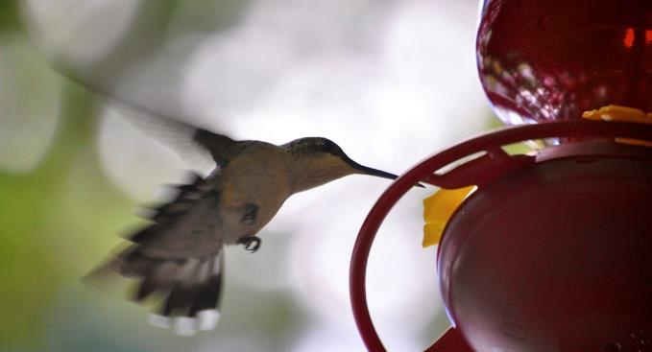
BIO10: Introduction to Principles of Biology
Dr. Paul Bradley
Energy & Membrane Transport

Slide 2
No lab tonight (2/23/22)
Next Week
  Lecture on Monday & Wednesday
  Labs on Monday & Wednesday
    Instead of lab activities there will be lecture/lab exams
    Lecture exams will cover all lecture/textbook material since the start of the semester until slide 28 of this lecture.
    Lab exams will cover all lab material since the start of the semester

Slide 3
By the end of this section you will be able to:
Explain what metabolic pathways are
State the first and second laws of thermodynamics
Explain the difference between kinetic and potential energy
Describe endergonic and exergonic reactions
Discuss how enzymes function as molecular catalysts

Slide 4
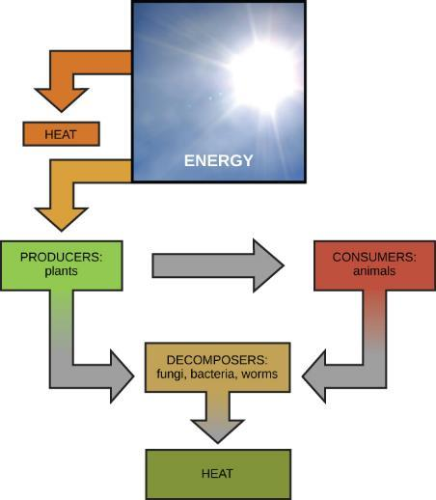
Energy Flow & Metabolism

Slide 5
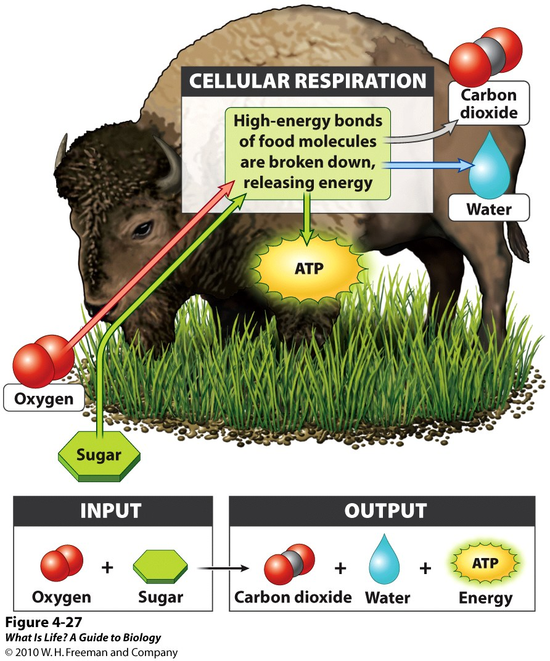
Energy Flow & Metabolism
Cellular processes such as the building and breaking down of complex molecules occur through stepwise chemical reactions.
Some of these chemical reactions are spontaneous and release energy
Together, all of the chemical reactions that take place inside cells, including those that consume or generate energy, are referred to as the cell’s metabolism.

Slide 6
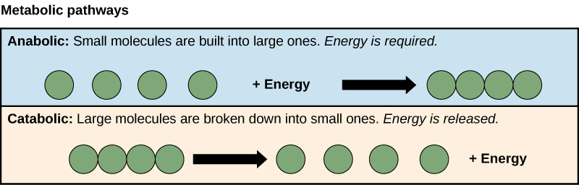
Metabolic Pathways
A metabolic pathway is a series of chemical reactions that takes a starting molecule and modifies it, step-by-step, through a series of metabolic intermediates, eventually yielding a final product.
Two types
  Anabolic pathways (building polymers) and require energy
    Example of synthesis (anabolism)
  Catabolic pathways (breaking down polymers into their monomers) and produce energy
    Example of degradation (catabolism)
Metabolic pathways do not take place on their own.
  Each reaction step is facilitated by a protein called an enzyme.

Slide 7
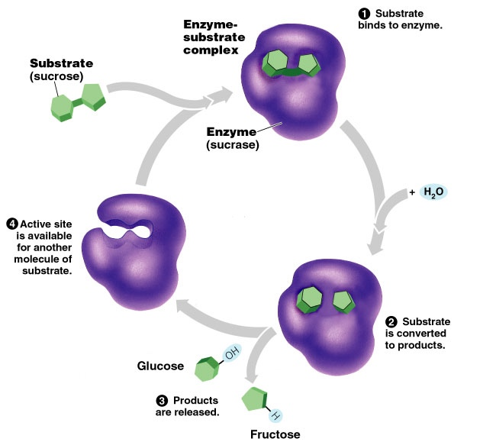
Enzymes: The Lock & Key Model
The chemical reactant to which an enzyme binds is called the substrate.
  In some reactions, a single reactant substrate is broken down into multiple products.
  In others, two substrates may come together to create one larger molecule.
The location within the enzyme where the substrate binds is called the enzyme’s active site.
  Active sites are subject to influences of the local environment.
Diffferent cellular environments can cause enzymes to denature
  A change in the three-dimensional shape and therefore the function of the enzyme.

Slide 8
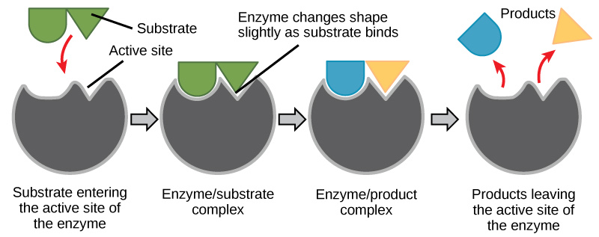
Enzymes: The Lock & Key Model
Enzymes are also suited to function best within a certain pH and salt concentration range, and, as with temperature, extreme pH, and salt concentrations can cause enzymes to denature.
For many years, scientists thought that enzyme-substrate binding took place in a simple “lock and key” fashion.
This model asserted that the enzyme and substrate fit together perfectly in one instantaneous step.

Slide 9
Enzymes: The Induced Fit Model
Current research supports a model called induced fit.
The induced-fit model expands on the lock-and-key model by describing a more dynamic binding between enzyme and substrate.
  As the enzyme and substrate come together, their interaction causes a mild shift in the enzyme’s structure that forms an ideal binding arrangement between enzyme and substrate.
  When an enzyme binds its substrate, an enzyme-substrate complex is formed.
    This complex lowers the activation energy of the reaction and promotes its rapid progression in one of multiple possible ways.
On a basic level, enzymes promote chemical reactions that involve more than one substrate by bringing the substrates together in an optimal orientation for reaction.
  Promote the reaction of their substrates is by creating an optimal environment within the active site for the reaction to occur.
  Lower activation energy by compromising the bond structure so that it is easier to break.
In these cases, it is important to remember that the enzyme will always return to its original state by the completion of the reaction.

Slide 10
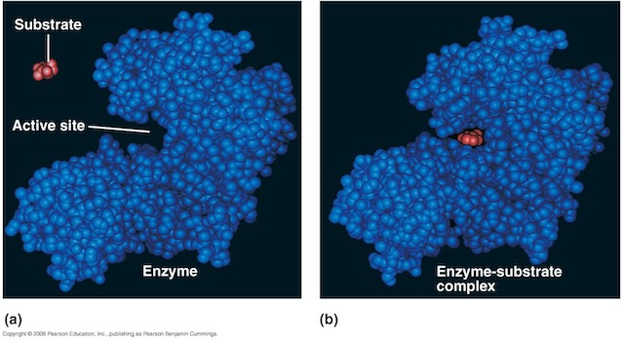
Enzymes: The Induced Fit Model
On a basic level, enzymes promote chemical reactions that involve more than one substrate by bringing the substrates together in an optimal orientation for reaction.
  Promote the reaction of their substrates is by creating an optimal environment within the active site for the reaction to occur.
  Lower activation energy by compromising the bond structure so that it is easier to break.
In these cases, it is important to remember that the enzyme will always return to its original state by the completion of the reaction.

Slide 11
Enzymes: The Induced Fit Model
In summary, the induced-fit model is an adjustment to the lock-and-key model and explains how enzymes and substrates undergo dynamic modifications during the transition state to increase the affinity of the substrate for the active site.

Slide 12
Enzyme Regulation
The rates of biochemical reactions are controlled by activation energy.
Enzymes lower and determine activation energies for chemical reactions.
Thus, the relative amounts and functioning of the variety of enzymes within a cell ultimately determine which reactions will proceed and at what rates.
In certain cellular environments, enzyme activity is partly controlled by environmental factors like pH, temperature, salt concentration, and, in some cases, cofactors or coenzymes.

Slide 13
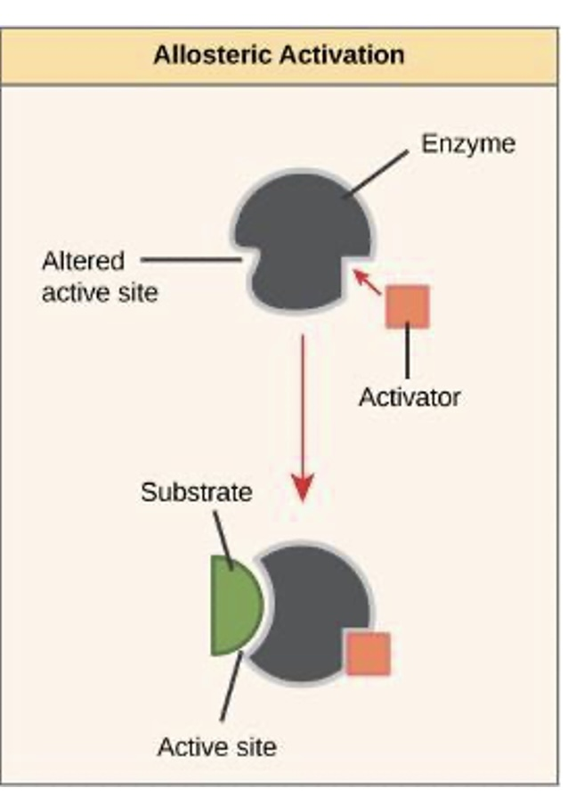
Helper Molecules
Many enzymes do not work optimally, or even at all, unless bound to other specific non-protein helper molecules.
Binding to these molecules promotes optimal shape and function of their respective enzymes.
Two examples of these types of helper molecules are:
  Cofactors
    Inorganic ions such as ions of iron and magnesium.
  Coenzymes
    Organic helper molecules, those with a basic atomic structure made up of carbon and hydrogen.
Like enzymes, these molecules participate in reactions without being changed themselves and are ultimately recycled and reused.
Some vitamins are the precursors of coenzymes and others act directly as coenzymes.
This type of activation is called allosteric activation.

Slide 14
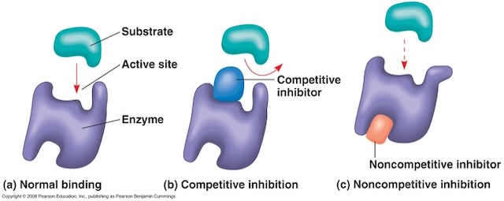
Enzyme Regulation
Enzymes can also be regulated in ways that either promote or reduce enzyme activity.
  In some cases of enzyme inhibition, an inhibitor molecule is similar enough to a substrate that it can bind to the active site and simply block the substrate from binding.
  This is called competitive inhibition, because an inhibitor molecule competes with the substrate for binding to the active site.

Slide 15
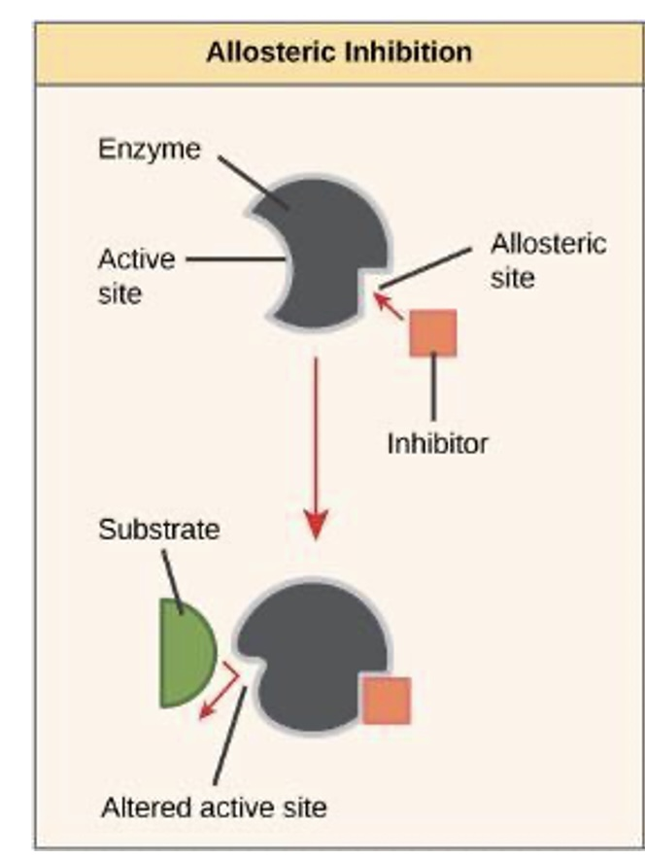
Enzyme Regulation
In noncompetitive inhibition, an inhibitor molecule binds to the enzyme in a location other than the active site
  called an allosteric site
  Acts to block substrate binding to the active site.
Some inhibitor molecules bind to enzymes in a location where their binding induces a conformational change that reduces the affinity of the enzyme for its substrate.
This type of inhibition is called allosteric inhibition.

Slide 16
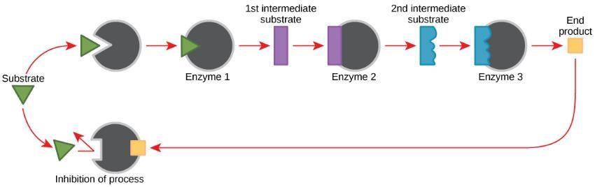
Metabolic Pathways
Metabolic pathways are a series of reactions catalyzed by multiple enzymes.

Slide 17
Feedback Inhibition
Feedback inhibition is when the end product of the pathway inhibits an upstream process and is an important regulatory mechanism in cells.
The cell responds to an abundance of the products by slowing down production during anabolic or catabolic reactions.

Slide 18
Thermodynamics
Thermodynamics is the study of energy and energy transfer involving physical matter.
The matter relevant to a particular case of energy transfer is called a system
  Everything outside of that matter is called the surroundings
  For example, when heating a pot of water on the stove, the system includes the stove, the pot, and the water.
  Energy is transferred within the system (between the stove, pot, and water).
There are two types of systems: open and closed.
  Open system - energy can be exchanged with its surroundings. The stovetop system is open because heat can be lost to the air.
  Closed system – energy cannot be exchanged with its surroundings.

Slide 19
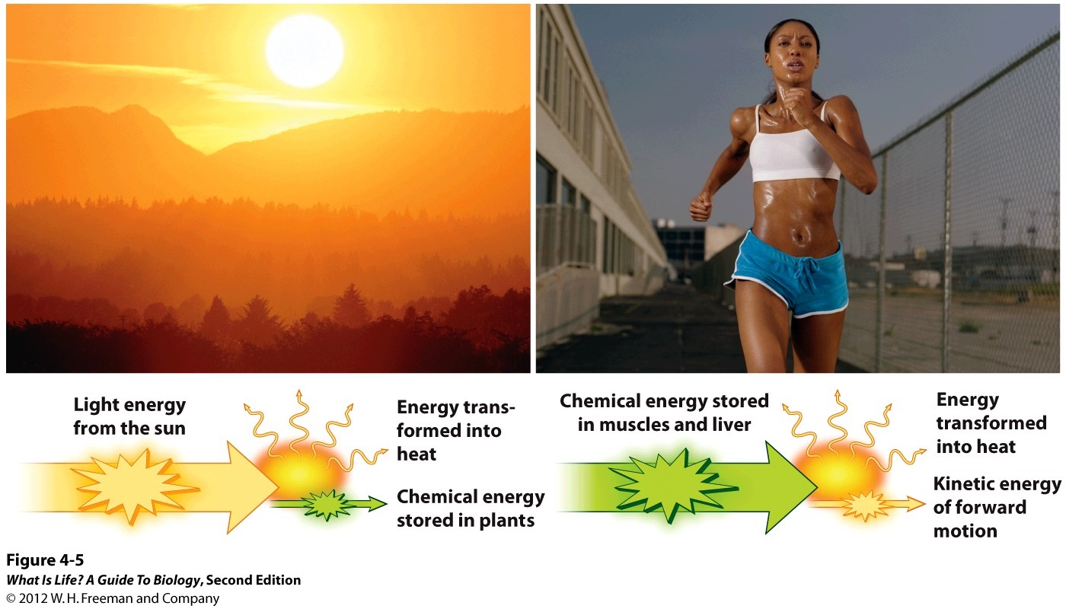
Thermodynamics
Biological organisms are open systems AND are inefficient systems!
Energy is exchanged between them and their surroundings as they use energy from the sun to perform photosynthesis or consume energy-storing molecules and release energy to the environment by doing work and releasing heat.
Like all things in the physical world, energy is subject to physical laws. The laws of thermodynamics govern the transfer of energy in and among all systems in the universe.
In general, energy is defined as the ability to do work, or to create some kind of change. Energy exists in different forms.
  For example, electrical energy, light energy, and heat energy are all different types of energy.

Slide 20
Thermodynamics
The first law of thermodynamics states that the total amount of energy in the universe is constant and conserved.
  there has always been, and always will be, exactly the same amount of energy in the universe.
According to the first law of thermodynamics, energy may be transferred from place to place or transformed into different forms, but it cannot be created or destroyed.
  Light bulbs transform electrical energy into light and heat energy.
  Gas stoves transform chemical energy from natural gas into heat energy.

Slide 21
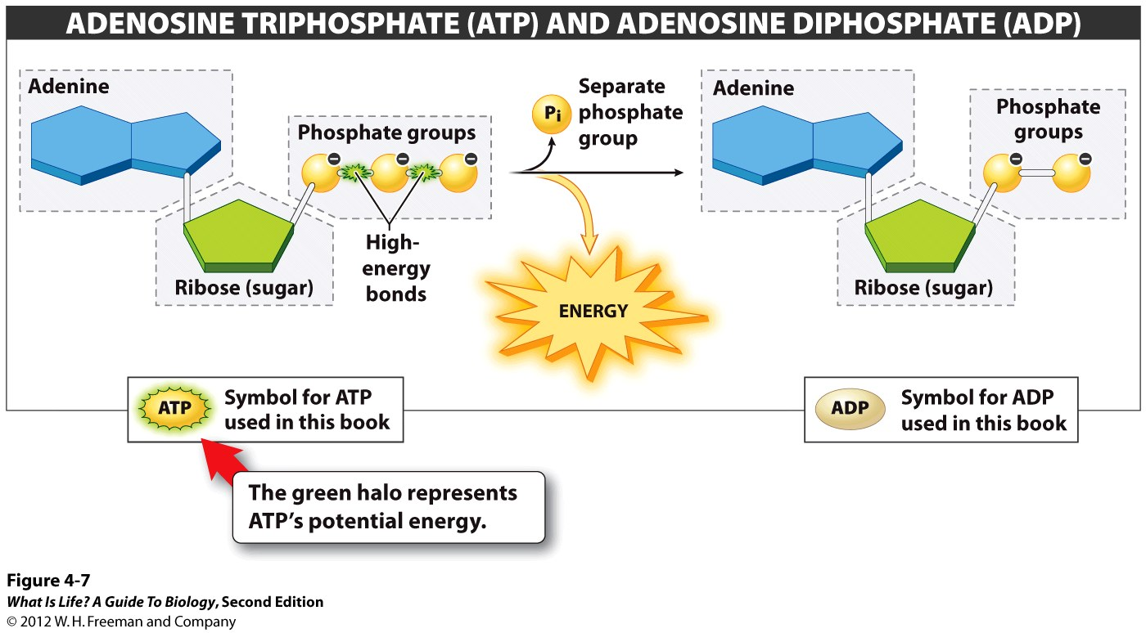
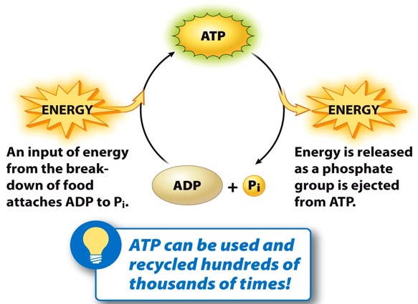
ATP
The challenge for all living organisms is to obtain energy from their surroundings in forms that they can transfer or transform into usable energy to do work.
Chemical energy stored within organic molecules such as sugars and fats is transferred and transformed through a series of cellular chemical reactions into energy within molecules of ATP.
  Energy in ATP molecules can do work such as:
    building complex
    molecules
    transporting materials
    powering the motion of
    cilia or flagella
    contracting muscle fibers
    to create movement

Slide 22
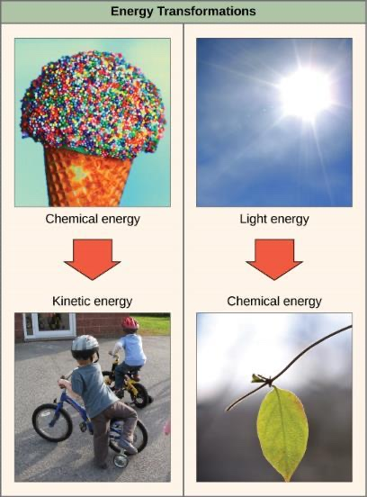
Energy Transformations

Slide 23
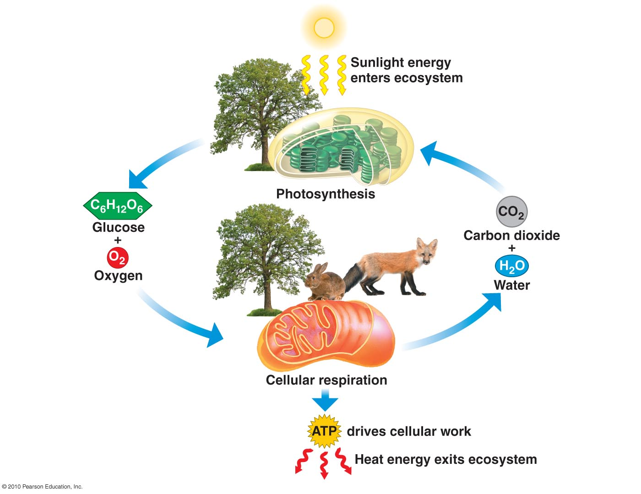
Energy Transformations
A living cell’s primary tasks of obtaining, transforming, and using energy to do work may seem simple. However, the second law of thermodynamics explains why these tasks are harder than they appear.
All energy transfers and transformations are never completely efficient.
In every energy transfer, some amount of energy is lost in a form that is unusable.
In most cases, this form is heat energy.
Thermodynamically, heat energy is defined as the energy transferred from one system to another that is not work.
  For example, when a light bulb is turned on, some of the energy being converted from electrical energy into light energy is lost as heat energy.
  Likewise, some energy is lost as heat energy during cellular metabolic reactions.

Slide 24
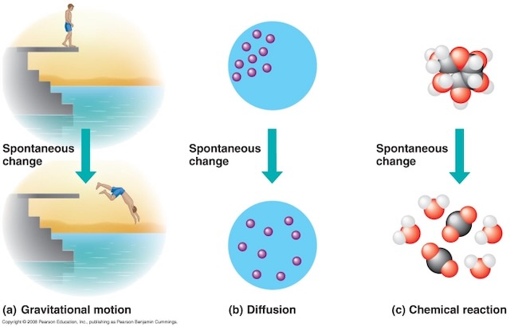
Energy Transformations
The more energy that is lost by a system to its surroundings, the less ordered and more random the system is.
Scientists refer to the measure of randomness or disorder within a system as entropy.
High entropy means high disorder and low energy.
  For example, entropy increases as molecules at a high concentration in one place diffuse and spread out.

Slide 25
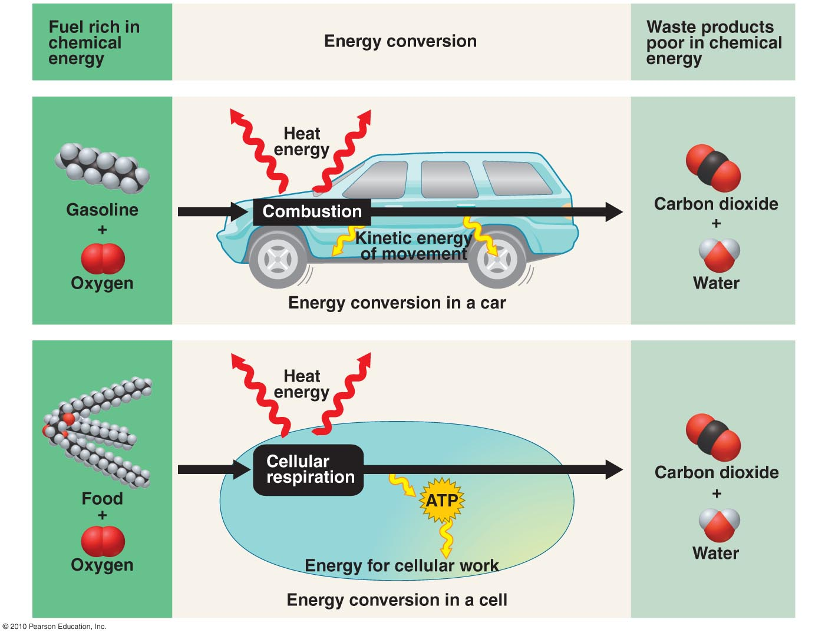
Energy Transformations
The second law of thermodynamics says that energy will always be lost as heat in energy transfers or transformations.
Living things are highly ordered, requiring constant energy input to be maintained in a state of low entropy.

Slide 26
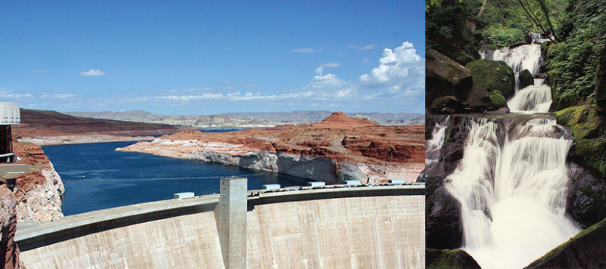
Potential & Kinetic Energy
When an object is in motion, there is energy associated with that object.
Energy associated with objects in motion is called kinetic energy.
  A speeding bullet, a walking person, and the rapid movement of molecules in the air (which produces heat) all have kinetic energy.
When an object is in lifted or raised, there is energy associated with that object.
Energy associated with objects that have received work (by being lifted...) is called potential energy.
  Energy is now stored in the object by virtue of its position and the force of gravity acting on it.
  When the object falls, the potential energy would is transformed into kinetic energy until all of the potential energy was exhausted when the ball rested on the ground.

Slide 27
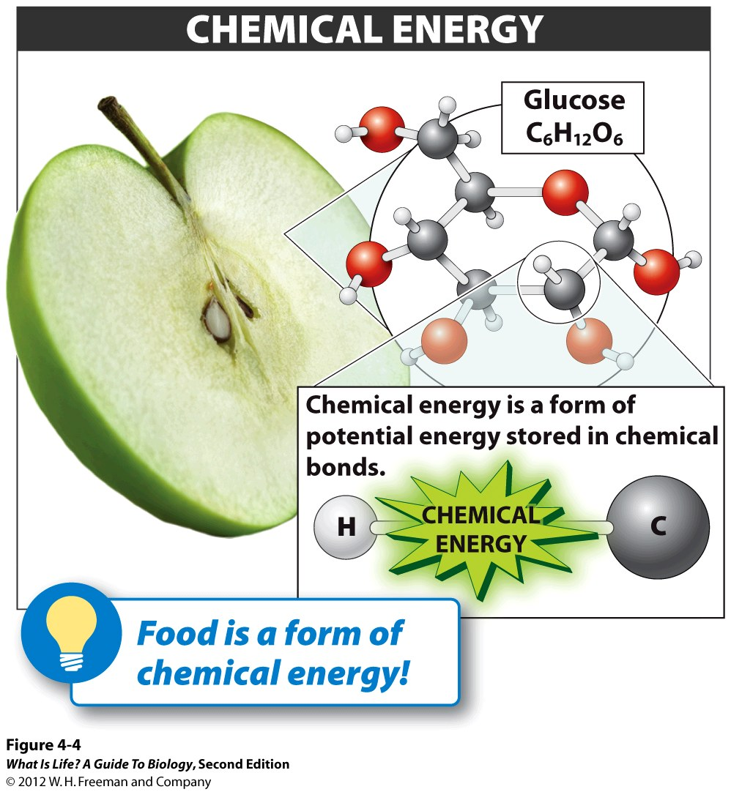
Potential & Kinetic Energy
Potential energy is also associated with the structure of matter.
  Such as a spring that is compressed or a rubber band that is pulled taut.
Potential energy stored within the bonds of food molecules
  This is because these bonds can release energy when broken.
The type of potential energy that exists within chemical bonds, and is released when those bonds are broken, is called chemical energy.
  Chemical energy is responsible for providing living cells with energy from food. The release of energy occurs when the molecular bonds within food molecules are broken.

Slide 28
Nothing PAST this slide will be on the first midterm exam

Slide 29
Free Energy
Free energy (G) specifically refers to the energy associated with a chemical reaction that is available after the losses are accounted for.
  Usable energy, or energy that is available to do work.
If energy is released during a chemical reaction, the ∆G will be a negative number.
A negative change in free energy also means that the products of the reaction have less free energy than the reactants, because they release some free energy during the reaction.
Reactions that have a negative change in free energy and consequently release free energy are called exergonic reactions.
  energy is exiting the system.
  These reactions are also referred to as spontaneous reactions, and their products have less stored energy than the reactants.
  The rusting of iron is an example of a spontaneous reaction that occurs slowly, little by little, over time.

Slide 30
Free Energy
If a chemical reaction absorbs energy, then the change in free energy, signified as ∆G for that reaction will be a positive value.
  In this case, the products have more free energy than the reactants.
  The products of these reactions can be thought of as energy-storing molecules.
  These chemical reactions are called endergonic reactions and they are non-spontaneous.
    Will not take place on its own without the addition of free energy.

Slide 31
Activation Energy
Both exergonic and endergonic reactions require at least a small amount of energy input to get going, before they can proceed.
For exergonic reactions only a small amount of energy is required...
  The (small or larger) input necessary for all chemical reactions to occur is called the activation energy.

Slide 32
Energy Transformations
A substance that helps a chemical reaction to occur is called a catalyst, and the molecules that catalyze biochemical reactions are called enzymes.
Most enzymes are proteins and perform the critical task of lowering the activation energies of chemical reactions inside the cell.
Enzymes do this by binding to the reactant molecules and holding them in such a way as to make the chemical bond-breaking and bond-forming processes take place more easily.
Enzymes do not change whether a reaction is exergonic (spontaneous) or endergonic.
They only reduce the activation energy required for the reaction to go forward.
In addition, an enzyme itself is unchanged by the reaction it catalyzes.
  Once one reaction has been catalyzed, the enzyme is able to participate in other reactions.

Slide 33
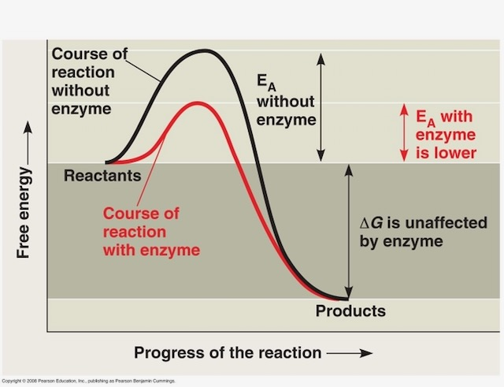
Energy Transformations
A substance that helps a chemical reaction to occur is called a catalyst, and the molecules that catalyze biochemical reactions are called enzymes.
Most enzymes are proteins and perform the critical task of lowering the activation energies of chemical reactions inside the cell.
Enzymes do this by binding to the reactant molecules and holding them in such a way as to make the chemical bond-breaking and bond-forming processes take place more easily.
Enzymes do not change whether a reaction is exergonic (spontaneous) or endergonic.
They only reduce the activation energy required for the reaction to go forward.
In addition, an enzyme itself is unchanged by the reaction it catalyzes.
  Once one reaction has been catalyzed, the enzyme is able to participate in other reactions.

Slide 34
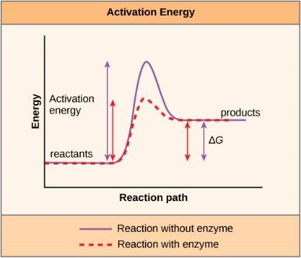
Energy Transformations
A substance that helps a chemical reaction to occur is called a catalyst, and the molecules that catalyze biochemical reactions are called enzymes.
Most enzymes are proteins and perform the critical task of lowering the activation energies of chemical reactions inside the cell.
Enzymes do this by binding to the reactant molecules and holding them in such a way as to make the chemical bond-breaking and bond-forming processes take place more easily.
Enzymes do not change whether a reaction is exergonic (spontaneous) or endergonic.
They only reduce the activation energy required for the reaction to go forward.
In addition, an enzyme itself is unchanged by the reaction it catalyzes.
  Once one reaction has been catalyzed, the enzyme is able to participate in other reactions.

Slide 35
End of Part 1 of Lecture

