Slide 1
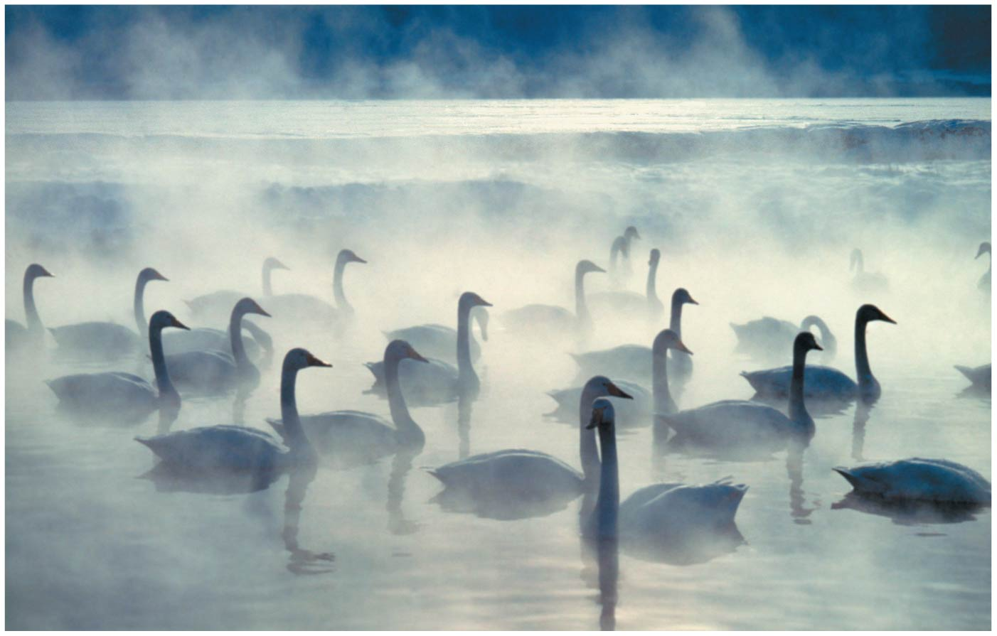
BIO10: Introduction to Principles of Biology
Dr. Paul Bradley
Chemistry & Water

Slide 2
By the end of this section you will be able to:
• Describe matter and elements
• Describe the interrelationship between protons, neutrons, and electrons, and the ways in which electrons can be donated or shared between atoms

Slide 3
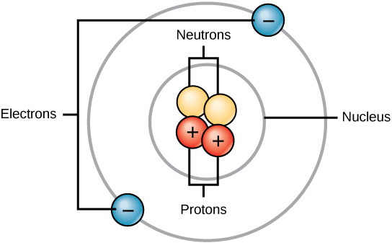
Atoms
Atoms are made up of protons and neutrons located within the nucleus, and electrons surrounding the nucleus.

Slide 4
Atoms & Element

Slide 5
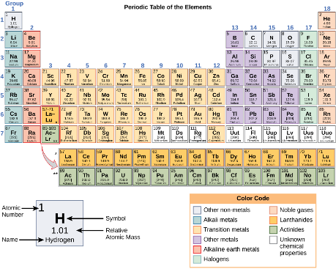
Periodic Table of Elements
Arranged in columns and rows based on the characteristics of the elements
Provides key information about the elements and how they might interact with each other to form molecules.
Most periodic tables provide a key or legend to the information they contain.

Slide 6
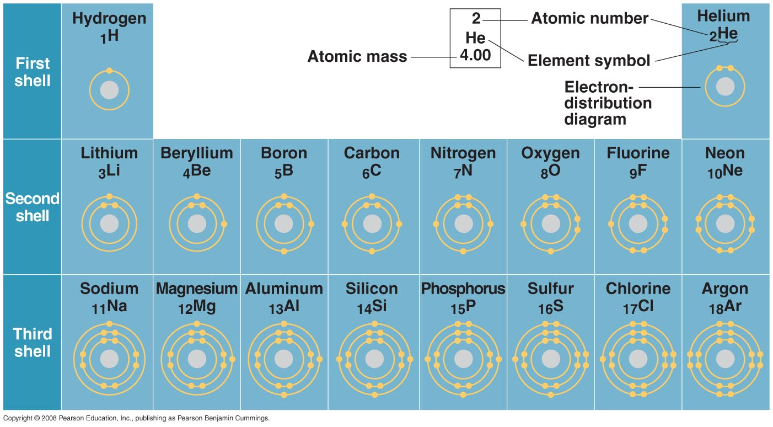

Slide 7
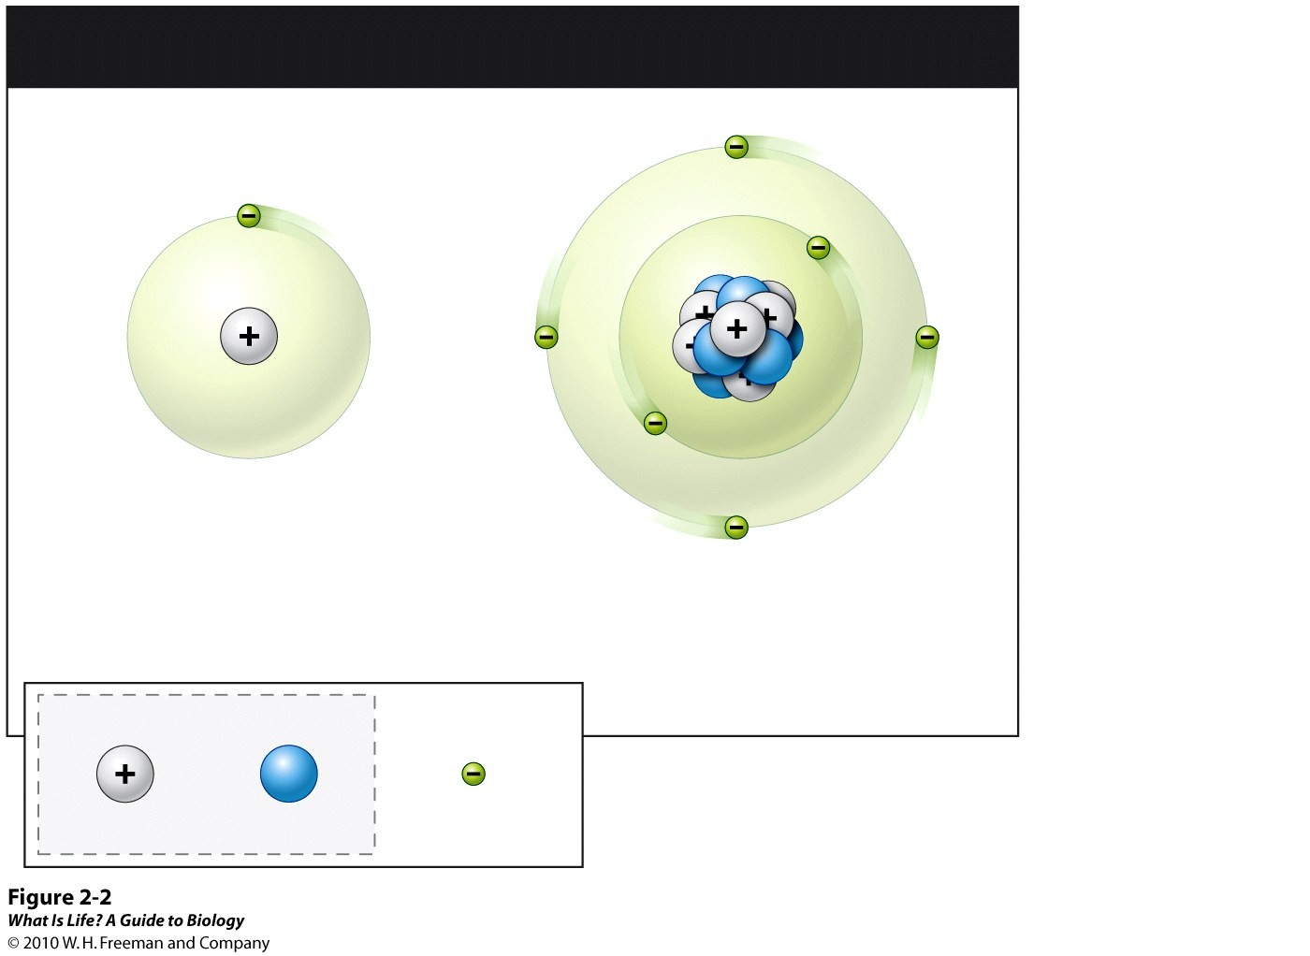
THE ATOM: BASIC STRUCTURE
Nucleus
Hydrogen atom
1 Proton
0 Neutrons
1 Electron
Carbon atom
6 Protons
6 Neutrons
6 Electrons
Nucleus:
Proton
Neutron
Electron

Slide 8
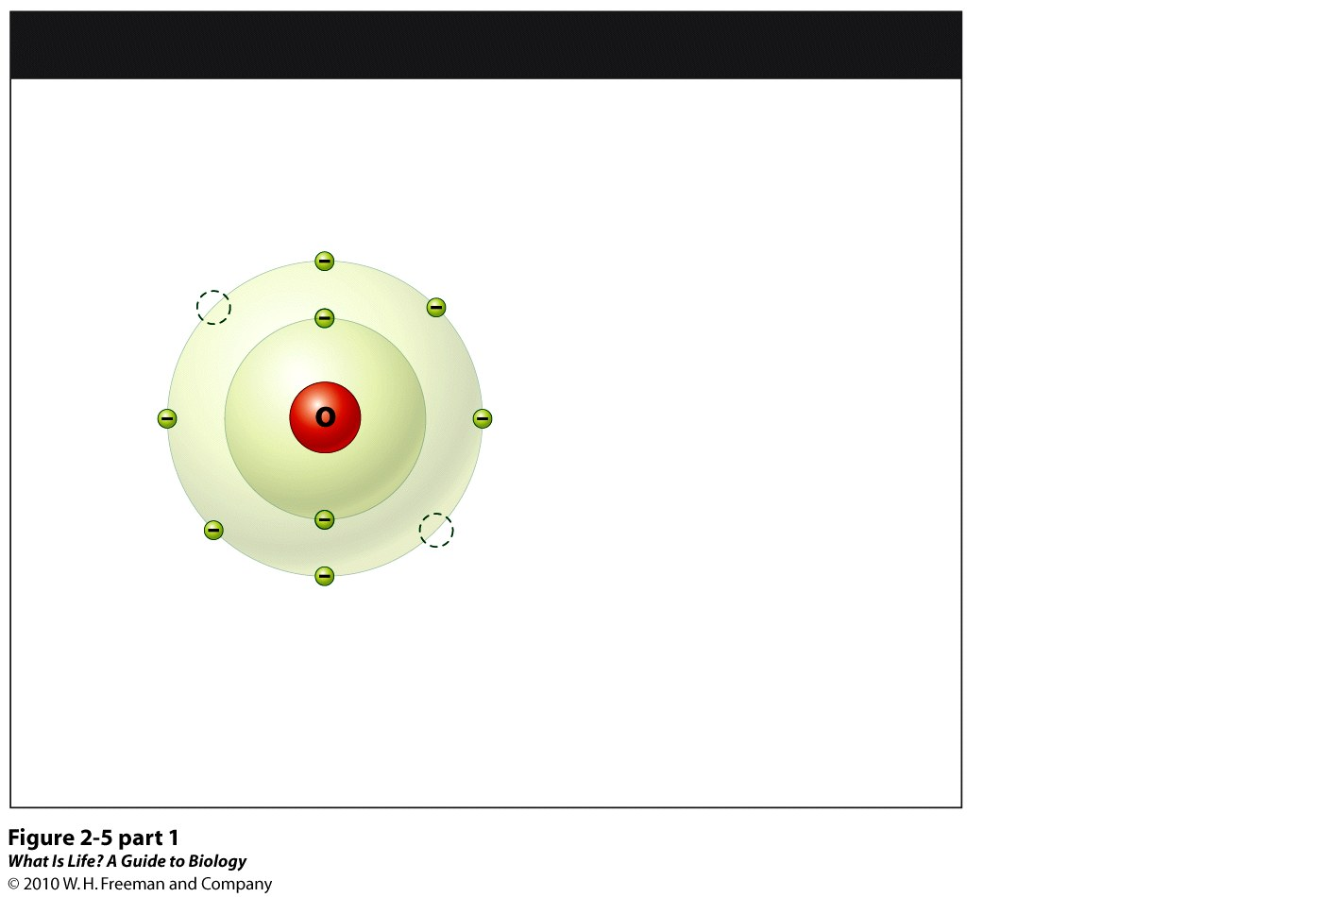
ELECTRON SHELLS AND ATOM STABILITY
ELECTRON SHELLS
Electrons move around the nucleus in designated areas called electron shells
First electron shell
(capacity: 2 electrons)
Second electron shell
(capacity: 8 electrons)
Vacancy
The chemical properties of an atom are largely determined by the number of electrons in its outer shell

Slide 9
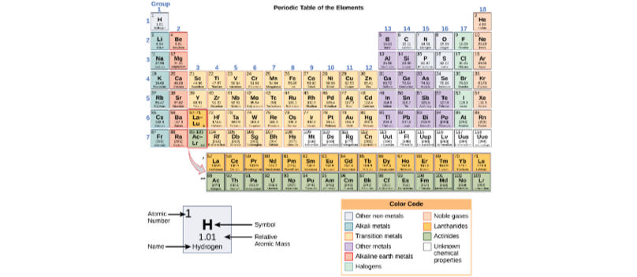

Slide 10
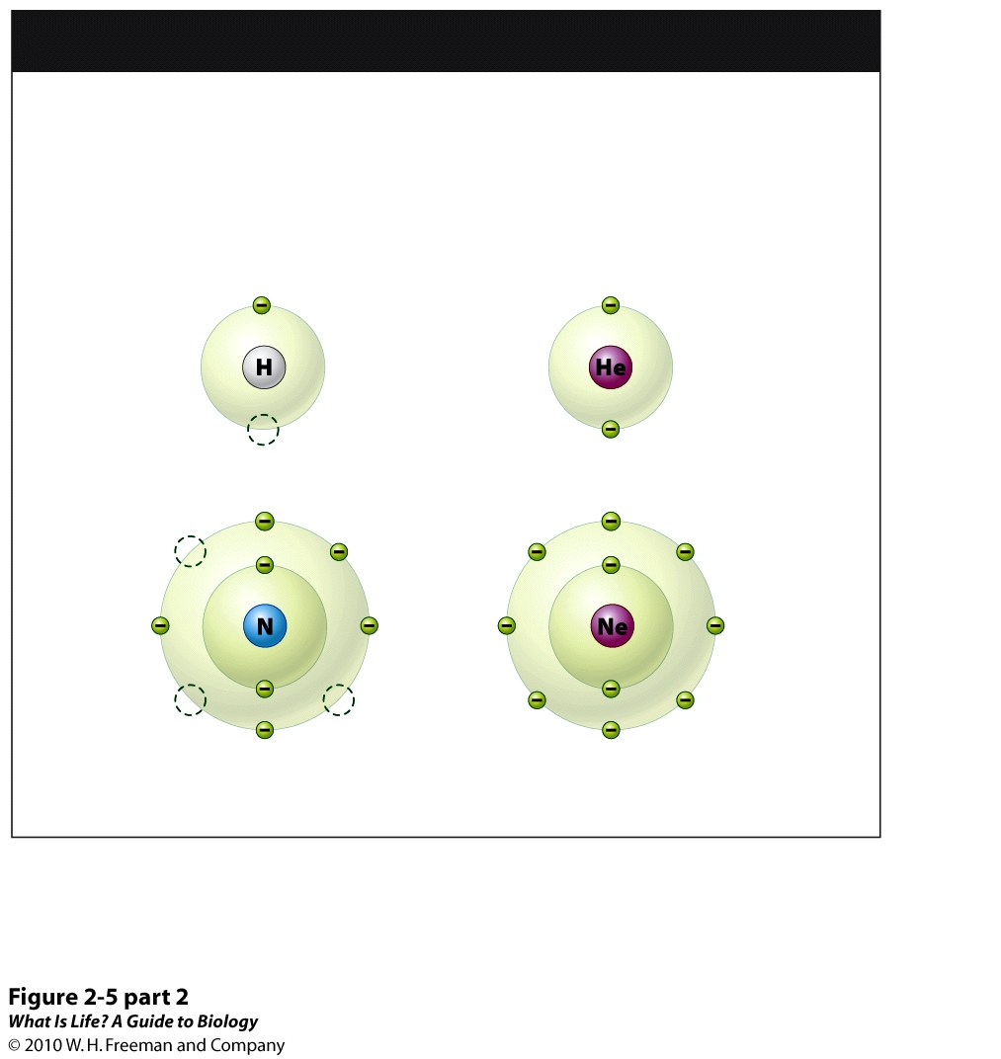
ATOMS NEED THEIR FILL (of electrons)!
Unstable
Atoms
Have electron vacancies in outermost shell
Stable
Atoms
Outermost shell is filled with electrons
Hydrogen atom
Helium atom
Nitrogen atom
Neon atom

Slide 11
GIVE OR TAKE?

Slide 12
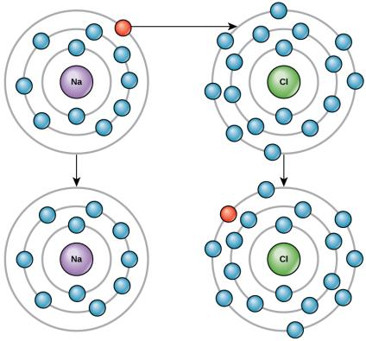
Electron Shells
Elements tend to fill their outermost shells with electrons. To do this, they can either donate or accept electrons from other elements.

Slide 13
Four types of Bonds
Ionic Bond
Covalent Bonds
Hydrogen Bonds
van der Waals Interactions

Slide 14
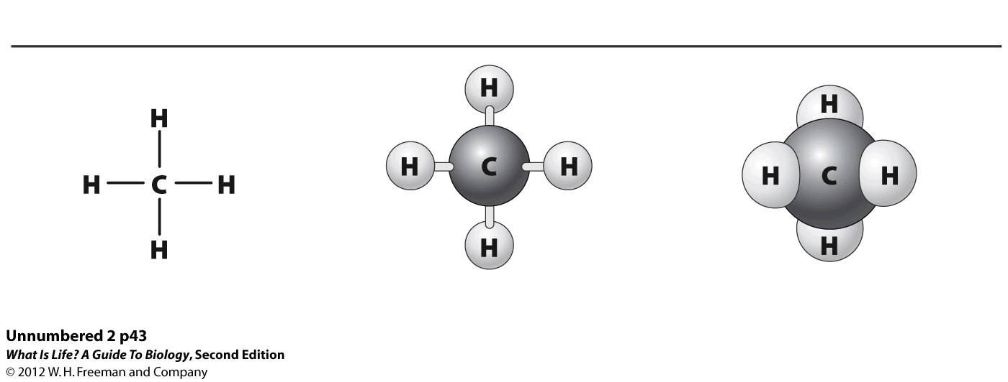
Different ways to draw the same thing...

Slide 15
Ions
Reminder: Atoms generally have the same number protons and electrons.

Slide 16
Ions are Charged Atoms
Reminder: Atoms generally have the same number protons and electrons.
However, when an atom donates an electron from its outer shell to the outer shell of a nearby atom the first atom no longer has an equal number of protons and electrons – it now has one less electron than the number of protons.
This loss of an electron results in the atom having a δ+ charge.
We call this a ”cation.”

Slide 17
Ions are Charged Atoms
Likewise, when an atom receives a donated electron to its outer shell from the outer shell of a nearby atom, the first atom no longer as an equal number of protons and electrons – it now has one more electron than the number of protons.
This gain of an electron results in the atom having a δ– charge.
We call this an “anion.”

Slide 18
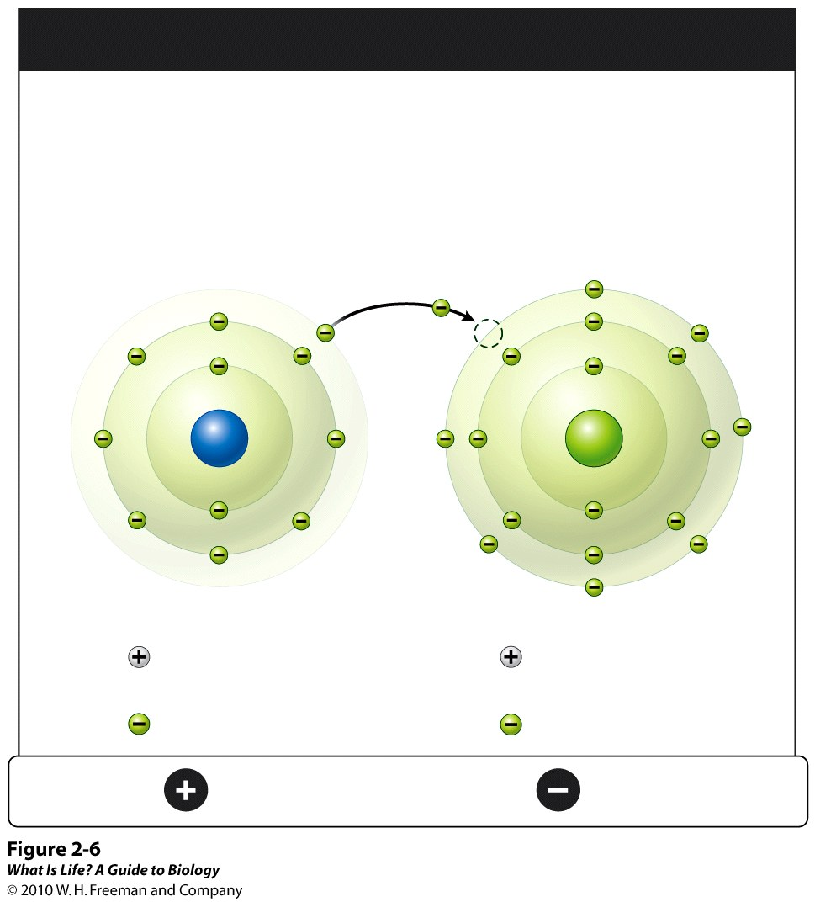
IONS ARE CHARGED ATOMS
• gaining of an
electron
• overall charge
becomes negative
(= ANION)
• loss of an
electron
• overall charge
becomes positive
(= CATION)
Donated electron
Na
Cl
Sodium ion
Chloride ion
11 Protons
11 Neutrons
10 Electrons
17 Protons
17 Neutrons
18 Electrons
NET
CHARGE
Positive
Negative

Slide 19
Ionic Bonds
When an atom of one element donates an electron to another atom of another element, one gains a δ- charge and one gains a δ+ charge.
Because positive and negative charges attract, these ions stay together and form an ionic bond (a bond between ions.)
The elements bond together with the electron from one element staying predominantly with the other element.
When Na+ and Cl– ions combine to produce NaCl, an electron from a sodium atom stays with the other seven from the chlorine atom
the sodium and chloride ions attract each other in a lattice of ions with a net zero charge.
Ionic bonds dissociate in water.

Slide 20
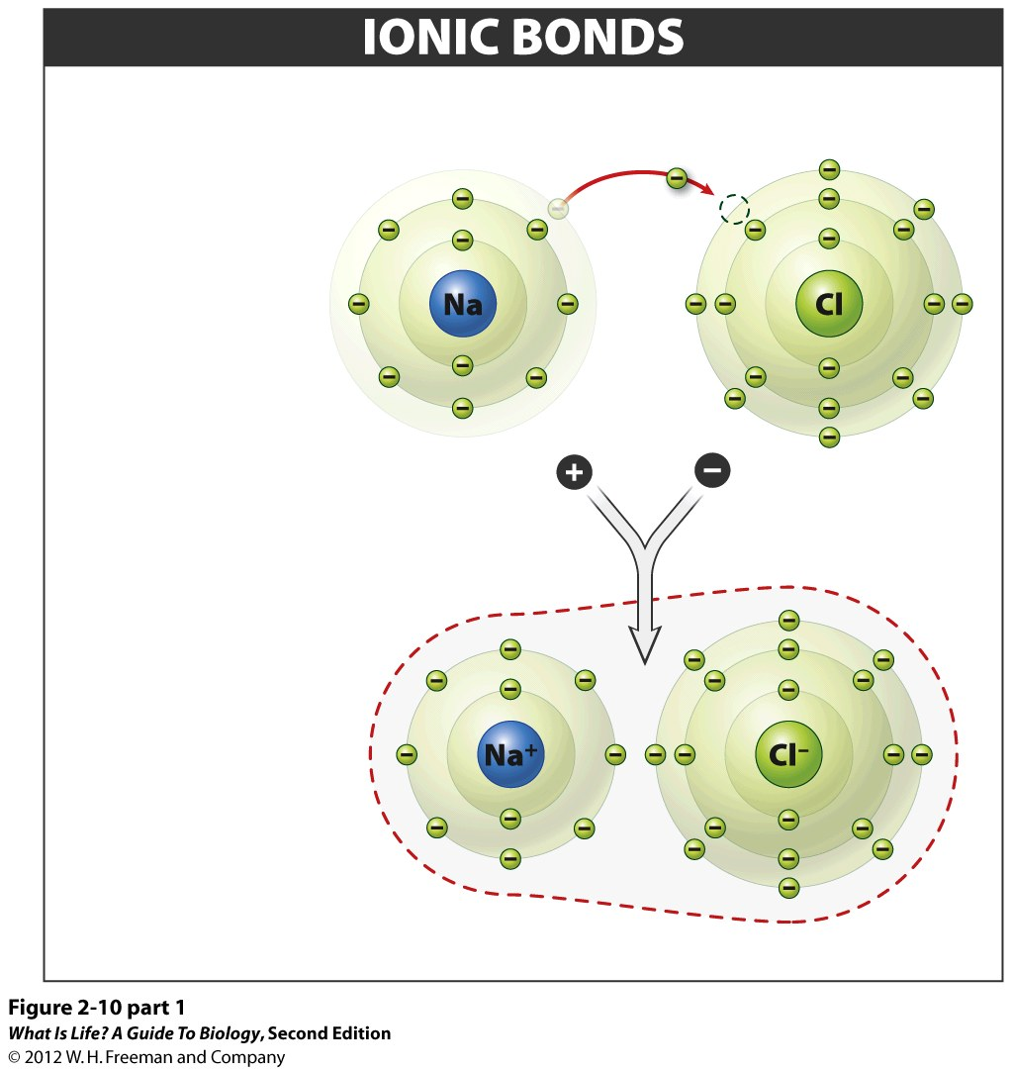
Donated electron
1
One atom
takes electrons
from another.
Sodium ion
Chloride ion
2
The result is
two oppositely
charged ions.
OPPOSITE CHARGES ATTRACT
3
IONIC BOND
– the attraction between oppositely charged ions
NaCl compound

Slide 21
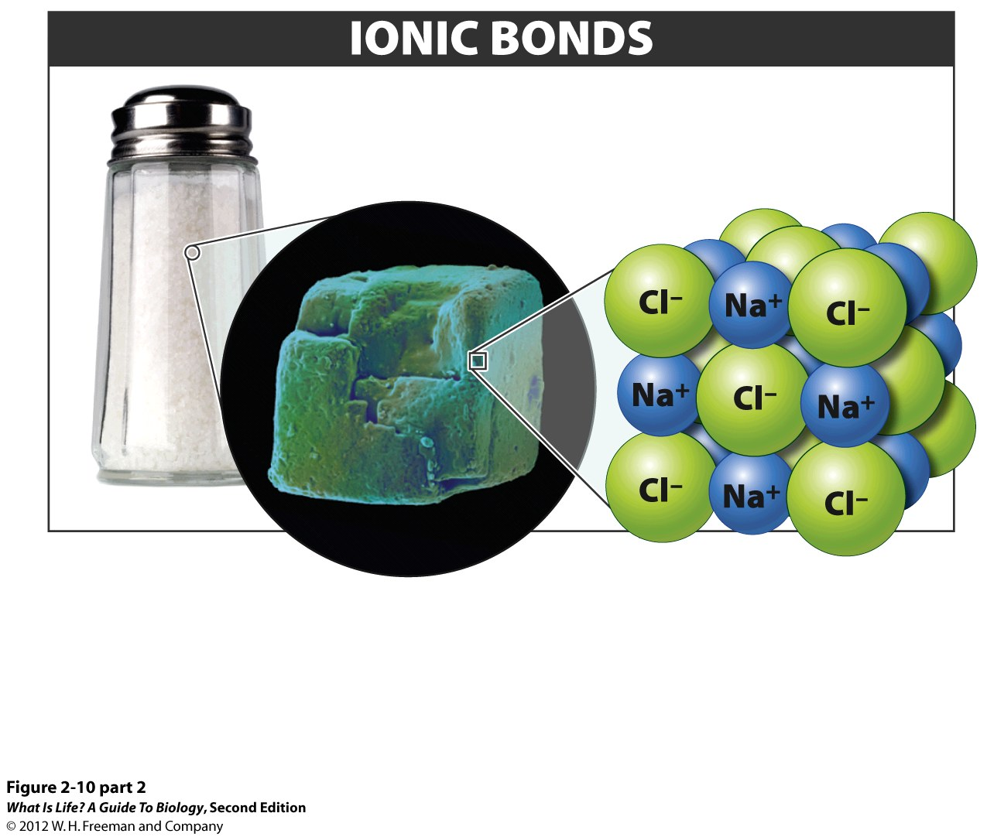
NaCl crystals
(table salt)
NaCl crystal
structure
When multiple Na⁺ ions and Cl– ions are attracted
to each other, a NaCl crystal structure forms.

Slide 22
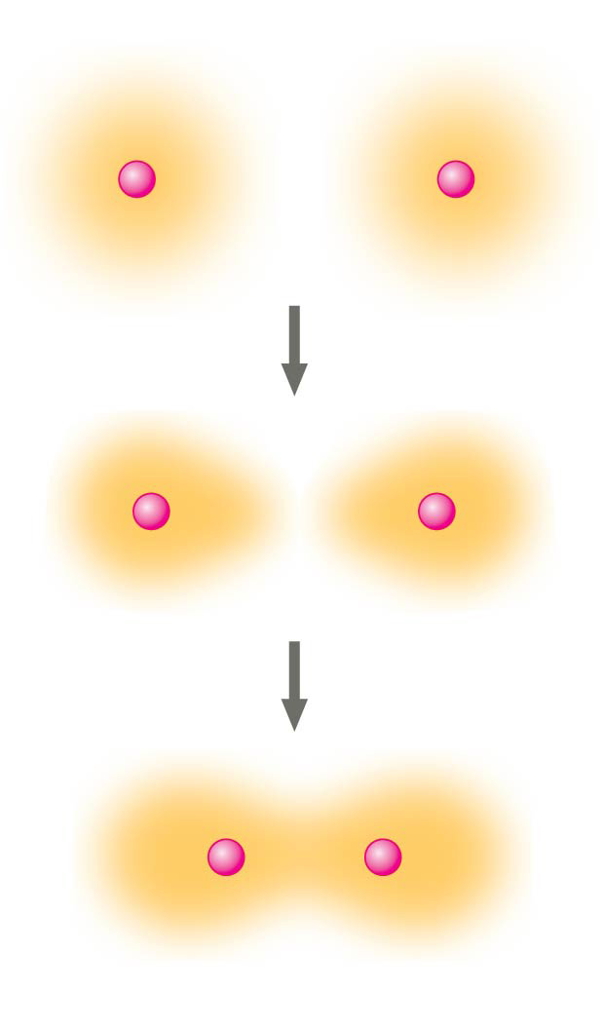
Covalent Bonds
Hydrogen atoms (2 H)
+
+
Another type of strong chemical bond between two or more atoms is a covalent bond.
These bonds form when an electron is shared between two elements and are the strongest and most common form of chemical bond in living organisms.
Covalent bonds do not dissociate in water.
+
+
+
+
Hydrogen
molecule (H₂)

Slide 23
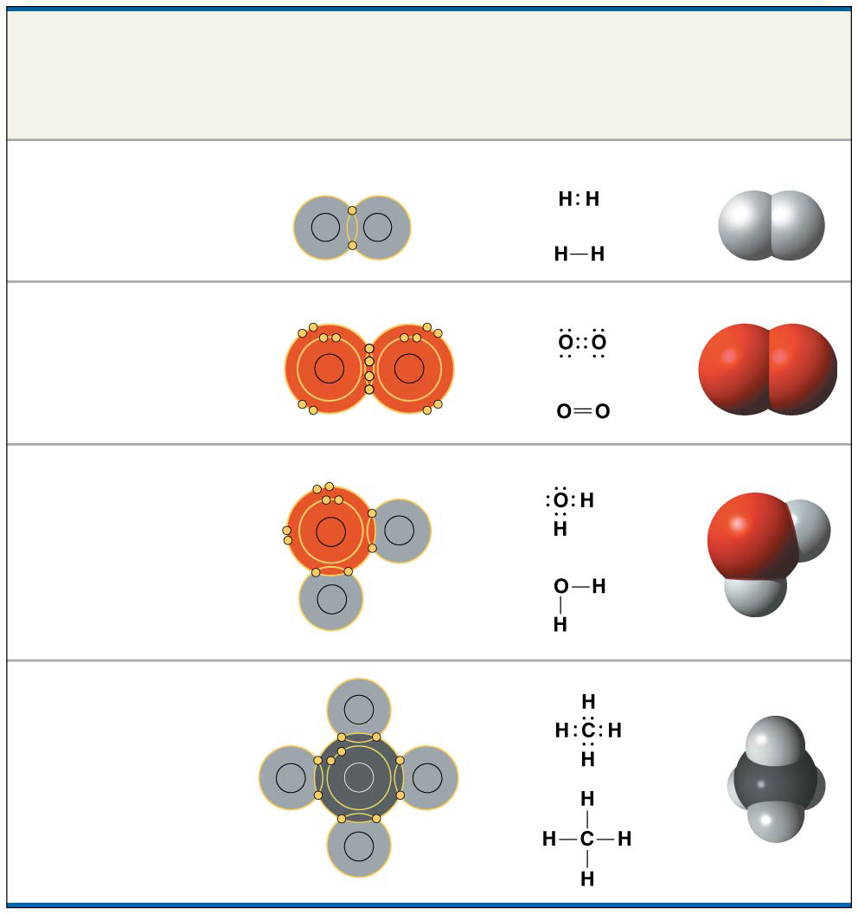
Covalent Bonds
Name and
Molecular
Formula
Electron
Distribution
Diagram
Lewis Dot
Structure and
Structural
Formula
Space-
Filling
Model
The number of covalent bonds formed by an depends on the number of pairs of valence electrons they share
Oxygen atoms form double covalent bonds when they share two pairs of electrons
(a) Hydrogen (H₂)
H
H
(b) Oxygen (O₂)
O
O
(c) Water (H₂O)
O
H
H
(d) Methane (CH₄)
H
H
C
H
H

Slide 24
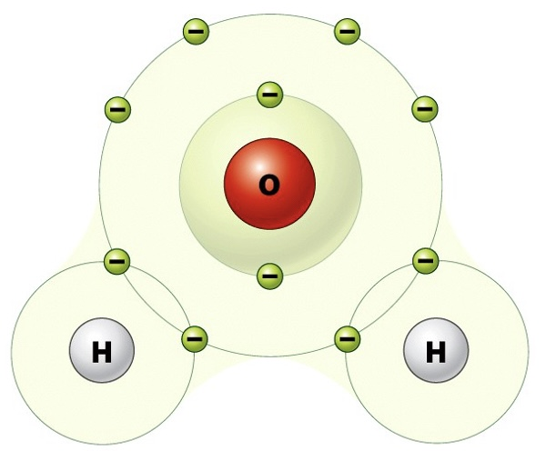
Covalent Bonds Hold Water Molecules Together
Hydrogen and oxygen atoms that combine to form water molecules are bound together by covalent bonds.
The electron from the hydrogen atom divides its time between the outer shell of the hydrogen atom and the incomplete outer shell of the oxygen atom.
To completely fill the outer shell of an oxygen atom, two electrons from two hydrogen atoms are needed, hence the subscript “2” in H₂O.
The electrons are shared between the atoms, dividing their time between them to “fill” the outer shell of each.
This sharing is a lower energy state for all of the atoms involved than if they existed without their outer shells filled.

Slide 25
Two Types of Covalent Bonds
Nonpolar Covalent Bonds
Polar Covalent Bonds
Determined by Electronegativity...

Slide 26
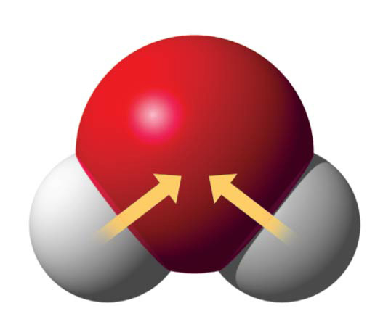
Electronegativity is a measure
of the “pull” that an atom exerts on shared electrons within a covalent bond
Of the atoms most commonly found in living cells oxygen, nitrogen, sulfur and phosphorus are all more electronegative than either carbon or hydrogen
Hence, O, N, S, and P do not share electrons equally with either C or H
δ−
O
H
H
δ+
δ+
H₂O
O, N, S, P more electronegative than C = H

Slide 27
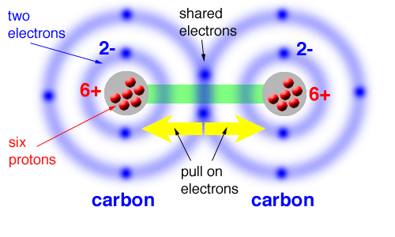
Nonpolar bond
Electronegativity contributes to the chemical properties of all biological molecules
Two atoms of the same element will share electrons equally (because they have identical electronegativity) thus forming a nonpolar covalent bond
But since O has a higher electronegativity than carbon, the negatively charged electron spend more time near the O atom creating a polar covalent bond

Slide 28
Two Types of Covalent Bonds
Nonpolar covalent bonds
  Form between two atoms of the same element or between different elements that share the electrons equally.
  For example, an oxygen atom can bond with another oxygen atom to fill their outer shells.
  This association is nonpolar because the electrons will be equally distributed between each oxygen atom.
    Two covalent bonds form between the two oxygen atoms because oxygen requires two shared electrons to fill its outermost shell.

Slide 29
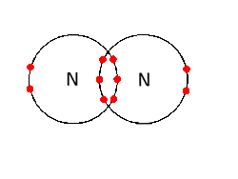
Two Types of Covalent Bonds
Nonpolar covalent bonds
  Nitrogen atoms will form three covalent bonds (also called triple covalent) between two atoms of nitrogen because each nitrogen atom needs three electrons to fill its outermost shell.

Slide 30
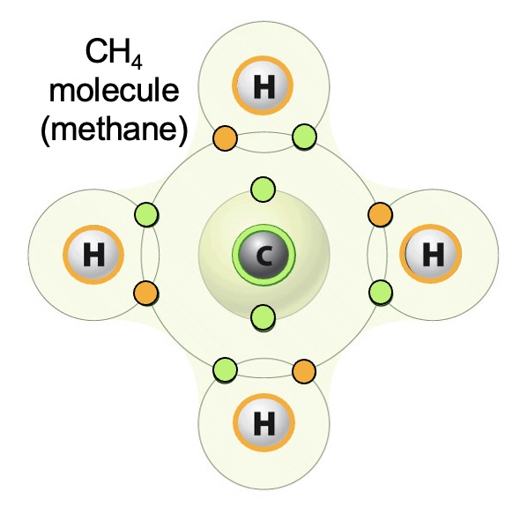
Two Types of Covalent Bonds
Nonpolar covalent bonds
  Another example of a nonpolar covalent bond is found in the methane (CH4) molecule. The carbon atom has four electrons in its outermost shell and needs four more to fill it. It gets these four from four hydrogen atoms, each atom providing one.

Slide 31
Two Types of Covalent Bonds
Polar covalent bonds
  The electrons shared by the atoms spend more time closer to one nucleus than to the other nucleus.
  Because of the unequal distribution of electrons between the different nuclei, a slightly positive (δ+) or slightly negative (δ–) charge develops.
  The covalent bonds between carbon and oxygen atoms are polar covalent bonds.
  The shared electrons spend more time near the oxygen nucleus, giving it a small negative charge, than they spend near the hydrogen nuclei, giving these molecules a small positive charge.

Slide 32
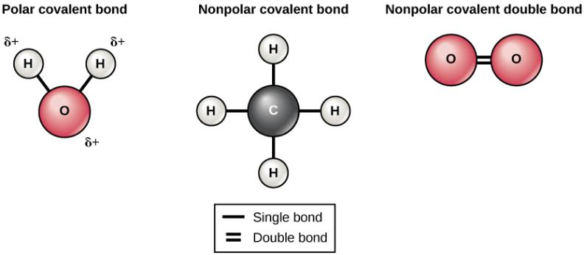
Covalent Bonds
δ–
The water molecule (left) depicts a polar bond with a slightly positive charge on the hydrogen atoms and a slightly negative charge on the oxygen. Examples of nonpolar bonds include methane (middle) and oxygen (right).

Slide 33
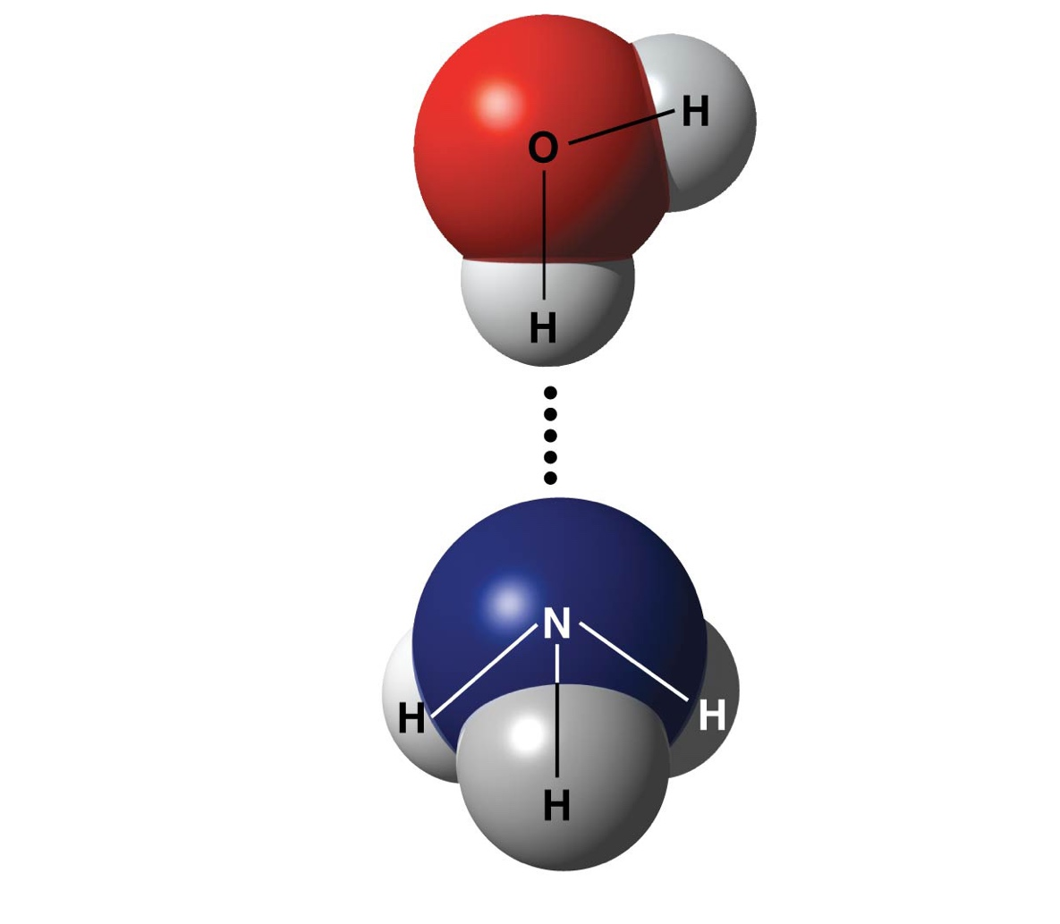
Hydrogen Bonds
A hydrogen bond forms when a hydrogen atom covalently bonded to one electronegative atom is also attracted to another electronegative atom
H-bonds are much weaker than covalent bonds
δ−
δ+
Water (H₂O)
In living cells, the electronegative partners are usually oxygen or nitrogen atoms
δ+
Hydrogen bond
δ−
Ammonia (NH₃)
δ+
δ+
δ+

Slide 34
Hydrogen Bonds
When polar covalent bonds containing a hydrogen atom form, the hydrogen atom in that bond has a slightly positive charge.
This is because the shared electron is pulled more strongly toward the other element and away from the hydrogen nucleus.
Because the hydrogen atom is slightly positive (δ+), it will be attracted to neighboring negative partial charges (δ–).
When this happens, a weak interaction occurs between the δ+ charge of the hydrogen atom of one molecule and the δ– charge of the other molecule.

Slide 35
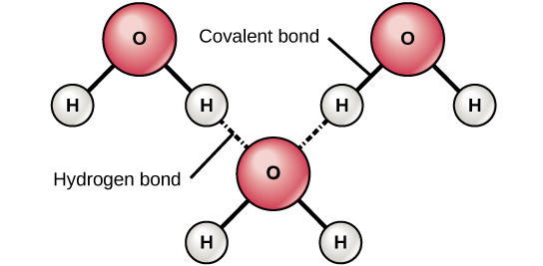
Covalent Bonds & Hydrogen Bonds Connect Water Molecules
The liquid nature of water is caused by the hydrogen bonds between water molecules.
If it were not for hydrogen bonding, water would be a gas rather than a liquid at room temperature.
Hydrogen bonds form between slightly positive (δ+) and slightly negative (δ–) charges of polar covalent molecules, such as water.

Slide 36
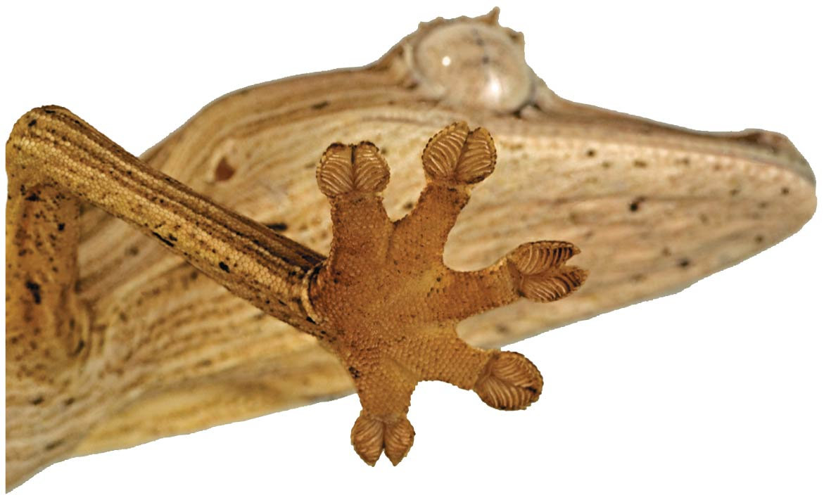
Van der Waals Interactions
Electrons are distributed asymmetrically in molecules or atoms; they may accumulate by chance in one part of a molecule
Van der Waals interactions are weak attractions between molecules that are close together as a result of these charges
Although they are weak bonds, collectively, such interactions can be strong, as between molecules of a gecko’s toe hairs and a wall surface

Slide 37

Water

Slide 38
By the end of this section you will be able to:
Describe the properties of water that are critical to maintaining life

Slide 39
Structure of Water
Water is a polar molecule:
the overall charge is unevenly distributed
Polarity allows water molecules to form hydrogen bonds with each other
δ−
O
H
H
δ+
δ+
H₂O

Slide 40
Structure of Water
There is no overall charge to a water molecule, but there is a slight positive charge on each hydrogen atom and a slight negative charge on the oxygen atom.
Because of these charges, the slightly positive hydrogen atoms repel each other and form the unique shape.
δ−
O
H
H
δ+
δ+
H₂O

Slide 41
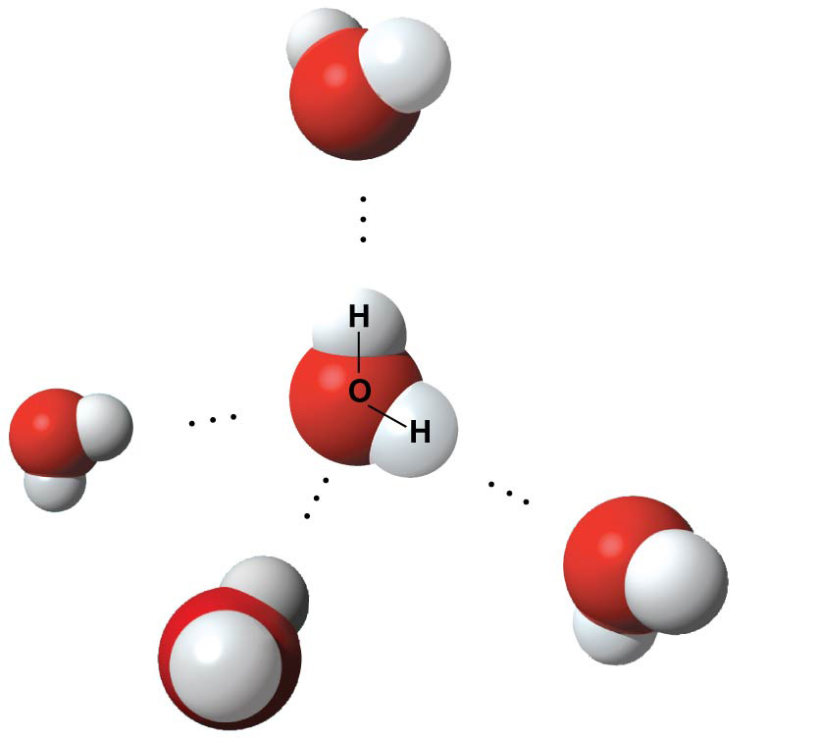
Water Molecules Interact with other Molecules
Each water molecule attracts other water molecules because of the positive and negative charges in the different parts of the molecule.
Water also attracts other polar molecules (such as sugars), forming hydrogen bonds.
When a substance readily forms hydrogen bonds with water, it can dissolve in water and is referred to as hydrophilic (“water-loving”).
Hydrogen bonds are not readily formed with nonpolar substances like oils and fats.
These nonpolar compounds are hydrophobic (“water- fearing”) and will not dissolve in water.
δ−
Hydrogen
bond
δ+
Polar covalent
bonds
δ+
δ−
δ−
δ+
δ+
δ−

Slide 42
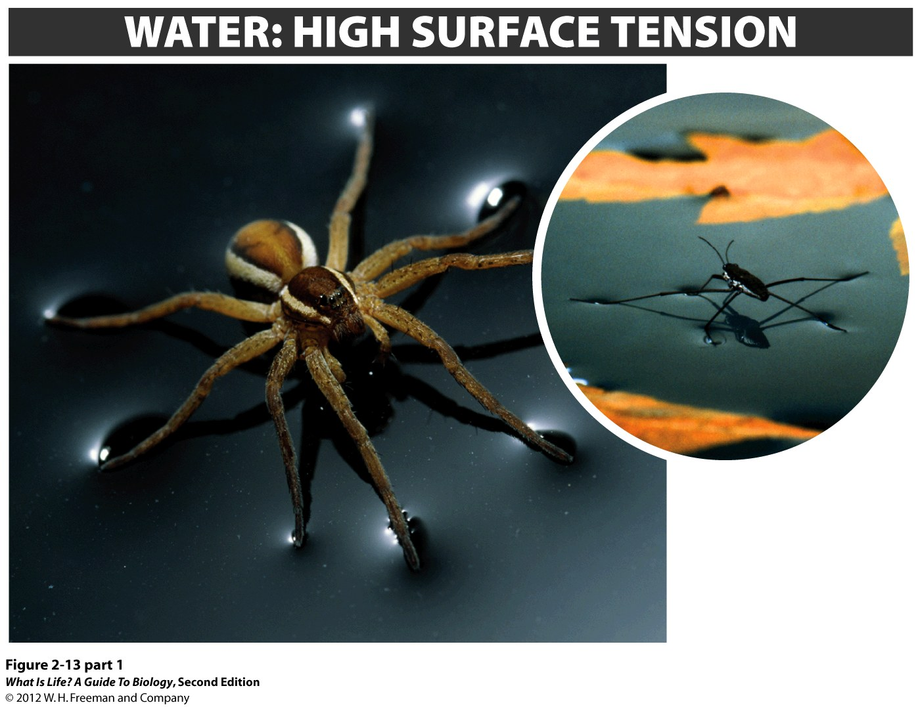
Cohesion & Surface Tension
Cohesion: how water molecules are attracted to each other (because of hydrogen bonding), keeping the molecules together at the liquid-air (gas) interface
Cohesion gives rise to surface tension, the capacity of a substance to withstand rupture when placed under tension or stress.
  When you drop a small object onto a droplet of water, the paper floats on top of the water droplet, although the object is denser (heavier) than the water. This occurs because of the surface tension that is created by the water molecules.
  Cohesion and surface tension keep the water molecules intact and the object floating on the top.

Slide 43
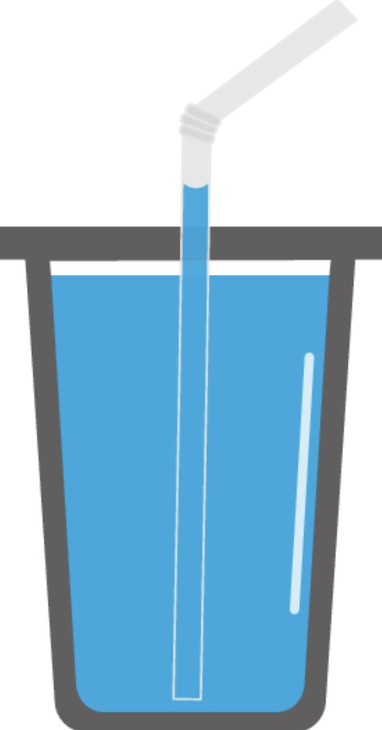

Adhesion
These cohesive forces are also related to the water’s property of adhesion, or the attraction between water molecules and other (non-water) molecules.
This is observed when water “climbs” up a straw placed in a glass of water.
This is because the water molecules are attracted to the straw and therefore adhere to it.
Same is true with how water “sticks” to leaves.

Slide 44
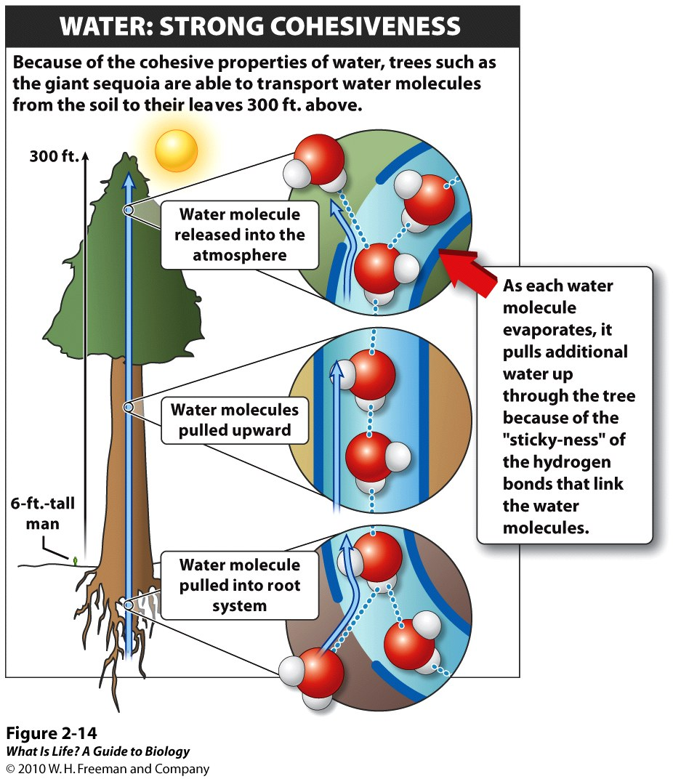
Cohesive and adhesive forces are important for sustaining life. For example, because of these forces, water can flow up from the roots to the tops of plants to feed the plant.
Notes:
FIGURE 2-14 Like a giant straw. Hydrogen bonds cause water molecules to "stick" together, so that they can be pulled up through the giant sequoia.

Slide 45
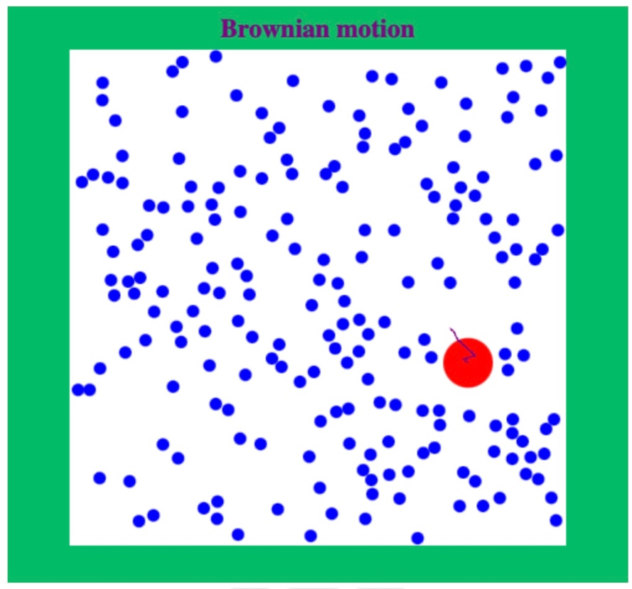
What is temperature?
Temperature is a measure of the motion (kinetic energy) of molecules.
  As the motion of molecules increases, energy is higher and thus temperature is higher.
  http://physics.bu.edu/~duffy/HTML5/brownian_motion.html

Slide 46
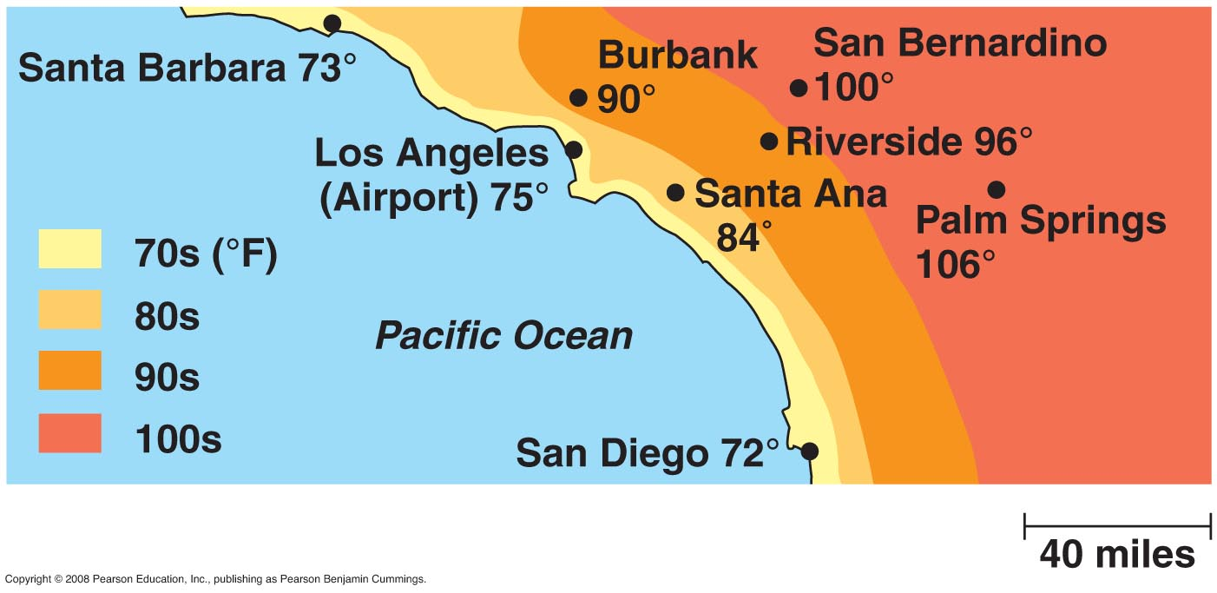
Specific Heat of Water
The specific heat of a substance is the amount of heat that must be absorbed or lost for 1 g of that substance to change its temperature by 1°C
Water resists changing its temperature because of its high specific heat

Slide 47
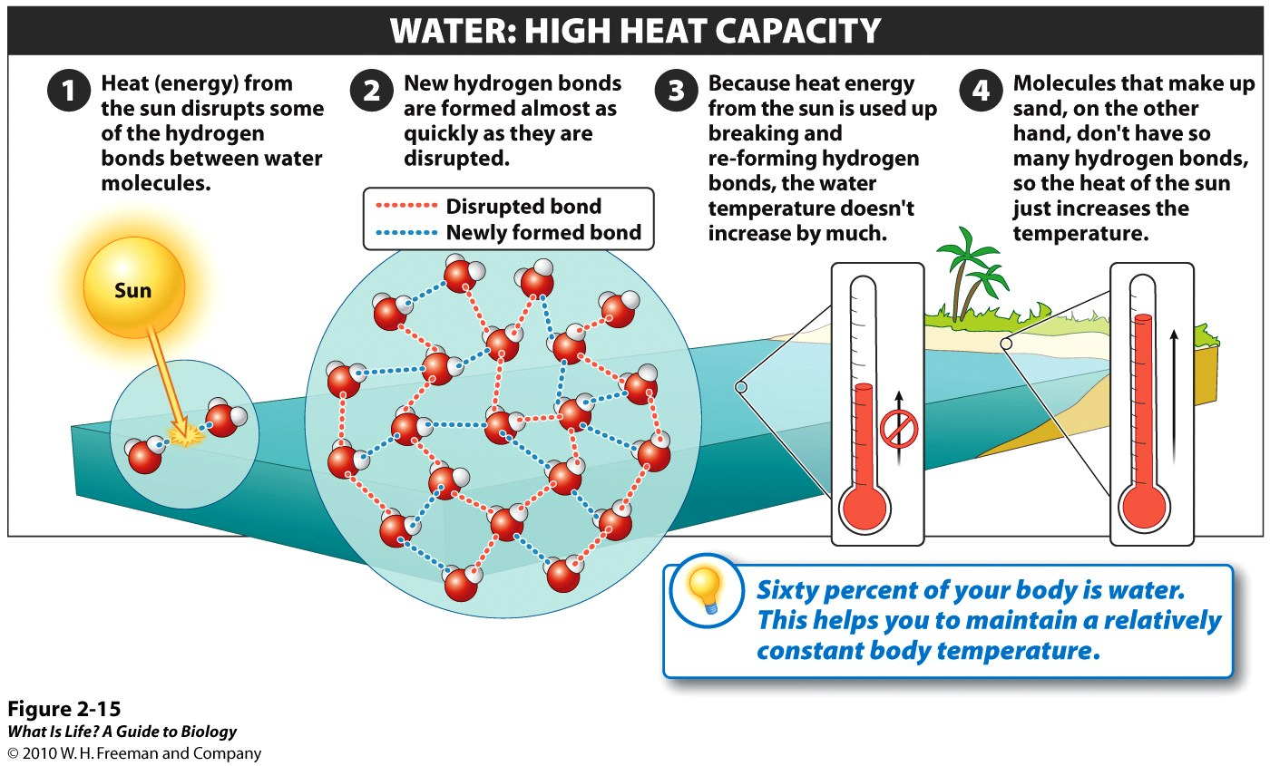
Specific Heat of Water
Hydrogen bonds between/among water molecules allows water to absorb a great deal of energy before its temperature rises.
Increased energy disrupts the hydrogen bonds between water molecules.
But because these bonds can be created and disrupted rapidly, water absorbs an increase in energy and temperature changes only minimally.
This means that water moderates temperature changes within organisms and in their environments.
Notes:
FIGURE 2-15 Water as a moderator of temperature change. Hydrogen bonds help water resist heating.

Slide 48
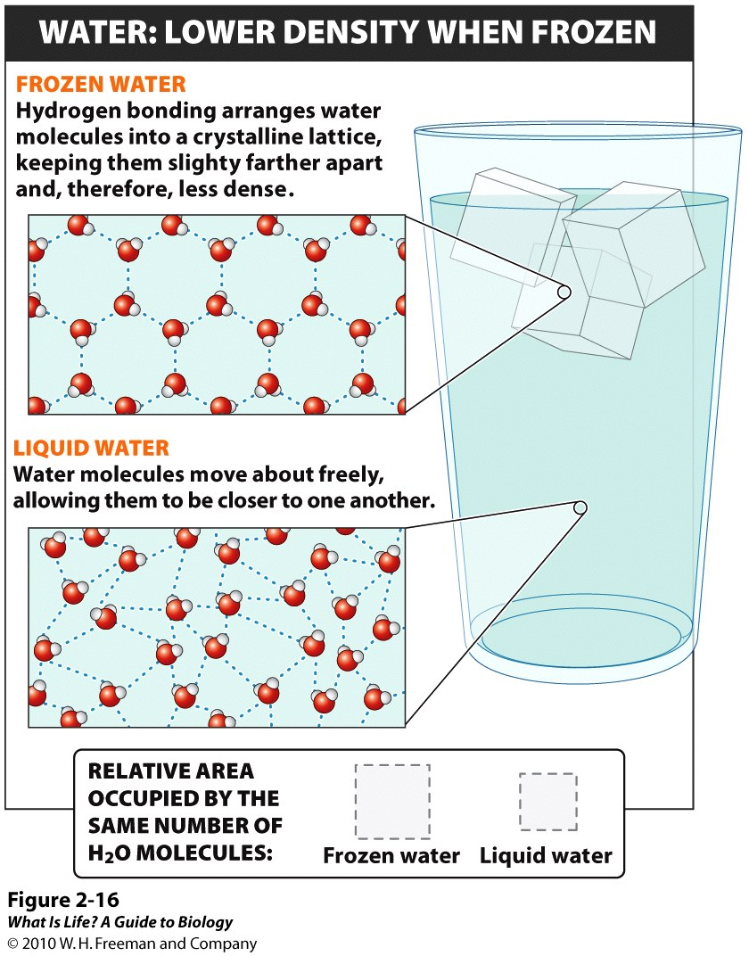
Ice has hydrogen bonds which cause it to only freeze with a rigid, lattice-like structure.
When frozen, ice is less dense than liquid water (the molecules are farther apart).
This means that ice floats on the surface of a body of water.

Slide 49
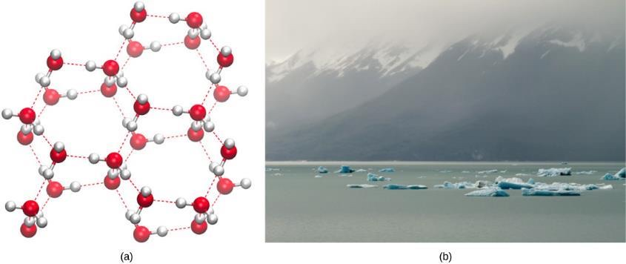
Water Terminology
In lakes, ponds, and oceans, ice will form on the surface of the water, creating an insulating barrier to protect the animal and plant life beneath from freezing in the water.
If this did not happen, plants and animals living in water would freeze in a block of ice and could not move freely, making life in cold temperatures difficult or impossible.

Slide 50
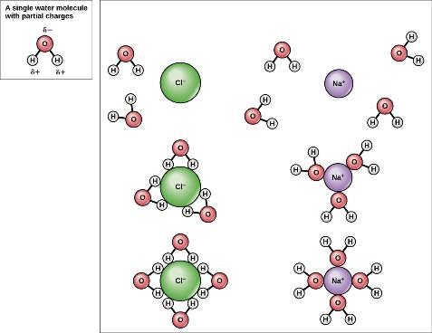
Water is a Solvent
Because water is polar, with slight positive and negative charges...
  ionic compounds and polar molecules can readily dissolve in it.
Water is, therefore, what is referred to as a solvent—a substance capable of dissolving another substance.
The charged particles will form hydrogen bonds with a surrounding layer of water molecules.
  called a sphere of hydration and serves to keep the particles separated or dispersed in the water..

Slide 51
Water is a Solvent
In the case of table salt (NaCl) mixed in water, the sodium and chloride ions separate, or dissociate, in the water, and spheres of hydration are formed around the ions.
A positively charged sodium ion is surrounded by the partially negative charges of oxygen atoms in water molecules.
A negatively charged chloride ion is surrounded by the partially positive charges of hydrogen atoms in water molecules.

Slide 52
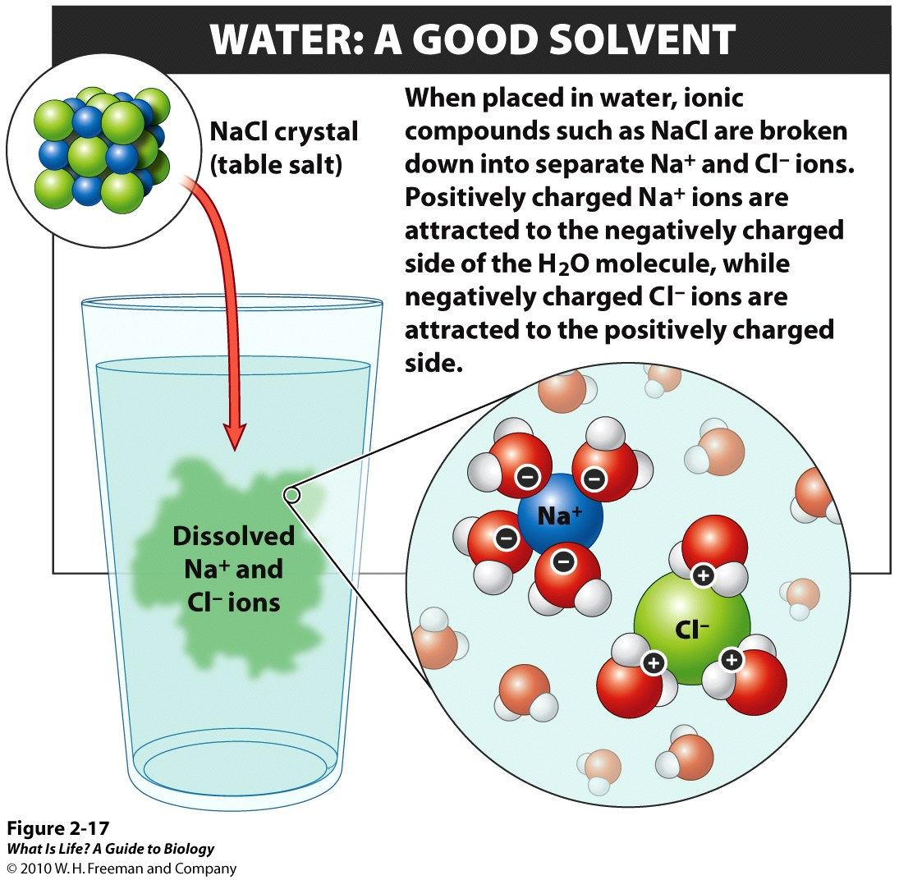

Slide 53
pH
pH is the measurement of the concentration of hydrogen ions that exists in a given solution.
High concentrations of hydrogen ions yield a low pH
Low concentrations of hydrogen ions result in a high pH.
The overall concentration of hydrogen ions is inversely related to its pH.

Slide 54
pH
Concentrations of
H⁺ (proton) and OH⁻ (hydroxide) are equal in pure water
An acid is any substance that increases the H⁺ concentration of a solution
A base is any substance that reduces the H⁺ concentration of a solution

Slide 55
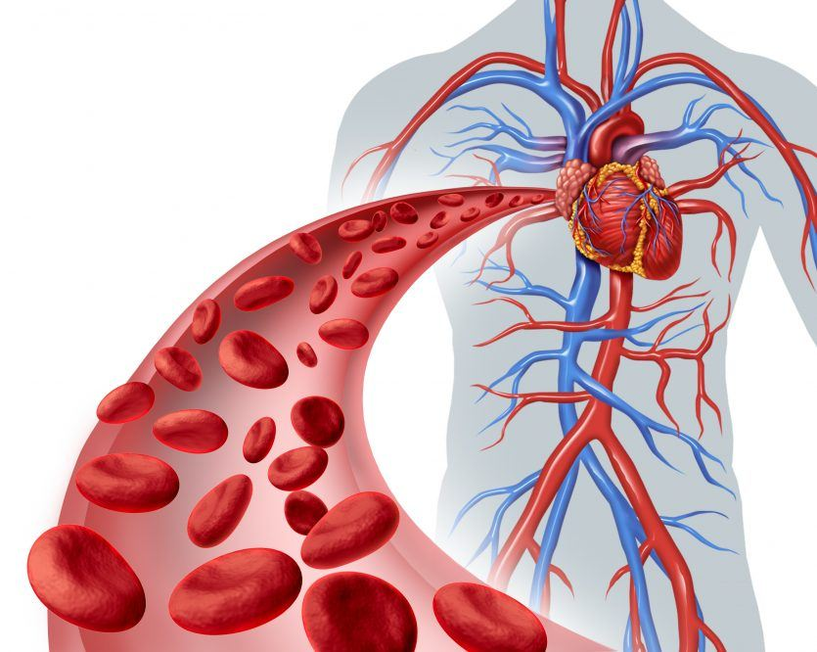
Buffering Changes in pH
Most cells in our bodies operate within a very narrow window of the pH scale, typically ranging only from 7.2 to 7.6.
  If the pH of the body is outside of this range, the respiratory system malfunctions, as do other organs in the body.
Buffers readily absorb excess H+ or OH–, keeping the pH of the body carefully maintained in the range.
Carbon dioxide is part of a prominent buffer system in the human body; it keeps the pH within the proper range.
  While carbonic acid is an important product in this reaction, its presence is fleeting because the carbonic acid is released from the body as carbon dioxide gas each time we breathe.
Without this buffer system, the pH in our bodies would fluctuate too much and we would fail to survive.

