Slide 1
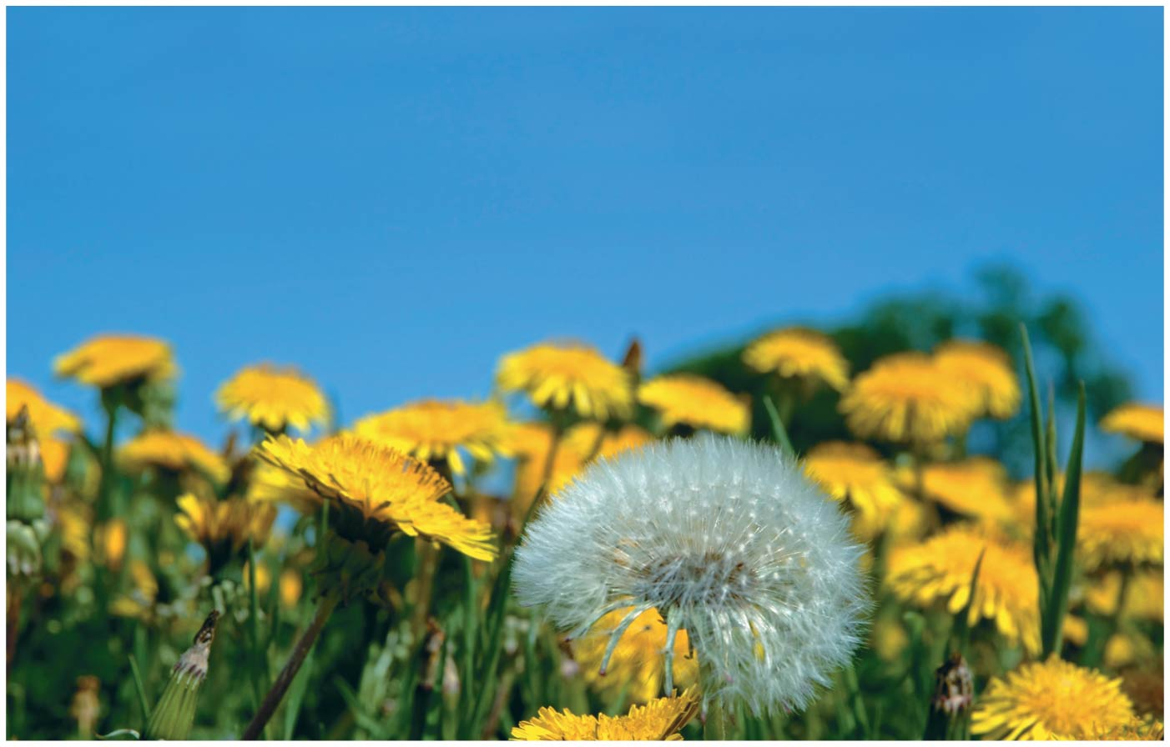
BIO10: Introduction to Principles of Biology
Dr. Paul Bradley
Introduction to Biology & Scientific Method

Slide 2
Syllabus
Lecture / Lab:
  Lecture is Monday & Wednesday 5:30pm – 6:50pm
  Lab is Monday -or- Wednesday 7:00pm – 9:50pm
    Your lab day is determined by your section

Slide 3
Syllabus
Canvas:
  Please familiarize yourself with Canvas, communication regarding the course will be based there, and you will upload some assignments there.
  PowerPoint slide sets for the lectures will be available on Canvas. You can access the course Canvas site using https://canvas.santarosa.edu.
  If you need more information, please contact Information Technology (https://it.santarosa.edu).

Slide 4
Syllabus
Office Hours:
  1pm – 4pm Tuesdays (other days/times available by appointment via email)
  Use the following link to setup an appointment: https://calendly.com/paulwbradley
  Link to setup appointment and link to Zoom room are both on Canvas

Slide 5
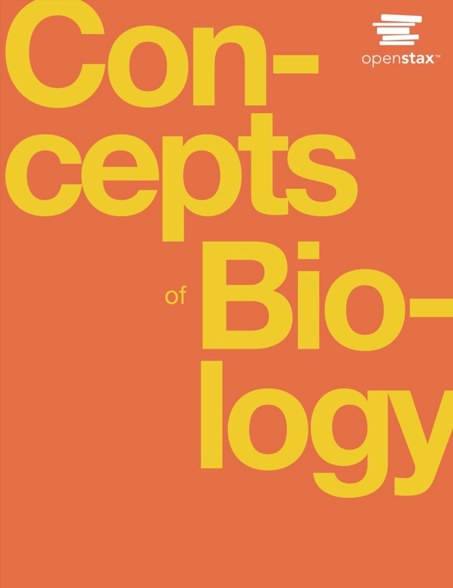
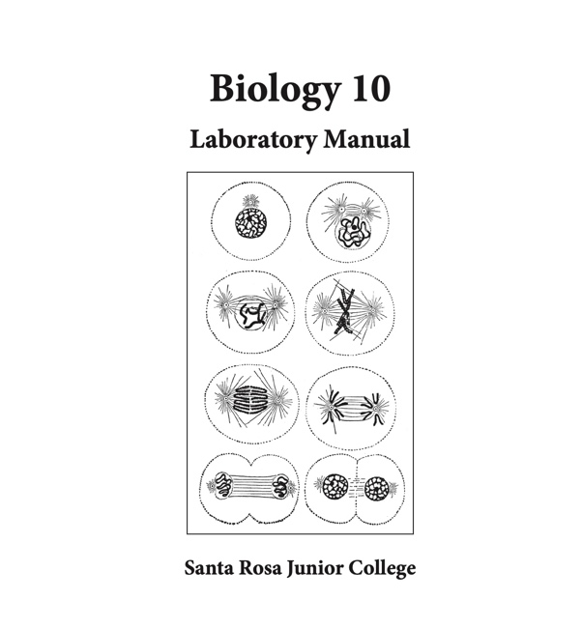
Syllabus
Textbook
  Free and online (link on Canvas)
Lab Manual
  You need to purchase at the bookstore

Slide 6
Syllabus
Expectations:
  Arrive to class on time prepared to actively participate in all classroom activities. This includes doing all assigned readings and homework before lecture. Be prepared to be called on for answers.
  Recognize and appreciate the uniqueness of your classmates and be respectful of each other’s views and opinions.
  Work collaboratively with fellow classmates.
  Come to me with any comments, questions, or concerns as soon as they arise.

Slide 7
Syllabus
Expectations:
  Attendance is required.
  However, if something arises in your life that prevents you from attending class such as getting sick, please reach out to me to let me know.
  A portion of your grade is based on positive participation and attendance. Points will be deducted for excess absences from lab and lecture.
  You may be dropped from the class if your absences exceed 10% of the total hours of class time (10.5 hours).
  When you are absent, it is your responsibility to obtain notes from a classmate, review my lecture slides, and/or complete the assigned homework for the day you missed. After you have reviewed all that on your own, you are welcome to come see me in office hours with any questions or clarifications.

Slide 8
Syllabus
Expectations:
  If you go by a name that is different from what is on the official course roster, please just let me know.
  Please don’t hesitate to help me know your pronouns. Mine are he, him, his.

Slide 9
Syllabus
Expectations:
  Any disruption to the learning environment will not be tolerated and will be referred to the college for disciplinary action.
  Examples of behaviors that interfere with student learning and are inappropriate during class:
    arriving late or leaving early
    using cell phones or other electronic devices
    packing up before the end of class
    chatting with neighbors
    and any offensive or demeaning behavior

Slide 10
Syllabus
Academic Integrity:
  Plagiarism and cheating are serious offenses that undermine the integrity of any academic institution.
  Plagiarism occurs when an idea is taken from a source other than the writer without citing that source. Quoting and paraphrasing ideas without citations are a form of plagiarism.
  Plagiarism and cheating on exams and/or assignments will most often result in an automatic “F” for the assignment and, as required, a report to the college.

Slide 11
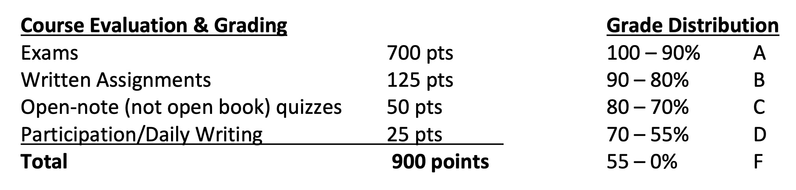
Syllabus
Grading:

Slide 12
How to do well in this course
Pay attention in lecture
Ask questions if you’re confused
Carefully read the textbook
  Learn every bold term
  Understand every figure, graph, diagram
  Make connections within and between chapters
    “What does this have to do with the other chapters?”
Keep up with readings

Slide 13
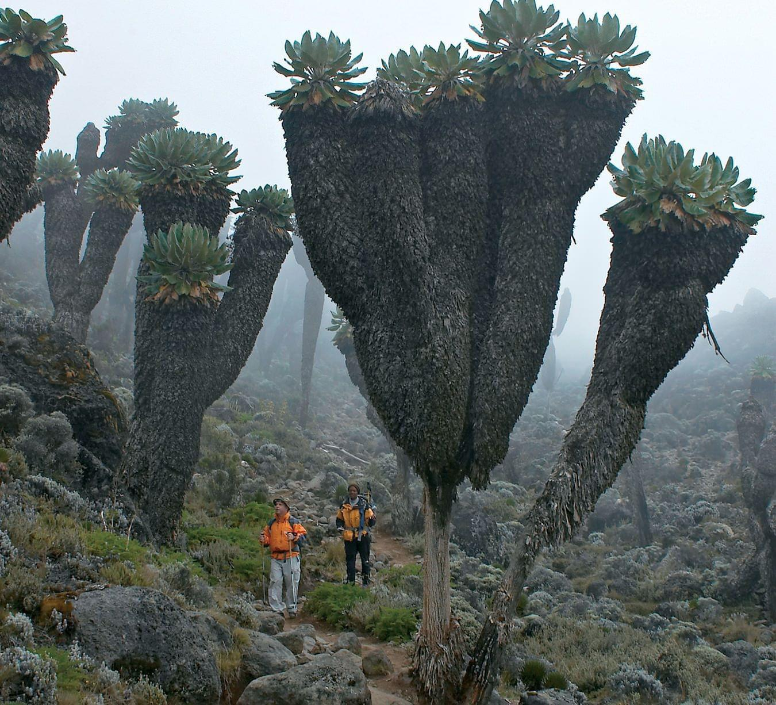
Moving on...

Slide 14
Themes and Concepts of Biology
By the end of this section, you will be able to:
Identify and describe the properties of life
Describe the levels of organization among living things
List examples of different sub disciplines in biology

Slide 15
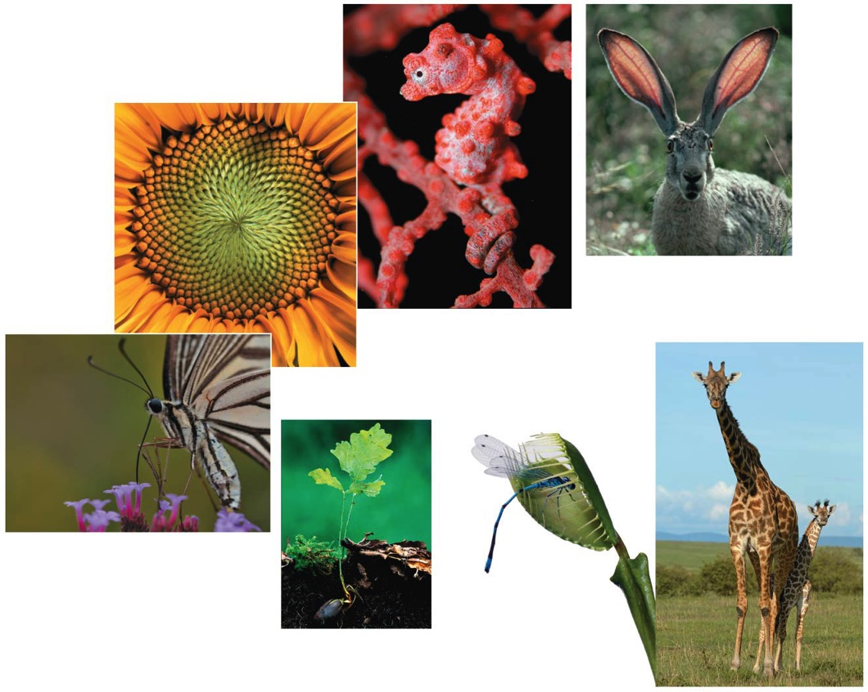
What is life?
Order
Regulation
Evolutionary
adaptation
Reproduction
Energy processing
Response
to the
environment
Growth and
development

Slide 16
What is life?
Regulation
Energy processing
Response
to the
environment
Growth and
development
Reproduction
Evolutionary
adaptation
Order

Slide 17
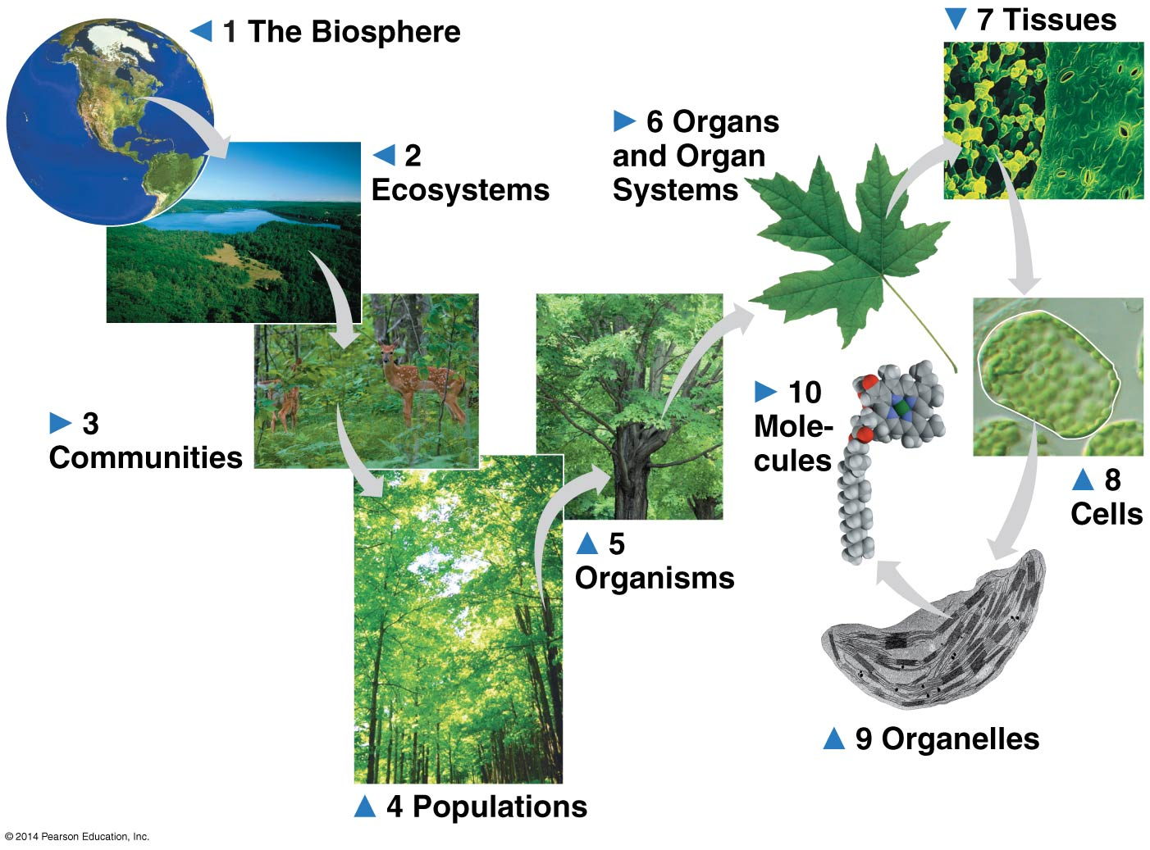
Levels of Biological Organization

Slide 18
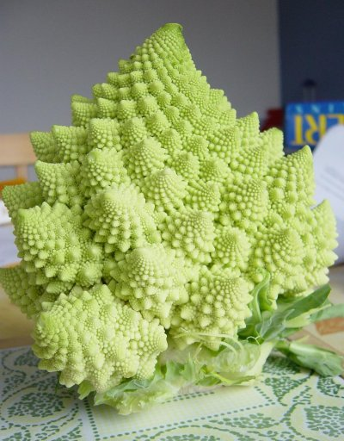
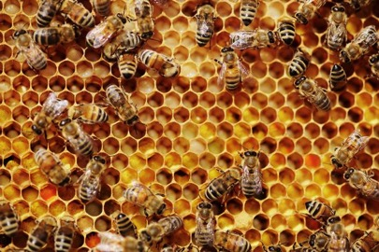
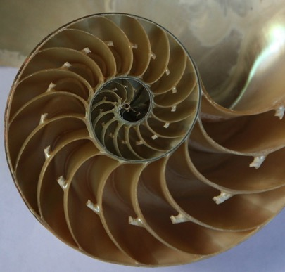
Natural Theology
Searches for evidences of the existence and attributes of God in the appearances of nature
Searches for greater understanding of God through understanding of nature
Claims complexity of nature was designed

Slide 19
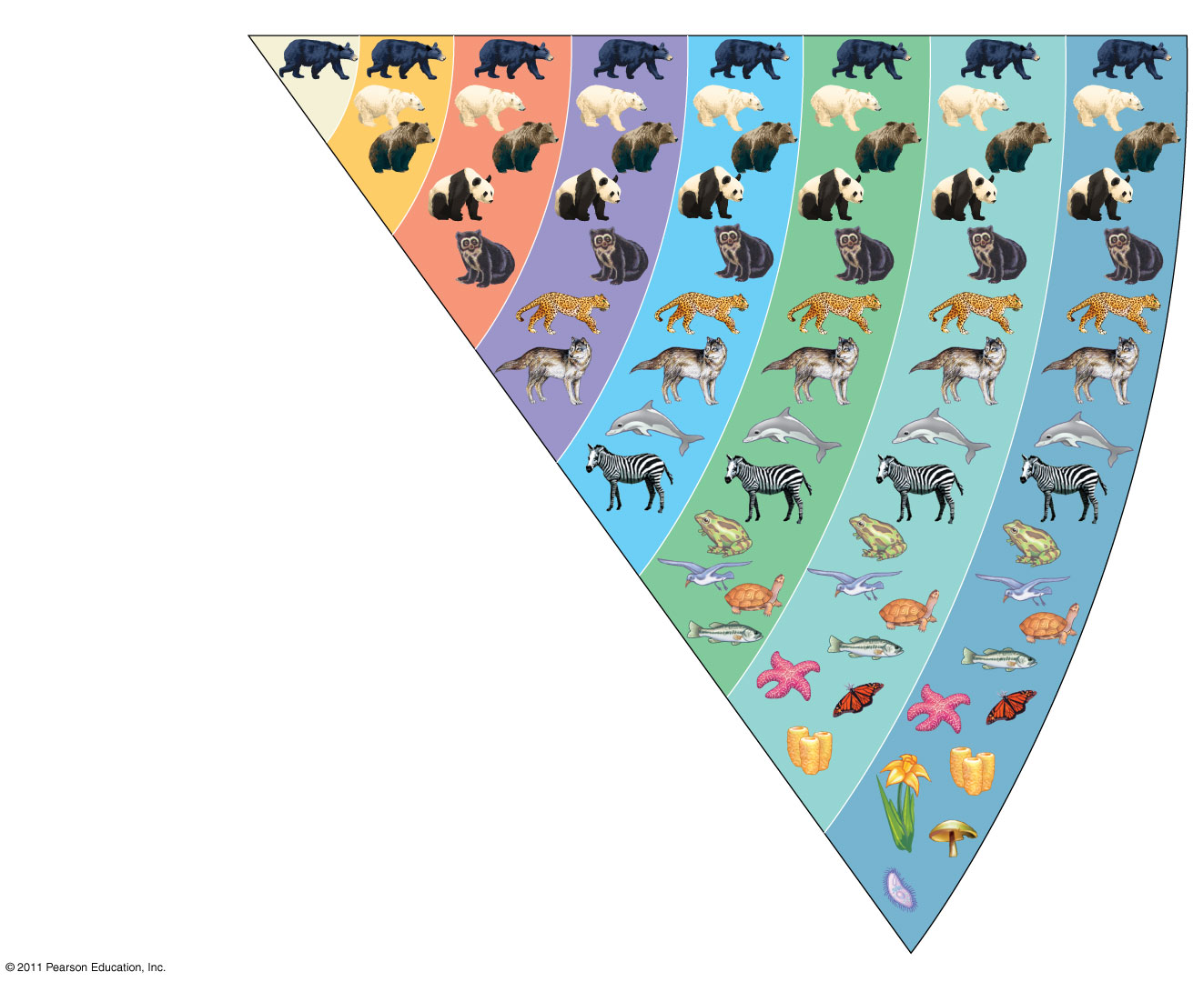
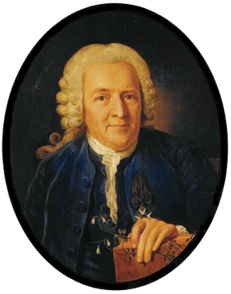
Species
Genus
Family
Order
Class
Phylum
Kingdom
Domain
Ursus americanus
(American black bear)
Ursus
Ursidae
Carnivora
Carl Linnaeus
Mammalia
Linnaeus tried to find order within the diversity of life
- sought to define and classify species based on structural differences
Linnaeus and most of his contemporaries believed that a creator had specially made and placed each species on Earth
Chordata
Animalia
Eukarya

Slide 20
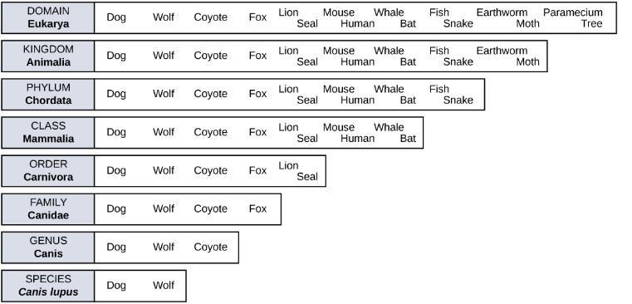
Linnaean Taxonomy
This diagram shows the levels of taxonomic hierarchy for a dog, from the broadest category—domain—to the most specific—species.
Notes:
First theme is the set of unifying levels of biological organization

Slide 21
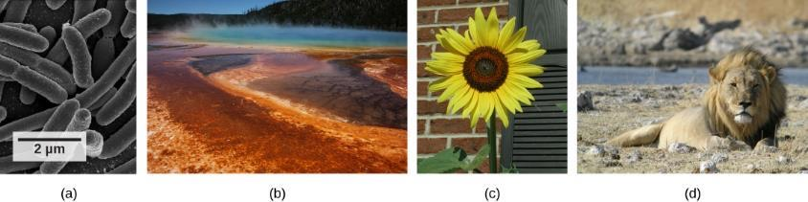
Domains of Life
(a) bacterial cells belong to the domain Bacteria, while the
(b) extremophiles, seen as colored mats in a hot spring, belong to domain Archaea.
(c) sunflower and
(d) lion are part of domain Eukarya

Slide 22
Evolution is not goal oriented
Life on Earth began with simple, unicellular organisms
The evolution of complex organisms occurred over billions of years
However, the vast majority of life on the planet (as measured by either biomass or variety of species) is still microbial

Slide 23
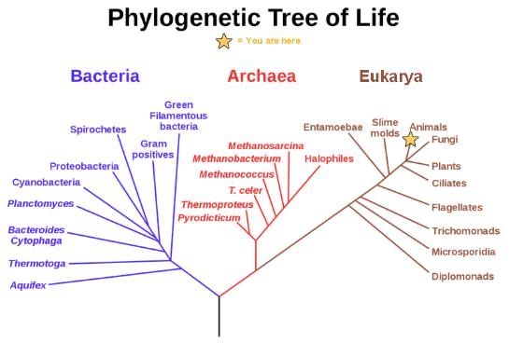
Phylogenetic Trees
This phylogenetic tree was constructed by microbiologist Carl Woese using genetic relationships. The tree shows the separation of living organisms into three domains: Bacteria, Archaea, and Eukarya.
Bacteria and Archaea are organisms without a nucleus or other organelles surrounded by a membrane and, therefore, are prokaryotes.

Slide 24
Sub Disciplines of Biology
The scope of biology is broad and contains many branches and sub disciplines.
For instance, molecular biology studies biological processes at the molecular level, including interactions among molecules such as DNA, RNA, and proteins.
Microbiology is the study of the structure and function of microorganisms.
  there are also microbial physiologists, microbial ecologists, microbial geneticists, among others.

Slide 25
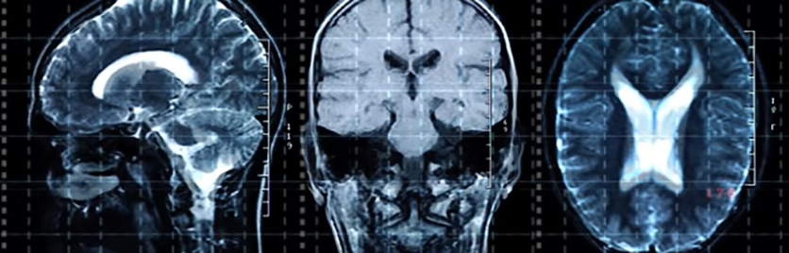
Sub Disciplines of Biology
Another field of biological study, neurobiology, studies the biology of the nervous system.

Slide 26
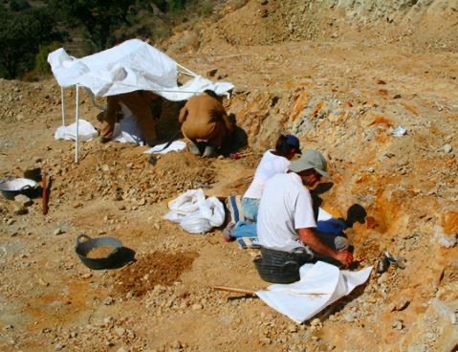
Sub Disciplines of Biology
Paleontology, another branch of biology, uses fossils to study life’s history.

Slide 27
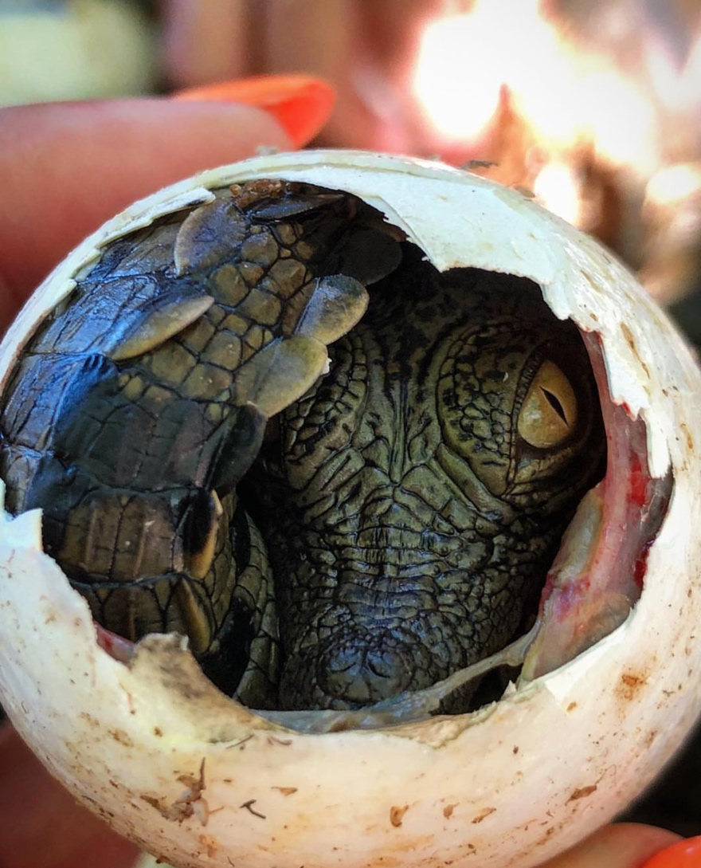
Sub Disciplines of Biology
Zoology and botany are the study of animals and plants, respectively.
Biologists can also specialize as biotechnologists, ecologists, or physiologists...

Slide 28
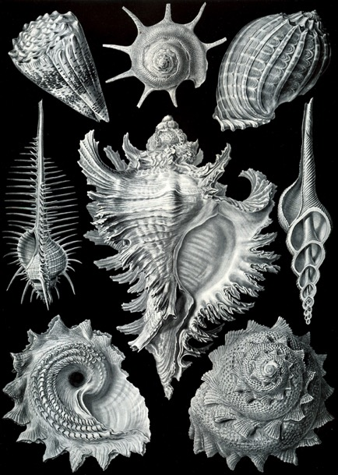
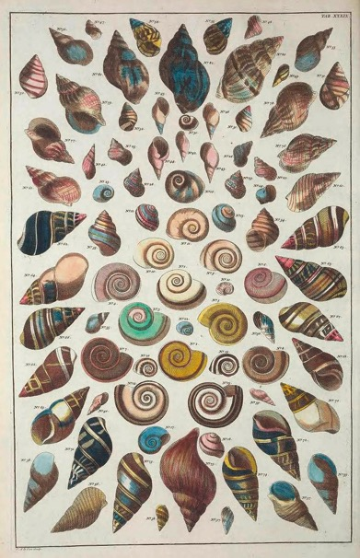
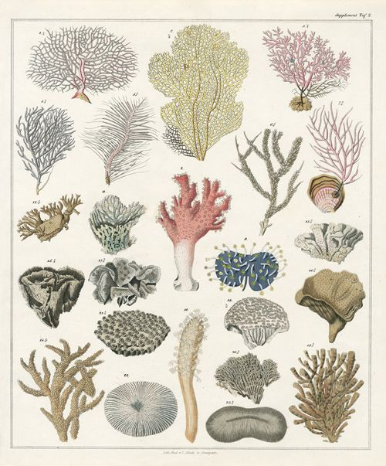
Natural History
Study of animals, plants, and minerals
Description, classification, & search for order

Slide 29
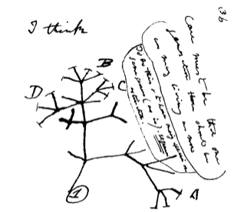
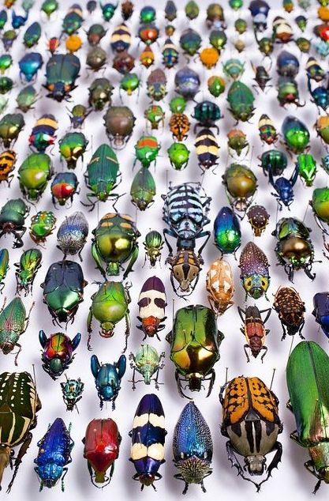
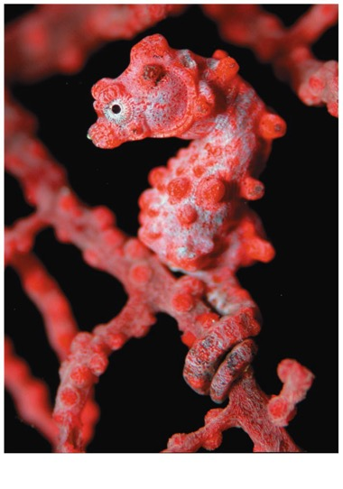
Theory of Evolution by Natural Selection
Darwin explained three broad observations
  The unity of life
  The diversity of life
  The match between organisms and their environment
  The interconnectedness of most of the fields of natural history

Slide 30
Theory of Evolution by Natural Selection
Darwin explained three broad observations
  The unity of life
  The diversity of life
  The match between organisms and their environment
  The interconnectedness of most of the fields of natural history

Slide 31
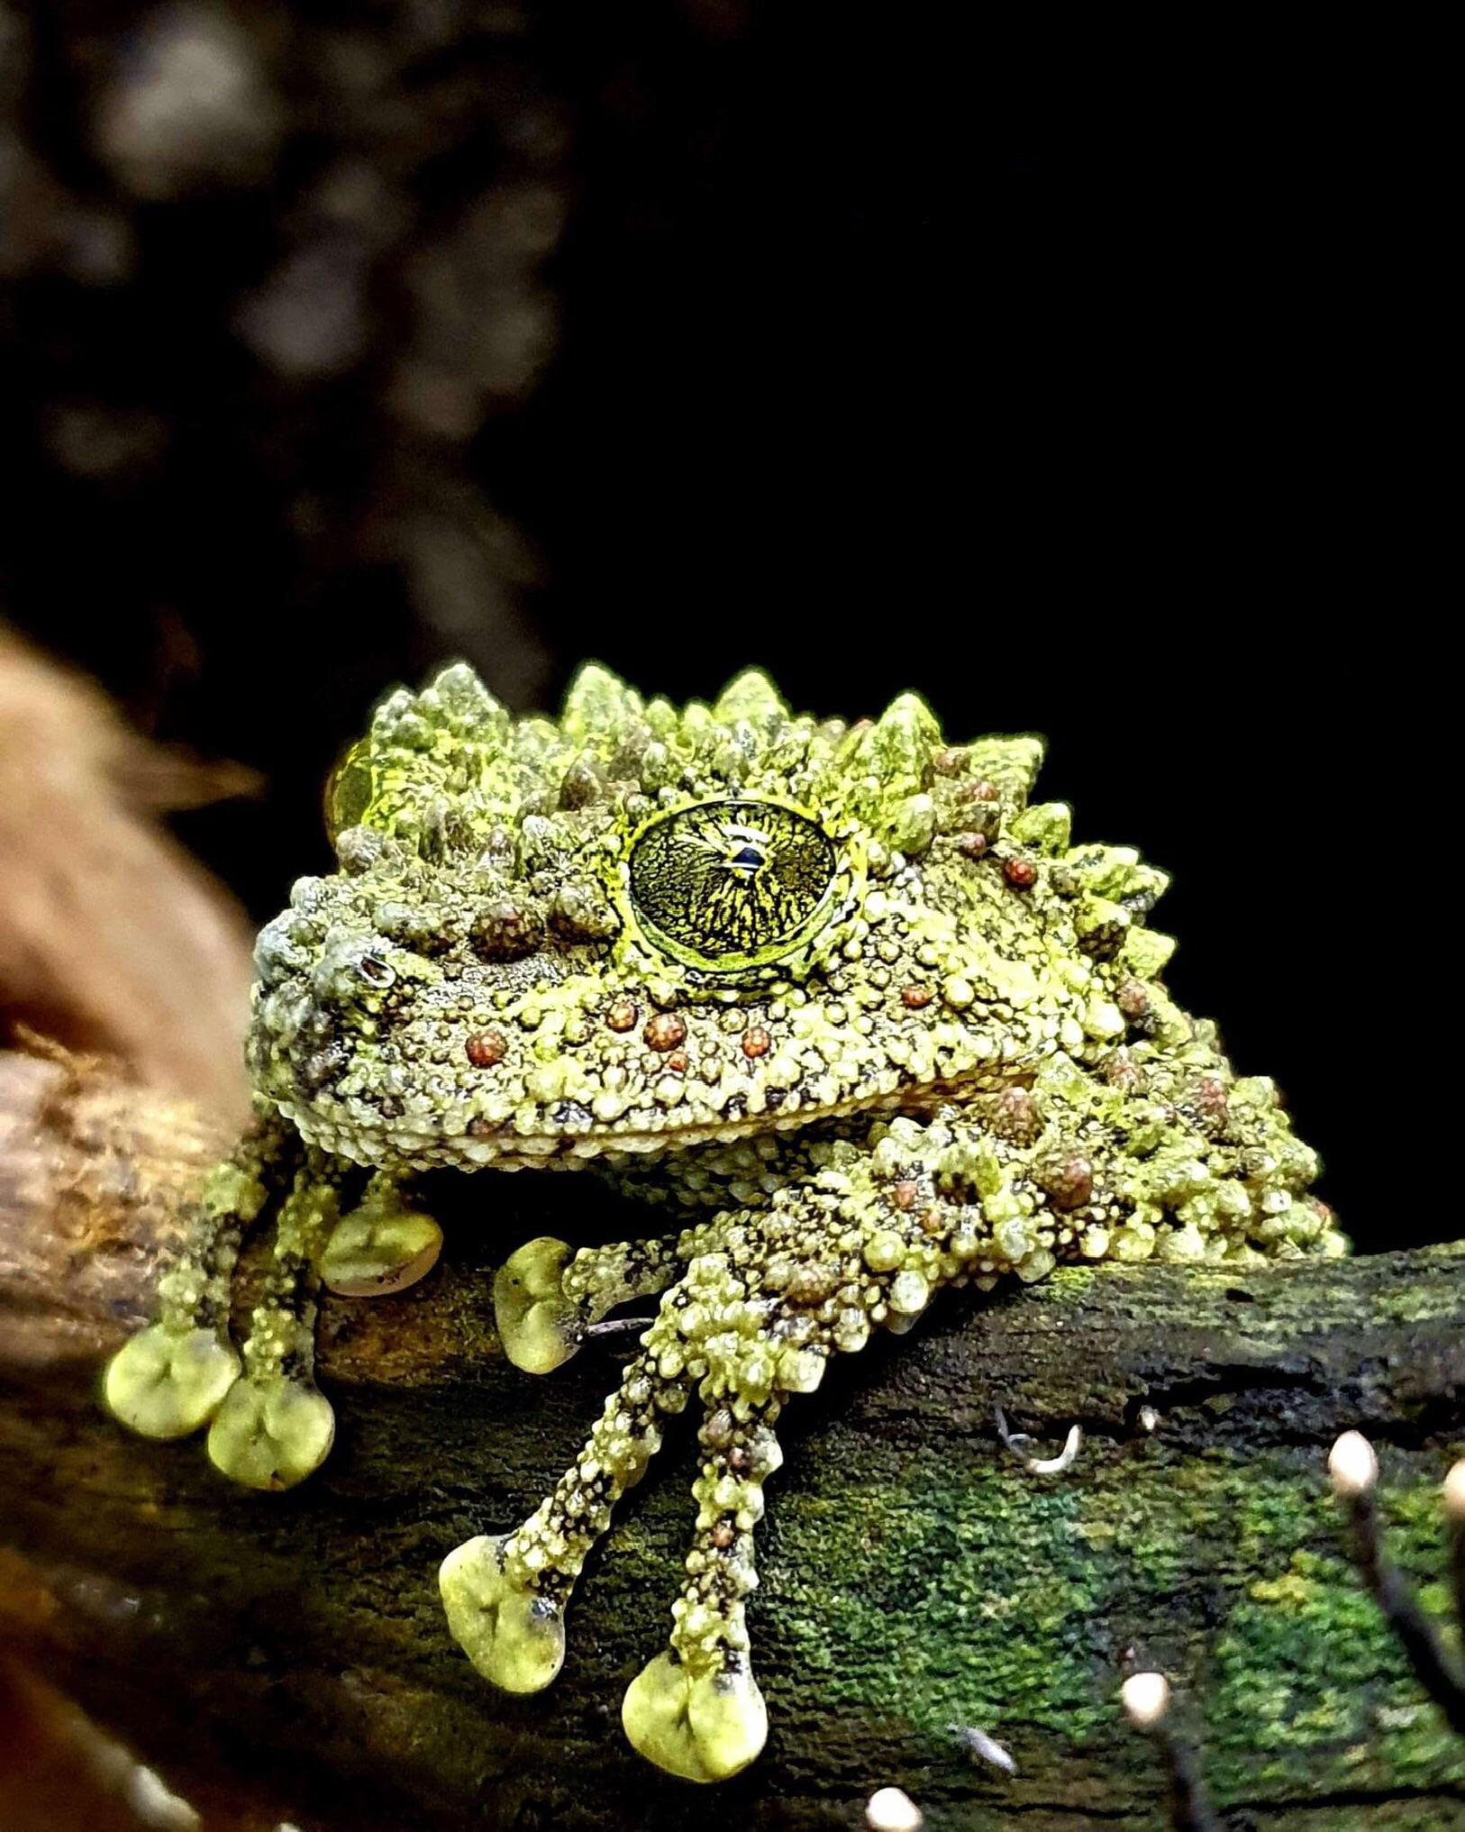
Moving on...

Slide 32
The Process of Science
By the end of this section, you will be able to:
  Identify the shared characteristics of the natural sciences
  Understand the process of scientific inquiry
  Compare inductive reasoning with deductive reasoning
  Describe the goals of basic science and applied science

Slide 33
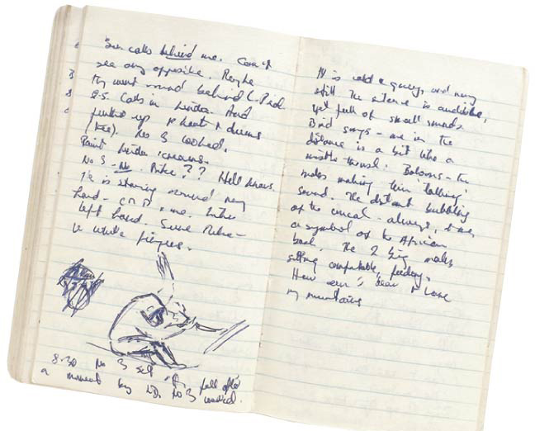
Observations
Biologists describe natural structures and processes
This approach is based on observation and the analysis of data
Recorded observations are called data
  Qualitative data often take the form of recorded descriptions
  Quantitative data are generally expressed as numerical measurement, organized into tables and graphs
Field or Lab Notebook

Slide 34
Questions
Questions must be
  Well defined
  Testable & Falsifiable
Elements of the question must be
  Measureable
  Controllable

Slide 35
Hypotheses
For example
  Observation: Your flashlight doesn’t work
  Question: Why doesn’t your flashlight work?
  Hypothesis 1: The batteries are dead
  Hypothesis 2: The bulb is burnt out
Both these hypotheses are testable & falsifiable

Slide 36
Hypotheses
For example
  Observation: Your flashlight doesn’t work
  Question: Why doesn’t your flashlight work?
  Hypothesis 1: The batteries are dead
  Hypothesis 2: The bulb is burnt out
Both these hypotheses are testable & falsifiable
Hypotheses can never be proven true!
- can be proven false
- can fail to be proven false
- can be “supported”

Slide 37
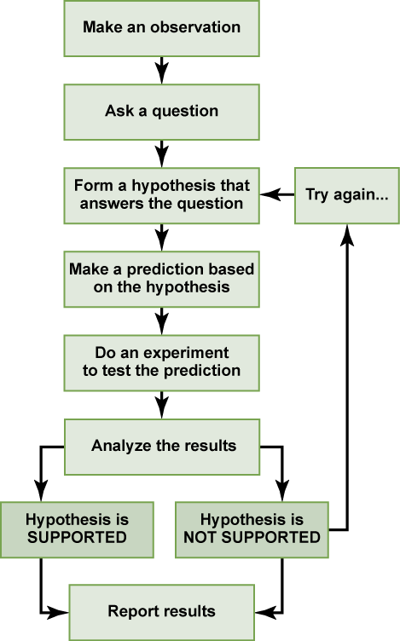
The scientific method
The scientific method is a series of defined steps that include experiments and careful observation.
If a hypothesis is not supported by data, a new hypothesis can be proposed.

Slide 38
The scientific method
Hypotheses: ideas that potentially explain an observation or a tentative answer/explanation to a well-framed question.

Slide 39
The scientific method
Hypotheses: ideas that potentially explain an observation or a tentative answer/explanation to a well-framed question.
  Can be tested by observation or experimentation
  A particular hypothesis can rarely be confirmed beyond a doubt.
  Can never be “proven.”

Slide 40
The scientific method
Predictions: statements that arise logically from hypotheses.
  An “if-then” statement explaining what (then...) would follow when a hypothesis (if...) were true.
    If... [insert hypothesis], then [insert prediction].
  Can be tested by observation or experimentation

Slide 41
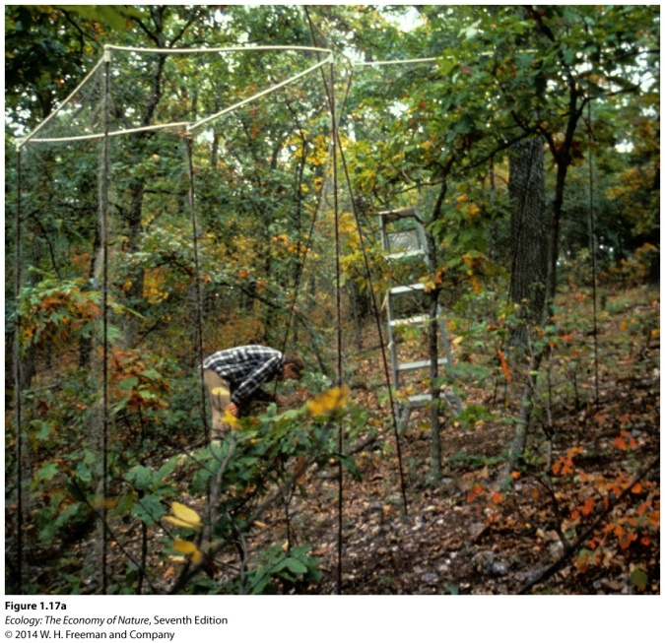
Manipulative experiments
Manipulative experiments: where a hypothesis is tested by altering a factor hypothesized to be the cause of a phenomenon.
Treatment: the factor that we want to manipulate in a study.
Control: a treatment that includes all aspects of an experiment except the factor of interest.
Example: Researchers want to test if birds are an important factor in determining the number of insects on oak trees.
Scientists manipulate the presence of birds on oak trees by placing cages around trees.
Some trees were left uncaged as controls.

Slide 42
Types of Hypotheses
  Alternative hypothesis – a statement where the “treatment” has an effect
    Most “hypotheses” should really be called “alternative hypotheses”
  Null hypothesis – a statement where the “treatment” has no effect

Slide 43
When there are multiple hypotheses, how do we pick the best hypothesis?
Parsimony: economical, cheap, not costly, not wasteful, orderly
We pick the simplest one, aka the most parsimonious one.

Slide 44
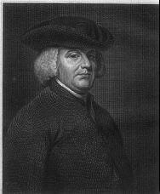
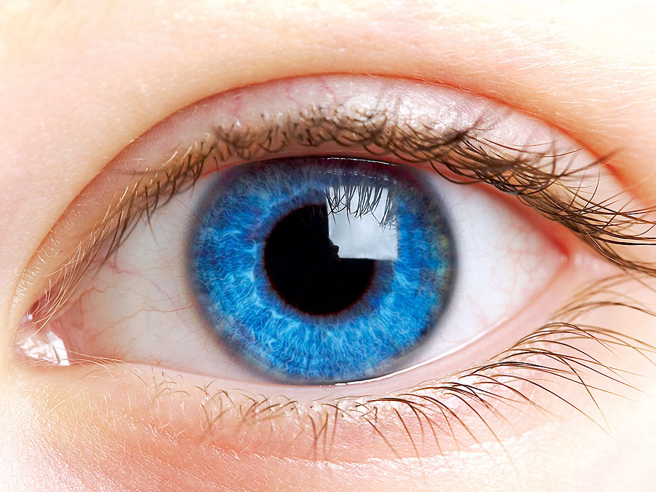
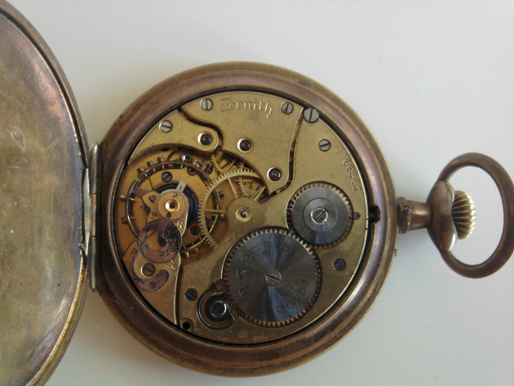
Science versus non-science
(pseudoscience)
William Paley
Paley argued that (just like a pocket-watch) the human eye was so complex of an organ, and so good at its job, that it must have be designed by an intelligent designer

Slide 45
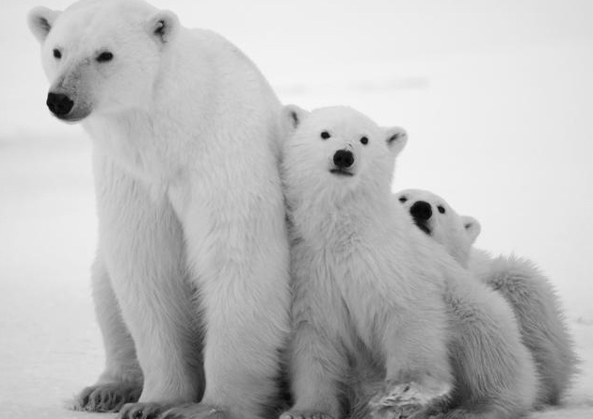
A Closer Look at the Role of Hypotheses in Scientific Inquiry
A scientific hypothesis must be testable and falsifiable
Hypothesis-based science often makes use of two or more alternative hypotheses
Failure to falsify a hypothesis does not prove a hypothesis
Falsifying a hypothesis through experimentation is not equivalent to failure
A hypothesis does not become a scientific theory until it has withstood repeated examinations, ideally through multiple types of inquiry

