Slide 1
Week Fourteen Lecture
Explosive Fire Behavior & Watch Out With Explosives

Slide 2
Introduction
Introduction:
This portion is going to concern fire that is so rapid that damage can happen in just a moment.

Slide 3
Learning Outcomes
Explosion Defined
Types of Explosions
Causes of Explosions (7)
Explosion Reaction
Strength of an Explosive
At the end of the reading and lecture, you should be able to describe the following in detail:

Slide 4
Learning Outcomes Continued…
Causes Explosions II
Explosions Triggered by:
Electrical Discharge
Open Flame
Hot Surfaces

Slide 5
Learning Outcomes Continued…
Physical Explosions
Blasting Agents and Explosive
Blasting Agents and Explosives working as Designed
Explosive Hazards from “A field Point of View”

Slide 6
Learning Outcomes Continued…
Examples of Explosive Ordinance
Two Phases of Explosive Behavior
Appendix of Explosive Devices
By the end of the reading assignment and lecture, you should have an understanding of the aforementioned “learning outcomes” listed above!
You need to be prepared for a 25 question quiz on this topic for next week!!!

Slide 7
Explosion Defined:
Violent Bursting often accompanied by a loud noise; high pressure is suddenly released.
Another simplified definition, “Anything that goes boom and does damage.

Slide 8
Types of Explosions:
_____________an explosion that is greater than the speed of sound with the following:
Usually a shock wave is sent out
Example of this type of explosive would be TNT (Trinitrotoluene) and other High X
Detonation

Slide 9
Types of Explosions Continued…
____________explosion generally in the Sub-sonic range as the reaction goes. Here are some other properties:
Instead of a rapid shock wave, the “pressure wave” is more of a pushing and propelling effect.
Black powder is a classic example of an explosive found in this arena.
Deflagration

Slide 10
Causes of Explosions:
There are at least “seven” ways explosions can occur with the result of energy being released:
1. Nuclear Fission:
Large amount of energy being released when certain atoms are _______(Plutonium) for example.
being split

Slide 11
Causes of Explosions Continued…
2. Nuclear Fusion:
Under great pressure and heat, four hydrogen atoms are fused into one helium atom.

Slide 12
Causes of Explosions Continued…
3. Inadequate Pressure Relief:
Trapped steam in a boiler or pipe.
Pressurized gas cylinder.
Liquid container exposed to a fire to name a few.

Slide 13
Causes of Explosions Continued…
4. BLEVE:
Boiling
Liquid
Expanding
Vapor
Explosion

Slide 14
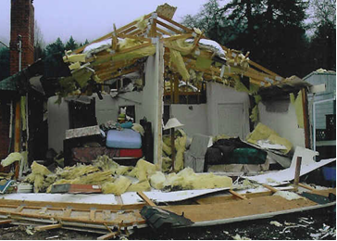
Causes of Explosions Continued…
5. Rapid Oxidation:
Here we can see pre-mixed combustion of propane
Photo Courtesy of: Bro Miller

Slide 15
Causes of Explosions Continued…
Rapid oxidation Continued…
By far, the most common type of explosive reaction
Simply, the chemical decomposition with the release of heat and light.

Slide 16
Causes of Explosions Continued…
6. ___________________:
Many “unstable molecules” will form long chains and release energy in the process.
Runaway Polymerization

Slide 17
Causes of Explosions Continued…
7. Decomposition of Molecules:
Molecules “breaking apart” release energy when the “chemical bonds” are being broken
Above certain concentration, hydrogen peroxide can “decompose” explosively.
2. Pressurized “acetylene” not only decomposes violently, but it can cause explosions as a gas

Slide 18
Explosion Reaction:
. A wave will pass along the body of the explosive.
Ahead of the wave, the explosive is unchanged.
Behind the wave, the explosive is instantaneously changed to a gas.

Slide 19
Strength of an Explosive:
Dependent on the amount of gas and heat that is released, and the rate the gas and heat that is released.
“Brisance” is the {the shattering or crushing effect of the explosion}
Rapid Expansion Must Take Place!!!
Gas pressure can reach into the thousands of kilo per centimeter.

Slide 20
Strength of an Explosive Continued…
Temperatures can be in the area of 3315° C and above (6000° F +).
Pressure waves move out enormous velocities in the thousands of meters per second (detonation cord will have a velocity of 6400 mps [21000fps]). The speed would get to San Diego from San Francisco in about 4minutes!!! The factors that govern the explosive strength are:

Slide 21
Strength of an Explosive Continued…
1.The rate of release.
2. The pressure release.
3. The quantity of gas released.

Slide 22
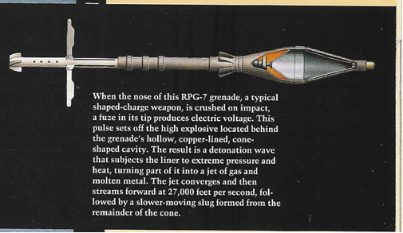
Strength of an Explosive Continued…
4. Directional factors controlling the release (HEAT round for example). [Refer to illustration below]

Slide 23
Strength of an Explosive Continued…
5. Mechanical effect is coincidental with the release.
6. The temperature of the released gas.

Slide 24
Strength of an Explosive Continued…
7. Physiological Effects

Slide 25
Causes of Explosions:
a._________
Generate high pressure by combustion in air or other gaseous environment.
b.__________
be it High Explosive, Oxidizers, etc.
Generate high pressure from the Decomposition process
Dusts and Mists:
b. Reactive Materials

Slide 26
Causes of Explosions Continued:
Explosions are triggered by:
Electrical discharge.
Open flame.
Hot Surface.

Slide 27
Causes of Explosions Continued:
Frequently described as rolling explosions, characterized as sounding like distant thunder.
Initiated by primary dust explosion.
Creates and ignites secondary dust dispersions.
Creates and ignites further dust explosions.

Slide 28
Causes of Explosions Continued:

Slide 29
Blasting Agents and Explosives:

Slide 30
Blasting Agents and Explosives:
Continued…
Any material designed for the blasting which has been tested for the following:
Blasting cap sensitivity.
Differential thermal analysis.
Thermal stability.
Burning behavior when on fire.
5. Must be insensitive as to pose little possibility from an “accidental detonation”.

Slide 31
Blasting Agents and Explosive Behavior as Designed:
A substance which, when subjected to the proper “stimuli” such as “blasting cap” will do the following:
Rapid decomposition (detonation velocity).
The reaction is self- propagating.
The reaction produces stable products (normally gases).
Production of immense heat in the area of 3315° C or 6000° F is not uncommon.
Pressures of enormous strength from action “of the heat” on produced or adjacent gases.

Slide 32
Summary:
An Explosion May Result From:
Chemical changes, such as those, which accompany the detonation of explosive or the combustion of flammable gas air mixture, dust air mixture, or mist air mixture.
Physical or mechanical changes, such as the bursting from a steam boiler, or high-pressure vessel.
Atomic changes, such as found in either a fission or fusion reaction.

Slide 33
“field point of view”:
1. Heating:
Max temperature for detonation
Prolonged exposure to lesser temperature {Duration of heat exposure?}
EVERY EXPLOSIVE BECOMES SENSITIZED FROM HEATING!!!!! The form of sensitivity is from shock mostly.

Slide 34
The terms “stable and unstable” are a “False Sense of Security”
Un-Stable Explosives start to decompose at 65° C (150° F)
Stable Explosives start to decompose at 204° C (400° F)
Brownish orange gas (nitrogen oxide) when the “decomposition process” is in full swing. “GET OUT DETONATION IS IMMINETE”.

Slide 35
“field point of view”:
Continued…
2. Burning:
“Primary explosives” (blasting caps and the like) explode immediately.
High explosive will or will not “go up” depending on variables:
Degree of containment (confinement in a container).
Quantity of Explosive. > H X the greater the chance for an explosion to occur.

Slide 36
“field point of view”:
Continued…
Rate of Temperature increase. > Temperature the greater the possibility of an explosion. Thermal Shock and Cooling is just as bad.
High Explosive (H X) in the process of burning will begin to “deflagrate” (burn at a subsonic rate). Deflagration leads to thermal shock and in turn leads to detonation.

Slide 37
“field point of view”:
Continued…
3. Already Exploded:
If a “low order” explosion has occurred, the “unexploded material can be spread for great distances.
This “unexploded material” can be “run over” The result of the friction of “this action” can lead shock and possible detonation.

Slide 38
“field point of view”:
Continued…
4. Toxic Gas Emissions:
Oxides of Nitrogen (Irritant Gas)
Other toxic gases depending on the makeup of the explosive.

Slide 39
Examples of Explosives and Ordinance:
1. Dynamite is one of the oldest high explosives around. This explosive is composed of varying degrees of nitroglycerin. Velocity of explosive wave ranges from 1219.2m/s to 7010.4m/s 4,000 to 23000 fps.

Slide 40
Examples of Explosives and Ordinance:
Continued… Dynamite
As it becomes old or stored improperly, the explosive becomes quite “unstable”. Some of the DANGER SIGNS:
An “oily film” develops on the stick(s).
Crystals can form on theses sticks as well.
The two aforementioned properties can permeate the surroundings.

Slide 41
Examples of Explosives and Ordinance:
Continued… Dynamite
The “Slightest Shock” can set them off. From the moving or slight temperature changes, the dynamite will likely “DETONATE”.
The fumes of “nitroglycerin” can cause severe headaches due to the rapid “dilation of the blood vessels”
Blasting caps pose a hazard as well most are of the “electric type”. DO NOT USE RADIOS IN THE AREA OF THESE TYPE CAPS. The EMR (Electromagnetic Radiation) can easily set them off!!!!!

Slide 42
Examples of Explosives and Ordinance:
2. Black Powder is a black granular Low Explosive, which has been around for centuries. This explosive is the oldest explosive. Some Dangers:
Extremely heat sensitive.
Shock Sensitive.
Burns at 365mps (1200fps)

Slide 43
Examples of Explosives and Ordinance:
3. ANFO (Ammonium Nitrate Fuel Oil Explosive) is an explosive that has all but replaced dynamite due to its cheaper cost, and most of all it is extremely stable. To detonate this type of explosive you need to have a “detonating device” that in turn is set off by a blasting cap.

Slide 44
Examples of Explosives and Ordinance:
Continued… ANFO
When undergoing combustion, ANFO will burn as a Class B and A material.
As with any “nitrate”, burning it becomes sensitive to shock and thermal decomposition and is liable to Detonate!!
Blast effect is quite devastating and a bit more powerful than dynamite.

Slide 45
Examples of Explosives and Ordinance:
4. Binary Explosive is an explosive where two “elements” need to be combined to make the explosive work. When the solid and liquid are combined we get the explosive. The term “water gel” is often the name of the mixture.
The hazards are the same for the ANFO type explosive except to a lesser degree.

Slide 46
Examples of Explosives and Ordinance:
5. C-4 or “Composition 4” is a high explosive used mainly as a “demolition explosive” by the military. The explosive is quite powerful with a detonation velocity of 7620mps (25000fps). The explosive has the consistency of Plato clay.

Slide 47
Examples of Explosives and Ordinance:
Continued… C-4
C-4 will burn as opposed to detonate. This is the reason it is used as an explosive in the military.
However, while the C-4 is burning if a shock is applied such as, “hitting it” will most likely cause it to Detonate!!!
The “fumes” from burning or detonation is quite toxic.

Slide 48
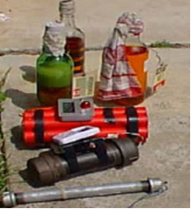
Examples of Explosives and Ordinance:
IED or Improvised Explosive Devices:

Slide 49
Examples of Explosives and Ordinance:
These “devices” –IED- are probably the most dangerous of the lot for the following reasons:
The “initiating device” is always with the explosive.
The “fusing” of the devices are mostly “inconsistent”

Slide 50
Examples of Explosives and Ordinance:
Continued… IED
The devices can have “decoy fusing” that leads to the device being detonated.
Commonly have a “tamper” defenses to set them off.

Slide 51
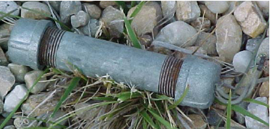
Examples of Explosives and Ordinance:
Continued… IED
Some common examples of these devices are simple as a “pipe bomb” to explosive “mines” of a sophisticated nature.

Slide 52
Examples of Explosives and Ordinance:
Continued… IED

Slide 53
Examples of Explosives and Ordinance:
Continued… IED
The devices can be of an Incendiary type

Slide 54
Examples of Explosives and Ordinance:
Booster Charge is used if the “Main Charge”
is difficult to detonate. {Secondary}

Slide 55
Ordinance is simply explosive devices that are designed to cause destruction of the following:
Personnel.
Structures.
Armored fighting vehicles as well as any mean of transport.
Aircraft in flight and on the ground.
“Hardened Target” such as bunkers and fortifications.
The “ordinance” is designed to “deal with any of the above” above “targets”. The ordinance can be specific or have the ability to deal “varied” type targets.

Slide 56
Examples of Explosives and Ordinance:
German Toe Mine ready
Mine open to show configuration

Slide 57
Examples of Explosives and Ordinance:
Small Arms Ammunition:
Generally “cartridges” will not explode when burning and are not contained. However, if the rounds are in weapons, this will be deadly in the event of a “cook off”. Also, this type of ammunition, if in a confined space, has the tendency to explode.

Slide 58
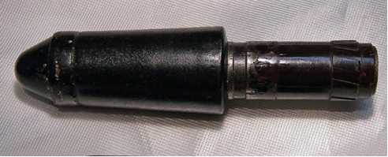
Explosive Grenades:
These devices are either thrown by hand or fired from a rifle. The main purpose of the grenade is to inflict “casualties” on personnel.
The grenades affect personnel by the propelling of fragments of metal at high velocities to tear the body. The blast effect of is deadly in confined spaces such as a room or bunker and the like.

Slide 59
Examples of Explosives and Ordinance:
The “Japanese” grenades of WW-II are some of the most dangerous grenade around. The explosive is “picric acid” based which becomes quite unstable under long storage or improper storage. A light shock has been known to set these devices off. One can only imagine what 50+ years of storage in a garage is going to do!!!! In addition, devices of Chinese design suffer from this same problem.

Slide 60
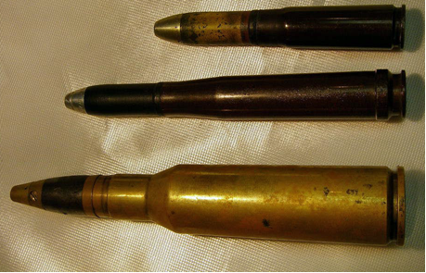
Examples of Explosives and Ordinance:
Explosive Shells and Rockets:
These can be doubly dangerous. The reason is that the fuse in the nose of the round may be attached and the primer in the shell casing is attached.

Slide 61
Examples of Explosives and Ordinance:
Now if we look at rockets the motor and warhead are linked as one. (Refer to the image of the AT-3 Sagger above)

Slide 62
Examples of Explosives and Ordinance:

Slide 63
Examples of Explosives and Ordinance:
BOTTOM LINE!!!! Leave the handling of Explosive Devices to the personnel, who are trained, to deal with such situations!!

Slide 64
Now let us look at the explosive behaviors of military explosive devices:
An explosion has “two phases”
PPW Positive Pressure Wave with immense pressure that can be in the thousands of kilos to the centimeter. The “wave” velocity is in the area of 3962 mps (13000fps)
Negative Pressure. Vacuum is partial. The rushing in of this “negative pressure” can be nearly as devastating as the PPW.

Slide 65
Now let us look at the explosive behaviors of military explosive devices:
Continued…
Also, the shock waves that “intersect” each other will be doubled in their destructive force. This is the reason atomic weapons are exploded in the “air above target”
The blast is the main killer in explosions of the high explosive variety.

Slide 66
Now let us look at the explosive behaviors of military explosive devices:

Slide 67
Now let us look at the explosive behaviors of military explosive devices:

