Slide 1
Chapter 8 Fire Characteristics: Liquid Combustibles

Slide 2
Objectives
Describe the flash point, fire point, and autoignition temperature of a flammable liquid.
List the three classes of flammable liquids, based on flash point and potential ambient temperatures.
Define the linear burning rate of a pool of liquid and explain why it varies with the diameter of the pool.

Slide 3
Objectives
Describe the physical considerations that affect the rate of flame spread of flammable liquids.
Explain boilover.
Explain a boiling liquid/expanding vapor explosion (BLEVE).

Slide 4
Ignition of Liquids
Liquids burn if the vapor concentration exceeds the lower flammable limit of that vapor in the air.
Vapor pressure of liquids increases with higher temperatures.

Slide 5
Flash Point
Flash point: The minimum temperature to which a liquid must be heated, in a standardized apparatus, so that a transient flame moves over the liquid when a small pilot flame is applied

Slide 6
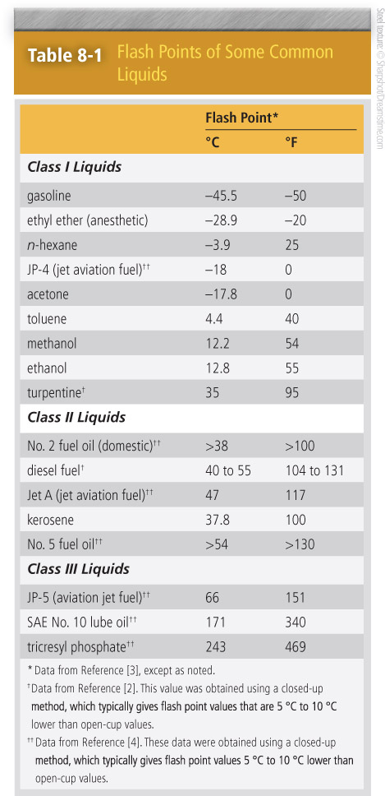
Flash Point

Slide 7
Fire Point
Fire point: The minimum temperature to which a liquid must be heated, in a standardized apparatus, so that sustained combustion results when a small pilot flame is applied as long as the liquid is at normal atmospheric pressure

Slide 8
Temperature Values
Variations in flash and fire point temperature values:
Intensity/size of ignition source
Length of time ignition source is held over the liquid
Rate of heating the liquid
Degree of air movement over the liquid

Slide 9
Liquid Flash Points
Classes of liquids:
Class I: flash points < 100 °F (38 °C)
Class II: flash points ≥ 100 °F (38 °C) but < 140 °F (60 °C)
Class III: flash points ≥ 140 °F (60 °C)
Liquid flash points range from at least −50 °F to 469 °F (−45.5 °C to 243 °C).

Slide 10
Flash Point Pressure
Fire and flash points depend on pressure.
Flash and fire points: lower than normal at pressures below atmospheric pressure
Flash and fire points: higher than normal at pressures above atmospheric pressure

Slide 11
Burning Rates of Liquid Pools
Pools of flammable liquid will burn at relatively steady rates until the liquid is consumed.
Linear burning rate: The rate at which the surface of a liquid pool recedes as it burns
Linear burning rate is converted to linear mass burning rate (kg/m²-s):
Linear burning rate × density of liquid (kg/m³) / 1000

Slide 12
Burning Rates of Liquid Pools
Total heat release rate for pool of liquid:
Rate of heat release per unit area × surface area of the pool.
Nature of the liquid and diameter of the pool determine the linear burning rate.

Slide 13
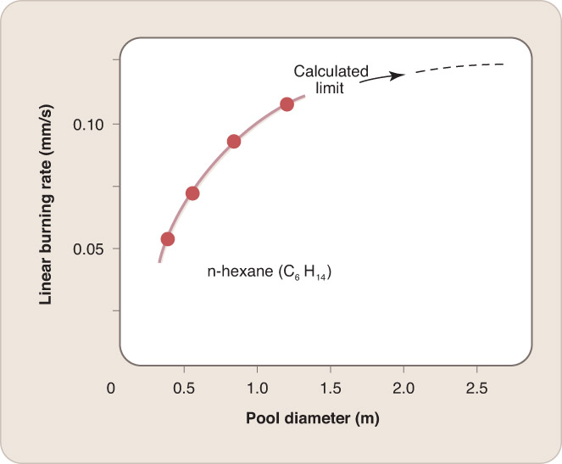
Burning Rates of Liquid Pools
Burning rate increases with pool diameter for pools > 0.2 m (with a limit at 3 m).

Slide 14
Factors Controlling the Burning Rate of a Liquid Pool
A small amount of flame radiation is needed to vaporize enough liquid to sustain the fire.
A flame over a small pool (< 0.2 m) is a laminar diffusion flame.
Combustion is relatively complete.
Flame is optically thin, low emissivity, and low radiant intensity to the fuel surface.
Flame produces enough radiation to vaporize sufficient liquid to keep burning.

Slide 15
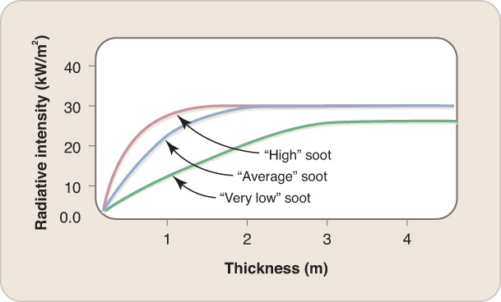
Factors Controlling the Burning Rate of a Liquid Pool
Flame radiation to the surface increases with increasing pool diameter (up to 3 m).
At larger diameters flames evolve from laminar to turbulent.

Slide 16
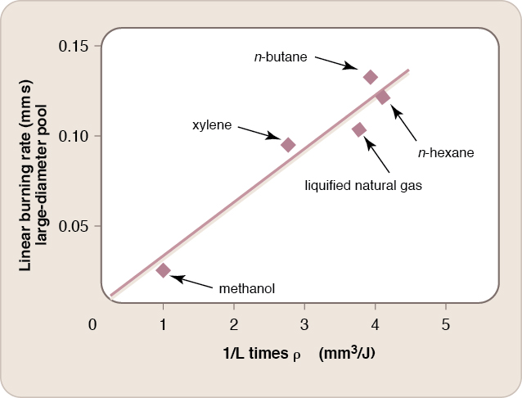
Factors Controlling the Burning Rate of a Liquid Pool
Increasing flame thickness will increase radiant output to a certain point.
Optically thick flames produce a heat flux on a liquid surface not sensitive to the chemical nature of the combustible.

Slide 17
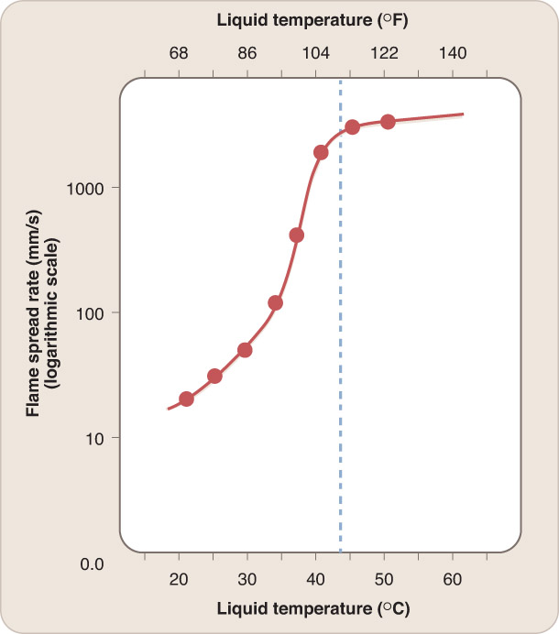
Flame Spread Rates Over Liquid Surfaces
Flames spread slowly over liquids with temperature well below the flash point.
Flame spread will occur if radiative heat transfer from the flame is sufficient to heat the adjacent cold liquid.

Slide 18
Flame Spread Rates Over Liquid Surfaces
Flames spread rapidly over liquids with temperature above flash point.
Vapor concentration just over the surface will exceed the upper flammability limit if liquid is too warm.
Direction/velocity of air flow impacts flame spread over a liquid pool.

Slide 19
Categories of Liquid Fires
Pool of liquid (open tank or spill)
Boilover: Key condition requires:
Upper layer of low-density combustible liquid
Lower layer of higher density fluid whose boiling point can be exceeded due to heat transfer from the upper fluid layer

Slide 20
Categories of Liquid Fires
Flowing liquid (overflowing or rapidly leaking tank)
Difficult to extinguish if the liquid continues to flow

Slide 21
Categories of Liquid Fires
Spray from a small orifice at high pressure
Fire point is not a relevant measure of flammability.
Flammability limit values are similar to those for that chemical’s vapor–air mixture.
Flames can be attacked by:
Relieving fluid pressure
Inerting the environment
Applying gas-phase active fire suppressant

Slide 22
Categories of Liquid Fires
Thin liquid layer drawn up by capillarity over the surface of a porous medium
Normally a small fire, but if the flame comes in contact with a large liquid pool or combustible, it would spread and grow into a larger fire

Slide 23
Categories of Liquid Fires
Confined liquid in a pressure vessel, heated by an external fire
An external fire will raise the internal heat/pressure as well as lower tensile strength of the container.
Boiling liquid/expanding vapor explosion (BLEVE)

Slide 24
Summary
Three temperatures characterize the ability to ignite a liquid. The flash point is the temperature at which piloted ignition occurs, but is not sustained; it is the temperature at which the vapor pressure of the liquid equals the lower flammability limit. At the slightly higher fire point, the flame is sustained. The autoignition temperature is hundreds of kelvins higher and applies to unpiloted ignition.

Slide 25
Summary
Class I liquids have flash points below 100 °F (38 °C), Class II liquids have flash points between 100 °F and 140 °F (38 °C and 60 °C), and Class III liquids have flash points at or above 140 °F (60 °C).

Slide 26
Summary
For a liquid pool of diameter < about 0.2 m, linear burning rate decreases as the pool diameter increases. In this pool-size range, fuel vaporization is affected by the container edges, which are heated by flame radiation. For pool diameters > 0.2 m, burning rate rises with increasing diameter. Flames become turbulent and sootier, so flame radiation increases and vaporizes the fuel faster. A limit to the burning rate is reached at pool diameters near 2 m, where flames are optically thick and flame radiation to the fuel surface is no longer increasing.

Slide 27
Summary
If the liquid is at or above its flash point, the flame spread rate is fast, and the entire pool is engulfed within seconds. In such a case, the liquid is already evaporating sufficiently to reach the lower flammability limit in the vapor phase over the fuel surface. As the liquid temperature decreases, flame radiation must heat the liquid to the flash point temperature and supply the heat of vaporization. As a result, the flame spread rate decreases sharply.

Slide 28
Summary
Liquid fuel fires generally fit into five categories: (1) a liquid pool, (2) a flowing liquid, (3) a spray from a small orifice at high pressure, (4) a thin liquid layer drawn up by wicking action over the surface of a porous medium, and (5) a liquid confined in a pressure vessel that is heated by an external fire.

Slide 29
Summary
Two consequences of fires are particularly hazardous: boilover and BLEVE. A boilover is a special case of a liquid pool, which can occur in an open container with flames over the upper of two immiscible liquid layers. If the lower layer, which has a higher density, has a lower boiling point, it can expand violently when its temperature reaches its boiling point.

Slide 30
Summary
A BLEVE is also a result of the sudden expansion of a liquid when it vaporizes to a gaseous state. When expansion occurs because the wall of the pressure vessel is weakened due to heating by the external fire, the vessel wall ruptures catastrophically. If the fluid is flammable and ignited by the external fire, flames are accelerated, and potential damage is multiplied.

