Slide 1
Chapter 13 Fire Fighting Chemicals

Slide 2
Objectives
Distinguish among fire extinguishment, fire control, and fire inerting.
List the four classes of fire, as used in the United States.
Describe the different ways in which water suppresses a fire, depending on its method of delivery and the geometry of the fire, and list the types of fires on which water should not be applied.

Slide 3
Objectives
Describe the roles of suppression-enhancing additives to water.
List the types of nonaqueous fire suppressants.

Slide 4
Objectives
Understand why the use of halon for fire extinguishment has been curtailed.
Explain how powdered agents are effective for fire extinguishment.

Slide 5
Introduction
Change in fire suppression chemistry
Manufacture and use of fully halogenated fire suppressants curtailed
New approaches developed

Slide 6
Definitions
Flame or fire extinguishment
Fire control
Flame or fire suppression
Fire inerting

Slide 7
Organization of Applied Chemicals
Types of fire on which they are effective:
Class A
Class B
Class C
Class D

Slide 8
Organization of Applied Chemicals
Phase of the chemical
Mechanism of action:
Interference with flame propagation
Thermal interaction
Dilution of fuel vapors and/or oxygen
Separation of fuel and flames

Slide 9
Organization of Applied Chemicals
Mode of application
Streaming
Total flooding
Application system

Slide 10
Water
Oldest fire suppressant
Automatic sprinkler systems
Actuation under most effective conditions
Residential sprinklers
Response time index (RTI) given in units of:
m^{1/2}s^{1/2} (ft^{1/2}s^{1/2})

Slide 11
Water
Plunge test
Heat transfer from hot air to the sprinkler is approximately proportional to the square root of the flow velocity.

Slide 12
Water
Equation 13-1: RTI = (M_{t} c_{t}/h_{c} A)v^{1/2}
M_{t} is the mass of the trigger.
c_{t} is the heat capacity of the trigger (J/g K).
h_{c} is the convective heat transfer coefficient from the air to the trigger (J/m² Ks).
A is the area of the trigger exposed to the hot air flow (m²).
v is the air velocity (m/s).

Slide 13
Water
Final units of the RTI are square root of length × square root of time.
Desirable features of using water:
Readily available
Low cost
Nonflammable
High heat of vaporization

Slide 14
Water
Desirable features of using water (cont’d):
Gasifies readily
Expands upon vaporization
Readily transportable at normal ambient temperature
Nontoxic
Limited property damage

Slide 15
Water
Class considerations:
Less desirable for Class B
Used with care in Class C
Should be avoided in Class D
Three effects of water to slow rate of combustion:
Water substantially cools contacted fuel area.
Hot surface vaporizes some of the water.
Absorbs enthalpy

Slide 16
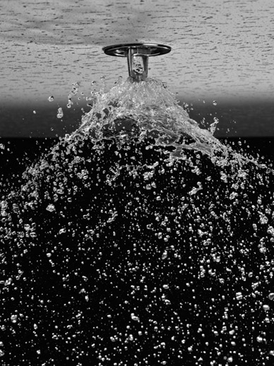
Water
Size distribution of water droplets from a sprinkler:
Too small
Too large
© Ocean/Corbis.

Slide 17
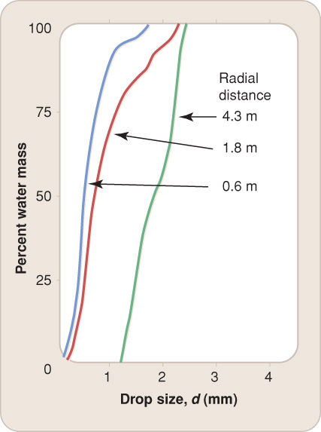
Water
Mean droplet diameter increases with the radial distance from the sprinkler axis.

Slide 18
Water
Three variables for mean diameter of water droplets:
Orifice diameter, D
Pressure drop, ∆P
Surface tension, σ
Equation 13-2: d_{d} = c(σD²/ΔP)^{1/3}
c is a constant determined experimentally.

Slide 19
Water
Surface tension of water
Wetting agent
Delivery rate required to control a fire
Water depth accumulated per unit time (mm/min or in./min)

Slide 20
Water
Water mist
Fine water mist extinguishes a fire by one of four mechanisms:
Removes heat
Evaporates and generates steam
Blocks radiative heat transfer
Cools the fuel surface

Slide 21
Enhanced Water
Water additives:
Alter droplet size
Improve ability to penetrate porous materials
Increase efficiency for heat absorption
Adding chemicals (inorganic salts)

Slide 22
Enhanced Water
Miscible organic compound
Residual liquid could become flammable.
Fire hose or sprinkler system flow is determined by:
Water pressure from the source
Inner diameter of the hose or piping
Resistance to flow of the moving water at the inner surface

Slide 23
Enhanced Water
Friction-reducing additives
Thickening additives
Problems with thickening water:
Poorer penetration of fuel masses
Greater friction loss in hoses
Inability to produce fine sprays
Slippery floors
Clean-up
Wildland fires

Slide 24
Aqueous Foams
Common characteristics
Class B foams separate fuel from air
Generally for large flammable liquid fires
Flammable organic fluids with densities lower than water
Gasoline
Oil or fat
Deep pools of alcohols

Slide 25
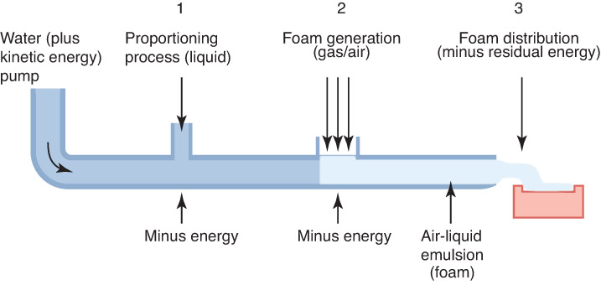
Aqueous Foams
Fireground conditions that negate benefits of aqueous foam:
High winds
Heat from the fire
Chemical action of certain vapors
Proportionally mixed with flowing water

Slide 26
Aqueous Foams
Aqueous film-forming foam
Film spreads over the surface of the fuel if the surface tension of the combustible liquid is greater than the surface tension of the AFFF solution by an amount in excess of the interfacial tension between the two liquids.
Can penetrate a porous fuel mass
Alcohol-resistant foaming agents

Slide 27
Aqueous Foams
Protein foams
Metal salt added
Organic solvent added
Higher surface tension than the values for AFFFs
Biodegradable
Fluoroprotein foam
Added surfactant
Compatible with dry chemical fire suppressants

Slide 28
Aqueous Foams
Medium- and high-expansion foam
Control or extinguish fires
More likely to stay on vertical surfaces
Delicate/easily blown by wind
Must be applied quickly and efficiently

Slide 29
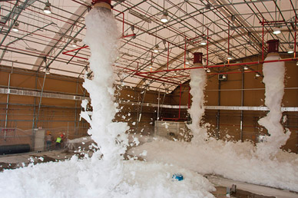
Aqueous Foams
Medium- and high-expansion foam (cont’d)
Well suited for flooding confined spaces
Courtesy of USACE Photo.

Slide 30
Nonaqueous Agents
Circumstances for alternative means of fire extinguishment:
Cluttered, enclosed spaces
Irreplaceable objects susceptible to water damage
Service interruption
Water storage and dispersion systems not practical
Materials incompatible with water:
Metals
Inorganic chemicals
Groundwater pollution
Electric shock hazard

Slide 31
Nonaqueous Agents
Nonaqueous fire suppressants:
Inert gases
Halogenated organic compounds
Powdered inorganic salts

Slide 32
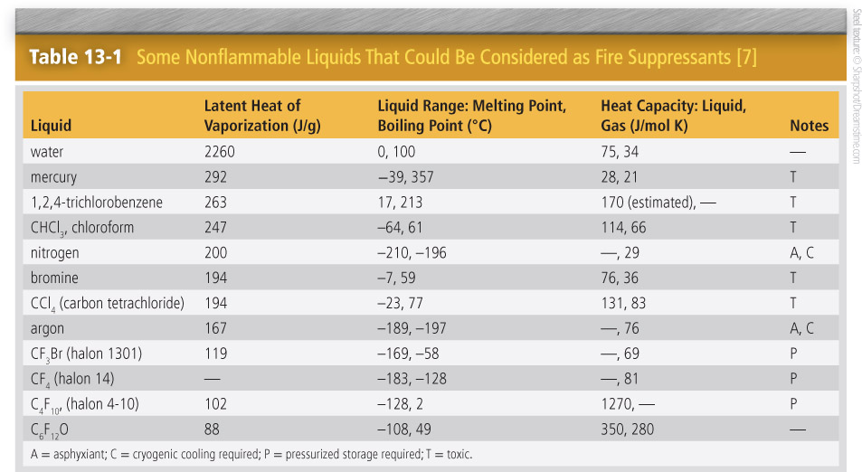
Nonaqueous Agents

Slide 33
Inert Gases
Clean agent
More efficient inert gases
Less efficient inert gases
Limitations of use:
Enclosure not airtight
Impractical to flood large compartment
Supply exhaustion
Cannot be projected very far

Slide 34
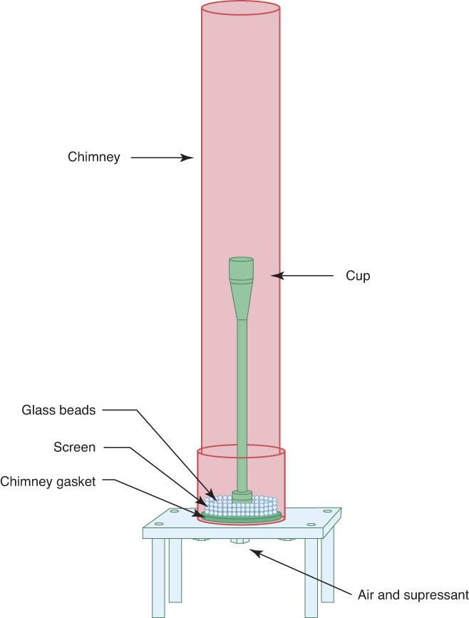
Inert Gases
Cup burner
Generally filled with n-heptane (C₇H₁₆)

Slide 35
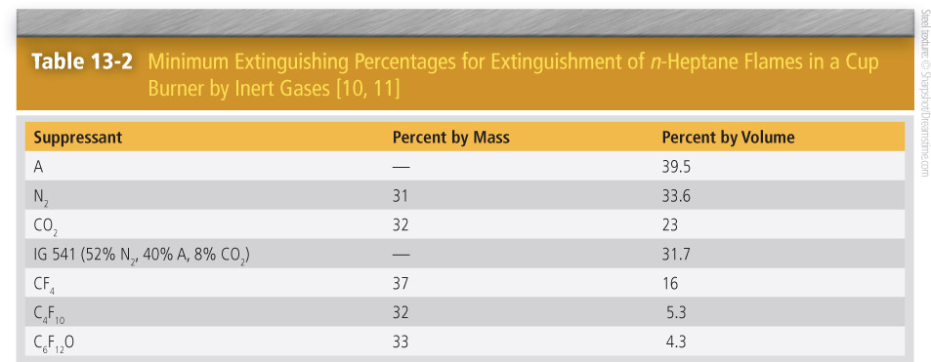
Inert Gases

Slide 36
Inert Gases
Four groups of inert gases:
Noble gases
Nitrogen
Carbon dioxide
Fully fluorinated organic molecules

Slide 37
Noble Gases
Noble gases
Identical, very low molar heat capacities
Helium, neon, argon, krypton
40 volume percent added to the air
Concern of asphyxiation
Mix inert gases with CO₂

Slide 38
Nitrogen
Nitrogen
One-third volume fraction addition to the air
Compressed gas
Cryogenic liquid
Lightweight semipermeable membranes
Reduces oxygen level to untenable point
Certain metals react exothermically.

Slide 39
Carbon Dioxide
Carbon dioxide is the most commonly used inert gas
More effective than nitrogen on a volume basis
However, a given volume of carbon dioxide is 1.57 times as heavy as nitrogen, so the two gases have nearly equal effectiveness of a mass basis.

Slide 40
Carbon Dioxide
Toxic at fire suppression levels
Storage
Gas or solid at normal atmospheric pressure
Solid form (dry ice)

Slide 41
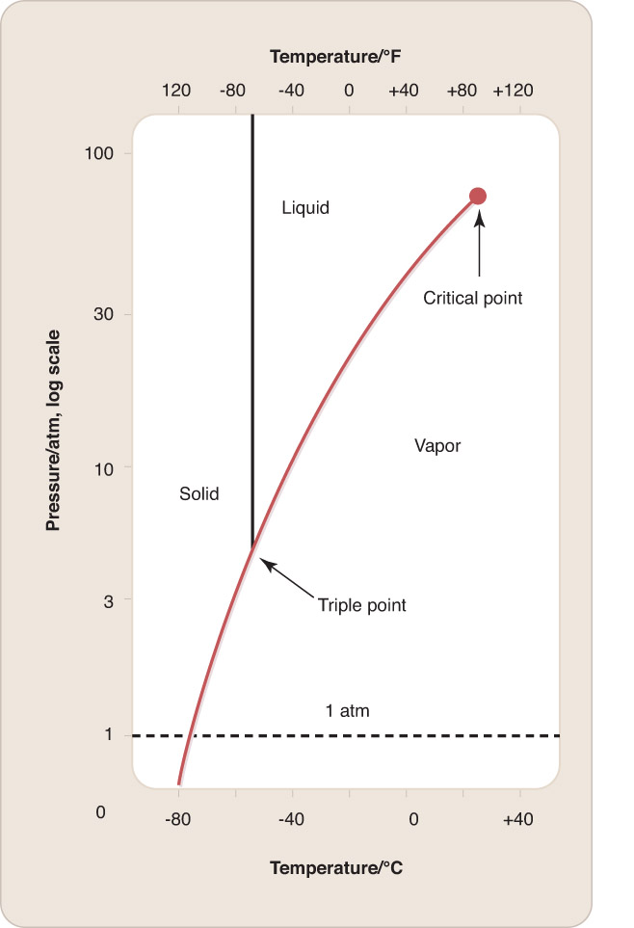
Carbon Dioxide

Slide 42
Carbon Dioxide
Liquid can exist at elevated pressures.
Triple point
Critical temperature
Vessels can hold 3× as much CO₂ as nitrogen.

Slide 43
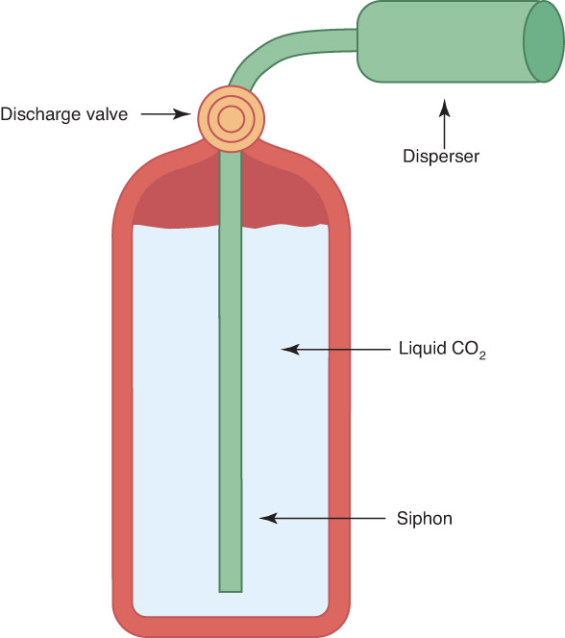
Carbon Dioxide
Hand-held extinguishers
High vapor pressure
Cooling effect of CO₂

Slide 44
Perfluorocarbons
Fully fluorinated hydrocarbons
Inert closed spaces against ignition
Smallest molecules stored as compressed gases at high pressures
Larger molecules
Rapid discharge

Slide 45
Perfluorocarbons
High heat capacities
Concentrations needed for inerting a space
Long atmospheric lifetime
Global warming potential
Use restricted by EPA
Perfluoroethylisopropyl ketone (C₆F₁₂O)

Slide 46
Active Halogenated Agents
Chemical derivatives of simple organic molecules
Liquids stored in pressurized tanks
Exist as gases at atmospheric pressure and normal temperatures
Classified as clean agents

Slide 47
Active Halogenated Agents
Inclusion of bromine or iodine atom
Chlorine
Fluorine atoms
Iodine compounds

Slide 48
Active Halogenated Agents
Halon
Number up to 5 digits
First digit = number of carbon atoms
Succeeding digits = numbers of fluorine, chlorine, bromine, and iodine atoms

Slide 49
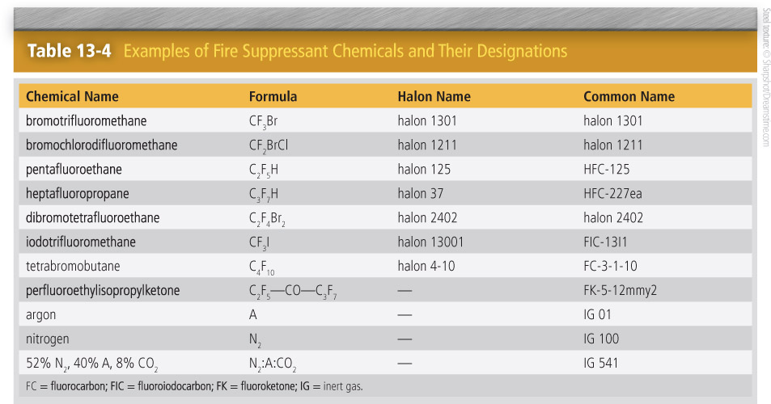
Active Halogenated Agents

Slide 50
Active Halogenated Agents
Nomenclature for halon:
Classic chlorine- and bromine-containing fire suppressants
Halogenated compounds
Halon 1301
Halon 1211
Halon 2402

Slide 51
Active Halogenated Agents

Slide 52
Active Halogenated Agents
Liquids when stored in pressurized tanks
Rapid delivery of compounds
Halon decomposition
Bromine-containing
Little harmful effect of exposure to halon 1301

Slide 53
Active Halogenated Agents
Speed of chain reactions in flame propagation
Bromine and chlorine atoms:
R–H + X → HX + R
Y + HX → HY + X
Net: R–H + Y → HY + R
R–H is an organic molecule.
X is a halogen atom.
Y is an H atom, O atom, or OH radical.

Slide 54
Active Halogenated Agents
Earth’s ozone layer
Phase out of firefighting halons
Halon 1301 used in some critical applications
Atmospheric lifetime
First generation of replacement chemicals
Organic compounds that lack bromine or chlorine
Global warming potential
Absorption of infrared radiation
Decreased use

Slide 55
Active Halogenated Agents
Clean chemical compounds
Inert gases and mixtures of them
Phasing out hydrochlorofluorocarbons
Bromotrifluoropropene testing for handheld extinguishers

Slide 56
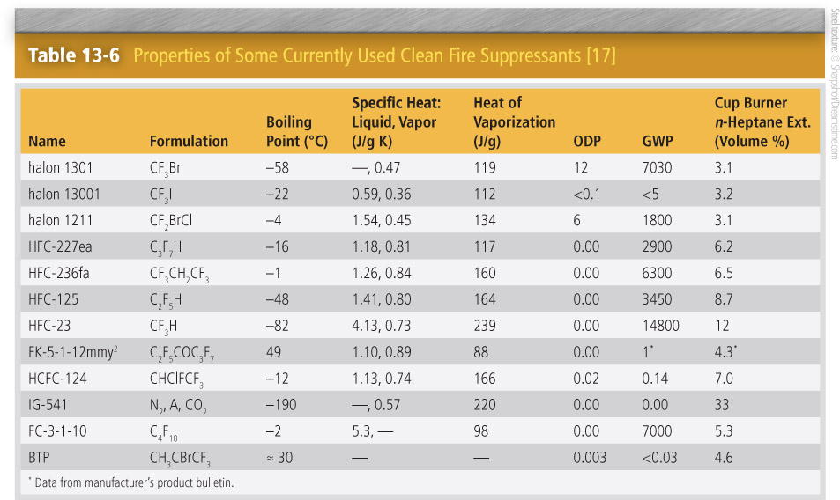
Active Halogenated Agents

Slide 57
Dry Chemical Agents
Dry chemical powder
Class B and Class C fires
Widely dispersed or applied in a stream
10 µm to 75 µm in size
Projected by an inert gas

Slide 58
Dry Chemical Agents
Process when dry chemical powder is applied to fire:
Finer particles vaporize.
Flame-propagating species react.
Particles shield the fuel surface from flame radiation.
Powder can smother the fire.

Slide 59
Dry Chemical Agents
Extinguishing efficiency of the powder depends on the particle surface area.
Least material needed for flame extinguishment

Slide 60
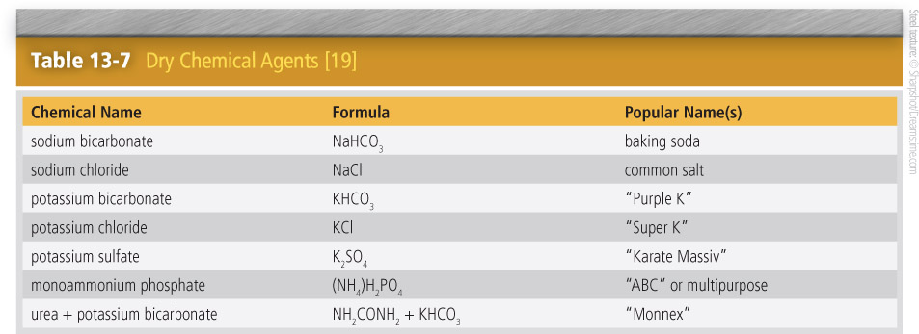
Dry Chemical Agents

Slide 61
Dry Chemical Agents
Special situations:
Rock dust
Granules of cellular glass
Difficult to compare effectiveness
Modified laboratory flame apparatus
Monoammonium phosphate

Slide 62
Dry Chemical Agents
Application of dry chemical agents on electrical fires
Ingredients are nontoxic.
Agents for extinguishing metal fires:
Powders
Liquid
Gases

Slide 63
Dry Chemical Agents
Metal fires are difficult to extinguish.
Very high temperatures
Long cooling times
Halons should not be used.

Slide 64
Extinguishment of Flowing Gas Flames
Very difficult to extinguish
Best tactic is to turn off gas flow.
Apply a suppressant to the base of the flame.
Interrupt fresh air supply to the fire.

Slide 65
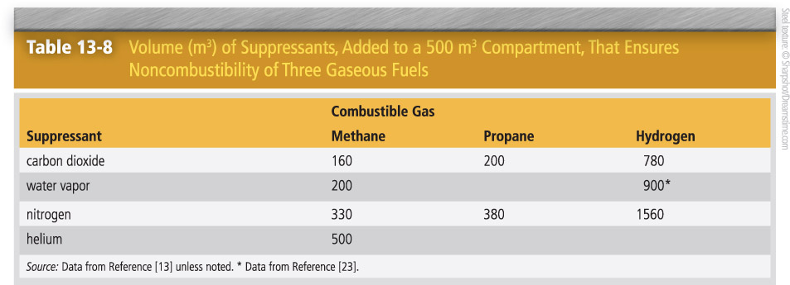
Extinguishment of Flowing Gas Flames

Slide 66
Extinguishment of Flowing Gas Flames
Flooding a compartment:
Slow process
Difficult to ensure ignition sources are passivated
Dangerously low levels of oxygen volume fraction
Flame arrestor

Slide 67
Extinguishment of a Shallow Liquid Fuel Spill Fire
Burn at a high intensity for short time
Automatic sprinkler system:
Fire point of liquid is close to or above boiling point of water.
Liquid is water soluble.
Liquid is denser than water.

Slide 68
Extinguishment of a Shallow Liquid Fuel Spill Fire
Sprinkler spray may limit fire damage.
Foam formulation or dry powder system may be required.

Slide 69
Extinguishment of a Deep Tank Liquid Fuel Fire
Can burn for hours or days
Cover the entire flame in one application.
Foams are ideal agents.
Fire of a liquid flowing from opening in a tank or overflowing from top are usually extinguished only by stopping flow.

Slide 70
Ultrafast Extinguishment of Fires
Fire must be quenched instantly.
Sensitive sensing
Fast-response flame suppression:
Storage container under high pressure
Gas generator

Slide 71
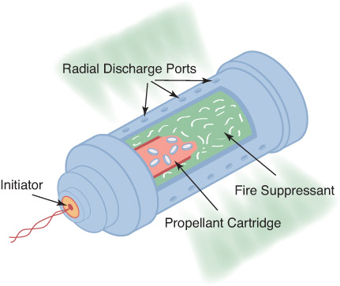
Ultrafast Extinguishment of Fires
Hybrid version

Slide 72
Summary
Chemicals that are used to extinguish or control fires can be categorized by the types of fires on which they are effective, the chemical phase, the mechanism of action, the mode of application, and the application system.

Slide 73
Summary
Water is widely used for fire suppression because it is readily available at low cost, is nonflammable, has a high heat of vaporization and gasifies readily, is nontoxic and does not decompose to form toxic products, and causes only limited property damage when used in moderation.

Slide 74
Summary
Water delivery and suppression effectiveness can be enhanced with chemical additives.

Slide 75
Summary
Water should not be used on electrical or metal fires and should be used with caution on liquid fuel fires. For these uses, alternative agents, both chemically inert and chemically active, are available.

Slide 76
Summary
Powdered agents (dry chemicals) are used on Class B and Class C fires.

Slide 77
Summary
Inert gases prevent or quench flames by increasing the heat capacity of the atmosphere and diluting the oxygen. Chemically active suppressants generally interfere with the chain propagating and chain branching chemistry in flames. The choice and uses of chemically active agents are limited by their effects on the environment.

