Slide 1
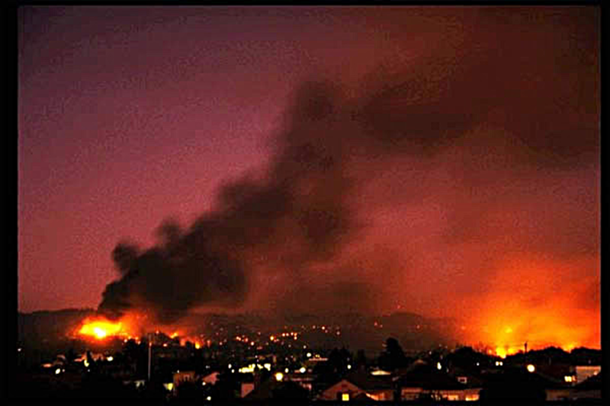
Lecture Notes: Week 13 Wild-land Fire Behavior
Lecture Notes: Week 13
Wild-land Fire Behavior
Considered the type of fire to hardest
To predict!!

Slide 2
Topics to be covered
At the end of the reading and lecture, you should be able to describe the following in detail:
Lecture on “Wild-land Fire Behavior”
Factors impacting Wildfire Behavior:
Fire Triangle
Modes of Heat Transfer
Environmental elements
Four Factors Of fuel and Fire Spread
Wind Effects

Slide 3
Topics to be covered Continued…
Three Weather factors on Wild-land Fire Behavior
Slope
Four factors of Topography
Danger Signs
Basic Fire Weather
Be prepared for a 25-question quiz on Week 13 material.

Slide 4
Topics to be covered Continued…
In this portion, we will discuss the factors that have an impact on wild-land fire behavior:
The fire Triangle.
The modes of heat transfer.
Environmental elements on fire behavior.
Four factors of fuel that affect the start and spread of fire.
The three factors of weather that affect fuel moisture.

Slide 5
Topics to be covered Continued…
The role of winds on fire behavior.
How slope will affect the spread of fire.
The four factors of topography that impact wild-land fire behavior.
Describe the danger signs of potential dangers that can develop in a “box canyon” and “steep narrow canyons”.

Slide 6
Wild-land Fire Behavior
The “fire triangle” is the means we will use in dealing with fire in the “wild-land arena” The fire triangle is composed of the following:
Oxygen: which is the air in this area of fire behavior.
Heat: commonly in the form of piloted ignition, is needed to start and maintain the fire growth.
Fuel: Mostly composed of hydrogen and carbon and some oxygen. (Typical makeup of wild-land fuels).
As we can see from the above all of the listed components need to be present for the fire to occur in our “wild-land fire”.

Slide 7
Wild-land Fire Behavior
Heat Transfer
Heat transfer is a vital factor not only with the start of the fire but on the behavior as well. We have three modes of heat transfer to be concerned with:
_________is the means of ray or wave that sends the heat energy to an object. This is the heat when you stand next to a campfire. This type of transfer can dry out surrounding fuels, and in some cases, the radiant heat can ignite the fuels as well.
Radiation

Slide 8
Wild-land Fire Behavior
Modes of heat Transfer Continued…
Convection is the means of heat being transferred via a fluid. Air is a classic example of this medium. The hot gases and embers can dry out the fuels as well ignite them (remember this mode of heat transfer is a sub-set of conduction).

Slide 9
Wild-land Fire Behavior
__________is the means of heat transfer through a solid such as metal. As we are aware, metals are a good conductor of heat. Wood, on the other hand, is not a good conductor of heat. This type of heat transfer is the least important in this arena.
Conduction

Slide 10
Wild-land Fire Behavior
The _____________are difficult to understand due to the nature of the weather. Weather is in a constant state of change. Let us look at the “environmental elements”:
environmental elements

Slide 11
Wild-land Fire Behavior
__________ is the measure of the warmth or coldness of a substance. In this case, air will be the substance. The main source heat for air in the outside environment is the solar ray of the sun.
Temperature

Slide 12
Wild-land Fire Behavior
It should be noted, the fuels in the sun could have a temperature difference of _________from our fuels in the shade.
10° C (50°F)

Slide 13
Wild-land Fire Behavior
It should be noted, the fuels in the sun could have a temperature difference of ________from our fuels in the shade.
10° C (50°F)

Slide 14
Wild-land Fire Behavior
A horizontal movement of air relative to the surface of the earth. This is one “environmental element” that has the ________
greatest effect on wildland fire behavior.

Slide 15
Wild-land Fire Behavior
Wind causes the following to happen to combustion and the spread of fire:
Increasing the supply of oxygen.
Influencing the direction of fire spread.
Drying of the fuels.
Carrying sparks and firebrands ahead of the main fire.
Moving air heated to the downwind fuels.

Slide 16
Wild-land Fire Behavior
___________: A ratio of the amount of moisture in the air can hold at a given temperature and pressure. If the air is saturated fully; this point (100%) commonly expressed as a percentage.
Relative Humidity

Slide 17
Wild-land Fire Behavior
Low humidity takes moisture from the fuels; fuels in turn, take moisture from the air when the humidity is high.

Slide 18
Wild-land Fire Behavior
This “________” is going to have an affect due to the energy it is going to take to ignite the given fuel because the water is going to be vaporized off first.
fuel moisture

Slide 19
Wild-land Fire Behavior
___________: The collective name given to moisture in the air that is big to fall from the sky in either liquid or solid form and able to reach the surface of the earth.
Precipitation

Slide 20
Wild-land Fire Behavior
“_____” are commonly called {1 hour fuels} due to the rapidity of moisture change. Rain is going to affect “these fuels” in a rapid manner.
light Fuels

Slide 21
Wild-land Fire Behavior
However, the “_________” will not respond as quickly due to the fact the moisture change occurs at such a slow rate by comparison. Light rainfall, over a longer period of time, will be absorbed more readily because it does not run off.
heavy fuels

Slide 22
Wild-land Fire Behavior
The “four factors” of fuel that impact the starting and spread of fire:
Fuel Types: The wild-land fuels vary in type from one area of the country to another and within the same area. There are four major types:

Slide 23
Wild-land Fire Behavior Four Factors continued…
Grass: found in most areas of the country, but are predominate in the desert/range regions of the country. (These are the fuels that are termed as “light and 1 hour”).

Slide 24
Wild-land Fire Behavior Four Factors continued…
Shrub: This is the “bushy fuels” found throughout most areas. In or area of the country, “sage brush, chaparral, scrub oak, etc are found. These fuels can be highly. combustible.
.

Slide 25
Wild-land Fire Behavior Four Factors continued…
Timber/litter: The most dominate in the mountainous areas of the country below the “alpine line”

Slide 26
Wild-land Fire Behavior Four Factors continued…
Logging Slash: The debris left behind from logging or thinning operations etc. The nature of fuel can be logs, chunks, branches, etc.

Slide 27
Wild-land Fire Behavior Four Factors continued…
Fuel properties: regardless of the type of fuel, fire behavior is dependent on “certain properties” We have many terms to discuss “properties”, but we will concentrate on the following:
Fuel Moisture: is the amount of water that is contained in a given fuel at a specific temperature and humidity.

Slide 28
Wild-land Fire Behavior Four Factors continued…
Size and Shape: The physical properties of the fuel. Basically, the fuels can be divided into two areas “light and heavy fuels”. Please refer to the diagrams Next slide:

Slide 29
Wild-land Fire Behavior Four Factors continued…

Slide 30
Wild-land Fire Behavior Four Factors continued…
Fuel Loading: The amount of “fuel quantity” in a given area. The amount of fuel in an area may not mean the fire will burn with more intensity. The “quantity of fuel available for combustion” is what concerns us the most.

Slide 31
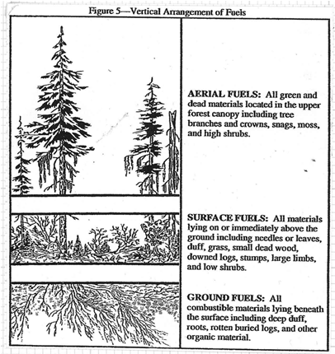
Wild-land Fire Behavior Four Factors continued…
Horizontal Continuity and Vertical Arrangement: is the manner in which the fuels are spread over a given area.

Slide 32
Wild-land Fire Behavior Factors of Topography on the Spread of Fire.
__________is the most consistent “environmental element” of the three discussed. The topography is the lay of the land be it flat, rolling hills, mountainous, etc. This “element” is the easiest to gage in terms of fire spread than either Fuel or Weather. Now, let us look at the properties of topography:
Topography

Slide 33
Wild-land Fire Behavior Factors of Topography on the Spread of Fire Continued…
Aspect: Is the direction on which the slope faces in relation to the sun. As can be seen by the diagram to follow, the “South West slope” is going to get most of the sun.
Wild-land Fire Behavior

Slide 34
Factors of Topography on the Spread of Fire Continued
Slope: The amount of degree of incline of hillside (i.e. steep slope). As can be noted from Fig. 7, the slope has an effect on fire spread.

Slide 35
Factors of Topography on the Spread of Fire Continued…
The Shape of the Country: “Box canyons, narrow canyons and other rugged topographic features” can have an affect the wind’s speed and direction.

Slide 36
Factors of Topography on the Spread of Fire Continued…
Box Canyons: Are especially deadly due to the “chimney effect”. This “effect” can produce “extreme” fire behavior. Refer to Fig. 8.

Slide 37
Factors of Topography on the Spread of Fire Continued…
Narrow Canyons: Fire can easily spread to the opposite side of these canyons by “radiant and spotting from convection”

Slide 38
Factors of Topography on the Spread of Fire Continued…
Wide Canyons: Prevailing wind direction can be altered by the direction of the canyon. “Spot fires” are not common except in “high winds” Strong differences in “fire behavior conditions” will occur on “North and South aspects

Slide 39
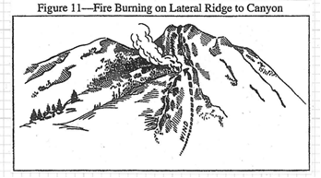
Factors of Topography on the Spread of Fire Continued…
Ridges: Fires burning along lateral ridges may change direction when the ridge drops off into a canyon.

Slide 40
Factors of Topography on the Spread of Fire Continued…
Saddles: As illustrated in Fig 11, the wind is blowing through this saddle or mountain pass. The wind speed can increase as it is restricted by the passage and spread out downwind side with the possibility of eddy winds.

Slide 41
Factors of Topography on the Spread of Fire Continued…
. Elevation: the height of the given terrain above mean sea level, usually expressed in feet or meters. The main “affect” of elevation is the type of fuel and the amount fuel present. ((Please refer to line drawing next slide))

Slide 42
Factors of Topography on the Spread of Fire Continued…

Slide 43
Factors of Topography on the Spread of Fire Continued…
Barriers: Is any obstruction either natural or manmade that is capable of checking or stopping the spread of a wild-land fire. (Refer to Fig 14/15 for some examples- Next Slide-).

Slide 44
Factors of Topography on the Spread of Fire Continued…

Slide 45
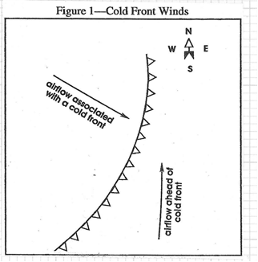
Basic Fire Weather:
The big factor that proves to be quite dangerous to us, increased fire behavior, is the coming “cold front”.
A “cold front” is the “boundary line” between a cooler air mass that is in the process of replacing a warmer air mass. (Refer to Fig 1).

Slide 46
Basic Fire Weather continued…
The associative winds that is typical of a “cold front”:
Southeasterly to southwesterly winds ahead of the cold front
Westerly to northwesterly winds behind the “cold front” and the air is cooler.

Slide 47
Basic Fire Weather continued…
Remember the wind direction is the direction the wind is blowing FROM. A wind coming from the east is called an “east wind”

Slide 48
Basic Fire Weather continued…
Indicators of the passing of a cold front are:
Large clouds of dust can precede the arrival of a “cold front”.
Winds have the tendency change from the southeast to the south, to the southwest, and increase in velocity before the arrival of the “cold front”.
A line of “cumulus clouds” can be seen coming from the west or northwest.
Winds will be strongest, erratic, and gusty as the front reaches you.
Winds will continue to shift as the front passes, generally resulting in strong, gusty, and cool winds out of the west/northwest.

Slide 49
Basic Fire Weather continued…
Potential dangerous conditions caused by the passing “cold front”:
Wind direction change is abrupt
Strong southerly winds ahead of the “cold front” can drive the fire head to the north or northeast. Refer to the fig 2 {{Next Slide}}.

Slide 50
Basic Fire Weather continued…

Slide 51
Basic Fire Weather continued…
Winds shifting to the west or northwest after the front has passed will drive the fire head to the east or southeast (refer to Fig. 3) -Previous Slide-.
Rapid drop in relative humidity within 24 hours of the cold front passing.

Slide 52
Basic Fire Weather continued…
Foehn Winds: A dry wind with strong downwind components, charcateristic of the lee (down wind) side of mountainous regions. The wind is commonly warm for the season, but not in all cases of this type of wind. The speed of these winds can reach speeds 64-97kph (40-60mph) and in some cases as much as 144kph (90 mph).

Slide 53
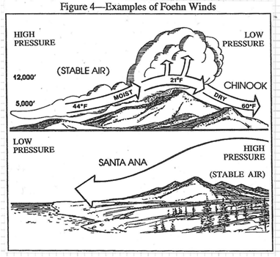
Basic Fire Weather continued…
The “Foehn” winds” cause a drop in humidity and fuel moisture is going to drop from the decreased humidity. The winds can persist for days!!! (Refer to Fig. 4):

Slide 54
Basic Fire Weather continued…
Now, let us look at some “Foehn” winds” common to the Western U.S.:
Chinook, found on the eastern slopes of the Rocky Mountains.
Santa Ana, Southern California.
Mono or North wind, Northern and central California.
East wind, Western Washington and Oregon

Slide 55
Basic Fire Weather continued…
Valley Winds: are winds that can have a dramatic effect on fire behavior. During “day time heating”, the winds are up slope, and during the night, the winds are “down slope”. The “down slope” usually begins a few hours after sundown.

Slide 56
Basic Fire Weather continued…

