Slide 1
Chapter 6 Combustion, Fire, and Flammability

Slide 2
Objectives
Describe how the U.S. fire incidence database enables development of a national profile of fires and fires losses.
Describe the process of combustion.
Explain flammability, in terms of both fire properties and practical application.

Slide 3
Objectives
Explain the nonflaming and flaming stages of fire.
Discuss the fire tetrahedron and explain how it is a focus for a unified view of fire initiation, growth, and termination.
Discuss the terms fire consequences, hazard, and risk.

Slide 4
Introduction
National Fire Incident Reporting System (NFIRS) database
Analysis of data can:
Identify contributions to fire problems
Identify emerging threats
Estimate effectiveness of standards and codes

Slide 5
NFIRS Analysis

Slide 6
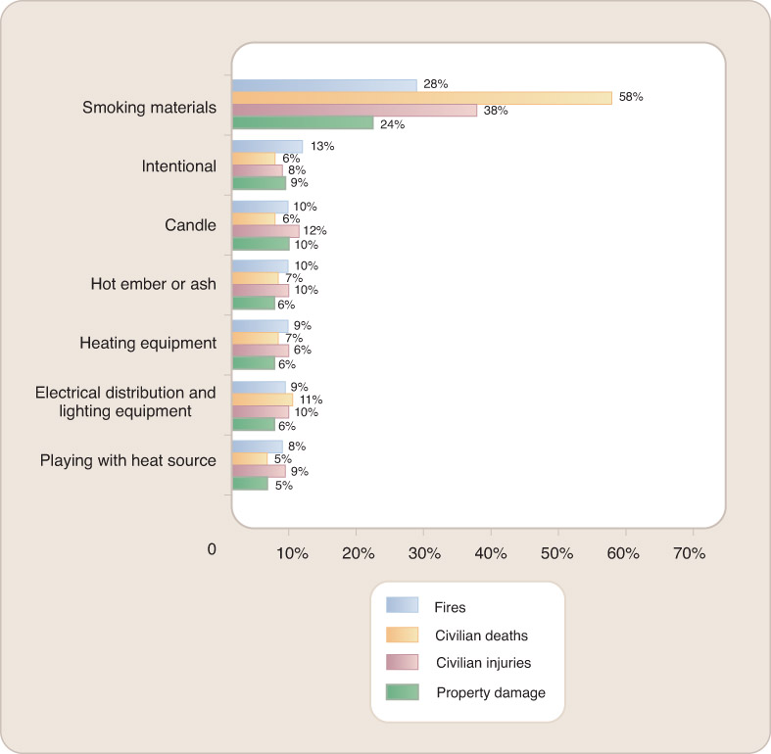
NFIRS Analysis
Reprinted with permission from SFPE Handbook of Fire Protection Engineering, 4th edition; Society of Fire Protection Engineers, Boston, p. vii, Copyright © 2008, National Fire Protection Association, Quincy, MA 02169. This reprinted material is not the complete and official position of the
NFPA or the referenced subject, which is represented only by the standard in its entirety.

Slide 7
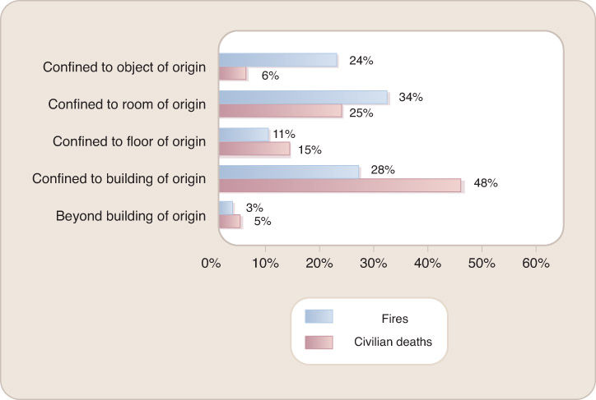
NFIRS Analysis
Reprinted with permission from SFPE Handbook of Fire Protection Engineering, 4th edition; Society of Fire Protection Engineers, Boston, p. 5, Copyright © 2008, National Fire Protection Association, Quincy, MA 02169. This reprinted material is not the complete and official position of the NFPA or the referenced subject, which is represented only by the standard in its entirety.

Slide 8
Combustion
Difference between combustion and fire.
Important definitions:
Chemical reaction
Exothermic
Fuel

Slide 9
Combustion
Important definitions:
Oxidizer
Vitiation
Substantive heat
Light

Slide 10
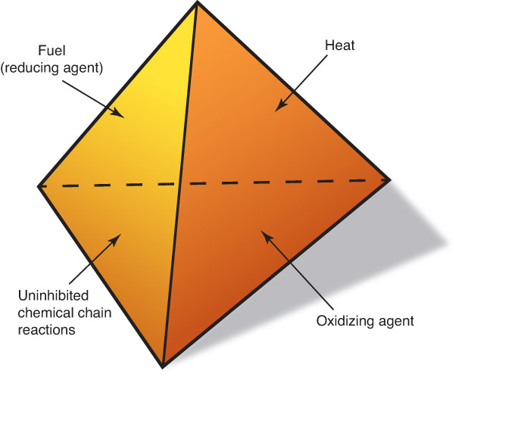
Fire Tetrahedron
Fire tetrahedron:
Fuel
Oxidant
Elevated temperature
Chemical chain reaction

Slide 11
Phenomenological Stages of a Fire
Nonflaming
Well-ventilated flaming; free burning
Underventilated flaming

Slide 12
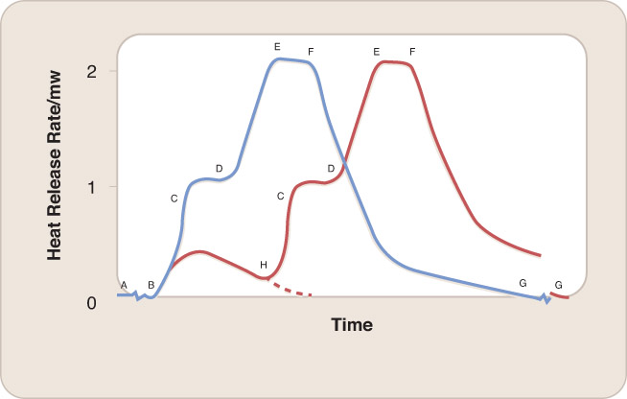
Flaming and Nonflaming Combustion
A. Smoldering ignition of the bed by a cigarette; some oxidative pyrolysis
B. Smoldering transition to well ventilated flaming; some oxidative pyrolysis
C. Room flashover; ventilation-limited flaming; extensive pyrolysis
D. Window breaks from the heat; burning no longer ventilation-limited
E. Maximum mass burning rate; extensive pyrolysis
F. Fuel begins to run out; extensive pyrolysis
G. Flames out; rubble smoldering
H. Door is opened

Slide 13
Fire Initiation
Sufficiently high temperature
Ignition: the onset of combustion
Smoldering
Most common initial stage of combustion in upholstered furniture fires that lead to injury or death
Generally occurs in porous materials that can form a carbonaceous char when heated

Slide 14
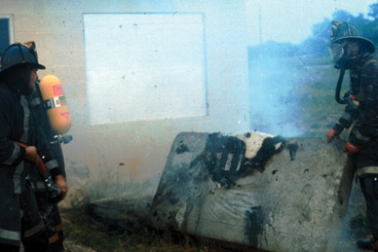
Fire Initiation
Reaction zones of smoldering materials
Pyrolysis stops when the heat source is removed.
Courtesy of the Upper Allen Fire Department.

Slide 15
Fire Initiation
Flames are the result of rapid gaseous oxidation reactions.
Need gaseous fuel to continue burning
Pyrolysis

Slide 16
Fire Spread
Determined by the composition of the combustible
Basic mechanism is the same, regardless of combustible composition.

Slide 17
Fire Ventilation
Fires can be well ventilated or ventilation limited.
Ventilation conditions can change during a fire.

Slide 18
Extinguishment
Extinguishment can be achieved via:
Coolant
Barrier
Reduction of available oxygen
Reduction of free radical concentration

Slide 19
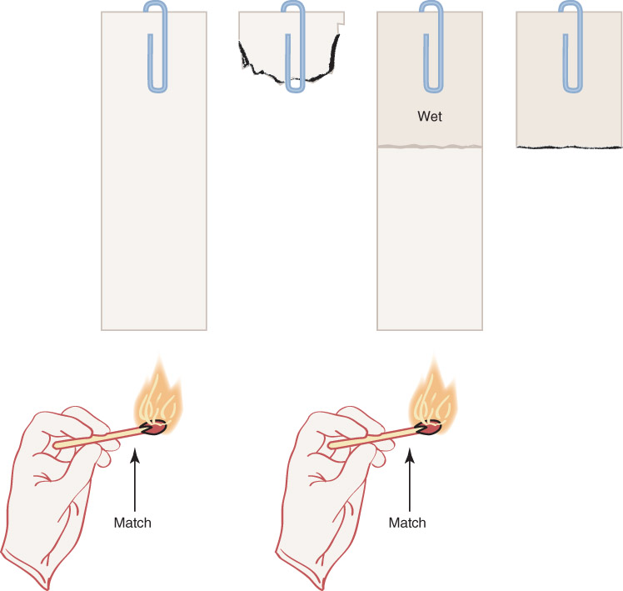
Extinguishment

Slide 20
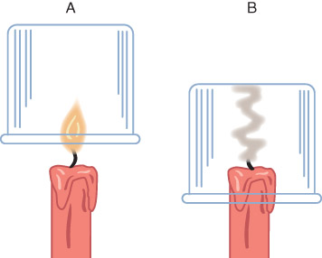
Extinguishment
One means of extinguishing a fire is to constrict the inflow of air, while diluting the existing air with noncombustible combustion products.

Slide 21
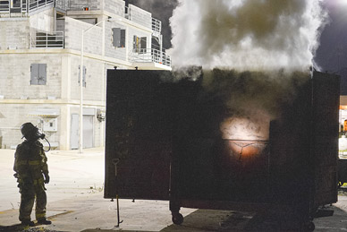
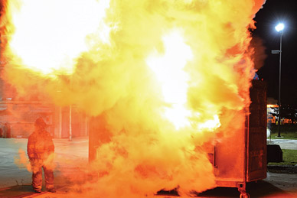
Backdraft
Backdraft: Intense flames emanating from a just-opened doorway that introduced fresh air to an oxygen-starved fire
© Jones & Bartlett Learning. Photographed by Glen E. Ellman.

Slide 22
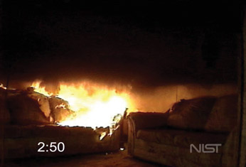
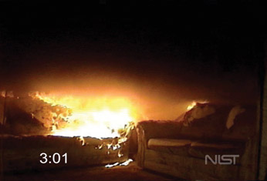
Two Examples of Room Fires
Family room fire test
Flameover/rollover
Flashover
Courtesy of National Institute of Standards and Technology.

Slide 23
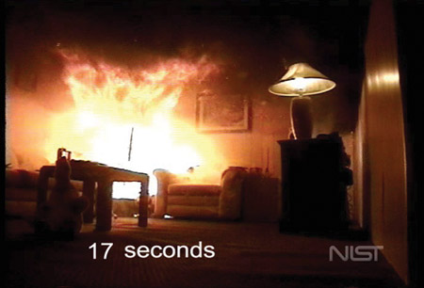
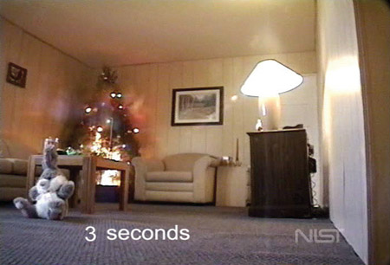
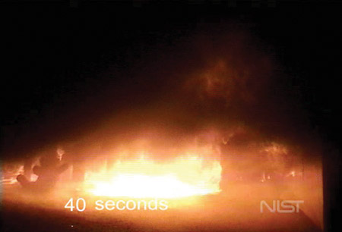
Two Examples of Room Fires
Dry Christmas tree fire test
Room is engulfed in flames in 40 seconds.
Courtesy of National Institute of Standards and Technology.

Slide 24
Flammability
Refers to how vigorously something burns
Little agreement on a more precise definition
Visual approach to defining flammability
Fire test to measure a certain quantity:
Time to ignition or self-extinguishment
Rate of heat release
Opaqueness of smoke
Test output becomes measure of flammability.

Slide 25
Fire Consequences, Hazard, and Risk
Fire hazard: A condition with the potential to create harmful consequences under a specified fire scenario
Fire consequence: A specific, quantified fire hazard
Fire risk: The undesired consequences of a fire multiplied by the likelihood of their happening

Slide 26
Flashover
Sharply increases the consequences of a fire
Reducing the likelihood of flashover is a principal goal of fire safety science
Heat release of 1 MW will bring an ordinary residential bedroom to flashover

Slide 27
Summary
Analysis of NFIRS data can identify the relative frequency of various types of fires. The knowledge gained enables others to provide guidance geared toward reducing losses from fires.
Combustion is an exothermic chemical reaction between a fuel and an oxidizer resulting in the generation of substantive heat and often light. Fire is a form of uncontained and destructive combustion.

Slide 28
Summary
The flammability of a material or product can be defined by whether it ignites and burns.
A fire can proceed through both nonflaming and flaming stages. The nonflaming stages consist of smoldering and pyrolysis; the flaming stages include well-ventilated, under-ventilated, and post-flashover fire.

Slide 29
Summary
The initiation and continuance of a fire require the four components that make up the fire tetrahedron: fuel, oxidant, heat, and chemical chain reaction.
The reactions that initiate a fire proceed very slowly unless the fuel is heated to hundreds of degrees Celsius. Common ignition sources include cigarettes, matches; friction; overheated electrical circuits; welding operations; space heaters; and lightning.

Slide 30
Summary
For a fire to spread, some of the enthalpy from the ignition region must heat unburned material to a temperature at which it can burn. Fire also can spread by the melting and dripping of burning material or by airborne firebrands.
A fire can be extinguished by cooling, reducing the oxygen supply, separating the fuel and the oxidizer, and decreasing the concentration of the flame-propagating free radicals.

Slide 31
Summary
Fire hazard is the potential for harm from a particular fire scenario. A fire consequence is a specific quantified hazard. Fire risk combines the severity of consequences and the probability that the consequences will occur. There is a sharp increase in the consequences and risk from a fire in a room if it proceeds to flashover.

