Slide 1
Cancer, HIV and AIDS
Chapter 23

Slide 2
https://www.youtube.com/watch?v=3wHYOEeAsD8
Second leading cause of death and disability in US
Cell’s DNA damaged from a carcinogen

Slide 3
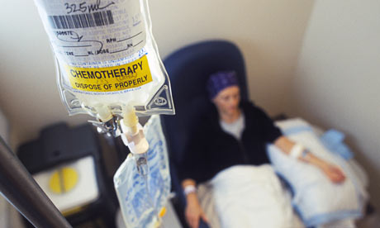
Medical Management
Surgery to remove tumor
Radiation to damage (kill) tumor cells
Chemotherapy: kill tumor cells
All cause some damage to the body
Directly damage both good and bad cells
May cause loss of appetite, N/V, malabsorption, other affects on nutrition

Slide 4
Cancer Prevention

Slide 5
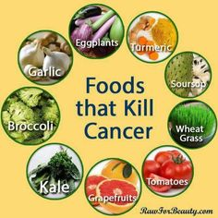
Cancer Prevention
Diet rich in a variety of plant foods, especially “cruciferous”
Plenty of fruits & vegetables
Healthy weight maintenance
Physical activity
Alcohol only in moderation
Low-fat & low-salt foods
Safe food preparation & storage
No smoking or other tobacco use

Slide 6
Nutrition Therapy
Minimize weight loss
Correct nutrient deficiencies
Manage complications that impair intake
Provide a diet that is tolerable & enjoyed
High Protein/High Calorie Diet

Slide 7
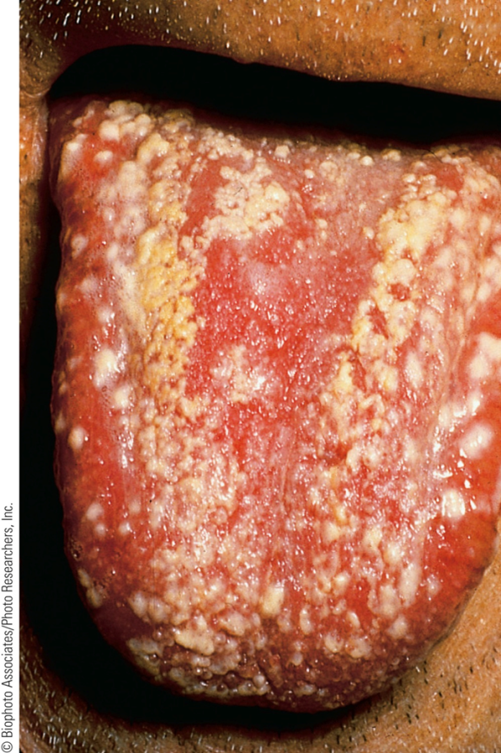
Food Related Problems
No appetite
Foods don’t taste right
Nausea/Vomiting
Sores in Mouth

Slide 8
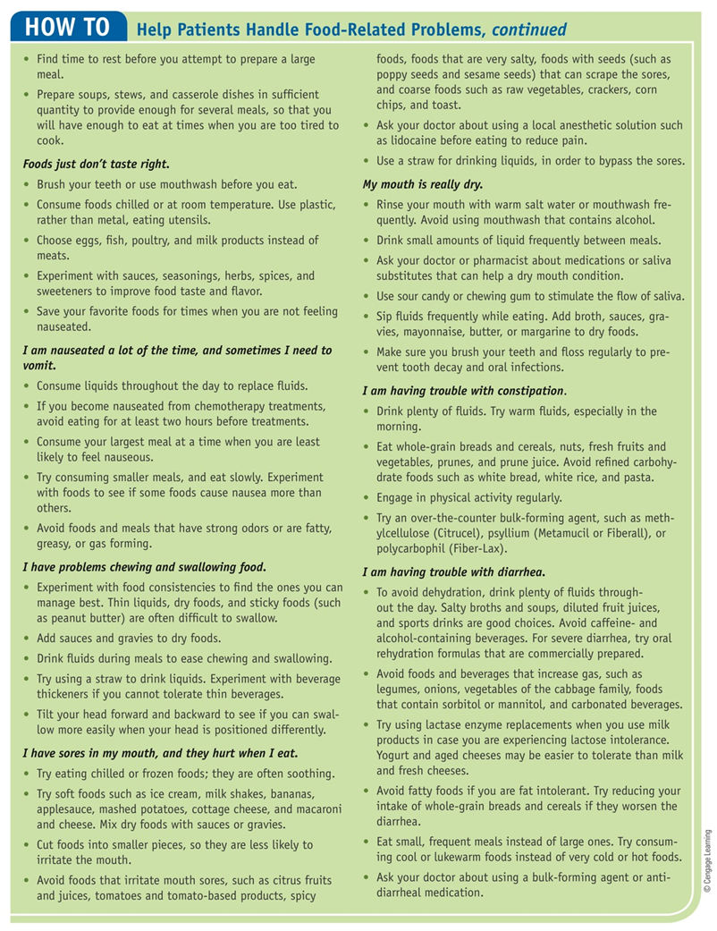

Slide 9
Cancer Cachexia
Wasting Associated with Cancer: “Cancer cachexia”
Anorexia
Muscle wasting
Weight loss
Fatigue
Notes:
Involuntary weight loss of >10% is cause for concern
Elevated BMR

Slide 10
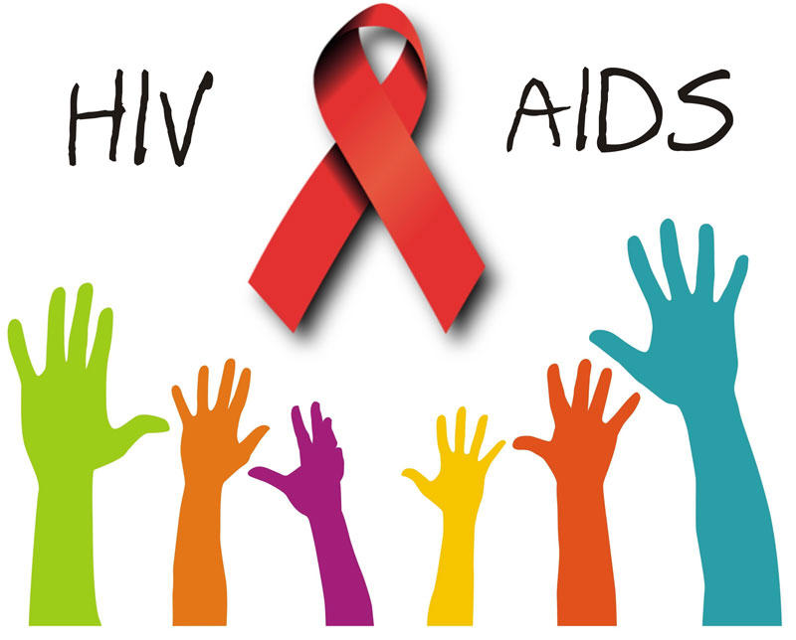
HIV
Attacks the immune system
Has no cure
Sexually transmitted or via
blood and shared needles

Slide 11
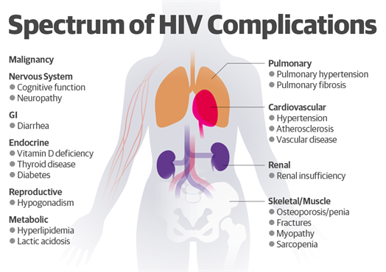
Notes:
Opportunistic infections
Certain cancers
Wasting
Lipodystrophy
Body-fat redistribution
Abnormal lipid levels
Insulin resistance

Slide 12
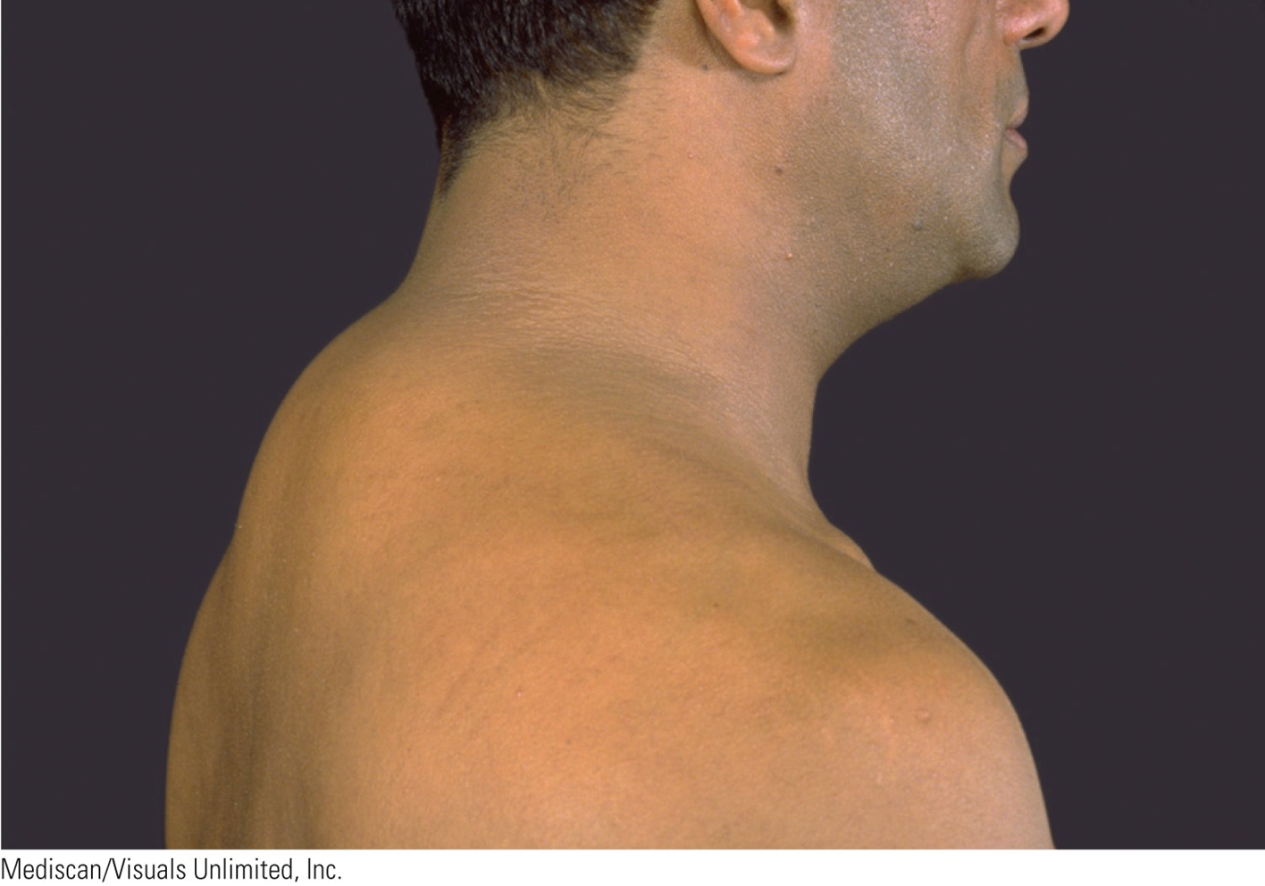
Notes:
Lose muscle tissue but unbalance in fat mass
Gain fat in neck abdomen while losing it face, buttocks, and arms legs

Slide 13
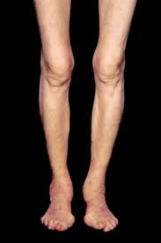
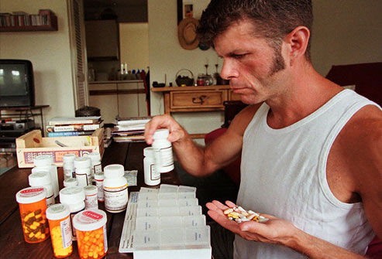
Food Related Problems
Sores in Mouth
Anorexia
Malabsorption
Notes:
elevatedBMR

Slide 14
MNT for HIV/AIDS
Multivitamin
Decrease saturated & trans fats
Food safety
Anabolic hormones/appetite stimulants/exercise
Weight maintenance
High calorie/High Protein
Small frequent feedings
Nutrient dense snacks
Liquid formulas

