Slide 1
Chapter 15 Nutrition Support
Enteral and Parenteral

Slide 2
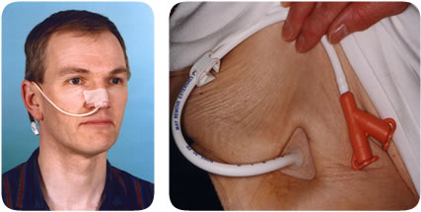
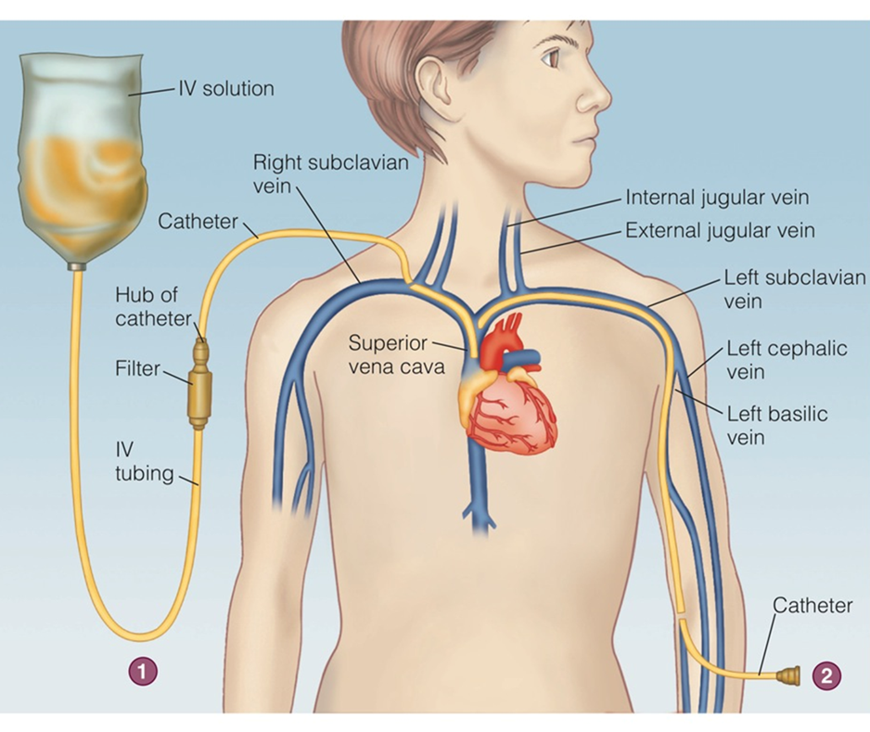
Nutrition Support

Slide 3
What are the differences?
Enteral vs Parenteral

Slide 4
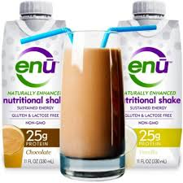
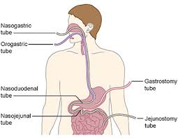
Enteral: Uses the GI tract
Oral supplements
Tube feeding

Slide 5
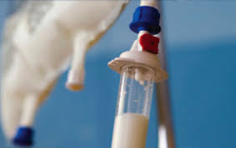
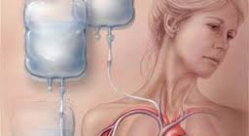
Parenteral: Uses the veins
Inadequate GI function

Slide 6
Which method is preferred?

Slide 7
Use of Enteral Nutrition Enteral nutrition video
Functioning GI tract
Swallowing disorders
Prolonged poor appetite
Malnutrition
Mechanical ventilation
Pancreatitis

Slide 8
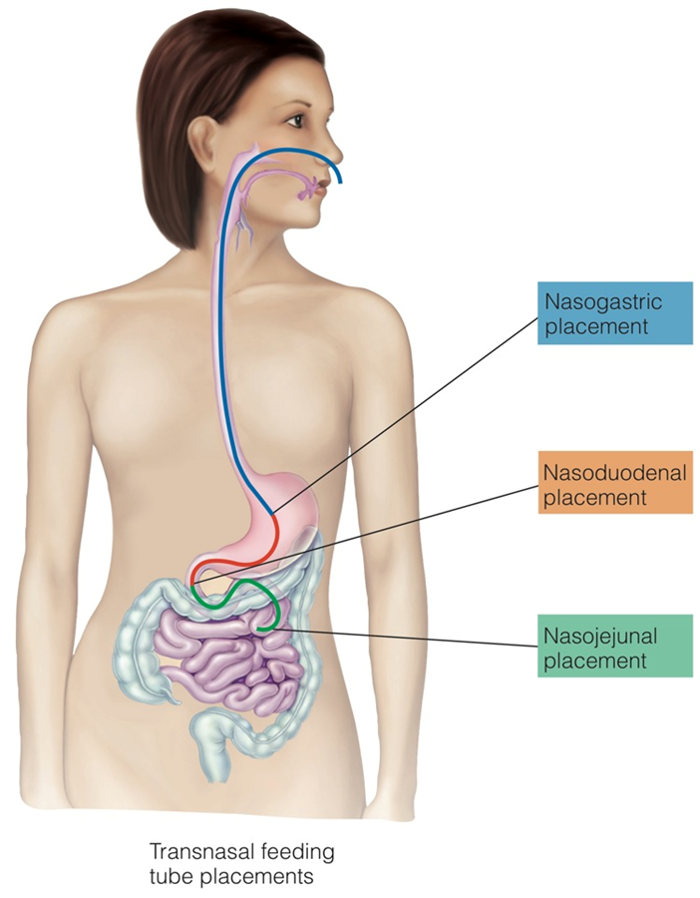
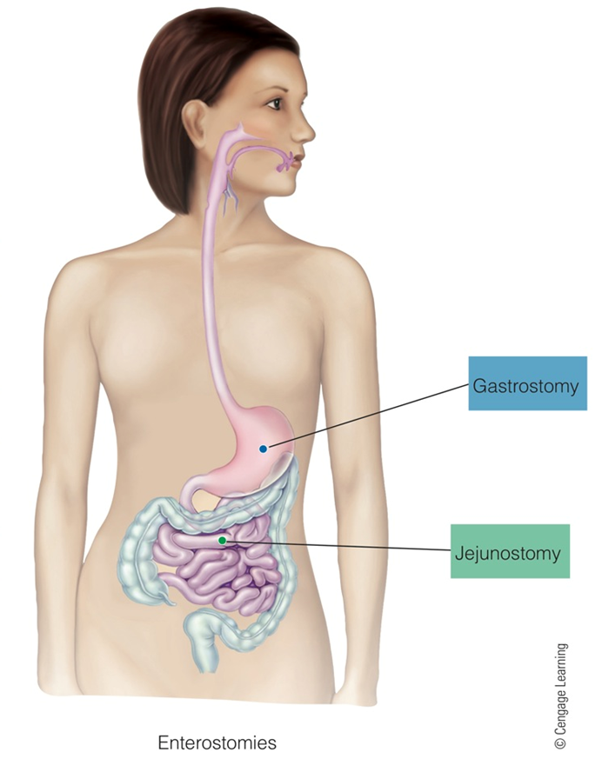

Slide 9
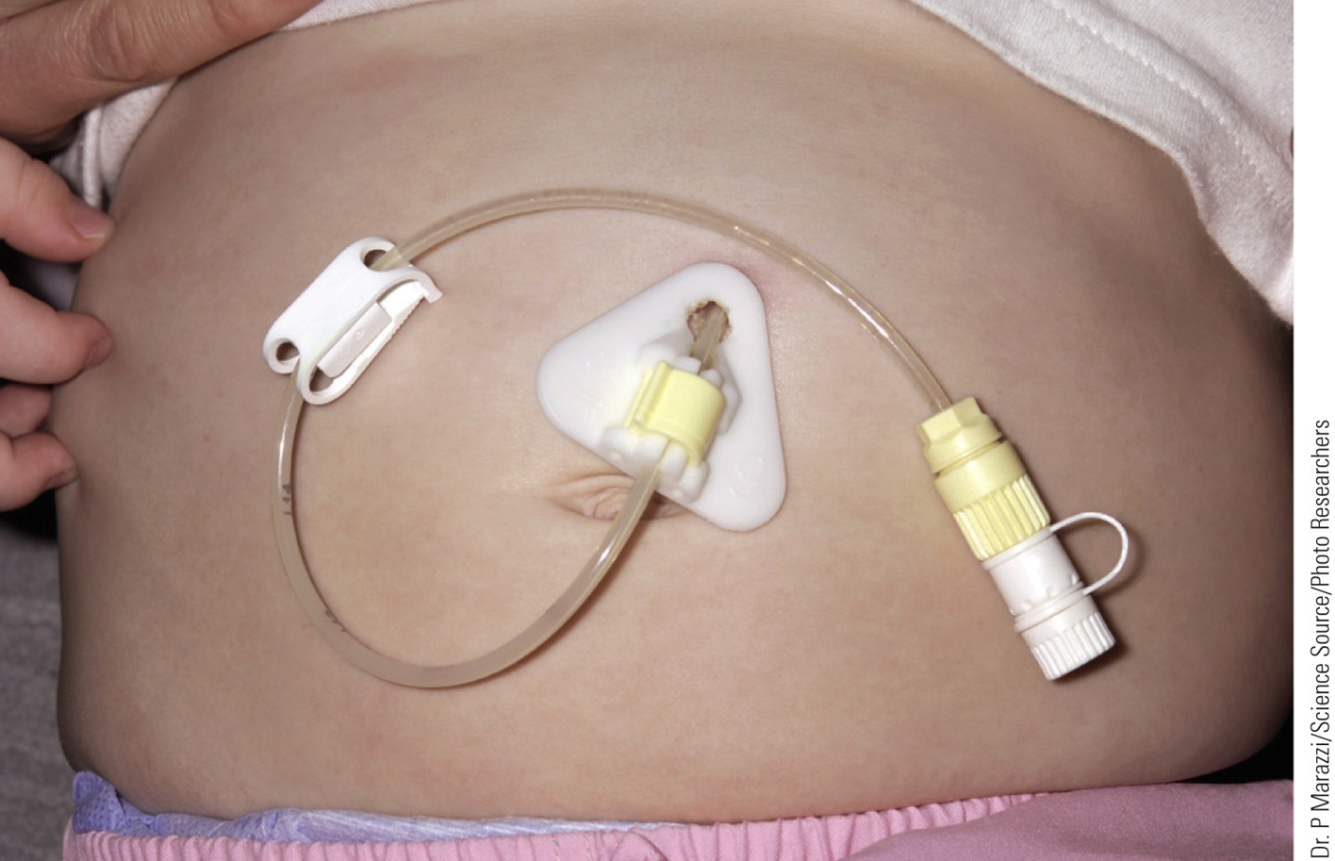

Slide 10
Gastrointestinal Route selection
Less than 4 weeks:
Nasogastric
Nasojejunal
Greater than 4 weeks:
Enterostomy, gastrostomy, or jejunostomy

Slide 11
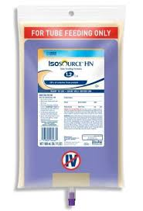
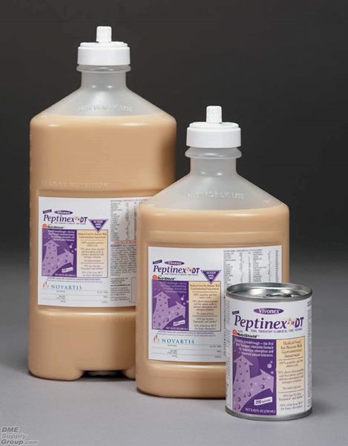
Choosing a Tube Feeding Formula
Types:
Standard
Elemental/Hydrolyzed
Disease Specific

Slide 12
Selection based on patient assessment
Standard
Intact proteins
Polysaccharides
Elemental
Amino acids
Glucose
Medical condition
Fluid and nutrition status
Ability to digest & absorb nutrients

Slide 13
Preparation
Safe Handling
Open vs Closed System
Family and patient instructions

Slide 14
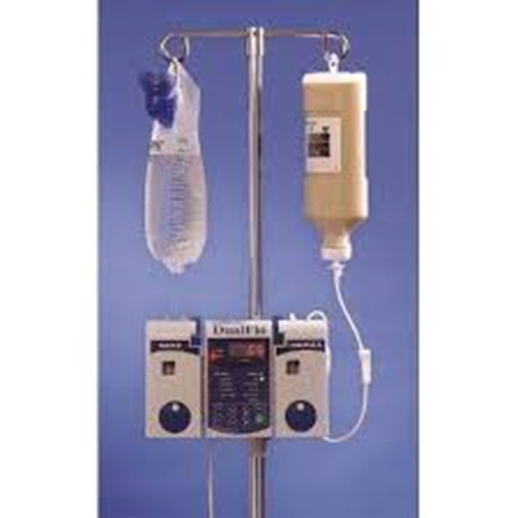
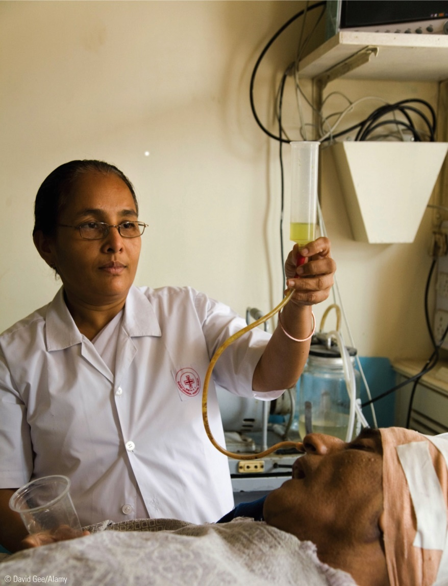
Enteral Formula Delivery
Intermittent
Bolus
Continuous

Slide 15
Tube Feeding Tolerance
Checking the gastric residual volume
Monitor patient’s
Weight
Hydration status
Lab test results
Bowel Movements

Slide 16
Enteral Nutrition: what can go wrong?
Diarrhea
Mechanical problems
Metabolic problems

Slide 17
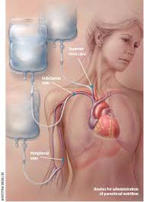
Parenteral Nutrition: Uses the veins
Inadequate GI function
Intestinal obstructions
Ileus
Short bowel syndrome
Intractable vomiting or diarrhea
Severe pancreatitis

Slide 19
Peripheral Parenteral Nutrition (PPN)
Short-term support
Patients with average nutrient needs & no fluid restrictions

Slide 20
Total Parenteral Nutrition (TPN)https://moodle.gprc.ab.ca/videos/nursing_videos/mosby_4th_edition/Advanced/skill/ZZ01.html
Long-term support
Patients with high nutrient needs or fluid restrictions

Slide 21
PN composition
Contain all essential amino acids
Concentrations: 3.5 to 20 percent
Carbohydrate
Main source of energy: glucose
Lipids
supply essential fatty acids; significant source of energy
10, 20, and 30 percent solutions
Added vitamins, minerals, electrolytes

Slide 22
Administering PN
Continuous
Critically ill
Malnourished
Cyclic
10-16 hours
Often provided at night
Team involved in insertion of line

Slide 24
Transition to Oral Diet
Gradually
Oral needs to be 2/3 of nutrient intake before discontinuing the tube
When 2/3-3/4 of nutrient needs are provided by enteral feedings, IV can be discontinued

