Slide 2
How much do you know about nutrition and health?
Name one food that you have heard is beneficial for your health
The only ways to prevent chronic diseases is to eat healthy and exercise every day. True or False?
You can influence the lifestyle and food choices your friends, family and patients have. True or False?
Nutrition plays a large role in preventing which chronic diseases?
Most Americans get the recommended amount of fiber in their diet (25-35g). True or False?

Slide 3
Health Care Professional and Nutrition
Responsibility and Opportunity

Slide 4
What is Nutrition?
https://www.youtube.com/watch?v=uYamwNVnCVU

Slide 5
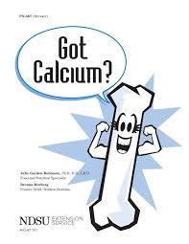
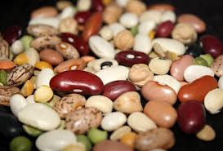
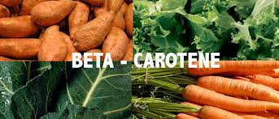
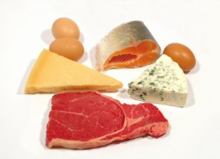
The Nutrients
Substances obtained from food
Used to provide energy & structure
Serve as regulating agents
Notes:
Promote growth, maintenance, & repair
May also reduce risk of disease
Regulating?

Slide 6
Six Classes of Nutrients
Carbohydrate
Fats
Protein
Vitamins
Minerals
Water

Slide 7
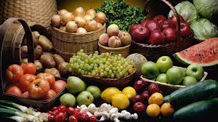
Essential Nutrients
Must be obtained from food
Body cannot make them for itself in sufficient quantities to meet physiological needs

Slide 8
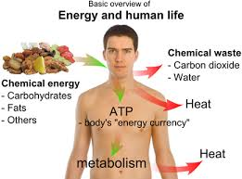
Carbohydrates, Fats and Protein
Are organic (contain carbon)
Provide energy
Notes:
Major fuels
Carbohydrates
Fats
Protein contributes when other fuels are not available

Slide 9
Vitamins
Are organic
Yield no energy
Facilitate release of energy

Slide 10
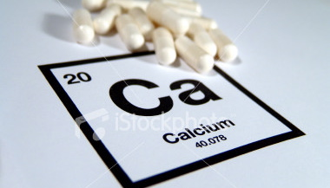
Minerals
Are inorganic
Yield no energy
Facilitate release of energy

Slide 11
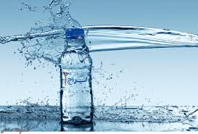
Water
Inorganic medium where all body processes take place

Slide 12
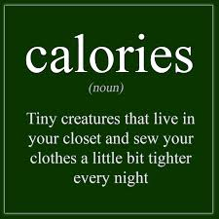

Slide 13
Calories
Units of measure of Energy
Kilocalorie = kcalorie = Calorie
Amount of heat energy needed to raise the temperature of 1 kilogram of water 1 degree C

Slide 14
Calories in Foods
Carbohydrates: 4 kcalories per gram
Protein: 4 kcalories per gram
Fats: 9 kcalories per gram
Alcohol: 7 kcalories per gram

Slide 15
Nutrient Recommendations
Sets of values to be used as nutrient intake goals by individuals
Notes:
defines amounts of:
Energy
Nutrients
Other dietary components
Physical activity
Meets the needs of most healthy people
Collaborative effort of US and Canada

Slide 16
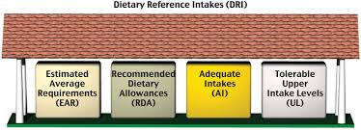

Slide 17
Dietary reference intakes
Estimated Average Requirements (EAR)
Average requirements to prevent chronic disease
Recommended Dietary Allowances (RDA)
Used to set goals for individuals;meets needs of 98% of population
Tolerable Upper Intake Levels (UL)
Hazardous when consumed in excess

Slide 18
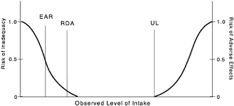

Slide 19
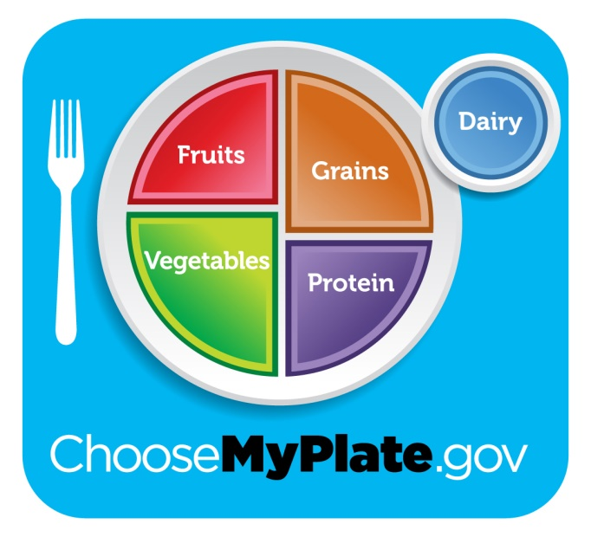
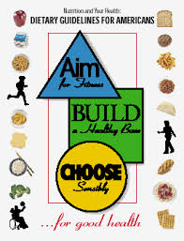
Dietary Guidelines and Food Guides
Address dietary concerns: overnutrition and undernutrition

Slide 20
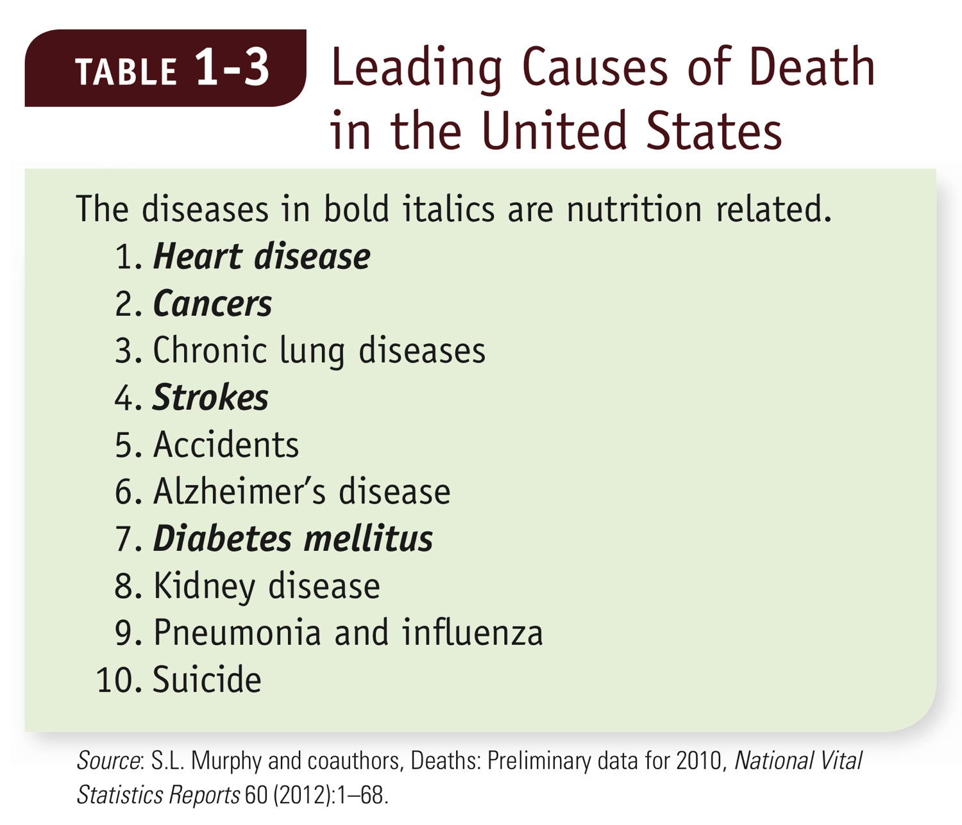
Notes:
Table 1-3 Leading Causes of Death in the United States

Slide 21
1.Follow a healthy eating pattern across the lifespan.
2.Focus on variety, nutrient density, and amount.
3.Limit calories from added sugars and saturated fats and reduce sodium intake.
4.Shift to healthier food and beverage choices.
5.Support healthy eating patterns for all.
Notes:
The main purpose of the Dietary Guidelines is to inform the development of Federal food, nutrition, and health policies and programs. The primary audiences are policymakers, as well as nutrition and health professionals, not the general public. The Dietary Guidelines is a critical tool for professionals to help Americans make healthy choices in their daily lives to help prevent chronic disease and enjoy a healthy diet. It serves as the evidence-based foundation for nutrition education materials that are developed by the Federal Government for the public. For example, Federal dietary guidance publications are required by law to be consistent with the Dietary Guidelines. It also is used to inform USDA and HHS food programs, such as USDA's National School Lunch Program and School Breakfast Program, which feed more than 30 million children each school day, and the Special Supplemental Nutrition Program for Women, Infants and Children, which uses the Dietary Guidelines as the scientific underpinning for its food packages and nutrition education program with about 8 million beneficiaries.

Slide 22
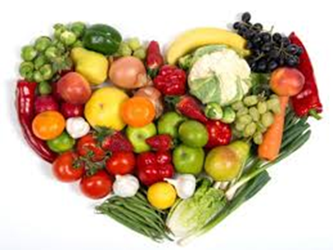
A healthy eating pattern includes:
•A variety of vegetables from all of the subgroups—dark green, red and orange, legumes (beans and peas), starchy, and other
•Fruits, especially whole fruits
•Grains, at least half of which are whole grains
•Fat-free or low-fat dairy, including milk, yogurt, cheese, and/or fortified soy beverages
•A variety of protein foods, including seafood, lean meats and poultry, eggs, legumes (beans and peas), and nuts, seeds, and soy products
•Oils

Slide 23
A healthy eating pattern limits:
Saturated fats and trans fats, added sugars, and sodium
Consume less than 10 percent of calories per day from added sugars[3]
Consume less than 10 percent of calories per day from saturated fats[4]
Consume less than 2,300 milligrams (mg) per day of sodium[5]
If alcohol is consumed, it should be consumed in moderation—up to one drink per day for women and up to two drinks per day for men—and only by adults of legal drinking age

Slide 24
What is a Nutritious Diet?
Nutrient density
Moderation
Variety
Adequacy
Balance
Calorie control

Slide 25
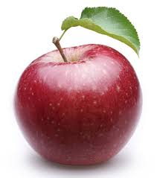
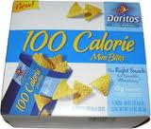
Nutrient Density
A measure of the nutrients a food provides relative to the energy it provides
More nutrients and fewer calories = more nutrient dense
vs
100 Calories
Notes:
Healthy eating pattern:
Emphasizes nutrient dense foods in the correct portion sizes
Nutrient density:

Slide 26
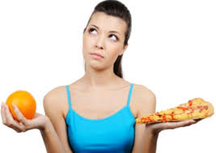

Slide 27
Food Guides
The USDA food patterns
Vegetables
Fruits
Grains
Milk and Milk Products
Protein ( animal and plant)
Notes:
Help people achieve the dietary guidelines
Each group contributes different nutrients so can reach balanced diet
Book has USDA food patterns with subgroups

Slide 28
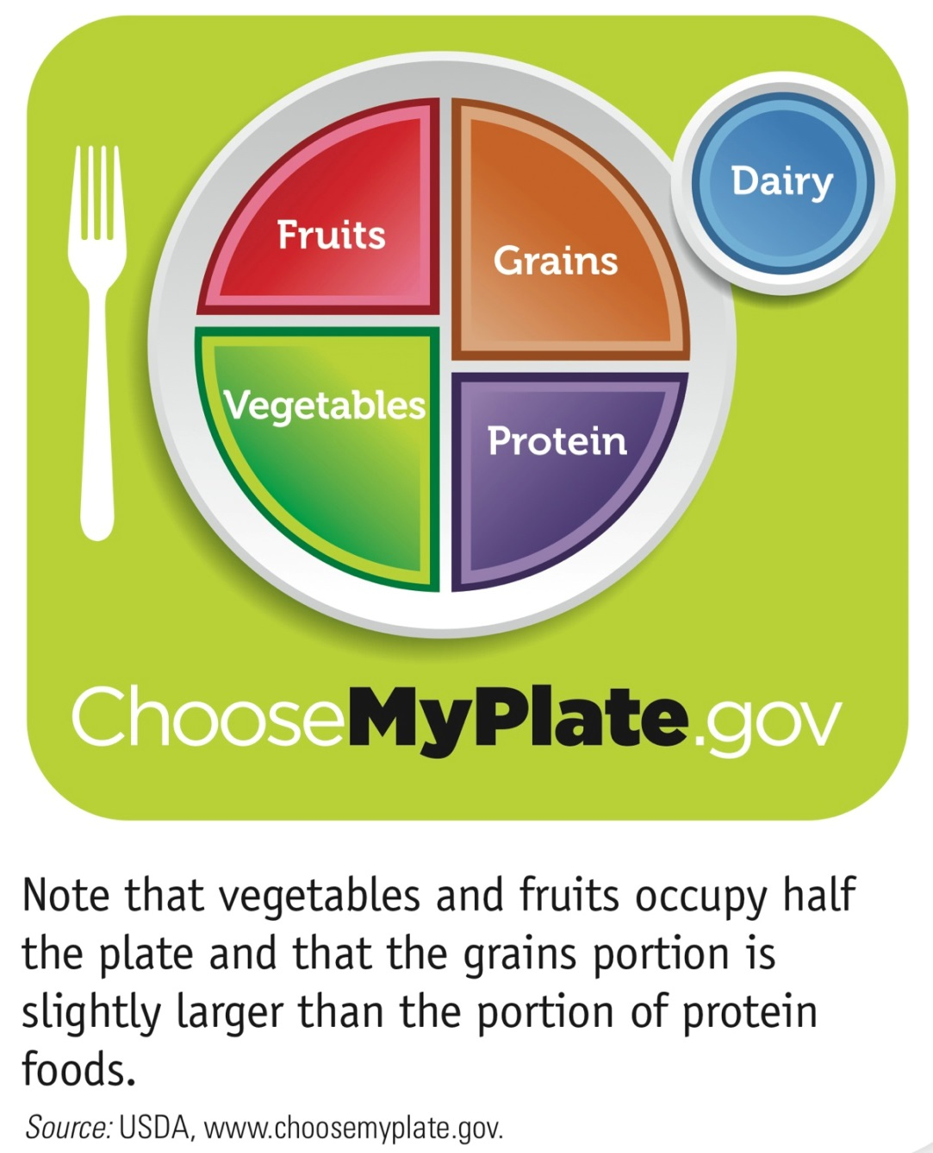
Notes:
Figure 1-6 MyPlate
Note that vegetables and fruits occupy half the plate and that the grains portion is slightly larger than the portion of protein foods.

Slide 29
http://www.choosemyplate.gov

Slide 30
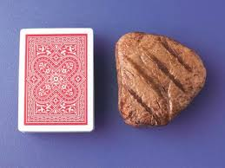
Portion Sizes
Healthy Diet= Nutrient dense foods in the proper portion sizes

Slide 31
Portion Sizes

Slide 32
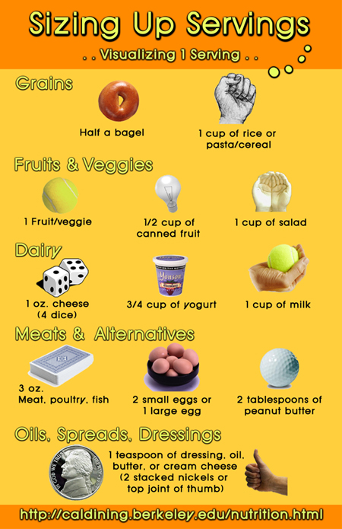
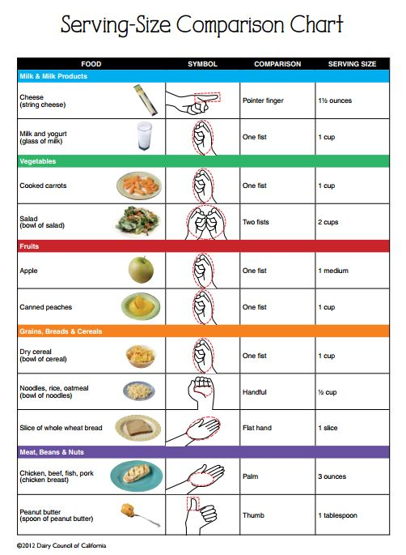

Slide 34
Portion Distortion, Eat Right, NHLBI, NIH

Slide 35
Food Labels
The ingredient list
All packaged foods must list all ingredients on the label in descending order of predominance by weight
Nutrition facts panel
Serving sizes
Daily values
Nutrient quantities
Notes:
Ingredient list good way to tell nutrient dense food from not nutrient dense foods
All labels for given product use same serving size
Daily Values: 1-set adequacy standards for nutrients that are desirable in the diet
and 2-moderation standards for the nutrients that must be limited
% compares key nutrients in the serving size of a food with the daily goals of a person consuming 2000 kcal diet
Good for comparison not for nutrient intake target like RDA
Also helps to make sense of the nutrient quantities in g/mg..
Nutrient Quantities:
Has to have certain nutrients and some vitamins
required by FDA

Slide 36
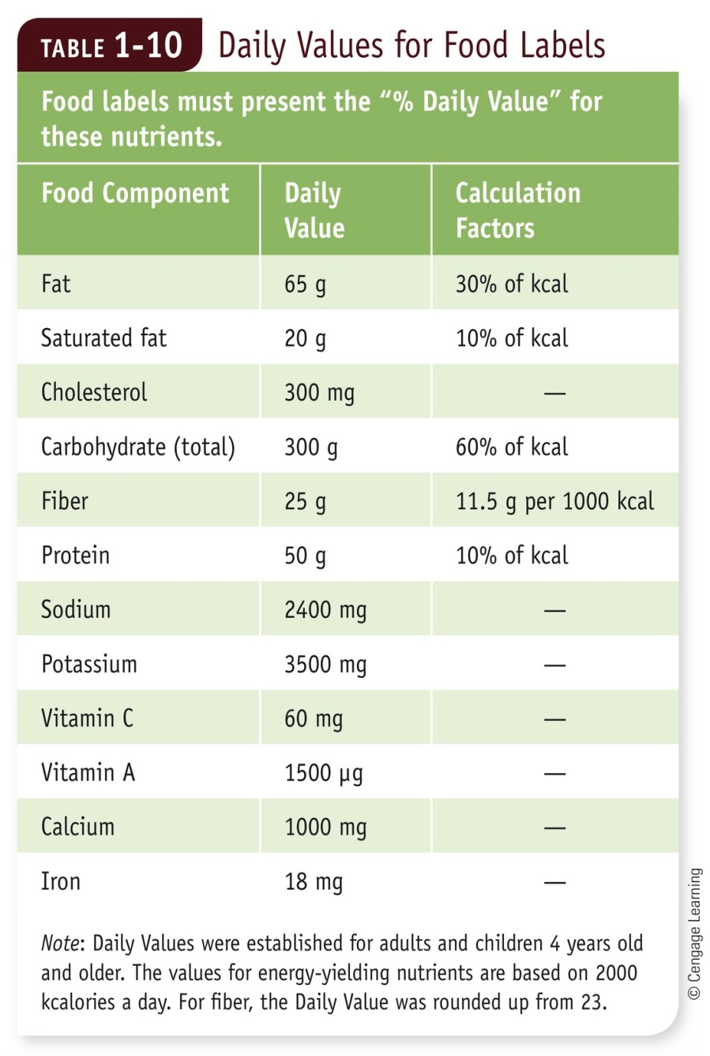
Set of nutrient standards for use on food labels
Compares nutrients with daily goals of a person consuming 2000 kcalories
Notes:
Table 1-10 Daily Values for Food Labels
Note: Daily Values were established for adults and children four years old and older. The values for energy-yielding nutrients are based on 2000 kcalories a day. For fiber, the Daily Value was rounded up from 23.

Slide 37
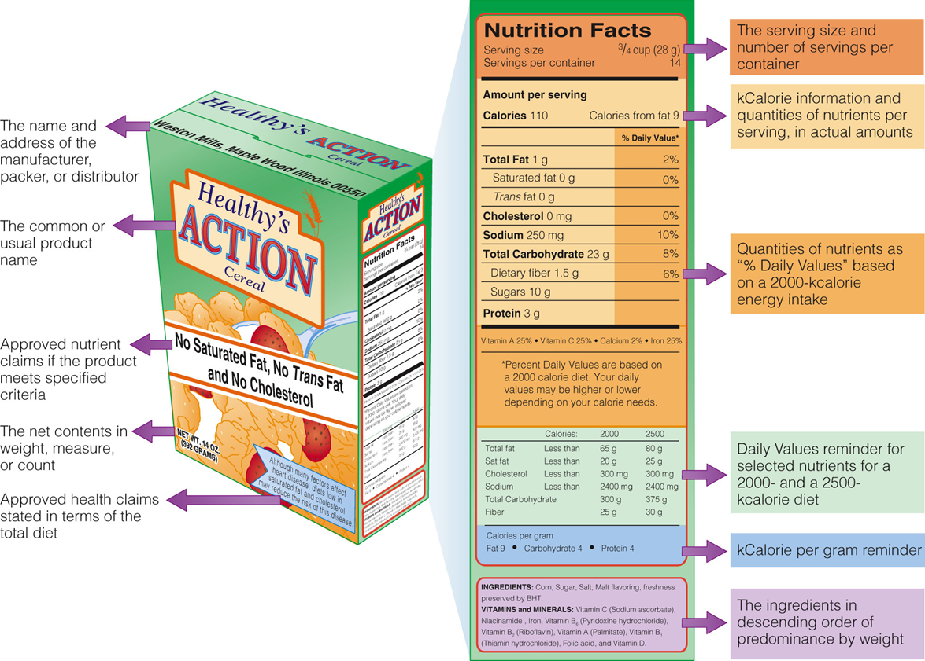
Notes:
Figure 1-7 Example of a Food Label

Slide 38
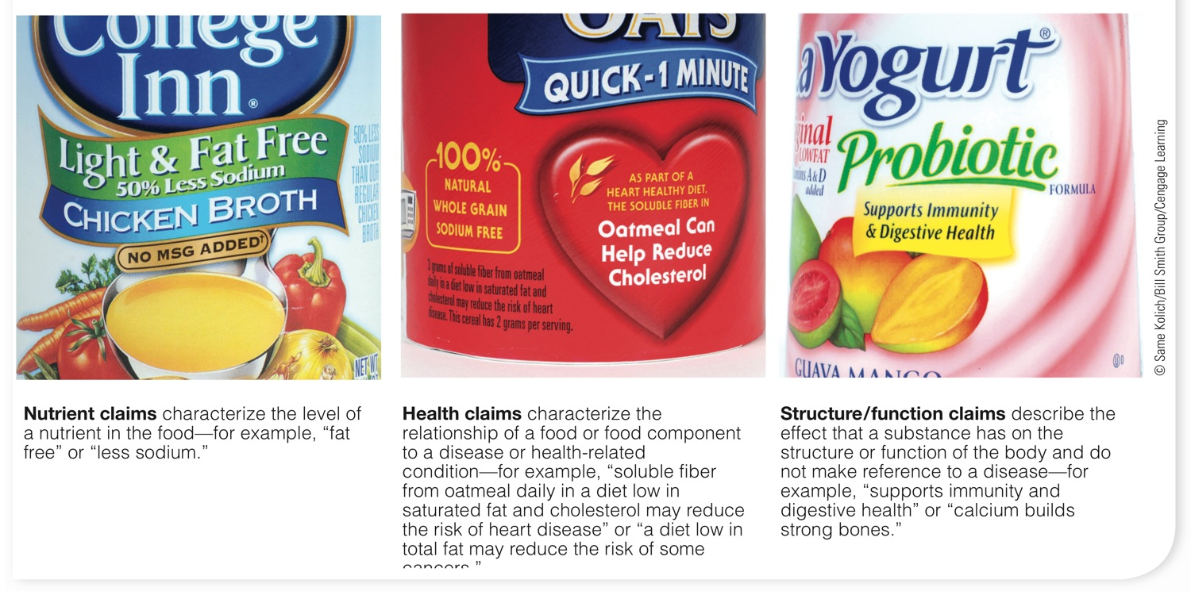
Notes:
Figure 1-8 Label Claims
Nutrient claims characterize the level of a nutrient in the food—for example, “fat free” or “less sodium.”
Health claims characterize the relationship of a food or food component to a disease or health-related condition—for example, “soluble fiber from oatmeal daily in a diet low in saturated fat and cholesterol may reduce the risk of heart disease” or “a diet low in total fat may reduce the risk of some cancers.”
Structure/function claims describe the effect that a substance has on the structure or function of the body and do not make reference to a disease—for example, “supports immunity and digestive health” or “calcium builds strong bones.” not FDA approved
Key is that it is hard for consumer to determine between health claim (regulated) and structure/function claim (unregulated)

Slide 39
Nutrition in Practice Chapter 1 Finding the Truth about Nutrition https://www.youtube.com/watch?v=TlCKwxaw-zs
https://www.youtube.com/watch?v=oNJ6rh4XIsA

Slide 40
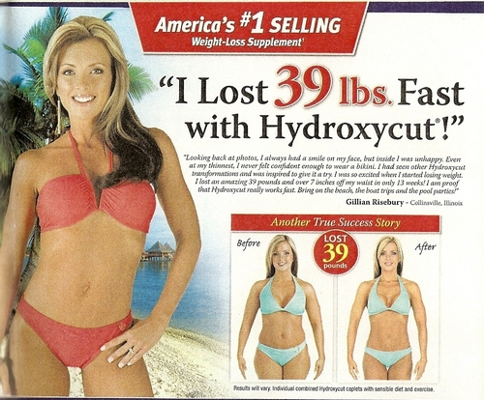

Slide 43
Why all the contradiction around nutrition information?
Media
Research
New Product Promotion
Notes:
so often?
1. Popular media have limited reporting time & space
2. Scientists often disagree on new findings
3. Preliminary findings reported before validation or disapproval
4. New products or treatments promoted before tests or scrutiny

Slide 44
Nutrition quackery

Slide 45
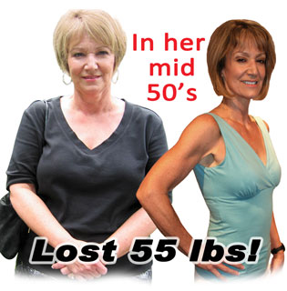
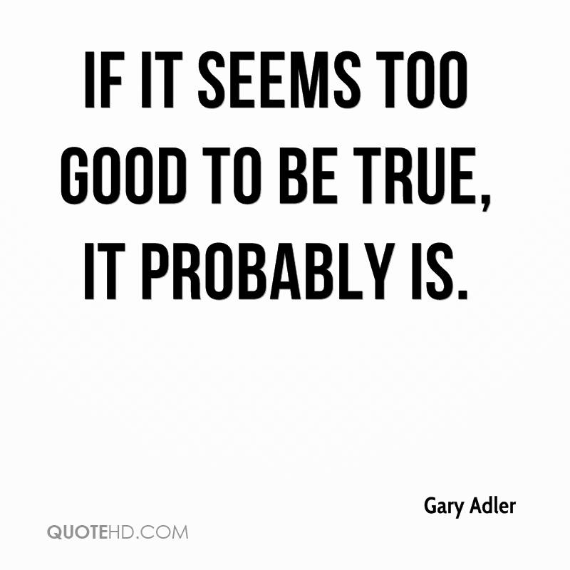
Product Does it all

Slide 47
http://www.quickweightloss.net

Slide 48
Nutrition Professionals
Registered Dietitian: Graduate of accredited baccalaureate program with internship
Dietetic technician: Associates degree
Nutrition professionals with advanced degrees: MS, MPH, PhD, DrPH
Other Health Care Professionals: Nurses, Doctors

Slide 49
Credible Sources of Nutrition Information
Valid information comes from scientific research
Page 35 Table NP1-2
Notes:
Properly designed studies
No animal results applied to humans
In peer reviewed journals

