Slide 1
CARDIAC ARREST MANAGEMENT
2016
Special acknowledgment to Santa Barbara EMS for the development and sharing of CAM.

Slide 2
GOAL
To maximize the number
of cardiac arrest patients that return home to their families neurologically intact

Slide 3
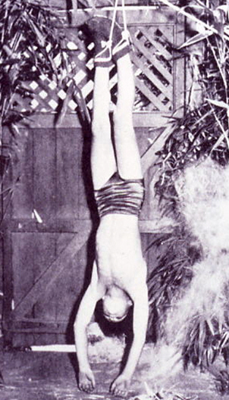
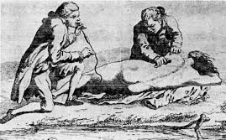
Advances in Resuscitation
1500s - Flagellation
Late 1700s - Inversion
Early 1700s - Fumigation

Slide 4
Cardiac Arrest:
The Prime Directive
Continuous high-quality chest compressions will be performed from the moment of recognition of cardiac arrest until return of spontaneous circulation.

Slide 5
BACK TO BASICS
Cornerstones of treatment:
Assessment
Patient Positioning
CPR
Continuous Chest Compressions
Airway/Ventilation/Oxygenation
Defibrillation
Possible, but unproven, value:
Advanced airway (ETI, SGA)
Vascular access (IV/IO)
Pressors (epinephrine)
Antiarrhythmics (amiodarone)
Notes:
We know that good BLS improves outcomes.
The value of other measures is unknown. Some (e.g., EPI, ETI) may be harmful.

Slide 6
STRATEGIES
HOW TO ACHIEVE THE GOAL:
Assigned defined roles
Rapid and accurate assessment
Adequate work space
Continuous high quality chest compressions
Prompt defibrillation
Airway with synchronized ventilations
ALS: Vascular access with medications
Resuscitation Management & Teamwork
Recognition of ROSC

Slide 7
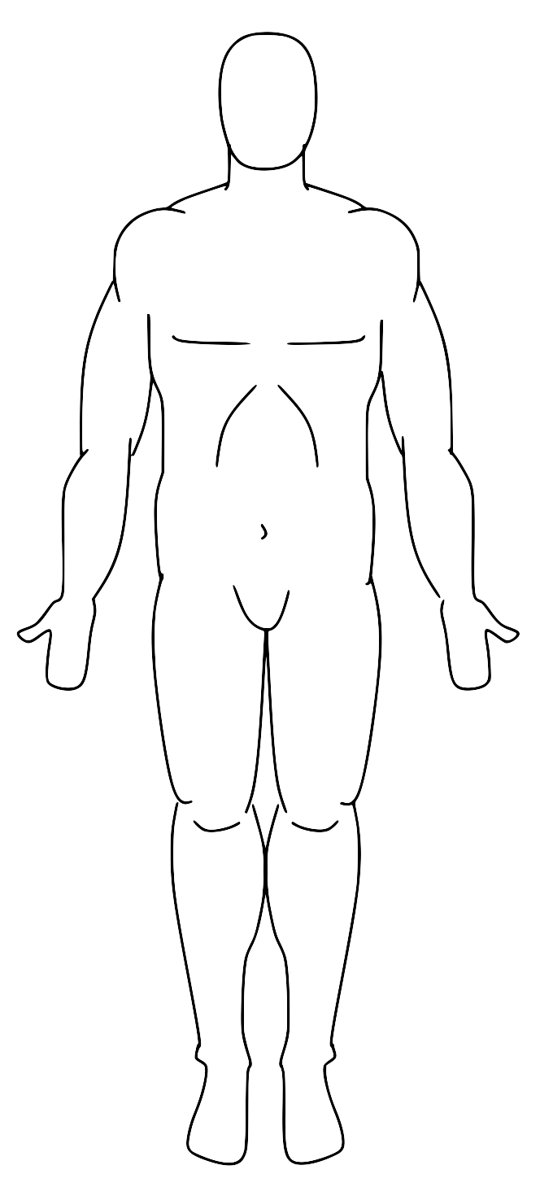
Assigned Roles
TRIANGLE OF LIFE
Rescuer 3
Assemble BVM/ETCO2
Maintains mask seal with 2 thumbs on mask technique
Compression Coach
Rescuer 2
Attach defibrillator, analyze
Defibrillate immediately prn
Provides 100ml of oxygen Q 10th compression.
Switches with Rescuer 1
Rescuer 1
Shake/Shout (no pulse check)
Open airway
Move to floor
Begin compressions
Rescuer 4
ALS:
IV/IO Meds
Advanced Airway PRN
ALS/BLS:
Gathers information and patient medications
Switches with Rescuer 1 or 2 as needed
Additional Rescuers
ALS/BLS:
Gathers information
Gathers patient medications
Switches with Rescuer 1 or 2 as needed
Other duties as assigned

Slide 8
Rapid and Accurate Assessment
Assess for Determination of Death
RESPONSIVE?
If no: Open airway – “shark hook” MEDICAL Patients Only, TRAUMA Patients get modified jaw thrust
BREATHING?
If no or agonal (gasping), start CPR
No need to check pulse
2 conditions when pulse check helpful (pulse, no breathing)
Heroin overdose
Cervical spinal cord injury

Slide 9
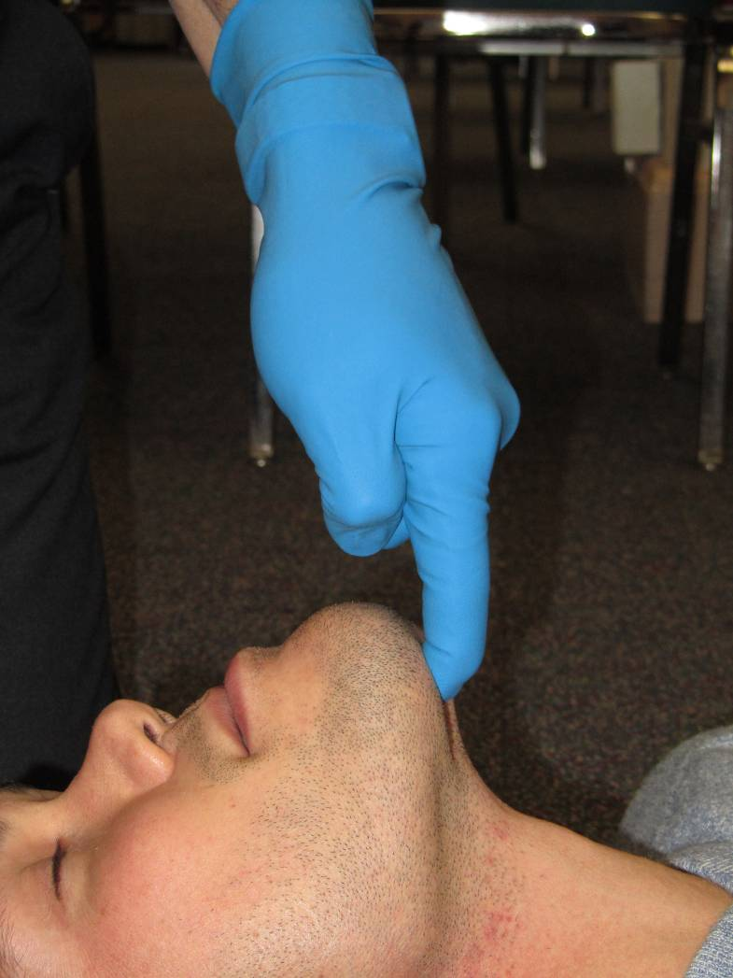
OPEN AIRWAY “SHARK HOOK”

Slide 10
Adequate Work Space
Move to floor
Need room for
Triangle of Life
Notes:
!

Slide 11
Continuous High Quality Chest Compressions
Rate 110/Minute- Use Metronome!
Depth 2+ Inches
Fully off the chest
Downstroke perfuses brain
Maintains brain viability – improves CPC score
Upstroke perfuses heart
Increases likelihood of successful defibrillation
All 3 are critically important – rate, depth and full recoil

Slide 12
CPR PRESERVES THE BRAIN
50%
40%
30%
20%
10%
0%
48%
Neurologically normal survival
15%
CPR
CCR
Standard CPR
Continuous Chest
Compression CPR
Kellum: Amer J Med 2006
Notes:
12

Slide 13
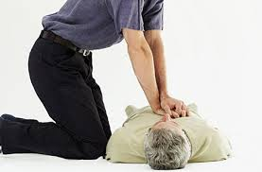
Shoulders Directly over hands
Knees Touching Arm
Notes:
13
Keep slide

Slide 14
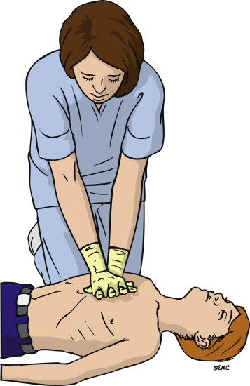
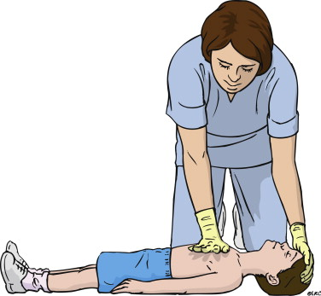
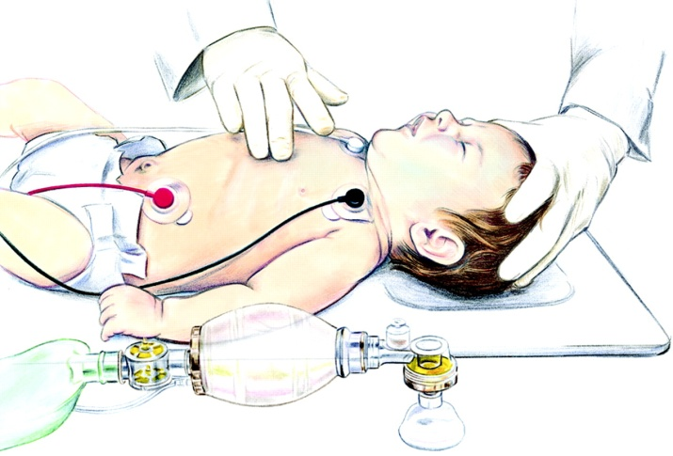
Pediatric Chest Compressions
Infant AND Child: ⅓ to ½ depth of chest.
Child – 1 or 2 hands
Infant – 2 fingers

Slide 15
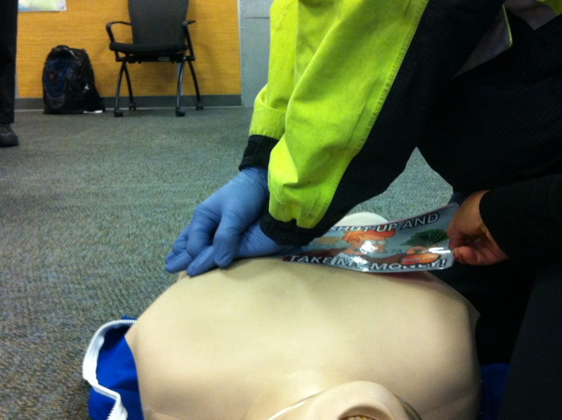
FULL RECOIL
Keep fingers on chest but allow palm to come off slightly
Should be able to swipe
a paper under palm
of hand during recoil
Notes:
15

Slide 16
Cardiac Arrest:
The Prime Directive
Continuous high-quality chest compressions will be performed from the moment of arrest until return of spontaneous circulation.
Notes:
STAY ON THE CHEST!!!!
Quality chest compressions: rate/depth/recoil
Switch every 2 minutes
Discuss position and hand position

Slide 17
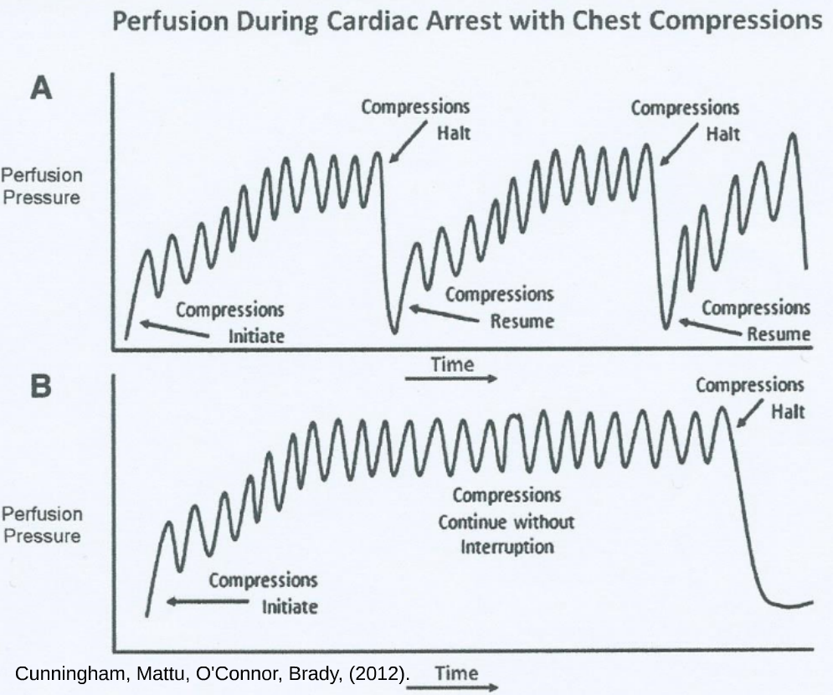
Interruption of Compressions
Notes:
This demonstrates why intermittent pauses in chest compression are detrimental. It takes up to 17 beats (each time) to reach the white line – which is the coronary perfusion pressure needed for successful defibrillation.

Slide 18
Mechanical CPR Devices may be used after resuscitation has reached the 10 minute mark

Slide 19
COMPRESSIONS:
KEY POINTS
Activate Metronome
Correct rescuer body position
Press Fast: 110 per minute
Press Deep: at least 2”
Full Chest Recoil
CONTINUOUS

Slide 20
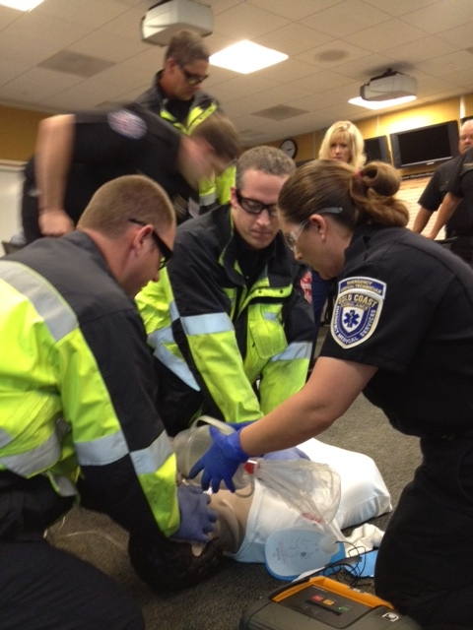
Airway With Synchronized Ventilations
300 ml
200 ml from “sucking” of chest recoil
100 ml from positive pressure
0.3 sec (upstroke time)
110 compressions in 60 seconds
On the upstroke of the 10th compression
Notes:
RESQPOD Not being used in this study.

Slide 21
VENTILATION: KEY POINTS
Good grip/seal
2 Thumbs on mask technique vs CE
Ventilation on the upstroke
1-hand bag squeeze
Rapid delivery
10:1
Don’t pause compressions
Notes:
1-hand bag squeeze for low volume breath.

Slide 22
AED USE
Continuous high performance CPR
Attach the AED
Analyze (brief pause in compressions for AED to analyze)
If AED advises to shock, restart compressions while AED charges.
Complete 30 compressions prior to shock being delivered.
Compressor counts out loud for last 5 compressions
Everyone clears the patient
Shock delivered and CPR begins immediately

Slide 23
Manual Monitor
Compressor counts out each compression (1-10)
Ventilator counts out every 10th compression, i.e; 10, 20, 30,etc.
Rescuer at head calls out to paramedic when compressions reach 200
Paramedic advises to continue compressions during charging then begins charging the monitor
Monitor fully charged, paramedic has rescuers clear patient
Paramedic either defibrillates or dumps the charge (within 3 seconds)
CPR begins immediately

Slide 24
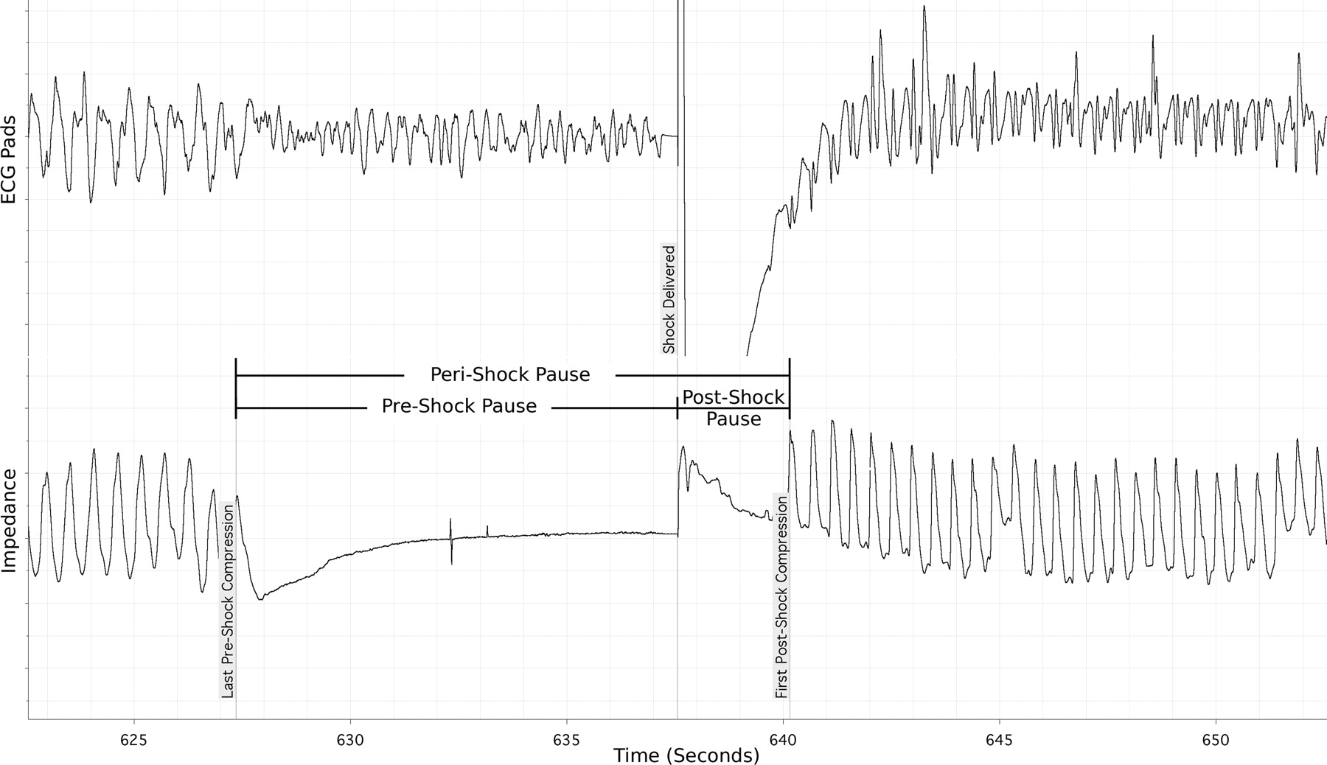
PAUSE FOR DEFIBRILLATION
Shock
18% decrease in survival every 5 seconds of preshock pause
14% decrease in survival for every 5 seconds of perishock pause.
Notes:
24
DON’T stop chest compression to charge the defibrillator, only stop long enough to deliver energy, AND DO NOT stop after defibrillation to check for pulse, immediately continue chest compressions
Cheskes, Circulation, 2011
Switch to manual monitor as soon as possible.

Slide 25
ALS
Ascertain number of AED shocks delivered
Attach ETCO₂ to BVM
Switch to manual monitor and check rhythm
Vascular Access IV, IO
Medications per protocol
Epinephrine
Amiodarone
Advanced Airway
Rescue airway
ETI – Only for failed BVM
Notes:
Note to engine crew: if BVM is successful, maintain! No advanced airway needed. You need to communicate airway status to ALS crew.

Slide 26
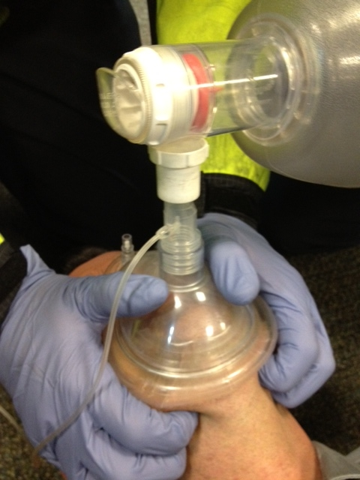
BVM WITH
CAPNOGRAPHY TUBING ATTACHED
Monitors CPR Quality
Indicates ROSC

Slide 27
Resuscitation Management
TEAM PRIORITIES:
Know your role-teamwork!
Rescuer #3 monitors compression
performance with metronome
Switch compressor every 2 minutes
without pause during rhythm check
20 minute minimum on scene resuscitation

Slide 28
1 RESCUER – Triangle of Life
Rescuer 1
Shake and shout
Move to floor
Open airway – shark hook
Begin compressions

Slide 29
2 RESCUERS-Triangle of Life
Rescuer 1
Shake and shout
Move to floor
Open airway - shark hook
Begin compressions
Counts 1-10 (repeat)
Rescuer 2
Activate metronome
Cut shirt
Attach defib and analyze
After first analyze and/or Defib place a NRB mask with high flow O2 on patient until a third rescuer arrives.
Counts on q ventilation: 10, 20, 30, etc.

Slide 30
3 RESCUERS – Triangle of Life
Rescuer 3
Assemble BVM/insert OPA
Maintains mask seal with 2 thumbs on mask technique
Compression coach
Pushes shock on AED
Rescuer 1
Shake and shout
Move to floor
Open airway
Begin compressions
Rescuer 2
Activate metronome
Cut shirt
Attach defib and analyze
Move AED to Rescuer 3
Delivers ventilations
Switches with rescuer 1 every 2 minutes

Slide 31
4 RESCUERS – Triangle of Life
Rescuer 3
Assemble BVM/insert OPA
Maintains mask seal with 2 thumbs on mask technique
Pushes shock on AED
Compression Coach
Rescuer 2
Activate metronome
Cut shirt
Attach defib and analyze
Defib PRN
Delivers ventilation
Switches with
Rescuer 1 every 2 minutes
Rescuer 1
Shake and shout
Move to floor
Open airway
Begin Compressions
Paramedic
Cardiac Monitor
Defibrillates as needed
ALS: IV/IO Meds
Advanced Airway PRN
Communicates with Rescuer #3
Monitors Triangle of Life
ETC02/CPR/Ventilations

Slide 32
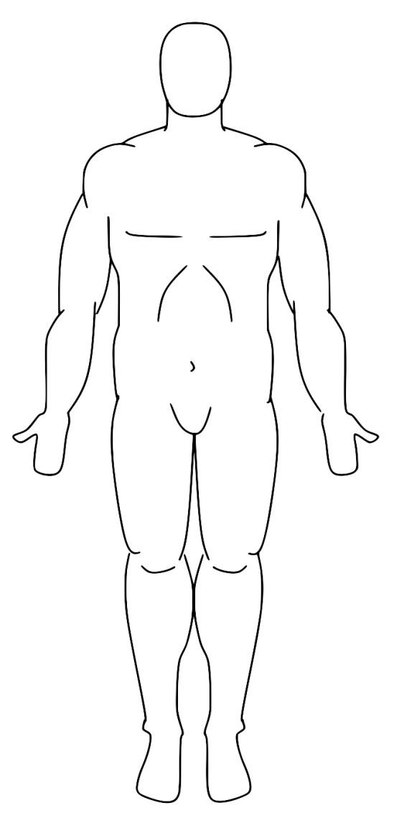
≥ 5 RESCUERS – Triangle of Life
Rescuer 3
Maintains mask seal with 2 thumbs on mask technique
Communicates with paramedic.
Advises paramedic at 170 compressions
Compression Coach
Ventilation Rotation
Provides 100ml of oxygen Q 10th compression.
Counts Q 10th compression. 10-20-30,etc
Compression Rotation
Counts 1-10 out loud during compressions
Paramedic
Cardiac Monitor
Defibrillates as needed
ALS: IV/IO Meds
Advanced Airway PRN
Communicates with Rescuer #3
Monitors Triangle of Life
ETC02/CPR/Ventilations
EMT
Attach ETC02
Sets up paramedic equipment as needed
Rotates into triangle of life if needed

Slide 33
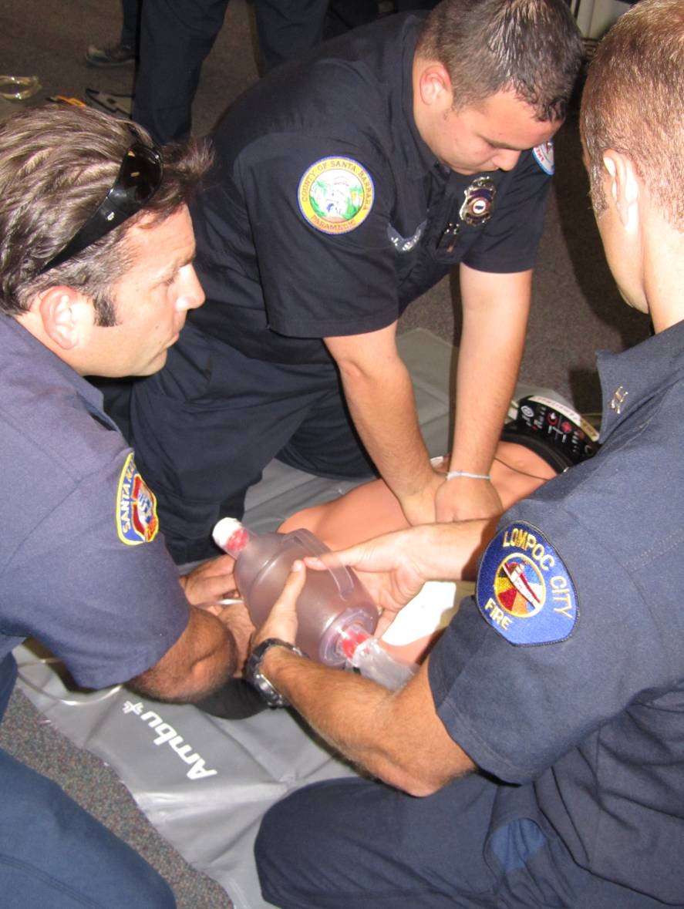
Rescuer 1
Rescuer 2
Rescuer 3
Monitor for decreased compression performance
Notes:
33

Slide 34
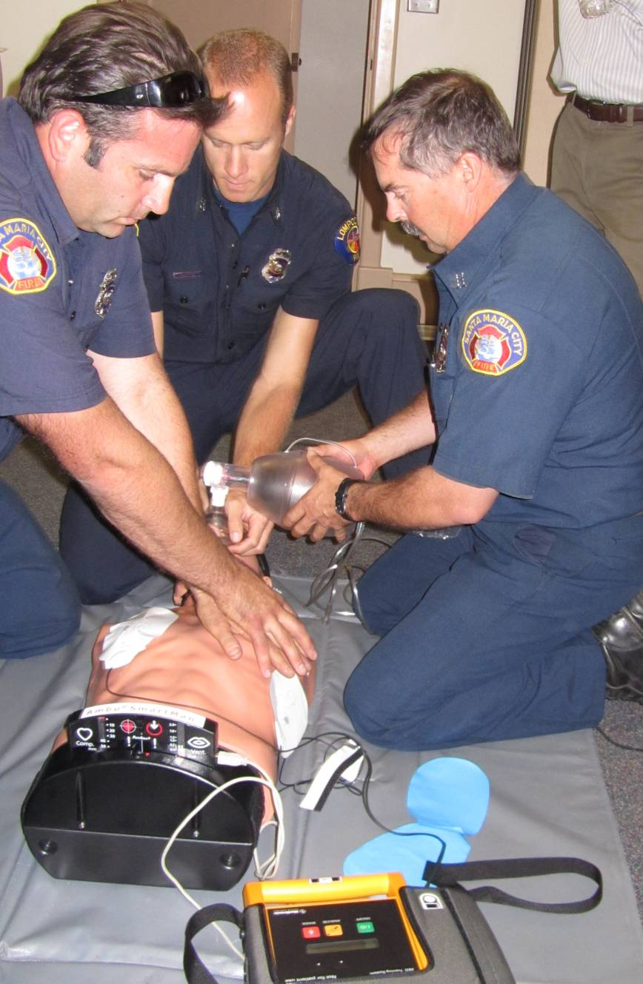
Rescuer 2
Rescuer 1
Rescuer 3
SWITCH
COMPRESSORS EVERY
2 MINUTES WITHOUT
PAUSING
COMPRESSIONS
Notes:
34

Slide 35
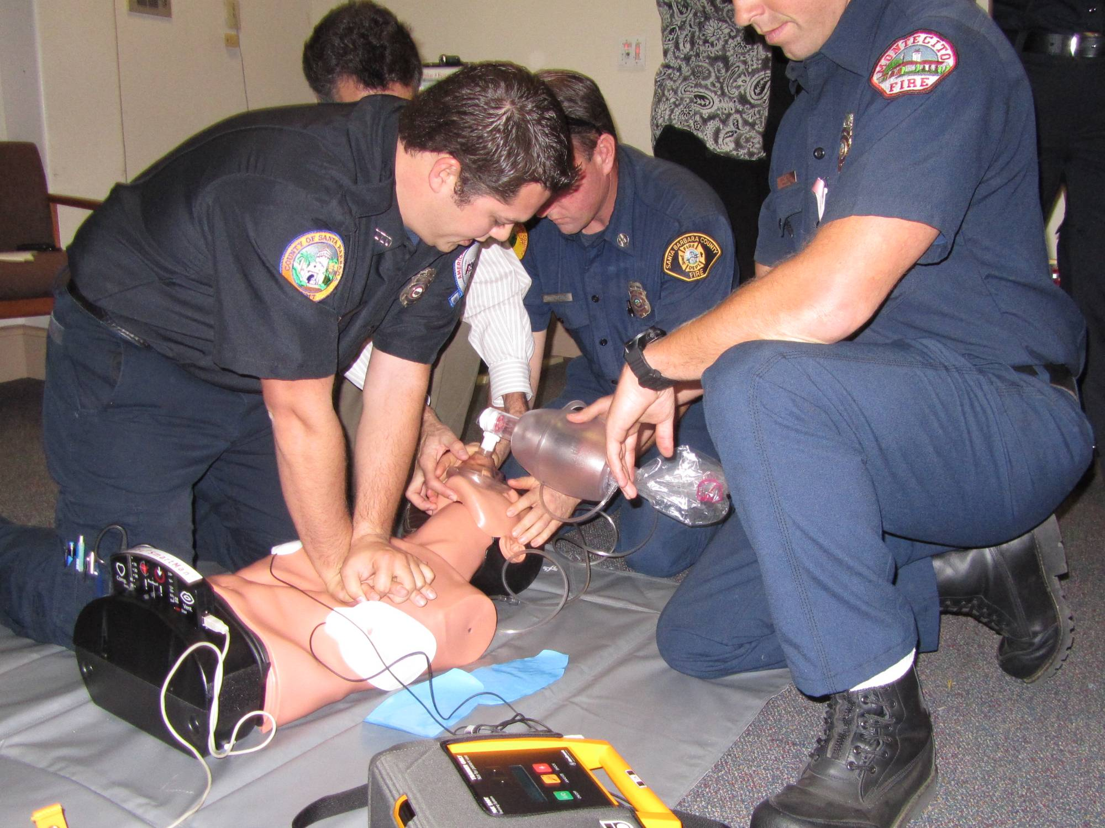
REMEMBER : Do NOT stop chest compressions for:
Ventilation
Charging of manual defibrillator
ALS Procedures

Slide 36
Role Assignments and Timekeeping in Triangle of Life
Ventilator focuses on delivering 100ml of oxygen every 10th upstroke. At the same time count aloud, 10-20-30,etc.
Compressor focuses on compressions counting aloud 1-10
Rescuer # 3 maintains seal on mask and coaches CPR. When compressions reach 200, advises paramedic.

Slide 37
TEACHING POINTS
* EMTs own CPR
* Minimize interruptions in CPR at all times
* Ensure proper depth of compressions (>2 inches)
* Ensure full chest recoil/decompression
Rotate compressors every 2 minutes
Designate a timekeeper
* Hover hands over chest during shock administration and be ready to compress as soon as patient is cleared
* Intubate or place advanced airway during ongoing CPR
* Place IV or IO during ongoing CPR
* Coordination and teamwork between EMTs and paramedics
Notes:
37

Slide 38
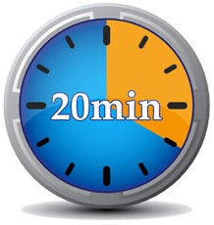
RESUSCITATION TIME:
20+ MINUTES ON SCENE
In ALL, except very rare cases
i.e. Unsafe scene
Unworkable scene

Slide 39
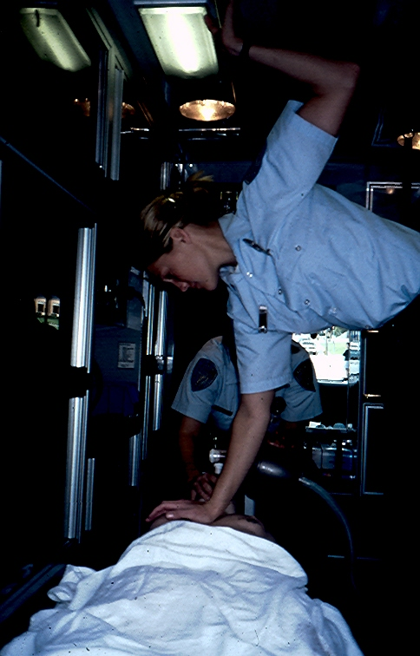
Transport + CPR = Poor quality compressions and Decreased ROSC
Notes:
Better to stay on scene and do compressions!
Remember: 20 minute scene time
39

Slide 40
When do BLS Providers STOP Chest Compressions?
While AED analyzes
Delivery of shocks
Log roll
Signs of Life
Movement
Awake
Notes:
Define “signs of life”
RE: “No Shock Advised” from AED… continue compressions after all NSI (no pulse check)

Slide 41
When do ALS Providers STOP Chest Compressions?
Rhythm analysis every 2 min
Delivery of shocks
Log roll
To perform pulse check
when ETCO₂ >20

Slide 42
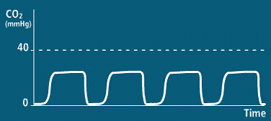
RECOGNITION OF ROSC
1. ETCO₂ increases to > 20
2. Stop compressions
3. Check for rhythm w/rate > 40
4. Check for carotid pulse
No more than 3 sec.
5. If pulse, switch to rescue breathing
500ml over 1 second, rate10-12/min

Slide 43
POST ROSC TREATMENT
Perform 12 lead
5-10 minutes on scene after ROSC is obtained is reasonable to ensure rhythm and patient stability.
Transport patient to the closest STEMI Receiving Center (SRC) if transport time is 30 minutes or less.

Slide 44
CAM Training Video
Click here for the CAM Training Video

