Slide 1
Santa Rosa Junior College Sports Medicine & Athletic Training Program
Monica Ohkubo, DSc, ATC, EMT-B
Head Athletic Trainer
Sports Medicine & Athletic Training Program Director

Slide 2
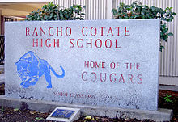
My Path…

Slide 3
OUCH…
https://youtu.be/DV-PavgmLaM

Slide 4
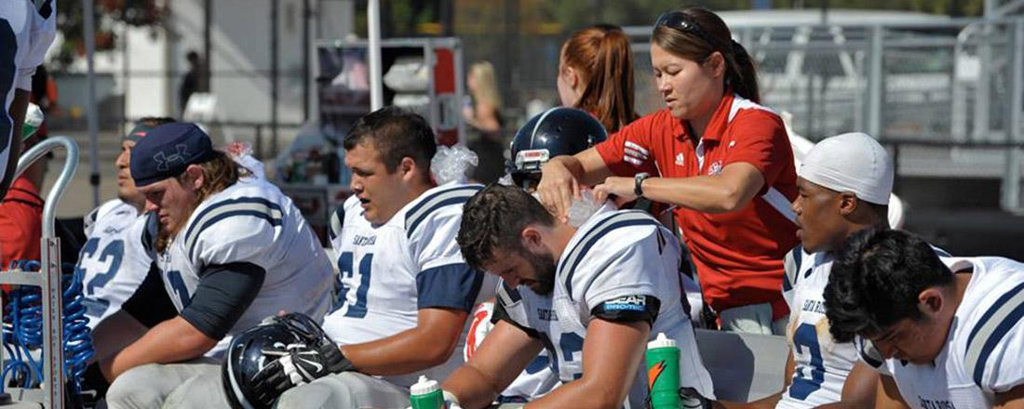
What is a Certified Athletic Trainer?
Health care professional
Prevention, recognition, management and rehabilitation of athletic injuries/illnesses
Oversees the total health care for the athlete

Slide 5
Sports Medicine Team

Slide 6
NOT a Personal Trainer!
AT
Bachelors minimum
Personal Trainer
Fitness goals
Varying certifications/ education
Board exam
CEUs
Code of ethics
Medical care

Slide 7
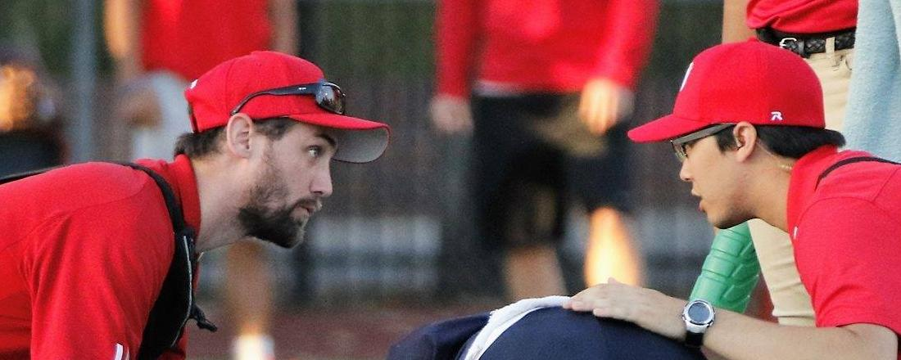
Roles and Responsibilities of the Certified Athletic Trainer
Prevention
Recognition, evaluation and assessment
Immediate care
Treatment, rehabilitation and reconditioning
Health care administration
Professional development and responsibility

Slide 8
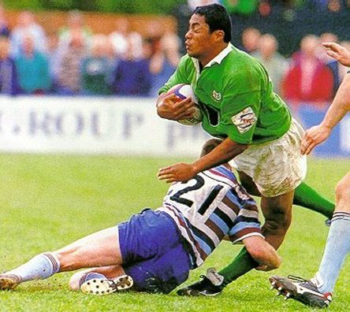

Slide 9
Prevention of Athletic Injuries
Appropriate training and conditioning
Environmental conditions
Protective equipment
Nutrition
Medications
Substance abuse

Slide 10
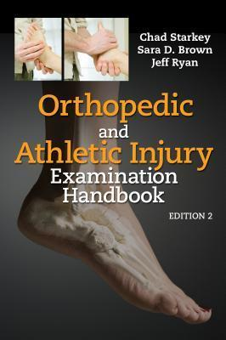
Recognition, Evaluation and Assessment of Athletic Injuries
What is the injury?
How bad is it?
First aid
Referral

Slide 11
Immediate Care of Injury & Illness
On-field assessment following acute injury
Administer first aid
Minor to catastrophic
Certified in CPR for healthcare providers
EMT-B = beyond basic certification

Slide 12
Treatment, Rehabilitation & Reconditioning
Work with team physician
Treatment/modalities
Rehabilitation programs
Psychosocial intervention

Slide 13
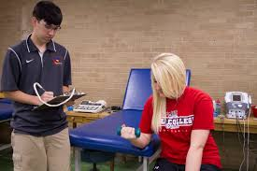
Organization & Administration
Documentation
Ordering equipment and supplies
Supervising personnel
Policies and procedures

Slide 14
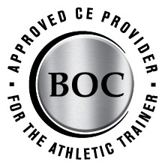
Professional Development & Responsibilities
CEUs
Athletic trainer as an educator
Athletic trainer as a counselor

Slide 15
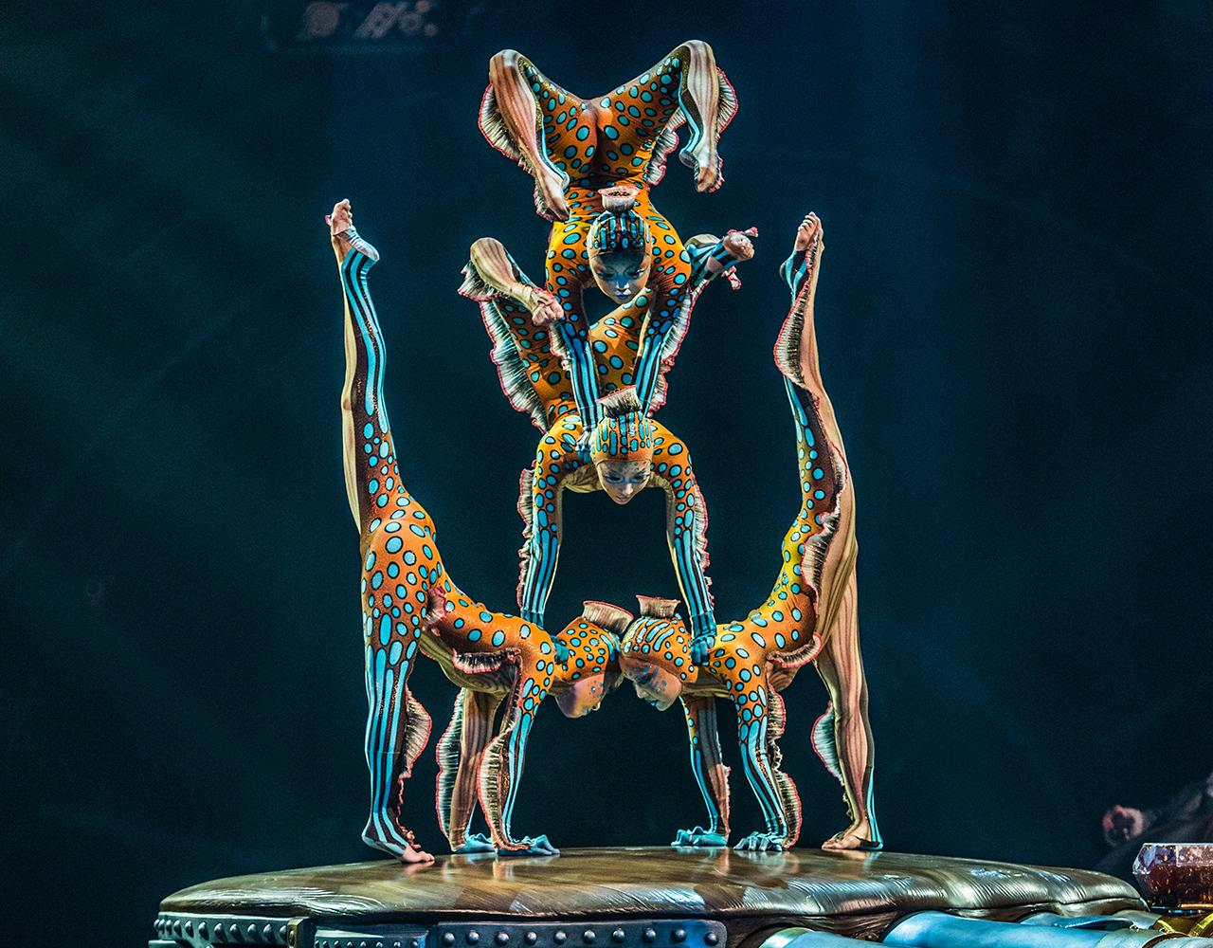

Slide 16
Employment Settings for the AT
Secondary schools
School districts
Colleges and Universities
Professional teams
Sports medicine clinics
Industrial settings
UPS, FedEx, ergonomic evaluations
Performing arts
Reality TV, dance groups, Cirque de Soleil, musicians
Armed forces

Slide 17
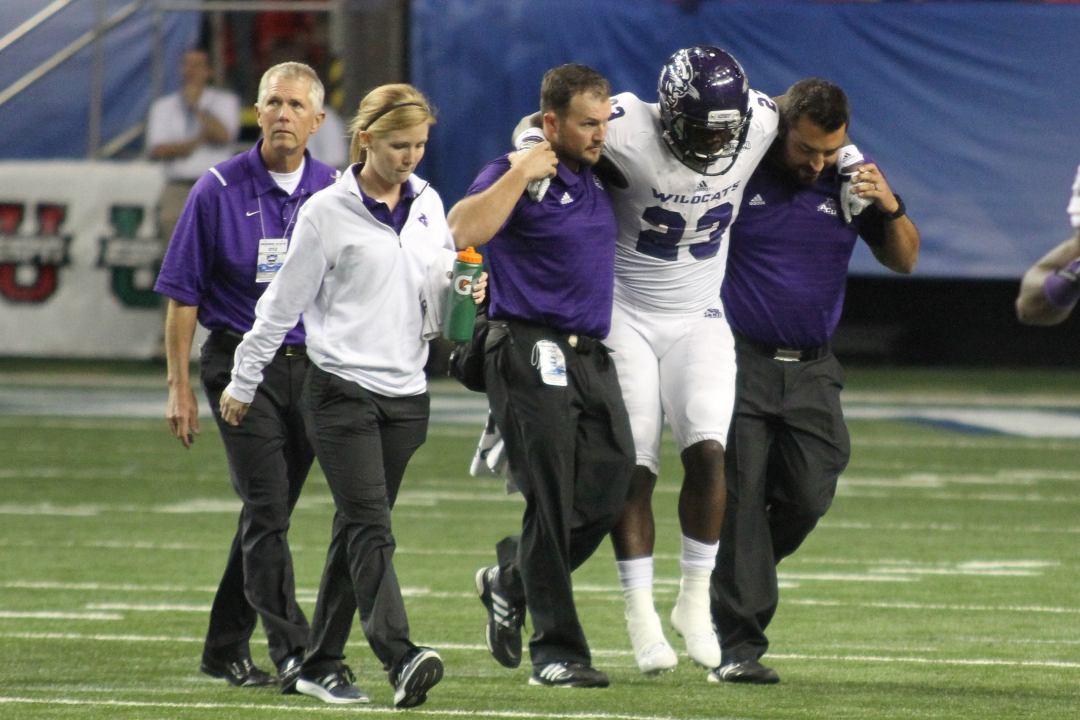

Slide 18
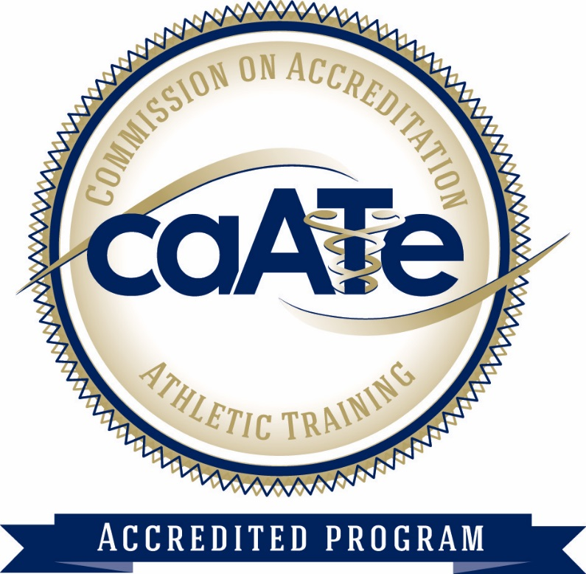
How Do I Become an AT?
Earn a degree from an accredited athletic training curriculum
San Jose State University, Fresno State, UOP, San Diego State, Sacramento State, etc.
Curriculum includes formal instruction in:
Injury/illness prevention, first aid and emergency care, assessment of injury and illness, human anatomy and physiology, therapeutic modalities and nutrition
Classroom learning and clinical experience
70%+ have Masters degrees
*All accredited AT education programs will be at the Masters’ level by Fall 2022

Slide 19
www.nata.org

Slide 20
SRJC Sports Medicine & Athletic Training Program
https://youtu.be/N3baPnzLLxo

Slide 21
Who Do We Help?
20 intercollegiate athletic teams
Nationally ranked teams, state championship teams, teams ranked in state, All-American athletes
Dance ensemble and dance production

Slide 22
Courses in Sports Medicine/Athletic Training
KINES 4: Care and Prevention of Athletic Injuries
KINES 62ABCD: Sports Medicine Lab
KINES 63: Lower Extremity Evaluation, Treatment
and Rehabilitation
KINES 64: Upper Extremity Evaluation, Treatment
and Rehabilitation

Slide 23
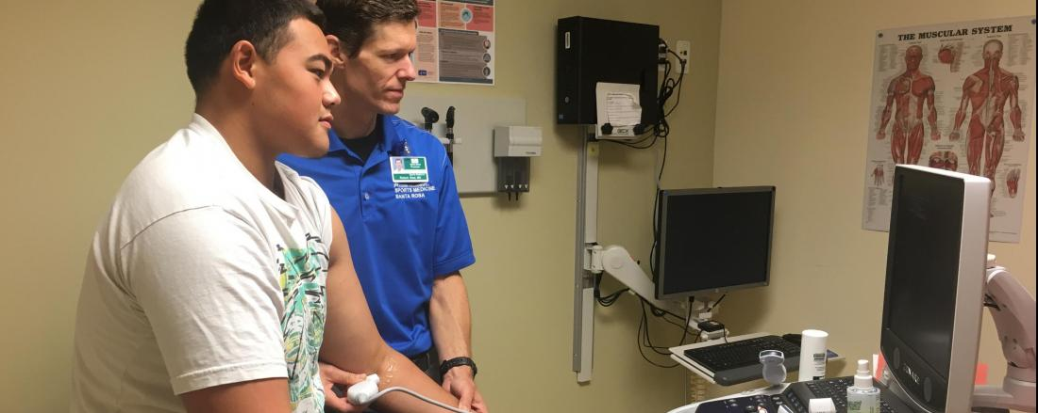
Not Just for Those Aspiring to be Certified Athletic Trainers
Those majoring/interested in:
Coaching
Personal training
Nursing
Pre-Med
Pre-PT
Chiropractic

Slide 24
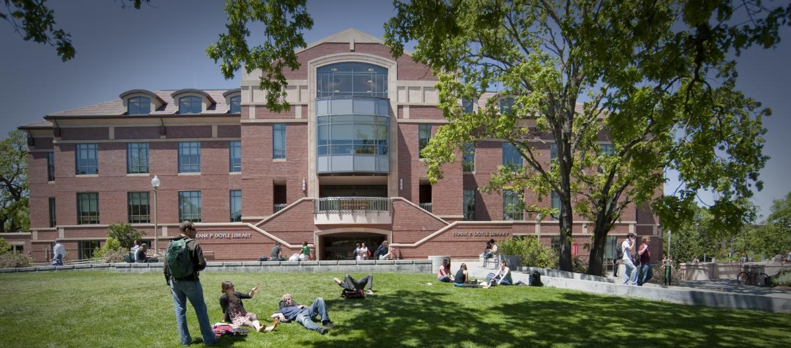
Why SRJC?
History of successful transfer to accredited athletic training curriculum programs
3000 sq. ft. state-of-the-art facility
A great deal of hands-on experience
High-caliber teams and athletes

Slide 25
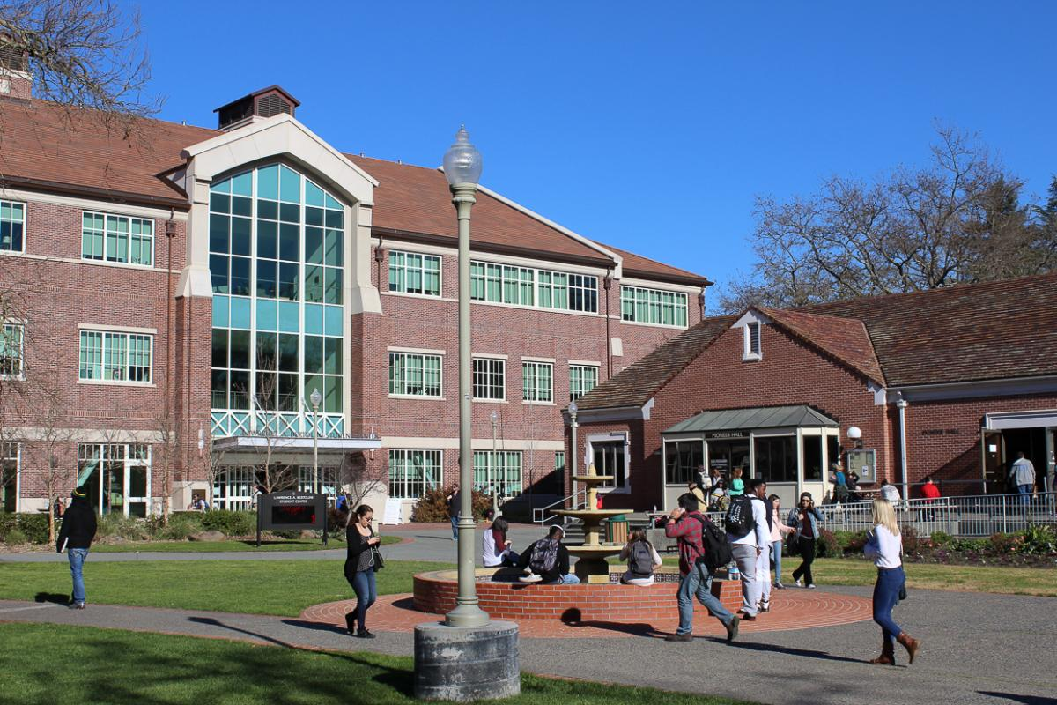
Why SRJC? (continued)
One of nation’s premier community colleges
Beautiful campus
Excellent facilities
Small class sizes

Slide 26
I’m curious. How do I find out more?
Tour the campus
Visit our facility
Job shadow our ATCs and athletic training students

Slide 27
Monica Ohkubo
mohkubo@santarosa.edu
(707) 527-4323

