Slide 1
Chp 11 The Hip and Thigh
Kines 80

Slide 2
Hip Joint Movements
Flexion Sagittal
Extension
Adduction Frontal
Abduction
Internal Rotation Transverse
External Rotation
Circumduction
BALL AND SOCKET JOINT

Slide 3
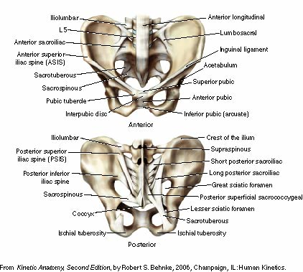
Pelvic Landmarks
Review anatomical landmarks
Innominate bone
Acetabulum
Hip Joint
Triaxial/Ball & Socket
6 fundamental mvmts

Slide 4
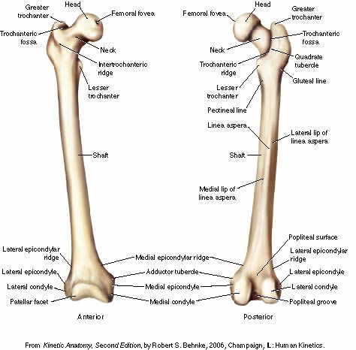
Femur
Bone type
Long bone
Epiphysis
Epiphyseal plate
Cartilage
Maturity
injuries

Slide 5
Acetabulofemoral Joint

Slide 6
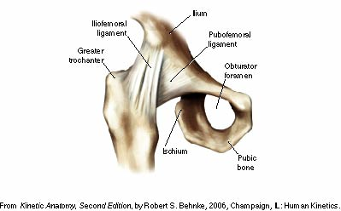
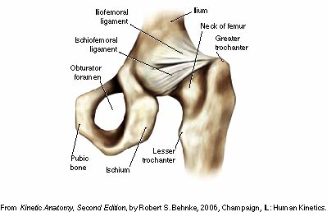
Ligaments

Slide 7
Muscles
Hip flexor muscles are used in moving thighs up toward trunk
Hip extensor muscles used eccentrically when pelvis & trunk move downward slowly on the femur and concentrically when trunk is raised on femur (rising to standing position)
In downward phase of knee-bend exercise, movement at hips & knees is flexion
muscles primarily involved - hip & knee extensors in eccentric contraction

Slide 8
Muscles
Muscles involved in hip & pelvic girdle motions depend largely on direction of movement and position of body in relation to earth & gravitational forces
Body part that moves most will be the part least stabilized
Standing on both feet & contracting hip flexors, the trunk & pelvis rotate anteriorly
Lying supine & contracting hip flexors, the thighs move forward into flexion on the stable pelvis

Slide 9
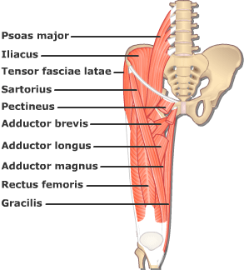
Hip Flexors

Slide 10
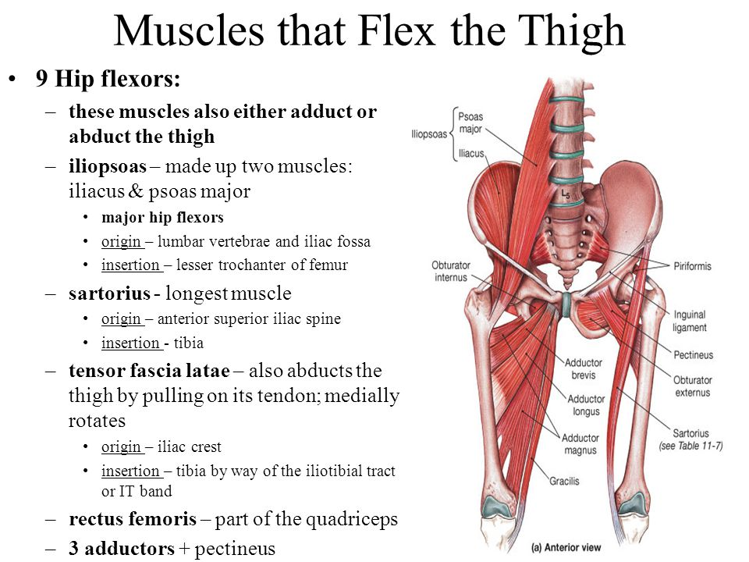
Hip Flexors

Slide 11
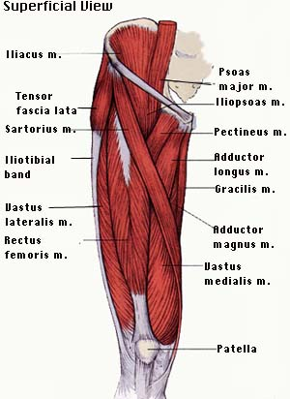
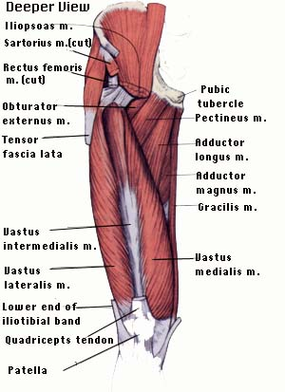
Anterior Muscles

Slide 12
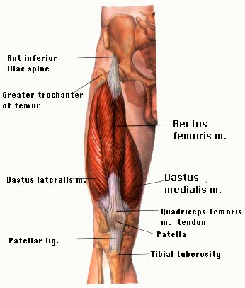
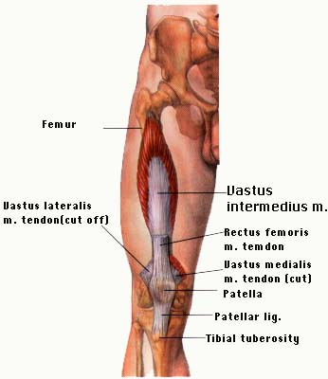
Anterior Deeper
)

Slide 13
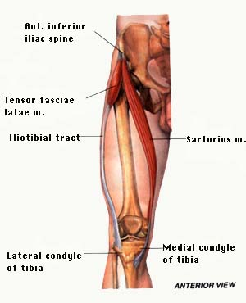
Anterior Deepest

Slide 14
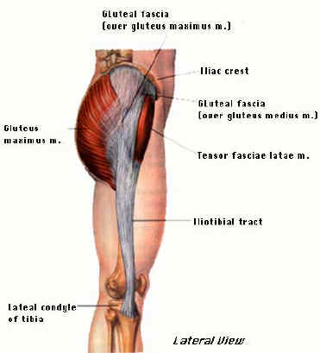
Lateral Muscles

Slide 15
Posterior Muscles

Slide 16
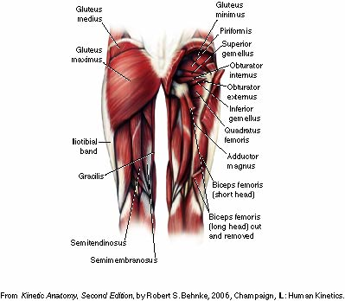
Posterior muscles

Slide 17
Sciatic Nerve

Slide 18
Pififormis Syndrome

Slide 19
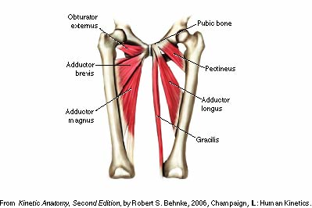
Adductors

Slide 21
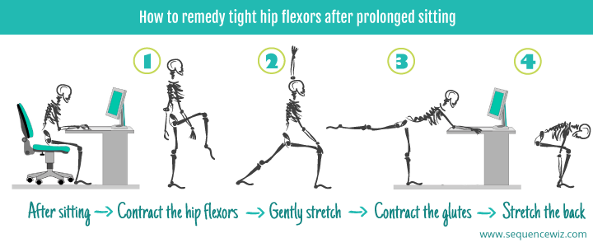

Slide 22
