Slide 1
Thorax

Slide 2
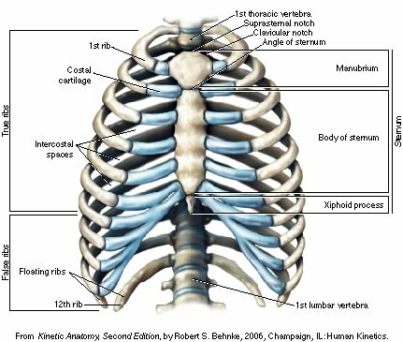
Bones of the Thorax and Landmarks
Anterior View
Thoracic vertebrae
Ribs
Sternum (cardiopulmonary
Resuscitation/xyphoid process)
Thoracic cavity (pleura)
True ribs (1-7) attach directly to sternum by costal cartilage
False ribs (8-10) attach by costal cartilage to the 7th rib cartilage
Floating ribs (11, 12) do not attach to sternum

Slide 3
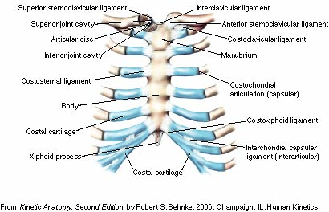
Costochondral joint and anterior ligaments of the thorax
Sternoclavicular joint
Rib-sternum joints
costochondral sprain

Slide 4
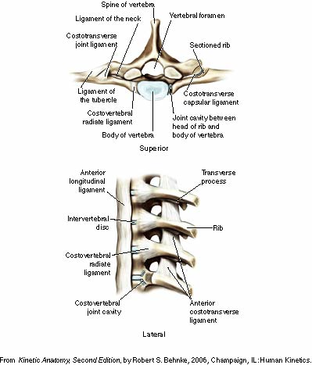
Articulations and ligaments of the thorax
Rib-thoracic vertebra joints

Slide 5
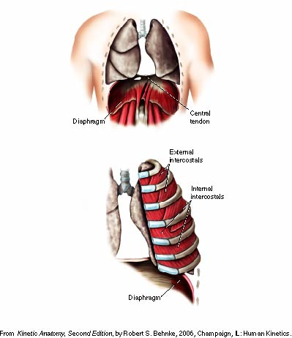
Main respiratory muscles
Quiet
Inspiration
Diaphragm
Internal/external intercostals
Expiration
Forced
Inspiration
Expiration

Slide 6
Muscles of the Chest, Upper Back and Shoulders

Slide 7
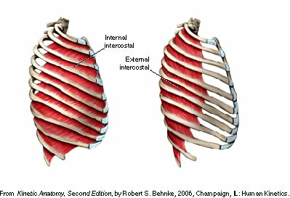
Inter and subcostals
External and internal
Subcostals
Lateral view

Slide 8
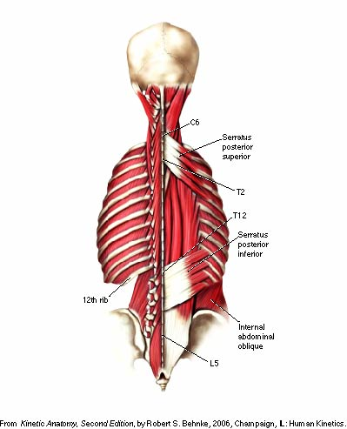
Serratus posterior, superior and inferior portions

Slide 9
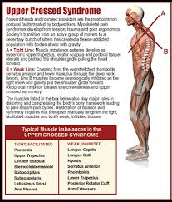

Slide 10
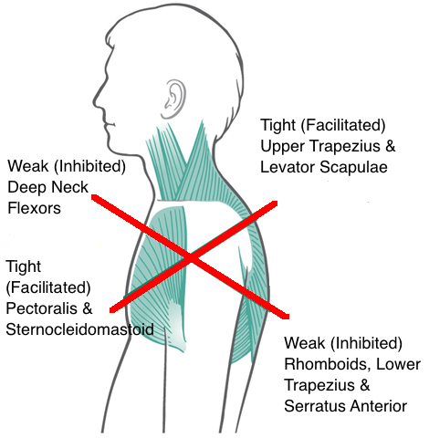

Slide 11
UCS Symptoms
neck pain
headache
weakness in the front of the neck
strain in the back of the neck
pain in the upper back and shoulders
tightness and pain in the chest
jaw pain
fatigue
lower back pain
trouble with sitting to read or watch TV
trouble driving for long periods
restricted movement in the neck and shoulders
pain and reduced movement in the ribs
pain, numbness, and tingling in the upper arms

Slide 12
Evaluating UCS
1. Identify the condition
2. Postural Assessments
Static
Position of ear, shoulders and GH joint
Dynamic
Gait, overhead press, pushing and pulling movements
• Arms falling forward or to side during the descent • Head migrating forward • Elevating or elevated shoulder blades • Elbows flexed or challenged in keeping arms straight

Slide 13
UCS Treatment
Exercise
Relax and lengthen the overactive muscles
Strengthen the underactive muscles
Devise ways to use these muscles synergistically in functional movements
This should increase strength, ROM and allow better movement patterns
BENEFITS
Decrease in pain
Better ROM and functional movements
Stability of upper body
Improved Physical performance

