Slide 1
Chapter 8
The Spinal Column and Pelvis

Slide 2
The Trunk and Spinal Column
Vertebral column – complex
  24 intricate & complex articulating vertebrae
  31 pairs of spinal nerves
  most complex part of body other than CNS
Abdominal muscles
  some sections linked by fascia & tendinous bands
  do not attach from bone to bone
Many small intrinsic muscles act on head, vertebral column, & thorax
  assist in spinal stabilization or respiration
  too deep to palpate

Slide 3
Bones
Normal curves within moveable spine
  Thoracic & sacral
  Cervical & lumbar
  Spinal curves enable it to absorb blows & shocks
Vertebrae increase in size from cervical to lumbar region due to lower back having to support more weight

Slide 4
Bones
24 articulating & 9 fused vertebrae
  7 cervical (neck) vertebrae
  12 thoracic (chest) vertebrae
  5 lumbar (lower back) vertebrae
  5 sacrum (posterior pelvic girdle) vertebrae
  4 coccyx (tail bone) vertebrae
First 2 cervical vertebrae - shapes allow for extensive rotary movements of head to side, as well as forward & backward movement

Slide 5
Bones
First 2 cervical vertebrae - atlas & axis
Vertebrae C2 through L5 - similar architecture
  body - anterior bony block
  central vertebral foramen for spinal cord
  transverse process projecting out laterally
  spinous process projecting posteriorly

Slide 6
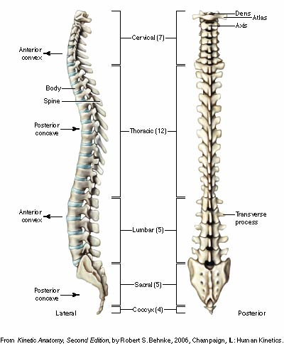
Lateral and Posterior

Slide 7
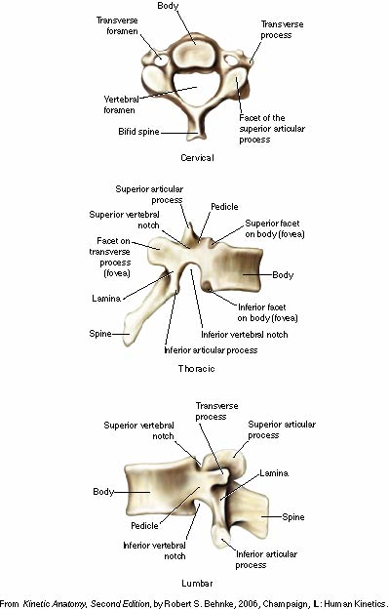
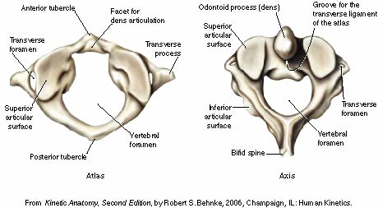
DIFFERENCES IN VERTEBRAL SECTIONS

Slide 8
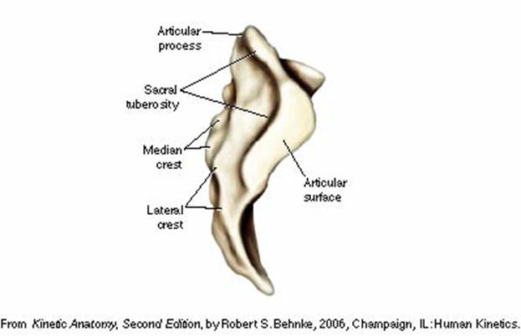
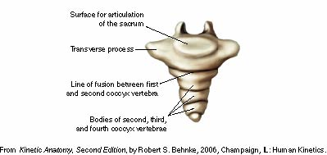
Sacrum, lateral view
Coccyx, anterior view

Slide 9
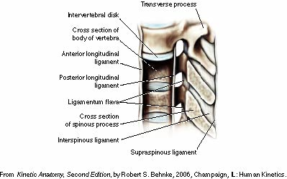
Spinal Column Ligaments

Slide 10
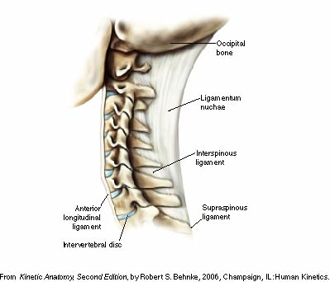
Intervertebral Disc

Slide 11
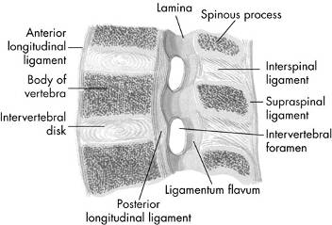
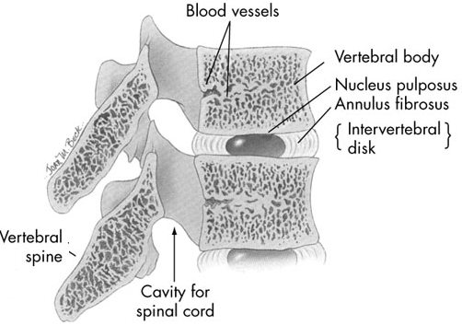
Joints
  Intervertebral disks
    between & adhering to articular cartilage of vertebral bodies
    annulus fibrosus - outer rim of dense fibrocartilage
    nucleus pulposus - central gelatinous, pulpy substance
    compressed elastic material
    allows compression in all
    directions along with torsion
    become less resilient with age, injury, or improper use, resulting
    in a weakened annulus fibrosus

Slide 12
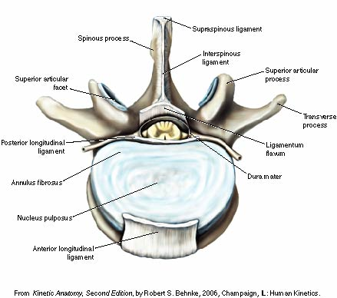
The Intervertebral Disc

Slide 13
COMMON CONDITIONS
Lordosis - increased anterior curve of lumbar & cervical curves (swayback)
Kyphosis - increased posterior curve of thoracic curve (hunchback, round shoulders)
Lumbar kyphosis - reduction of normal lordotic curve, resulting in a flat-back appearance
Scoliosis – excessive lateral curvatures or sideward deviations of spine

Slide 14
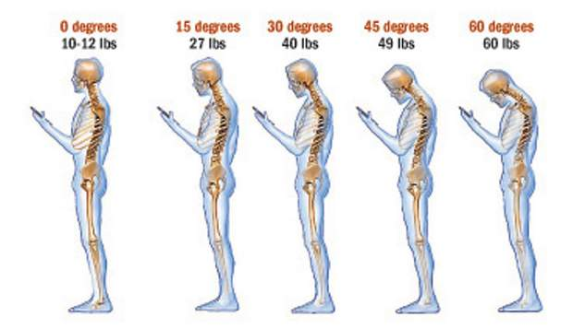

Slide 15
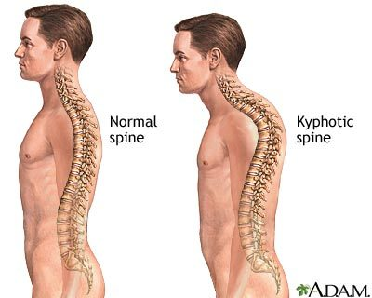
40-45 degrees of rounding
Hyper - KYPHOSIS
Hunchback
Round back
Causes:
Tight muscles:
Weak muscles:
Treatment:
Notes:
developmental problems; degenerative diseases, such as arthritis of the spine; osteoporosis with compression fractures of the vertebrae; or trauma to the spine. Types:
Postural – slouching, girls, no pain

Slide 16
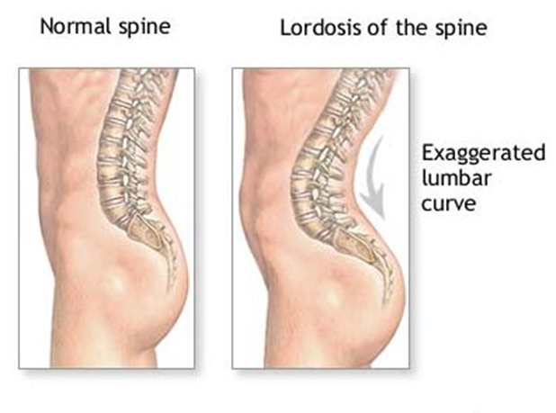
Hyper - Lordosis
80% percent of all hyper -lordosis cases have decreased heart, lung, and cardiovascular capacity
Causes:
Tight muscles:
Weak muscles:
Treatment:
Notes:
Lumbar hyperlordosis
Swayback
Anterior curve
Convex

Slide 17
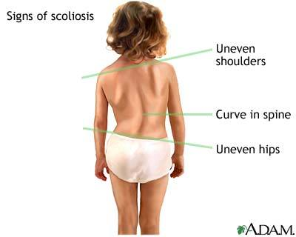
Scoliosis - scoliosis is a structural imbalance of the body as a whole.
Contributes to:
Causes:
Tight muscles:
Weak muscles:
Treatments:
Notes:
Causes: posture, inactivity, sedentary . The spinal imbalance affects the arms, legs, head pelvis, and rib cage as well as the rest of the body.
Contributes to: headaches, insomnia, back pain, shallow breathing and sciatica

Slide 18
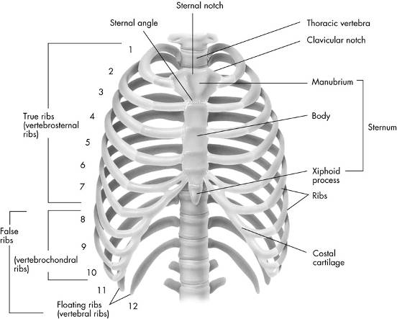
Bones
12 pairs of ribs
  7 pairs of true ribs attach directly to sternum
  5 pairs of false ribs
    3 pairs attach indirectly to sternum
    2 pairs of floating ribs - ends are free

Slide 19
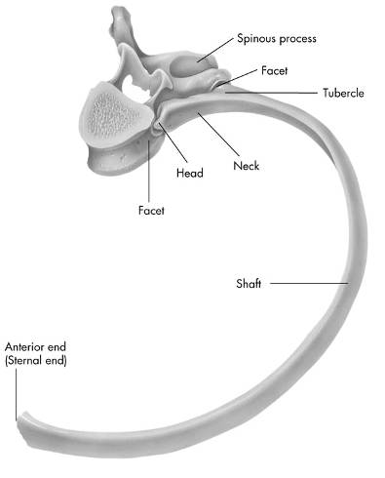
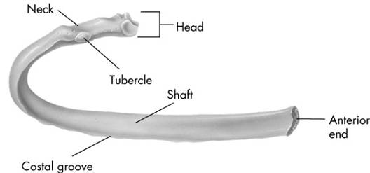
Bones
  All ribs attached posteriorly to thoracic vertebrae
Sternum
  Manubrium, body of sternum, & xiphoid process

Slide 20
Bones
Key bony landmarks
  muscles of neck
    mastoid process
    transverse processes of cervical spine
    spinous processes of cervical spine
    spinous processes of upper 4 thoracic vertebrae
    manubrium of sternum
    medial clavicle

Slide 21
Bones
Key bony landmarks
  posterior muscles of spine
    spinous processes of thoracic spine
    transverse processes of thoracic spine
    posterior ribs
  anterior trunk muscles
    borders of lower 8 ribs
    costal cartilages of ribs
    iliac crest
    pubic crest

Slide 22
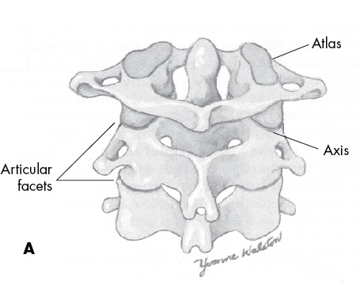
Joints
Atlantooccipital joint
  first joint
  formed by occipital condyles of skull sitting on articular fossa of the 1st vertebra
  allows capital flexion & extension
Atlantoaxial joint
  Atlas (C1) sits on axis (C2)
  Most cervical rotation occurs here
  Trochoid or pivot-type joint
  Most mobile joint of any two vertebrae

Slide 23
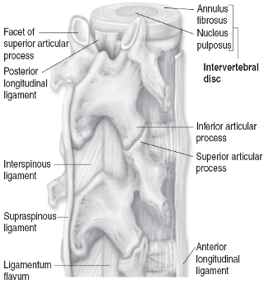
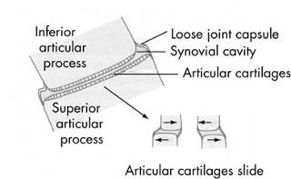
Joints
Minimal movement between any 2 vertebrae (except atlantoaxial joint)
  Cumulative effect of combined movement from several vertebrae allows for substantial movements
  Vertebral articulations classified as arthrodial
  Gliding-type joints due to limited gliding movements
  Gliding movement between superior & inferior articular processes of facets joints

Slide 24
Joints
Most movement occurs in cervical & lumbar
Some slight thoracic movement
Movements of head
  Movement between cranium & 1st cervical and within other cervical vertebrae
  Referred as cervical movements
Trunk movements
  Lumbar motion terminology describes combined motion in thoracic & lumbar

Slide 25
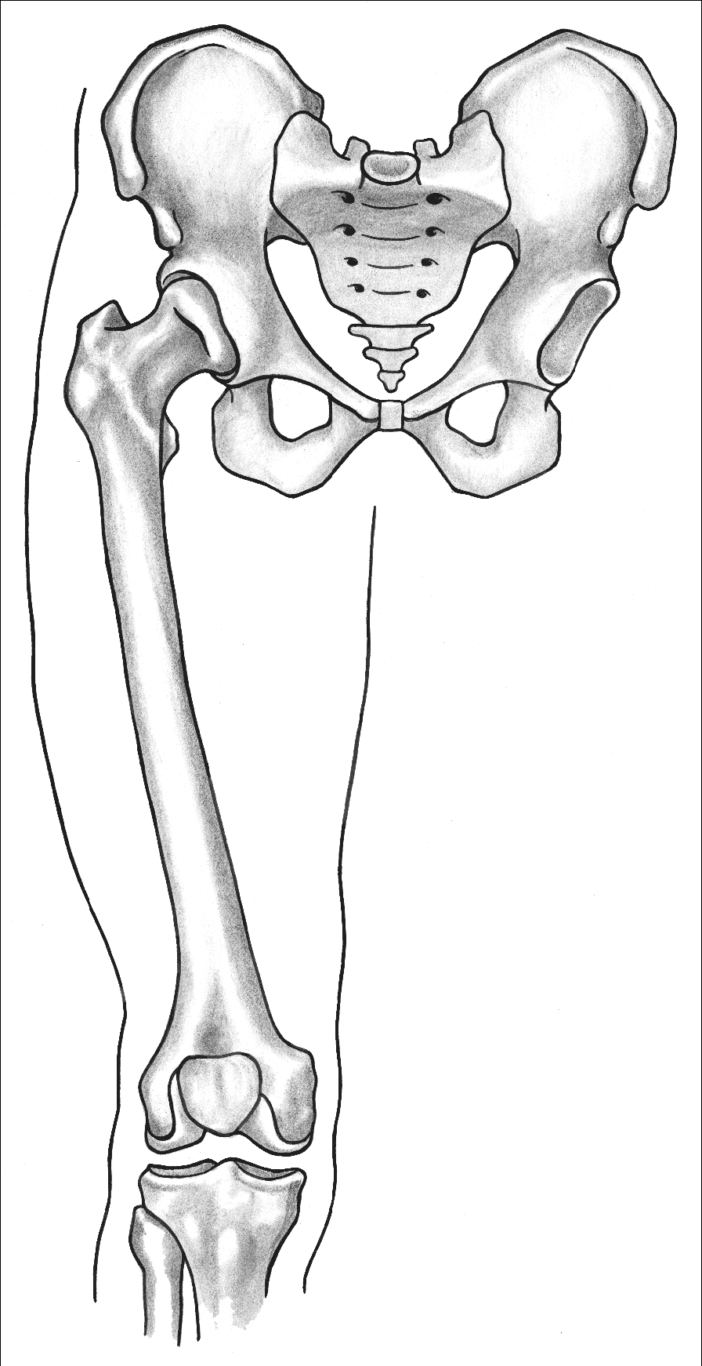
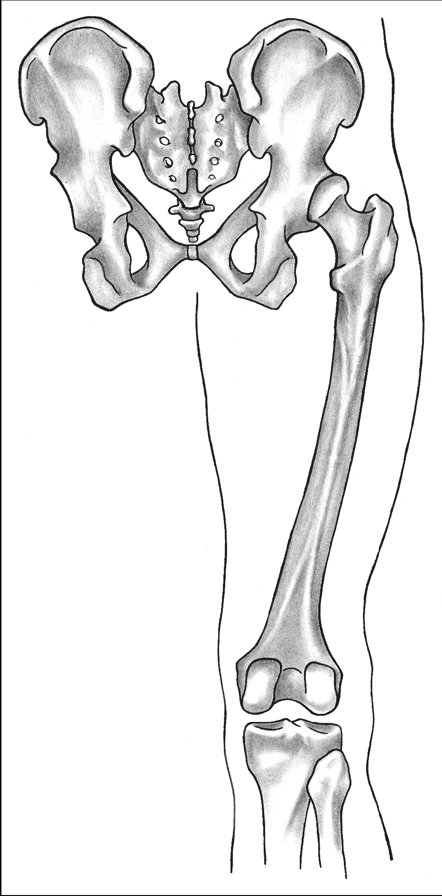
Joints
Anteriorly
  Two pelvic bones join to form symphysis pubis, amphiarthrodial
Posteriorly
  Sacrum is between the 2 pelvic bones & forms the sacroiliac joints
  Strong ligaments unite these bones to form rigid, slightly movable joints

Slide 26
Trunk & Spinal Column Muscles
Large abdominal muscles - lumbar movements
  Rectus abdominis, external oblique abdominal, internal oblique abdominal & quadratus lumborum
Numerous small muscles
  Many originate on one vertebra & insert on next vertebra
  Important in functioning of spine
Grouped according to location & function

Slide 27
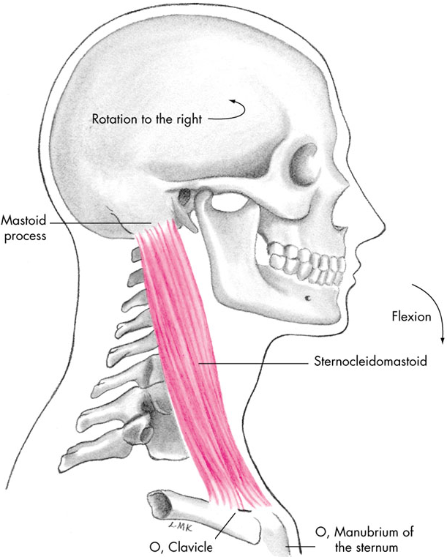
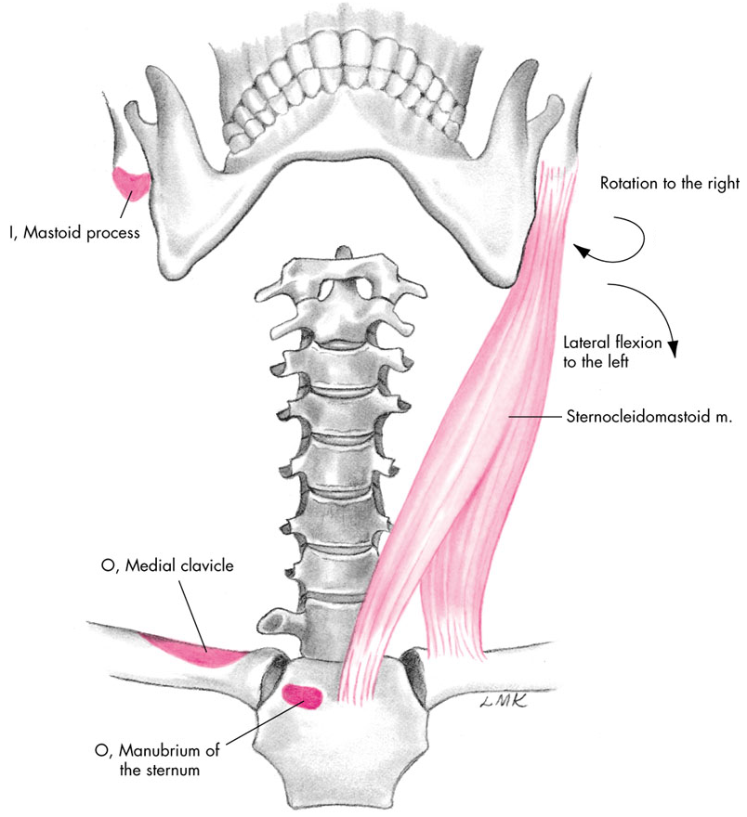
Cervical Flexion
Agonists
  Sternocleidomastoid

Slide 28
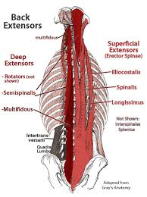
Lumbar Extension
Agonists
(groups)
  Iliocostalis
  Semispinalis
  Spinalis
  Longissimus
  Erector Spinae
  Multifidus
  QL

Slide 29
Trunk & Spinal Column Muscles
Abdominal wall muscles do not go from bone to bone but attach into an aponeurosis (fascia) around rectus abdominis area
  external oblique abdominal, internal oblique abdominal & transversus abdominis

Slide 30
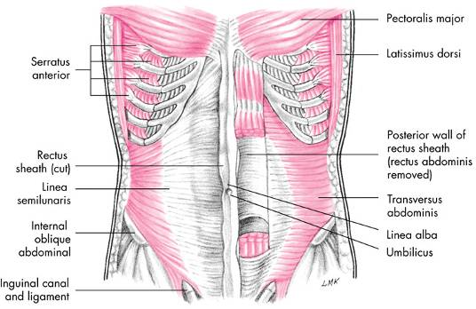
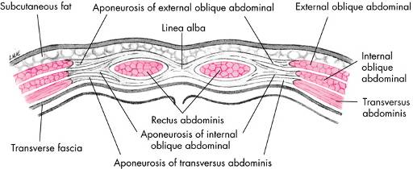
Muscles of the Abdominal Wall
Rectus abdominis
External oblique abdominal
Internal oblique abdominal
Transverse abdominis

Slide 31
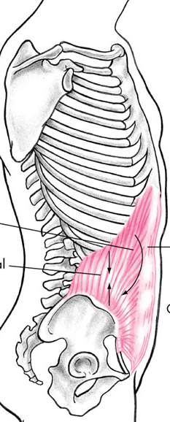
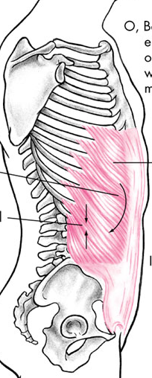
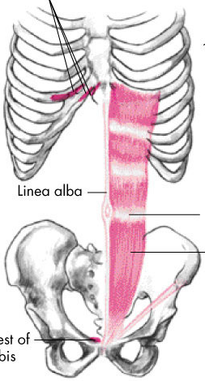
Lumbar Flexion
Agonists
  Rectus abdominis
  External oblique abdominal
  Internal oblique abdominal
Notes:
000000

Slide 32
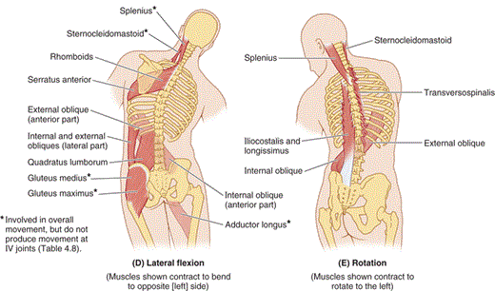
Lumbar Rotation
Lateral Flexion
  IO, EO
  QL, Erector Sp
  Rotation
    IO, EO

Slide 33
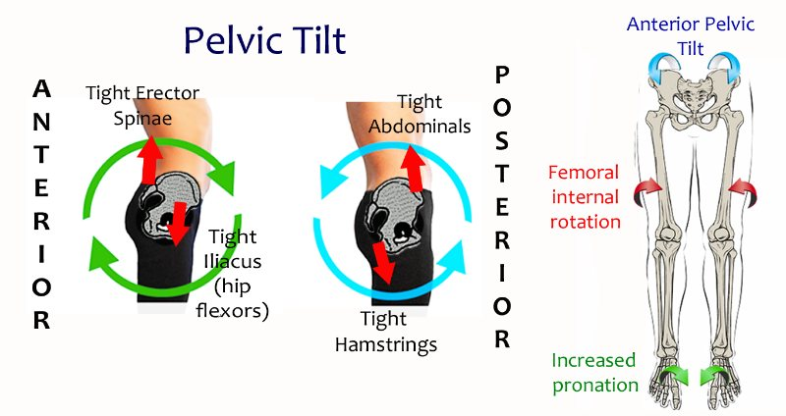

Slide 34
