Slide 1
Chapter 5
The Wrist and Hand

Slide 2
Objectives
List the bones of the wrist and hand and the significant anatomical landmarks for attachment
Identify the joints formed as a result of the ligamentous structures that join the bones together
Explain the movements possible by the wrist, fingers and thumb
Identify the muscles originating within (intrinsic) the wrist, hand and thumb involved in movement
Identify the muscles originating outside of (extrinsic) the wrist, hand and thumb involved in movement

Slide 3
Wrist & hand
Many sports require precise functioning of wrist and hand.
Archery, bowling, golf, baseball, tennis, basketball, volleyball, etc.
Joint actions
  Flexion, extension, abduction, adduction, opposition reposition
  29 bones (including radius and ulna)
  8 carpals, 5 metacarpals, 14 phalanges
  25 joints
  30 muscles
  18 intrinsic

Slide 4
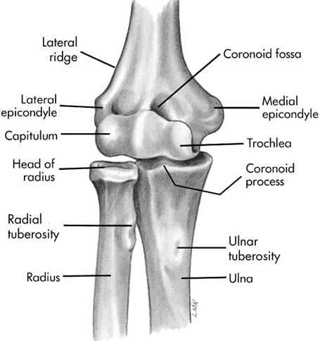
bones
Medial epicondyle, medial condyloid ridge, & coranoid process - origin for many wrist & finger flexors
Lateral epicondyle & lateral supracondylar ridge - origin for many wrist & finger extensors

Slide 5
Carpals
Eight carpal bones
  scaphoid (boat-shaped) or navicular
Scaphoid most often injured
  From falling on outstretched hand
  Often dismissed as a sprain. Significant problem if not recognized & treated properly. Usually long period of precise immobilization or surgery

Slide 6
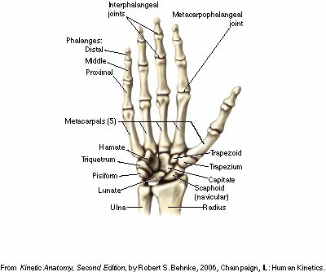
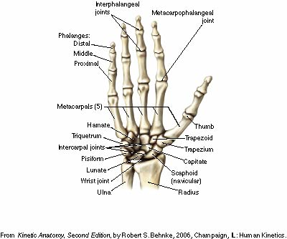
Bones of the hand
Carpals, Metacarpals, Phalanges

Slide 7
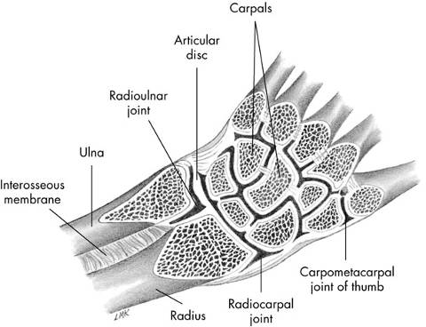
joints
Wrist joint
  condyloid-type joint
  allows flexion, extension, abduction, & adduction
  motion occurs primarily between distal radius & proximal carpal row (scaphoid, lunate, & triquetrum)
  known as radiocarpal jt.

Slide 8
Joints
Radioulnar
Radiocarpals
Midcarpals
Intercarpals
Carpometacarpals - CMC
Metacarpalphalangeal - MCP
Interphalangeal – IP, DIP. PIP

Slide 9
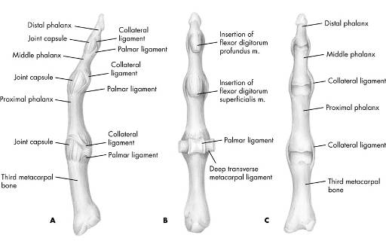
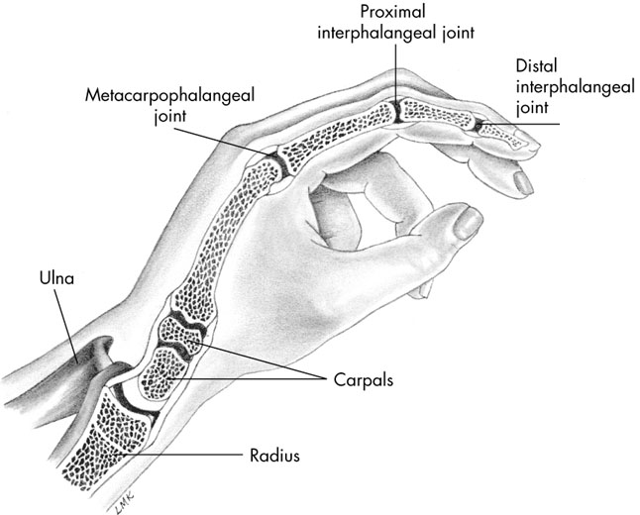
joints
Each finger has 3 joints
  Metacarpophalangeal (MCP) joints
  Proximal interphalangeal (PIP) joints
  Distal interphalangeal (DIP) joints

Slide 10
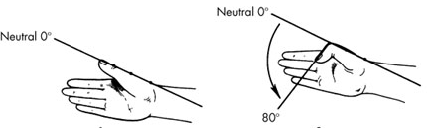
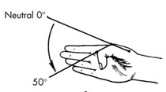
joints
Thumb has 2 joints
  Metacarpophalangeal (MCP) joint
Full extension into 40 to 90 degrees of flexion
    Ginglymus
  Interphalangeal (IP) joint
    Flex 80 to 90 degrees
    Ginglymus

Slide 11

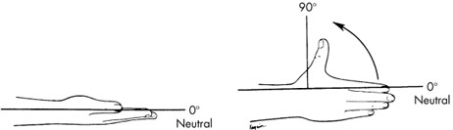
joints
Thumb has 2 joints
  Carpometacarpal (CMC) joint of thumb
    Unique saddle-type joint
    50 to 70 degrees of abduction
    Flex 15 to 45 degrees & extend 0 to 20 degrees

Slide 12
movements
Wrist
  Flexion & extension
  Abduction & adduction
Fingers
  Flex & extend
  MCP joints also abduct & adduct

Slide 13
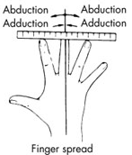
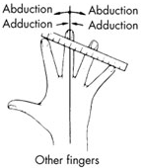
movements
Middle phalange is reference point to differentiate abduction & adduction
  Thumb, index & middle fingers abduct when they move laterally toward radial side of hand
  Ring & little fingers adduction when they move medially toward ulnar side of hand
  Medial movement of thumb, index & middle fingers toward ulnar side of hand is adduction
  Lateral movement of ring & little finger toward radial side of hand is abduction

Slide 14
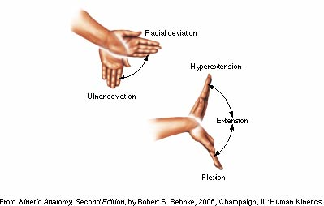
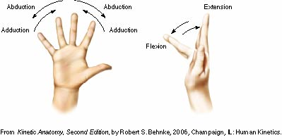
movements
Which Plane?
Where is medial?

Slide 15
muscles
Extrinsic muscles of wrist & hand grouped according to function & location
6 muscles move wrist but not fingers & thumb
  3 wrist flexors
    flexor carpi radialis
    flexor carpi ulnaris
    palmaris longus
  3 wrist extensors
    extensor carpi radialis longus
    extensor carpi radialis brevis
    extensor carpi ulnaris

Slide 16
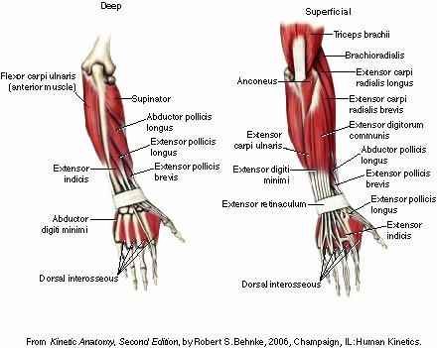
Posterior muscles
Wrist and Hand
Superficial & Deep

Slide 17
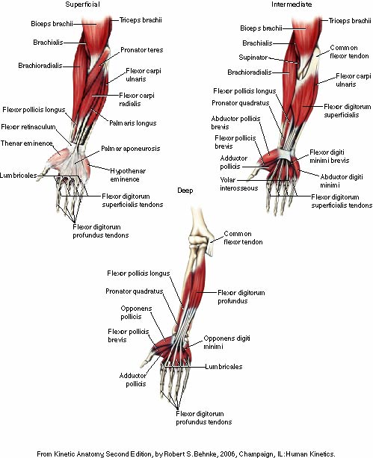
Anterior muscles
Common Flexor Tendon
Flexor Carpi Radialis
Flexor Carpi Ulnaris
Flexor Digitorum Superficialis
Palmaris Longus
Flexor Digitorum Profundus

Slide 18
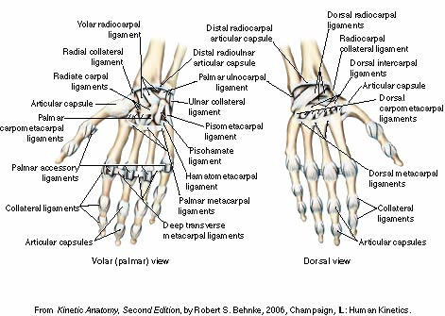
LIGAMENTS
Capsular
Volar Radiocarpal
Dorsal Radiocarpa
Collateral

Slide 19
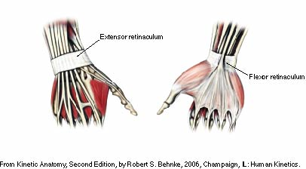
Flexor & extensor retinacula
Dorsal
Ventral
Carpal Tunnel Syndrome

Slide 20
Carpal tunnel
Carpal tunnel syndrome
  Swelling & inflammation can cause increased pressure in carpal tunnel resulting in decreased function of median nerve leading to reduced motor & sensation function in its distribution
  Particularly common with repetitive use of the hand and wrist in manual labor and clerical work such as typing and keyboarding
  Often, slight modifications in
  work habits and hand & wrist
  positions during these activities
  can be preventative
  Flexibility exercises for the wrist
  & finger flexors may be helpful

Slide 21
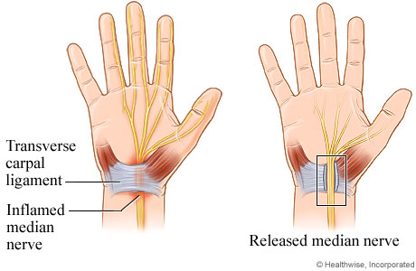
CARPAL TUNNEL SURGERY

Slide 22
Activity
Holding your hand in the anatomical position, spread your fingers apart. What movements occurred at the
  A. index finger MP joint (by what muscle)?
  B. middle finger MP joint (by what muscle)?
  C. ring finger MP joint (by what muscle)?
  D. little finger MP joint (by what muscle)?

