Slide 1
KINES 80
Chapter 4

Slide 2
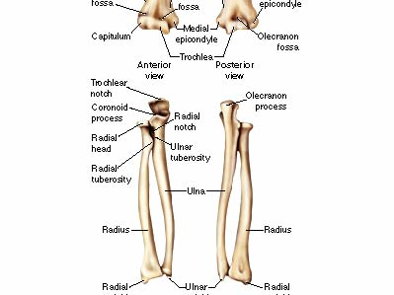
Bones of the Elbow and Forearm
Bony landmarks for the radius, ulna and humerus. Yes, you need to know these. Looks like a lot, but it is slightly repetitive.

Slide 3
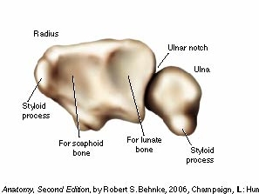
Facets on the distal surface of the radius

Slide 4
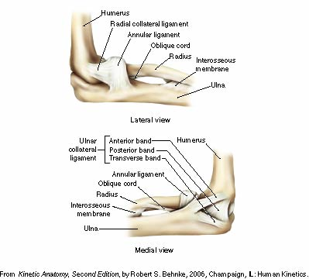
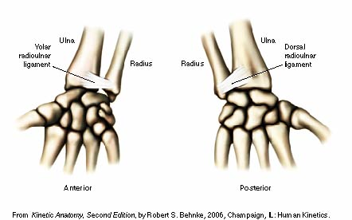
Major ligaments of elbow and distal radioulnar joint

Slide 5
The Elbow & Radioulnar Joints
Most upper extremity movements involve the elbow & radioulnar joints
Usually grouped together due to close anatomical relationship
Elbow joint movements may be clearly distinguished from those of the radioulnar joints
Radioulnar joint movements may be distinguished from those of the wrist

Slide 6
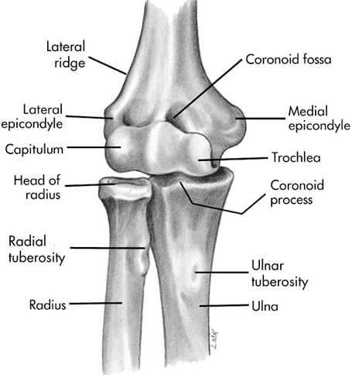
Bones
Ulna is much larger proximally than radius
Radius is much larger distally than ulna
Scapula & humerus serve as proximal attachments for muscles that flex & extend the elbow
Ulna & radius serve as distal attachments for these same muscles

Slide 7
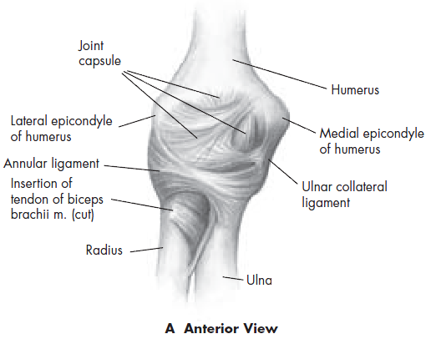
Joints
Ginglymus or hinge-type joint
Allows only flexion & extension
2 interrelated joints
  humeroulnar joint
  radiohumeral joints

Slide 8
Joints
Elbow motions
  primarily involve movement between articular surfaces of humerus & ulna
  specifically humeral trochlear fitting into ulna trochlear notch
  radial head has a relatively small amount of contact with capitulum of humerus
  As elbow reaches full extension, olecranon process is received by olecranon fossa
    increased joint stability when fully extended

Slide 9
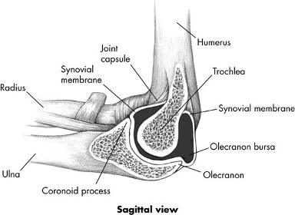
Joints
As elbow flexes 20 degrees or more, its bony stability is unlocked, allowing for more side-to-side laxity
Stability in flexion is more dependent on the lateral (radial collateral ligament) & the medial or (ulnar collateral ligament)

Slide 10
Joints
Radioulnar joint
  Joint between shafts of radius & ulna held tightly together between proximal & distal articulations by an interosseus membrane (syndesmosis)
    substantial rotary motion between the bones

Slide 11
Joints
Synergy between glenohumeral, elbow, & radioulnar joint muscles
  As the radioulnar joint goes through its ROM, glenohumeral & elbow muscles contract to stabilize or assist in the effectiveness of movement at the radioulnar joints
  Ex. when tightening a screw with a screwdriver which involves radioulnar supination, we tend to externally rotate & flex the glenohumeral & elbow joints, respectfully

Slide 12
Joints
Synergy between glenohumeral, elbow, & radioulnar joint muscles
  Conversely, when loosening a tight screw with pronation, we tend to internally rotate & extend the elbow & glenohumeral joints, respectfully
  we depend on both the agonists and antagonists in the surrounding joints to assist in an appropriate amount of stabilization & assistance with the required task

Slide 13
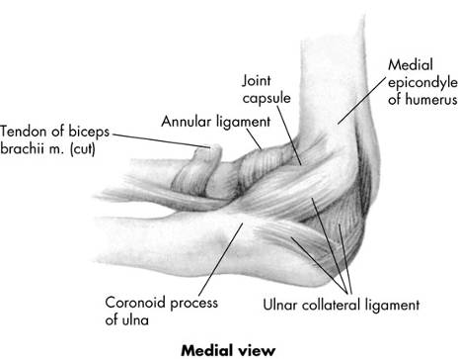
Joints
Ulnar collateral ligament is critical in providing medial support to prevent elbow from abducting when stressed in physical activity
  Many contact sports & throwing activities place stress on medial aspect of joint, resulting in injury

Slide 14
Fundamental Movements and Muscles of the Elbow and Forearm
Flexion (anterior muscles)
Brachialis, brachioradialis, biceps brachii
Extension (posterior muscles)
Triceps brachii, anconeus
Supination
Biceps brachii, supinator
Pronation
Pronator quadratus, pronator teres

Slide 15
Movements
Pronation
  internal rotary movement of radius on ulna that results in hand moving from palm-up to palm-down position
Supination
  external rotary movement of radius on ulna that results in hand moving from palm-down to palm-up position

Slide 16
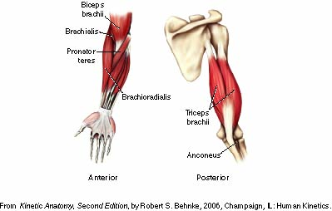
Muscles of the elbow
Anterior:
Brachialis, brachioradialis – 1 joint
movement
Biceps brachii – name movements
at 3 joints
Posterior:
Triceps brachii – movements at
which joints
Anconeus – elbow joint only

Slide 17
Muscles
Radioulnar pronators
  Pronator teres
  Pronator quadratus
  Brachioradialis
Radioulnar supinators
  Biceps brachii
  Supinator muscle
  Brachioradialis

Slide 18
Muscles
“Tennis elbow" - common problem usually involving extensor digitorum muscle near its origin on lateral epicondyle
  known lateral epicondylitis
  associated with gripping & lifting activities
Medial epicondylitis
  somewhat less common
  known as golfer's elbow
  associated with medial wrist flexor & pronator group near their origin on medial epicondyle
  Both conditions involve muscles which cross elbow but act primarily on wrist & hand

Slide 19
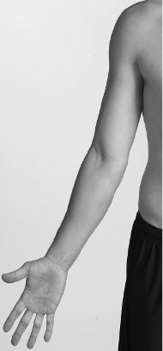
Muscles
Anterior
  Primarily flexion & pronation
    Biceps brachii
    Brachialis
    Brachioradialis
    Pronator teres
    Pronator quadratus

Slide 20
Muscles
Posterior
  Primarily extension & supination
    Triceps brachii
    Anconeus
    Supinator

Slide 21
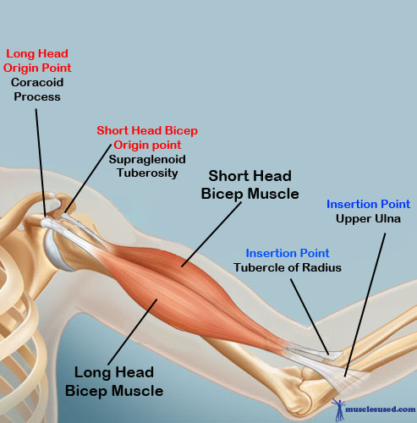
Bicep Brachii Origin and Insertion

Slide 22
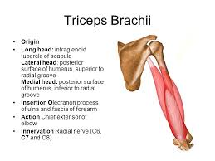
Triceps Brachii Origin and Insertion

