Slide 1
KINES 80
Chapter 1
Structures

Slide 2
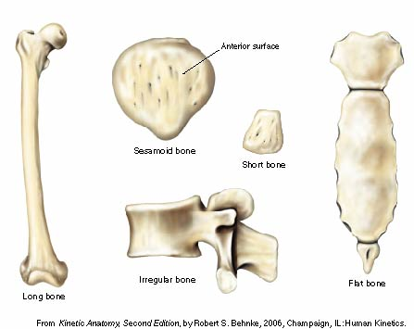

Slide 3
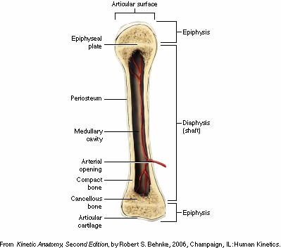

Slide 4
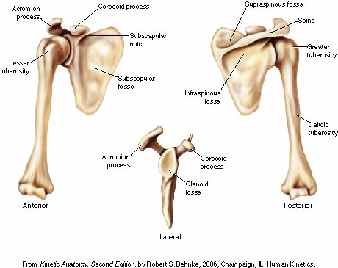

Slide 5
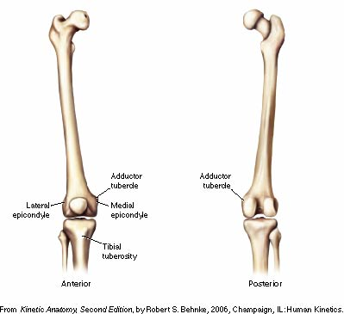

Slide 6
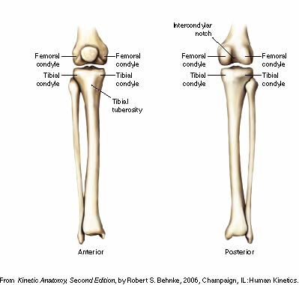

Slide 7
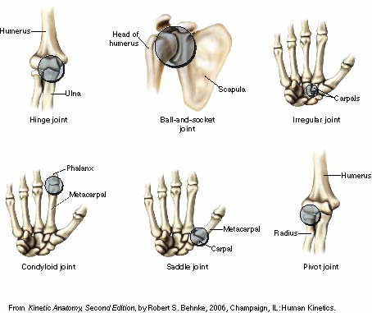

Slide 8
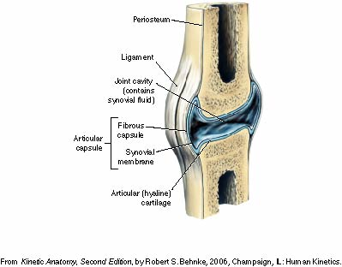

Slide 9
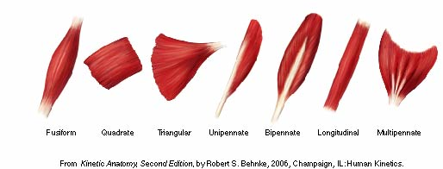

Slide 10
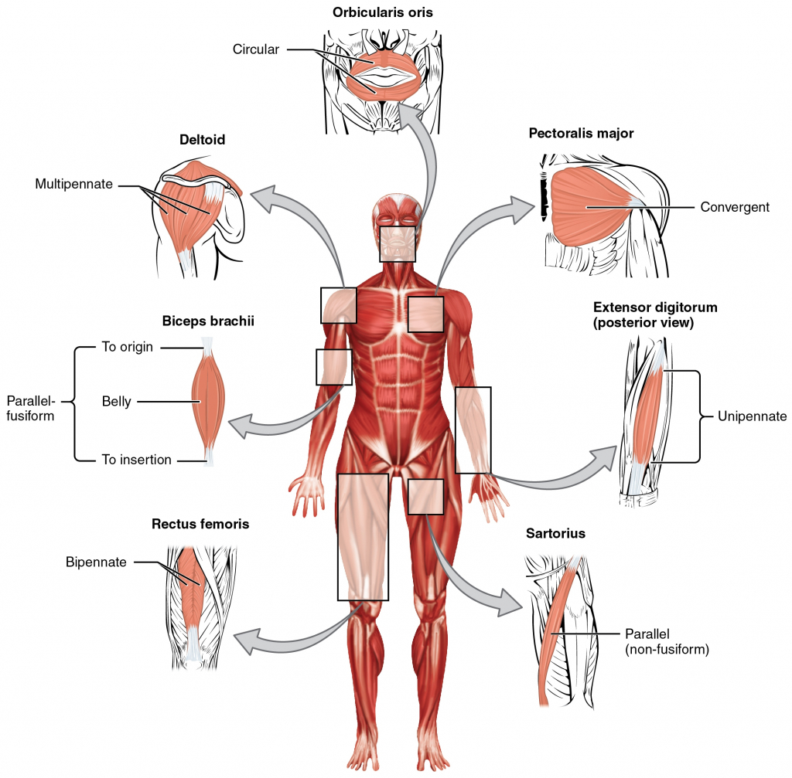

Slide 11
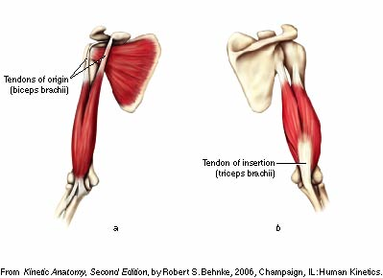

Slide 12
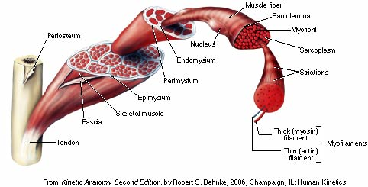

Slide 13
Muscle Nomenclature
Muscles are usually named due to
visual appearance
anatomical location
function
Shape – deltoid, rhomboid
Size – gluteus maximus, teres minor
Number of divisions – triceps brachii
Direction of its fibers – external abdominal oblique

Slide 14
Muscle Nomenclature
Location - rectus femoris, palmaris longus
Points of attachment - coracobrachialis, extensor hallucis longus, flexor digitorum longus
Action - erector spinae, supinator, extensor digiti minimi
Action & shape – pronator quadratus

Slide 15
Muscle Tissue Properties
Irritability or Excitability - property of muscle being sensitive or responsive to chemical, electrical, or mechanical stimuli
Contractility - ability of muscle to contract & develop tension or internal force against resistance when stimulated

Slide 16
Muscle Tissue Properties
Extensibility - ability of muscle to be passively stretched beyond it normal resting length
Elasticity - ability of muscle to return to its original length following stretching

Slide 17
Role of Muscles
Agonist muscles
Primary or prime movers, or muscles most involved
Some agonist muscles, because of their relative location, size, length, or force generation capacity, are able to contribute significantly more to the joint movement than other agonists
Assisters or assistant movers
Agonist muscles that contribute significantly less to the joint motion
Consensus among all authorities regarding which muscles are primary movers and which are weak assistants does not exist in every case

Slide 18
Role of Muscles
Antagonist muscles
located on opposite side of joint from agonist
have the opposite concentric action
known as contralateral muscles
work in cooperation with agonist muscles by relaxing & allowing movement
when contracting concentrically perform the opposite joint motion of agonist
Ex. quadriceps muscles are antagonists to hamstrings in knee flexion

Slide 19
Role of Muscles
Stabilizers
surround joint or body part
contract to fixate or stabilize the area to enable another limb or body segment to exert force & move
known as fixators
essential in establishing a relatively firm base for the more distal joints to work from when carrying out movements
Ex. biceps curl
muscles of scapula & glenohumeral joint must contract in order to maintain shoulder complex & humerus in a relatively static position so that the biceps brachii can more effectively perform curls

Slide 20
Role of Muscles
Synergist
assist in action of agonists
not necessarily prime movers for the action
known as guiding muscles
assist in refined movement & rule out undesired motions
helping synergists & true synergists

Slide 21
Uniarticular, biarticular, and multiarticular muscles
Uniarticular muscles
Cross & act directly only on the joint that they cross
Ex. Brachialis
Can only pull humerus & ulna closer together

Slide 22
Uniarticular, biarticular, and multiarticular muscles
Multiarticular muscles act on three or more joints due to the line of pull between their origin & insertion crossing multiple joints
Principles relative to biarticular muscles apply similarly to multiarticular muscles

Slide 23
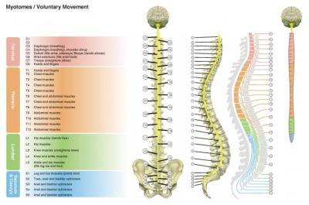
Spinal Nerves and Plexuses

Slide 24
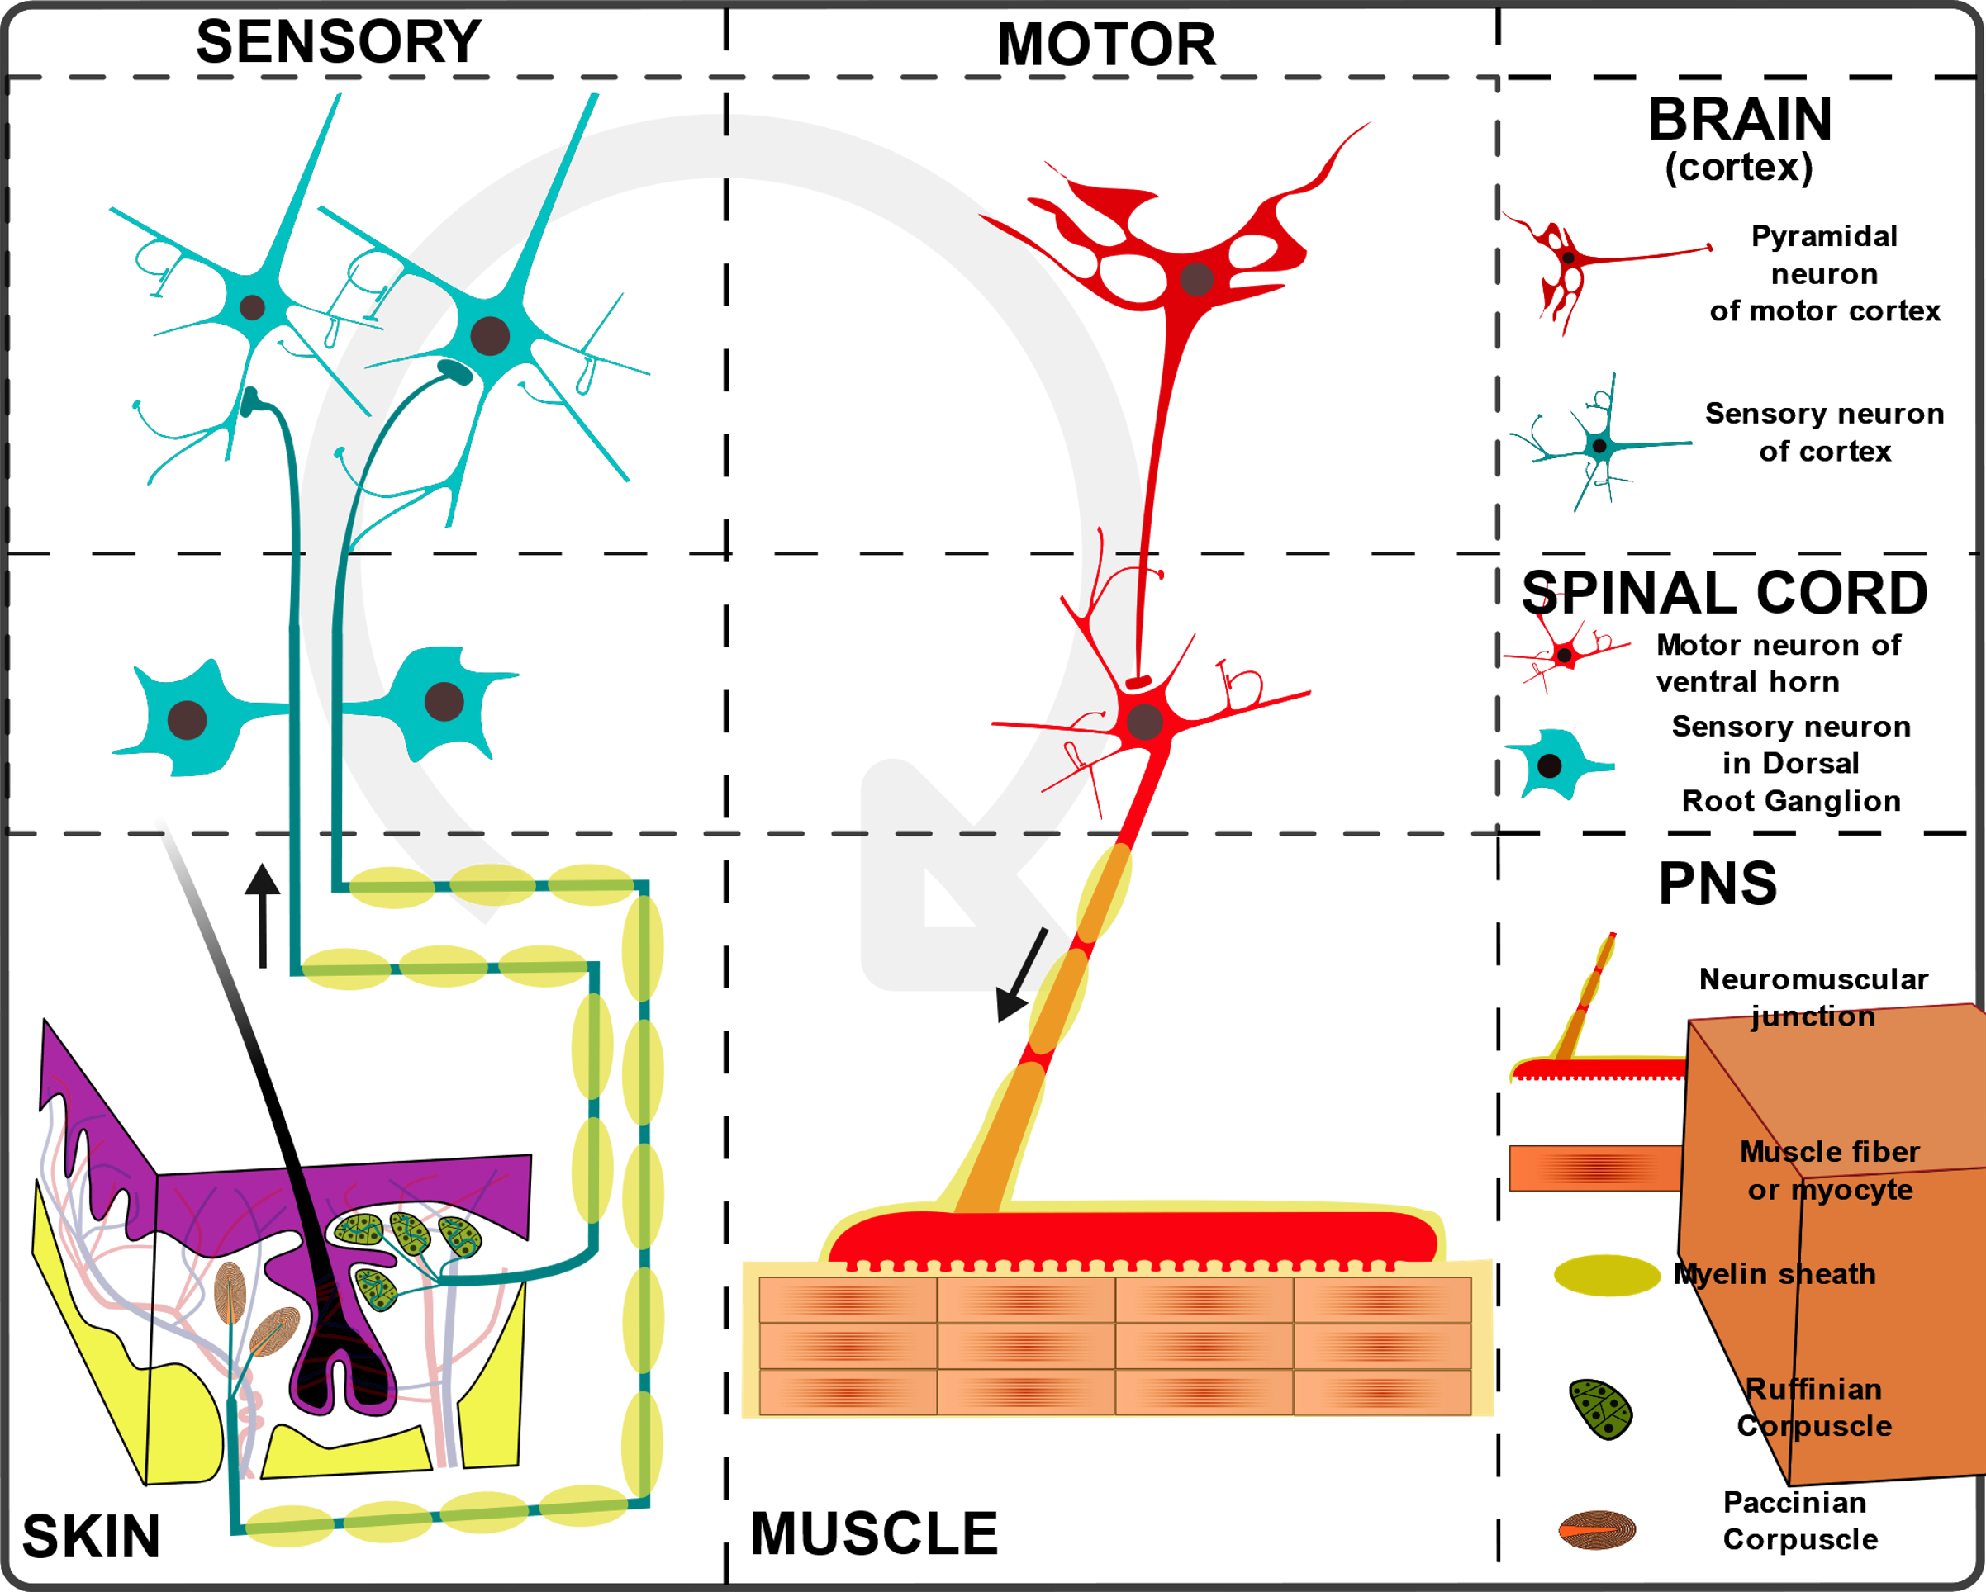
Motor and Sensory Neurons

Slide 25
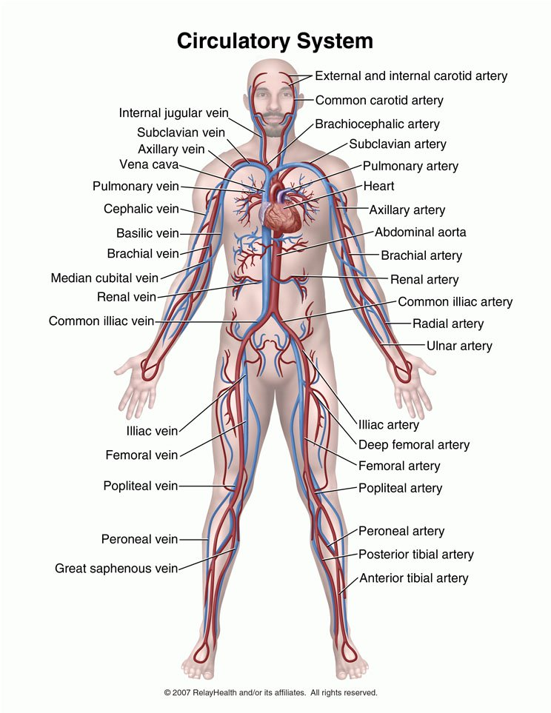
Blood Vessels

