Slide 1
Chapter 9 Fire Characteristics: Solid Combustibles

Slide 2
Objectives
List the three significant differences between the burning of a solid fuel and the burning of gaseous and liquid fuels.
Describe the thermal and chemical processes that result in the ignition and burning of a solid.

Slide 3
Objectives
Describe how char formation and melting occur and how they affect the burning rate.
List the types of combustible solids.
Describe the types of polymers and explain how they gasify.

Slide 4
Objectives
Describe at least four classes of mechanisms by which fire-retardant additives act to modify the ignition and burning of solids.
Discuss the use of calorimetry to measure the heat-release rates of materials and products.

Slide 5
Solid Combustibles
Vigorous burning of solid combustibles has caused huge fires:
Hartford Circus Fire
Apollo I fire
Dupont Plaza Hotel fire
Station and Kiss nightclub fires
Sofa Super Store fire

Slide 6
Solids Versus Gases and Liquids
Three differences of burning a solid fuel versus gaseous and liquid fuels:
Significant chemical change occurs in solids.
Emitted volatiles may not have the same chemistry.
Heat transfer to, from, and within the solid requires consideration of changes in the fuel surface and chemical changes that have occurred below the surface.

Slide 7
Materials and Products
Material
A single substance that can be made of a single chemical component, mixture of chemicals, or nonhomogeneous mixture
Product
A commercially available item composed of one or more materials and not chemically homogeneous

Slide 8
Materials and Products
The burning behavior of products is measured with large-scale tests, while fire properties of materials are determined in bench-scale tests.

Slide 9
Pyrolysis
Pyrolysis = decomposition process for a solid fuel
Oxidative pyrolysis
Anaerobic pyrolysis
Material’s temperature must be high enough for chemical bonds to break
The heat of gasification of a material is required (kJ/g).
Heat of gasification will change as the chemistry of the fuel changes.

Slide 10
Pyrolysis
Solid must have exterior surface heated high enough to produce pyrolysis gases rapidly enough to exceed lower flammability limit in the space above the surface
Composition of pyrolyzate depends on:
Chemistry of solid fuel
Rate of pyrolysis
Availability of oxygen

Slide 11
Pyrolysis
Gasification rate for solid fuel ignition is determined by heating scenario:
Conduction: Heat of gasification might be higher than with radiant heat.
Radiation: Can be more efficient than surface heating
Pyrolysis reaction rates increase rapidly with increasing temperatures.

Slide 12
Ignition to Flaming Combustion
Temperature of 502–750 °F (270–400 °C) is necessary for piloted ignition of most organic solids.
Autoignition if surface sufficiently high temperature
Minimum radiative flux to make a solid ignitable by pilot flame is 10–40 kW/m².

Slide 13
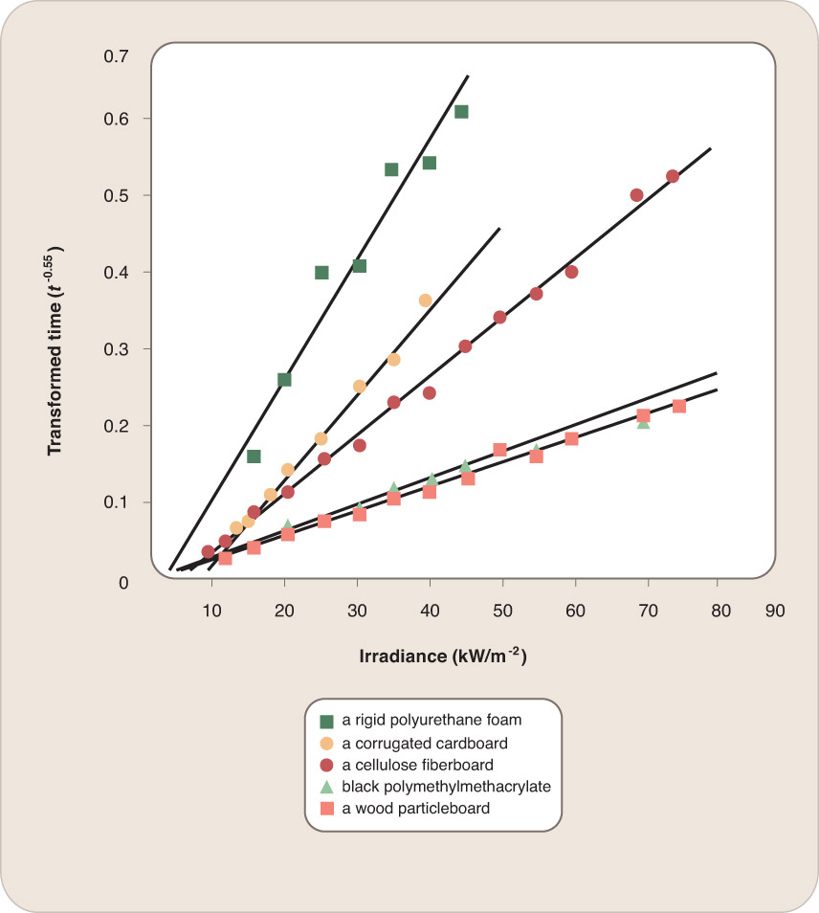
Ignition to Flaming Combustion
Data from: Babrauskas, V., Ignition Handbook, Fire Science Publishers, Issaquah, WA, 2003.

Slide 14
Ignition to Flaming Combustion
Multiple combustible products are involved in serious fires. Second combustible product may be ignited via:
Piloted ignition
Unpiloted radiative ignition

Slide 15
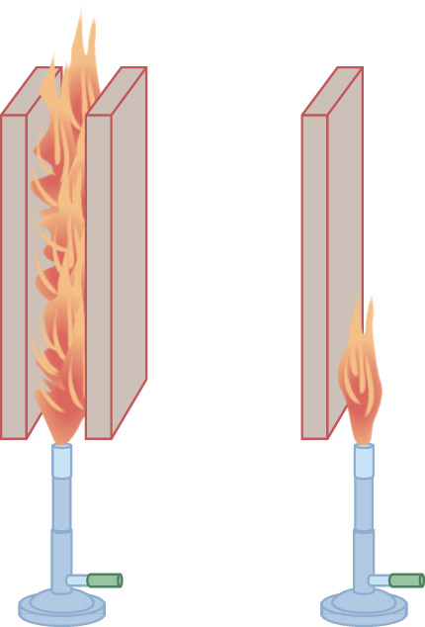
Ignition to Flaming Combustion
Potential surface heat losses can affect ignition:
Surface can lose heat by conduction into the interior of the solid.
Surface can lose heat by radiating it away to cooler surroundings

Slide 16
Ignition to Nonflaming Combustion
Nonflaming combustion can occur if material:
Is initially porous
Has interior surfaces that support exothermic reaction with oxygen to produce a porous carbonaceous char
Is a good insulator

Slide 17
Ignition to Nonflaming Combustion
Smoldering can begin via nonflaming ignition source.
For smoldering to self-sustain or progress, generated heat must exceed the diffused heat.

Slide 18
Ignition to Nonflaming Combustion
Thermal process of spontaneous ignition followed by self-heating. Haystack:
If humid conditions, aerobic fungi and bacteria grow and generate heat biologically.
A thick haystack with small heat losses can increase interior temperature to 165 °F (75 °C).
Oxygen reacts with decomposition products.
Thermal runaway
Temperature can rise high enough for spontaneous flaming ignition.

Slide 19
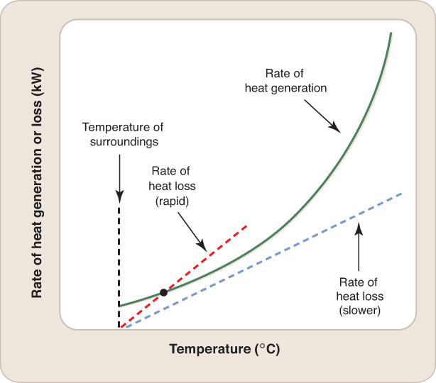
Ignition to Nonflaming Combustion
Insulation is effective at trapping heat.
Initial rate of heat generation can be slow.
Rate of convective cooling directly proportional to difference between temperature of warm object and temperature of surroundings

Slide 20
Ignition to Nonflaming Combustion
Initial temperature:
Rate of heat generation is positive.
Rate of cooling is zero.
Temperature of material must continue to rise until cooling curve intersects heating curve.
Most materials cannot spontaneously burst into flame.
Most dangerous: rags in contact with certain oils, low-grade charcoal, some animal feeds

Slide 21
Char Formation and Melting
Categories of burning behavior:
Materials that burn with formation of growing surface char layer
Materials that burn with little or no char

Slide 22
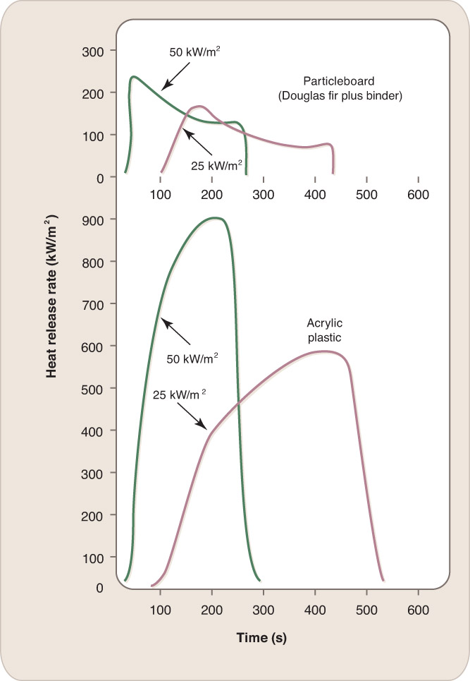
Char Formation and Melting

Slide 23
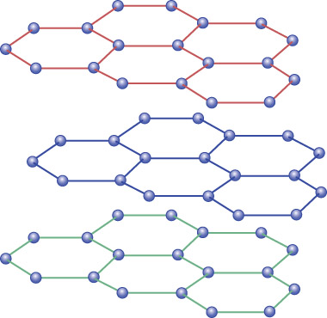
Char Formation and Melting
Fire-generated char:
Irregularities in carbon atoms array
Brittle
Porous cellular material
Poor heat conductor
Creates insulation factor

Slide 24
Char Formation and Melting
Rate of char formation of woods is proportional to the radiant heat flux impinging on the surface.
If heat flux = 30 kW/m², then average charring rate would be 0.025 in/min (0.01 mm/s).
Noncharring combustibles melt while burning.

Slide 25
Mass Burning Rate
Ignited solid’s contribution to fire intensity:
Rate at which unit area of the burning surface is consumed
Rate at which flames spread over fuel surface, increasing burning surface area
Combustible’s ability to ignite other combustible items in the vicinity
Mass burning rate (g/m²-s) or heat-release rate (kW/m²)

Slide 26
Mass Burning Rate
Steadily burning material has heat balance:
Net heat to surface = heat flux from flame to surface (kW/m²)—rate at which heat is lost by reradiation (kW/m²)

Slide 27
Mass Burning Rate
Rate of heat absorption required to sustain a flow of combustible pyrolyzate (kJ/m²-s) = mass rate of gasification per unit surface area (g/m²-s) × heat of gasification (kJ/g).
Equation 9-1: Q = 56.7 × (T/1000)⁴ heat flux per unit surface area.

Slide 28
Mass Burning Rate
Upper layer gases reach 500 K, radiant flux to the burning product will be approx. 3.5 kW/m².
At 800 K, radiant flux will be 23 kW/m².
Post-flashover, the upper layer temperature will reach 1100 K with a radiant flux of 83 kW/m².

Slide 29
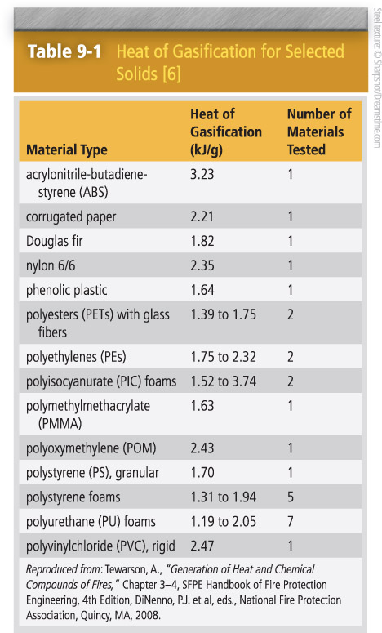
Mass Burning Rate

Slide 30
Mass Burning Rate
Table 9-1:
Wide range of values
Variation in heats of gasification samples is due to variation in chemical composition of generic materials.
Only small portion of heat released by burning must return to the pyrolyzing solid to maintain continuing supply of combustible vapor to the flame.

Slide 31
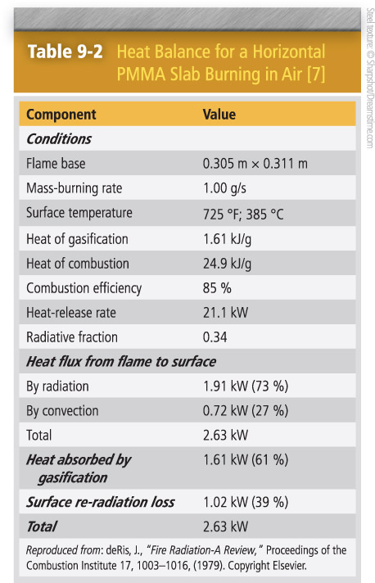
Mass Burning Rate

Slide 32
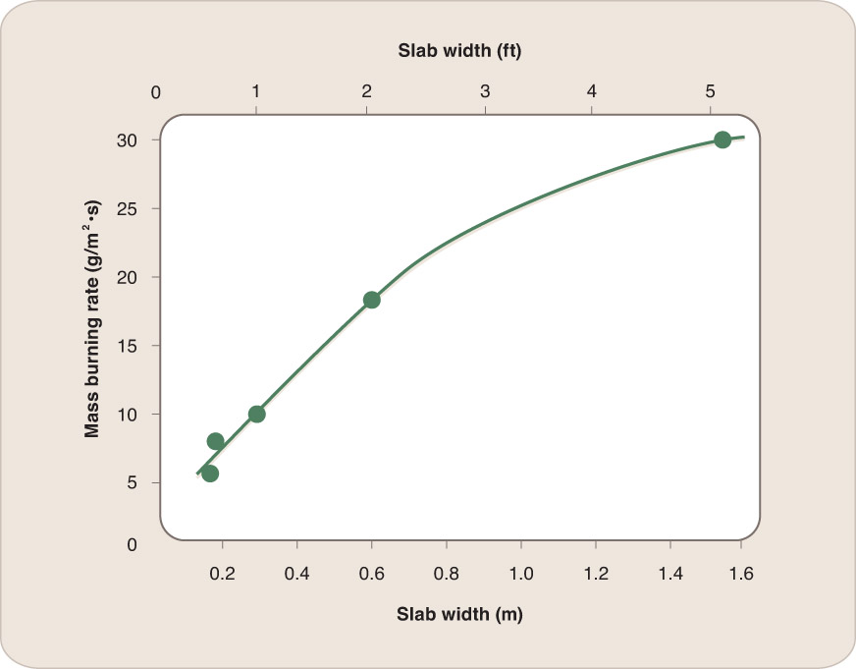
Mass Burning Rate
Burning rates are greater for larger PMMA slabs but flame temperature levels off eventually.

Slide 33
Flame Spread Rate
Rate of flame spread becomes dependent on:
Orientation of spread
Degree of radiative preheating
Magnitude and direction of any external airflow.
Thermal thickness of the solid

Slide 34
Flame Spread Rate
Downward flame spread is generally very slow unless the surface was preheated.
Upward flame spread is more rapid.

Slide 35
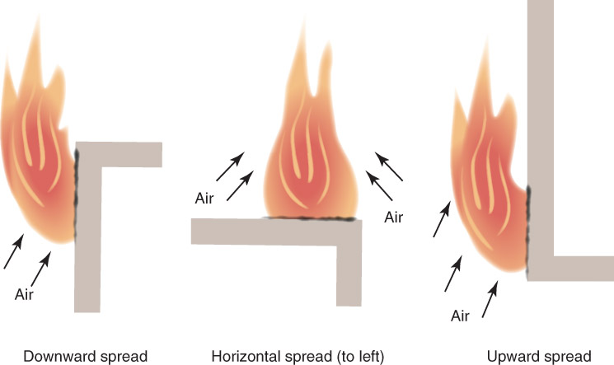
Flame Spread Rate
Airflow pushes flames away from unburned material in downward flame spread.
In upward flame spread, the flame preheats the unburned material.

Slide 36
Flame Spread Rate
Additional airflow in direction flame is moving enhances flame spread rate.
Airflow in opposite direction slows flame spread rate.
Rate of flame spread is inversely proportional to thickness of the solid.

Slide 37
Effects of Uncommon Fire Environments
Consequences of higher flame temperature:
Greater flame spread rate due to greater rate of heat transfer from flame to surroundings
Flames less readily quenched by cool surfaces
Sootier flames that emit more radiation
Certain solids will only burn in oxygen-enriched air.

Slide 38
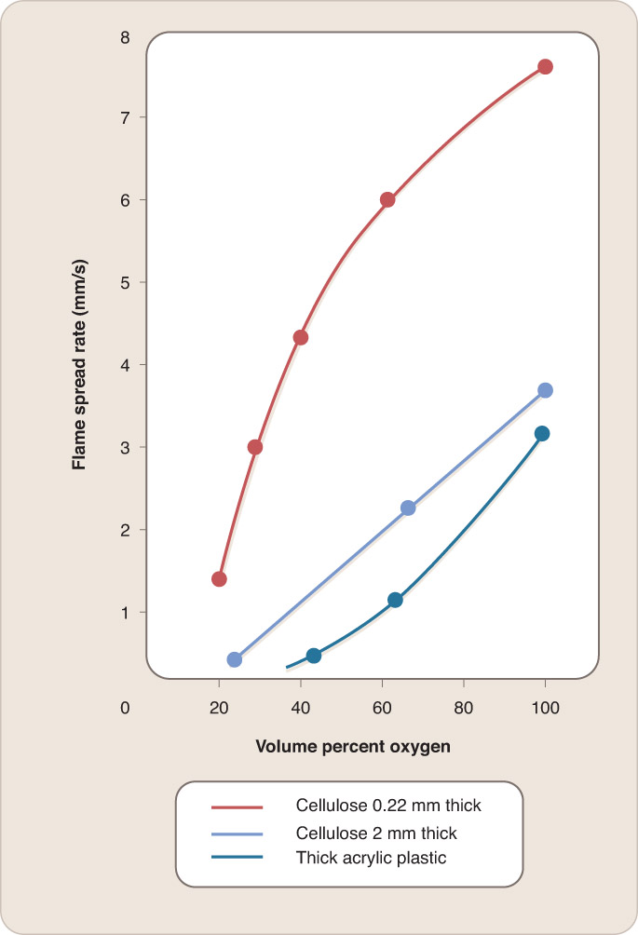
Effects of Uncommon Fire Environments
Data from: Lastrina, F.A., Magee, R.S., and McAlevy, F.R., “Flame Spread Over Fuel Beds: Solid Phase Energy Considerations,” Proceedings of the Combustion
Institute 13, 935–948, (1971).

Slide 39
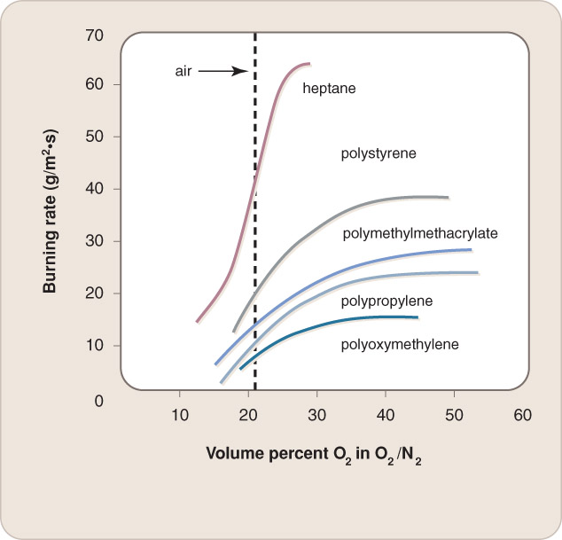
Effects of Uncommon Fire Environments
Rate of horizontal flame spread increases with increasing oxygen percentage.
Burning rate per unit area increases at higher oxygen concentration.
Reproduced from: Tewarson, A., “Generation of Heat and Chemical Compounds of Fires,” Chapter 3–4, SFPE Handbook of Fire Protection Engineering, 4th Edition, DiNenno, P.J. et al, eds., National Fire Protection Association, Quincy, MA, 2008.

Slide 40
Effects of Uncommon Fire Environments
Changes in air pressure may not affect flame temperature if the volume percentage of oxygen remains 21%.
Rate of flame spread over solid surfaces increases with increasing pressure.

Slide 41
Effects of Uncommon Fire Environments
Most atmospheres that are breathable will support combustion.
Fires in microgravity conditions behave differently.

Slide 42
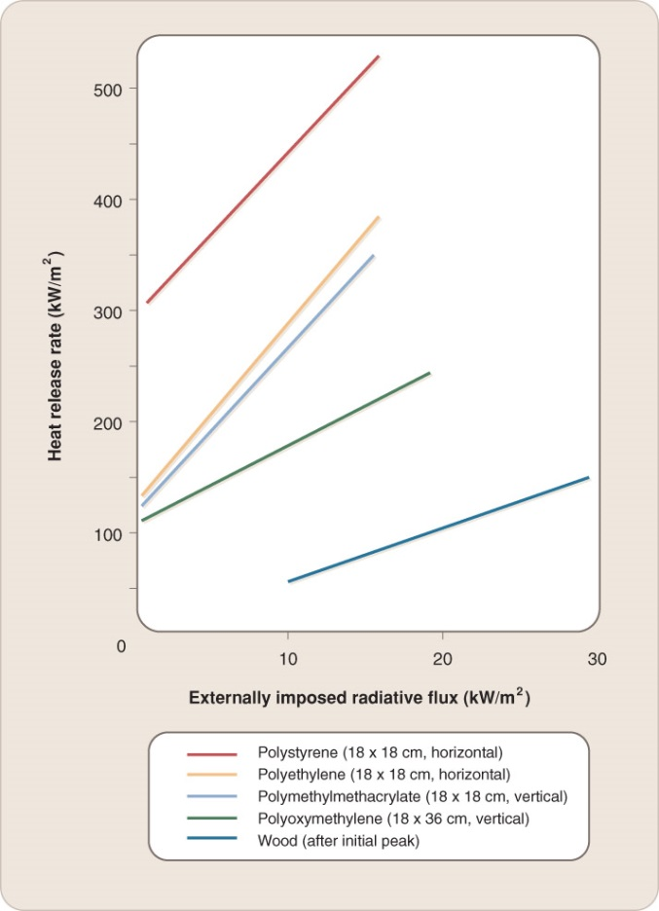
Test Methods for Measuring Ignition, Burning Rate, and Flame Spread Rate
Test methods must simulate thermal radiation correctly.
Data from: Lastrina, F.A., Magee, R.S., and McAlevy, F.R., “Flame Spread Over Fuel Beds: Solid Phase Energy Considerations,” Proceedings of the Combustion Institute 13: 935–948, (1971).

Slide 43
Test Methods for Measuring Ignition, Burning Rate, and Flame Spread Rate
Four sources of thermal radiation:
Flames from the burning product
Flames from the burning objects
Hot smoke
Hot ceiling and upper walls

Slide 44
Test Methods for Measuring Ignition, Burning Rate, and Flame Spread Rate
Apparatus have been developed to impose a variable radiant flux on a specimen.
ASTME 1354, Standard Test Method for Heat and Visible Smoke Release Rates for Materials and Products Using an Oxygen Consumption Calorimeter

Slide 45
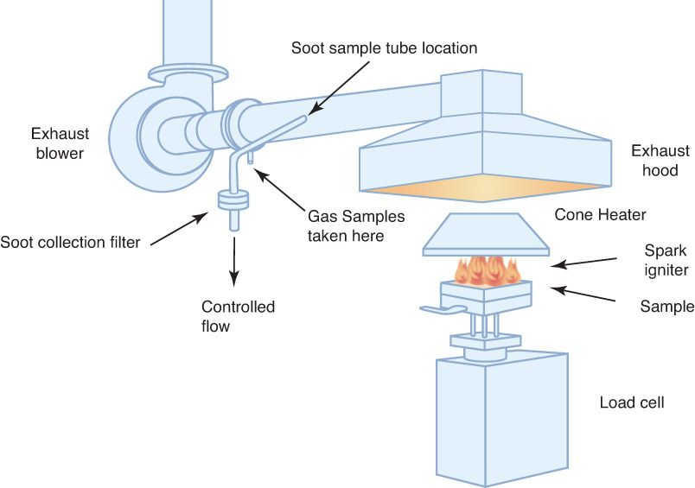
Test Methods for Measuring Ignition, Burning Rate, and Flame Spread Rate

Slide 46
Test Methods for Measuring Ignition, Burning Rate, and Flame Spread Rate
Oxygen consumption calorimetry
Oxygen Index Test:
Sample is ignited and volume percent of oxygen is reduced until the flame goes out.
Limiting oxygen index (LOI)
High LOI value indicates a material that is more difficult to ignite.
LOI values are used to estimate relative flammability.

Slide 47
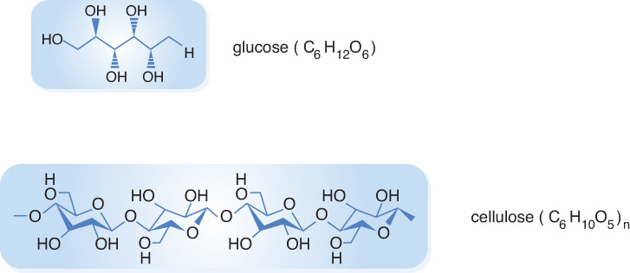
Cellulosic and Other Natural Materials
Cellulosic: A material composed entirely or mostly of a polymer of glucose

Slide 48
Cellulosic and Other Natural Materials
Polymer
Condensation polymer
Cotton consists of more than 90% cellulose, while woods contain only 40–50% cellulose.

Slide 49
Cellulosic and Other Natural Materials
Chemical composition of wood includes cellulose, lignin, hemicelluloses, extractives, and minerals.
Fire behavior of wood is initially influenced by its moisture content.
Drier wood has less water to eliminate and burns faster.

Slide 50
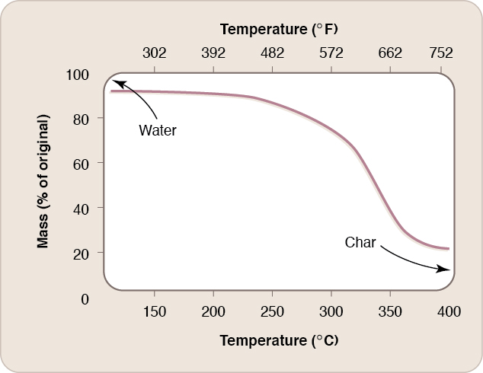
Cellulosic and Other Natural Materials
Gasification of wood is complex.
Data from: Kirk-Othmer Encyclopedia of Chemical Technology, 5th edition, Kroschwitz, J.I., ed., J. Wiley, New York, 2007.

Slide 51
Cellulosic and Other Natural Materials
Combustion of dry woods = net heat of approximately 18 kJ/g (combustion of volatiles + combustion of residual char).
Natural materials have a high protein content (animal products).
Thermal decomposition of products emits diverse gases.
Generally less flammable than cellulosic materials

Slide 52
Synthetic Polymer Materials
Monomer: Small molecule that can combine with other molecules to form a repeating chain molecule, or polymer
Oligomer: Molecule consisting of a few monomer units

Slide 53
Synthetic Polymer Materials
Polymers can be sorted by:
Addition and condensation polymers
Linear, branched, or cross-linked polymers
Homopolymer or copolymer
Thermoplastic, thermoset, and elastomeric polymers

Slide 54
Addition Polymers
Addition polymers are built of successive monomeric units without elimination of any molecule or fragment.
Monomer of addition polymer has carbon−carbon double bond.
Vinyl polymers

Slide 55
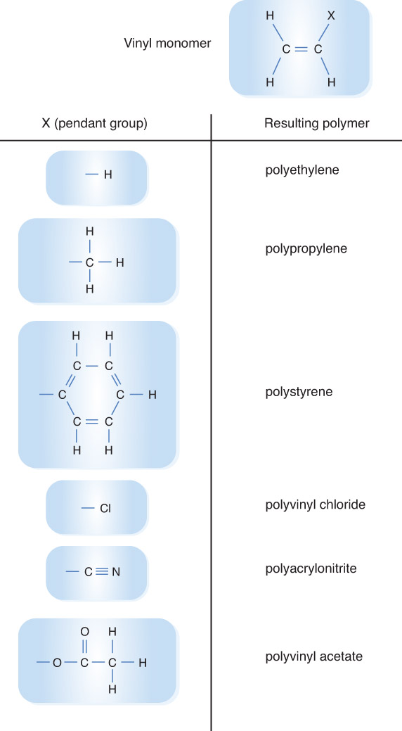
Addition Polymers

Slide 56
Addition Polymers
Commercially important polymers formed from vinyl polymers.
Vinyl polymers can form linear polymers.
Cross-linking stabilizes the fire behavior of a polymer.

Slide 57
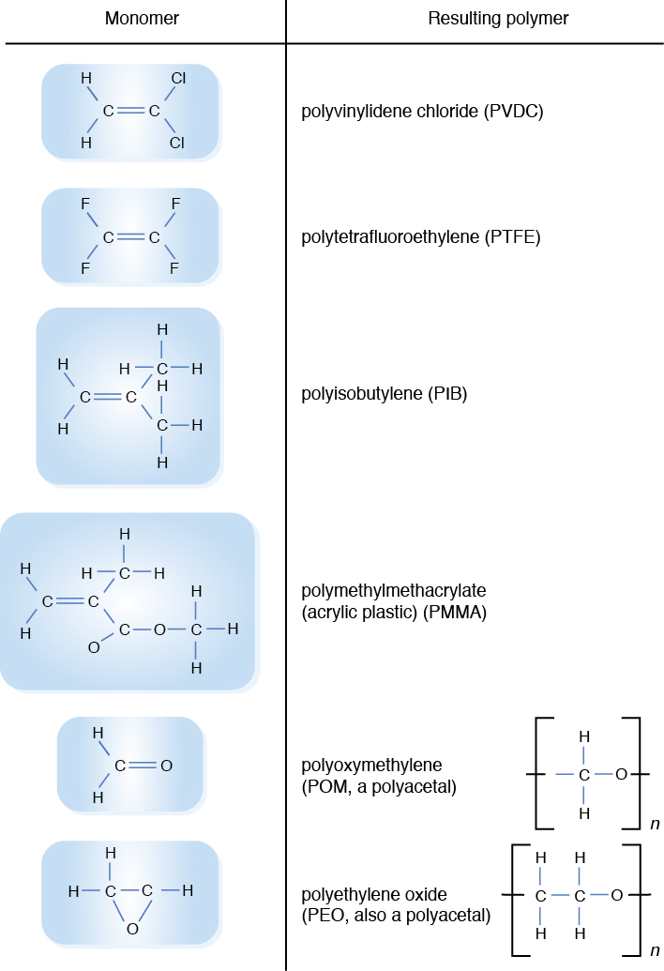
Addition Polymers
Data from: Kirk-Othmer Encyclopedia of Chemical Technology, 5th edition, Kroschwitz, J.I., ed., J. Wiley, New York, 2007.

Slide 58
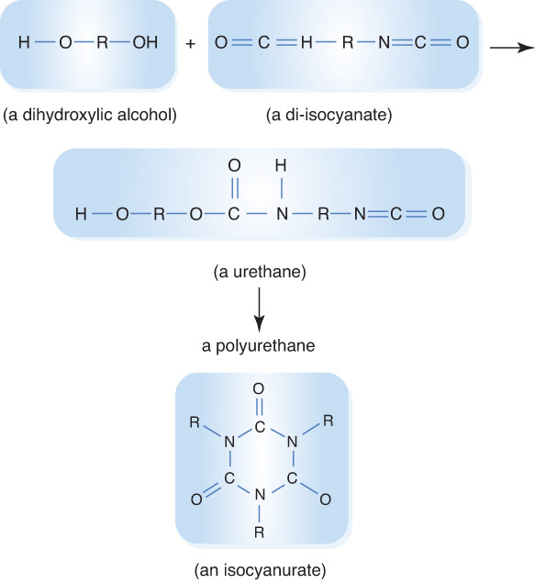
Addition Polymers

Slide 59
Addition Polymers
Three modes of addition polymer decomposition:
Unzipping
Random scission
Elimination

Slide 60
Addition Polymers
Other addition polymers:
Modacrylics
Totally fluorinated polymers
Polyurethanes
Isocyanurate cross-linked rigid foams

Slide 61
Condensation Polymers
Examples: neoprene and nylon
Formed via elimination of a small molecule each time another link is added to the polymer chain
Combinations of organic acids with alcohols, or organic acids with amines

Slide 62
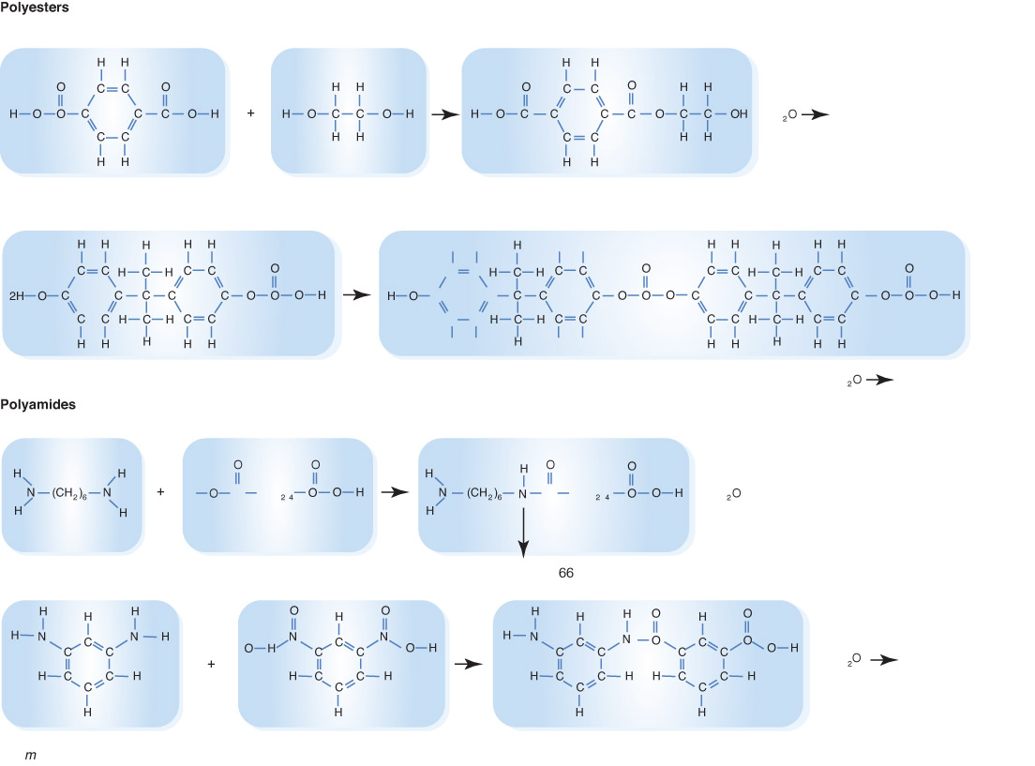
Condensation Polymers

Slide 63
Condensation Polymers
Aramids are condensation polymers used to make protective gear.
Thermoset polymers char when heated.
Commercial plastics are not pure polymers.

Slide 64
Fire Retardants
Polymeric materials that do not do well in fire tests are modified by fire retardants (FRs).
Chemical additive that slows the ignition and/or burning rate of a material
FR chemicals are largely halogen compounds.
Provide resistance to small ignition sources
FR chemicals often added at a minimal level

Slide 65
Fire Retardants
Age can affect a product’s FR concentration.
FR additives modify ignition and burning of solids through 4 known mechanisms:
Char formation
Gas-phase flame inhibition
Solid-phase heat absorption
Barrier formation

Slide 66
Fire Retardants
Application of FR additives:
Woods impregnated with inorganic salts to promote char formation
Cellulosic materials filled with borax and/or boric acid to reduce tendency to smolder or flame
Rigid solid materials coated with FR paints

Slide 67
Fire Retardants
Application of FR additives (cont’d):
Synthetic polymers are copolymerized with small proportions of bromine-containing monomers.
Vinyl polymers are FR through a combination of halogenated organic compound and antimony oxide.
Barrier material will slow or prevent passage of pyrolized material to fresh air.

Slide 68
Composite Materials and Furnishings
Composite: Product consisting of more than one material
Most commonly encountered combustible items are composite.
Full-scale fire tests with actual products and realistic simulation of ignition source and radiative environment

Slide 69
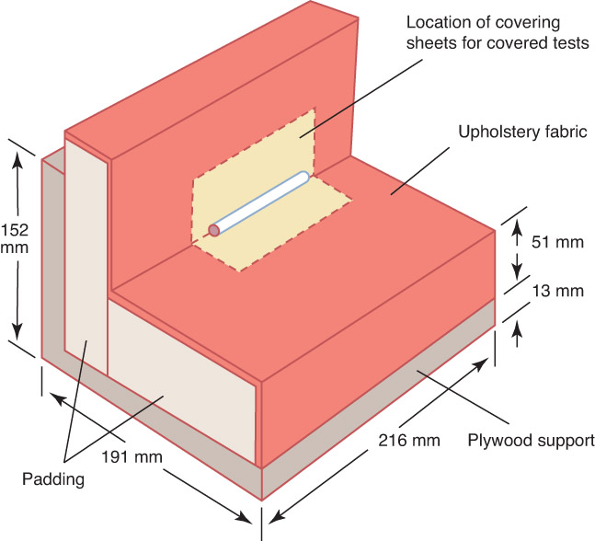
Composite Materials and Furnishings
No systematic measurements have been completed of the ease of flaming ignition for full-scale combustibles.
Reproduced from: NFPA 260, Standard Methods of Test and Classification System for Cigarette Ignition Resistance of Components of Upholstered Furniture, National Fire Protection Association, Quincy, MA, 2013.

Slide 70
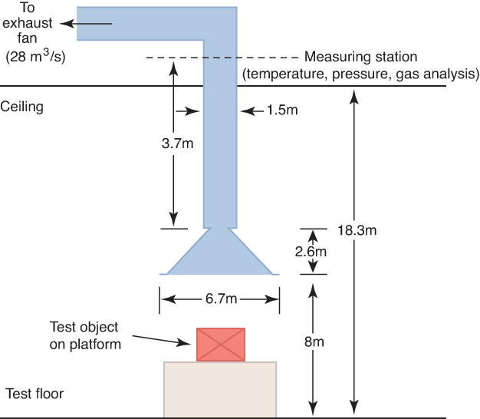
Composite Materials and Furnishings
Calorimeters measure the burning rate versus time of certain furnishing items.
Oxygen consumption calorimetry

Slide 71
Composite Materials and Furnishings
Underlying principle of oxygen consumption calorimetry is that for all common combustibles, approximately 13.1 kJ of heat is released per gram of oxygen consumed.
Basic required measurements in oxygen consumption calorimetry comprise continuous gas flow and temperature in the duct and the oxygen concentration in that flow.

Slide 72
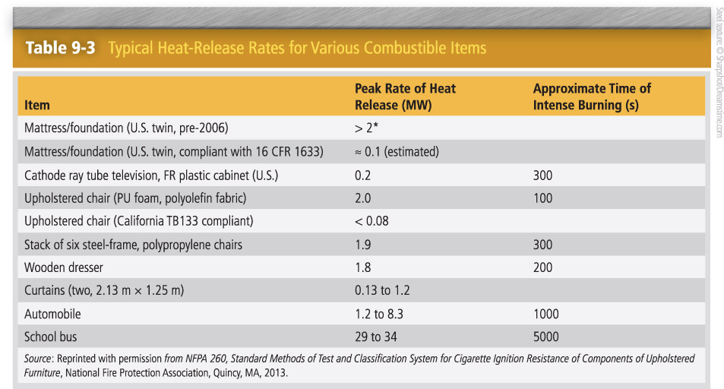
Composite Materials and Furnishings
Researchers can only estimate heat-release rates for upholstered furniture.

Slide 73
Acid–Base Pairs
Alkaline substances will react with any other acids, releasing substantial heat and possibly causing nearby materials to ignite.
Most common alkalis:
Sodium hydroxide (lye)
Calcium oxide (quick lime)

Slide 74
Metals
Combustion of metals
Oxidation of metal is a highly exothermic process.
Thermal conductivity of metals is approximately 1000 times that of the most common organic polymers.
Combustible metal powders

Slide 75
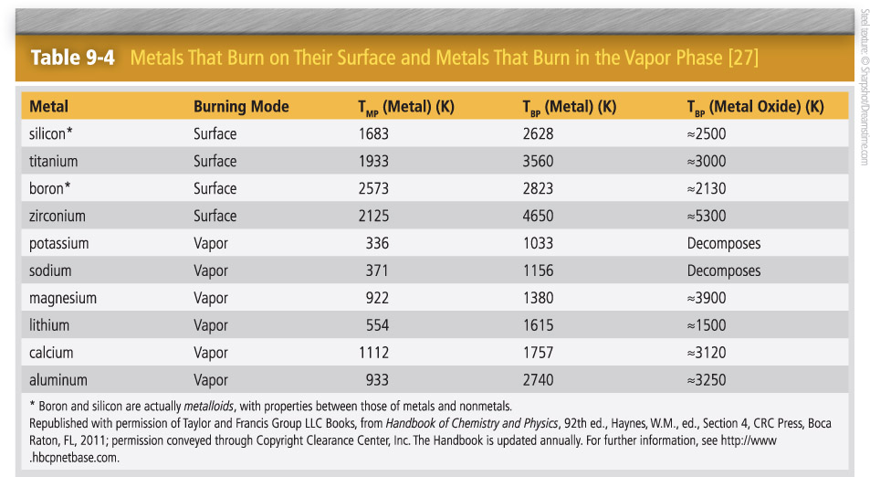
Metals
Two categories of metals:
Burn on their surface
Burn in the vapor phase

Slide 76
Metals
Flame temperature of a metal is limited by the boiling point (T_{BP}) of its oxide.
Hot metals can react rapidly and exothermically with water to form hydrogen:
2 Al + 3 H₂O_{liq} → Al₂O₃ + 3 H₂ + 819 kJ

Slide 77
Metals
Magnesium can ignite under some conditions at 932 °F.
Some magnesium alloys have lower ignition temperatures.
Molten magnesium in contact with iron oxide produces a highly energetic thermite reaction:
3 Mg + Fe₂O₃ → 3 MgO + 2 Fe + 971 kJ
When finely divided, magnesium burns in an atmosphere of any of the following pure gases to yield:
Steam: MgO + H₂
Carbon dioxide: MgO + CO
Nitrogen: Mg₃N₂
Halon 1301 (CF₃Br): MgF₂, MgFBr, MgBr₂, C

Slide 78
Metals
Aluminum:
Higher boiling point
Powder is used in solid propellant rocket fuels.
Powder reacts violently with halogenated liquids (common solvents and fire suppressants).
Reacts with iron oxide in a thermite reaction to produce temperatures high enough to melt steel
Will not burn in nitrogen

Slide 79
Metals
Iron and steel can burn in pure oxygen.
Fine steel wool or steel dust can ignite.
Massive pieces of titanium generally cannot be ignited.
Fine turnings or thin chips will burn vigorously.
Titanium dust clouds can ignite.

Slide 80
Metals
Alkali metals (lithium, sodium, potassium) have low melting points.
On contact with water at room temperature, sodium and potassium generate hydrogen exothermically and burst into flame spontaneously.
Alkali metals can be ignited by heating in dry air.
Lithium can burn in pure nitrogen.

Slide 81
Metals
NaK is a sodium–potassium alloy with a low melting point.
Used as a heat-transfer fluid
Fire properties resemble those of sodium and potassium.

Slide 82
Exothermic Materials
A material that can undergo chemical reaction that releases heat without an additional oxidizer, such as oxygen from the air
Easier ignition, faster fire growth, higher flame temperatures, more difficult to extinguish

Slide 83
Exothermic Materials
Heat release processes:
Thermal instability
Self-polymerization
Intramolecular oxidation–reduction
Oxidizing agent in contact with a reducing agent

Slide 84
Exothermic Materials
Oxidizers might get mixed with common materials and react exothermically.
Common classes:
Nitric acid and salts
Perchloric acid and salts
Chromic acid and salts
Permanganic acid and salts

Slide 85
Exothermic Materials
Common classes:
Fluorine, chlorine, bromine, and iodine
Inorganic peroxides
Calcium hypochlorite
Potassium persulfate
Manganese dioxide
Chlorate, bromate, and iodate salts

Slide 86
Summary
The pyrolysis of a solid to form gaseous fragments can be characterized by a heat of gasification. During pyrolysis, chemical change occurs within the solid, and the chemistry of the volatiles is rarely the same as the chemistry of the solid.

Slide 87
Summary
The ignition of the pyrolyzate from a solid is similar to the ignition of gases and vapors, except that heat losses from the fuel surface to the interior and to the surroundings can delay or prevent the ignition.

Slide 88
Summary
For a fuel to smolder or self-heat, it must be porous, its interior surfaces must react exothermically with oxygen, and the material must be a good insulator.

Slide 89
Summary
Surface char formation slows burning by insulating the subsurface materials from the flame radiation and by sequestering carbon.

Slide 90
Summary
For solids that melt during burning, dripping or running of the liquid increases the fire spread rate due to the increase in burning surface. The flaming liquid can also ignite other combustibles on contact.

Slide 91
Summary
The burning rate depends on the radiant flux to the surface. Early in a fire, this flux comes from the local flames; most of the flux is derived from the hot surroundings.

Slide 92
Summary
The flame spread rate depends on whether the spread direction is upward (fastest), lateral (slow), or downward (slow, except when dripping occurs); the degree of radiative preheating; the thermal thickness of the solid; the ambient oxygen percentage; and the direction of any airflow.

Slide 93
Summary
Nearly all common solid combustibles are polymers, which consist of strings of identical building blocks. Polymers are classified based on whether they are formed by addition or by condensation; synthesized by nature or by humans; linear or cross-linked; composed of a single building block or multiple building blocks; or thermoplastic, thermoset, or elastomeric.

Slide 94
Summary
Many formulations of each of the families of plastics exist, as do many different types of woods. The burning properties of these solid combustibles can vary considerably.

Slide 95
Summary
Fire retardants are added to combustible materials to help them meet flammability criteria. These additives work by promoting char formation, inhibiting the flame chemistry, absorbing heat in the solid, and/or forming a barrier between the flame and the fuel surface.

Slide 96
Summary
Most common combustible items consist of multiple materials. We cannot yet quantify the fire behavior of a composite from its constituent materials. Instead, the fire performance is measured by burning the entire item or estimated from tests of small specimens of the materials or a representative composite.

Slide 97
Summary
Oxygen consumption calorimetry is a tool for determining the rate of heat release from a product (or specimens from a product).

Slide 98
Summary
Exothermic materials and finely divided metals pose unusual and potentially severe fire hazards, but are found almost exclusively in nonresidential settings.

