Slide 1
Chapter 7 Fire Characteristics: Gaseous Combustibles

Slide 2
Objectives
Describe the categorization of flames.
Characterize laminar and turbulent flames.
Define deflagration and detonation, and explain the difference between the two.
Discuss flammability limits and burning velocity, as well as their relationship to fire hazard.

Slide 3
Objectives
Understand the difference between piloted ignition and autoignition.
Explain the potential hazard from a gas leak.
Explain the importance of chain branching in combustion chemistry.

Slide 4
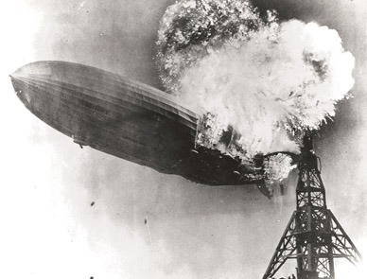
Gaseous Fuels
Oxidation of gaseous fuels generates a lot of heat.
Courtesy of the US Navy.

Slide 5
Categorization of Flames
Categories of flame:
Premixed/diffusion flames
Laminar/turbulent flames
Stationary/propagating flames
Subsonic/supersonic flames
Most fires are subsonic, turbulent diffusion flames when particularly hazardous.

Slide 6
Premixed Versus Diffusion Flames
Premixed flame example: residential gas leak and after a few minutes a person lights a match.
Stoichiometric mixture according to: CH₄ + 2O₂ → 2H₂O
Burning velocity
Percentage/ratio of oxygen and gaseous material affects flame propagation and peak temperature.

Slide 7
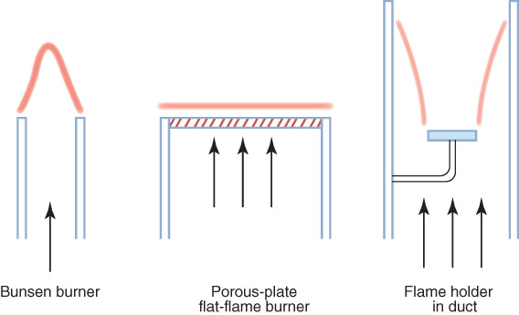
Premixed Versus Diffusion Flames
Premixed flames can be stabilized to burn in a stationary position for measurement.

Slide 8
Premixed Versus Diffusion Flames
Diffusion flame: fuel and oxidizer gases initially exist as separate volumes.
Combustion occurs when an ignition source is placed near the interface of fuel and oxidizer.
Diffusion flame temperatures are lower than premixed flames.

Slide 9
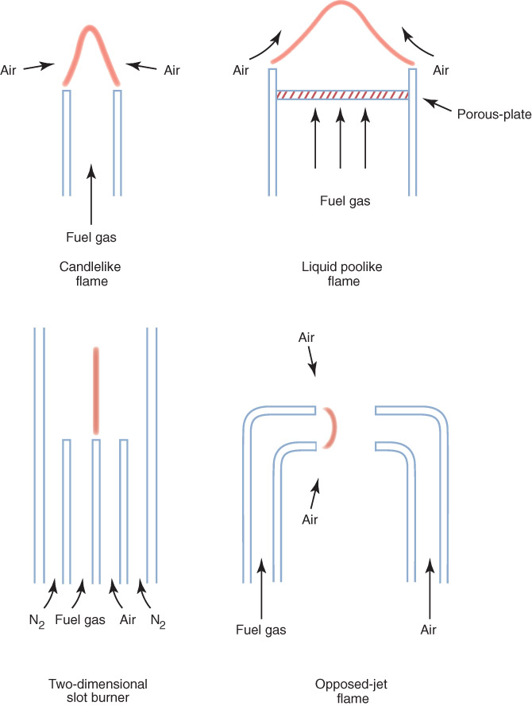
Premixed Versus Diffusion Flames
Fires are predominantly diffusion flames, but stationary diffusion flames can be developed.

Slide 10
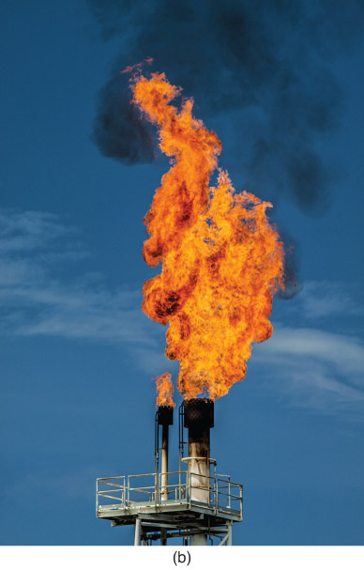
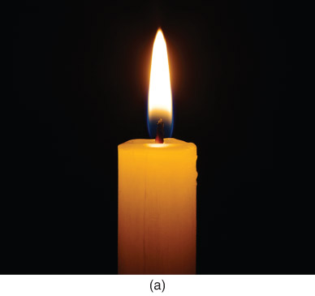
Laminar Versus Turbulent Flames
© irin-k/ShutterStock, Inc.
© Tigergallery/ShutterStock, Inc.

Slide 11
Laminar Versus Turbulent Flames: Laminar Flames
Smooth flow streamlines and negligible velocity component fluctuations
Straight or gentle curving line
Low Reynolds number value
Diffusion flame shorter than 0.1 m (4 in.)
Lower rates of combustion and convective heat loss

Slide 12
Laminar Versus Turbulent Flames: Turbulent Flames
Significant fluctuations in velocity and temperature profiles
Erratic particle paths
High Reynolds number values
Diffusion flame taller than 0.3 m (1 ft)
Higher rates of combustion and convective heat loss

Slide 13
Ignition of Gases
First step: generation of a species highly reactive enough to destabilize a fuel molecule
Piloted ignition
Auto-ignition

Slide 14
Ignition of Gases
Ignition depends on:
Energy of the spark
Gaseous fuel
Equivalence ratio of the fuel–air mixture
A near-stoichiometric mixture demonstrates the greatest sensitivity to ignition.

Slide 15
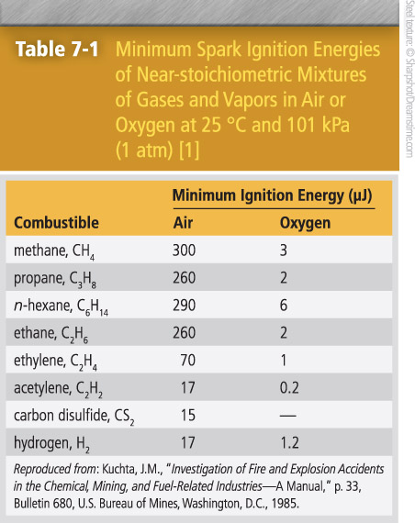
Minimum Spark Ignition Energies
Fuel–oxygen mixtures ignite with weak sparks more easily than fuel–air mixtures.
Saturated hydrocarbons all ignite similarly in air.
Progressive unsaturation in a hydrocarbon molecule favors much easier ignition.

Slide 16
Ignition Energy
The minimum ignition energy needed to ignite most fuel vapor–air mixtures is approximately inversely proportional to the square of the absolute pressure.
Gas mixtures can be ignited with an existing flame, introducing free radicals.

Slide 17
Gas/Vapor–Air Mixtures
Can be ignited via contact with a surface hot enough to raise the mixture’s temperature
Relative autoignition temperatures can be obtained for certain gases.

Slide 18
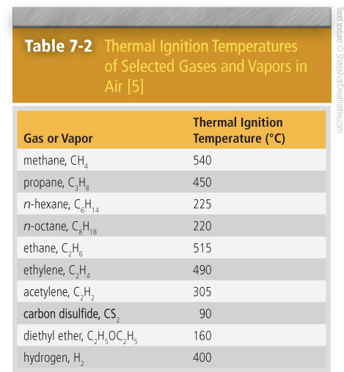
Gas/Vapor–Air Mixtures
Carbon disulfide is easier to ignite via thermal ignition than hydrogen.
Hydrogen and carbon disulfide require similar ignition energies.
Increases in molecular weight of saturated hydrocarbons requires a lower thermal ignition temperature.
Acetylene is easier to ignite than ethane.

Slide 19
Flammability Limits
Mixtures too rich or too lean are difficult to ignite and slower to burn.
Nitrogen in a methane–air mixture absorbs some heat, lowers the temperature, and causes slower flame reactions.
More nitrogen would cause the mixture to be nonflammable.
Lean flammability limit (lean limit)
Upper flammability limit (rich limit)

Slide 20
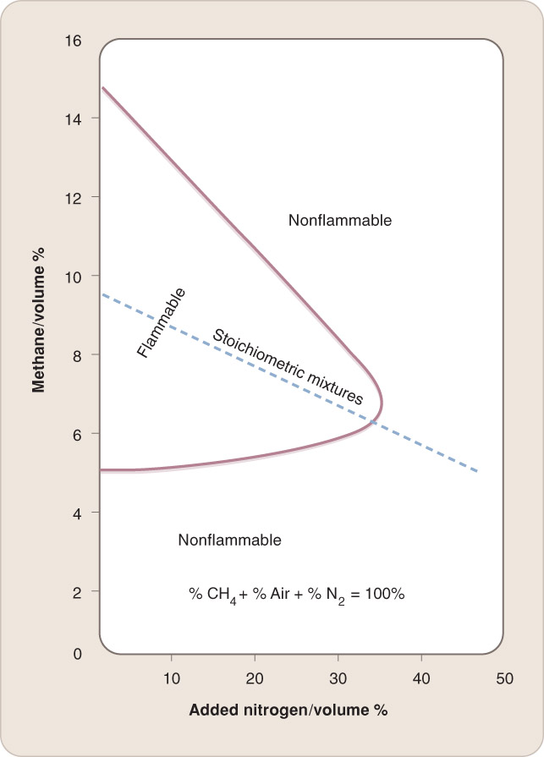
Flammability Limits
Dilution of a methane–air mixture with nitrogen

Slide 21
Flammability Limits
Wider at higher temperatures
Independent of pressure at ordinary and high pressures (> 50 kPa)
Approach each other at low pressures
No propane–air mixture is flammable at < 4 kPa.

Slide 22
Flammability Limits
Hydrogen, carbon disulfide, acetylene, and fuel vapors mixed with oxygen have wide flammability limits.

Slide 23
Burning Velocity
Burning velocity: The speed with which a flame moves through unburned gas
Burning velocity is approximately proportional to (q″ × κ)^{1/2}, where:
q″ = mean rate of heat generation in the flame
κ = thermal conductivity of gas mixture

Slide 24
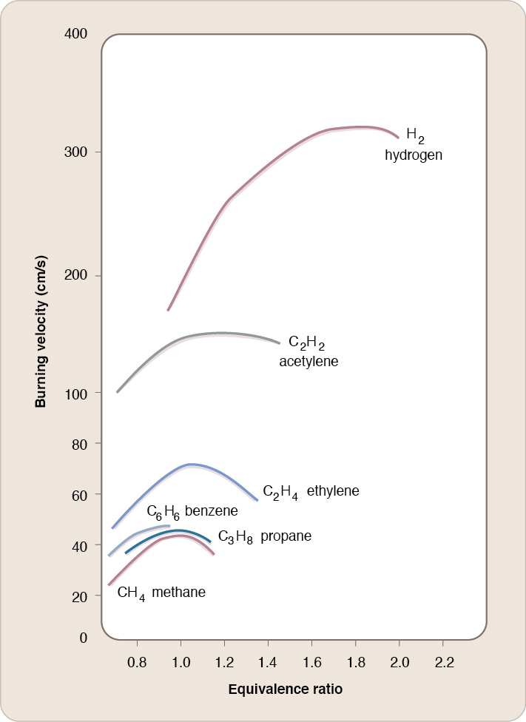
Burning Velocity
It is difficult to make absolute measurements of true burning velocities.
Most hydrocarbons have a similar magnitude of their burning velocity.

Slide 25
Burning Velocity
A flame could move faster than its measured burning velocity if:
Laboratory apparatus surfaces slow the flame movement.
Flame raises the temperature of the gas enough to cause motion and carry the flame toward unburned gas.
Flame is a turbulent premixed flame.

Slide 26
Explosions, Deflagrations, and Detonations
Explosion: The rapid release of energy and increase in pressure when a premixed flame propagates in a confined space
Deflagration: Subsonic combustion
Detonation: Supersonic combustion

Slide 27
Explosions, Deflagrations, and Detonations
Deflagration
Propagates at subsonic velocity
Burning velocity depends on chemically controlled rate of heat release in the flame.
Diffusion flames are typically deflagrations.

Slide 28
Explosions, Deflagrations, and Detonations
Detonation
Propagates at supersonic velocity
Velocity is calculated with the heat of combustion and the physical properties of the mixture.
Damage from a detonation is generally due to the generated high pressure.

Slide 29
Hydrogen Oxidation
Chain reaction
Most critical step:
H + O₂ → OH + O
Chain branching reaction
Next step:
OH + H₂ → H₂O + H
Chain propagation reaction

Slide 30
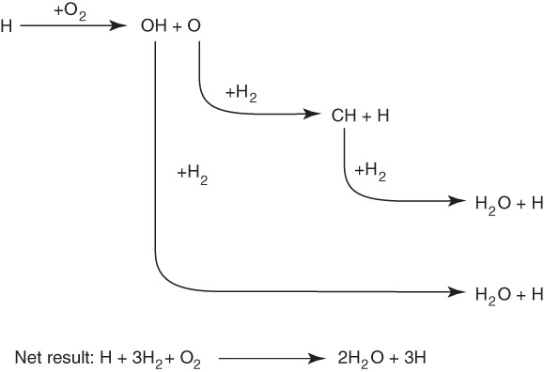
Hydrogen Oxidation
Next step:
O + H₂ → OH + H
This branching sequence of reactions leads to an H₂–O₂ explosion.

Slide 31
Hydrogen Oxidation
Sequence continues until one or both reactants is consumed.
Chain termination reactions
H + O → OH and H + OH → H₂O
The hydrogen oxidation reaction is unique in its small number of chemical species and reactions.

Slide 32
Premixed Methane–Oxygen Flame Chemistry
Methane is the simplest hydrocarbon fuel but still involves 53 chemical species and 325 reactions.
Methane–oxygen reaction involves chain initiation, propagation, branching, and termination steps.

Slide 33
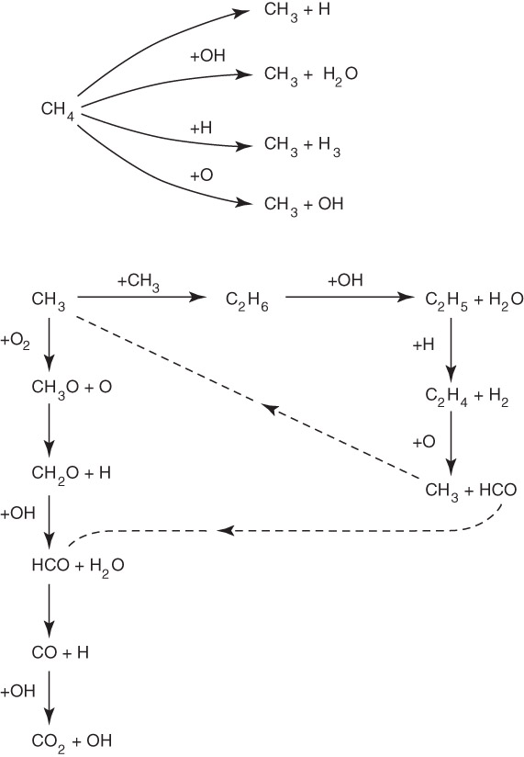
Premixed Methane–Oxygen Flame Chemistry

Slide 34
Combustion of Larger Hydrocarbon Fuels
Fuels with a greater number of carbon atoms involve greater numbers of chemical species and reactions for the flame mechanism.

Slide 35
Hydrogen (H₂)
Among the most dangerous gases (fire-wise)
Odorless
Almost invisible flame

Slide 36
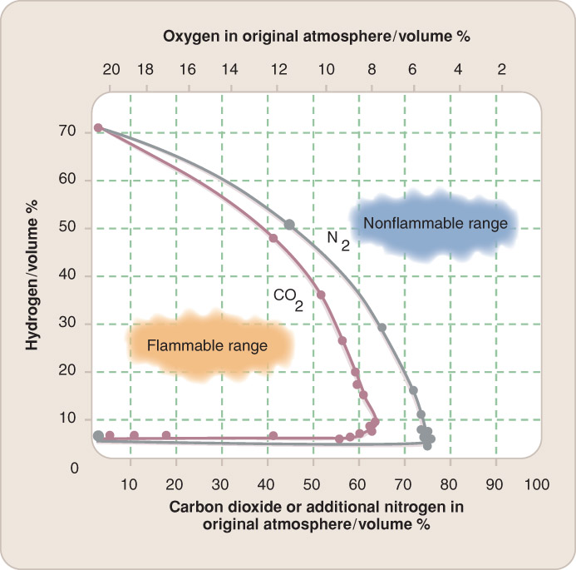
Hydrogen (H₂)
Wide flammability limits
Easily ignited when mixed with air
Higher burning velocity than any other combustible

Slide 37
Hydrogen (H₂)
Flammable levels of hydrogen are generated in well-known situations.
Hydrogen is light.
Can rise to the upper area of a compartment

Slide 38
Acetylene (C₂H₂)
Extremely reactive and flammable
Must be stored in cylinders filled with porous mass
Can be effectively stored as liquid, but flows out as gas
Wide flammability limits

Slide 39
Acetylene (C₂H₂)
Fusible plug that opens at 212 °F is required in all acetylene tanks in North America.
Acetylene–air flames propagate rapidly.
Copper and copper alloys are not used in storing or delivering acetylene.

Slide 40
Methane (CH₄)
Odorless gas
Lighter than air
Main constituent of natural gas
Flammability similar to other saturated hydrocarbon gases

Slide 41
Ethylene (C₂H₄)
Industrial gas
Faint, sweet odor
Ethylene–air mixtures, compared to saturated hydrocarbon-air mixtures:
Wider flammability limits
Easier to ignite
More rapid flame propagation
Can detonate
More luminous flames

Slide 42
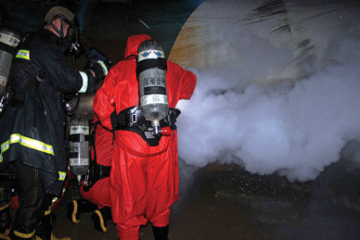
Ammonia (NH₃)
Commercial refrigerant and fertilizer
Sharp, pungent odor
Ammonia–air mixtures, compared to hydrocarbon-air mixtures:
Difficult to ignite
Burn more slowly
© TPG/TOPHO/AP Images

Slide 43
Summary
The molecules that combust in a flaming fire are nearly always in the gas phase.
Flames can be characterized as premixed or diffusion, laminar or turbulent, and stationary or propagating. A deflagration is a subsonic flame; a detonation is a supersonic flame.

Slide 44
Summary
Mixtures of fuel and air are flammable if the fuel concentration is greater than the lean flammability limit and less than the rich flammability limit.
A premixed flame has a higher burning velocity than a diffusion flame of the same fuel. The burning rate of the former is determined by the flame chemistry; the burning rate of the latter is determined by the diffusion of fuel and air into each other.

Slide 45
Summary
Piloted ignition is the ignition of a flammable mixture by a source that provides the high temperature and/or source of the free radicals needed to initiate the flame chemistry. Autoignition occurs when the temperature of the fuel–air mixture is high enough for the collision energy of the molecules to break the molecules’ bonds.

Slide 46
Summary
Reactions for the combustion of fuel molecules include chain initiation steps, chain propagating steps, chain branching steps, and chain termination steps.

Slide 47
Summary
The initiation steps create the free radicals that propagate the flame; the termination steps remove the free radicals, converting them into stable species. The chain branching steps multiply the number of active species in the flame, thus determining the number of simultaneous chain propagating steps. The key chain branching reaction step is H + O₂ → OH + O.

Slide 48
Summary
A leak of flammable gas can pose a serious fire hazard. Near the leak, the atmosphere is fuel rich. Far away from the leak, the atmosphere is fuel lean. If an ignition source is active in the region where the mixture is within the flammable limits, an explosion is possible.

